Slide 1


Social needs for people affected by cancer
Module 5
The content contained within this module was co-developed by the Macmillan Local Authority Partnership Programme in Tower Hamlets and included input from Macmillan Cancer Support, Transforming Cancer Services Team (part of Healthy London Partnership),Trusts and Primary Care.
When using these slides locally, please ensure branding includes London Borough of Tower Hamlets, Macmillan Cancer Support and Healthy London Partnership. Thank you.

Slide 2
Introduction
Training content for managing cancer as a long term condition
Purpose
The content within these slides can be used and adapted for local use in Protected Learning Time and other training sessions on cancer as a long term condition.
This module is one of five – it can be used in isolation or as part of a wider training package. The modules are:
Personalised cancer care interventions
Holistic cancer care reviews
Consequences of treatment
Psychological support and rehabilitation
Social needs of people affected by cancer
Intended audience
CCG clinical leads
Macmillan GPs
Primary Care Nursing Forum leads
Training Hubs
Social prescribing teams
Acknowledgements
The content contained within this module was co-developed with London clinicians from Transforming Cancer Services Team (part of Healthy London Partnership), Macmillan Cancer Support, Trusts and Primary Care.
When using these slides locally, please ensure branding includes Health Education England, Macmillan and Healthy London Partnership. Thank you

Slide 3
Aims and Objectives
An improved understanding of the impact of cancer and its treatment on a person’s life – including long term consequences, and how needs may change over time
An improved understanding of how to enable access to joined-up holistic support for people affected by cancer between health and social care settings
Confidence in your ability to make a positive impact on a person’s quality of life, enabling them to meet their personal goals through a multi-professional approach
An understanding of how to provide a more seamless experience of care for people with cancer, by promoting more integrated working between professionals. This includes improving communication of a person’s needs, appropriate signposting, coordinating care planning, and reducing duplication.

Slide 4
Background

Slide 5
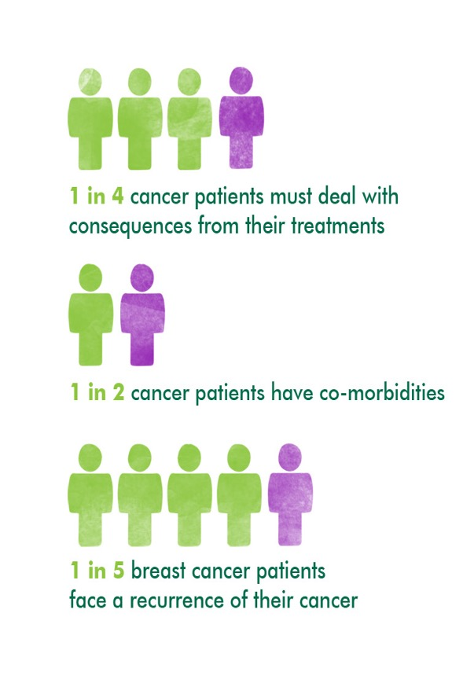
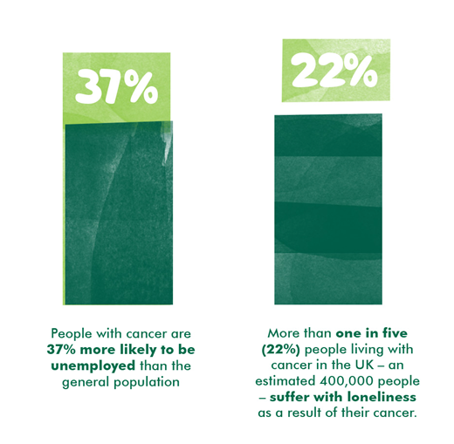
Not everyone with cancer is living well
Notes:
1 in 4 deal with the consequences of their treatment
1 in 2 cancer patients have two or more comorbidities
Macmillan Cancer Support (2013). Cured – but at what cost?
Walkington L. Patterns of breast cancer recurrence and associated health care costs of 1000 patients treated in Leeds: a longitudinal study. June 2012 – Submitted as a research abstract to the National Cancer Intelligence Network ‘Cancer Outcomes Conference’.
Macmillan Cancer Support (2009) It’s no life. Living with the long-term effects of cancer.
De Boer et al (2009). Cancer survivors and unemployment: a meta-analysis and meta-regression. JAMA. 301: 753-762.

Slide 6







People with cancer have significant social care needs
Practical and personal needs
64%
Mobility - 32%
Housework and cooking - 31%
Personal care - 14%
Emotional needs
78%
Macmillan Cancer Support. Hidden at home. 2015. London
Notes:
Also impact on family/friends/carers. Impact on relationships.
Importantly ability to work.

Slide 7
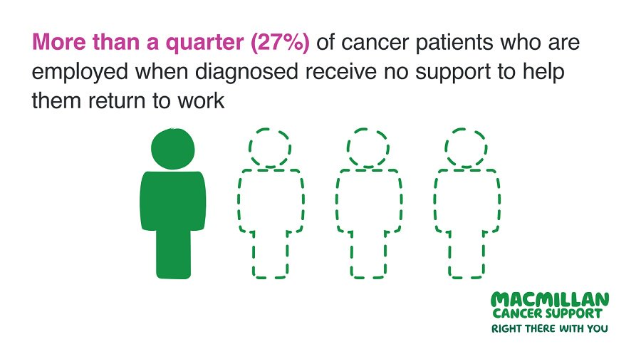
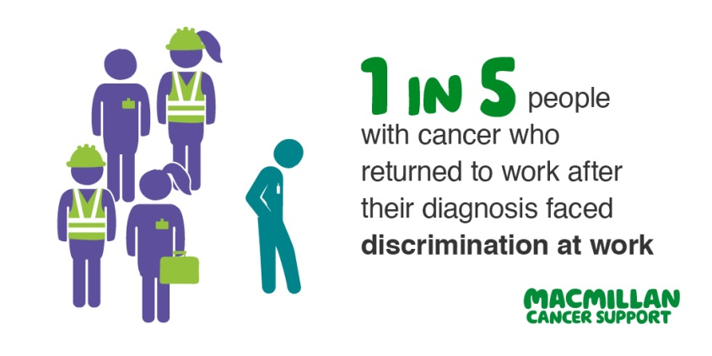
Many want to work…but they need more support to do so
More than a quarter (27%) of people employed when diagnosed with cancer received no support to help them return to work
1 in 5 (20%) who returned to work after their diagnosis faced discrimination

Slide 8
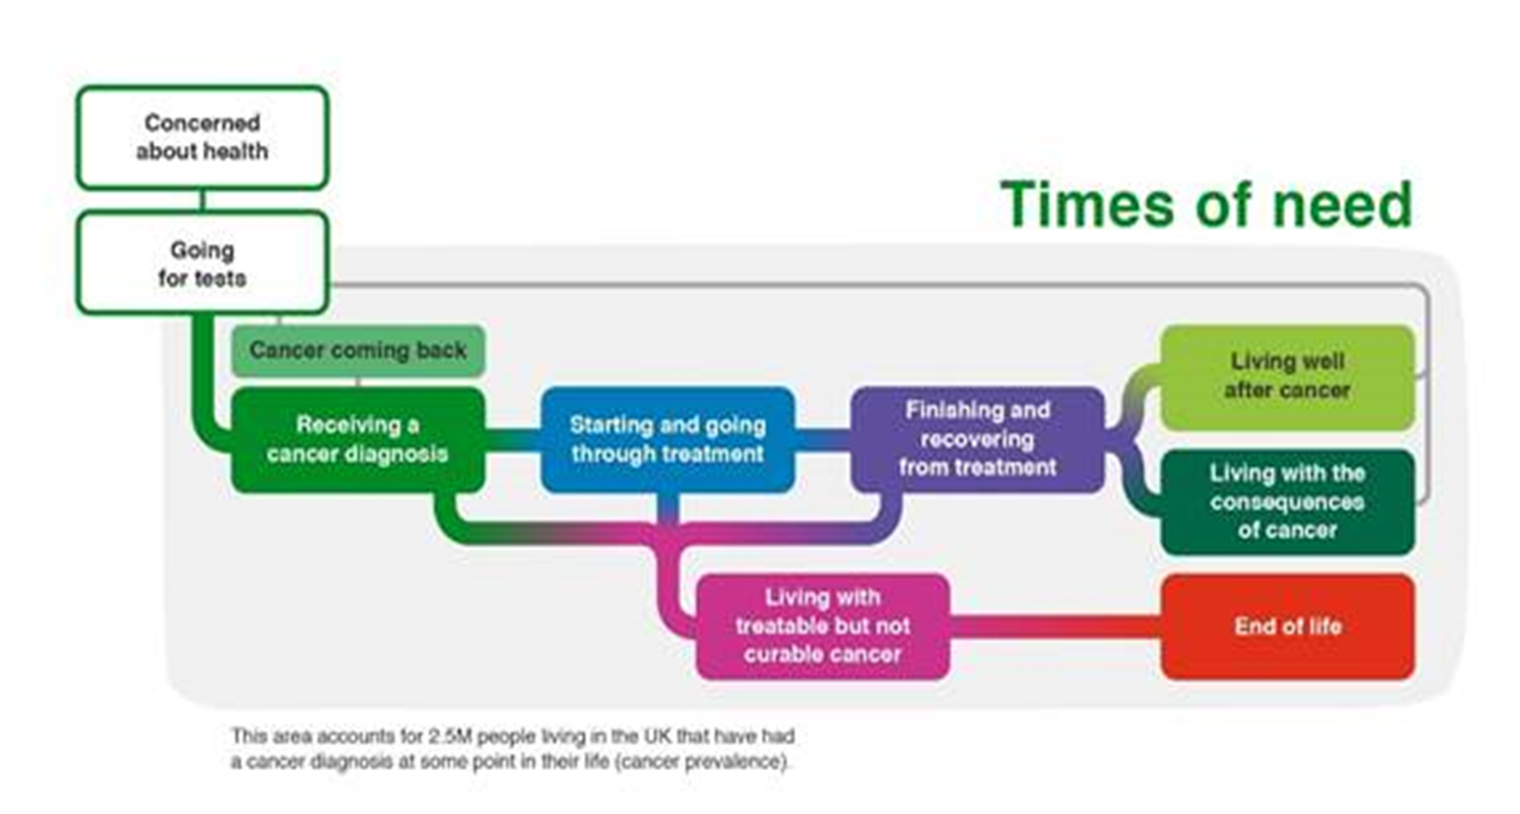
People’s needs change over time

Slide 9
Frequency of “concerns” stated by clients of the Macmillan Social Prescribing Services in London (1)
Tower Hamlets: July 2017- April 2019

Slide 10
Frequency of “concerns” stated by clients of the Macmillan Social Prescribing Services in London (2)
Kingston Social Prescribing Service (Jan to Oct 2019)

Slide 11
National Cancer Patient Experience Survey (2019)
Question | London average | National average
Q55. Do you think the GPs and nurses at your general practice did everything they could to support you while you were having cancer treatment? | 54.1 | 58.3
Q24. Did hospital staff give you information about how to get financial help or any benefits you might be entitled to? | 61.4 | 62.6
Q51. Did the doctors or nurses give your family or someone close to you all the information they needed to help care for you at home? | 56.0 | 59.8
Q23. Did hospital staff discuss with you or give you information about the impact cancer could have on your day to day activities (for example, your work life or education)? | 81.6 | 84.0
Q53. Once your cancer treatment finished, were you given enough care and support from health or social services (for example, district nurses, home helps or physiotherapists)? | 39.6 | 45.0
Q52. During your cancer treatment, were you given enough care and support from health or social services (for example, district nurses, home helps or physiotherapists)? | 44.4 | 52.1
Q57. Have you been given a care plan? | 38.2 | 37.6
Q56. Did the different people treating and caring for you (such as GP, hospital doctors, hospital nurses, specialist nurses, community nurses) work well together to give you the best possible care? | 68.5 | 72.8
More data available at: https://www.healthylondon.org/our-work/cancer/patient-experience-survey/
Notes:
Numbers are small – 70+
Recently diagnosed

Slide 12
Group activities and reflections

Slide 13
Group activity
Reflect on a conversation with someone who has cancer
(this maybe one you have had or one you have witnessed)
Things you may want to think about:
What was it like?
What went well? Why?
What could have been better? How?
Feedback thoughts to the group
Notes:
If you have not had direct experience think about what a supportive conversation may be like?

Slide 14
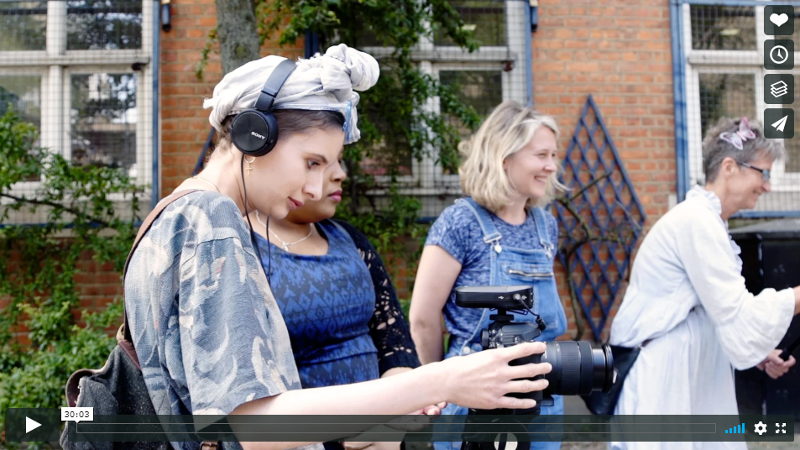
Video. Mind the Dash
A documentary made by, and exploring the stories of, a group of people affected by cancer from East London. Throughout the three month project they found strength through sharing their experiences with one another.
The film is a tribute to the power of collaboration and telling your own personal story. This project was funded by Macmillan Cancer Support macmillan.org.uk. It was delivered in partnership with the Bromley by Bow Centre bbbc.org.uk and Yarrow Films.
https://vimeo.com/295738943

Slide 15
Team around someone living with cancer

Slide 16

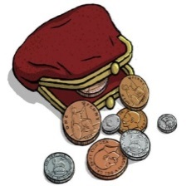
People face challenges in assessing support
Headline findings from insight from 48 East London residents:
People not asked about their holistic needs systematically.
Most felt unprepared for “the end of the sausage machine” and for long term consequences of treatment – many experience depression / low self-esteem for months and years.
Impact on housing and finance can be severe – people who rent privately are particularly vulnerable; welfare system complex to navigate.
Social isolation / loneliness – participation in community activities requires a level of physical and emotional wellbeing.
People need support to make the best possible use of services
Support to access information
Access to advocacy
Following up
Navigating the whole system
Support to understand information
Notes:
It’s not enough to know that services exist – people need support to make best possible use of these services.

Slide 17
People face inconsistencies re:
Inconsistency
When and how their needs are identified
Access to support
Quality of support
How care planning is done
How care is personalised
What information is shared with key people
Notes:
BECKY

Slide 18
Group Activity
Each table has a case study to discuss. The case studies are based on real people living with cancer in East London.
Please read your case study, and then discuss the questions as a group.
Your facilitator will guide the conversation. We will feedback to the whole group.
Notes:
ZEREEN

Slide 19
Questions for discussions
Discuss and agree how you would work together to provide personalised care and support to the person in your case study:
What are their main priorities and worries?
Who is already involved in their life professionally and personally? Who else could be involved?
What information and advice would you offer at this moment?
How could everybody work together in a joined-up way to support them?
What other support might this person and their family need in order to engage with services?
Notes:
ZEREEN

Slide 20
1. Rebecca
Background
Rebecca is a single woman in her mid-40s.
A project manager, also studying part time for a Master’s degree.
Moved to London a few years ago. Has a wide circle of friends, but her family all live abroad.
Diagnosed with breast cancer a few months ago. Has had surgery, followed by chemotherapy. Now undergoing radiotherapy.
Main priorities and concerns
Money and housing – privately renting, and not entitled to paid sick leave from employer.
Side effects of treatment – fatigue, concentration difficulties, early menopause.
The challenges of staying physically active and socially connected to friends.

Slide 21
2. Francesca
Background
Francesca is in her early 50s, living with her partner and their 3 children. One has complex special educational needs. The oldest is known to social services due to challenging behaviour.
Finished treatment for colorectal cancer 3 years ago. Also living with asthma, and has a history of mental health issues.
Main priorities and concerns
Emotional wellbeing – she feels she hasn’t been able to come to terms with cancer; body image and low self-esteem. She has obsessive compulsive disorder, which is exacerbated by stress.
Money and housing – the family is at risk of eviction from their private tenancy, due to rent arrears. Now on Universal Credit.
Cost of childcare and isolating because of COVID – makes it difficult to be available for appointments, either online or in person.

Slide 22
3. Obasi
Background
A single man in his mid-20s, working for a start up company.
Recently diagnosed with a brain tumour and waiting to start treatment.
Lives with his younger, twin brothers in a privately rented flat. Their parents live overseas.
Main priorities and concerns
Feels unsupported by healthcare professionals due to poor experiences at diagnosis.
Staying independent and planning for the future is important to him.
Money and housing – rent consumes a large proportion of monthly income; he is only entitled to statutory sick pay and gets 20 days of annual leave per year. His brothers are students and so they have very little income.
Emotional wellbeing – anxiety, sleep difficulties. He doesn’t talk to his family much as he doesn’t want to worry them. He feels a sense of responsibility for his younger brothers.
Managing symptoms – restricted movement on right side of body.

Slide 23
4. Jim
Background
Jim is a man in his mid-60s, living with his husband and young grand daughter.
Diagnosed with bladder cancer. Recovering from chemotherapy, and waiting to have bladder reconstruction surgery.
Main priorities and concerns
Emotional wellbeing - anxiety about the impact of major surgery, and painful memories of his father’s death.
Family life – his husband is finding it hard to accept his diagnosis, and behaving in a challenging way. His grand daughter doesn’t understand the seriousness of the cancer and its treatment.
Volunteering – he has been too unwell to maintain his volunteering role at the local hospice. He is also anxious about being around people who are dying.
Physical fitness – he wants to build up his physical strength before surgery.

Slide 24
5. Janet
Background
Janet is a woman in her late 60s, working as a freelance journalist.
Her partner lives nearby. She has two grown-up daughters, and a brother with complex health needs. She cares for her brother on a part-time basis.
Recently finished treatment for early stage lung cancer.
Main priorities and concerns
Emotional wellbeing – her husband passed away from lung cancer 2 years ago. She had a psychotic reaction to a drug prescribed for pain relief. She has just had her final session with a clinical psychologist. Her partner finds it difficult to talk about the impact of her cancer.
Side effects of treatment – fatigue, nausea, shooting pains, Deep Vein Thrombosis.
Regaining physical fitness.

Slide 25
How do I increase my knowledge?
Increased knowledge
See your resource pack for a variety of services and organisations who can help
Read Macmillan’s evidence review on people’s needs at different stages (in your resource pack)
Macmillan Information and Support Centres are a good bridge between hospital and community
Make use of the Community Navigators and Health & Wellbeing Hubs at the Ideas Stores
Encourage people to participate in peer support groups, HOPE self-management course, and carers’ services
Macmillan Social Prescribing service and generic social prescribing in GP practices are a source of local information
Notes:
To address these gaps in knowledge, we’ve identified these solutions to increase knowledge among both people affected by cancer, and among professionals.

Slide 26
People do not have a seamless experience of care
Lack of coordination and smooth transfer of care
Between generic and cancer-specific services
Between different teams
Between different sectors
Transitions between services
Transitions at the end of treatment
Notes:
BECKY

Slide 27
Identifying and supporting people’s holistic needs
Things we need to know in order to provide personalised care to a person with cancer:
How are they feeling physically and emotionally?
What matters most to them? What’s their most pressing concern that they need support with?
Where are they in the cancer pathway?
Do they have any other long term health conditions?
Who is in their support network? E.g. partner, family members.
  Do they have a carer who may benefit from support?
  Do they care for anyone else?
  Do they live alone?
Do they have any additional support needs? E.g. interpreter, advocacy, learning disability
Supporting someone in an integrated way will require information sharing – it’s essential to seek consent to do this.
Notes:
You may need to pro-actively ask if people need information and support on finances, housing and employment issues.

Slide 28
How can I offer holistic support in an integrated way?
Ways of working
Identify the key agencies and professionals in the team around the person that we need to liaise with.
Request and share care & support plans
Pass on clinical concerns to their clinical team to follow up.
Follow up signposting and referral to other services, to ensure uptake and impact.
Follow up with the person after an agreed period of time, to see how things are progressing.
Provide feedback on progress to all relevant professionals.

Slide 29
The Key Message
Having personalised, holistic conversations with people with cancer
And timely, joined-up conversations between professionals
Will enable us to tackle the 3 challenges: knowledge, inconsistency, and lack of coordination of care.

Slide 30
Useful Resources

Slide 31
Useful Resource
Macmillan resources for patients
https://www.macmillan.org.uk/about-us/what-we-do/right-there-with-you
https://www.macmillan.org.uk/information-and-support#346212
Macmillan Freephone
For patients/professionals 0808 808 00 00
Cancer tool kit (clinical resource) Royal College GPs
https://www.rcgp.org.uk/clinical-and-research/resources/toolkits/primary-care-cancer-toolkit.aspx/

Slide 32
Some Useful Services
Age UK
Macmillan information & support services at your local hospital
Maggie’s Centres
Trekstock – a cancer charity for young adults
Teenage Cancer Trust
Social prescribing services and link workers
Talking Therapies (IAPT)
Psycho-oncology teams
Cancer Rehabilitation services
Lymphoedema services
Hospices
Housing
Social care
Welfare and benefits advice services

Slide 33
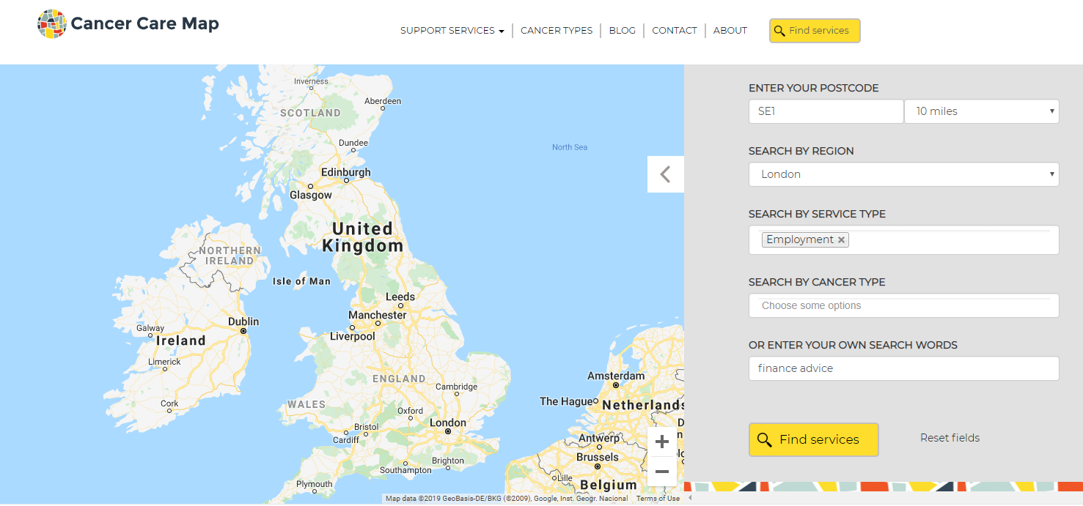
Cancer Care Map
https://www.cancercaremap.org/
Cancer Care Map is a simple, online resource that aims to help people find cancer-related services in their local area wherever you are in the UK.
People with cancer and their friends and family can either search for a service or can browse the types of services available. It uses stories and videos to show how the services have benefited other people living with cancer and their friends and family.
Cancer Care Map is tailored to people with cancer, and their family members. It is also designed for healthcare professionals to use in consultations.

Slide 34
More Useful Resources
A Powerpoint presentation that includes facilitator notes which can be used to train social prescribers on the needs of people living with cancer and the support available
A Network Guide to outline the role that Social Prescribers can play locally in supporting PLWC and to provide case study examples of where we know this is already working well
A resource pack that can be shared with Social Prescribers (or utilised by other members of the team) to outline key resources that may support them in their role and to support PLWC
A 10 Top Tips to be shared with other members of the practice team to demonstrate why people should think of social prescribers when supporting PLWC​

