Slide 1
Why psychosocial support and cancer rehabilitation are important Module 4

Slide 2
Introduction
Training content for managing cancer as a long term condition
Purpose
The content within these slides can be used and adapted for local use in Protected Learning Time and other training sessions on cancer as a long term condition.
This module is one of five – it can be used in isolation or as part of a wider training package. The modules are:
Personalised cancer care interventions
Holistic cancer care reviews
Consequences of treatment
Psychological support and rehabilitation
Social needs of people affected by cancer
Intended audience
CCG clinical leads
Macmillan GPs
Primary Care Nursing Forum leads
Training Hubs
Social prescribing teams
Acknowledgements
The content contained within this module was co-developed with London clinicians from Transforming Cancer Services Team (part of Healthy London Partnership), Macmillan Cancer Support, Trusts and Primary Care.
When using these slides locally, please ensure branding includes Health Education England, Macmillan and Healthy London Partnership. Thank you

Slide 3
Aims and objectives of this module
Aims
Help improve holistic understanding of the long term management of people affected by cancer
Objectives
Understand the impact of cancer treatment on patients
Identify red flags that signal psychological, physical and emotional impact
Explore some key psychological and physical consequences of cancer treatment through the use of case studies
Apply skills in practice
Highlight online educational tools and other resources that can enhance patient care
Notes:
These slides have been prepared to assist you in developing educational agendas and events for primary and community healthcare staff. The slides, specifically focused on managing and supporting patients in the community. Aims and objectives are outlined above

Slide 4
Psychosocial Support

Slide 5
Why is the psychosocial support for cancer work so important?
Establishes parity of esteem so there is the same level of attention paid to mental health as physical health within cancer care. ((No health without mental health, 2011; NHS Mandate, Five Year Forward View for Mental Health, 2016 FYFV).
Better informed commissioning decisions can be made based on greater understanding of the current picture in London
58% of people diagnosed with cancer feel their emotional needs are not looked after as much as their physical needs (Macmillan, 2006)
Cancer patients have a 55% higher risk of suicide than those without cancer (Calati et al, 2017)
Cancer and its treatments have the potential to significantly impact on mental health, physical health and socio-economic status in multiple ways.

Slide 6
Why is the psychosocial support for cancer work so important? The economic argument
Healthcare costs for people with long term conditions (cancer is now considered for many a LTC) are 50% higher in people with depression/anxiety
Psychological therapy reduces physical health care costs by average of 20% (meta-analysis of 91 studies) (Layard & Clark, 2014)
Where a mental health problem coexists with a physical health problem it can increase their physical healthcare costs by 45-75% after adjusting for severity of the disease (King’s Fund, 2012)
Health Foundation report (August, 2018)
Patients most able to manage a mental health condition, as well as physical health conditions:
experienced 49% fewer emergency admissions than those who were least able.
had a length of stay in hospital 41% shorter compared to those least able
32 % fewer A & E attendances
18 % fewer GP appointments

Slide 7
Using an adjustment model to conceptualise living with and beyond cancer
Psychological distress is a common and understandable response to a diagnosis of cancer and living with and beyond cancer
Cancer and its treatments have the potential to significantly impact on mental health, physical health and socio-economic status in multiple ways.
The majority of people use a variety of resources to cope including their own inner emotional resources, external support systems (e.g family/friends/3rd sector) and the guidance of trusted healthcare professionals.
The ‘ARC’ model of adjustment to cancer is based on the direct experience of people living with cancer which has been central to developing this framework. Most people will never need to be referred for a specialist psychological intervention.
However, for some the impact of cancer and its treatment can be overwhelming.
In the year following diagnosis, around one in ten patients will experience symptoms of anxiety and depression severe enough to warrant intervention by specialist psychological/psychiatric services (NICE, 2004)

Slide 8
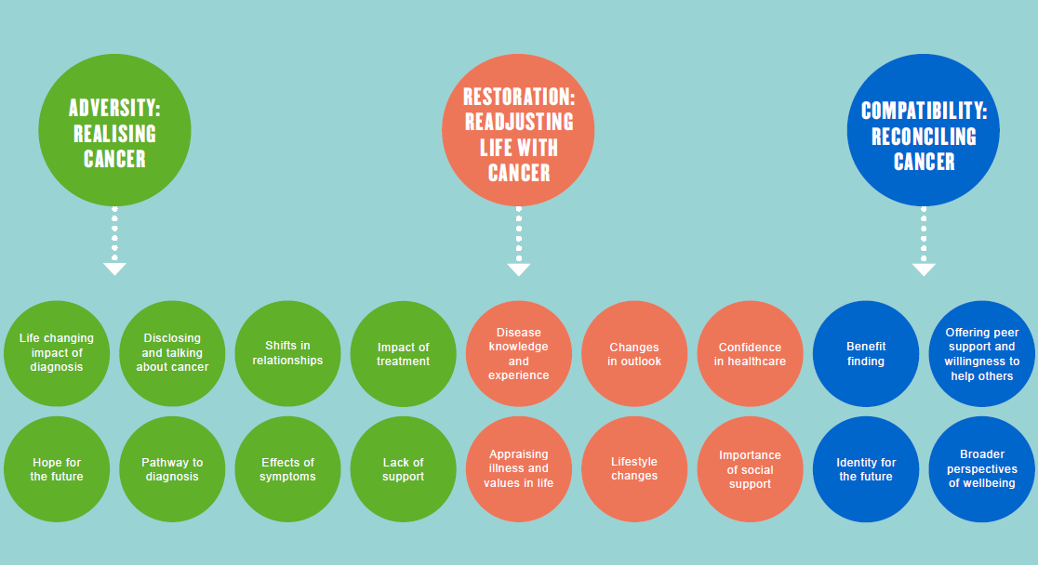
The ‘ARC’ model of adjustment for living with and beyond cancer (Le Boutillier et al 2019)

Slide 9
A London integrated pathway for cancer psychosocial support has been developed
Integrated personalised care pathway approach
This is a whole pathway for psychological care from diagnosis, through treatment, cancer rehabilitation, recovery, living with and beyond cancer and end of life care.
Distinction between universal, enhanced and specialist support
An adjustment model underpins the pathway. Majority of people cope with support from family/friends, self-management, third sector, information and signposting
Different services have key roles at different points along the pathway – no single service alone is sufficient
Pathway needs both IAPT and Psycho-oncology teams- not either/or.
Psycho-oncology teams will share expertise across the whole pathway, including consultation and training with primary care and IAPT services.

Slide 10
A
universal support
B
enhanced support
C
specialist support
Healthcare system
underlying principle: how to prevent distress and promote adjustment
prompt, efficient, reliable systems e.g. for appointments and reporting
effective communication between staff/services across the pathway
Level 1 care – All
compassionate communication
active listening
timely information, advice and links with social care e.g regarding employment, finances, benefits etc
facilitating access to peer support, open groups, online forums,
third sector organisations
social prescribing
digital resources
Keyworker – e.g. clinical nurse specialist
meets person at diagnosis to establish a reliable relationship
develops a holistic understanding of the impact of cancer on the person
maintains a reliable single point of contact throughout
guides the person in effective self-management
identifies needs, signposts to specific resources and reviews impact
advocates psychosocial perspective in MDT
Personalised care
HNA – holistic needs assessment and care plan, at key points in pathway
EOT – end of treatment review, includes HNA and treatment summary (TS)
HWBE – health & wellbeing event
CCR – cancer care review in primary care
all Level 1 care, plus:
Level 2
assessment of significant distress & psychological issues identified in HNA or routine cancer care
first-line psychological interventions to enhance self-management e.g. relaxation, worry tree, structured problem-solving, motivational interviewing
consultation and advice from specialist service (e.g. Level 3-4 psycho-oncology service to guide Level 2 input)
signposts/refers to specific cancer psychological care resources e.g. structured support groups
Community
Primary Care-level 2 support from a trained primary care nurse/other professional
IAPT Step 2 : low-intensity interventions, e.g. guided self-help for anxiety or depression, psycho-educational groups, computerised CBT (non-cancer specific)
all Level 1&2 care, plus:
specialist clinical assessment of distress & mental health in the context of cancer
developing a comprehensive biopsychosocial psychological formulation or multidimensional diagnostic profile
Level 3
assess and deliver interventions with complex presentations that include cancer and psychosocial factors
psychological interventions e.g. counselling, solution-focused therapy, focused on cancer-related difficulties
IAPT Step 3: High-intensity unidisciplinary interventions (non-cancer specific) e.g. CBT, counselling for depression.
Level 4
embedded within cancer MDT input
assess and intervene with complex psychological, psychotherapeutic or pharmacological interventions
management of non-acute risk
enabling effective liaison of mental health & related services to cancer MDT

Slide 11
LONDON INTEGRATED PATHWAY FOR CANCER PSYCHOSOCIAL SUPPORT
as per NICE IOG 2004
NICE Level 1
Level 2 assessment
& first-line input
e.g. by Clinical Nurse Specialist
All hospital staff
e.g. clinic, ward, administrative
NICE Level 2
General Hospital
Liaison Psychiatry
Holistic
Needs
Plan
1
2
hospital
NICE Level 3&4
Psycho-oncology team
(incl. counselling, clinical psychology, oncology psychiatry, psychotherapy etc)
Level 3/4
specialists
support for
self-management
information resources
social prescribing
third sector
social care
digital
consultation training & supervision
4
PERSONALISED CARE
Patients & Carers
Community Palliative
Care Services
community
Primary Care
IAPT - Community Psychological Therapies
GPs, primary care staff & ‘care navigator’ roles
Cancer
Care
Plan
3
Comm. & Specialist Mental Health
B
enhanced support
C
specialist support
A
universal support
V5.6

Slide 12
LONDON INTEGRATED PATHWAY FOR CANCER PSYCHOSOCIAL SUPPORT
as per NICE IOG 2004
NICE Level 1
NICE Level 2
All hospital staff
e.g. clinic, ward, administrative
Level 2 assessment
& first-line input
e.g. by Clinical Nurse Specialist
General Hospital
Liaison Psychiatry
Holistic
Needs
Plan
1
2
hospital
NICE Level 3&4
Psycho-oncology team
(incl. counselling, clinical psychology, oncology psychiatry, psychotherapy etc)
Level 3/4
specialists
support for
self-management
information resources
social prescribing
third sector
social care
digital
4
PERSONALISED CARE
Patients & Carers
Community Palliative
Care Services
community
Primary Care
IAPT - Community Psychological Therapies
GPs, primary care staff & ‘care navigator’ roles
Cancer
Care
Plan
3
Comm. & Specialist Mental Health
B
enhanced support
C
specialist support
A
universal support
V5.6

Slide 13
Referral criteria (i)
Acute/Hospital Context
1
Level 1 > 2
2
Level 2 > Psycho-oncology
All staff to request or implement Level 2 input when:
HNA or other screening identifies heightened distress (e.g. DT>5, GAD/PHQ>9)
patient or carer self-identify poor coping or psychological issues that affect function
clinical impression of persistent significant distress in clinical encounters
clinician concerns about difficulties with decisions, adherence, treatments.
When there is clinical evidence of significant concerns relating to treatment, mental health or risk, direct referral to Level 3/4 would be appropriate.
Clinical judgement, taking into account:
Keyworker observes pattern of poor psychological adjustment over time
Level 2 assessment identifies significant severity, persistence and functional impact of distress, and background complexities/ vulnerabilities e.g. trauma, multiple losses, relevant mental health history
Level 2 input (e.g. ‘worry tree’, sleep hygiene) has not proved sufficient
Holistic care requires multiprofessional coordination (hospital/mental health) and/or multidisciplinary input (e.g. psychosexual rehabilitation)

Slide 14
Referral criteria (ii)
Primary / Community Context
3
GP > Psycho-oncology
GP > IAPT
Clinical judgement, taking into account:
undergoing active cancer tests & treatments, or unstable/advancing/progressive disease
significant cancer /treatment consequences (e.g. epilepsy, GvHD, neutropenia, dysphagia), requiring multidisciplinary input.
Frequent and/or ongoing hospital contact for cancer care
Psychosocial factors impacting adversely on:
- accessing cancer tests/treatment adherence
-decision-making (e.g treatment decisions )
-health self-management (e.g medication adherence_ - -cancer rehab
requires multiprofessional coordination with cancer mdt and other services (e.g. mental health) and/or multidisciplinary input (e.g. psychosexual rehabilitation)
Usually seen for up to 12-24 months after End Of Treatment
Clinical judgement, taking into account:
Meets general criteria for IAPT g mild/moderate anxiety and/or depression
Medically stable/cancer remission/cancer ‘in the background’
Few hospital cancer-related contacts/routine follow up
Nil or mild/well-managed physical consequences of treatment
link to pre-existing issues, e.g. previous anxiety disorder re-activated by cancer uncertainty
unidisciplinary input sufficient
No acute mental health risk concerns

Slide 15
Referral criteria (iii)
4
Psycho-oncology teams leading service coordination and sharing expertise across the pathway
Psycho-oncology teams will :
Across the whole pathway, coordinate and collaborate with other enhanced & specialist services (e.g. general hospital liaison psychiatry, community and specialist mental health, palliative care, primary care, IAPT, third-sector providers and others) to ensure the delivery of personalised care with a safe, individualised, comprehensive and clear plan.
provide consultation, expert advice and training on cancer and psychological issues to a range of professionals across the whole pathway
The aim of this function overall will be to ensure:
patients are offered all relevant choices
all people with pre-existing SMI have optimal cancer treatment
GPs , primary care staff and cancer MDTs are offered clear and reliable advice on how cancer care and mental health / psychological care will be coordinated

Slide 16
Case example Referral appropriate for IAPT
Patient RS, a woman in her 40s, with a young family, in stable remission for eighteen months, but with mobility problems following brain surgery was referred by her GP to IAPT service with concerns about low mood and adjustment. IAPT colleagues sought psycho-oncology advice; the team were able to look up her medical records (with consent) and advised a joint assessment session to clarify her needs, preferences and best options. It was agreed that starting with a psychological wellbeing practitioner (PWP) within IAPT would be a helpful initial step. She made good use of this input, resulting in measured clinically significant improvement and started to go to the gym. A year later she remains well in herself and has maintained gym activity.
Notes:
This slide indicates when an IAPT services can provide really important input along the cancer pathway.

Slide 17
Case example: Psycho-oncology working collaboratively with Primary Care
A young woman with two young children, limited social support and an unusual haematological cancer is in remission after acute treatment, but adhering poorly to her medical monitoring and attending psycho-oncology sporadically in crisis, raising concerns about her wellbeing. The psycho-oncologist liaised closely with the GP to agree a ‘safety net’ that would respect her autonomy while also holding her vulnerability in mind. The collaborative formulation and planning with the GP has proved useful in managing the risk jointly, facilitating her medical monitoring and preventing unnecessary referrals to crisis services that she had previously experienced as coercive and stigmatising.
Notes:
Psycho-oncology teams can have a really vital role in sharing their expertise across the pathway, including working more closely with primary care.

Slide 18
Key role for Primary Care: Preventing distress and promoting adjustment
Significant positive impact on patients, carers and families with the following simple steps:
focusing on effective communication and good partnership working between all staff across the whole pathway (for example Holistic Needs Assessments including care plans and Treatment summaries (TS) being shared with patient and GP)
patients, families and carers being communicated with compassionately by all staff
high quality cancer care reviews (CCRs) taking place within primary care (see TCST 4 point model)
prompt efficient and reliable appointment systems and reporting processes in place across the whole pathway
robust safety netting and follow-up in primary care
early identification of who may need extra support (e.g by asking about bereavement and past losses, by having a thorough knowledge of current or past mental health issues, being aware of social isolation and socio-economic deprivation)
supporting a psychologically minded culture within primary and community care and across all cancer services emphasising the integration between physical health and psychological well-being.
Supporting self-management across the pathway
Localising the London Integrated Pathway for Cancer Psychosocial Support and referring when appropriate based on agreed referral criteria.

Slide 19
Cancer rehabilitation

Slide 20
Understanding Cancer Rehabilitation
Rehabilitation is an essential component of high quality cancer care
Rehabilitation spans the entire cancer pathway from diagnosis to palliative care.
Rehabilitation brings a focus on ‘adding life to years’.
Rehabilitation is everyone’s business with AHPs as the specialist workforce.
Notes:
There s a national NHS England work programme called AHPs into Action which is a significant lever for developing AHP led rehab services

Slide 21
The model of rehabilitation services
Ref: NHS England Commissioning Guidance (2016)
Notes:
This diagram lifted from the national commissioning guidance shows the different levels of rehabilitation available
Complexity of patients decrease as numbers increase

Slide 22
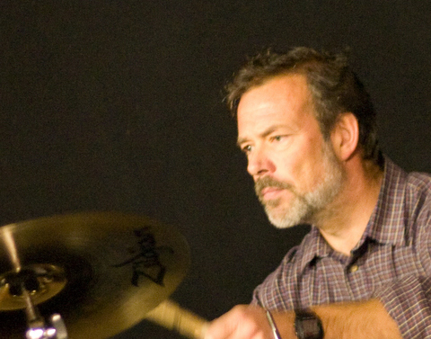
Why improving cancer rehabilitation is important
David Jillings, Trustee, Pelvic Radiation Disease Association
‘Rehabilitation has for a long time been Cinderella at the cancer ball, often relying for funding on a Fairy Godmother in an NHS Hospital Trust, or the charitable sector. Unsurprisingly, the availability of all the necessary services is patchy. There are many excellent rehab providers, but most of these stand isolated.
Is there even one part of London where every cancer patient can have the full spectrum of their needs addressed, from pre-treatment until as long afterwards as it is needed, holistically encompassing physical, financial and emotional needs, and involving family and carers, MDT, and GPs?’
“I want access to a therapist who specialises in cancer.”
Service User, TCST Engagement Event
“Services should also be available to patient’s family etc. It’s not just about me as an individual; it’s about my whole family who have been affected by the experience.”
Service User, TCST Engagement Event
“None of the services join up or seem to communicate with each other.”
Service User, TCST Engagement Event
Notes:
David lives with the consequences of pelvic radiotherapy and is a firm advocate of early referral to rehab and better access across the entire pathway
The quotes are from stakeholder engagement work in London as part of TCST work to develop commissioning guidance

Slide 23
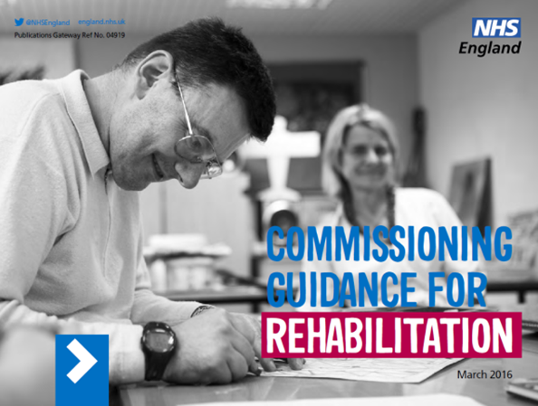
Understanding Rehabilitation
Rehabilitation is not a ‘nice to have’ or an optional add-on, but a vital aspect of care and should be available to all.
‘Rehabilitation is the development, to the maximum degree possible, of an individual’s function and/or role, both mentally and physically, within their family and social networks and within education/training and the workplace where appropriate’ (NHS England 2016)
Rehabilitation intervention underpins all conditions.
Rehabilitation spans the entire life course and pathways, including prehabilitation and palliative rehab.
Rehabilitation is everyone’s business, although AHPs are recognised as the specialist workforce
Notes:
We need to move away from thinking of rehab/cancer rehab as a ‘nice to have’ or ‘optional extra’
It is an integral part of patient care and needs to be considered across all patient pathways and across the lifespan
It is everyone’s business
Top image is the NHS England Commisioning Guidance for rehab: a blueprint for how rehab should be commisioned
Below is the NCAT report on Cancer Rehab (archived now as NCAT is disbanded): was a seminal publication and still relevant now, although slightly outdated

Slide 24
4 stages of cancer rehabilitation
Preventative: reducing the impact of expected disabilities and improving coping strategies.
Restorative: returning individual to pre-treatment/disease levels.
Supportive: in presence of persistent disease and need for treatment, rehab is aimed at limiting functional loss and providing support.
Palliative: preventing further loss of function, measures put in place to eliminate or reduce complications and to provide symptom management.
(Dietz 1980)
Notes:
This slide highlights that cancer rehab has 4 key roles from prevention (e.g, prehabilitation programmes) all the way through to palliative rehab (e.g symptom management of fatigue or breathlessness in metastatic cancer)

Slide 25
Why is rehabilitation important?
‘A modern healthcare system must do more than just stop people dying. It needs to equip them to live their lives, fulfil their maximum potential and optimise their contribution to family life, their community and society as a whole’ (NHS England 2016)
Notes:
Highlights role that rehab plays in maximising quality of life and function
Holistic nature encompassing care of physical, emotional, spiritual etc
2 pictures represent some musculoskeletal issues facing women after breast cancer; scarring and postural abnormalities secondary surgery and pain. Audience need to think about how these physical issues might impact on work, relationships, sexuality etc. This highlights the need for a holistic approach to rehab.

Slide 26
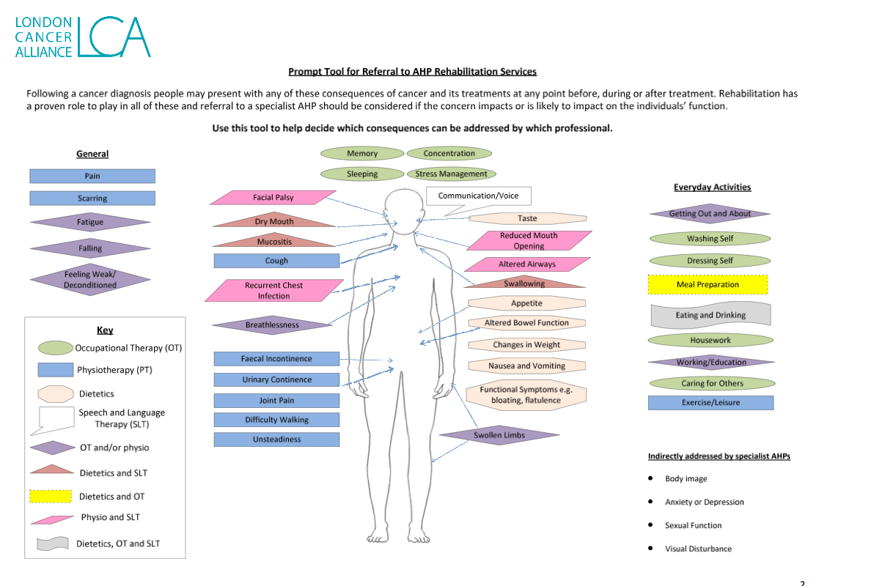
http://www.londoncanceralliance.nhs.uk/media/116517/lca-rehabilitation-referral-prompt-tool-december-2015.pdf
Notes:
This and the next slides outline what resources are available to support the assessment and management of people Living with and Beyond cancer with rehab needs; includes examples of best practice and a mural showing what is important to patients
This tool was developed by London Cancer Alliance and is available online
It highlights a wide range of possible consequences of cancer treatment that would be amenable to cancer rehab. And which AHP is best suited to manage them.

Slide 27
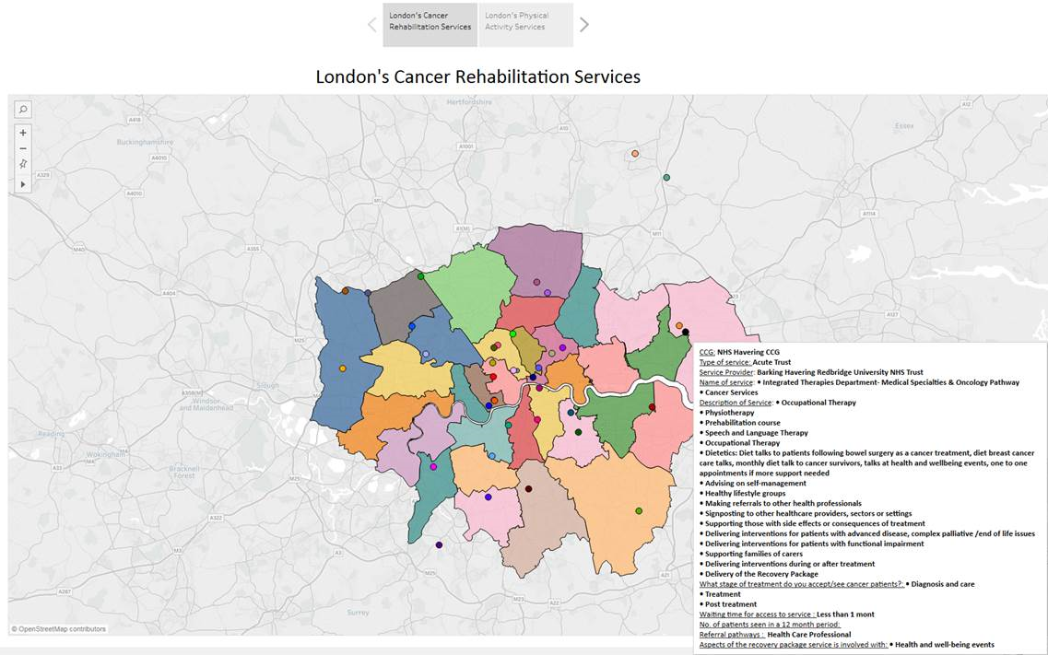
Maps of cancer rehab services in each STP
TCST mapping resources here Dimbleby Cancer Care map here
Notes:
The TCST mapping report highlights what services are available in each STP area, an example is shown
There is also the Dimbleby Cancer Care map which is comprehensive

Slide 28
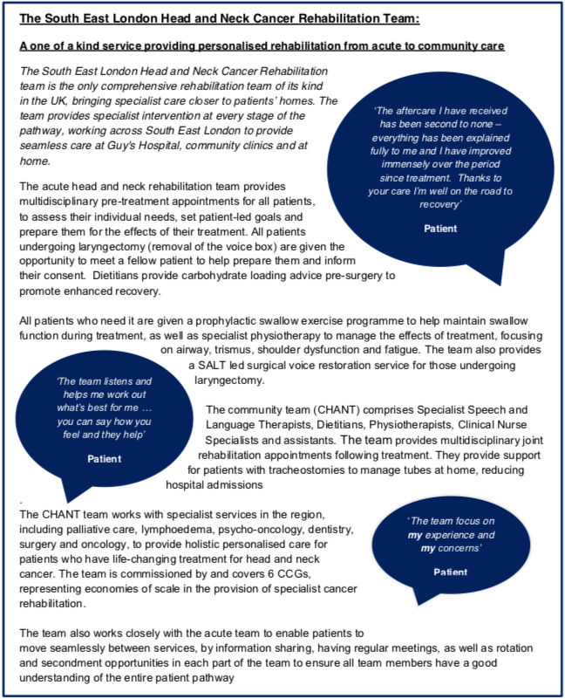
Notes:
Comprehensive service for patients with head and neck cancer. Model could be replicated for other tumour groups

Slide 29
Examples of best practice: physical activity
Notes:
Palliative rehabilitation : multi disciplinary team based within a hospice. Embraces personalised care.

Slide 30
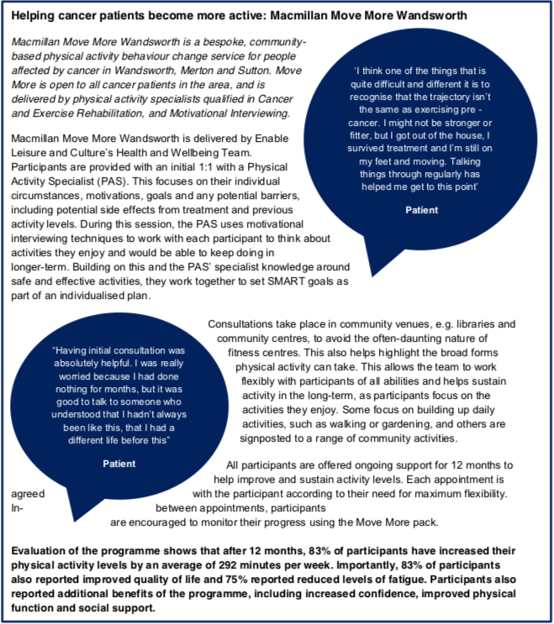
Notes:
Community physical activity programme. Originally Macmillan funded, now funded by CCG.

Slide 31
Key actions for primary care
Assess rehabilitation needs during Cancer Care Reviews:
Consider use of AHP prompt tool
Ask patient ‘what matters to them’
Think holistically and how physical and psychosocial factors are interlinked
Know availability of local services (NHS and other) to help with physical activity, diet and nutrition, speech and communication challenges, musculoskeletal and neurological consequences of treatment etc
Use TCST and Dimbleby mapping resources
Remember early intervention matters to prevent chronicity and improve outcomes.

Slide 32
Background Info/Further reading

Slide 33
Improving supportive care for adults with cancer: NICE Stepped Care Model (2004)

Slide 34
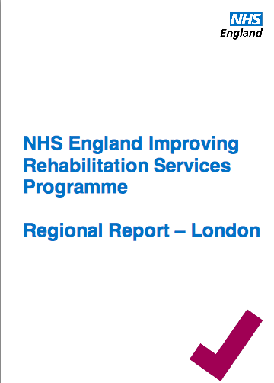
Background: developing a ‘helicopter view’
Findings from the London region rehabilitation report:
Poor awareness of the scope of rehabilitation and the fact that rehabilitation happens along and across every pathway of care
Little to guide commissioners, providers & others on what good looks like and how to measure it
Lack of quality data relating to many aspects of rehabilitation service delivery
Developing the workforce is key to the delivery of better outcomes
Notes:
NHS England Regional Rehabilitation Lead report published 2017 highlighted some key challenges for rehabilitation in London, as shown on the slide
Work carried out by Karen Robb, this was a 9mth project
Full reference is here: https://www.england.nhs.uk/london/wp-content/uploads/sites/8/2016/09/rehab-leads-report-london.pdf

Slide 35
Levers and Drivers
Rehabilitation is a vital component in the care of people living with and beyond cancer and is part of the Cancer Taskforce recommendations.
Demand for services will grow as our population ages, and more people survive cancer and live with the consequences of their cancer treatment.
The ‘Long Term Plan’ has highlighted the importance of personalised care. Empowering people and supporting them to stay well within their communities, is key.
Rehabilitation services support the integrated care agenda.
Rehab services provide a range of benefits for the wider healthcare economy; most notably by keeping patients out of hospital, supporting early discharge and providing care closer to home.
Notes:
There are many levers and drivers, importantly rehab is integral to delivering personalised care AND it makes economic sense

Slide 36
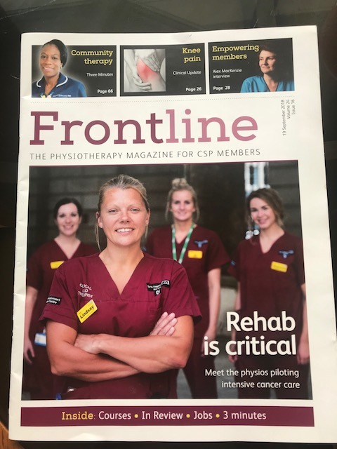
Cost benefits of Rehabilitation
There have been several reports highlighting the economic benefits of good rehabilitation:
*NHS England Commissioning Guidance
*AHP Cancer Toolkit
A London example:
Specialist neuro-oncology therapies team at Barts
NHS Trust
Set up to deal with excessive length of stay (LOS)
Each day 90min contact per patient
Preliminary reports show:
Functional outcomes and patient experience is better
For complex cases, the service can save >25k/yr in community care costs
Reducing LoS = savings > £20k/month
Notes:
Two important documents clearly outline the economic benefits of delivering good rehabilitation
The Barts neuro oncology team are funded by Macmillan to reduce length of stay: preliminary reporting suggested significant benefits for patients and the system

Slide 37
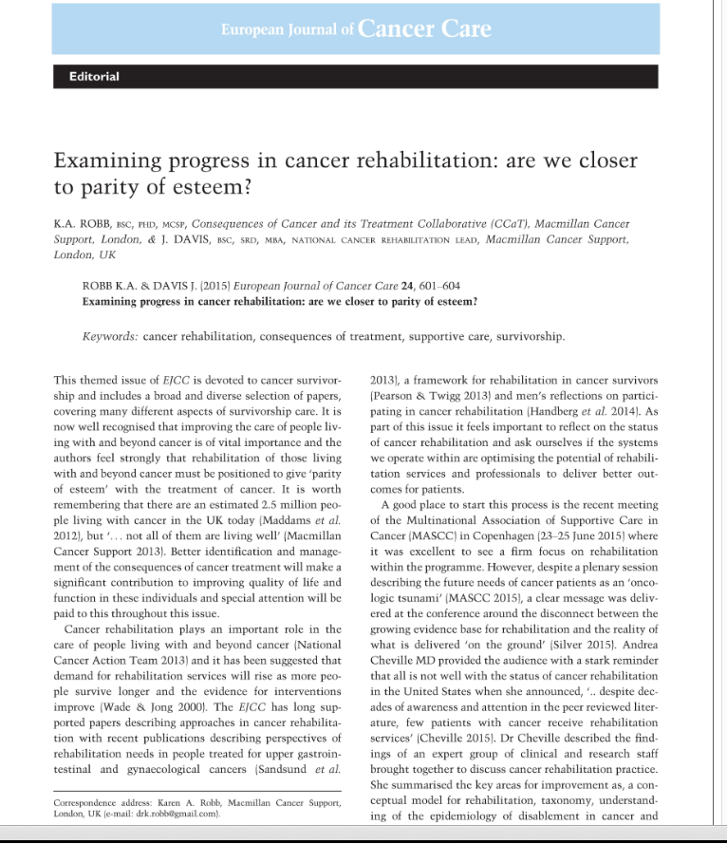
To optimise the rehabilitation solution we need to…
Define what good looks like
Have the tools to measure it
Use this to continually drive rehabilitation across all pathways, until and including end of life, to maximise mental and physical health, independence and occupation.
…TCST believes London needs guidance and a suite of resources to support the commissioning of consequences of treatment inc. cancer rehabilitation.
Notes:
Dr Karen Robb, Macmillan Rehab Clin lead and June Davis, National lead for cancer rehab at Macmillan authored this editorial
The 3 bullet points illustrate what needs to be done to maximise the impact of cancer rehab
TCST believe comprehensive commissioning guidance is needed to help address conseq of treatment e.g. we were aware from previous work in lymphoedema that our commissioning stakeholders were not clear what a good service looks like nor how it should be commissioned

Slide 38
Benefits of good rehabilitation
Notes:
This important document from NHS England shows how effective rehab delivers better outcomes and has potential for cost savings through reduced length of stays, decreased admissions, better self management etc
There are many economic benefits of good cancer rehab outlined in the Cancer Care toolkit (shown).
Specific example highlighted by Macmillan: for every £1 NHS spends on lymphoedema care, it saves £100 in hospital admissions

