Slide 1
Managing Consequences of Treatment in Primary Care Module 3

Slide 2
Introduction
Training content for managing cancer as a long term condition
Purpose
The content within these slides can be used and adapted for local use in Protected Learning Time and other training sessions on cancer as a long term condition.
This module is one of five – it can be used in isolation or as part of a wider training package. The modules are:
Personalised cancer care interventions
Holistic cancer care reviews
Consequences of treatment
Psychological support and rehabilitation
Social needs of people affected by cancer
Intended audience
CCG clinical leads
Macmillan GPs
Primary Care Nursing Forum leads
Training Hubs
Social prescribing teams
Acknowledgements
The content contained within this module was co-developed with London clinicians from Transforming Cancer Services Team (part of Healthy London Partnership), Macmillan Cancer Support, Trusts and Primary Care.
When using these slides locally, please ensure branding includes Health Education England, Macmillan and Healthy London Partnership. Thank you

Slide 3
Aims and Objectives
Aims
Help improve holistic understanding of the long term management of people affected by cancer
Objectives
Understand the impact of cancer treatment on patients in short, medium and long term
Identify the types of cancers where consequences of treatment are most likely
Recognise some of the main consequences of treatment, their symptoms and how to manage them
Apply skills in practice
Highlight online educational tools and other resources that can enhance patient care

Slide 4
Consequences of Treatment

Slide 5
The main consequences of treatment
Gastro-intestinal and urinary
Cardiovascular
Sexual problems
Endocrine
Psychological
Lymphoedema

Slide 6
GI and Urinary COT

Slide 7
GI and Urinary consequences – tumours most affected
Types of tumours most affected:
Rectal cancer
Prostate cancer
Cervical cancer
Endometrial cancer
Bladder cancer

Slide 8
GI syndromes secondary to Pelvic Treatment
Faecal incontinence
Urgency
Diarrhoea
Rectal Bleeding
Faecal Leakage
Strictures/Fistulas/Fissures
Abdominal pain/bloating/flatulence
Stoma problems
Weight problems

Slide 9
Management of GI Sx in Primary Care
Acute
Can relate to cancer or treatment
If related to chemotherapy or tyrosine kinase inhibitors (eg sunitinib) – use loperamide and liaise with oncology team
If on immunotherapy – at risk of colitis – requires admission, not for loperamide (masks symptoms)
Consider neutropenic enterocolitis if on chemotherapy. Needs referral into Acute Oncology Service
Long term
Consequence of surgery
Pelvic RT
Consider oncological emergencies – obstruction, perforation, haemorrhage, infection
Notes:
GI symptom can be related to cancer diagnosis or oncology treatments
Chemotherapies can cause diarrhea – CTC grading system assess severity (grade 3 =>7x/24 hours and usually necessitates medical assessment)
Immunotherapies can cause an acute colitis
If on chemotherapy, think about an neutropenic typhlitis
Post GI surgery – can cause long term bowel changes
Pancreatic surgery – can lead to pancreatic insuffiency

Slide 10
Basic Assessment
Trigger Questions…
How many times do you open your bowels in 24 hours
Do you have to get up at night to open your bowels?
Do you have urgency/have to rush to the toilet
Do you have faecal leakage/soiling/incontinence
Do you have symptoms that are preventing you from enjoying your life?
Rectal bleeding – may be mild and not serious but always needs specialist assessment so refer
Drug Hx - ? Laxatives, loperamide, anti-muscarinics, metformin, iron

Slide 11
Basic Advice and Referral
Advise keeping a bowel and diet diary
Dietary advice - ? too much fibre, avoid high fat/coffeine/alcohol. Advise avoiding skipping meals.
Dietician referral may be helpful
Stool bulking agents may be helpful if constipation or tenesmus
Anti-diarrhoeal agents – if chronic diarrheoa
Toilet access advice – local authority websites, radar key, toilet cards. Disability rights UK

Slide 12
Further Management of GI Sx
Diarrhoea
Stool sample, C.Difficile, consider pancreatic insufficiency
May need specialist tests so refer if any doubt
Dietician referral may be helpful
? Low dose tri-cyclic
Pain on defaecation
Examine – fissures, piles. ? Manage in primary care or consider referral
Ulceration - refer. Consider abx, bulking agents
Acupuncture/neuropathic agents, anti-depressant drugs

Slide 13
Other symptoms secondary to Pelvic Disease and Treatment
Urinary Incontinence
Bleeding
Infertility
Erectile Dysfunction
Vaginal Stenosis and Pain

Slide 14
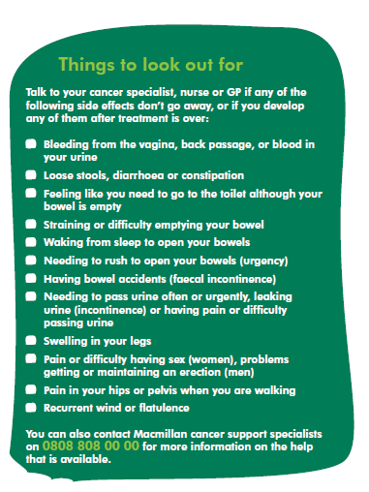
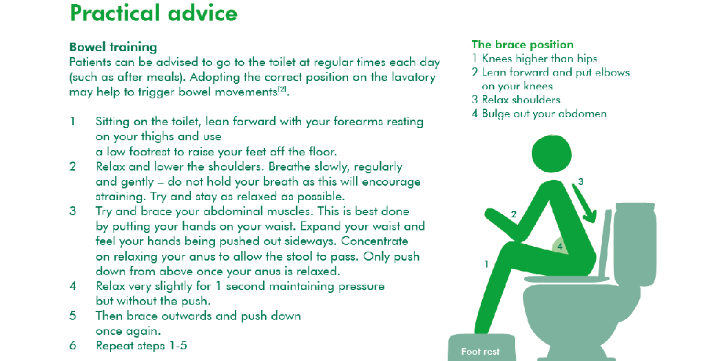
Empower people
Supporting self-management

Slide 15
Other Long term effects
Pelvic Radiation Disease
Cancer related fatigue
Chemotherapy induced Peripheral Neuropathy
Lymphoedema
Heart Failure/IHD
Psychological consequences
Remember co-morbidities and contra-indications

Slide 16
Consequences of Treatment: Immunotherapy

Slide 17
Consequences of treatment: Immunotherapy
Due to the immunomodulatory nature of these drugs, the immune-related side-effects can mimic autoimmune disorders:
Pneumonitis
Thyroiditis
Colitis
Hepatitis
Nephritis
Myocarditis
Hypophysitis
Dermatitis
Myositis
Encephalitis
Immunotherapy Alert Card
Early detection
Timely treatment
Reduce admissions

Slide 18
Consequences of Treatment: Chemotherapy, TKIs, MAbs

Slide 19
Consequences of treatment: Chemotherapy, TKIs, MAbs
Side Effect | Cause | Considerations
Myelosuppression | Intensive chemotherapy regimes, age risk factor, bone marrow disease | Patients given GSCF to prevent neutropenia for high risk oncology chemo regimes; may require transfusions, check bleeding
Neutropenic sepsis | Intensive chemotherapy regimes, bone marrow transplant myeloablative chemotherapy | Urgent referral, door to needle time
Nausea and vomiting | Melphalan, carboplatin, cisplatin, high dose cyclophosphamide | Check local treatment protocol for N&V management; dehydration risk
Mucositis | High dose chemotherapy | Potential for infection, reduce pain, encourage oral hygiene
Diarrhoea | Irinotecan, 5-FU, Capecitabine | Can be acute or delayed. Risk of secondary AKI, stoma management
Skin reactions e.g. PPE, acneiform rash | Capecitabine, 5-FU, EGFR inhibitors e.g. afatinib | Emollients and steroid creams for prophylaxis
Hypertension | Bevacizumab, carfilzomib | Amlodipine, ACE inhibitors, ARB’s

Slide 20
Consequences of treatment: Chemotherapy, TKIs, MAbs
Side Effect | Cause | Considerations
Neuropathy | Oxaliplatin, high dose paclitaxel, docetaxel | Potentially irreversible
LVEF Dysfunction | Anthracyclines, Herceptin | ACE inhibitor initiation, cardiac echogram
Encephalopathy | High dose: Ifosfamide, cyclophosphamide, methotrexate | Requires urgent referral
Haemorrhagic cystitis | Ifosfamide, cyclophosphamide | Patients should have emergency mesna doses
Thromboembolism | Cancer + other risk factors; thalidomide, lenalidomide, pomalidomide | VTE risk assessment, patients on LMWH sliding scale or NOAC should have documented treatment plan
Nephrotoxicity | High dose methotrexate, cisplatin, carboplatin | Check for concurrent nephrotoxic drugs and drugs with high renal clearance
Tumour Lysis Syndrome | AML, ALL, APML and SCLC; venetoclax | Low/intermediate risk patients managed with allopurinol

Slide 21
Consequences of Treatment: Cardiovascular

Slide 22
Cardiovascular Consequences of Treatment for Cancer
Cancer treatment should be considered a risk factor for cardiovascular disease
Acute
5FU chemotherapy - MI
Herceptin – reduced EF
Immunotherapy – myocarditis (rare)
Arrythmias
Long term
Chest RT (esp left sided)
Hormone therapies
Chemotherapies such as anthracyclines –reduced EF (esp for breast, haematological, sarcoma, childhood cancers)

Slide 23
Cardiovascular consequences - Issues for Primary Care
Accurate coding so primary care teams are always aware of previous treatments
Ensure secondary care physicians fully aware of any cardiovascular history or significant risk factors
Consider risk factors prior to cancer treatment and ensure optimum treatment to reduce risks and reduce treatment delays
Ensure patients at risk receive regular cardiovascular checks in Primary Care – even if asymptomatic
Involve cardiology if develop symptoms or signs of abnormal cardiac function and ensure all information regarding previous treatments on referral.
If a patients who has received potential cardiotoxic treatment is considering getting pregnant – refer
Consider referral in these patients also if considering high level exercise competitions

Slide 24
Notes:
We will be working in collaboration with clinicians and researchers to roll out our CoT guidance model and continue awareness raising.
Heart health guide – launched this month (Nov 2015)
After cancer, cardiovascular disease is the leading cause of long-term morbidity & death among cancer survivors. We know that some cancer treatments can lead to heart problems, especially in patients with pre-existing cardiovascular (CV) risk factors.
Our newest guide for primary care provides guidance on managing heart health during and after cancer treatment. Endorsed by the British Heart Foundation, UKONS and British Cardio-Oncology Society.

Slide 25
Consequences of Treatment: Sexual Dysfunction, Endocrine and Other Toxicities

Slide 26
Sexual Problems following Cancer Treatment
Erectile dysfunction common after pelvic treatment – both surgery and radiotherapy
Vaginal dryness/dyspareunia also common – hormone treatment for breast cancer
Post surgery (stoma formation) can affect body image and relationships
Can have significant impact on quality of life
Important for GP/Nurse to be aware of risk and give the patient the opportunity to discuss

Slide 27
Erectile Dysfunction Management
Surgical Treatment – consider early treatment even pre-surgery
Radiotherapy – consider early treatment <3 months
General review/co-morbidities/drug causes
Psychosexual Therapy
PDE5-I as required
Consider daily PDE5-I
Consider dual therapy with vacuum device
Referral for specialist treatment - alprostadil

Slide 28
Endocrine consequences of Cancer treatment
Acute to long term
Diabetes Mellitus for patients on long term steroids, pancreatic surgery
Thyroid dysfunction for patients on tyrosine kinase inhibitors and immunotherapy
Hypophysitis for patients on immunotherapy
Long term
Osteoporosis – especially for patients on ADT and AI (prostate and breast). Baseline DEXA advises
Again important to code treatment and for primary care teams to be aware of the risk

Slide 29
Other Toxicities
Neurological
PSN – can occur after chemotherapy stops – no known cure, treat as other PSN
Chronic pain syndromes
Memory impairment (‘chemo brain’)
Respiratory
Pneumonitis – usually occurs whilst on treatment
Skin
Post RT
Acneform rash with targeted treatment
Difficulty eating/speaking
Post RT for head and neck/Upper GI cancers
Increased risk of a second cancer - especially those who received childhood RT

Slide 30
Lymphoedema

Slide 31
Lymphoedema
Primary Lymphoedema, where there is a congenital lymphatic abnormality or Secondary Lymphoedema, where the lymphatic system is damaged by an extrinsic process such as trauma, disease or infection
Lymphoedema is staged according to the International Society of Lymphoedema Staging as follows:
ISL Stage 0: A subclinical state where swelling is not evident despite impaired lymph transport. This stage may exist for months or years before oedema becomes evident.
ISL Stage I: This represents early onset of the condition where there is accumulation of tissue fluid that subsides with limb elevation. The oedema may be pitting at this stage.
ISL Stage II: Limb elevation alone rarely reduces swelling and pitting is manifest.
ISL Late Stage II: There may or may not be pitting as tissue fibrosis is more evident.
ISL Stage III: The tissue is hard (fibrotic) and pitting is absent. Skin changes such as thickening, hyperpigmentation, increased skin folds, fat deposits and warty overgrowths develop.

Slide 32
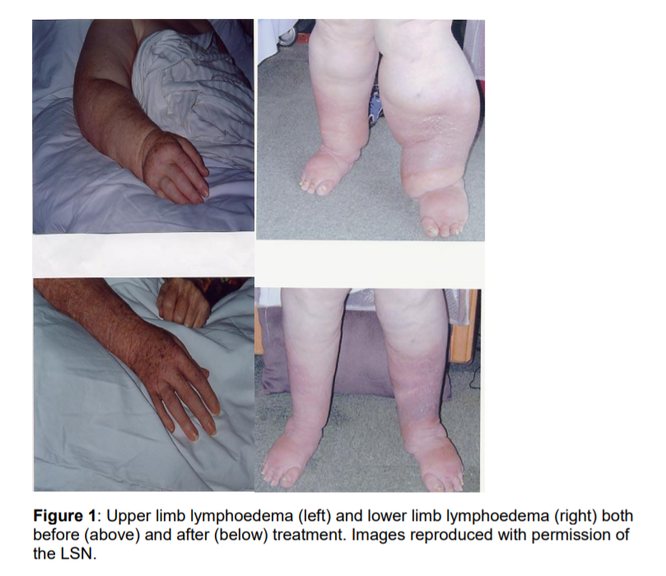
The British Lymphology Society recognises 4 population groups
Group 1: People ‘at risk’.
Group 2: People with mild and uncomplicated oedema.
Group 3: People with moderate to severe or complicated oedema.
Group 4: People with oedema and advanced malignancy.
Images of upper limb and lower limb lymphoedema before and after treatment are

Slide 33
Consequences of Treatment: Psychological

Slide 34
Psychological Consequences of Cancer Treatment
Multiple potential significant psychological effects
Anxiety, depression, fear of recurrence, reduced confidence, memory problems, body image issues
Can have a very significant impact on quality of life
Can affect all people living with cancer including carers
Significant variation in treatments available
Masterclass dedicated to this later in the year

Slide 35
How to contact oncology
Patients on treatment
Acute oncology services/acute oncology assessment unit
Oncology SpR/Consultant on call
Oncology CNS
Non-urgent
Oncology CNS
via PA – to book back in to clinic

Slide 36
Key Messages for Primary Care
Keep your cancer register up to date
Good coding in practice – cancer diagnoses and treatment
Good quality cancer care reviews
Previous cancer diagnoses and treatments considered in all long term condition reviews
Be aware of basic management strategies for common consequences
Regular lifestyle and self management advice
Know when to refer on for specialist input

