Slide 1
COVID-19 – IMPLICATIONS OF THE NEW STRAIN FOR HOMELESS SECTOR
Professor Andrew Hayward
Dr Al Story

Slide 2


Slide 3
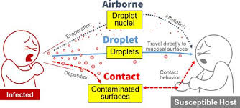

Slide 4

WHAT WE KNOW
Multiple mutations (23)
Emerged end of September
Dominant strain in London, South East and East of England
Increased despite lockdown
Affects all age groups
Leads to hospitalisations and deaths
Spreads effectively in nursing homes
Present in all parts of the country
Approx 50% more infectious
Infected people carry higher levels of virus

Slide 5

WHAT DON’T WE KNOW?
What is the effect of mutations on:
Severity?
Duration of Infectiousness?
Symptom profiles?
Speed of spread between individuals?
Asymptomatic/pre-symptomatic spread?
Reinfection following natural infection?
Infection following vaccination?

Slide 6



R=1 Day Zero

Slide 7

R=1 Day Five

Slide 8
R=1 Day 10

Slide 9

R=1 Day 15

Slide 10

R=1 Day 20

Slide 11
R=1 Day 25

Slide 12
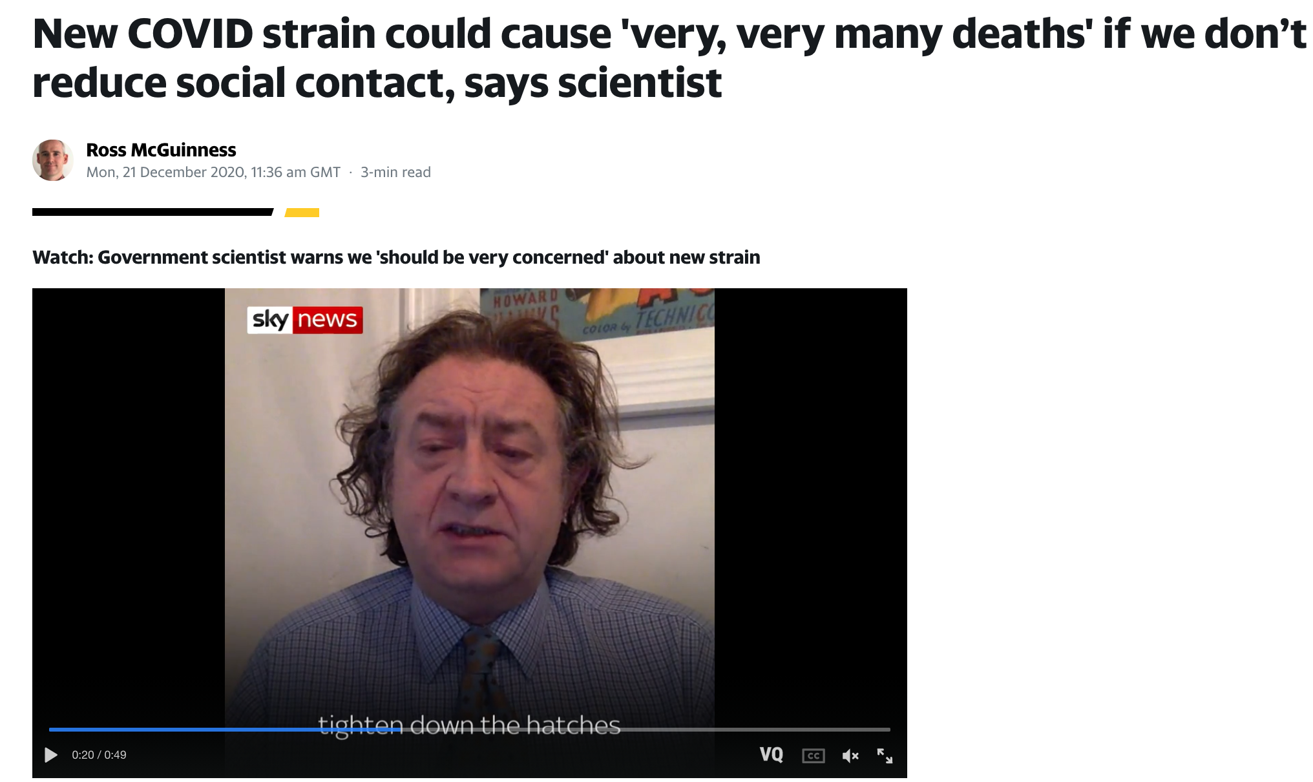
New Variant Increases Transmission Rate by 50%

Slide 13
R=1.5 Day Zero

Slide 14
R=1.5 Day 5

Slide 15
R=1.5 Day 10

Slide 16
R=1.5 Day 10

Slide 17
R=1.5 Day 20

Slide 18
R=1.5 Day 25

Slide 19

R=1.5 Day 30

Slide 20
R=1.5 Day 35

Slide 21
R=1.5 Day 40

Slide 22
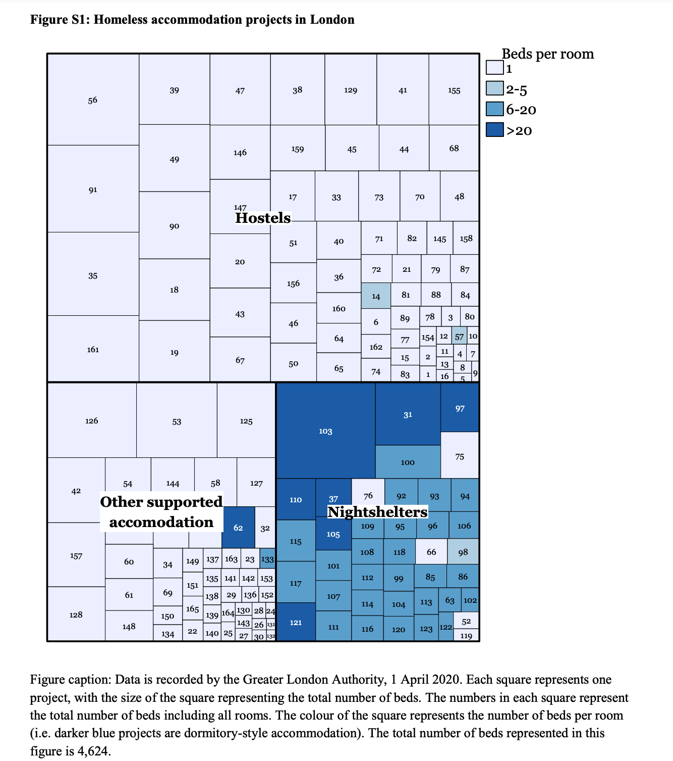

Slide 23

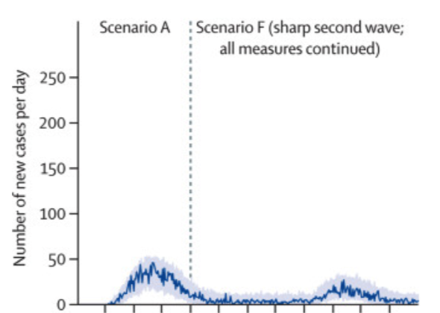
In this 1st wave of SARS-CoV-2 infections in England, we estimated that preventive measures avoided
  21,092 infections
  1,164 hospitalised
  338 ICU admissions
  266 deaths

Slide 24
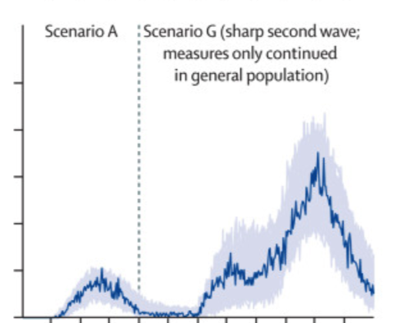

Slide 25
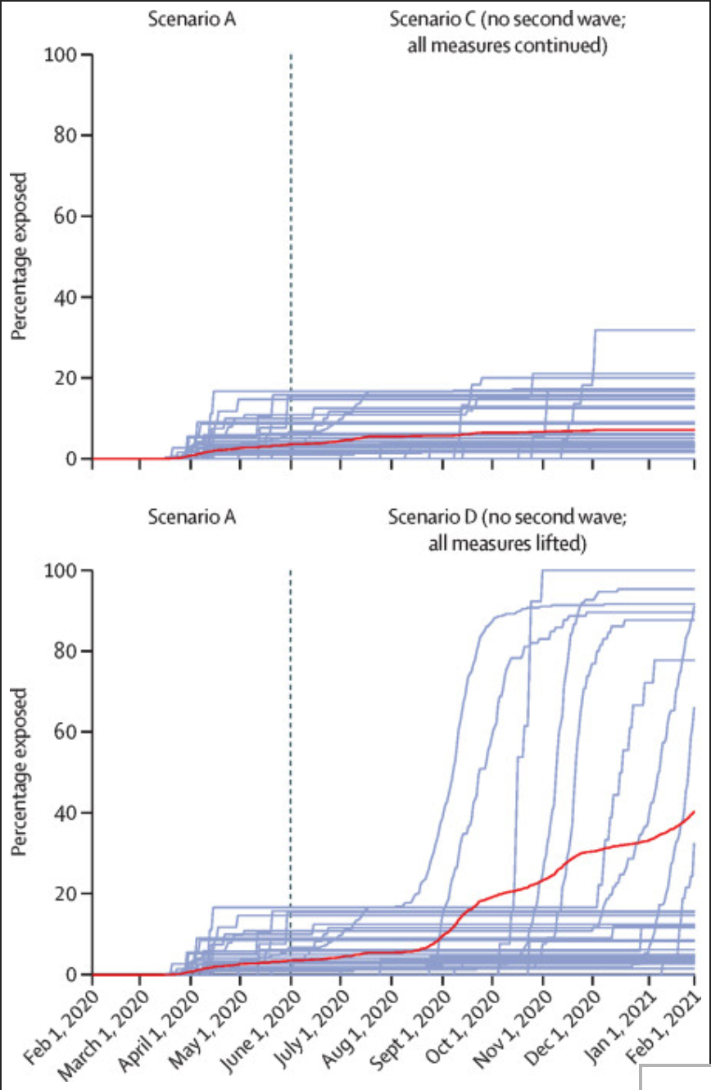

Slide 26
Reports of Outbreaks
London | 3%-4% of residents screened in 3 hotels diagnosed with COVID-19 in first 2 weeks of April – all had come from Night Shelter Accommodation. No outbreaks identified since despite screening in 58 venues. – Find&Treat Data
Boston | 36% of 408 Nightshelter residents tested positive.
https://doi.org/10.1001/jama.2020.6887
Chicago | 24% (19/80) of night shelter residents tested positive - 2 staff in homeless sector died of COVID-19
https://chicago.suntimes.com/columnists/2020/5/21/21266311/covid-19-outbreak-homeless-shelter-raises-concerns-some-staying-there
King County Seattle | 18% of night shelter residents (35/195) and 21% of staff (8/38) across three shelter
https://www.cdc.gov/mmwr/volumes/69/wr/mm6917e2.htm
Toronto | 40% (18/45) of night shelter residents with 2 deaths - 88 positive Willowdale Welcome Centre for Migrants
https://www.youtube.com/watch?v=xZ-HjC_aHyQ https://nationalpost.com/pmn/news-pmn/canada-news-pmn/covid-19-spreads-in-homeless-shelter-who-seeks-funds-in-the-news-for-april-25
San Francisco | MSC South Night Shelter San Francisco 96 residents 10 staff diagnosed with COVID-19
https://sanfrancisco.cbslocal.com/2020/04/19/coronavirus-update-san-francisco-homeless-shelter-outbreak-grows-to-over-100-confirmed-cases/
Los Angeles | > 100 diagnosed cases at Union Recue Mission Night Shelter despite weekly testing and intensive control measures
https://www.nbclosangeles.com/investigations/coronavirus-spreads-to-most-skid-row-homeless-shelters-despite-efforts-to-stop-it/2360838/
Boston San Francisco Seattle 5 night shelter study | 37% among residents and 21% among staff members. Rates were as high as 95 of 143 residents (66%) tested at the San Francisco shelter and 15 of 50 staff members (30%) tested at the Boston shelter
https://jamanetwork.com/channels/health-forum/fullarticle/2765745
Philadelphia | 21% (32/149) residents of night shelter in Philadelphia. 1 death
https://www.inquirer.com/news/covid-outbreak-death-philadelphia-homeless-shelter-after-city-broke-up-encampment-convention-center-20200501.html
Maine | 39% (21/54) night shelter
https://bangordailynews.com/2020/04/29/mainefocus/bangor-homeless-shelter-records-coronavirus-outbreak-among-20-residents-and-staff/
New York | 21% (32/149) residents of homeless shelter tested positive - 1 death
https://blogs.lse.ac.uk/socialpolicy/2020/06/01/new-yorks-homeless-population-should-not-be-pushed-into-the-shadows-during-the-covid-19-pandemic/

Slide 27
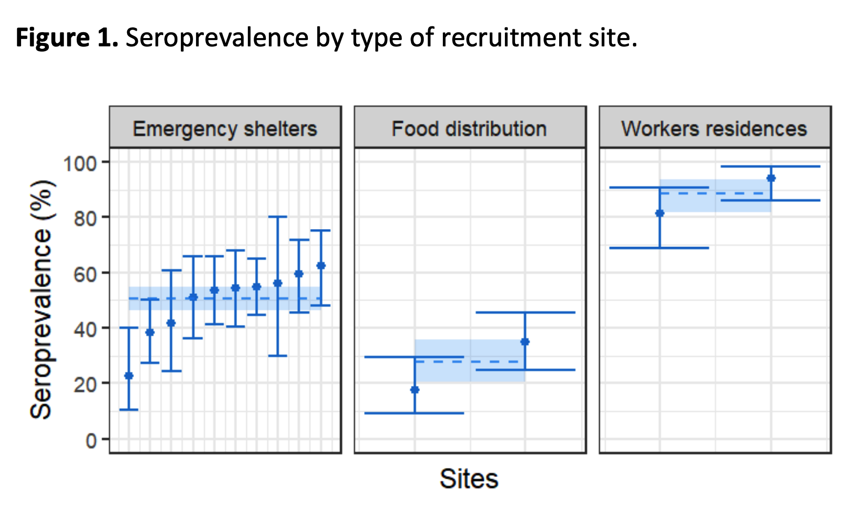
High seroprevalence of SARS-CoV-2 antibodies among people living in precarious situations in Ile de France
Odds Ratios for infection
Sharing room with > 5 others - 4.3 p<0.0001
Sharing bathroom with 5 > others - 3.1 p< 0.0001
High crowding index vs low crowding index – 6.7 p,0.0001
https://epicentre.msf.org/sites/default/files/2020-10/High_seroprevalence_of_SARS-CoV-2_antibodies_among_people_living_in_precarious.pdf

Slide 28





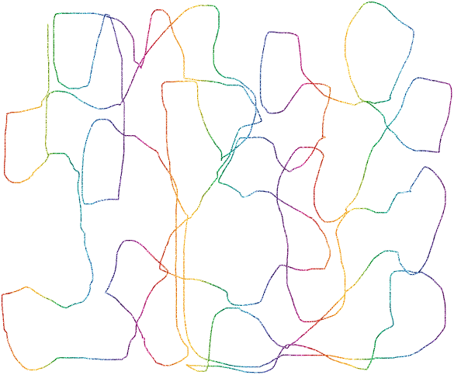





R=1.5 Day Zero - Isolation and Multiple Layers of Protection
Prevent Spread despite increased R

Slide 29










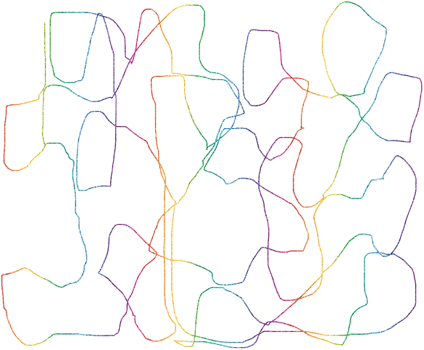
R=1.5 Day 5 - Isolation and Multiple Layers of Protection
Prevent Spread despite increased R

Slide 30







R=1.5 Day 10 - Isolation + Multiple Layers of Protection
Prevent Spread despite increased R

Slide 31


Slide 32
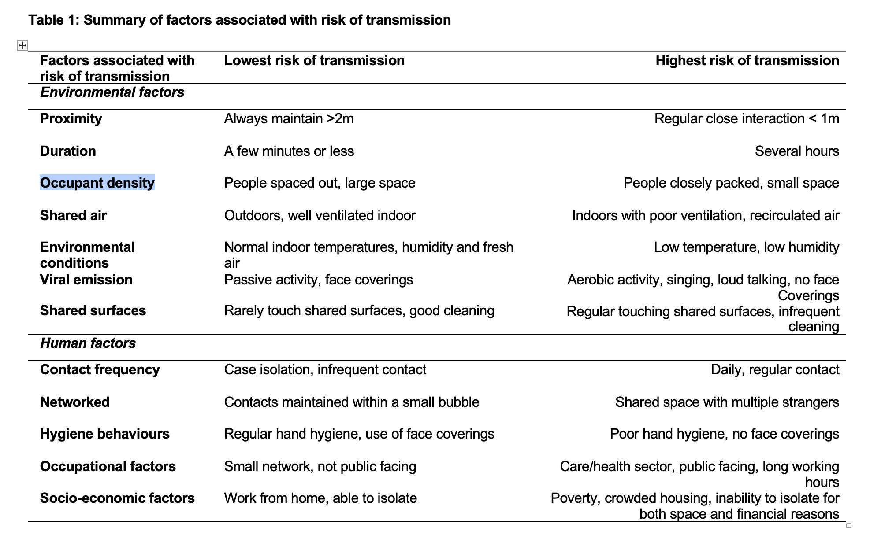

Slide 33

Staff Team
Don’t come to work if you have and symptoms or have recent contact
FACE - SPACE - HANDS at work - lead by example
FACE - SPACE - HANDS outside work

Slide 34
Residents
Pre-arrival/entry screening - Always Check
Welfare checks = Symptom checks - at least daily
Encourage residents to
  follow FACE - SPACE - HANDS
  Report symptoms
  Get tested
  Stay In

Slide 35
A. Covid-19 Symptom Screening
1 | Fever starting in last 7 days (2 readings over 37.5C or self-reported fever if no thermometer)
2 | Breathing difficulties starting in last 7 days (Too breathless to complete sentences)
3 | New dry and persistent cough starting in last 7 days
4 | Change in sense of smell or taste in last 7 days
If yes to any of above you must phone the Find and Treat team on 020 3447 9842 to arrange testing Record this on CHAIN as a Timeline Event

Slide 36
Rule In
Rule Out

Slide 37
Residents
Staff Team
Pre-arrival/entry screening
Welfare checks = Symptom checks - at least daily
Encourage residents to
  follow FACE - SPACE - HANDS
  Report symptoms
  Get tested
  Stay In
Local community

Slide 38
Outreach testing
Residents
Staff Team
Symptomatic cases AND their close contacts
Close contact means having face-to-face contact with someone less than a metre away (even if a face-covering or face-mask is worn) or being within 2 metres of an infected person for 15 minutes or more

Slide 39
Outreach testing
Residents
Staff Team
Outbreak control
Everyone needs testing!
Two or more test-confirmed cases of COVID-19 or clinically suspected cases of COVID-19 among individuals associated with a specific setting with illness onset dates within 14 days

Slide 40
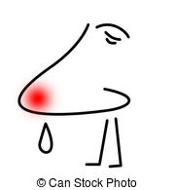
Nose fatigue
Fear
Stigma
Refusal

Slide 41
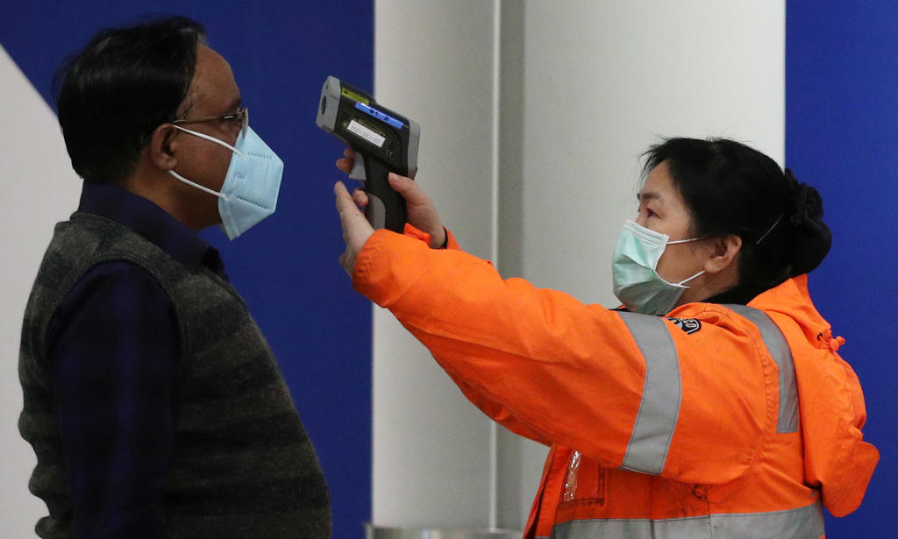
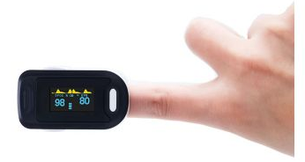
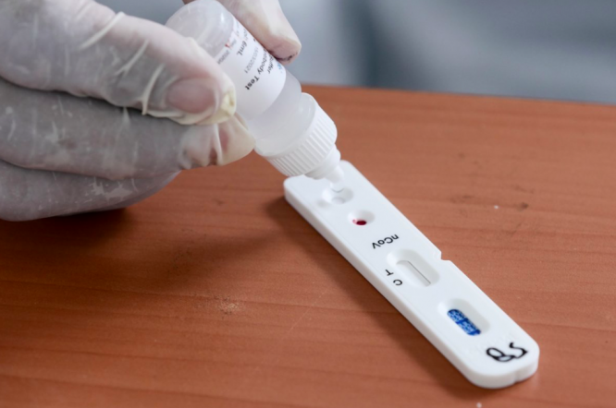
Working together
Skin sensing thermometer
Pulse Oximeter
Lateral Flow Test

Slide 42
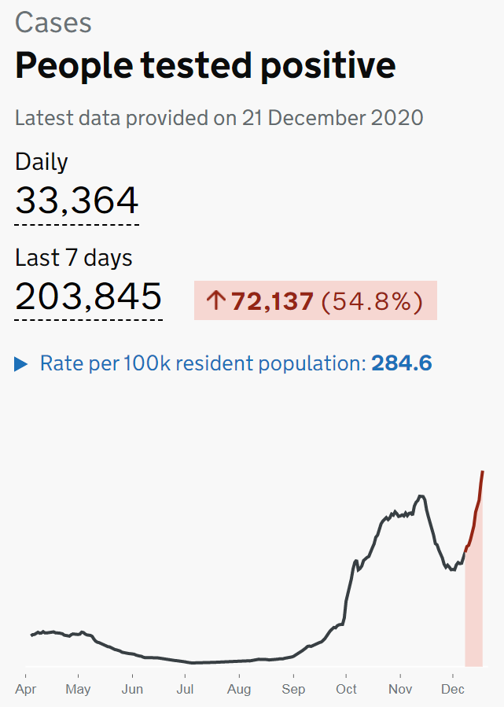

Slide 43
