Slide 1
Bridging the gaps in discharge processes
No standardization of discharge process
Patients were getting “lost to follow-up” (11% in pilot CCG), no safety netting in place
Huge variation in service quality & appointment frequency but overall oversubscribed Urology OP
GPs were not receiving adequate information on onward management of discharged patients
Patients were not being supported to self-manage
Governed by a contracts and hospital-level SOP, the pathway now ensures:
The decision and responsibility for transfer with Secondary Care (SOP, contracts). Patient has informed about transfer at last OPA.
The practice will be informed of transfer and will receive a HNA and Treatment Summary outlining clear PSA thresholds and criteria for re-referral . Practices will write to patient confirming transfer and offer a Welcome Appointment to discuss holistic needs (LCS).
Urology MDT audit of transferred patients which is ratified by primary care and acts as a safety net
Primary care follow-up is to be offered to 100% of eligible patients. Monitored and evaluated by CCG /Federation (LCS).
GPNs and GPs more confident in managing these patients as a long term condition

Slide 2
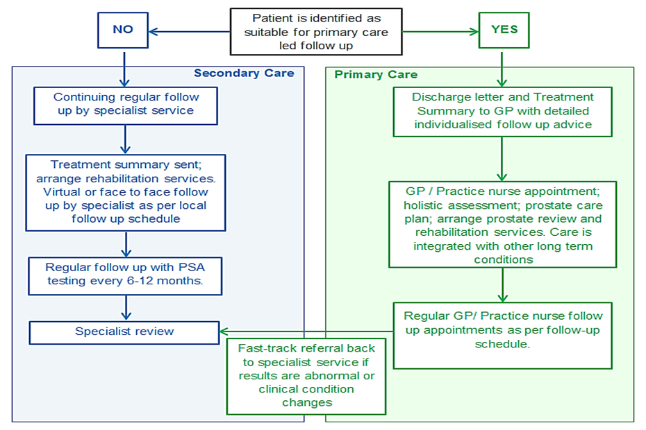
Primary care stratified follow-up of stable prostate cancer patients

Slide 3
High level pathway appears not to have been localised enough for full implementation
Diagnosis and Treatment
End of treatment & living beyond cancer
GP
Refer patient (2WW)
GP Support - Includes cancer care review within 6 months of diagnosis and referral back to specialist team, as required
Secondary Care Admin
Process referral
Entry onto cancer IT system and remote monitoring database
Decision recorded on IT cancer system
Preparation of Treatment Summary and invitation to aftercare appointment
MDT
Once PSA stable, Stratified follow-up OPA with clinician:
HNA completed
Treatment Summary reviewed and updated as required. Discharge letter completed
HNA and TS given to patient and all documents sent to GP.
Discharge to Primary Care for all eligible individuals.
Urgent referral back to secondary care as per triggers outlined on Treatment Summary
Treatment decision /
Treatment /
End of treatment clinical OPA with: discussion of future surveillance tests, support information and healthy living advice
Treatment summary completed
Medical
GP Led Follow Up: Welcome appointment: with signposting or referral to relevant services. Annual holistic needs assessments are offered and PSA testing conducted every 6-12 months as per the individual’s surveillance schedule
Investigations and diagnosis
Patient
Patient info. describes follow-up options
Patient actively engaged as a partner in their care throughout pathway.
CNS
Holistic Needs Assessment
Discuss follow-up options with patient
Holistic Needs Assessment reviewed as needed
Support services
Health and well-being events AND additional support services (sexual functioning, continence, psychological/emotional support, rehab, diet and nutrition, physical activity, peer support)
Notes:
NCEL Guidelines which needs to be agreed across the disciplines.
"There has been various ideas discussed one being a dedicated discharge clinic delivered by CNS'. Another has been early identification of these patients from the outset in MDT, so there is a record of early identification”

Slide 4
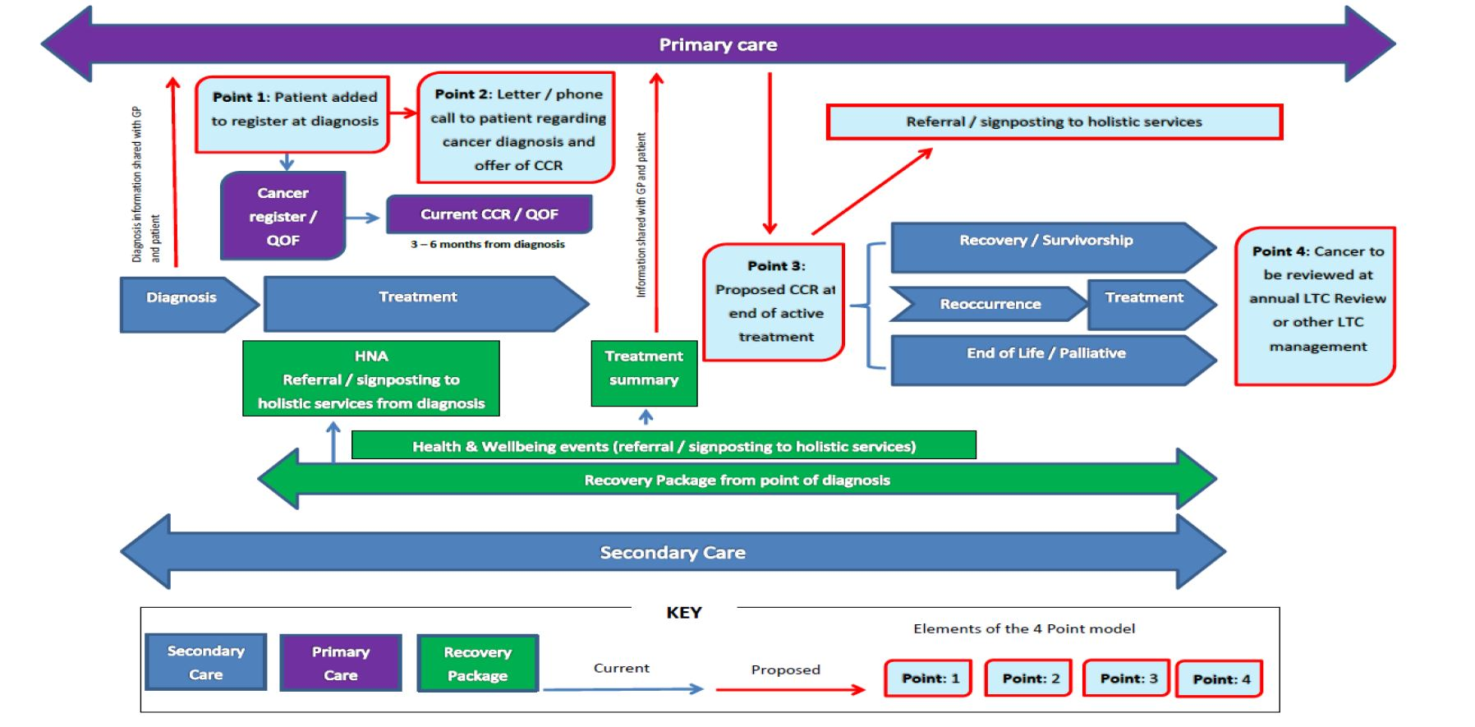
Cancer Patient pathway

Slide 5
8 Key Points
Maintain a prostate cancer follow-up register with an active recall system
Offer a ‘welcome appointment’ to all newly transferred/discharged patients. Practice to start a holistic care plan and reviewed at subsequent follow-up consultations. Patients to be asked how they would like to receive their PSA results.
Add all existing patients (those you have already following up) to the prostate cancer register. Contact the consultant is PSA thresholds are missing.
Identify a named clinical lead (GP or Nurse) who should attend locally arranged training, complete a minimum 30 minute training session accredited by BMJ Learning and disseminate training material to other staff within the practice. Recommended modules available form your Cancer Lead GP or Macmillan GP.
Signpost patient to resources to promote self-management of symptoms such as fatigue and incontinence as well as signposting to appropriate services to be made available for patients.
Check PSA levels against patient specific “normal ranges”/parameters as per their Treatment Summary. Lab normal ranges may not reflect patient specific threshold.
Inform patients of their specific PSA results according to patient’s specifications. Refer back to the Urology team if a specialist review is required. Practices to advise patients about the referral and to inform them if they haven’t received a clinic appointment within 14 days.
Follow up any patient failing to make an appointment or failing to attend the review consultation.

