Slide 1
Role of community pharmacy for children and young people with asthma during Covid (& beyond)
Raj Matharu (Chair), Bipin Patel, Darush Attar & Marsha Alter

Slide 2




Joining instructions/Teams etiquette
Use the mute button and camera off when you join the call or when others are talking
Raise your hand up if you want to speak during the Q&A session
Use the group chat feature to ask questions
This session is being recorded. A link will be available on the HLP website with any slides
2

Slide 3
Agenda
Presenter | Subject
Raj Matharu | Welcome, context and vision: incorporating pharmacy into acute/elective teams
Bipin Patel | Joining up primary and community asthma care: Bexley CYP inhaler pilot
Darush Attar | Responding to Covid-19: remote inhaler technique training
Marsha Alter | Looking to the future: what do patients want from their pharmacists and how technology can improve care

Slide 4


Community pharmacy vision
Acute Care: referrals via NHS 111 into the Community Pharmacy Consultation Service (CPCS). NHS data shows that inhalers are the most requested emergency supply by patients with Salbutamol as number 1 request.
Planned Care: managing Long Term Condition (LTC) patients within the pharmacy working in partnership with GPs and PCNs. Registration of the patient via the pharmacy’s Electronic Prescription Service (EPS). Community pharmacists regularly seen more repeat prescriptions of SABA as opposed to ICS. Regularly patients will advise that they “only need the blue inhaler as the brown one doesn’t work.”

Slide 5


Asthma death toll in England/Wales highest this decade*
New data shows asthma deaths have increased by a third in the last decade as Asthma UK calls on the NHS to urgently tackle issues with basic asthma care
*Astham UK website Friday 9 August 2019

Slide 6
Urgent medicines supply

Slide 7

Improving partnerships
Respiratory
Clinical Lead:
Grainee
d’Anconna
, Consultant Pharmacist for Respiratory
CCG Test
Beds:
Lambeth and
Bexley
Governance / Engagement:
RRPG will be used as the WG for this work, which has membership of clinicians across SEL providers and commissioners. Chaired
by Jin On / Amy Dewar. The group purpose will be to support development, implementation and tracking of benefits of the proje
ct.
Regular reports and input
will come to and from both the IPMO Board and RRPG.
What is the project:
Identify a cohort of airways disease patients
(
with either mental or physical health issues
)
from at least 2 GP practices in each of the 2
SEL boroughs.
Optimise
their treatment from medicines and adherence,
utilising
primary care pharmacists, community pharmacists and hospital pharmacists.
What work is already happening in SEL related to this:
Virtual Clinics in parts of Lambeth and
Southwark
. Inhaler technique service in
Bexley
Thoughts on measures of success:
1.
Number of patients seen by a pharmacist of those that had been identified (quarterly monitoring)
2.
Number of pharmacists that had received adherence training
3.
Number of patients who have been identified using the adherence screener in practice
4.
Number of patients where a referral or support was required from pharmacist in another sector
5.
Number of patients offered VBA for smoking cessation by a pharmacy professional
6.
Number of patients who have had inhaler counselling and follow up review

Slide 8
#AskAboutAsthma
The campaign aims to encourage health professionals, children and young people and their families to ASK for three simple effective interventions to help them control their asthma by:
Having an asthma management plan
Being able to use their inhaler effectively
Having an annual asthma review (as a minimum)

Slide 9
Joining up primary and community asthma care: Bexley CYP inhaler pilot
Bipin Patel
BBG LPC Chair & pharmacy contractor

Slide 10


Bexley Children & Young People Pharmacy Pilot
https://www.youtube.com/watch?v=Lz1ARolGZtQ

Slide 11
Pre-COVID
Use of CPCF Advance services: MURs & NMS
The pilot used the pharmacy medicine use reviews (MURs) and new medicine service (NMS) as a gateway
Asthma patients were taken through a protocol to assess their asthma and use of inhalers on SONAR (IT platform for the pilot)
At the end of the consultation, the patient was RAG rated

Slide 12
Post-COVID
Use of websites to inform asthma patients and their parents
https://www.firstpct.org/
https://www.firstpct.org/
https://www.asthma.org.uk/advice
https://www.asthma.org.uk/advice/inhaler-videos/facemask-child/

Slide 13
Make Every Contact Count
What can you do?
Acute Care: referrals via NHS 111 into the Community Pharmacy Consultation Service (CPCS). Engage with your CPCS and signpost to the Asthma UK websites for inhaler technique, remind them of the importance of using ICS inhalers regularly and update their asthma plan.
Planned Care: managing Long Term Condition (LTC) patients within the pharmacy working in partnership with GPs and PCNs. There is a shift to eRD prescribing, check with patients that regularly use SABAs instead of their ICS. Start conversations with patients on how they feel about their asthma and inhalers.
Flu Vaccination. Remind them to get their flu vaccination this winter
https://www.healthpublications.gov.uk/ViewArticle.html?sp=Sfluvaccinesforthe2020to2021seasonposter

Slide 14
Remote consultations, stock issues, optimising inhaler use
Darush Attar-Zadeh BPharm MFRPSII
Resp Lead Barnet CCG
RightBreathe Pharmacist

Slide 15
https://www.guidelinesinpractice.co.uk/supplements/practical-tips-for-maintaining-asthma-care-prompted-by-a-supply-issue-during-the-covid-19-pandemic/455516.article

Slide 17



Making every contact count:
Never ask a person ‘do you know how to use their inhaler?’

Slide 18
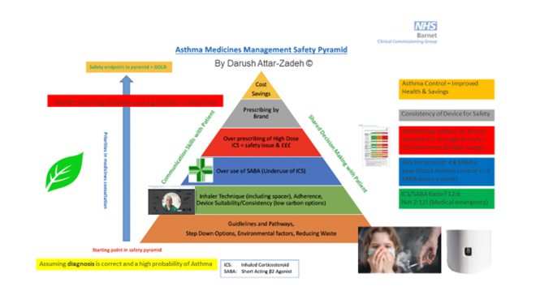
Notes:
Early and accurate diagnosis – the amount of medicines wastage when people are given treatments they don’t need. But far more importantly not getting treatments they do potentially need – pharmacological and non-pharmacological e.g. physio, psychological, social services
Thinking before we prescribe
Fit to care - The aim of this document is to provide guidance for commissioners and clinicians to the skills, knowledge and training required by healthcare professionals working with patients with a respiratory condition in a primary or community care setting.
– no delegation without education
Dose counters important
Prior to exploring SABA prescribing, these are some of the other considerations that are on the mind of a medicines optimisation pharmacist
For patients with asthma – our aim is to try and shift the ratio of ICS/SABA from 2:12, to more like 12:2
To ensure effective inhaler use, GINA recommends the 4 ‘C’s’:
Choose the most appropriate device for the patient before prescribing. Consider medication, physical problems, e.g. arthritis, patient skills, and cost. For ICS by pMDI prescribe a spacer
Check inhaler technique at every opportunity. Ask the patient to show you how they use their inhaler. Check technique against a device-specific checklist
Correct using a physical demonstration (e.g. with a placebo device)
Confirm that you can demonstrate correct technique for each of the inhalers you prescribe.
Global Initiative for Asthma. Global strategy for asthma management and prevention, updated 2019. https://ginasthma.org/wp-content/uploads/2019/06/GINA-2019-main-report-June-2019-wms.pdf [Accessed July 2020]

Slide 19
Improving inhaler technique
Potential implications of sub-optimal technique:
Poor control
Increase in side effects
Increased dose
Escalation of treatment
Increased hospital admission
Increased cost
https://www.respiratoryfutures.org.uk/media/69775/ukig-inhaler-standards-january-2017.pdf
Notes:
Potential implications of poor technique;
Poor control of condition
Increased dose – the inhaler is ‘not working’ so the dose is increased
Increase in side effects
Escalation of treatment – step up with additional medicines
Increased hospital admission (and length of stay) – due to poor control and exacerbations
Increased cost – from increased medicine use, increased use of services and hospital admissions
Can also lead to increase in death from poor control
Consider that even with good technique 20-50% of the inhaled medication is deposited in the lung and between 50-80 % of the medication is swallowed, which can cause systemic side effects, particularly with inhaled corticosteroids (Ref Usmani O, Capstick, Chowhan, Scullian J, Choosing an appropriate inhaler device for the treatment of adults with asthma or COPD)
With sub-optimal technique this is less and more medicine will be swallowed, potentially resulting in increased systemic side effects and less symptom control. This could result in increase of dose, escalation of treatment, possible increase in hospital admission and increased cost of treatment. (Ref Usmani O, Capstick, Chowhan, Scullian J, Choosing an appropriate inhaler device for the treatment of adults with asthma or COPD)

Slide 20
https://www.pcrs-uk.org/annual-conference

Slide 22
https://www.pcrs-uk.org/standard-fit-care

Slide 23
Innovative idea’s to improve technique and track adherence in children.
The whistling noise from clip–tone is picked up by the app and eliminates the baddies.
https://www.nhs.uk/apps-library/rafi-tone/

Slide 24

Children and inhalers
Age of child will affect choice of device
Size of face-masks with spacers
Licensing issues
Concerns about steroid use (natural) & growth
Use of RB ICS traffic light signals (more useful in adults)
Promote ownership by child (what does good asthma look like to you?)
Video consulting: usually as an add on to telephone appointment for necessary parts (inhaler technique)
Follow ups remotely where possible
Notes:
Age of child will affect choice of device
Size of face-masks with spacers – ensure correct size (for example the Flow-Vu comes in 4 sizes and you can get a ‘mask sizer’ template to help find correct size)
Need to consider licensing issues as discussed earlier
Use of inhalers at school – inhalers in school legislation
Consultations with parent / carer – in consultations with children healthcare professionals often spoke to parents / carers. Concerns of both parties need to be discussed and resolved, for example concerns about steroid use and growth
Promote ownership by child, include them in generating personal action plans
Child v young person – as child grows older need to revisit inhaler choice, motivation for adherence etc.
(CPPE Consulting with children and young people e-learning may be useful – it considers balancing parent/carer and children’s views in triadic consultations.)
For information only;
Guidance on the use of inhaler systems (devices) in children under the age of 5 years with chronic asthma TA10
Corticosteroids and bronchodilators should be delivered by MDI plus spacer. A face mask is required until the child can breathe reproducibly using the spacer mouthpiece
Alternative – nebuliser, or DPI for children 3-5 years
Inhaler devices for routine treatment of chronic asthma in older children (aged 5-15 years) TA38
Corticosteroids via MDI and spacer as first choice, BUT acknowledges that if a child is unlikely to use that other inhalers can be considered
Bronchodilators – consider a wider range of inhalers as they are likely to be carried around.

Slide 25
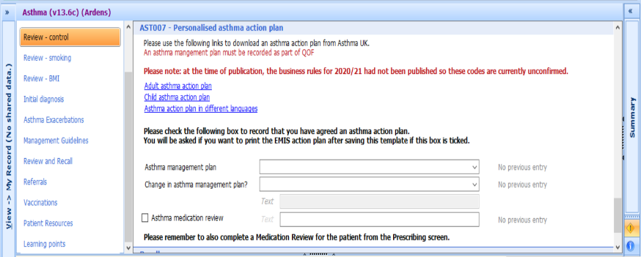
Use of templates, that can be sent to patients digitally – AccuRx, SMS
Notes:
Video consulting: usually as an add on to telephone appointment for necessary parts (inhaler technique)
Follow ups remotely where possible

Slide 26

www.rightbreathe.com

Slide 27
Some spacers can make whistling sounds if you breathe too fast (whistle bad)
https://www.asthma.org.uk/advice/inhaler-videos/single-breath-and-hold/

Slide 28
https://www.pharmaceutical-journal.com/cpd-and-learning/learning/remote-consultations-how-pharmacy-teams-can-practise-them-successfully/20208102.article

Slide 29
Community Pharmacy
Marsha Alter, Community Pharmacist & Community Pharmacy Research Champion
Middlesex Group of LPCs

Slide 30
Rewind to 2018
Ask About Asthma Campaign
The pledge to set up face-to-face
inhaler technique training for
Community Pharmacists

Slide 31
Reporting back in 2019
Ask About Asthma Campaign
We developed a series of successful FREE
interactive inhaler technique workshops and
invited other healthcare professionals to join.
New Pledge…to develop a CYP asthma
review service specification

Slide 32
Moving on to 2020
Ask About Asthma Campaign
The MPG was looking forward to having data to show that Community Pharmacy CYP Asthma Reviews, developed in collaboration with other health care asthma leads and the CCG, improved inhaler technique and overall quality of life.
Notes:
Working with a CCG respiratory lead, LPC representative, and taking advice and recommendations from Pharmacists after the inhaler workshops and other health care respiratory leads.

Slide 33
BUT Covid-19 happened !!
Service development came to a standstill as CCGs could no longer commit financially and LPCs prioritised Covid-related support for their Community Pharmacy colleagues.

Slide 34
Can we find “good” in Covid-19?
Suddenly there was increased interest in “good asthma control” and people who had not been adhering to prescribed preventative treatment panicked, put in prescription requests and began taking care of their respiratory health.
Surgeries were quick to respond and urgently conducted searches of their respiratory patients ensuring that those requiring treatment had up to date prescriptions
The panic led to some overprescribing and inhaler shortages, but organisations and drug companies collaborated to ensure that patients received their required treatment molecules.

Slide 35
How did community pharmacy adapt?
Since Covid-19 it became difficult in the pharmacy to fully demonstrate, or coach inhaler technique but we have continued to EDUCATE
Some Pharmacies used VIDEO technology, unfortunately not funded by NHSE
Pharmacists familiar with children’s asthma sites could direct CYP to apps such as RAFI TONE

Slide 36
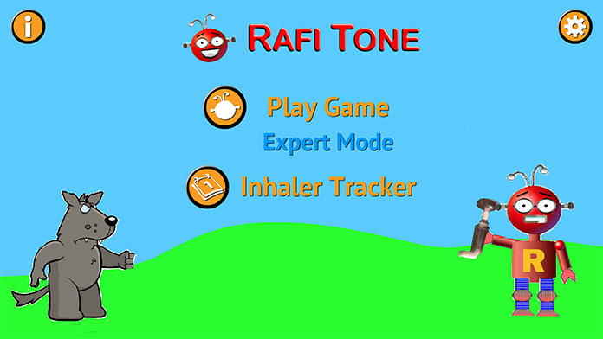
Rafi-Tone
A newly validated app called Rafi-Tone, developed by clinicians in the UK, makes using an inhaler with a spacer easier and more fun for young children with wheeze or asthma symptoms. By motivating positive inhaler technique, medication is likely to be far more effective; something that is even more crucial during the Covid-19 crisis as those with asthma are advised to be particularly vigilant about taking their medication as prescribed to ensure optimum control.

Slide 37
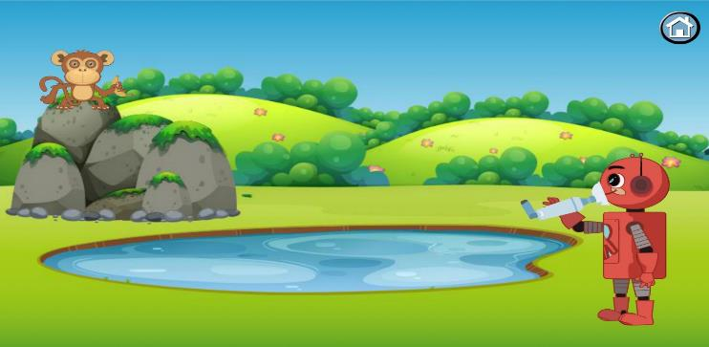
Rafi-Tone
Who is it suitable for? How does it work?
Young children with wheeze or asthma symptoms.
Using an inhaler, spacer and small whistle mask manufactured by Clement Clarke International Ltd, young children can make sure they are taking their medication correctly. If no air leaks from around the mask, it emits a musical tone and Rafi Robot appears to defeat the baddies in the app.
The app tracks when and how effectively the inhaler is used, and the characters interact with the child when they breathe properly.

Slide 38
Remote consultations and video technology…the future?
The arrival of Covid-19 forced the world to change the way we communicate and conduct our lives.
The forced wide-spread use of video platforms has revolutionised interactions generally.
NHSE provided FREE video technology to enable remote visual consultations in primary and secondary care

Slide 39
However…
Whilst telephone and video consultations now the “norm” for Primary and Secondary care consultations with apparently 99% of surgeries video enabled,
Community Pharmacies have had to source and finance their own technology.
☹

Slide 40
What could the future look like for Community Pharmacy?
Enabling remote consultations in community Pharmacy could extend the reach of healthcare to the “harder to engage” communities and those who are isolating or vulnerable.
LATEST NEWS!!
The PSNC announced that from SEPT 1ST
Community Pharmacy no longer requires paper consent for reviews and MURS/NMS can be conducted remotely
☺

Slide 41
What could the future look like for Community Pharmacy?
There are now several companies developing video platforms specifically designed for Community Pharmacy each platform having additional functions to suit the needs of individual businesses.
The MPG is researching the acceptability and feasibility of platforms for Community Pharmacy consultations.
A survey in collaboration with SCARU (Self Care Academic Research Unit), Imperial College) indicates positive interim results for general public acceptability.

Slide 42
What could the future look like for Community Pharmacy CYP Asthma Reviews?
Remembering that most Pharmacies have at least 6 annual patient-prescription contacts for long term condition…MAKE EVERY CONTACT COUNT?
CYP who have not engaged with primary care for annual asthma reviews could be offered a review in Community Pharmacy.
Community Asthma Nurse or Respiratory Consultant to digitally refer CYP to Community Pharmacy for monitoring.

Slide 43
What could the future look like for Community Pharmacy CYP Asthma Reviews?
Inhaler technique check and coaching…use of apps?
Asthma review if concerns raised during the Pharmacy Asthma Quality questions…Reliever vs Preventer/asthma plan/spacer (enabling provision of spacer or peak flow meter if necessary).
Review with parent or caregiver administering inhalers.
Opportunistic or referral from another provider.
Opportunity include healthy lifestyle and smoking cessation

Slide 44
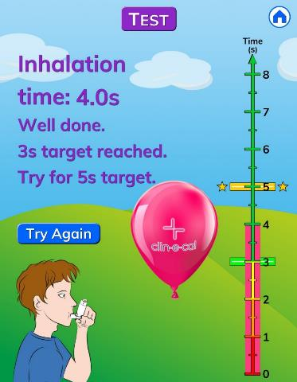
Community Pharmacy and CYP asthma related research
The MPG is hoping to collaborate with Clement Clarke, Imperial College and the NIHR to evaluate future CYP asthma review services including the benefits of training devices and training apps.
For example the clip tone device used with associated animated app:

Slide 45
SO what could the future look like for Community Pharmacy and CYP with asthma?
Collaborative, integrated, commissioned CYP asthma services
Technology enabled CHOICE to ensure that Community Pharmacy services remain accessible to the whole community
Engaging in community asthma research projects to assist further improvements in healthcare provision
Notes:
The LPCs are doing their best to ensure that Community Pharmacy is included in funding discussions.
The LPCs are collaborating with NHSE, PHE, NIHR and a number of other organisations to establish integrated Community Pharmacy pathways..

Slide 46
All the work we do with our partners moves us closer towards our goal to make London the healthiest global city.
www.healthylondon.org
england.healthylondon@nhs.net
@healthyLDN

