Slide 1
How specialist nurses can support the 3 #AAA asks and improve asthma care across the system
Tori Hadaway (Chair), Pippa Hall, Alison Summerfield, Anika Tanna, Natasha Brennan & Eleanor Doran

Slide 2




Joining instructions/Teams etiquette
Use the mute button and camera off when you join the call or when others are talking
Raise your hand up if you want to speak during the Q&A session
Use the group chat feature to ask questions
This session is being recorded. A link will be available on the HLP website with any slides
2

Slide 3
Agenda
Presenter | Affiliation | Subject
Tori Hadaway | Barts Health | Welcome and context
Pippa Hall | Royal Brompton | Paediatric biologic homecare service: Service development due to Covid-19
Anika Tanna & Alison Summerfield | Hillingdon Hospitals | Asthma Role Modelling clinics: Improving paediatric asthma management in primary care
Natasha Brennan & Eleanor Doran | Whittington Health | Sustaining the 48-hour Telephone Triage Service in Islington

Slide 4
#AskAboutAsthma
The campaign aims to encourage health professionals, children and young people and their families to ASK for three simple effective interventions to help them control their asthma by:
Having an asthma management plan
Being able to use their inhaler effectively
Having an annual asthma review (as a minimum)

Slide 5


Paediatric biologic homecare service
Service development due to Covid-19
Pippa Hall
Angela Jamalzadeh
Paediatric Respiratory Nurse Specialists

Slide 6
Biologic service pre covid-19
MDT decision to start biologic
Discuss with family at clinic appointment with named consultant and information pack given
Start date arranged: first 3 doses administered on Ward due to longer observation period (as per hospital guideline)
All subsequent injections required observation period of 1 hour – patients attended nurse-led clinic
Review in clinic with consultant every 3-4 months depending on biologic
With each monthly injection, completed spirometry, FeNO, PAQLQ and ACT as per monitoring guidelines

Slide 7
Covid-19 March 2020
Lockdown, f2f appointments stopped, therefore needed to consider alternative means to administer injections
At this time, homecare was not set up for paediatrics on biologic treatment
Needed to source homecare provider happy to take on this agreement asap
Adult service had transitioned all biologic patients to homecare with no f2f training, patients independently had to read resource packs and watch videos
No existing competency documentation to use as template
No other centre had paediatric homecare set up for biologics
Starting from scratch……..

Slide 8
Homecare set-up
Homecare provider quickly identified to take on both Xolair and Mepolizumab contracts
Suitable patients identified for homecare administration (MDT decision) and contacted
Agreed patients/families would attend for 1 face to face training session
Advised going forward when injections due, video call would be undertaken with them
Initially no standard video call software available, so advised families it would be by means available

Slide 9
Homecare patients
25 patients
1 transferred back to Gibraltar
1 transferred back to Leicester
6 patients not suitable (safeguarding, dose not licensed for homecare, behaviour issues, allergic reactions, poor control)
2 administered at home by local CNS
14 suitable for homecare (self administration or parent)
**During lockdown acquired 1 new started patient (total 23 excluding 2 transfers)**
Overall 70% of patients receiving homecare administration

Slide 10
Homecare service outline
Patient attends clinic for 1 injection f2f training, complete competency sheet, registration and prescription form, receive information pack
Those who had good lung function technique were also issued with a home spirometer - Nuvoair
All families consented to 2 weekly/monthly video calls to coincide with their injections and made aware this would continue for the foreseeable future
If any issues with injection technique or concerns about asthma, f2f will be offered
At each monthly call, PAQLQ, ACT/cACT and questions about OCS, unscheduled care visits and hospital admissions. Also complete spirometry prior to call
If spirometry is decreased or they are unwell, BDR can be done and worked out by physiologists and clinical plan can be made with team if required

Slide 11
Homecare currently
All families still happy to receive video calls and all remembering
Still transferring some calls over to Attend Anywhere. Sometimes have to use alternative video platform if poor internet connection.
Most patients like the spirometer device/find it easy to use
Patients are happy to complete the questionnaires during call
Families receive 1 or 2 monthly deliveries of biologics and so far, no major issues. Families are finding it easy to arrange, after first delivery completed, receive email reminders before next delivery due
Receive 3-4 monthly clinic appointment with consultant via Attend Anywhere

Slide 12
Pros & cons
Pros | Cons
Reduced burden on clinic days as video calls scheduled any day/ time of the week | 1 incident injection not given properly, unable to repeat (Datix)
In some patients initially parents have been giving the injections but a couple of adolescent patients have now taken on the task and self administer which is good preparation for transition to adult services | 1 incident plunger pulled out of syringe, family had to collect new syringe from RBH as could not be reissued by homecare company, needed repeat video call (cost impact) (Datix)
Families are keen to continue homecare as quicker/easier/more convenient and happy to continue video calls | No f2f contact with families anymore
Demonstrated that homecare biologic service in paediatrics is possible and can work | 1 family returned to hospital administration due to safeguarding concerns

Slide 13
Other centres
Cardiff- seen in hospital and not using homecare. Seen in person so can be reviewed and ensure compliance
Newcastle- couple of Xolair families taught, once competency passed video call available if needed so not routine. Some GP practice nurses administer and some DGHs administer. No Mepolizumab patients taught to self administer. Use peak flow as home monitoring. Majority continue to receive at hospital f2f.
Basingstoke have trained some of the Xolair patients for home administration (no further details)
Exeter is offering Xolair self-administration at home (no further details)
Kings are in the process of signing up to Mepolizumab homecare but no further details
Birmingham, Oxford, Scotland, Nottingham and Manchester have all signed up for Mepolizumab homecare but no further details

Slide 14
Patient experience
Feedback
Changes to service quick and smooth, helpful having video call, saves time on travel (Patient)
Video call necessary, good having home lung function, thank you for setting up and ongoing support (Parent)
Nervous at beginning, contributing to breaking 1 syringe and 2 sharps bins! Feel completely supported when injections are due with video call from nurses. Deliveries work well (Parent)
Will be strange going back to hospital care, saves times and missing less school (Parent)
Initially not keen as don’t like needles (but nurses made it more comfortable). Communication with homecare team useful, deliveries on time, text reminders helpful. Nurses are really nice and very patient. Helpful to have lung function machine, helps with awareness of health (Patient and parent)
Thankful for how the team has changed the service and the help and support from RBH team to ensure can still have the medication and regular review (Patient)

Slide 15
Future for the service
Where do we go from here?
Currently continuing homecare for those now established
Offering homecare to any future patients once established, if deemed suitable by MDT
Continuing CNS video calls when injections due to ensure adherence utilising directly observed therapy

Slide 16

Thank you to everyone in the DA team with the management, set up and development of this new service.

Slide 17
Asthma Role Modelling clinics
Improving paediatric asthma management in primary care
Anika Tanna
Alison Summerfield

Slide 18
Agenda
What are role modelling clinics?
Structure of the clinics
Financial Support
What have we achieved so far?
Practice nurse feedback
Patient feedback
‘Keep in Touch’ Forum
How Covid-19 impacted the clinics

Slide 19

What are role modelling clinics?
An initiative in Hillingdon to upskill practice nurses in paediatric asthma reviews and management
Paediatric respiratory nurse specialists work alongside practice nurses to review children with asthma
Clinics run on a 6 weekly basis at each GP practice in the borough

Slide 20
What is the clinic structure?
Weeks 1 & 2:
Teaching from specialist nurses
Observing specialist nurse consultations (30 minutes per patient)
Weeks 3 - 5:
Practice nurses take lead in consultations with support from specialist nurses
1 hour teaching session led by respiratory team for all clinical staff in the practice
Week 6:
Feedback and debrief regarding the clinics.

Slide 21
What financial support is required?
Funding Structure
Business case presented to CCG commissioners
Hillingdon Confederation deliver service once commissioned
Funding
- Backfill for Practice Nurse time (£30/h – equates to £720 per practice over a 6 week period)
- Additional funding for 0.5 wte Band 7 Respiratory Nurse Time (approx £10,000 for a 6 month period)
- Project Management to support the scheme - £20,000 per annum

Slide 22
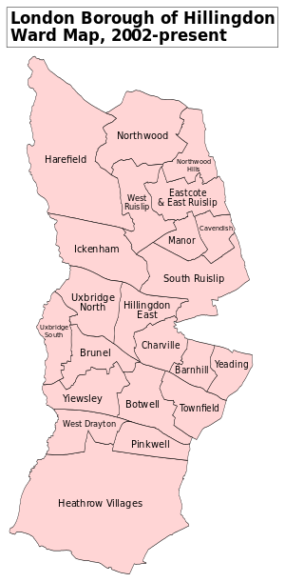
Our Ambition
To achieve whole practice coverage in Hillingdon over a two year period

Slide 23
What have we achieved so far?
Practice involvement
Clinics completed in 6 practices
Clinics in progress in 4 practices
2 practices scheduled for September 2020
Appointment Acceptance
206 patients accepted an appointment (88%)
29 patients declined an appointment (12%) – had recent review, unable to attend due to parental work commitments
Attendance Rates
179 patients attended (77%)
34 patients did not attend (15%) – skewed by double appointments for siblings who did not attend

Slide 24
Confidence was low in several areas
Pre Clinic Questionnaire
 | Yes | No
Do you have an Asthma Diploma? | 22% | 78%
I do not currently see children for asthma reviews | 33% | 67%
Do you follow a structured asthma review when seeing patients | 78% | 22%
Are you aware of the North West London Children's Asthma guidelines? | 44% | 56%
What are your main concerns when reviewing children with asthma?
No formal Training
Changing medication
Inhaler technique

Slide 25
Nurses reported increased confidence in all age groups after conducting the clinics
On a scale from 1(low) to 10 (high), How confident are you reviewing a child with asthma in the following age groups: | Pre | Post
Age 5 - 11 years | 2.9 | 9.0
Age 12 - 15 years
 | 4.4 | 9.0
Age 16 - 18 years | 5.3 | 9.0
How confident are you performing a structured asthma review? | 4.3 | 9.0

Slide 26
Nurses reported increased confidence in all areas after conducting the clinics
Post Clinic Questionnaire
Please rate the following statements from 1 (low) to 10 (high) | Min | Max | Average
I am more confident reviewing children with asthma | 9 | 10 | 9.3
I have learned new skills | 9 | 10 | 9.5
This training will help when I am reviewing adult patients with asthma | 9 | 10 | 9.7
The trainer was skilled and knowledgeable | 10 | 10 | 10.0

Slide 27
Nurses reported increased confidence in all areas after conducting the clinics
How likely are you to do the following during asthma review? (1 being low - 10 being high) | Pre | Post
Ask about adherence to treatment | 7.0 | 9.8
Ask about acute episodes or asthma since last reviewed | 7.8 | 10.0
Check inhaler technique | 7.0 | 10.0
Provide a written asthma management plan for the patient | 6.6 | 10.0
On a scale of 1 (low) to 10 (low), how likely are you to do use the following to assess current asthma control? | Pre | Post
Use the Royal College of Physicians 'three question' | 6.7 | 10.0
Use the Asthma control test/Children's asthma control test | 5.8 | 10.0

Slide 28
Patient feedback was strongly positive
99% of respondents stated that they were very likely or likely to recommend the clinic to their friends and family.
99% of respondents stated that they were happy with the joint appointment.
77% of respondents stated that their overall experience was ‘Great’, a further 14% described it as ‘Good’.
91% of respondents stated that the information given was ‘Great’ and a further 9% described it as ‘Good’

Slide 29

Additional benefits
Building relationships between primary and secondary care
  Good rapport built between practice nurses and hospital asthma team
  Increased knowledge of referral pathways, contact numbers for secondary care team for advice and patient discussions
Practice level changes
  Some practice nurses have become practice asthma leads following the clinics
  Personalised care plan and asthma review templates uploaded onto surgery electronic records
  Acute emergency equipment checked in practice, e.g. inhalers and facemasks/mouthpieces

Slide 30



Next Steps – ‘Keep in Touch’ Forum
Support network for practice nurses who have participated in the Role Modelling Clinics
Annual meeting dates for education, support and case based discussions
Sharing information of new guidelines, evidence based changing practice

Slide 31

Impact of Covid-19
Clinics suspended during March/April
Clinics resumed from May onwards on a virtual basis – some face to face consultations resumed depending on practice and patient preference
Opportunities during covid -19
  More practice nurse time available during covid-19 whilst routine work suspended.
  Parents more flexible with virtual appointment times

Slide 32


Sustaining the 48hr Telephone Triage Service in Islington
Natasha Brennan and Eleanor Doran
Made possible by: Natasha Brennan, Zalika Begum, Sallay Kamara Rogers, Eleanor Doran, Wendy Ramtohul, Tom Holiday, John Moreiras

Slide 33

48hr Telephone Triage Service Overview
48hr Telephone Triage Service Overview
In July 2018 the Paediatric Primary Care Team expanded to include a 48hr Telephone Triage service
We developed a proforma which RAG rated patients, allowing us to identify the absence of red flags and appropriate follow up care
Our team receives daily emails to whh-tr.ppc48hrreview@nhs.net from both Whittington and UCL hospitals – following the eligibility criteria: ≥ 18 months of age and registered with an Islington GP
Asthma UK (2018) reported that only an average of 28% of CYP in London were received a 48hr review post hospital attendance, this was similar to the national average
Recommendations from both NRAD, 2014 and SIGN/BTS, 2019 suggest that asthma reviews are an opportunity to assess control and optimise management accordingly
NRAD do confirm that 10% of deaths occur within 28 days post discharge which indicates a review is IMPORTANT however does this need to be within 48 hours – and are we currently meeting this?
A post attack review has two purposes - first to establish if the attack is resolving and identify the absence of red flags and secondly to reduce further risk with an aim to get control
Notes:
The service started in July 2018 (WHITT) and (UCH) September 2018
We recorded all nurse activity – we then took a snapshot of a 3/12 period (SEP/OCT and NOV) in order to analysis the effectiveness of the service across one of the busier periods across ED departments.
165 referral received from ED at Whitt and UCLH between 1st Sept 18 and the 30th Nov 18- 128 (Whittington) 37 (UCLH)
57% received a 48 hour review by a PPC nurse
15% received a 48 hour review by GP

Slide 34
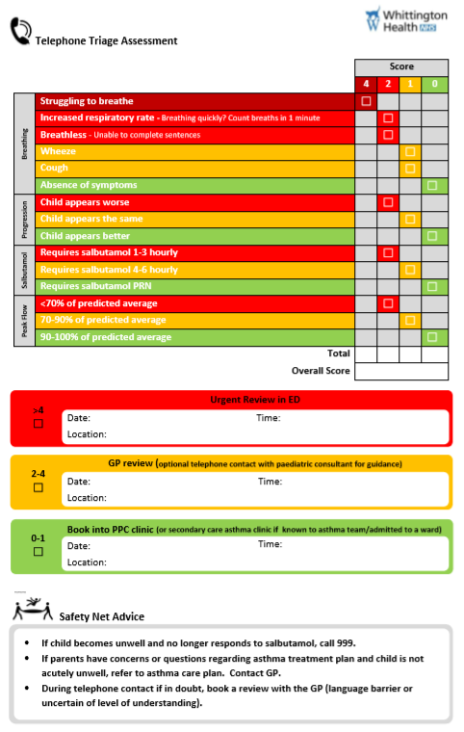
48 Hour Telephone Triage Tool
Formulated by and grounded in expert experience of:
  PPC Nursing Team
  Dr John Moreiras, Paediatric Consultant
  Whittington paeds asthma
Scores for Breathing, Progression, Salbutamol use and Peak Flow
Generates total score
Notes:
Embedded in EMIS

Slide 35
Triage Outcomes
≥ 4 = RED
  Patient deteriorated post discharge
  Urgent return to ED for assessment
2 to 3 = Yellow
  Not better / Condition not improving
  Requires face to face 48 hour review
  GP or PPC review
0 to 1 = Green
  Improved / Acute attack resolved
  No requirement for in-person review
  Routine f/u with PPC or secondary care
Unable to contact?
No answer?
ALL patients referred through to PPC team are given a routine appointment for PPC review in PPC clinic
Notes:
How the RAG rating system works

Slide 36
Summary of Outcomes 2018
Triage tool:
  Data suggest is safe to use
  Triage outcomes correlate with patient condition
  No evidence of adverse outcomes
PPCN 48 hour review service:
  Achieves rates of 48 hour review double the national average
  Cost effective – saves money on A&E re-attendance / admissions
  Highly rated by patients and families
  Makes patients with asthma safer
Receiving a review after ED attendance in Islington makes you:
  2.5 times less likely to re-attend A&E
  3.8 times less likely to be re-admitted
Notes:
Snapshot of 2018 data shows that from Sep-Nov 2018
Nil adverse outcomes when using the tool
Correctly identified right place of care for the patient

Slide 37
48hr Review Telephone Triage Comparative Data 2018 to 2019
(01/09/2018- 30/11/2018 and 01/09/2019- 30/11/2019)
Notes:
Nellie has interpreted our 2019 data and will present this now

Slide 38
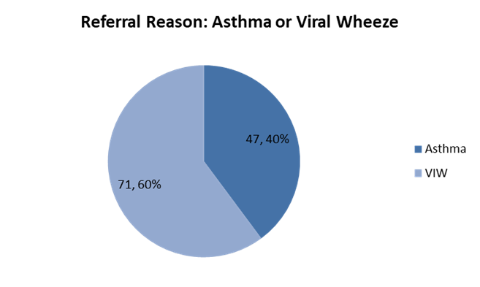
Overview September-November 2018 to September-November 2019
2018
2019
2018
2019

Slide 39
2019 September to November Data Overview
Notes:
Patient’s no seen is due to a combination of cancellation by patient/parents and DNAs.
95% reviewed face to face following ED attendance
2018= majority green
IS THE RIGED TIME IMPORTANT ?
GREEN and YELLOW patients average time seen f2f following 48 hour review was around 28 days which is in line with the NRAD recommendations

Slide 40
Re-Attendance within 7 days of Discharge Table of Data
Category | No. of re-attendances from D/C within 7 days 2019 | No. of re-attendances within 7 days of D/C 2018
Green | 1 | 0
Yellow | 2 | 2
Red | 2 | 3
GP (no triage score) | 2 | 0
Unsuccessful 48hr review | 0 | 5
Total | 7 | 10
Total referrals | 118 | 165
Green % | 3% | 0%
Yellow % | 5% | 7%
Red % | 100% | 100%
GP (no triage score) % | 15% | 0%
Unsuccessful 48hr review % | 0% | 11%
No adverse outcomes attributed to the 48hr Review Triage Tool in 2018 and 2019
Notes:
Green re-attandance patient- see face to face by GP on the same day as the 48hr how, chest review completed, sats and peak flow all normal. So no indication at this time that a re-attendance is necessary. No adverse outcomes
Patients triaged as yellow where referred for a f2f same day review with the GP and appropriately referred to ED following this appointment.
Red patients were appropriately referred to ED by the triage tool.

Slide 41
Achieving the 48hr Review During COVID 19
Islington CCN business continuity plan (2020) identified that the 48hr review was an essential service during COVID 19 due to the fact that it would help prevent hospital re-attendance rates
PPC clinics completed virtually from March 2020 to June 2020
UCLH paediatric ED closed March 2020 and patient were directed to Whittington
Significant reduction in ED presentation for Wheeze and Asthma
Some patients not presenting when appropriate
Patients were not able to be seen face to face following the 48hr review
PPC team spent longer completing the 48hr telephone reviews and scheduled more virtual follow up care for patients
Due to the requirement to do virtual consultations this highlighted need to have review conducted by highly skilled and competent HCPs

Slide 42
Summary
The 48 hour telephone triage determines if an attack is resolving and identifies the absence of red flags
The comparative data shows that we are reaching over double the national average as recorded by Asthma UK 2018
Our results show that the triage tool works and appropriately determines the correct place of care for our patients
The tool is safe and nil adverse outcomes were identified when using the triage tool
This tool has enabled us to identify patients who required support with management who may have not previously been identified
This tool correctly identifies patients who need to be reviewed the same day as symptoms were not improving (appropriate ED re attendances highlighted)
We are able to support families by providing a post attack review which empowers families to better manage their child following an acute attack without having to return to an acute setting
GP relationships are growing and the PPC profile is recognised
‘The 48 hour telephone triage tool’ has been nominated for three categories in the upcoming 2020 Nursing Times Awards
Currently publishing our data and gold standard work with asthma

Slide 43
Questions to the panel

Slide 44
All the work we do with our partners moves us closer towards our goal to make London the healthiest global city.
www.healthylondon.org
england.healthylondon@nhs.net
@healthyLDN

