Slide 1
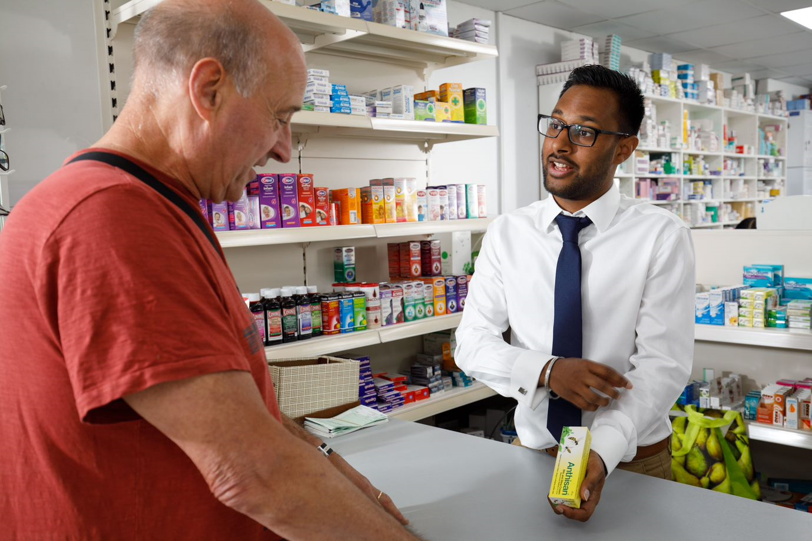


The role of community pharmacists in driving early detection of cancer
Shabina Azmi – Community Pharmacy and Primary Care programme facilitator at Health Education England

Slide 2
Agenda
Cancer prevalence
Cancer diagnosis across London – how are we performing?
Training Needs Analysis findings
An opportunity for community pharmacy discussion

Slide 3
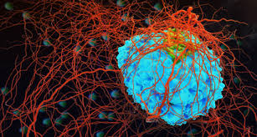
Cancer prevalence
Cancer accounts for around 25% of deaths in England
The stage of the tumour at diagnosis is a major determinant of patient outcomes from cancer
Diagnosis at an early stage of the cancer's development leads to dramatically improved survival chances.
The NHS Long-term plan stipulates the ambition is for 75% of all cancers to be diagnosed at stage 1 or 2 by 2028
Notes:
Cancer outcomes in England lag behind other European countries with comparable healthcare systems and a key factor in this is failing to diagnose patients early enoughi . Late stage diagnosis is associated with poorer survival (lower one year and five year survival rates), because treatment is less likely to be curativeii. It is estimated that more than 40% of children born today will develop cancer at some stage in their life.
Diagnosis at an early stage of the cancer's development leads to dramatically improved survival chances. Specific public health interventions, such as screening programmes and information/education campaigns aim to improve rates of early diagnosis. An indicator on the proportion of cancers diagnosed at an early stage is, therefore, a useful proxy for assessing improvements in cancer survival rates.

Slide 4
Current performance in diagnosing cancer across London
Notes:
London has a significant challenge to overcome to achieve this target
If we continue to do what we are currently doing to earlier diagnose this target will NOT be met and we need to think differently
London has agreed lung and abdominal cancers are where the biggest wins are likely to be made to support achievement of this target

Slide 5
Survival rate in London areas
Notes:
One-year cancer survival rates are an important measure as translate into timely access to treatments and better patient outcomes
This measure has been steadily improving across London in line with England
However 1 in 4 people are still not surviving one year after diagnosis
Variation across the region between 73.8% in SE and 75.8% in SW

Slide 6
Cancers diagnosed through A&E
Notes:
Patients diagnosed via an A/E presentation are almost twice as likely to die within a year of diagnosis compared to those diagnosed via a GP urgent referral route
Year on year less patients are being diagnosed via A/E but still around 1 in 5 patients on average continue to be diagnosed via this route
Some cancers are difficult to diagnose and patients may visit their GP multiple times before being referred
Across London there is variation in this measure as shown in this slide for NEL

Slide 7
Bowel Screening Uptake
Notes:
Around two in three cancers diagnosed via screening programmes are at an early stage, so improving uptake to these programmes is key
Bowel cancer is common (around 1 in 20 people will get it in their lifetime)
Less than 60% of people in London invited to take part in bowel screening do so
Variation across London CCGs - In Havering 37% take part compared to 59% in Bromley

Slide 8


Community pharmacy – How can we support?
Early cancer diagnosis is referenced twice in the CPCF as a prevention and detection service
Pharmacists are well placed to review patients presenting multiple times for over the counter medication and who present at appointments asking for advice
Equipping pharmacies with the tools and knowledge to identify red flag cancer symptoms and allowing them to make direct referrals could increase early diagnosis of cancer in patients who may not have recognised their symptoms or presented at their GP.
This route of referral could reduce the number of patients diagnosed late or through emergency presentation
Notes:
Leave this open …workshop…these are the oppo, co-develop to drive forward…

Slide 9
Training Needs Analysis
HEE identified the need to conduct a training needs analysis in collaboration with the London Transforming Cancer Services Team (NHSE/I)
Analysis and reporting undertaken by Work Psychology Group
Notes:
Early cancer diagnosis is referenced twice in the CPCF as a prevention and detection service which, if found effective and best delivered by community pharmacy, could be mainstreamed in the CPCF over the course of the settlement period. This is in the context of community pharmacy complementing the content of forthcoming PCN service specifications.
This training needs analysis was carried out in collaboration with the London Transforming Cancer Services Team (NHSI)
to identify pharmacy specific and cross-profession training needs so with a view to informing the design and delivery of a bespoke educational resource strategy to support the upskilling of the sector in readiness for this.
This project is an opportunity to demonstrate to the other professions through Training Hubs that community pharmacists and their teams are both engaged and capable of delivering vital prevention services within PCNs.
Evidence from the survey will also put community pharmacy in the region in good stead to bid for PhIF funding related to prevention and detection.

Slide 10
Training Needs Analysis Related to Early Cancer Diagnoses for Community Pharmacy Employees in London
August 2020

Slide 11
Approach
Across September and October 2019, individuals working within a community pharmacy setting in London were invited to complete a Training Needs Analysis (TNA) survey, to help identify learning needs in relation to the community pharmacy context.
The specific objectives of the TNA survey were to understand the community pharmacy’s knowledge and skills across a number of areas including:
  Knowledge of potential cancer signs and symptoms
  Knowledge of screening programmes
  Perceived risks of cancer
  Attitudes towards cancer and early diagnosis
Notes:
This project is an opportunity to demonstrate to the other professions through Training Hubs that community pharmacists and their teams are both engaged and capable of delivering vital prevention services within PCNs.
Evidence from the survey will also put community pharmacy in the region in good stead to bid for PhIF funding related to prevention and detection.

Slide 12
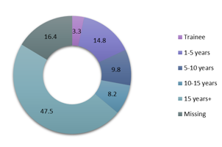
Sample
61 respondents completed the Training Needs Analysis (TNA) Survey
Respondent sample by Job Role
Respondent sample by Years Qualified
Notes:
Respondent samples good representation of all London CCGs and representative of most pharmacy types from multiples to small independents

Slide 13
TNA Survey Results

Slide 14
Awareness of Cancer Screening Programmes
Results suggest individuals are engaged and recognise the value of these programmes, evidenced through their proactivity in increasing uptake.
It may therefore be useful to focus any training in this area around specific information (i.e. screening programme ages). In addition to this, based on the current sample, it may be valuable to provide more in depth training on alternative options that could be recommended to patients if they do not fit within the screening age.
Notes:
Respondents noted that they were aware of screening programmes that were available for different cancer types
However, whilst many had an awareness, when reviewing the questions that asked about specific details of these programmes (i.e. screening ages, alternative options, new faecal immunochemical test), it identified a significant proportion of individuals that are not aware of this information.

Slide 15
Role Beliefs & Confidence in Cancer Diagnosis
Results suggest that for many, they understand the potential signs of cancer, however, where they feel less confident is in regard to engaging in these conversations with patients (with this being one of the most popular study day topics selected).
Therefore, it may be of value to focus any training interventions around the practical skills of how to utilise the knowledge that they have and to engage in these interactions with patients.
Notes:
Respondents felt that cancer prevention was part of their roles as a member of the primary care and community healthcare team. In addition, the majority considered that they could take more of an active role themselves in supporting this activity.
However, the vast majority were either unsure or disagreed that they felt able or equipped to have specific conversations with patients about how both their life-style could link to cancer or how to respond to patients relating to certain cancer-based symptoms.

Slide 16
Knowledge of Factors Increasing Chance of Cancer
Knowledge-based training on supporting those working in a community pharmacy setting in understanding the lifestyle changes that patients could make to reduce their chances of developing cancer could be a key priority for future training activities.
Notes:
In comparison to the respondents knowledge in relation to symptoms that could indicate cancer, there was a lot more uncertainty across the sample when asked about possible factors that may increase a person’s chance of developing cancer (with the exception of factors in relation to cigarettes/smoking).
Before implementing any training activity in this area, it may be helpful to consider if there are particular complexities associated with this knowledge area that may have an impact on how success any training is. Is this part of a broader area / skill set that is less familiar at the moment to those working in community pharmacy settings?

Slide 17
Cancer Prescription Knowledge
Provision of a greater level of detail around a patient’s prescriptions could support the pharmacy team in feeling more confident in providing holistic care (i.e. monitoring and treatment of toxicity, counselling the patient).
Notes:
Just over half of respondents recorded that they had dispensed some form of cancer treatment, however for those that do, the majority are performing this task several times a week.
Despite this nearly all respondents noted not having access to written protocol and treatment plans of patients, patient diagnosis or other information (i.e. height, weight).
Furthermore, the majority recorded how they had not counselled these patients in relation to their prescriptions.

Slide 18
Confidence Speak to Cancer Patients
Based on these results, it is not clear if the uncertainty with regard to this aspect of care is in relation to a lack of knowledge in this area or due to not knowing how to apply the knowledge that they may have into practice.
It therefore may be useful to clarify this first before considering more specific training and development plans, i.e. through follow-up interviews.
Notes:
There were mixed views when respondents were asked about their level of confidence in speaking to patients with cancer.
Whilst many felt comfortable with dispensing prescriptions in this area, the majority were less certain in relation to the other ways in which they could liaise with individuals either with cancer or those that had survived cancer (i.e. through counselling conversations).
A number of topics within this area (e.g. managing side effects of cancer treatments, supporting patients with cancer) also received significant support for being the focus of study days.

Slide 19
Learnings from TNA
Respondents recognise that within their role within the pharmacy team they could have a more prominent role to support the broader primary care team in relation to the early diagnosis of cancer and are engaged and willing to take a more active role in this area.
Often, this level of intrinsic motivation is challenging to establish when seeking to develop knowledge and skills. This is a very positive finding and how to maintain this, should be a consideration when thinking about next steps.
  Based on this, it may be helpful to consider if it is possible to involve members of the Community Pharmacy team in co-creating training interventions. This will also help to ensure that levels of engagement remain and that they are bought in to any future development programmes.

Slide 20
Learnings from TNA (2)
Consider specific knowledge gaps that Community Pharmacy population have.
  How can these be addressed in a timely manner to ensure that the pharmacy team can support the broader primary care workforce ? (i.e. use of screening processes) and the early diagnosis of cancer and ongoing support for those with cancer.)
    Could this be delivered virtually so that it is easily accessible for all and in an easy to use manner so that individuals can refer to this information on an ongoing basis?
Once individuals have the basic knowledge and understanding
  consider opportunities for training that allow members of the pharmacy team to develop practical skills to support them in engaging in conversations with patients

Slide 21
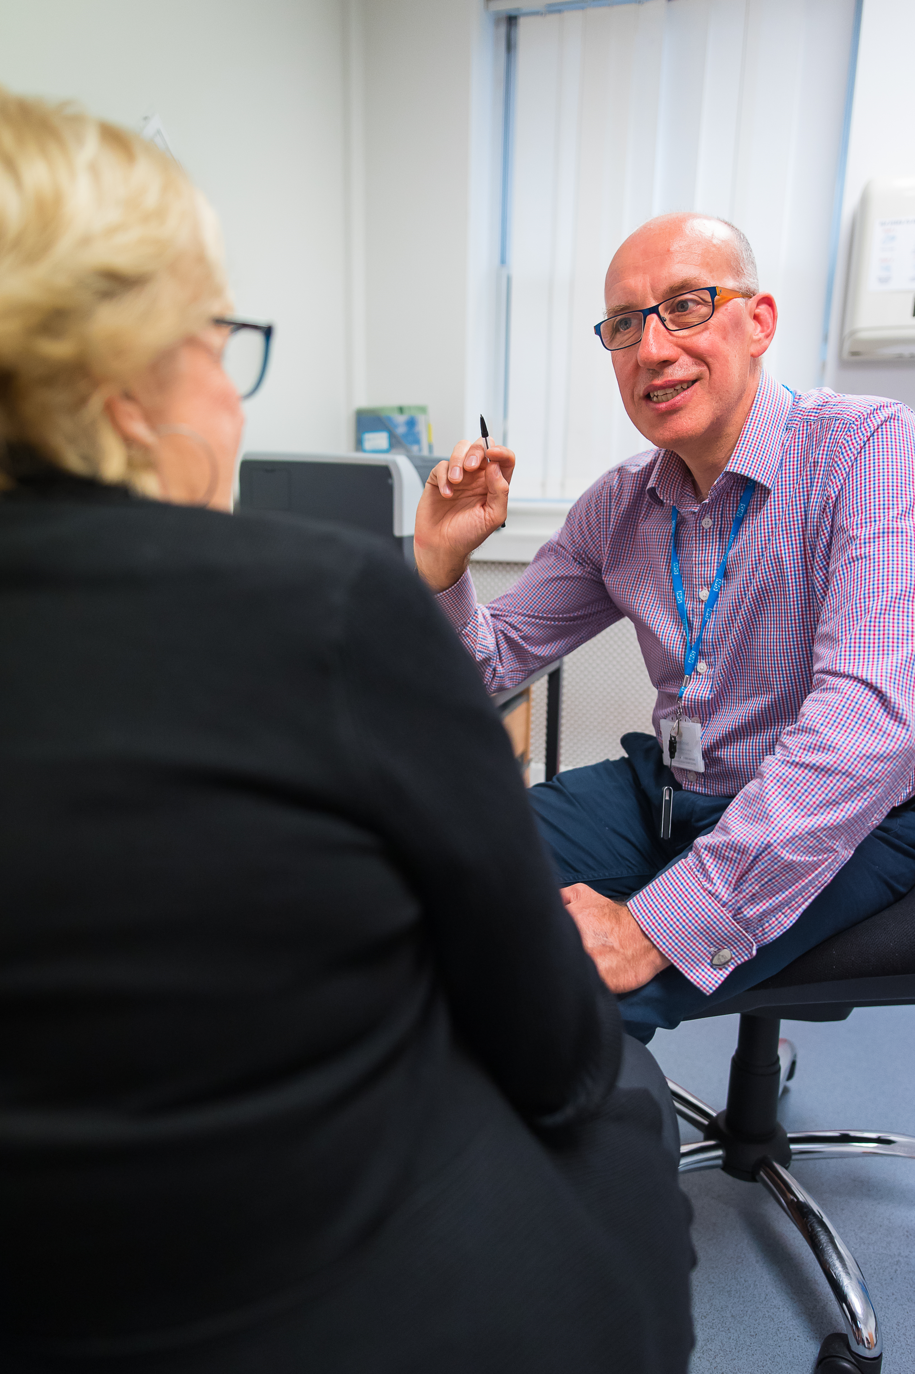
An opportunity for community pharmacy
Screening services embedded within community pharmacy to enable early cancer diagnosis (links to strategy for London)
  Point-of-care testing
Play an active part of the referral pathway
  reducing waiting times for diagnosis
  Less burden on other parts of healthcare system
  earlier treatment and improved health outcomes
The draft PCN service specification recognises the need for locally agreed standardised systems and processes for identifying people with suspected cancer, referral management and safety netting.
Community pharmacists should be included to drive this service
Notes:
London strategy – planned care for routine appointment for existing patients

Slide 22
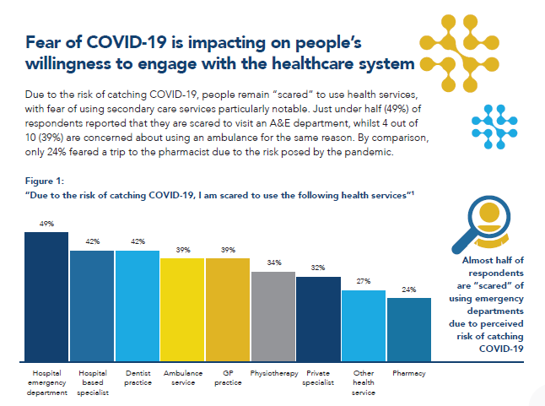
Patients are least afraid to go to their local pharmacy
Notes:
Impact of COVID-19 on public attitudes to engaging with the healthcare system
Methodology
• The survey was conducted by Censuswide between 29 May 2020 and 03 June 2020
• The survey included 2,000 adults per country from France, Germany, Italy, Spain and the UK, nationally representative in terms of gender and age
• Censuswide abide by and employ members of the Market Research Society which is based on the ESOMAR principles
REFERENCES
1 Respondents selected ‘Strongly agree’ or ‘Agree’ when asked to what extent they agreed or disagreed with the statement “Due to the risk of catching COVID-19, I am scared to use the following health services”
2 Respondents selected ‘Strongly agree’ or ‘Agree’ when asked to what extent they agreed or disagreed with the statement “I am reluctant to use the following health services because I don’t want to take up their time and capacity during the pandemic”
3 Cancer Research UK, Over 2 million people waiting for cancer screening, tests and treatments, June 2020

Slide 23

Notes:
What do we do as next steps after these findings?
Could we pilot?

