Slide 1



Transforming children and young people’s mental health
Welcome pack
For schools and colleges in the 2019-20 Mental Health Support Teams programme.
Issue date: November 2019

Slide 2
Welcome, and thank you for taking an important step to promote and support good mental health in your organisation. You are one of the first schools or colleges nationally to be signing up to work with a Mental Health Support Team (MHST). Once recruited, trained and fully operational, your MHST will help you to improve your approach to children and young people’s mental health, providing additional capacity and supplementing the support that is available from specialist NHS services.
This pack is provided to help you get ready to work with a MHST and includes information to help develop your wider approach to promoting and supporting good mental health.
● Context (slides 3-4): summary of the commitments made in the Green Paper and NHS Long Term Plan to support children and young people’s mental health.
● Components (slides 5-13): further information on MHSTs, senior mental health leads in schools and colleges, and the Link Programme.
● Whole School or College Approach (slides 14-15): a summary of the Public Health England model, and potential school and college actions to support good mental health and wellbeing.
● Getting ready for an MHST (slides 16-20): information on what next, and where to go for support as you prepare to work with a MHST.
● Annex (slides 21-29): further detail to help you prepare.
Introduction and contents
Contents
Contents
Contents
Context
Context
Context
Context
Components
Components
Components
Components
Checklist
Checklist
Getting ready for an MHST
Annex
Annex

Slide 3
The following commitments are in place for schools and colleges, to improve children and young people’s mental health:
Funding for new Mental Health Support Teams (MHSTs), to provide extra capacity for early intervention and ongoing help within a school and college setting.​
Encouraging schools and colleges to identify a senior mental health lead, with a new offer of training (from June 2020 subject to contract award) to help leads and staff to deliver whole school and college approaches to promoting better mental health.
Mental Health Awareness Training for a member of staff from all state-funded secondary schools in England by March 2020.
National roll out of the Mental Health Services and School/College Link Programme training nationally from Autumn 2019, supporting stronger partnerships between schools and colleges and local specialist NHS children and young people’s mental health services (CYPMHS).
Context
Context

Slide 4
Investment in NHS specialist mental health service provision outside schools and colleges
“By 2023-24, at least an additional 345,000 children and young people aged 0-25 will be able to access support from NHS-funded services including MHSTs”.
.
“Over the coming decade the goal is to ensure that 100% of children and young people who need specialist mental health care can access it.”
Context
Under the NHS Long Term Plan, “funding for children and young people’s mental health services will grow faster than both overall NHS funding and total mental health spending”.
.
Testing approaches to deliver four-week waiting times, ahead of “introducing new national waiting time standards for all children and young people who need specialist mental health services”.
.
“A new approach to young adult mental health services for people aged 18-25 will support the transition to adulthood.”
.
Delivering these commitments requires major growth in the NHS children and young people's mental health workforce. Funding is in place to recruit and train thousands of new CYPMH staff over the next five years, building on the 22% growth since 2016. The main constraint is how fast the NHS can do this, and retain staff, to grow capacity.

Slide 5
Transforming mental health provision for children and young people in schools
and colleges:
key components.
Components

Slide 6
Mental Health Support Teams
Mental Health Support Teams (MHSTs) are a new resource, funded by and accountable to the NHS. They will work with, and in, schools and colleges to support you with mental health and wellbeing and to treat mild to moderate mental health issues. As one of the first schools or colleges to receive this support, you are helping to develop approaches to introducing MHSTs, which will help us all learn how best to do this to deliver the best outcomes for children, young people and schools and colleges.
Each MHST will comprise:
Education Mental Health Practitioners (EMHPs): each team will have four EMHPs. The training will help them to support schools and colleges to develop and implement their whole school or college approach to mental health, and deliver a range of interventions for mild to moderate mental health needs.
Supervisors: senior-level therapists or staff who will train and then act as supervisors to the EMHPs, and work with schools and colleges to embed the support. Their training has been commissioned to run alongside the EMHP training programme.
Team manager: each MHST will have a team manager or lead, who may manage one or more team and will liaise with EMHP training providers (Higher Education Institutions).
Administrative support: each team should have its own dedicated support.
Components

Slide 7
The three core functions of a Mental Health
Support Team
Each Mental Health Support Team (MHST) is expected to cover a population of approximately 8,000 children
and young people.
1. Delivering evidence-based interventions for mild to moderate mental health issues
The new teams will carry out interventions alongside established provision such as counselling, educational psychologists and school nurses, building on the menu of support already available and not replacing it. The MHST will provide:
Individual face-to-face work: for example, effective, brief, low-intensity interventions for children, young people and families experiencing anxiety, low mood, friendship or behavioural difficulties, based on up to date evidence.
Group work for pupils or parents such as Cognitive Behavioural Therapy for young people for conditions such as self-harm and anxiety.
Group parenting classes to include issues around conduct disorder and communication difficulties.
2. Supporting the senior mental health lead in each school or college to introduce or develop their whole school or college approach:
MHSTs will:
  Work with the senior mental health lead (‘senior lead’) and existing service providers, to map what provision is already in place in settings and where the gaps are.
Provide targeted help as agreed with the senior lead, for example to support monitoring of wellbeing across the schools and colleges or teaching about mental health (in the context of health education becoming compulsory from September 2020), understanding how peer support and interpersonal relationships impact on children and young people’s wellbeing and mental health and training others to help children and young people, parents/carers and teachers to identify and manage stress and anxiety.
3. Giving timely advice to school and college staff and liaising with external specialist services, to help children and young people to get the right support and stay in education:
MHSTs will:
Work as part of an integrated referral system with community services to ensure that children and young people who need it receive appropriate support as quickly as possible.
External support could include more specialist NHS mental health support, support for autism spectrum disorder, learning difficulties or physical needs, or for issues such as substance misuse.
Help ensure smooth transition from specialist services.
Components

Slide 8
Mental Health Support Team principles
Several core principles have been established to guide the implementation and operation of Mental Health Support Teams (MHSTs):
There should be clear and appropriate local governance involving health and education.
MHSTs should be additional to, and integrated with, existing support.
The approach to allocating MHST time and resources to schools and colleges should be transparent and agreed by the local governance board.
MHST support should be responsive to individual schools' and colleges' needs, not a ‘one size fits all’.
Children and young people should be able to access appropriate support all year, not just during term time.
MHSTs should co-produce their approach and service offer with users.
MHSTs should be delivered in a way to take account of disadvantage and seek to reduce health inequalities.
Components

Slide 9
Mental health roles in education
Your school or college will need to assign a lead, or leads, to engage with the MHST and develop your organisation's capability to promote positive mental health. Three roles are envisaged, which may be undertaken by one individual, or up to three different people depending on what will work best for your organisation. Roles should be performed by individual(s) who are part of your senior leadership team or have their express endorsement. The three roles are as follows:
School or college MHST coordinator: the senior point of contact in a school or college for liaising with the MHST. This is primarily a logistical and collaborative role, involving in planning for MHST implementation and managing interactions with statutory roles, and may or may not be performed by the senior mental health lead.
Link Programme lead: the senior individual within your school or college who will attend, or has already attended, the Link Programme training and develops your working relationship with local Children and Young People’s Mental Health Services (CYPMHS).
Senior mental health lead: the senior individual from your school or college who will attend training to support the development of your whole-school or college approach to mental health (available from June 2020, subject to contract). This role may or may not be performed by the school or college MHST coordinator.
Components

Slide 10
Senior mental health leads in schools and colleges
Most schools and colleges have an individual who leads on mental health as part of their role: - 82% of schools including those with a sixth form, 81% of primary and 86% of secondary
- 77% of post-16 education settings including sixth forms and 91% of further education colleges.
Each school or college is different and these mental health leads will inevitably have different levels of skills and knowledge to support positive mental health, and different responsibilities, as roles are locally defined.
Schools and colleges are encouraged to develop a strategic senior mental health lead role, with the skills and knowledge to lead a whole school and college approach (see slides 14 and 15) to mental health.
To support schools and colleges, a comprehensive senior mental health lead training course is expected to be available for the first cohorts from June 2020 (subject to the training contract). See the School and College Information and Resources area on the FutureNHS Collaboration platform for information on what the training will involve (also see slide 20).
This training will be free for one member of staff per education setting and, if not in a senior role, the nominee should have the senior management team's support.
Components

Slide 11
Senior mental health lead training
This training will equip senior mental health leads to establish a positive whole school or college approach to mental health, so that they:
Can support the identification of at-risk children and young people and those exhibiting signs of mental ill health.
Know how to access children and young people’s mental health services, and refer children and young people into NHS services where appropriate.
Can improve the coordination of support for the mental health needs of young people within the school or college.
Know how to support staff in contact with children and young people with mental health needs.
Can support the delivery and measurement of outcomes of interventions on children and young people’s education and mental health.
Can support a positive whole school/college approach to mental health and wellbeing.
Components

Slide 12
The Link Programme
The Link Programme provides training to develop effective partnership working between schools and colleges and local specialist NHS children and young people's mental health services (CYPMHS). For a demonstration of how the programme works, watch this animation.
Leads attending from schools and colleges will explore how education and health are currently working together; develop knowledge of mental health problems seen by specialist NHS services and in schools and colleges; reflect on how they currently manage mental health issues; and build knowledge on the purpose of, and methods for, measuring wellbeing.
It will then be rolled-out over four years to all schools and colleges, through named points of contact in NHS CYPMHS who have not yet benefitted from the pilots, involving relevant voluntary and community sector organisations.
Schools and colleges attending training pilots have reported increased satisfaction with working relationships, better understanding of referral routes, improved knowledge and awareness of mental health issues among school lead contacts, and improved timeliness and appropriateness of referrals to NHS CYPMHS.
Components

Slide 13

The Link Programme
For further information:
https://www.annafreud.org/what-we-do/schools-in-mind/our-work-with-schools/the-link-programme/
Components

Slide 14
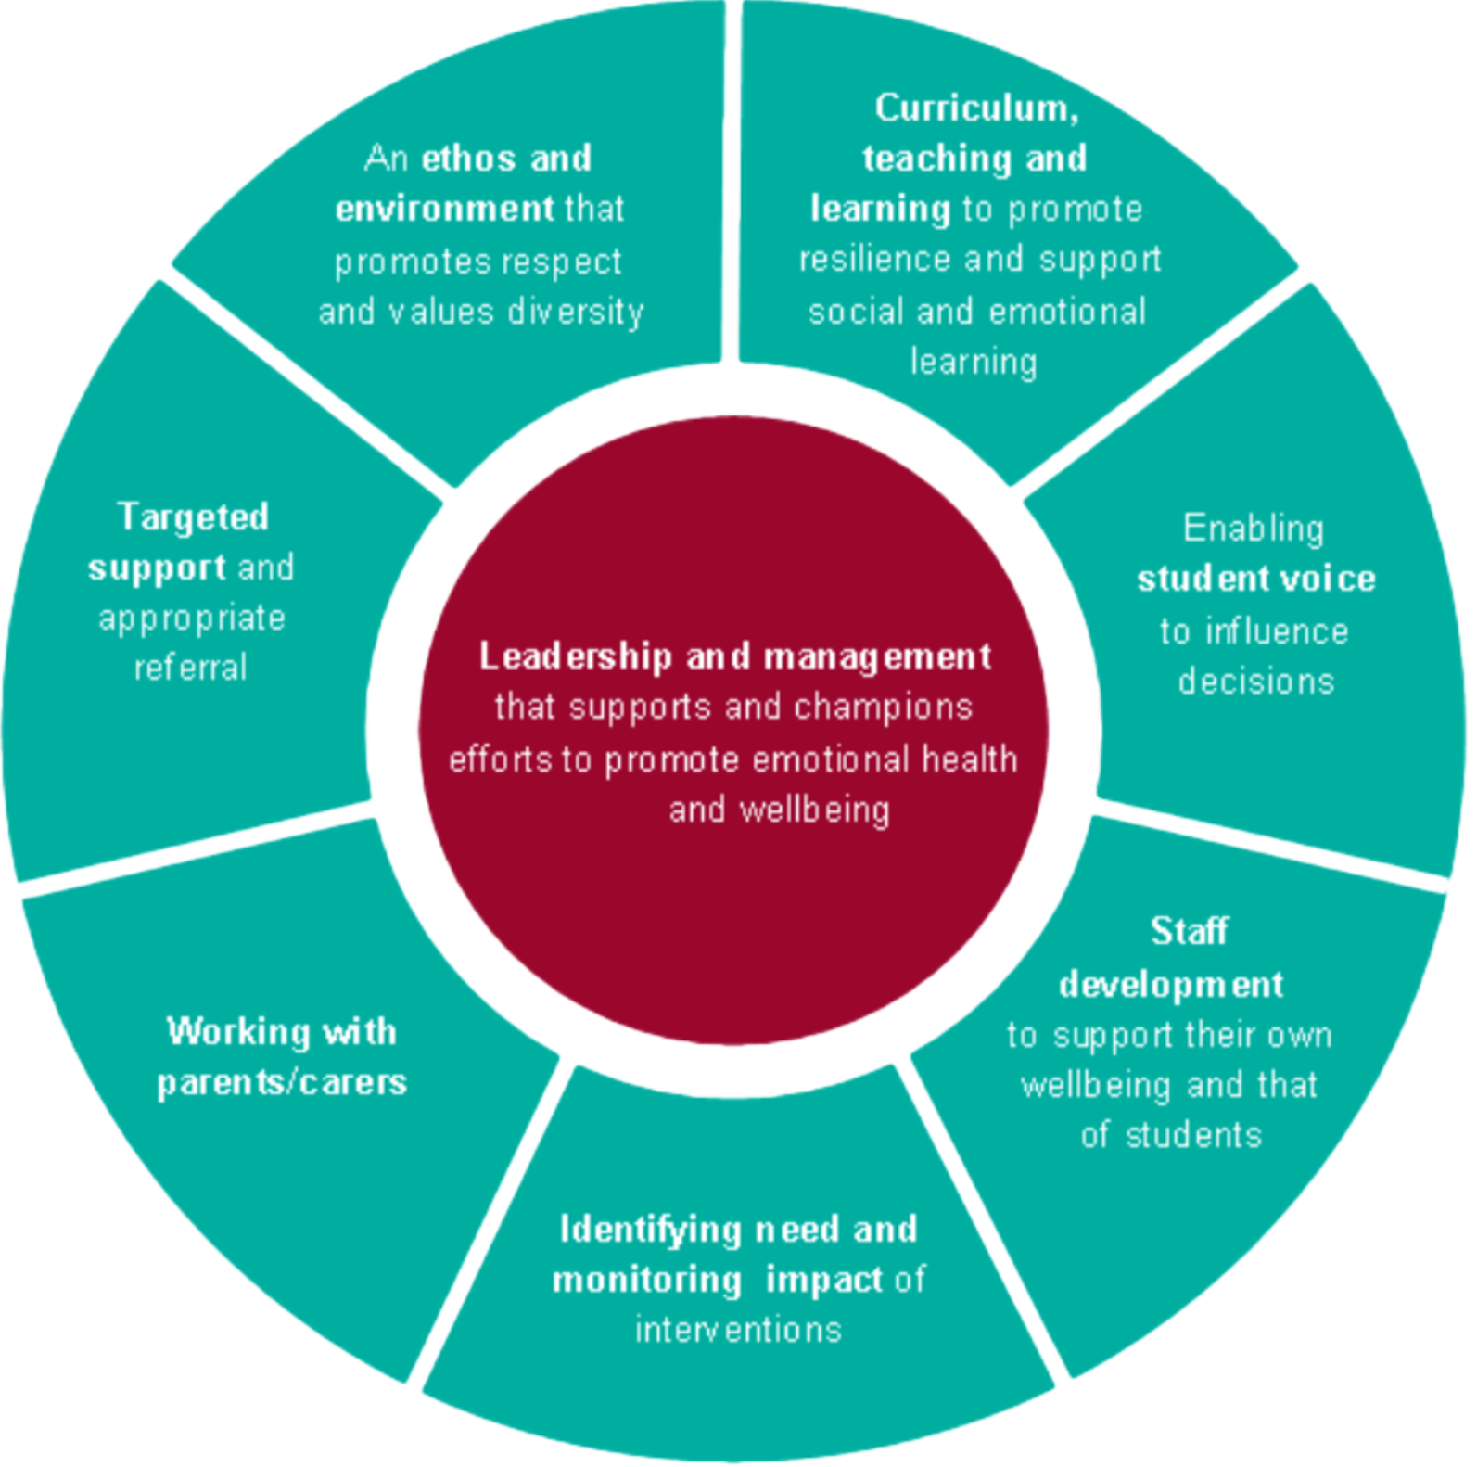
Public Health England’s whole school or college approach model
Schools and colleges are in a unique position to help prevent mental health problems by promoting wellbeing, positive mental health and resilience as part of an integrated approach that is tailored to the needs of their pupils and students.
A whole school or college approach is one that goes beyond the teaching in the classroom to pervade wider aspects of school life. Training for senior mental health leads will explore the components of this in more detail.
The Department for Education published a report in May 2018 providing case study examples of the work schools and colleges have undertaken in nine key areas to support mental health including the whole school/college approach, identifying mental health needs and the role of the mental health lead. The case studies can be found here and illustrate the type of actions a setting may take as part of a whole school/college approach to mental health.
Whole School or College Approach

Slide 15
School and college roles in pupil wellbeing and mental health
Prevention: school context
Prevention: universal/ pastoral
Identification of needs
Early support
in schools
Referral to external specialist support
Leadership commitment, knowledge and skills
Curriculum
SEND graduated response
School-based counselling
Triage with specialist input
Wellbeing promotion for pupils
Voluntary and community sector in the school or community
Targeted interventions for those who need it
School ethos, values
Behaviour responses
Staff wellbeing, including workload reduction programme
Training for school staff, including ITT, NPQ, CPD, MHAT
Interventions delivered by Mental Health Support teams
External specialist provision in/near school
Wellbeing measurement
Wider activities: PE & sport, character
Additional pastoral support
Additional support: education psychologist, school nurse etc
Accessible specialist treatment and support
Accountability, incentives
As part of a whole-school or college approach to mental health and wellbeing

Slide 16
Getting ready to welcome a Mental Health Support Team into your school or college
Getting ready for an MHST

Slide 17
The 2019-20 Mental Health Support
Team set-up year
All Mental Health Support Teams (MHSTs) are expected to take a year to become fully operational, to allow a year to recruit and train the Educational Mental Health Practitioners (EMHP) who will be the key team members of each team. For this reason it may take some time before MHSTs start to interact fully with schools and colleges. If your school or college has offered training placements for EMHPs then you will have closer links to the teams from an earlier stage.
There are two ‘waves’ of MHST sites in 2019-20:​
Wave 1: EMHPs begin training September 2019, MHSTs to be fully operational by September 2020​.
Wave 2: EMHPs begin training January 2020, MHSTs to be fully operational by January 2021.​
If you are not sure which wave your school or college is part of, please contact your MHST service manager.
As you go through the process of embedding an MHST into your school or college, we want to support you to help ensure this programme works well to suit your specific context. Following this welcome pack, we will look to develop further guidance and share best practice.
The DfE regional implementation team would welcome your feedback on what is working well and what next-stage support would be helpful as MHSTs are introduced. You can contact them at: MHGP.DELIVERY@education.gov.uk
Getting ready for an MHST

Slide 18
Readiness actions
There are some key actions that all schools and colleges will need to take in preparation for the Mental Health Support Teams (MHSTs).
Immediate actions:
Provide a named MHST coordinator to work with your local Clinical Commissioning Group (CCG) and the incoming MHST.
Discuss with the MHST the possibility of hosting an Education Mental Health Practitioner (EMHP).
Help EMHPs/MHSTs to understand your setting, specific needs, build networks and integrate into your school or college (for schools and colleges hosting EMHP trainees only at this stage).
Agree placement plans jointly with the MHST, complete DBS checks as necessary and ensure EMHPs/the MHST are familiar with the local safeguarding policy and procedures (for schools and colleges hosting EMHP trainees only at this stage).
Involve, or plan to involve, children and young people and their families/carers in the set up of your MHST.
Confirm the commitment within your school or college that your MHST will be additional to your existing provision.
Be aware of and be involved in the Governance procedures. For further information on establishing governance, contact your MHST Project Lead.
Medium-term actions:
Consider accommodation needs in your setting for mental health practitioners to work with children and young people and their families in preparation for becoming operational.
Be prepared to share information held by your school or college on its current mental health provision and experiences on the introduction of the MHSTs.
Set up a process for identifying and referring pupils or students for additional support with your MHST.
The Annex (slides 21-29) provides supporting information for these actions.
Getting ready for an MHST

Slide 19
What training and support is available for schools and colleges now?
Mental Health Awareness Training (see slide 3) for a member of staff from all state-funded secondary schools in England by March 2020.
Link Programme training (see slides 10-11) is being rolled out from Autumn 2019 for all schools and colleges. The Link programme is complementary to the work of Mental Health Support Teams (MHSTs), improving joint working between education and NHS children and young people’s mental health services, raising awareness of mental health concerns and improving referrals to specialist help when needed. It provides an opportunity to find out more about the support available to schools and colleges locally and to work with mental health colleagues to better join up their work.
Mental Health and Behaviour Guidance which will help schools/colleges to identify pupils whose behaviour may be a result of an underlying mental health difficulty and direct them towards information about how they can adapt their approaches to support these pupils with their individual needs, within the context of an approach that is based on clear expectation of behaviour.
Respectful schools tool to support schools and colleges to develop a whole-school or college approach which promotes respect and discipline. This can help combat bullying, harassment and prejudice of any kind.
Guidance on effective school-based counselling this provides settings with practical, evidence-based advice, informed by schools or colleges and counselling experts, on how to delivery high quality school or college-based counselling, which can be an important complement to what MHSTs provide.
The RSHE Hub will be available on gov.uk from April 2020. This will host training materials for teachers, including how to implement the new RSHE curriculum, online training materials for teachers, signposting to quality-assured resources and good practice case studies.
Chief Medical Officers’ advice on screen and social media use.
Getting ready for an MHST

Slide 20
Where to go for further support
Your Mental Health Support Team (MHST) Team Manager
This should be your first point of contact as they will be the day-to-day manager of the MHST. They will also be in contact with the universities who are training the Education Mental Health Practitioners.
You can also make contact through:
Department for Education (DfE) regional leads
DfE has appointed a regional implementation team, working jointly with NHS England and Health Education England regional leads, to support the wider education system to continue to develop mental health provision, including MHST implementation. The team’s aim is to help and facilitate schools and colleges to engage in and benefit from the programme by providing direct, targeted support to them and to MHST sites.
The regional leads are visiting schools and colleges to:
Listen and respond to concerns
Provide advice and support based on what is working elsewhere in the programme
The FutureNHS Collaboration Platform
This is a bespoke online collaborative platform where you can access information, guidance and communications from your local MHST. It will also be one of the key ways to receive updates and access resources about the programme, although it is still very much in development.
Observe and learn from practice
To sign up to this platform:
Email england.cyp-mentalhealth@nhs.net with the name of your school or college, which trailblazer/MHST site you are linked to, and which year of delivery (2018/19 or Wave 1 or 2 in 2019/20) you are part of.
Request access to ‘Collaborative Working in Education Settings’ and the ‘School and College Information and Resources’ areas.
You can contact
your DfE or NHS England regional
lead with any queries or concerns via the Collaboration Platform regional discussion forums for schools and colleges.
Getting ready for an MHST
Checklist
The DfE implementation team would welcome your feedback on what is working well, and what next-stage support would be helpful as MHSTs are introduced. You can contact them at: MHGP.DELIVERY@education.gov.uk to share your thoughts.

Slide 21
Supporting information to help you prepare for an MHST
Annex

Slide 22
The role of the Mental Health Support Team coordinator
Why is this necessary? A named Mental Health Support Team (MHST) coordinator is required in your school or college to work closely with Education Mental Health Practitioners (EMHPs) and other staff in your Mental Health Support Team. Consultation with schools and colleges suggests that, to operate effectively, MHST coordinators need to be part of the senior leadership team or have express senior team endorsement. The purpose of this role is to ensure the MHST is implemented effectively and that the service works for you and your setting.
The role of a MHST coordinator:
To engage fully with the MHSTs and work with Clinical Commissioning Groups to plan for implementation. This includes working with the MHST Service Manager or Project Lead, with the involvement of the senior clinical leads as appropriate, to scope and design what support the MHST will provide and agreeing which pupils or students the EMHPs will see and how.
To confirm their commitment to achieving the key aims and principles of the programme, including sharing best practice and lessons learned and engaging fully with the monitoring and evaluation of the programme to help inform future rollout.
To support engagement with their MHST and manage interactions with statutory roles in schools and colleges, including the SENCO, Designated Safeguarding Lead and Designated Teacher for Looked-After and Previously Looked-After Children. The head teacher or principal should confirm that the MHST coordinator within a setting will have the time and support available to sustain commitment to the role.
Action: You should already have shared the details of the MHST coordinator in your school or college with your NHS Clinical Commissioning Group MHST Service Manager as part of the application process to be a MHST site. If you have not already done so, or the details of this person have since changed, please let your MHST Service Manager know.
Annex

Slide 23
Welcoming the trainee Education Mental Health Practitioner allocated to your setting
For schools and colleges hosting Education Mental Health Practitioner (EMHP) trainees only
Why is this necessary? EMHPs in Mental Health Support Teams (MHSTs) will work closely with your named senior point of contact. They will be trained to provide clinical support and advice to children and young people and/or parents carers which will be tailored to the needs of your setting.
Action: If you have agreed to host a trainee EMHP you should now have been allocated a trainee to your setting. However, if this has not yet happened please make contact with your MHST service lead to find out about timing. There will also be some engagement required with the university delivering the EMHP training course.
EMHPs will complete a one-year, full-time education programme through a combination of study with a local university and supervised practice learning, gaining knowledge and experience of both education and mental health services. The training programme covers six modules, including a specific module on supporting colleagues in education to identify and manage issues related to mental health and wellbeing. For an overview of the EMHP training, click here. The full course content can be found on the Collaboration Platform.
You can help support your EMHP by:
Making them feel welcome. Induction might include: premises orientation, security passes/codes etc, key staff and contact details, safeguarding, health and safety and other relevant procedures.
Understanding the scope of their role.
Ensuring your school or college staff, pupils and students and parents and carers are aware of the MHST and the EMHP and their work and how to access it.
Actively help the EMHP’s/EMHPs’ integration into the setting by providing guidance and information on your settings and any particular needs, as well as the existing support available to pupils and students.
Help facilitate EMHP work with the wider setting – staff, parents and carers and pupils and students – for example to train and educate on basic mental health awareness and raise mental health awareness via, for example, assemblies, emails and drop in sessions.
Provide or suggest opportunities for EMHPs to build networks with the whole support community, particularly to support onward referral.
Working with the MHST to identify individual cases for the EMHP to see.
Annex

Slide 24
Planning to involve pupils and students, parents and carers in service co-design
Why is this necessary? We want to ensure that the support provided by Mental Health Support Teams (MHSTs) has been informed by the views of pupils and students and parents and carers so that it meets their needs. This could include designing aspects of delivery, as well as potentially highlighting mental health issues within the setting that they see as priority for the MHSTs to address.
Action: You should have a plan in place for how you are going to consult with pupils and students and parents and carers. For example, you might want to write to or invite parents and carers into your school or college to explain about MHSTs and seek their views on the type of support they would like to see included. Or you might prefer to administer a questionnaire for your pupils and students and their parents and carers to complete, seeking their views on the kind of support they would like to see included.
Annex

Slide 25
Committing to maintain existing levels of mental health provision
Why is this necessary? As part of the application process you were asked to commit to the principle that the introduction of the Mental Health Support Teams (MHSTs) support is additional to, rather than substituting for, existing support. This is important because we want MHSTs to add value to the good practice that already exists in schools and colleges, rather than replacing it, and to and complement the work of other specialists such as school nurses, educational psychologists and counsellors.
Action: Make sure you have completed a full audit or self-assessment of current provision in your setting which may be shared and agreed with your senior leadership team, and discussed with your MHST so that the support provided by them complements and builds on that which is already provided.
Annex

Slide 26
Be aware of, and get involved in, the governance procedures
Why is this necessary: Mental Health Support Teams (MHSTs) need strong leadership, oversight and governance structures to work effectively within education settings. Oversight and governance of the MHSTs should fit within existing governance structures and functions across both mental health and education systems; this might include links with school governors, MAT trustees or leadership, local transformation plan boards, health and wellbeing boards, safeguarding boards, sustainability and transformation partnership (STP) boards, integrated commissioning boards and any other relevant local organisations.
Action: There are a number of day to day operational/governance procedures that should be considered during the early stages of MHST implementation. For further information on establishing governance, contact your MHST Project Lead. It is the responsibility of the MHST Project Lead and the school or college MHST co-ordinator to ensure that the right operational processes are in place prior to MHSTs starting the programme.
Annex

Slide 27
Consider accommodation needs for Education
Mental Health Practitioners to work with children and young people
Why this is necessary? EMHPs will need a quiet to space to work with children, young people and/or parents and carers on a one-to-one basis and in small groups. In some cases this would be better located in or close to the MHST site, but we would ask that you consider making available a suitable room in your school or college for MHSTs to deliver the interventions.
Action: Think about an appropriate, dedicated private space in your setting where individuals will feel relaxed, secure and able to respond well to the intervention. Talk to your EMHP to find out when this space is likely to be needed and make sure these times are protected in the timetable, including during busy periods. Also consider whether rooms are available out of school or college hours for those who would prefer not to have interventions during the school day.
Annex

Slide 28
Set up a process for identifying and referring pupils or students for additional support with your Mental
Health Support Team
Why is this necessary? It will be important for the Mental Health Support Team (MHST) to work with your school or college to agree a process for triage and referrals – either to existing support systems within the school or college, to additional support provided by the MHSTs, or to external support services where specialist input is needed. The process for identifying and referring pupils or students for additional support should be clearly defined and understood by school or college staff, the MHST, other support services provided within the setting, pupils and students and, where possible, parents and carers.
Action: Schools and colleges will need to work with the MHST to define a process for referring pupils or students to the MHST team. Most education settings will already have systems in place to identify and triage children and young people with mental health needs.
Annex

Slide 29
Additional education context and resources
A new OFSTED inspection framework from September 2019, with greater focus on resilience, confidence, independence and keeping healthy, including assessments of ‘behaviour and attitudes’ and ‘personal development’.
Curriculum reforms to make relationships, sex and health education compulsory from September 2020.
The Online Harms White Paper sets out the government’s plans for a world-leading package of measures to keep UK users safe online.
Initial Teacher Training Standards to equip teachers to identify and respond appropriately to children with mental health needs, and work with colleagues to ensure they get the right support, and a new Early Career Framework.
Trials of evidence on school-based interventions to support children and young people’s mental health and wellbeing.
The Timpson Review of exclusions and government response.
A Whole School Framework for Emotional wellbeing and mental health​ by the National Children’s Bureau.
Case Studies: The case studies illustrate the type of actions a setting may take as part of a whole-school or college approach to mental health.
Education Mental Health Practitioners: more information on the recruitment of EMHPs.
Annex

