Slide 1
DIALOG
Pan London Training package

Slide 2
Section 1
Section 2
Section 3
What is DIALOG?
How to rate DIALOG
DIALOG+
When should DIALOG be completed?
DIALOG as an outcome measure
Why DIALOG was agreed as the London PROM
Recovery principles
Reflection exercise
Service user feedback on DIALOG and DIALOG+
Useful examples of how data is starting to be used
Analysing DIALOG data
How to use DIALOG on EPR
Using DIALOG+ in the care plan

Slide 3
Section 1

Slide 4
What is DIALOG?
DIALOG is a set of 11 simple questions that cover different areas of a person’s life.
Relationships with friends and family
Meeting with your mental health professional
Accommodation
Practical help you receive
Medication
Mental health
Physical
health
Personal safety
Leisure activities
Job
situation
Friendships

Slide 5
How to rate DIALOG
Section 1
How satisfied are you with….
Your mental health?
Your physical health?
Your job situation?
Your accommodation?
Your leisure activities?
Your relationships with your partner/family?
Your friendships?
Your personal safety?
Your medication?
he practical help you receive?
Your meeting with your mental health professionals?
How satisfied are you with your mental health?
How satisfied are you with your physical health?
The first eight questions cover different areas of a persons life- these are referred to as ‘life domains’
How satisfied are you with your job situation?
How satisfied are you with your accommodation?
How satisfied are you with your leisure activities?
How satisfied are you with your relationships with your partner/family?
How satisfied are you with your friendships?
How satisfied are you with your personal safety?
…and the last three are about your treatment- these are referred to as ‘treatment domains’
How satisfied are you with your medication?
How satisfied are you with the practical help you receive?
How satisfied are you with your meetings with mental health professionals?
DIALOG can help facilitate a person-centred approach by supporting meaningful conversations between service users and the healthcare professional about what aspects of their lives are important to them.

Slide 6
How to rate DIALOG
The survey is designed to measure how a person rates their quality of life and experience of the care that they receive.
… with 1 being totally dissatisfied and 7 being totally satisfied.
Totally dissatisfied
Fairly dissatisfied
Fairly satisfied
Totally satisfied
1
2
3
4
5
6
7
Very dissatisfied
Very satisfied
In the middle
Scores: 1-3 explicit dissatisfaction, 4 neutral middle, 5-7 explicit satisfaction

Slide 7
DIALOG +
DIALOG+ is a specific intervention that uses the DIALOG scale and a 4- step approach based on solution focused therapy.
DIALOG+ uses the scores identified by the person to help structure a conversation between the healthcare professional and the person to explore their identified needs and wishes, support care planning, and help service users take an active problem-solving approach to promoting recovery.
DIALOG+ uses a 4 step approach
4. Agreeing on actions
Agreeing on defined actions to improve the patient’s condition and/or social situation. This step involves an agreement on specific and defined actions from the patient or the healthcare professional or both. The agreed actions are briefly documented.
3. Exploring options
2. Looking forward
Asking the patient about what practical actions might help
to bring about the desired change. This covers actions taken by the patient, the healthcare professional or someone else.
Directing the patient from a description of the problem to
considering desired alternative scenarios. The patient is asked to imagine what changes he/she would like to see to replace the current undesirable situation. This can focus on long-term preferred outcomes and more short term small changes.
1. Understanding
Exploring both positive and negative aspects of the situation in the given domain. The person is first asked to explain the reasons for dissatisfaction and wishes for more help (or distress/concern in case of MH). Then the person is encouraged to consider existing strengths or coping strategies.
To find out more information see the Operational Manual

Slide 8
When should DIALOG be completed?
London has agreed minimum time points in which DIALOG should be completed to ensure a standardised process.
Every 4 weeks for acute treatment – inpatients and crisis teams.
No longer than 6 months for ongoing treatment in community services and outpatient clinics.
At the start of a new treatment episode i.e. admission to an inpatient treatment, home treatment service, or other community service; referral to new provider organisation.)
Episode start
For acute treatment DIALOG should be carried out within 48 hours.
For community settings it should be obtained within the first or second meeting
Review
More frequent DIALOGs maybe carried out if embedded within Care Programme Approach (CPA) process or when carrying out DIALOG is clinically indicated.
At the end of treatment episode (discharge from a team, service or provider organisation).
Episode end

Slide 9
DIALOG as an outcome measure
PROMs provide services with a measure of the subjective impact of the services on a person’s health and wellbeing.
Healthcare professionals call this a patient reported outcome measure (PROM).
It is an assessment of health status and health-related quality of life that comes directly from the patient.
In London DIALOG has been agreed to be used for Early Intervention in Psychosis (EIP) and Care Programme Approach (CPA) services. DIALOG can be used in wider mental health service in the future.

Slide 10
Why has DIALOG been chosen as the London Patient Reported Outcome Measure (PROM)?
London mental health partners came together to agree that DIALOG should be the London Patient Reported Outcome Measure (PROM).
DIALOG was agreed to be used because……..
3
1
2
The information can be used for planning for individual patients and whole services.
The scale has been shown to have good psychometric properties.
It is simple to use.
4
5
6
It can be used to evaluate treatment and has the advantage that each item is meaningful.
The use of DIALOG + has been shown to improve quality of life through a solution focused approach.
Service users report satisfaction in using it.

Slide 11
Recovery Principles: CHIME framework
The CHIME framework is a conceptual framework for personal recovery in mental health. It stands for Connectedness, Hope, Identity, Meaningful and Empowerment. This framework can complement the DIALOG approach.
Connectedness
Hope & Optimism
Having good relationships and being connected to other people in positive ways. Characterised by: peer support and support groups; support from others; community.
Having hope and optimism that recovery is possible and relationships that support this. Characterised by: motivation to change; positive thinking and valuing success; having dreams and aspirations
Empowerment
Identity
Having control over life, focusing on strengths, and taking personal responsibility.
Regaining a positive sense of self and identity and overcoming stigma.
Meaningful
Living a meaningful and purposeful life, as defined by the person (not others). Characterised by: meaning in mental ‘illness experience’; spirituality; meaningful life and social goals.
Source: Leamy et al 2011

Slide 12
Optional Personal Reflection Exercise for trainees 1/2
We are now going to undertake a short exercise that helps put the recovery principles into context
Step 1
Fold a piece of paper in 4
Step 2
On each quarter put aspects of your life that represent how you and others see you i.e. mother, friend etc
(This is not for sharing unless you wish to do so).
Step 3
Group reflection
Trainers: please see facilitation prompts within the notes section of the slides
Notes:
The purpose of this exercise is to think about aspects of your life that represent how you and others see you.
Facilitation points trainers may which to adapt:
The aspects you have identified within the exercise are the meaningful components that make you who you are……they may be a mother, looking after pets, enjoying your career, or enjoying a particular hobby. If any of those components are taken away it could negatively affect your sense of self.
For a person who is experiencing ill health – they can often feel a overwhelmed by their illness:
Identity – they may feel like they are being seen as a ‘condition’ rather than as a person who is unwell.
Hope and optimism – service users may not be at a stage (perhaps early on in their recovery) where they have much hope or optimism. Healthcare professionals can support service users by being there for them and carrying this for them.
Meaning and Purpose – the reason’s to get better. This needs to be lead by the person but is linked to a person’s identity.
Empowerment - How would service users recognised they have improved in their recovery? What is meaningful to them? For example would it be attending their regular bingo class they used to enjoy.
Connectedness – the person experiencing ill health needs to want this

Slide 13
Section 2

Slide 14
Service user feedback on DIALOG and DIALOG+
Service users have described the benefits of using DIALOG and DIALOG+
Watch this short video to hear what service users who have used DIALOG think
[Placeholder]
We recommend that Trusts co-deliver the training with service users, with service users reflecting on their own experience of how DIALOG/DIALOG+ has supported them. In the initial delivery of training Trusts may not be able have a pool of service users to co deliver sessions. They may wish to play the service user vignette video or the Pat Deegan video

Slide 15
Section 3

Slide 16
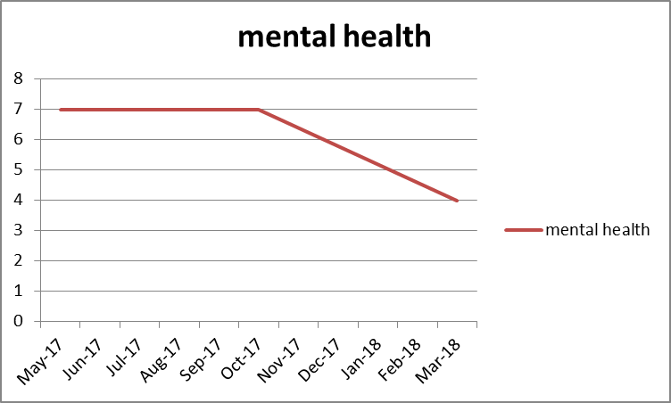
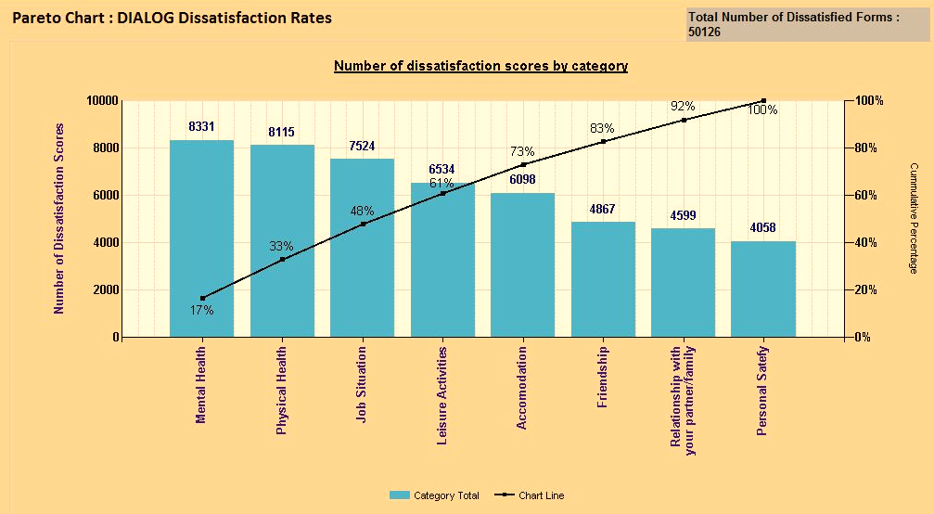
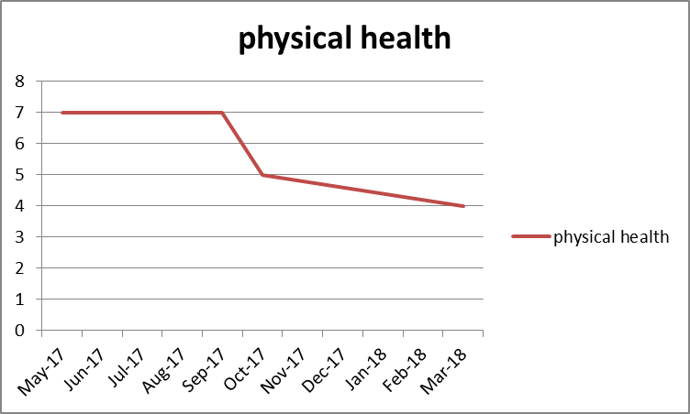
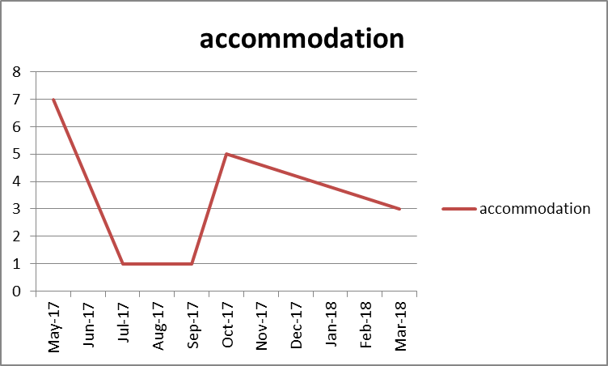
Useful examples of how DIALOG data is starting to be used
The data can be understood at an individual level. These charts shows how individual DIALOG question categories can be viewed to explore trends over time. The example is over a 10-month period.
There are different ways that DIALOG data can be understood and used to support a person’s mental health and improve the quality of the service.
The data can be used to better understand team needs. The data shows other aspects of people’s lives that they are dissatisfied with, beyond their mental health, such as physical health, job situation and leisure activities. This can be used to direct focus around patients’ needs or for example staff skills and expertise.
Source: This data is anonymised data taken from East London NHS Foundation Trust

Slide 17
Analysing DIALOG data
Each of the DIALOG questions are rated using a Likert scale
from 1 (totally dissatisfied) 7 (totally satisfied).
Subjective quality of life
The first eight DIALOG questions rate the satisfaction levels within different areas of life e.g accommodation. The mean score of all eight questions gives an overall score of subjective quality of life as a Patient Rated Outcome Measure (PROM).
Treatment domains
The final three items ask to rate different aspects of treatment. The mean score of the last three question gives an overall score for treatment satisfaction as a Patient Reported Experience Measure (PREM).
When analysing the difference between scores over two timepoints it is important to acknowledge the initial score to understand the overall scope for improvement in satisfaction.
A high initial score = less room for improvement
A low score = improvement is more likely
When evaluating satisfaction of the treatment episode the most recent score given during the current treatment period is most relevant than changes over time.
When evaluating treatment episode satisfaction the change score should be considered to understand if subjective quality of life has improved. Either mean scores across the eight rated life domains or ratings of single life domains can be selected. This may depend on the focus, and context of care, the situation of the patients and the purpose of the evaluation.
*Treatment episode- refers to the period of time a person is receiving treatment (from the initial DIALOG score to the last DIALOG score).

Slide 18
Analysing DIALOG data
DIALOG data can be analysed at an individual item level or represented as mean scores for the team, service or organisation. The below information should be read in conjunction with the analytical framework.
Individual
Service
Organisation
Used for an assessment of personal problems and areas of strength.
For subjective quality of life scores below 4 (explicit dissatisfaction) require particular attention.
When evaluating treatment episode, any improvement in subjective quality of life is a meaningful increase.
For service users receiving long term care it is unrealistic to expect consistent and ongoing improvements; understanding personal context is important.
The data can be viewed in different ways- Scores of single domains (DIALOG questions) of people in a service can be shown as means (average satisfaction scores) or as a % of patients who have explicit dissatisfaction/satisfaction. Mean team scores allow for review of data across every item.
When considering changes over time, global mean scores as well as single can be used depending on the purpose For example if one evaluates full services with variable treatment tasks for a range of patients, it is reasonable to explore first the global scores before considering the ratings of single life domains. This applies to most services in most situations. However, there may also be specific questions, e.g. on how services affect the wide spread dissatisfaction of patients with their physical health.
Analysing the global score provides a general evaluation, whilst the analysis of single domains provides more specific information about what exactly services do and do not achieve.
When interpreting scores:
The average subjective quality of life score of ALL patients in a service should not improve as patients with better quality of life will be discharged and new patients with lower quality of life be admitted, yet when you look at individual scores improvements should be expected.
A change of overall mean scores of >0.125 reflects an average improvement of at least one scale point in at least one life domain (question) and may be a guide for overall meaningful improvement.
Ideally treatment satisfaction scores should consistently stay above 4 and the % of patients with dissatisfaction <4 kept to a minimum
Follows same principles as the interpretation for all patients in a service.
When evaluating data at an organisation level the patient groups become very large, this means that the differences between the mean scores tend to become smaller therefore percentages of explicit dissatisfaction or very satisfied become more informative than mean scores.
Domain- refers to the individual DIALOG question e.g How satisfied are you with your job situation?
Treatment episode- refers to the period of time a person is receiving treatment (from the initial DIALOG score to the last DIALOG score).
Global score- refers to the total DIALOG scores rather than single items

Slide 19
How to use DIALOG on Electronic Patient Records (EPR) systems
[Placeholder]
Trusts to add in EPR information e.g. screenshots and instructions of how to navigate your EPR system in relation to DIALOG

Slide 20
Using DIALOG+ in the care plan
[Placeholder]
Trust might want to add examples of their care plans.
DIALOG can improve the care planning process.
Where Trusts move towards DIALOG+ there may be an opportunity to streamline this process.

