Slide 1
Chapter 4 - Personalised care for cancer and inequalities

Slide 2
Personalised care & inequalities – outline
Personalised care London picture
Why are inequalities in personalised care important?
What do cancer patients think?
What should the pathway look like?
Key milestones
Care plans
Primary care (training gaps, registers, structured approach)
comorbidity
Rehabilitation services in London for cancer
Variation in access to psycho-oncology support
Variation in access to lymphoedema services
Social care needs and cancer
Debt and cancer
Wigs and prostheses
New quality of life metrics for cancer (NHSE)

Slide 3
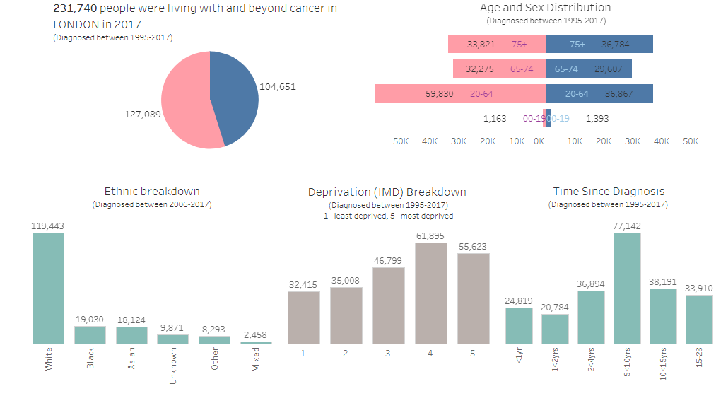
Personalised care London picture
Half of all people living with cancer in the 40% most deprived quintiles
Notes:
https://www.healthylondon.org/resource/2017-cancer-prevalence-dashboard/
Interactive prevalence tool for London

Slide 4
Why are inequalities in personalised care important?
People living with cancer in the most socio-economically deprived areas faced almost 25% more emergency admissions in their last year of life compared to people from the least deprived areas
Macmillan Inequalities ‘Time to Talk’ report
People with the lowest incomes:
• are almost twice as likely to
report a need for more emotional
support
• are twice as likely to want more
practical support inside the home
• are three times more likely to
need practical support outside
the home than people with a higher income.
Notes:
Quality Health. 2017. National Cancer Patient Experience Survey 2018. http://www.ncpes.co.uk/reports/2017-
reports/national-reports- 2http://www.ncpes.co.uk/reports/2017-reports/national-reports-2
5. Quality Health. 2017. National Cancer Patient Experience Survey 2018. http://www.ncpes.co.uk/reports/2017-
reports/national-reports-2
From Macmillan report on inequalities

Slide 5
What do cancer patients think?
Care and support after cancer treatment finished (Q51) National cancer patient experience survey (NCPES) 2017
Q51 Once your cancer treatment finished, were you given enough care and support from health or social services (for example, district nurses, home helps or physiotherapists)?
Nationally
Deprivation
The biggest difference between the least and most deprived groups … 48% of respondents from the least deprived group gave a positive response, compared to 43% of respondents from the most deprived group.
Ethnicity
The biggest difference is on question 51, where 46% of white respondents gave a positive response, compared to 31% of black respondents
In London
Updated results for London Q51 – 42% white and 33% BME felt happy with the social support provided to them after discharge
Notes:
http://www.ncpes.co.uk/reports/2017-reports/local-reports-2/cancer-alliances/4001-national-cancer-vanguard-north-central-and-north-east-london-2017-ncpes-report-e57000002/file
NCPES 2017

Slide 6
What do cancer patients think?
Analysis of London electronic holistic needs assessment data (2017): Top 10 concerns
Worry fear or anxiety 6. Moving around (walking)
Tired, exhausted or fatigue 7. Work or education
Pain or discomfort 8. Sadness depression
Eating, appetite or taste 9. Money or housing
Sleep problems 10. Difficulty making plans

Slide 7
What should the pathway look like? Key milestones
Key milestones on the cancer pathway
Personalised care which comprises:
1.Holistic needs assessment (in hospital) across 4 domains and care plan
2. Treatment summary
3. Cancer care review (in the community, but not specified under Quality Outcomes Framework (QOF) – there are no quality standards)
4.Stratified follow up – make sure that patients get onto the best follow up pathway for their cancer
Notes:
In order to use Holistic Needs Assessments to identify issues and meet needs we need to first ensure high quality assessments are taking place in an equitable way.
“Macmillan welcomes the LTP’s commitment to delivering personalised care to everyone diagnosed with cancer by 2021 (including a needs assessment, care plan and information and support on health and wellbeing, along with access to a Clinical Nurse Specialist or other supporter worker), and to put stratified follow-up pathways in place for clinically appropriate cancers by 2023.” Macmillan response to the NHS Long term plan

Slide 8
What should the pathway look like? Care planning
Variation between trusts in whether they do electronic needs assessments

Slide 9
What should the pathway look like? Primary care
1. Training gaps
A London training needs assessment for primary care (2016) :
46% of GPs felt clear/very clear in their role of supporting people after active treatment for breast, colorectal and prostate cancer. Only 39% of nurses felt clear/sometimes clear in their role.
More than half of GPs and nurses were unsure about consequences of treatment, such as cardiovascular and bone health.
45% of GPs had received “a little training” in the last 3 years and only 26% of nurses had completed a cancer specific module or looked at resources in the last 3 years.
2. Registers
There is a discrepancy between QOF and cancer registries –meaning GPs not always able to follow up patients as they are unaware they have cancer
3. Structured approach
Annual multi-morbidity reviews should be the norm, recommended by NICE guideline 56
NCPES data show that patients do not always know they have a care plan
There is variation in cancer care reviews: some CCGs commission these, great variation
Cancer has late effects – risk of recurrence or new primary cancer. Primary care not likely to do routine follow up as not commissioned
Notes:
https://www.quality-health.co.uk/surveys/national-cancer-patie
nt-experience-survey
All relates –GPs need training and awareness of cancer if patients present to primary care for other issues which may be a recurrence (red flags)

Slide 10
What should the pathway look like?–co-morbidities
Varies with age i.e.as expected more comorbidity with increasing age. 12% cancer patients overall have comorbidity – 6% of under 60s to 25% of over 80s. Very likely under-reporting as only reflect those people with hospital admission due to co-morbidity –estimated as 70% of patients have a comorbidity (MacmIllan)
Notes:
Prevalence in London by CCG and STP with Charlson Comorbidity Index score Transforming Cancer Services Team Produced by Molly Loughran— molly.loughran@phe.gov.uk
27nd June 2017
Measuring comorbidity is a good way to understand the complexity of medical needs faced by cancer patients.
The Charlson score notes whether patients have 0, 1, 2 or 3+ comorbidities. Study of prevalent cases in London & W Essex from 2007-14 showed little differences in comorbidity between different STPs.

Slide 11
Rehabilitation services for cancer
Mapping of Pan-London Cancer Rehabilitation Services due to be published in July 2019
Shows all services in London
There is also a directory of services for cancer patients – the cancer care map (this is in development): will be a great resource for primary care and patients to access services in local areas
www.Cancercaremap.org
Notes:
very important to make the distinction between complementary and alternative therapies. NHS Choices covers the issue here https://www.nhs.uk/conditions/complementary-and-alternative-medicine/
Macmillan’s position is here https://www.macmillan.org.uk/information-and-support/coping/complementary-therapies/complementary-therapies-explained/complementary-therapies-our-position.html
https://www.macmillan.org.uk/information-and-support/coping/complementary-therapies/complementary-therapies-explained
The NHS England approach on personalised care, incl HNA and signposting / referring to treatment, information and support, aims to ensure that people know how to access both NHS and non-NHS provision that meets their needs and they have choice and control over this. up to local NHS commissioners as to which services they would fund, but NICE guidance should be followed.

Slide 12
Variation in psycho oncology services London
Psycho-oncology is a ‘multi-disciplinary speciality focusing on the psychological and mental health care of people affected by cancer, carers and families, contributing through direct and indirect care to improving clinical outcomes, patient experience and quality of life’ (TCST May 2018)
Mapping of psycho-oncology support in November 2017 showed gaps in:
Chelsea and Westminster (includes West Middlesex)
Princess Alexandra (West Essex)
Epsom St Helier Hospital*
* in discussions April 2019
Notes:
The Psychological impact of cancer: commissioning recommendations, pathway and service specifications on psychosocial support for adults affected by cancer. May 2018

Slide 13
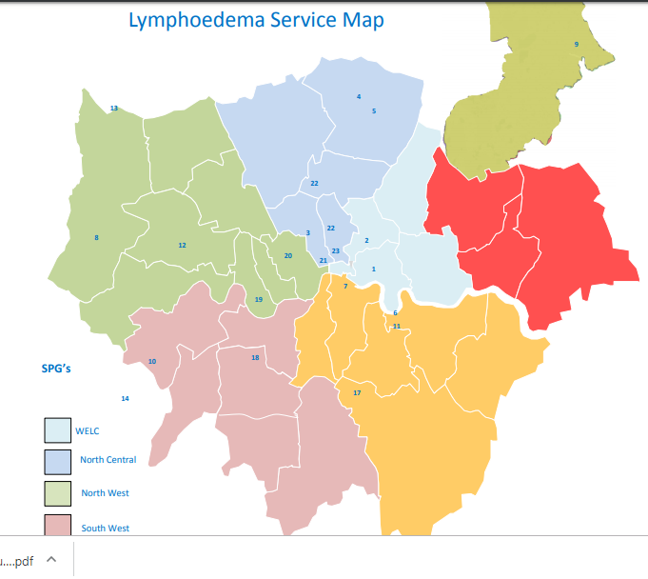
Variation in lymphoedema services
Mapping by TCST 2016
Using estimates of 1.33 persons with Lymphoedema per 1000 population (ca and non ca) = 11,700 people
Gaps all over London:
NWL: Brent, Harrow and Hounslow
SWL: Croydon
SEL: Bromley and Lambeth
NEL: BHR
NCL: Barnet
Fragmented commissioning by CCG, NHSE or charities
Notes:
file:///C:/Users/lannik/Downloads/Commissioning%20guidance%20lymphoedema%20August%202016%20(1).pdf

Slide 14
Personalised care – household bills arrears GLA data 2018-19
Recent data from the GLA survey highlight the London assembly areas with highest levels of people living with household bills arrears.
Notes:
https://s3-eu-west-1.amazonaws.com/londondatastore-upload/postcode_sectors_combined_2011_A4_v2ii.png

Slide 15
Social care and cancer
Chitris et al May 2014 Nuffield Report
Macmillan model first trialled in Glasgow.
Reviewed and supported almost 2500 patients since 2014. Top 3 concerns were: money and housing, fatigue and getting around
Dedicated housing professional on the team, who has ‘so far prevented 26 people becoming homeless’.
Dealing with issues in one place through one person model
Improving the cancer journey ‘more than the sum of its parts’. Edinburgh Napier University Snowden and Young
Paper takes a wider look at cancer survivorship. Inclusion of very important aspects beyond physical comorbidity described as ‘emotional and practical needs’, including activities of daily living (ADLs)
Studied over 8000 people with a diagnosis of cancer in two areas of England. Found that only 10% of new diagnoses had a social services assessment and in the year after diagnosis only 10% had SS support
Caveats – it is the gap between observed and expected – but assessments ideally should be much higher
May have changed very positively since the Care Act 2014 (need to repeat the study)
Increased use of Social services with comorbidities
https://www.nuffieldtrust.org.uk/research/use-of-health-and-social-care-by-people-with-cancer
Notes:
NLAP Model Macmillan Glasgow

Slide 16
Wigs/prostheses
Recent event Black Women Rising event – support group / awareness event for BAME women with cancer (most of which were Breast cancer patients) issue of lack of appropriate wigs and prosthesis for breast cancer came up.
5727 new breast cancer diagnoses in London 2017 – if 41% BAME this is potentially affecting 2348 women per year
In terms of prostheses, women feel that the skin tone they are given is completely inappropriate.: either very dark or they have to settle with the similar tone given to White /Caucasian women.
With wig provision, lack of variety of stock and assuming that the same stock of synthetic wigs will suffice for all BAME women.
Anita (one of the main manufacturers of breast prosthesis) – Austria – says they find it difficult to get the right skin-tone colours to match BAME women.
Main manufacturers –Anita, NicolaJane and Zelima
Issues – no clear commissioning routes, comes in the tariff for each trust via the appliance office.
Case study
In one instance, the patient said she was given an inappropriate wig (she had curly hair). After 3 attempts to get the supply from the trust she was being treated at with no success, she requested to be given a voucher or be reimbursed to purchase it herself which was almost like a tug of war. Finally she found a suitable Wig online for herself.
Notes:
https://www.breastcancercare.org.uk/get-involved/social-events/black-women-rising
Black women rising event March 28, 2019 in Peckham

Slide 17
Measuring improvements - New quality of life metric planned – national NHSE cancer
This will capture people’s experience of living with cancer more fully
The QoL pilot project aims to:
evaluate data collection methods
gather data to develop summary QoL metric(s).
The project is underway in five Cancer Alliances working in eight hospital Trusts:
Breast, prostate and colorectal cancer patients are included.
The goals is to collect a minimum of 1000 patient questionnaires.
Patients are recruited between 12-24 months after the end of treatment.
Electronic and paper questionnaires are in use. The two electronic data collection platforms currently in use are:
My Medical Record
eHNA
From NHSE slides

Slide 18
Personalised care
Summary
Why are inequalities important? - Increased emergency admissions for people in more deprived groups, and reflected in patient surveys
Pathways
Much variation in holistic care assessments
Much variation in primary care registers and whether commissioned to do cancer care reviews
Variation in rehabilitation – psycho-oncology, lymphoedema and social care assistance
Variation in access to appropriate wigs and prostheses
Potential links to social prescribing work across London
Recommendations
Ensure primary care registers are up to date, so that primary care can support all people following a cancer diagnosis
Populate the cancer care map so that GPs and patients know how to access local services/support
Ensure equal access to rehab: including
all trusts have psychosocial offer
equitable lymphoedema commissioning and provision in order to prevent more costly worsening of the conditions
Address wig/prosthetic gaps for Black and minority ethnic patients
Notes:
Personalised care London picture
Why are inequalities in personalised care important?
What do cancer patients think?
What should the pathway look like?
Key milestones
Care plans
Primary care (training gaps, registers, structured approach)
comorbidity
Rehabilitation services in London for cancer
Variation in access to psycho-oncology support
Variation in access to lymphoedema services
Social care needs and cancer
Debt and cancer
Wigs and prostheses
New quality of life metrics for cancer (NHSE)

Slide 19
List of abbreviations
ADL activities of daily living
BBV Blood borne virus
CCG Clinical commissioning group
eHNA electronic health needs assessment
eRS electronic referral system
GI Gastrointestinal
GMS1 General medical services GP contract
GP General Practitioner
HPV Human papilloma virus
IVDU Intravenous drug user
LD Learning disability
LTP NHS Long Term Plan (2019)
NCIN National Cancer Intelligence Network
NCL North Central London
NCPES National cancer patient experience survey
NEL North East London
NWL North West London
Office for National Statistics (ONS)
Public Health England Fingertips data
SEL South East London
STP Sustainability and transformation partnership
SWL South West London
TA Temporary accommodation
TCST Transforming cancer services team
2WW Two week wait

