Slide 1
Ch 3 Inequalities in access and treatment for cancer

Slide 2
Access and treatment for cancer outline
Cancer diagnosed as an emergency in London
Variation
Types of treatment (breast cancer)
Variation in bowel cancer outcomes
Variation in lung cancer outcomes
5 year survival
Treatment modalities variation
Variation in access to trial treatment and surgery

Slide 3
Cancer diagnosed as an emergency

Slide 4
Cancer diagnosed as an emergency – UCL audit
UCLPartners (UCLP) 2015 audit
27 patients had an in-depth interview as part of a research sub-study.
The most common reason for delay was not thinking the problem was serious (53%)
No-one stated that they were too embarrassed to go to their GP
Only 6% were worried about wasting the GPs time
7% of people had delay because they were worried about what would be found. This group tended to wait the longest before seeking help
Participants were put off seeking help for a second or third time if a medical practitioner had already given them a tentative diagnosis
In London, 41% of lung cancers and 28% of colorectal cancers are diagnosed through an emergency route compared to 38% and 25% England average.
UCLP 2015
Deep dive of 963 patients presenting as an emergency
The primary care root cause analysis in 138 patients showed:
78% of patients had one or more co-morbidities
64% of patients went to A&E with symptoms lasting less than a month
63% of patients had seen their GP for the same problem prior to A&E and over half of these patients had been referred by their GP for tests but deteriorated whilst waiting.

Slide 5
Cancer diagnosed as an emergency
This is a complex area (Zhou et al 2016)
Being diagnosed as an emergency - patients have poorer clinical and patient reported outcomes than patients not diagnosed as an emergency
Combination of tumour related, patient related, and healthcare related factors
Tumour related – more likely to be cancer with non specific symptoms
Patient related -23% of patients had had ‘red flag’ symptoms
Youngest and oldest age groups – more likely to be diagnosed as an emergency
Colorectal cancer audit- 20% of patients had had ‘typical alarm symptoms recorded in the year before diagnosis’
Higher levels of comorbidity with other hospitalizations in the year prior to diagnosis
Ethnic minorities, more likely to be non white or Asian
Healthcare related – practices with better access, lower levels emergency presentation
“Evidence from an English national data source indicates that approximately 30% of emergency presentations are generated by direct emergency referral to hospital services by primary-care physicians”
Reflections on Zhou et al (2016):
Is cancer being masked by multi-morbidity in the elderly?
Is there an issue with patients not having timely access to a GP?
Notes:
Zhou et al 2016 Nature reviews clinical oncology. Diagnosis of cancer as an emergency: a critical review of current evidence

Slide 6
Cancer diagnosed as an emergency (London)
1 year rolling average from Q1 2018: Best Croydon, worst Waltham Forest

Slide 7
Access and emergency presentations
What needs to change in London?
Recommendations
If emergency presentations are more common in ethnic minority patients – address difficulties in getting a GP appointment in areas with high deprivation/BME groups
Education: Consider cancer in older patients with multi-morbidity
Summary:
Cancer presenting as an emergency is a complex area
It varies from highest (worst ) in Waltham Forest and lowest (best) in Croydon
It reflects a number of different factors which include age, ethnicity, and deteriorating whilst already having been referred by their GP

Slide 8
Treatment outcomes

Slide 9
Outcomes for treatment for certain cancers
Description of data used
No data specifically on mortality from ‘cancer operations’ in the aggregate, but there are data on individual surgeons’ performance. There are also data for different cancers which we can use to reflect on certain clinical outcomes:
Breast cancer NABCOP
For Breast cancer using NABCOP data on breast conserving surgery (sx) and mastectomies for women aged 50-69 years and then women aged 70+ years
Breast cancer – having a clinical nurse specialist (CNS)
Colorectal cancer NBOCA
Colorectal cancer from 2018 NBOCA 90 day survival & 2 year survival https://www.nboca.org.uk/content/uploads/2018/12/NBOCA-annual-report2018.pdf
Lung cancer LCCPOP
0 and 90 day survival data
1 yr. survival https://www.rcplondon.ac.uk/projects/outputs/lung-cancer-clinical-outcomes-publication-2018-audit-period-2016
5 year survival data

Slide 10
Breast cancer - variation in breast conserving sx for early invasive cancer
Variation in breast conserving surgery for younger ages (50-69yo) highest in Croydon 81% and lowest UCL at 47%. For older women, also variation in % having BCS - highest N Middx 69% and lowest Croydon 22% - caveats does not take clinical complexity/comborbidity into account for early invasive cancer, and no CI

Slide 11
Breast cancer –variation in mastectomy for early invasive cancer
Much variation in mastectx for younger ages (50-69yo) highest in UCL 40% and lowest North Middx 15%. For older women, also variation in % - highest Hillingdon 33% and lowest London NW 18%. Does not take clinical complexity/comborbidity into account for early invasive cancer, and no CI

Slide 12
Breast cancer - having a named CNS London
Much variation in having a CNS for younger ages (50-69yo) highest in four trusts 100% and lowest Royal Free 65%. For older women, also variation in % - highest at 100% in a few trusts, lowest Royal Free 47%. Time lag as these are 2017 data and numbers are small (no CI shown).
Notes:
Source 2019 NABCOP audit

Slide 13
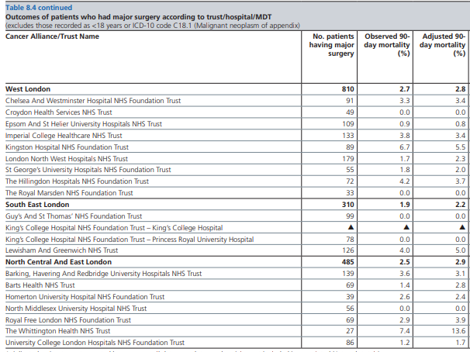
Bowel cancer – 90 day adjusted mortality
Highest Whittington adjusted 90d mortality – 13.6%, followed by Kingston Hospital 5.5%, and 5 trusts had 0% in 2018. Caveats are small numbers, no CI, and one year snapshot data

Slide 14
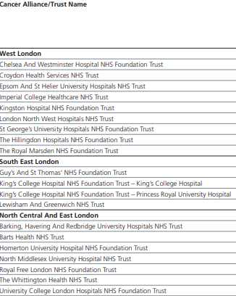
Bowel ca – adjusted 2 year mortality
Kingston and Whittington still have the highest adjusted 2 year mortality for bowel cancer after major surgery. Caveats as this does not take stage and comorbidity into account, and small numbers.

Slide 15
Lung cancer 30 and 90 day survival
Both 30 and 90 day survival for lung cancer is not stat significantly different from expected – pls note limited number of trusts doing cardiothoracics
Surgical trust | Number of resections | 30-day survival adjusted (%) | 30-day survival significance | 90-day survival adjusted (%) | 90-day survival significance
Barts Health NHS Trust | 206 | 99.2 | è | 97.8 | è
Guy's and St Thomas' NHS FT | 518 | 98.6 | è | 97.4 | è
Imperial College Healthcare NHS Trust | 159 | 98 | è | 96 | è
Royal Brompton and Harefield NHS FT | 402 | 98 | è | 96.3 | è
St George's Healthcare NHS Trust | 194 | 99.5 | è | 98.4 | è
University College London Hospitals NHS FT | 236 | 97.5 | è | 95 | è
England | 6,343 | 98.2 |  | 96.5
è Not statistically significantly different to expected ê Significantly worse than expected

Slide 16
Lung cancer 30 and 90 day survival
1 year survival for lung ca is not stat significantly different from expected – pls note limited number of trusts doing cardiothoracics
Surgical trust | 1-year survival adjusted (%) | 1-year survival significance
Barts Health NHS Trust | 91.5 | è
Guy’s and St Thomas’ NHS FT | 89.2 | è
Imperial College Healthcare NHS Trust | 88.1 | è
Royal Brompton and Harefield NHS FT | 92.6 | è
St George's Healthcare NHS Trust | 86.4 | è
University College London Hospitals NHS FT | 81.5 | è
England | 88.7
è Not statistically significantly different to expected

Slide 17
5 year survival

Slide 18
FIVE year survival
The following graphs show the variation in 5 year survival for breast, colorectal and lung cancer by STP only
There is variation across different STPs for patients diagnosed between 2012-16, although the confidence intervals do overlap
Five year survival is thought to reflect cancer treatment rather than early diagnosis
We need to reflect on system issues as to why these differences exist

Slide 19
5 year survival BREAST cancer 2012-16 data women all ages
Highest survival at five years in SWL (86%), lowest in NCL (82%). However, variation is not significantly different

Slide 20
5 year survival colorectal cancer 2012-16 all persons all ages
Highest survival at five years in NWL (62%), lowest in NEL (56%). NEL significantly worse survival than NWL, but not England

Slide 21
5 year survival lung cancer all persons all ages
Highest survival at 5 years in SWL (20%), lowest in SEL (15%). SEL and NEL significantly worse survival than SWL, but not England.

Slide 22
Access to treatments
Notes:
The TCST-NCRAS Partnership looked at treatment modalities (surgery, chemotherapy and radiotherapy) for different cancer types, by STP
The cancers considered were breast, colorectal, non small cell lung, prostate, bladder, pancreas, and stomach
The data in this presentation is based on an updated version of the Cancer Treatment SOP developed by the CRUK-NCRAS Partnership (v4.5) http://www.ncin.org.uk/cancer_type_and_topic_specific_work/topic_specific_work/main_cancer_treatments
All patients diagnosed with malignant cancer while resident in England in 2013-2016 were included. Death certificate only registrations are included. Only treatment administered in England is investigated.
Treatments occurring in the period from 1 month before diagnosis to either 6, 9, 12, 15 or 18 months after diagnosis are displayed for tumours diagnosed in 2013 to 2016, by tumour site and stage at diagnosis. Only tumour sites with sufficiently large counts (n>5) across all modalities and stage groupings are included.
Note: Unadjusted proportions are presented.
There are a number of considerations that should be made when comparing unadjusted treatment rates by STP. For example:
The characteristics of the region’s population could differ (e.g. stage at diagnosis, deprivation, age, sex, ethnicity, comorbidities etc.).
The sample size of the region could be small, so random variation could have a bigger influence.
There could be differing levels of missing data between STPs

Slide 23
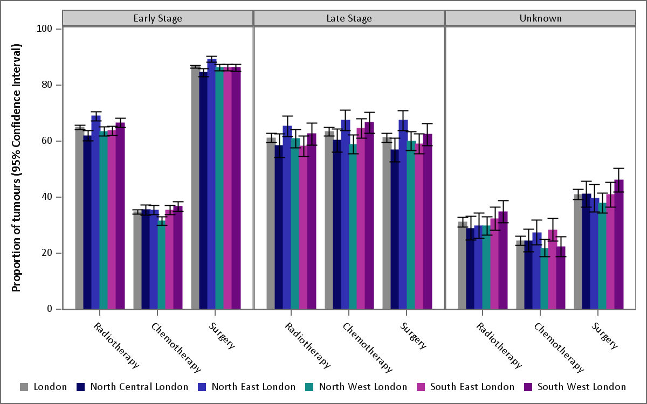
Variation in treatment modalities by STP – breast cancer [DXT=radiotherapy, CXT chemotherapy]
Early stage: NEL higher radio and surgery rates/ NCL lower radio and surgery rates compared to London
Notes:
Proportion of Breast tumours treated, by modality and stage (2013-16)
The TCST-NCRAS Partnership looked at treatment modalities (surgery, chemotherapy and radiotherapy) for different cancer types, by STP
The cancers considered were breast, colorectal, non small cell lung, prostate, bladder, pancreas, and stomach
The data in this presentation is based on an updated version of the Cancer Treatment SOP developed by the CRUK-NCRAS Partnership (v4.5) http://www.ncin.org.uk/cancer_type_and_topic_specific_work/topic_specific_work/main_cancer_treatments
All patients diagnosed with malignant cancer while resident in England in 2013-2016 were included. Death certificate only registrations are included. Only treatment administered in England is investigated.
Treatments occurring in the period from 1 month before diagnosis to either 6, 9, 12, 15 or 18 months after diagnosis are displayed for tumours diagnosed in 2013 to 2016, by tumour site and stage at diagnosis. Only tumour sites with sufficiently large counts (n>5) across all modalities and stage groupings are included.
Note: Unadjusted proportions are presented.
There are a number of considerations that should be made when comparing unadjusted treatment rates by STP. For example:
The characteristics of the region’s population could differ (e.g. stage at diagnosis, deprivation, age, sex, ethnicity, comorbidities etc.).
The sample size of the region could be small, so random variation could have a bigger influence.
There could be differing levels of missing data between STPs

Slide 24
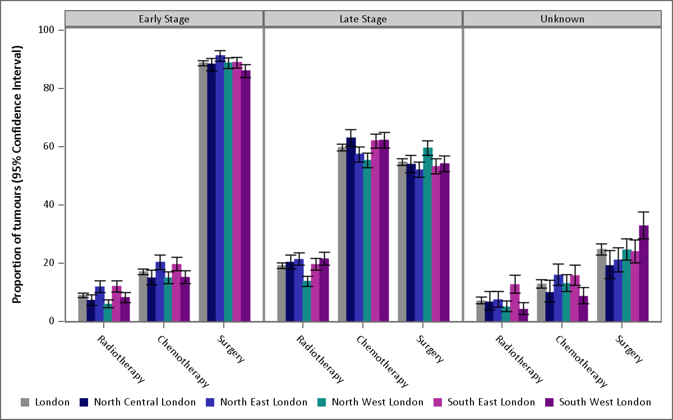
Variation in treatment modalities by STP – colorectal cancer [DXT=radiotherapy, CXT chemotherapy]
Early stage: Significantly higher DXT rates in NEL and SEL, with higher CXT also
NWL: Significantly lower DXT rates for early and late stage/ Significantly lower CXT rates for early stage (& lower for late stage)/ Significantly higher surgery rates for late stage
Notes:
Proportion of Colorectal tumours treated, by modality and stage (2013-16)
The TCST-NCRAS Partnership looked at treatment modalities (surgery, chemotherapy and radiotherapy) for different cancer types, by STP
The cancers considered were breast, colorectal, non small cell lung, prostate, bladder, pancreas, and stomach
The data in this presentation is based on an updated version of the Cancer Treatment SOP developed by the CRUK-NCRAS Partnership (v4.5) http://www.ncin.org.uk/cancer_type_and_topic_specific_work/topic_specific_work/main_cancer_treatments
All patients diagnosed with malignant cancer while resident in England in 2013-2016 were included. Death certificate only registrations are included. Only treatment administered in England is investigated.
Treatments occurring in the period from 1 month before diagnosis to either 6, 9, 12, 15 or 18 months after diagnosis are displayed for tumours diagnosed in 2013 to 2016, by tumour site and stage at diagnosis. Only tumour sites with sufficiently large counts (n>5) across all modalities and stage groupings are included.
Note: Unadjusted proportions are presented.
There are a number of considerations that should be made when comparing unadjusted treatment rates by STP. For example:
The characteristics of the region’s population could differ (e.g. stage at diagnosis, deprivation, age, sex, ethnicity, comorbidities etc.).
The sample size of the region could be small, so random variation could have a bigger influence.
There could be differing levels of missing data between STPs

Slide 25
Variation in treatment modalities by STP – non small cell lung cancer [DXT=radiotherapy, CXT chemotherapy]
NEL and NWL (early stage): lower DXT rates compared with London
NWL (late stage): higher DXT and lower CXT rates
NEL (late stage): lower DXT rates
SEL and SWL (early stage): lower levels of surgery than the London average (radiotherapy higher instead?)
Notes:
Proportion of Non small cell lung tumours treated, by modality and stage (2013-16)
The TCST-NCRAS Partnership looked at treatment modalities (surgery, chemotherapy and radiotherapy) for different cancer types, by STP
The cancers considered were breast, colorectal, non small cell lung, prostate, bladder, pancreas, and stomach
The data in this presentation is based on an updated version of the Cancer Treatment SOP developed by the CRUK-NCRAS Partnership (v4.5) http://www.ncin.org.uk/cancer_type_and_topic_specific_work/topic_specific_work/main_cancer_treatments
All patients diagnosed with malignant cancer while resident in England in 2013-2016 were included. Death certificate only registrations are included. Only treatment administered in England is investigated.
Treatments occurring in the period from 1 month before diagnosis to either 6, 9, 12, 15 or 18 months after diagnosis are displayed for tumours diagnosed in 2013 to 2016, by tumour site and stage at diagnosis. Only tumour sites with sufficiently large counts (n>5) across all modalities and stage groupings are included.
Note: Unadjusted proportions are presented.
There are a number of considerations that should be made when comparing unadjusted treatment rates by STP. For example:
The characteristics of the region’s population could differ (e.g. stage at diagnosis, deprivation, age, sex, ethnicity, comorbidities etc.).
The sample size of the region could be small, so random variation could have a bigger influence.
There could be differing levels of missing data between STPs

Slide 26
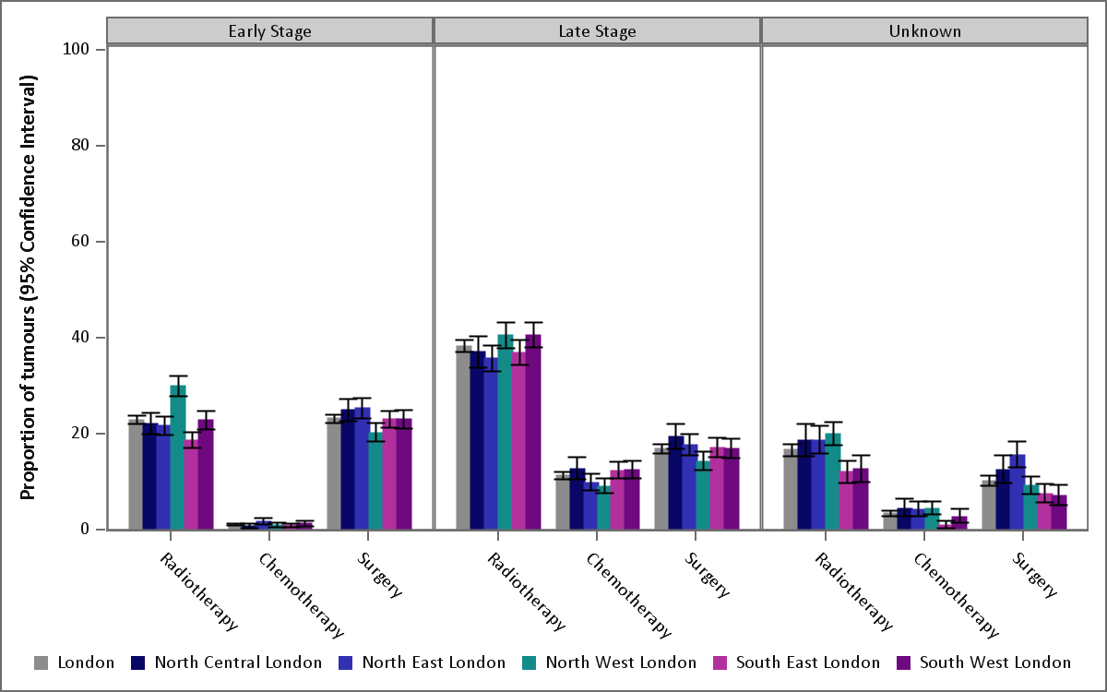
Variation in treatment modalities by STP – prostate cancer [DXT=radiotherapy, CXT chemotherapy]
NWL: Significantly higher DXT rates compared to London for early stage
Notes:
Proportion of Prostate tumours treated, by modality and stage (2013-16)

Slide 27
Variation in treatment modalities by STP – bladder cancer [DXT=radiotherapy, CXT chemotherapy]
SEL: Significantly lower CXT and DXT rates compared with London and other STPs for early stage cancers
Notes:
Proportion of bladder tumours treated, by modality and stage (2013-16)

Slide 28
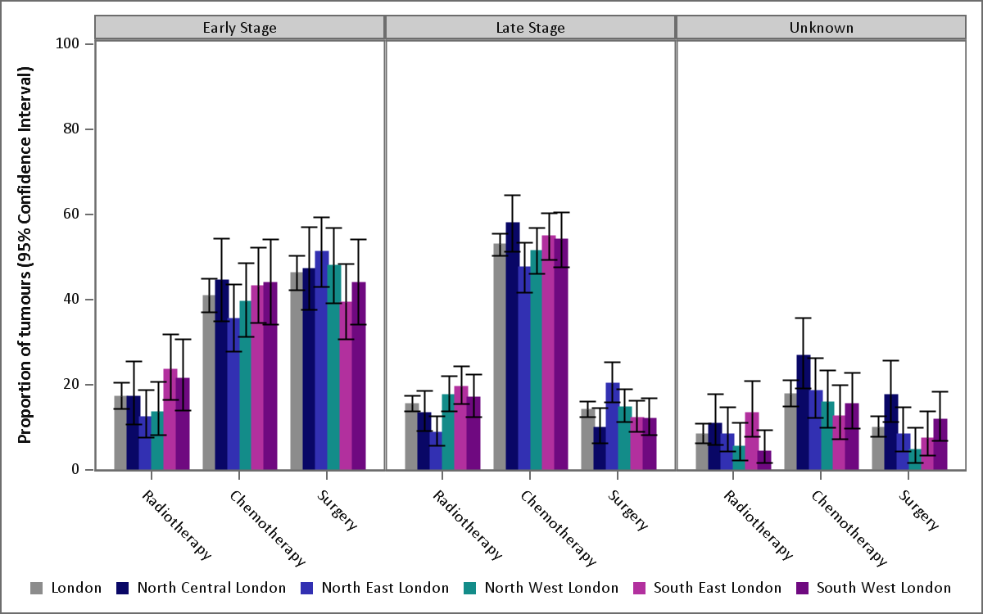
Variation in treatment modalities by STP –stomach cancer
NEL: Significantly lower radiotherapy rates for late stage tumours
Notes:
Proportion of Stomach tumours treated, by modality and stage (2013-16)

Slide 29
Access to trials or surgery
People from BME groups are less likely to participate in clinical cancer trials. Some of the barriers to participation include cultural factors such as fear and cancer stigma, and mistrust of the medical system. (RP Symonds et al. Recruitment of ethnic minorities into cancer clinical trials: experience from the front lines. British Journal of Cancer. 2012. 107(7): 1017–1021.)
https://www.macmillan.org.uk/documents/aboutus/research/inclusionprojects/experiencesofbmepeople.pdf
No London data but would be worth measuring
English study - more deprived people had lower odds and lower rates of receiving surgery in early stage lung cancer Belot et al 2019

Slide 30
Treatment
What needs to change in London?
Summary:
For older breast cancer patients, their access to breast conserving surgery varies slightly across London, as does recording of and access to a breast CNS
Mortality for bowel cancer varies in London trusts –with higher mortality in the Whittington and Kingston, although CI are not calculated and numbers are small
Lung cancer outcomes are not SS different in London
5 year survival for breast bowel and lung cancer does vary slightly but this is not SS
Treatment modalities – access
to treatments varies across STPs
Recommendations
Review the access to breast conserving surgery in older women in London
Review CNS recording and provision for older women in London

Slide 31
List of abbreviations
BBV Blood borne virus
CCG Clinical commissioning group
CXT chemotherapy
DXT radiotherapy
eHNA electronic health needs assessment
eRS electronic referral system
GI Gastrointestinal
GMS1 General medical services GP contract
GP General Practitioner
HPV Human papilloma virus
IVDU Intravenous drug user
LD Learning disability
LTP NHS Long Term Plan (2019)
NCIN National Cancer Intelligence Network
NCL North Central London
NCPES National cancer patient experience survey
NEL North East London
NWL North West London
Office for National Statistics (ONS)
Public Health England Fingertips data
SEL South East London
STP Sustainability and transformation partnership
SWL South West London
TA Temporary accommodation
TCST Transforming cancer services team
2WW Two week wait

