Slide 1
CHAPTER 2
Early diagnosis of cancer and inequalities

Slide 2
Early diagnosis outline
Screening and cancer inequalities
Stage 1 and 2 diagnoses across London
Evidence review of what works in early diagnosis internationally and nationally
Variation in 1 year survival across London
Recommendations for reducing inequalities in ED

Slide 3
EARLY diagnosis
.
What does the evidence tell us – screening and deprivation
Large inequalities in the uptake of cancer screening services in socio-economically deprived areas, even though screening saves lives. This has been shown in relation to bowel, breast and cervical screening programmes.
Bertoni et al Italian study in 6000 women – for those with less education and from more deprived areas -25% increase in uptake by ‘loss framing’ i.e. showing women that there are negative consequences of not attending and also giving more background information (2018)
Differences in health literacy, awareness of symptoms and attitudes about cancer. Huf et al 2016
These have also been linked to healthier behaviours and the stage of diagnosis.
Compared to the highest income groups, people in the most income deprived areas in England are 20% more likely to have their cancer diagnosed at a late stage.
Reduced ability and opportunity to seek support.
Exploratory studies have indicated that the more socioeconomically deprived a person, the harder it is for them to seek help – an understandable reality of having a longer list of essentials they need to manage, whether financial, psychological or relational
Notes:
Duffy et al
(2017). Rapid review of evaluation of interventions to improve participation in cancer screening services. J Med Screen. Vol 24 (3) 127-145.
https://phescreening.blog.gov.uk/2019/04/09/how-the-north-midlands-breast-screening-team-uses-facebook-to-increase-breast-screening-uptake/
Lyratzopoulos, G et al. 2012. Socio-demographic inequalities in stage of cancer diagnosis: evidence from
patients with female breast, lung, colon, rectal, prostate, renal, bladder, melanoma, ovarian and endometrial
cancer. https://academic.oup.com/annonc/article/24/3/843/207310
Bertoni et al March 2018. Promoting breast cancer screening take ups with zero cost: evidence from an experiment on formatting invitation letters in Italy. IZA Institute of Labour economics.
Huf et al 2016 https://www.thelancet.com/journals/lancet/article/PIIS0140-6736(16)32293-0/fulltext

Slide 4
Early diagnosis
Screening, deprivation and ethnicity
“People in more deprived groups are less likely to complete bowel screening (35% for the most deprived group compared to 61% for the least deprived) and are more likely to die from bowel cancer
Women in the most deprived groups (most deprived quintile) are less likely to attend cervical screening when compared to the least deprived quintile yet are more likely to have high risk HPV, and a higher risk of being diagnosed with/dying from cervical cancer.
Women in the most deprived groups are generally less likely to participate in breast screening for the most deprived groups compared to the least deprived) but are more likely to die from breast cancer
Uptake of bowel screening in England is lower in the ethnically diverse areas (38% compared to 52 - 58% in other areas)
Women from ethnic minority groups are less likely to attend cervical screening compared to White British women”
PHE screening inequalities strategy 2018
Notes:
https://phescreening.blog.gov.uk/wp-content/uploads/sites/152/2018/03/Supporting-the-health-system-to-reduce-inequalities-in-screening.pdf
https://www.pharmaceutical-journal.com/news-and-analysis/news/pharmacists-to-refer-patients-for-chest-x-rays-in-research-pilot/20206456.article

Slide 5
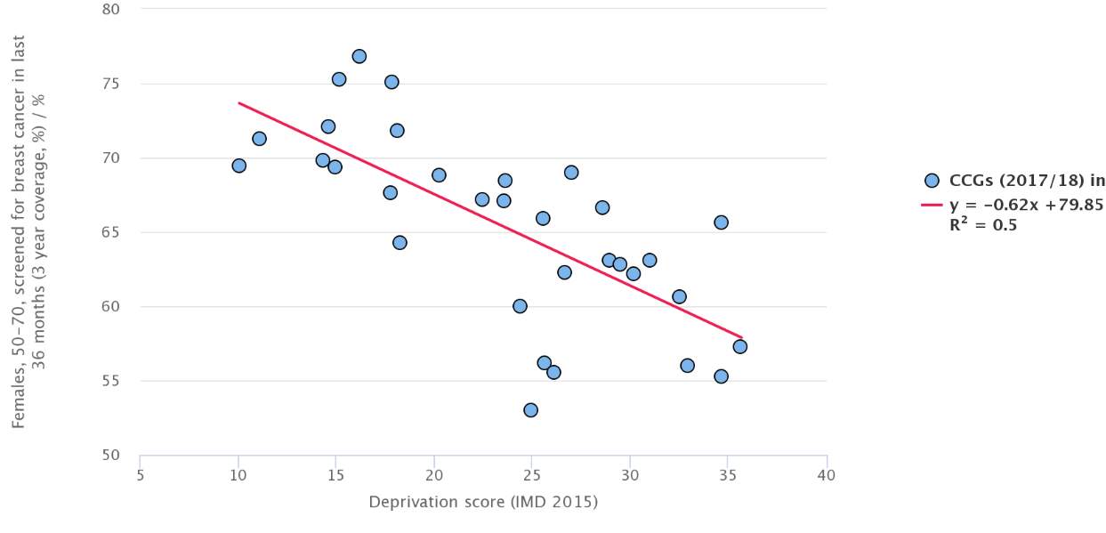
Early diagnosis–breast screening and deprivation
Relationship between breast screening and deprivation (screening reduces as deprivation increases) correlation coefficient -0.6

Slide 6
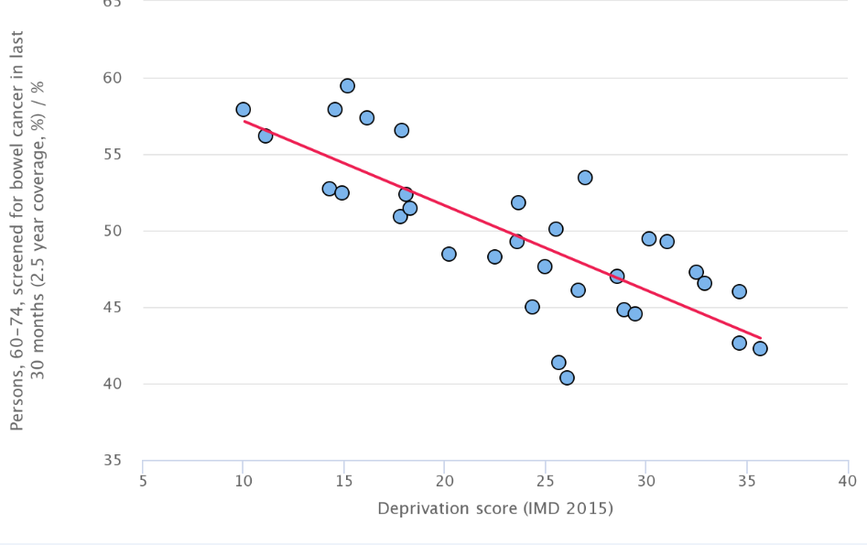
Early diagnosis-bowel screening and deprivation
Relationship between breast screening and deprivation (screening reduces as deprivation increases) correlation coefficient -0.6

Slide 7
Stage 1 and 2 diagnosis

Slide 8
Early diagnosis data London by CCG
% of cancers diagnosed at Stages 1 and 2: highest in Waltham Forest, lowest Greenwich

Slide 9
What works with inequalities and early diagnosis

Slide 10
Early diagnosis – what works
Further evidence on screening – national/international evidence
Duffy et al (2017)
International and national review of studies to improve screening coverage. Interventions that consistently improved screening (including in underserved populations): pre screening reminders, general practitioner endorsement, more personalised reminders for non-participants, and more acceptable screening tests in bowel and cervical screening (FIT increased participation by 15-20%, and HPV self sampling raised by 10% respectively).
North Midlands breast screening service and Facebook
With the help of a digital PR and communications agency, the North Midlands Breast Screening Service:
linked with local GP practices that had active Facebook pages promoted the service on local Facebook community groups popular with women over 50
The team posts information aimed at encouraging women to spread the message about the benefits and importance of screening

Slide 11
Case study –Tower Hamlets bowel screening
Bowel screening call service (summary from J Shankleman Public Health Advisor)
70% of men and women contacted around their 60th birthday by telephone and offered health promotion to encourage uptake of bowel screening
20% of men and women in the above group sent endorsement letter by practice if not reached by telephone
50% of men and women aged 61 – 70 who have not participated in bowel screening in the last 3 months contacted by telephone and offered health promotion to encourage uptake of bowel screening
40% of men and women in the above group sent endorsement letter by practice if not reached by telephone
A calling service to previous non-responders was used in NEL in 2012 , with Community Links as a commissioned provider across 18 practices in 3 primary care trusts.
Stephen Duffy paper (2014), now cited as evidence of effectiveness. Community Links is now commissioned by Royal Marsden Partners RMP (all NW and SW London CCGs) and 2 NELCCGs to call non-responders via practices.
The Tower Hamlets ACE project paid practices to do their own calling, also successful, 5% greater coverage in practices achieving at least mean performance.
Whitechapel HC (mainly Bangladeshi, very deprived population) adapted this model over the last year building on relationships with their practice population and using face to face engagement of non-responders, also providing additional resources (disposable gloves and kidney dishes). This drove their coverage from 35% to over 50% in less than a year.

Slide 12
Case study - Community Links breast & bowel screening
In 2017, in the London borough of Newham:
9% of those screened (87 people in total) had bowel abnormalities detected early
Breast cancer screening support programme resulted in a 5% to 10% increase in coverage
In 2015 to 2016, people were at least two and a half times more likely to attend screening when they were contacted by phone. Without the telephone outreach service they are likely to have remained non-responders with an increased chance of being diagnosed with cancer late.
https://phescreening.blog.gov.uk/2019/05/03/tackling-screening-inequalities-in-bame-communities/

Slide 13
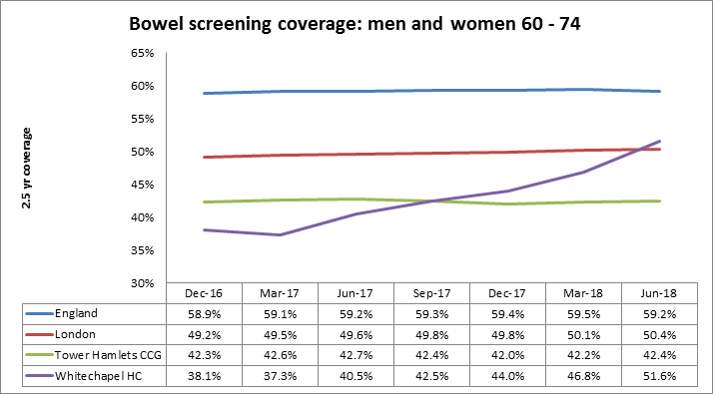
Case study - Whitechapel bowel screening
Coverage end of June 2018 was 52%, higher than the London average of 50%. - It had increased by 14% from 37% over 15 months.
Uptake also increased-contacted people quickly when non-responding.
Process – identifying a problem in their practice population (a high number of bowel cancer cases and low screening uptake), robust system for identifying and contacting screening non-responders, inviting patients for appointments with health care assistants, recognising barriers to completing the kit (handling poo, understanding the instructions), engagement through longstanding relationships and trust, requesting replacement kits on behalf of non-responders, using practical resources (disposable kidney dishes and sets of gloves)
Judith Shankleman Public Health Advisor TCST April 2019

Slide 14
Case study Kingston and community screening
From Tony Al-Hosri, Cancer screening lead Kingston Council Public Health
Religious groups and screening –ensuring that promotional and invitation letters sent in appropriate languages and also myth busting around preventative health to re-frame as staying well/healthy rather than preventing illness. Cultural sensitivity around stigma around cervical screening.
One year evaluation of the community development worker approach to screening in marginalised groups in Kingston from Jan 2018-Jan 2019
546 people had face to face cancer awareness presentations, 68% of whom had never been screened before. Wide variety of engagement methods tried with different parts of the community –Gypsy and Traveller, Korean and religious communities, digital communications, communications in libraries, newsletters etc.
Uncovered issues – screening letters not in languages other than English, cultural stigma around cancer (Gypsy Traveller), association of cervical screening with promiscuity (religious groups), need to convince faith and other trusted leaders and consider the message (i.e. staying well rather than preventing illness).
Key points – need to align with existing initiatives such s the community links direct phone calls as some GP info overload with multiple initiatives. New community development worker (CDW) about to be recruited. Too early to attribute changes in screening coverage to the CDW initiative, however more evaluation will follow.
Notes:
Briefing from Kingston PH –Tony Al Hosri

Slide 15
1 year survival

Slide 16
Early diagnosis and ONE year survival in London
The following tables and graphs show the variation in one year survival for breast, colorectal and lung cancer
One year survival is thought to reflect early diagnosis
There is variation across different STPs for patients diagnosed in 2016
Although the confidence intervals do overlap, we need to reflect on system issues as to why these differences exist

Slide 17
Breast cancer ONE year survival 2016 data ONS
Highest one-year survival in SWL (97%), lowest in NCL (96%)
Statistically significant variation only between NCL (lowest) and SWL (highest)
Notes:
Breast cancer: One year Age-standardised net survival for patients diagnosed 2011 to 2015
95% CI
North West London
One
96.2
95.5
96.9
North Central London
One
94.8
93.9
95.8
North East London
One
94.5
93.6
95.5
South East London
One
95.1
94.3
96.0
South West London
One
95.1
94.2
96.0
London
One
95.2
94.9
95.6
England
One
95.6
95.4
95.7

Slide 18
Colorectal cancer ONE year survival ONS
Survival ranged from 83% (NCL) to 78% (NEL)
Notes:
COLORECTAL cancer: Age-standardised net survival for patients diagnosed 2011 to 2015 95% CI North West London 3,839 One 80.2 78.9 81.5 Five 61.3 58.9 63.7 North Central London 2,592 One 78.5 76.9 80.2 Five 59.8 57.0 62.7 North East London 3,253 One 76.0 74.5 77.6 Five 56.9 54.4 59.6 South East London 3,587 One 78.5 77.1 79.9 Five 57.3 54.6 60.0 South West London 3,268 One 80.8 79.5 82.3 Five 60.5 57.9 63.3 London 16,539 One 78.9 78.3 79.6 Five 59.8 58.7 61.0 England 164,980 One 78.4 78.2 78.6 Five 60.5 60.1 60.9

Slide 19
Lung cancer ONE year survival ONS
There is variation in one-year lung cancer survival between STP areas, with NEL survival significantly lower than all other STPs at 41%
Survival ranges from 41% (NEL) to 47% (NCL and SWL)

Slide 20
Early diagnosis
Summary:
Screening is lower in deprived areas of London (PHE Fingertips 2017-18)
Screening is lower in ethnically diverse areas (national data)
Calling patients for invitations in their own language works
Making the screening more convenient in terms of place and materials works (bowel cancer)
Not all differences can be ascribed to culture or religion - but if they are, use community trusted links to break down myths/barriers
Differences in Stage ½ at diagnosis do not seem to relate to deprivation –patient and service factors probably as important
There is variation in one year survival for colorectal cancer – some CI overlap but some do not so there are significant differences. NEL worst at 78%, NCL best at 83%
Recommendations
Make screening invitations easy to attend: schedule in family planning or GUM as well as GPs
Make screening invitations easy to accept: multi-lingual written materials, friendly callers in own language for people not attending, understand and pitch invitations to attract different communities, using community leaders where possible
Make screening simpler: FIT testing, HPV self sampling if possible
Notes:
Noted interim findings May 2019 of the Sir Mike Richards Independent Review of National Cancer Screening Programmes in England ref 000544

Slide 21
List of abbreviations
BBV Blood borne virus
CCG Clinical commissioning group
eHNA electronic health needs assessment
eRS electronic referral system
GI Gastrointestinal
GMS1 General medical services GP contract
GP General Practitioner
HPV Human papilloma virus
IVDU Intravenous drug user
LD Learning disability
LTP NHS Long Term Plan (2019)
NCIN National Cancer Intelligence Network
NCL North Central London
NCPES National cancer patient experience survey
NEL North East London
NWL North West London
Office for National Statistics (ONS)
Public Health England Fingertips data
SEL South East London
STP Sustainability and transformation partnership
SWL South West London
TA Temporary accommodation
TCST Transforming cancer services team
2WW Two week wait

