Slide 1
Children and young people’s refreshed case for change This slide set is to help you share the case for change locally.
Sara Nelson
Programme Lead, CYP, Homeless Health and Good Thinking
HLP CYP Transformation Board
March 2019

Slide 2
Aspirations for London’s Children and Young People
Children and Young People up to the age of 25 make up a third of our population and the whole of our future.
In London, as a leading global city, we aspire to provide the best services and care possible to enable our young people to thrive on the journey to adulthood. In reality the evidence suggests that on a range of health indices we are falling short of our aspiration. This document sets a clear vision for excellence, rigorously underpinned by evidence and best practice to bridge these gaps by 2028.
Children and Young People rightly should be at the centre of any changes, seeking to partner with their energy, passion and enthusiasm as advocates for change, to co-produce a healthy future with the NHS, Local Authorities, Public health other public bodies and the third sector.

Slide 3
Why do we need to change?

Slide 4
Future model of care for children and young peope
Promotion of a health promoting child friendly city
Ensures children and young people are seen as an integrated service with no gaps, which is provided close to where the users are living or learning and has streamlined access
Ensures that service provision is consistent and accessible across the CCG / ICS/ local authority area, while still allowing flexibility to meet need at community neighbourhood area and primary care network level
Ensures children and young people are safeguarded, including early identification and co-ordinated support of emerging need
Emphasises early help to reduce the need for children and young people to access intensive or statutory services
Develops close working relationships and integration with social care, education and other health partners as paramount to creating a seamless service
Supports children and young people to be able to self-care where possible and appropriate
Develops a fully integrated information technology system that allows the seamless transfer of/access to appropriate clinical and non-clinical information across all services
Is able to deliver efficiencies with no compromise in service quality
RESOURCE PACK to help with CYP work available here

Slide 5
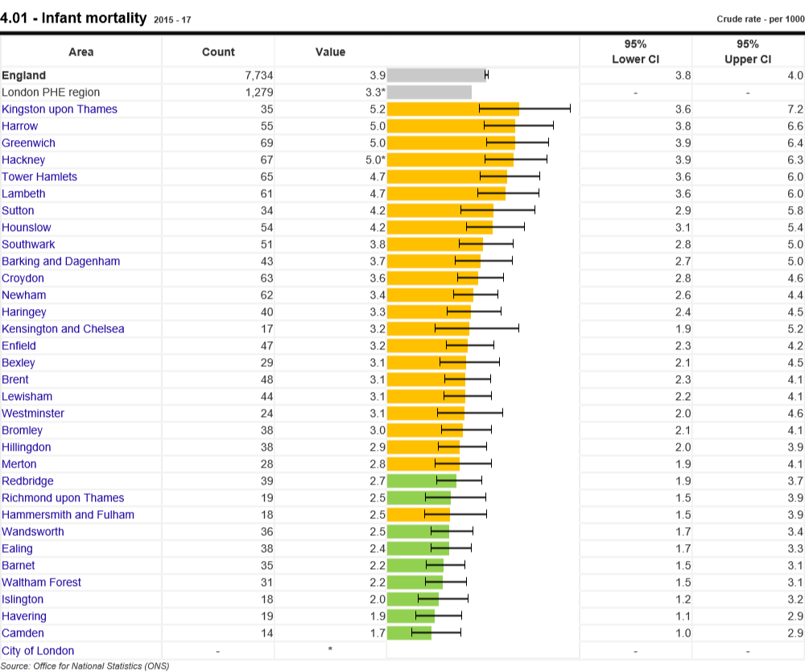
Reduction in childhood mortality
Issue
8 boroughs have higher infant mortality than the average for England
UK childhood mortality is worse than our western counterparts (Viner, Ward and Wolfe 2018, Nuffield Trust and AYPH, 2019)
If the UK had the same childhood mortality for children aged 0-14 years as Sweden there would be five fewer child deaths every day and about 1,951 fewer child deaths (Wolfe et al, 2013)
Figure 2 Child mortality for children and young people aged 1-17 years. Source: PHE Fingertips Child and Maternal health Mortality data
https://fingertips.phe.org.uk/profile/child-health-profiles/data#page/1/gid/1938133232/pat/42/par/R3/ati/102/are/E09000002

Slide 6
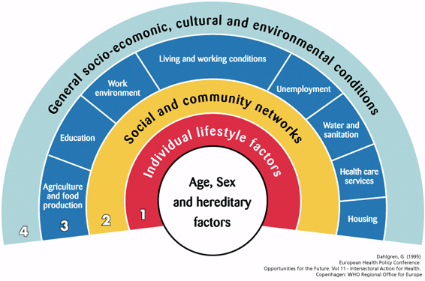
Health inequalities
The most deprived 0-24 year olds were 58% more likely to go to A&E than the least deprived groups, with the most deprived teenagers experiencing A&E attendance rates that were almost 70% higher than the least deprived (Nuffield Trust, 2017).
The most deprived groups were 55% more likely to experience an unplanned hospital admission than the least deprived, despite the gap between the two groups having narrowed.
These inequalities have a significant financial cost: if unplanned admissions for all groups were brought down to the level of the least deprived, this would lead to a decrease of around 244,690 paediatric hospital emergency admissions (based on 2015/16 figure). This would represent a potential saving of £245 million per year.
Unplanned hospital admissions for the ten most common conditions were consistently highest amongst CYP from the most deprived areas. (Nuffield Trust, 2017)
Link between adverse childhood experiences and health and social problems in later life such as addiction, contact with the criminal justice system and mental health issues (Centers for Disease Control and Prevention, 2014)
Looked after children have much higher levels of mental illness than their counterparts – while one in ten children nationally has a diagnosable mental health condition (DHSC & DFE, 2017) 45 per cent of looked after children are estimated to have a diagnosable disorder ^{(NICE)}
‘over a quarter of young men and a third of young women in secure settings have long standing physical complaints’ (RCPCH, 2013)

Slide 7
Prevention
Best start in Life: Early years programmes
Immunisations – below target
Breastfeeding - initiation is higher in London than the rest of England with 86% compared to 74% .
Obesity - nearly 40 per cent of London children aged 10-11 years noted to be overweight or obese. A clear deprivation gradient exists, with obesity rates highest in the most deprived 10 per cent of the population.
One in four children is overweight or obese when they start school (Rudolf et al 2011), which puts them at greater risk of cardiovascular disease and diabetes in later life.
Smoking - Teenagers starting to smoke is an important health issue, as damage to arteries can begin at an early age. It is estimated from a recent British study that one in five teenagers started smoking by the age of 17 years. Teens were also more likely to smoke if their parents smoked ⁽⁶¹⁾.
Alcohol and substance misuse - CYP can be affected by substance misuse through their own use and impeded by their parents / caregivers. Both aspects need tackling. Early age drinking is associated with health and social problems and risky behaviours (smoking and sexual activity). Most substances mis-used are cannabis and then alcohol. London’s rate of alcohol specific hospital admissions for under 18 year olds is 19.4 per 100,000 children, lower than the England rate of 34.2 per 100,000. Parental alcohol misuse is strongly implicated in domestic violence and abuse.
Sexual health
Over a third (36%) of all new sexually transmitted infections occur in ages 15-24 years. Young people tend to have more partners and are less likely to use protection such as condoms.
Child sexual exploitation is also an issue which increases the risk of sexually transmitted infections.
Violence reduction 2018 study of 1824 knife stabbings in under 25 years. The findings showed a higher incidence in young boys aged 14 to 18 years, with the majority from more deprived communities

Slide 8
Oral Health
Poor oral health is the greatest cause of surgical admission for children and young people.
NHS England (London) spends around £73 million per year on dental services in primary care for children in London. In 2016-17, there were 11,632 finished consultant episodes for children with a primary diagnosis of dental decay London, at a cost of almost £10m per year
HLP undertook work in conjunction with Queen Mary’s University London on parents seeking analgesia for their child’s pain published in BMJ Open
65% of parents seeking pain medications for their children were doing so to relieve their child’s oral pain.
41% of the children had toothache;
20% had pain from a newly erupting tooth and
15% had a painful mouth ulcer.
Only 305 of children with oral pain had seen a dentist before the pharmacy visit while 28% had seen between one and four different health professionals
Nearly one in ten children had signs and symptoms indicating a dental emergency. Community pharmacy staff signposted them to emergency services.
The cost to the NHS of children contacting health professionals outside dentistry over the period was £36,573 (an annual cost of £373,288).
Saturdays and Sundays were the peak days for parents to visit pharmacies for pain medication for children’s oral pain possibly due to limited urgent dental care services over the weekend.
Need to work with HEE and others to address this
.

Slide 9
Long term conditions: asthma, diabetes and epilepsy
Asthma
Audit in Harrow, showed asthma admissions could be reduced by 16% through use of a local improvement scheme to improve care and follow up (Levy et al (2018)
If 60% of child emergency admissions were prevented, this could save £2.8million across London. If there was a 75% reduction the savings would be even greater, at £3.5m, and if adults were included this figure would rise further (AUK)
Diabetes
Approximately 6280 children and young people with Type 1 diabetes and the highest levels of children with Type 2 diabetes in the country - 234 CYP
Only 28% of children in the London are achieving the recommended level of blood sugar control.
Epilepsy
2,000 children and young people with epilepsy in London.
The average primary school will have 1-2 pupils and the average secondary school 4-5 pupils
Inadequate management has been demonstrated in almost 50% of investigated cases;
24-59% of studied deaths in young people with epilepsy were thought to be potentially avoidable;
The proportion of UK paediatric services with access to an epilepsy specialist nurse is only 59% ⁽⁷⁸⁾ and
Mental health co-morbidities are five times more common in CYP with epilepsy than in the general population.
HLP Epilepsy standards
Schools resources asthma diabetes epilepsy

Slide 10
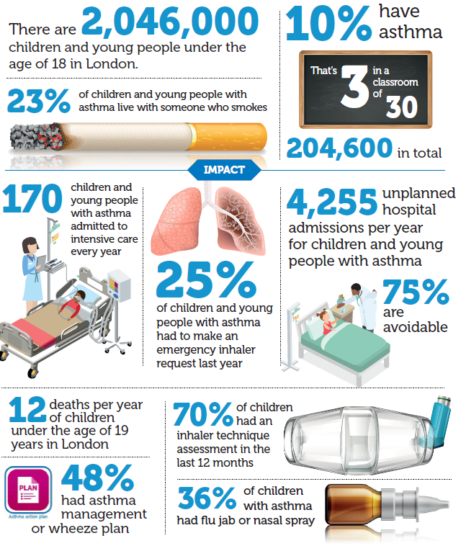
What are we doing for asthma?
Significant burden, outcomes poor, evidence for ROI
System wide approach across NHS, DsPH, PHE, Education, Mayor of London
Commitment to act
HLP Asthma programme
Asthma ambitions
Asthma standards
#AskAboutAsthma
NHS air pollution reduction toolkit
Asthma peer review
Asthma death investigations
Establishing asthma networks across NW, NC, NE and SE London
Significant health burden – see infographic
Notes:
Social movement for change

Slide 11
Child and Adolescent Mental Health
One in nine children and young people aged between 5 and 19 years have a mental health disorder
Half of all mental health problems are established by the age of 14 years
Between one in twelve and one in fifteen children and young people will deliberately self-harm.
Around half of all children and young people who attempt suicide fail to receive follow-up mental health treatment. Of those who do get care, up to 77% don’t properly complete their outpatient treatment. Of the 145 suicides by children and young people in England from January 2014 to April 2015, more than half (54%) had previously self-harmed
People with severe mental health illnesses tend to die 15-20 years earlier than those without. ⁽⁸⁴⁾
Peer review showed care to be fragmented and delayed, CAMHS provision for CYP in crisis presenting to local trusts was inadequate representing a system failure.
New care models to deliver an integrated approach across health, social care, education and the voluntary sector (iThrive)
Not currently meeting access and waiting time standards for CYP Community Eating Disorder Services

Slide 12
Learning disability and autistic spectrum disorder
Diagnoses of ASD rising and it is estimated to affect one in every 100 children. That equates to 22,000 children in London.
It is thought that for every three children with a diagnosis of autism there are another two children who have the condition but have not been given a formal diagnosis.
Children and their families told us they were struggling to access diagnostic and support services. In addition, ‘diagnostic overshadowing’ occurs where other physical health concerns are attributed to a diagnosis of autism.
15% of pupils may have special educational needs, only 3% are estimated to have a formal statement of special educational need. In 2014, statutory duty for local authorities and clinical commissioning groups to jointly produce Education health and care plans (EHCPs) to cover children and young adults up to the age of 25 years. Each local authority to produce a local offer for parents of children with such needs.
Of the estimated 22,000 children in London (the majority of whom are accommodated in mainstream schools), only 41,000 children have an education health and care plan.
The Long Term Plan aims to have at least 75% of those eligible have a yearly health check to tackle causes of comorbidity and preventable deaths

Slide 13
Primary care
Children are estimated to account for around a quarter of a typical GP’s workload
Not all GPs or practice nurses have the skills and confidence in their paediatric knowledge as they may not have received any formal training in child health
Young people report the lowest levels of satisfaction with GP services and have the shortest consultation times (Association of Young People’s Health 2016)
CYP are also twice as likely as other groups to attend A&E or walk-in centres rather than see their GP or practice nurse. (Wolfe & McKee 2014)
Linkages between individual primary care organisations and services and public health services and schools vary across London and within boroughs.
Transitory nature of population makes consistency and continuity of care more difficult
Shortage of GP and nurses nationally

Slide 14
What are we doing?
HLP CYP programme has undertaken extensive work in this area including:
Development of a community and primary care toolkit for CYP
Development of standards for out of hospital (OOH) models of care for CYP, an associated compendium of effective and innovative models and research into the potential of new models of care to reduce Emergency Department attendance.
Development of a model of networked primary care for CYP see diagram on next slide

Slide 15
Transition
Process is often fragmented, confusing, sometimes frightening and desperately difficult to navigate
Effective transition from paediatric to adult services for young people improves outcomes and quality of life
NHS England have provided service specifications for diabetes and mental health whereas inadequate transition has been associated with poorer long-term outcomes.
There should be no predetermined age of transfer. The process should be unique to the individual young person and their stage of development.
The findings of the London Acute Care Standards for Children and Young People demonstrated that there is wide variation in the quality of provision for transition. It was recognised that effective transition requires integration across primary, secondary and community care as well as social care.
Transition to adult services should be as seamless and flexible as possible for the young person. It should start from Year 9 or earlier (age 13 or 14) dependent on the YP and may last until 25.

Slide 16
Paediatric provider sector changes
Demand continues to rise -hospital often the first port of call ED presentations by children increasing by 20% in the last decade
HLP study of attendances in the acute care setting reviewed the potential new models of care to reduce emergency attendance (Viner et al 2017)
A supportive peer-led review in 2016 -17 of the 26 sites in London that deliver acute medical care to CYP assessed organisations against the London acute care standards for children and young people
Key findings concluded that there was much to celebrate. Reviewers were of the opinion that CYP, and their families, were largely well served by the 26 hospital sites visited: their voices were heard and appropriate and often highly innovative care was provided. Paediatric staff were clearly passionate about the services they provided. Staff were often working under a great deal of pressure, whether due to demand or lack of resource, but were seen to be highly committed to their work - and to the children and young people for whom they care.
However, the relationships between commissioners and providers varied hugely across London
Achievement of the London acute care standards for children and young people was variable, in every category, although trusts saw them as being important and were striving to meet them. Reviewers felt that full achievement of the standards may be a significant challenge on some sites.
Much good practice was seen in the district general hospitals innovation and excellence was not limited to the specialist and academic centres.
Many trusts work with a number of CCGs, constantly juggling different local priorities. At times, it was observed that this resulted in inequity of care being delivered by trusts to CYP depending on their CCG of origin. Reviewers saw this as being hard for staff and unfair to the CYP the trusts looked after.
Resources for children's services are spread thinly across London; at times in ways that appear unequal. The development of Sustainability and Transformation Partnerships (STPs) Integrated Care Systems (ICS) should help to deliver a more joined up population based approach.

Slide 17
What are our enablers for transformational change?

Slide 18
Child and Young Person-Friendly City
Child Friendly Cities and Communities is a worldwide programme.
Supports cities and communities to use a child rights-based approach
The framework can be used by planners, decision-makers and frontline professionals in
both statutory and voluntary agencies.
It helps to provide a common framework on which to describe initiatives in different parts of the system
Seven Principles see diagram right
Seven main themes
Child-friendly urban design
Natural environment
Independent mobility
Health and well-being
Open spaces and recreation
Children’s participation
Educational outcomes

Slide 19
Digital: Improving information and data sharing through new technology
Maximising the use of new technologies using effective IT strategies providing systems that communicate across organisational boundaries is the strategic direction outlined in the long term plan.
Key enablers are
improved data sharing across organisations,
Better use of technology e.g. emails or online consultations.
Increased use of digital health solutions to enable people to undertake self-care (egg Babylon, Good Thinking)
NHSGo CYP find advice using NHS Digital content on conditions, with rolling content on topical matters, a service finder and information about rights for CYP. NHSGo is free to download on iTunes and Google play www.nhsgo.uk
Digital Health Passport for CYP – Those with a personalised asthma action plan are four times less likely to present to hospital. The HLP programme is testing a digital version of the Asthma UK action plan. It has the potential to make long-term conditions easier and more fun to manage and connect young people, school nurses and carers. The app encourages a young person to record symptom data, such as peak flow, that can help them identify a change requiring an intervention. A key part of this project involves the sharing of care plans between healthcare professionals and school nurses to join up care. Working alongside One London (London Health and Care Record Exemplar) will be key to unlocking the integration of data across the capital.
Digital red book supports personalised care for 0-5 years
Linking interoperable data within the child health information system and the proposed HLP digital health passport has the potential to provide families, healthcare and education professionals with immunisation data and development reviews. Access to this information is intended to promote strong parent-child attachment and positive parenting, resulting in better social and emotional wellbeing among children, readiness for school and improved learning.
Currently work on the digital health passport for asthma could be expanded to other conditions to enable CYP/parents to manage their long term conditions

Slide 20
Workforce
A skilled workforce is essential to the provision of safe and effective care and good experiences for children, young people and their families.
Future workforce will need to be different if services are to be sustained. It may include navigators, extended roles for specialist nurses, physician’s assistants or other roles that work across organisational boundaries.
Increased uptake of Return to Practice programme can provide benefit to children and young people
Opportunity for new Trainee Nursing Associate role is intended to benefit CYP who have changing, complex, and long-term care needs.
Paediatric and neonatal services embraced innovative workforce solutions with the advent of advanced clinical practice, further progress could be made to understand how best to utilise skills of advanced clinical practitioners
The NHS Youth Forum highlighted the need for improved mental health training for staff and improved flexibility for young people to access services. HLP has developed a number of resources to help educate the future workforce, such as the mental health in schools toolkit, Paediatric care in Practice e-learning portal, and the asthma and primary care toolkits
HLP peer review process noted the effectiveness of acute care services for CYP came down to the strength of leadership, at all levels.
London Acute Care Standards for CYP cannot be met without sufficient staff numbers being in place. E.g. not all trusts met Standard 40, which requires that a consultant paediatrician be present and readily available in the hospital to cover extended day working (up until 10pm), seven days a week.
The Capital Nurse Programme seeks to secure a sustainable nursing workforce for London. Paediatric skills of these nurses could be increased. e.g., Barts Health NHS Trust has been running a Managing the Sick Child course for adult nurses since February 2017.
Greater use of paediatric advanced nurse practitioners and clinicians’ assistants. PANPs could bring a wealth of knowledge and experience to paediatric services; it was noted how effective they had been in neonatal services.
Pharmacists are a vital element of the primary and community care NHS team. Working more closely with pharmacists has significant potential to improve the care and management of children and young people with long term health needs, and reflects NICE guidelines on community pharmacies promoting health and wellbeing.
Work is being done to break down barriers between secondary and community care but the funding flows often hamper this aim. Integrated care organisations are well placed to lead the way;
Closer working relationships between and across organisations and the development of new job roles will be important to ensure better outcomes for CYP across London

Slide 21
Integrated Commissioning
Cohesive commissioning of children’s health and wellbeing services can be challenging due to the split nature of funding across public health, local authority, CCGs and NHS England. Improvements in services can only be made through organisations working collaboratively looking at the need of their populations. The NHS Long Term Plan may begin to unlock opportunities
The future will require
development of clear information and consistent standardised pathways enabling CYP to access the right care at the right time in the right place and support for the management of long term conditions
greater focus on prevention to support CYP families to live healthier lives
joint working between health and social care integrating our scarce resources wisely
commissioning community and voluntary sector organisations to help provide support
all elements of the system working together to support good health and well being
maximise potential for universal services so can identify problems and take action earlier
greater use of technology should be used more widely
collaborating with all partners to increase efficiency and effectiveness
development of more integrated person centered co-ordinated and proactive care
provision of more joined up care closer to home through strong primary care networks
provision of support to CYP as they move to adult services

Slide 22
Conclusion
Future services need to be designed and coproduced around needs of CYP and their families
Key partnership issues such as poor housing, air quality early help and schools to be worked through with GLA and local authorities
Complex and fragmented provider landscape, with real pressures around staffing and workforce. Innovations led by HEE working with providers will be key to ensuring paediatric services are sustainable and responsive to population needs.
Maximising resources may mean there needs to be greater collaboration and pooling resources both financial and human bringing community, primary, secondary, tertiary care, public health, voluntary sector and commissioners together to reduce the variation
Harnessing the skills and leadership from across the city to improve the quality and optimise health outcomes for children and young people will be key.
The new Integrated Care Systems have the opportunity to improve health services for children and young people across the capital to become the best in the world.

