Slide 1
Why good primary care is essential for children and young people with asthma
Oliver Anglin (Chair), Julia Moody & Ren Lawlor

Slide 2
Joining instructions/Teams etiquette
Use the mute button and camera off when you join the call or when others are talking
Raise your hand up if you want to speak during the Q&A session
Use the group chat feature to ask questions
This session is being recorded. A link will be available on the HLP website with any slides
2

Slide 3
Agenda
Presenter | Affiliation | Subject
Oliver Anglin | GP and Chair of LALIG | Welcome, context, key roles of primary care
Ren Lawlor | University of Greenwich | Diagnosis and Asthma Reviews Children and Young People
Julia Moody | GP and Children’s Lead Tower Hamlets | Children’s asthma in primary care: the Tower Hamlets experience
Q&A session

Slide 4
#AskAboutAsthma
The campaign aims to encourage health professionals, children and young people and their families to ASK for three simple effective interventions to help them control their asthma by:
Having an asthma management plan
Being able to use their inhaler effectively
Having an annual asthma review (as a minimum)

Slide 5
Role of primary care
Making diagnosis
Education for patients and parents
Regular reviews (needs time) and taking appropriate action
Post-exacerbation review
Identifying high risk patients
Appropriately trained staff

Slide 6
Diagnosis and Asthma Reviews Children and Young People
Ren Lawlor MSc, Advanced Nurse Practitioner, Senior Lecturer – University of Greenwich
c.lawlor@gre.ac.uk

Slide 7
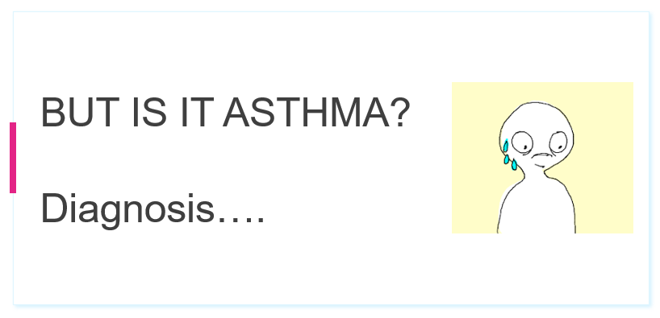
Diagnosis

Slide 8
Review the symptoms
Presence of more than one of:
Caused by:
Variable airflow obstruction
Hyperresponsiveness and airway inflammation
Wheeze
Breathlessness
Chest tightness
Cough
Notes:
Emphasise the variable nature of the symptoms.
1. BTS/SIGN 153. British guideline on the management of asthma. 2016.

Slide 9
Clinical features that increase probability of asthma
Frequent and recurrent
Are worse at night and in the early morning
Occur in response to, or are worse after, exercise or other triggers, such as exposure to pets, cold or damp air, or with emotions or laughter
Occur apart from colds
Personal history of atopic disorder
Family history of atopic disorder or asthma
Widespread wheeze on auscultation
History of improvement in symptoms or lung function in response to adequate therapy
Notes:
Also:
Personal history of atopic disorder
Family history of atopic disorder or asthma
Widespread wheeze on auscultation
History of improvement in symptoms or lung function in response to adequate therapy

Slide 10
Clinical features that lower probability of asthma
Symptoms with colds only
Isolated cough in absence of wheeze or difficulty breathing
History of moist cough
Prominence dizziness, light headedness, peripheral tingling
Repeatedly normal chest exam when symptomatic
Normal peak expiratory flow or spirometry when symptomatic
No response to trial asthma therapy
Significant smoking history (i.e. >20 pack-years)
Notes:
Also:
Personal history of atopic disorder
Family history of atopic disorder or asthma
Widespread wheeze on auscultation
History of improvement in symptoms or lung function in response to adequate therapy

Slide 11
Reasons to refer to specialist
Persistent wet or productive cough
Family history of unusual chest disease
Failure to thrive
Unexpected clinical findings e.g. focal signs, abnormal voice or cry, dysphagia, inspiratory stridor
Nasal polyps
Failure to respond to conventional treatment (particularly inhaled corticosteroids above 400 mcg/day or frequent use of steroid tablets)
Recurrent severe upper respiratory tract infection
Excessive, recurrent gastric reflux, indigestion, vomiting
Notes:
Also:
Personal history of atopic disorder
Family history of atopic disorder or asthma
Widespread wheeze on auscultation
History of improvement in symptoms or lung function in response to adequate therapy

Slide 12
Consider additional diagnoses
Rhinitis:
Allergic
Nonallergic
Polypoid
Hyperventilation
Glottic dysfunction
Chronic sinusitis
Asthma
Psychopathologies
Obesity
Reflux
Hormonal disturbances
Other conditions:
Atopic dermatitis
Eczema
Respiratory infections
Image reproduced from: Boulet LP. Eur Res J. 2009; 33:897–906.
Notes:
Rhinitis and chronic sinusitis:
Most allergic asthma patients (up to 95%, according to some studies) also suffer from rhinitis
GORD:
Most asthma patients report GORD symptoms and/or have an abnormal oesophageal 24-hour pH test; however, improvement in asthma following GORD treatment is variable
Obstructive sleep apnoea:
Relationship with asthma not well-defined; associated with upper and lower airway inflammation, and airway collapsibility may be increased
Weight loss usually improves both sleep apnoea and asthma
Hormonal disturbances:
In up to 40% of female patients, asthma worsens during the pre-menstrual period (possibly due to reduced response to ICS and bronchodilators)
Psychopathologies:
May trigger asthma symptoms, affect patients’ perception of their asthma symptoms, and affect adherence to therapy
Hyperventilation and glottic dysfunction:
May mimic asthma, and are often associated with anxiety or other psychopathologies
Atopic dermatitis:
Risk factor for asthma; often associated with severe forms of asthma
Boulet LP. Eur Res J. 2009; 33:897–906.

Slide 13
Diagnosing asthma – BTS/SIGN guidelines
Structured clinical assessment, looking for:
Recurrent episodes of symptoms Recorded observation of wheeze Symptom variability
History of atopy No symptoms of alternative diagnosis Record of variable PEF or FEV₁
High probability of asthma
Intermediate probability of asthma
Low probability of asthma
Code as: suspected asthma
Test for airway obstruction
spirometry and bronchodilator reversibility
Initiation of treatment
Poor response
Investigation options:
Other diagnosis unlikely
Assess response objectively
(lung function/validated symptom score)
Reversibility
PEF chart
Challenge tests
FeNO
Blood eosinophils
Skin-prick/IgE
Investigate/treat for other more likely diagnosis
Good response
Good response
Poor response
Suspected asthma:
Watchful waiting (if asymptomatic) or commence treatment access response objectively
Asthma
Other diagnosis confirmed
Adjust maintenance dose. Provide self-management. Arrange ongoing review
1. BTS/SIGN 153. 2019.
Notes:
BTS/SIGN guidance is more closely in line with PCRS-UK’s recommendation that NICE is.
This is from the 2016 guideline. In patients presenting with respiratory symptoms (wheeze, cough, breathlessness and chest tightness), probability of asthma is determined based on the structured clinical assessment (based on recurrent/variable symptoms, wheeze, atopy, variable PEF or FEV1 readings, and the absence of symptoms suggesting another diagnosis).
In children under 5 and others unable to undertake spirometry in whom there is a high or intermediate probability of asthma, the options are: monitored initiation of treatment or watchful waiting according to the assessed probability of asthma.

Slide 14
Calculating PEF variability
Highest reading – Lowest reading
x 100 =
Variability
Average reading
EXAMPLE: 4 readings taken in a single day: 590, 580, 550, 480 L/min (average: 550)
590 – 480
x 100 =
20.0%
550
Upper limit of normal variability is 20% if using 4 readings/day (may be lower for 2 readings)

Slide 15
IT IS ASTHMA!

Slide 16
Perform a structured review
Smoking Ask every patient, every time – don’t assume their status
Inhaler technique Major cause of poor control
Monitoring E.g. Royal College of Physicians’ ‘3 questions’
Pharmacotherapy Review current prescriptions; consider stepping up or down
Lifestyle Exercise, diet, alcohol – but also vaccines and comorbidities
Education Knowledge, medication, self-monitoring, emergency plan
Support Don’t forget the parents
SIMPLE Framework originally proposed by Anna Murphy, Consultant Respiratory Pharmacist. Ryan D, et al. Prim Care Resp J. 2013; 22:365–73.
Notes:
SIMPLES is a memory aid for clinicians on how to perform a structured review – but the review should be focused on the patient’s needs, including their ideas, concerns and expectations.
Smoking: always ask, even if a patient has been listed as a ‘non-smoker’ at their last 10 reviews. Offer smokers assistance in smoking cessation.
Inhaler technique: correcting technique can significantly improve asthma control.
Monitoring: evaluate patients’ report of symptoms. Encourage patients to self-monitor symptoms and lung function between reviews
Pharmacotherapy: ‘current prescriptions’ includes treatment for comorbidities (eg NSAIDs).
1. Ryan D, et al. 'SIMPLES': a structured primary care approach to adults with difficult asthma. Prim Care Resp J. 2013; 22:365–73.
2. Pinnock H, et al. Prim Care Resp J. 2010; 10(9)

Slide 17
Teenage compliance
Focusing on these three situations:
Teenagers
Shape of certain inhaler types¹
Personal or peer preference¹
Portability
1. De Simoni A, et al. BMJ Open. 2017; 7:e015245.

Slide 18
Maintaining technique between reviews: what helps?
Inhaler technique
Inhaler labels:¹ personalised reminder labels help maintain technique
Videos:² eg UK Inhaler Group, Asthma UK, RightBreathe
Local pharmacist:³ pharmacists have regular contact with patients and can help maintain inhaler technique
1. Basheti I et al. npj Prim Care Res Med 2017;27:9; 2. Müller T et al. Respir Med 2017;129:140-44; 3. Ruud K et al. Patient education and counselling 2018;101:1828-37.
Notes:
People are different in the ways they learn. Patients who learn best through reading may benefit from inhaler labels, reading the patient information leaflet or using the inhaler technique cards. Others may learn better using visual tools such as videos.
Below are a few studies demonstrating the effectiveness of different tools:
Inhaler labels: in one study, patients who were issued with personalised inhaler technique reminder labels had better technique three months later than those who were not.
Videos: after having watched the video, 76% of patients with incorrect inhaler use demonstrated correct inhaler use. 72% of patients still used their inhalation devices correctly at follow-up.
Local pharmacist: a study conducted in Norway investigated whether the inhalation technique improved among patients with asthma and COPD through an inhalation technique assessment service at local pharmacies. Inhalation technique improved significantly for both new and experienced users and all assessed devices. The technique remained significantly improved at follow-up.
As yet, there are few studies on the efficacy of apps.
Basheti I et al. Effect of novel inhaler technique reminder labels on the retention of inhaler technique skills in asthma: a single-blind randomized controlled trial. npj Prim Care Res Med 2017;27:9.
Müller T et al. Optimizing inhalation technique using web-based videos in obstructive lung diseases Respir Med. 2017;129:140-44. https://www.sciencedirect.com/science/article/pii/S0954611117301750
Ruud K et al. Evaluation of a structured pharmacist-led inhalation technique assessment service for patients with asthma and COPD in Norwegian pharmacies. Patient education and counselling 2018;101(10):1828-37. https://www.sciencedirect.com/science/article/pii/S0738399118302581

Slide 19
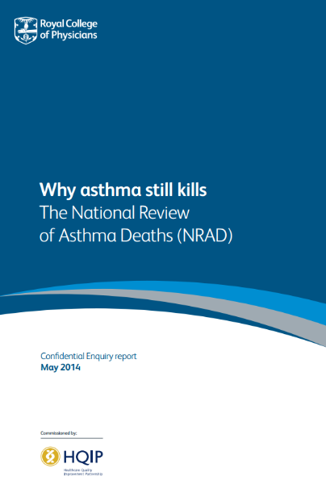
Why is a PAAP important?
In a review of asthma processes in 135 GP practices:
Of 195 patients who died of asthma, only 24% (33/195) had been provided with a PAAP¹
Self-management, including a written asthma action plan and regular medical review:²
almost halves the risk of hospitalisation
significantly reduces emergency department attendances and unscheduled consultations
improves asthma control and quality of life
‘Wider use of PAAPs has the potential to prevent death from asthma’
1. Royal College of Physicians. Why asthma still kills: National Review of Asthma Deaths 2014; 2. Pinnock H. Breathe 2015:11:99–109.

Slide 20
Personalised Asthma Action Plans
Use details from the patient’s individual experience of asthma as a foundation for their PAAP
Use the patient’s language in consultation and design of PAAP
Make it simple or complex according to the patient’s own understanding

Slide 21
Patient X: example of a PAAP
Understands when asthma is well controlled
I can climb two flights of stairs without difficulty
Describes different stages of worsening asthma
If I’m getting breathless climbing the stairs, my asthma is getting worse
If I can’t speak properly, I know my asthma has got really bad
Recollects timescales of previous asthma episodes
Understands how and when to step up asthma medicines
If I am getting breathless climbing the stairs, I will take my reliever more regularly and double my preventer dose
Understands when to seek medical advice/emergency help
If I wake up in the night coughing, I should make an appointment to see my GP that day
Will call 999 if I’m not able to speak properly
It usually takes two to three days for me to go from having difficulty climbing stairs to not being able to talk properly
Adapted from Newell K, Lawlor R. Nursing Times 2015;111:12-15.
Notes:
Emphasise that this is for this individual patient. She knows she is well when she is able to do certain daily activities (eg climbing two flights of stairs, speaking fluently, sleeping silently, kneeling down to pray, cycling/walking to work).
Patients’ preferences in monitoring their own health and their perceptions of being ‘well’ or ‘unwell’ will vary – ensure every patient knows what the plan means for them.
Point out that many patients will only be able to self-manage as far as step two or three - if that‘s the case, their plan should go no further.
Some patients choose to use PEF recordings to monitor their asthma, while others prefer to keep a watchful eye on their symptoms. For each patient it is different. If your patient does keep a record of PEF you can include peak flow readings in their PAAP. If they don’t, the PAAP might be more symptom orientated.
COPD plan would differ only in terms of recognising the usual symptoms when well as very few COPD patients will ever be asymptomatic.
1. Newell K, Lawlor R, Bunce R. Co-creating personalised asthma action plans. Nursing Times 2015; 11(18):12–14.

Slide 22
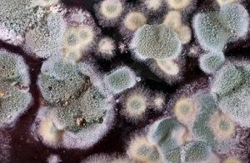
Triggers
Infections like colds and flu
Allergies eg pollen, dust mites
Smoke, fumes and pollution
Medicines e.g. salbutamol, ibuprofen, aspirin
Emotions eg stress, laughter
Weather eg cold air, humidity
Mould or damp
Exercise
1. https://www.nhs.uk/conditions/asthma/causes/
Notes:
Once the patient knows their triggers, they can try to avoid them, which may help control their asthma symptoms.
https://www.nhs.uk/conditions/asthma/causes/

Slide 23
A PAAP can be completed…
Key questions for patient or parent/carer to consider:
What are your asthma triggers?¹
How well is your asthma currently being managed? What is your best peak flow?¹
What are the names of your medications? When do you need to use these?²
How do you feel when you are having an asthma attack?²
What should you do when you are having an asthma attack?²
…on a sheet of paper
…in an email
…on the back of an envelope
…in a video recording
PCRA, 2020
Notes:
Video recording should never replace written PAAP, but it is recognised it can be useful if the patient can neither read nor write.

Slide 24
Children’s asthma in primary care: the Tower Hamlets experience
Dr Julia Moody, Tower Hamlets Together
Julia.moody@nhs.net

Slide 25
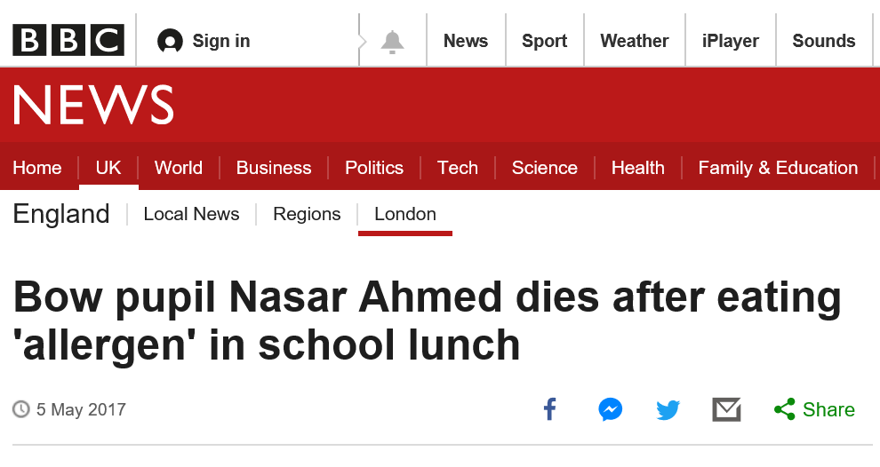
Headlines

Slide 26
Utilising QI methodologies
To improve outcomes for CYP
with wheeze and asthma in TH
Rita Araujo – Children’s Transformation Manager
Katie Cole – Associate Director of Public Health
Tori Hadaway – Specialist Asthma Nurse
on behalf of THT – Born Well Growing Well
www.towerhamletstogether.com
#TH2GETHER

Slide 27
Themes: Engagement with families
Lack of information from health professionals, need for holistic approach, review after hospital attendance valued
Air Pollution interface
Creating asthma awareness - needs to be system wide, written and verbally
Management in Schools - good place for peer support, lack of awareness/knowledge

Slide 28
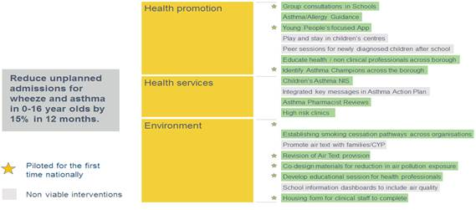
The programme

Slide 29
Overarching outcomes
2017 - 40% of CYP with diagnosis of asthma had an Asthma Action Plan >> 2019 - 75% of CYP with diagnosis of asthma had an Asthma Action Plan
Number of CYP with diagnosis of asthma increased by 1% (2018 to 2019) – currently at prevalence of 5%
Identified 503 CYP who were at risk of having an asthma attack
ACT scores improved for 92% CYP reviewed twice
757 professionals educated across the system with increase in confidence and knowledge levels
Our target of reducing non-elective/planned admissions for CYP with wheeze/asthma by 15% has been surpassed by reducing this by 22% in the last 12 months

Slide 30
Next steps?

Slide 31
Children’s Asthma in Primary Care

Slide 32
Could do better?

Slide 33
Always!

Slide 34
SHARED (AMAZING) GUIDELINES
https://drive.google.com/file/d/1a-XKLJqORFGm0VoD8SKTtknEX4Z5-kMs/view

Slide 35
EMIS template
Linked self populating self management plan

Slide 36
Network Incentive Schemes
Asthma Reviews annually
Increased Management Plans from 40% to 75%
Case finding searches; to increase prevalence
Prescribing; to review correct spacer prescribing

Slide 37
Trigger tools

Slide 38
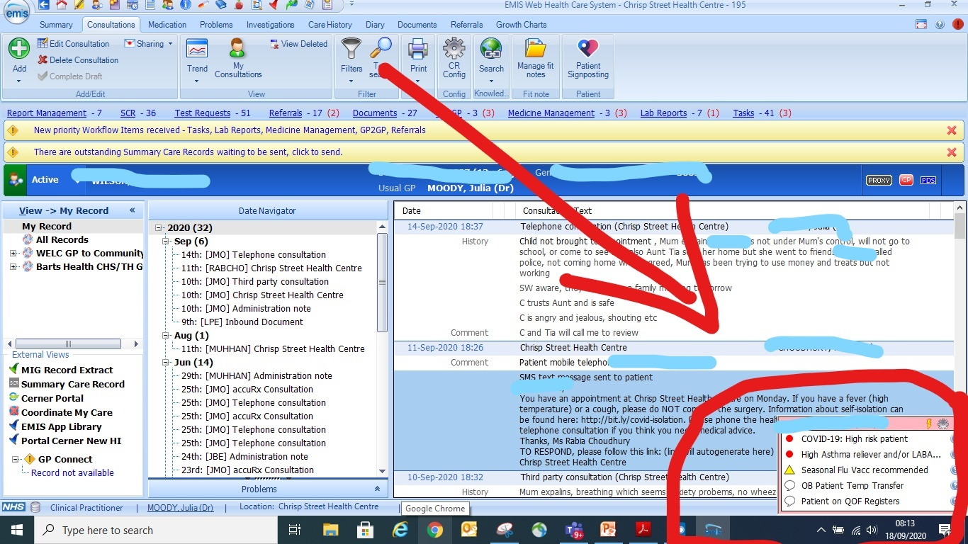

Slide 39
Management plans

Slide 40
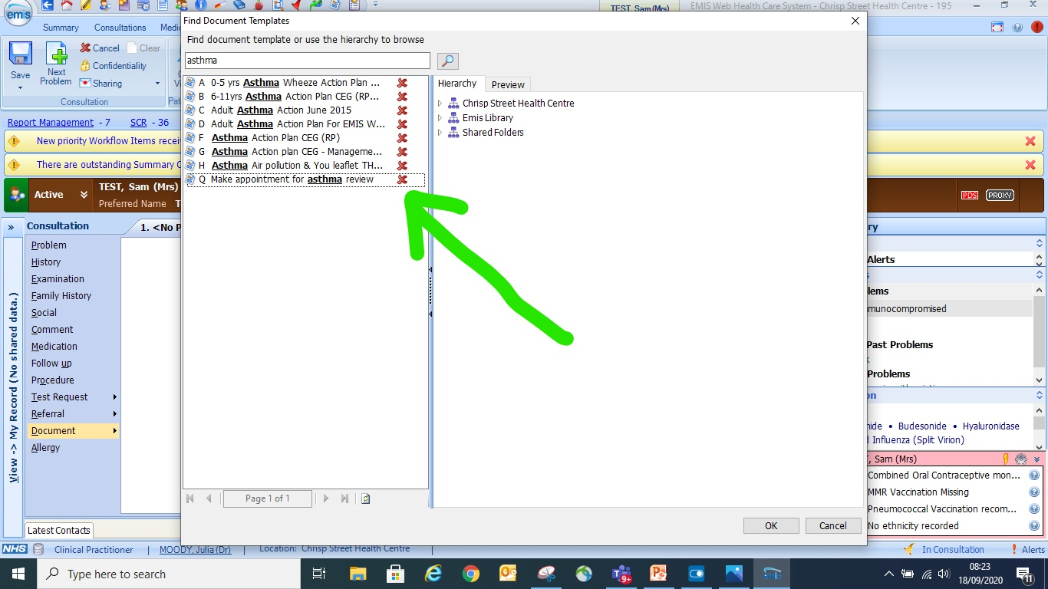

Slide 41
48-hour reviews
10% of asthma deaths had an admission in the past month (NRAD)
26% of asthma admissions have a review within 48hrs (Asthma UK)

Slide 42
Barriers
Whose job is this?
Who knows that it needs to be done?
What exactly needs to be done?
Is there any point?

Slide 43
48 Hour Telephone Triage Tool
Formulated by and grounded in expert experience of:
PPC Nursing Team
Dr John Moreiras, Paediatric Consultant
Whittington Health Asthma Team
Scores for Breathing, Progression, Salbutamol use and Peak Flow
Generates total score
Notes:
This is the tool

Slide 44
Patients who did not receive any form of 48 review were…
48 Hour Telephone Triage Tool
2.5 times more likely to re-attend A&E
3.8 times more likely to be re-admitted
Notes:
“Not contactable” group is not a perfect control
Were some patients “not contactable” because they had re-attended A&E when attempt to contact was made?
Other confounders?
Numbers of re-attendance / readmission are small
But further data exists…
Note these outcomes are context specific
which part of the process provides the benefit?

Slide 45
What good came from Covid-19?
Tower Hamlets GP Care Group
Covid home monitoring service, tds reviews by ANPs, supported by OOH hubs
Extending to include asthma and wheeze reviews

Slide 46
Barriers
Getting a daily list out of the hospital
Robust training and quality monitoring
Workforce

Slide 47
And next?
More training….
Locality Paediatricians supporting “Health Around the Child“ Model, MDTs in Primary Care
Maintain Paediatric Hotline, PRAC, A+G
Assessing quality of reviews
Where are the other 4%?

Slide 48
All the work we do with our partners moves us closer towards our goal to make London the healthiest global city.
www.healthylondon.org
england.healthylondon@nhs.net
@healthyLDN

