Slide 1
Supporting the older child: transition to adult care and the relationship between anxiety and asthma
Sara Nelson (Chair), Sam Prigmore & Fran Beresford

Slide 2
Joining instructions/Teams etiquette
Use the mute button and camera off when you join the call or when others are talking
Raise your hand up if you want to speak during the Q&A session
Use the group chat feature to ask questions
This session is being recorded. A link will be available on the HLP website with any slides
2

Slide 3
Agenda
Presenter | Affiliation | Subject
Sam Prigmore | St Georges Hospital | Adolescent to Adults: Tips on transition
Fran Beresford | Royal Brompton Hospital | Asthma and anxiety in children and young people

Slide 4
Adolescent to Adults: Tips on Transition
Sam Prigmore
Consultant Respiratory Nurse (Adult)
St George’s Hospital, Tooting

Slide 5
And a survivor …..!!

Slide 6
The UK has the highest asthma mortality rate among young people aged 10–24 among the European countries
The second highest among 15- to 19-year-olds.
Shah et al (2019) Nuffield Trust

Slide 7
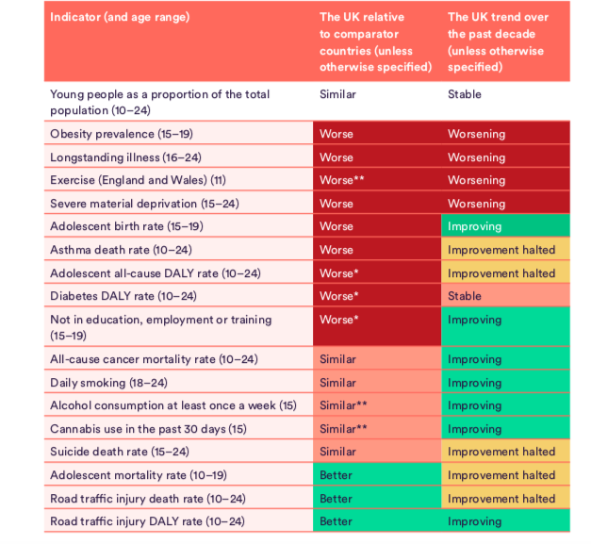
Shah et al (2019) Nuffield Trust

Slide 8
N= 28 children and young people (10-19 years old n = 18)
In children and young people, poor recognition of risk of adverse outcome was found to be an important avoidable factor in:
70% children and 83% young people in primary care
29% children and 33% young people in secondary care.
Inadequate care in 48% of cases

Slide 9
Levy et al 2019 British Journal of General Practice

Slide 10
NICE guidance on transition
Over-arching principles:
Involvement of young people in development of services
Developmentally appropriate
Person-centered approach
Health and social care integrated
Transition planning
Not rigid age threshold
Annual meeting
Named key worker to coordinate
NICE NG43 Feb 2016

Slide 11
NICE guidance on transition
NICE guidance on transition
Support before transfer
Joint appointments, clinic with adult services
Parental involvement
Care plan
Support after transfer
Same practitioner in adult services (x2) after transition
Support infrastructure
Management accountability for strategy and policies
NICE NG43 Feb 2016

Slide 12
NICE Quality Standards for Transition
Five Quality Standards:
Planning Transition
13-14yrs old onwards
Annual meeting
Named worker
Introduction to adults’ service
Missed first appointment after transfer to adult service
NICE QS 140 Dec 2016

Slide 13
Proactive Care
Named professional
Support to manage themselves
Smoke-free environments
Exercise opportunities
Accessible Care
Timely diagnosis
Prompt access to their inhaler
Immediate medical care, advice and medicines
High-quality, evidence based care
Co-ordinated Care
Asthma management plan
Regular structured reviews
Commissioned care package
Real time information sharing
Structured, formalised transition process from child to adult care to ensure children do not fall between the gaps
Healthy London Partnership’s Children and Young People Programme Aug 2020

Slide 14
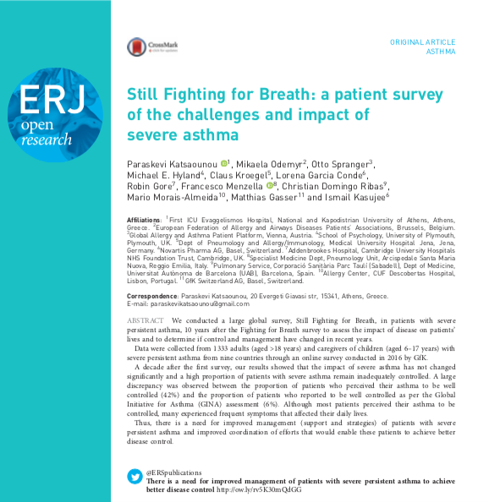
Katsaounou et al 2018 ERJ Open Res; 4:0076-2018

Slide 15
Katsaounou et al 2018 ERJ Open Res; 4:0076-2018

Slide 16
Katsaounou et al 2018 ERJ Open Res; 4:0076-2018

Slide 17
Meet some typical patients
David
16 years old
Atopic asthma
Numerous
admissions
Never intubated
Grace
17 years old
Premature -28/40
Atopic asthma
Multiple food allergies
Anaphylaxis in past
Micha
17 ½ years old
Atopic asthma
Numerous
admissions
Intubated x 2 in last
year

Slide 18
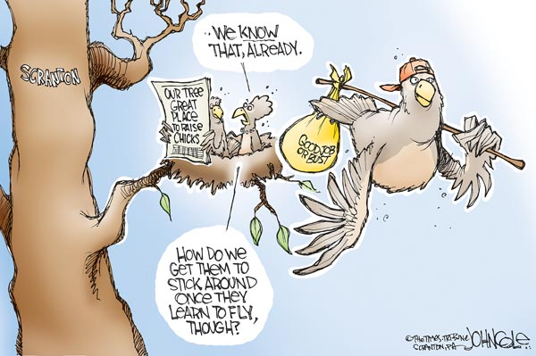
In Preparation…….
Understanding of asthma, triggers, exacerbations
Self management
How and when to get help

Slide 19
Considerations
Risky behaviours
Smoking
Drugs
Alcohol
Responsibilities
Management plans
Asthma
Allergies
Skin
Long term conditions
Stresses of life!
GCSE/ A levels
Family dynamics
Peer pressure
Relationships

Slide 20
David
David
16 years old
Atopic asthma
Numerous admissions
Never intubated

Slide 21
Adherence is an issue ….
WHO Adherence to long-term therapies: evidence for action WHO ISBN 92-4-1545992 http://www.who.int/chp/knowledge/publications/adherence_full_reportpdf
Breekveldt-Postma. Respiratory medicine. 2004;98(8):752-9.
Haupt Pharmacy World & Science. 2008 2008/10/01;30(5):509-14.
Asthma UK http://www.asthma.org.uk/how-we
Ranges from 30-70%
Particular problem in children and adolescents¹
In trials 70-90%, In real life ˂50%^{2, 3}
Analysis of prescription records of people with difficult asthma. A third of people used less inhaled medication than prescribed⁴

Slide 22
Management considerations
Medications
Adult doses
Adult care
Outpatients
Inpatients
Communication
Email / phone

Slide 23
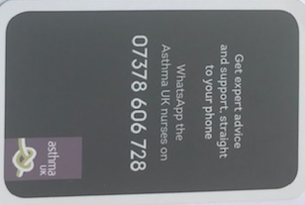
Management considerations

Slide 24
COVID messages
Social distancing
Face covering
Hand hygiene
Self isolation
Regular preventer treatment
Influenza vaccination

Slide 25
Grace
Grace
17 years old
Premature – 28/40
Atopic asthma
Multiple food allergies
Anaphylaxis in past

Slide 26
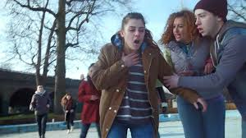

Slide 27
Micha
Micha
17 ½ years old
Atopic asthma
Numerous admissions
Intubated x 2 in last year

Slide 28
Tips for parents
Acknowledge letting go can be hard!
Support for them!
Independence
Let teenager speak!
Solo appointments
Requesting prescriptions
Acute exacerbations
Permission
E.g. prescriptions,
Information from HCP

Slide 29
Asthma UK

Slide 30
Anxiety in Young People with Asthma
Dr Fran Beresford
Clinical Psychologist
Royal Brompton Hospital

Slide 31
Prevalence of Mental Health Difficulties
Mental Health Difficulties
10% of children (age 5-16) suffer from clinically significant mental health illness
People with a chronic health condition have 2-6x higher risk of mental health illness
Maternal depression is associated with 5x risk of child having mental health illness
Public Health England (Dec 2016). The mental health of children and young people in England

Slide 32
Prevalence of Mental Health Difficulties
Anxiety in Young People with Asthma
One in 5 adolescents with asthma have an anxiety disorder
Adolescents with asthma 3 times prevalence of anxiety disorders than found in healthy young people
J Dudeney et al. Pediatric Pulmonology. 2017;9999:1–9 Anxiety in youth with asthma: A meta-analysis
Anxiety in Parents of Children with Asthma
parents of children and young people with asthma have higher levels of anxiety than parents of those without
evidence indicating that mothers who were stressed during pregnancy were more likely to have young children who developed asthma
G Easter et al. J Pediatr Psychol. 2015;40:1–10. Systematic review and meta-analysis of anxious and depressive symptoms in caregivers of children with asthma. & Roy-Byrne et al. Anxiety disorders and comorbid medical illness. Gen Hosp Psychiatry. 2008;30: 208–225.

Slide 33
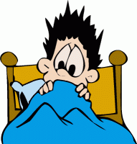
Anxiety – What is it?
Anxiety is an innate adaptive response to danger
The Fight or Flight response is an evolutionary response from our ancestors.
When our ancestors were cavemen, they had to be alert to protect themselves against predators: It was survival of the fittest.
The amygdala is the part of the brain that manages the Fight or Flight reflex that keeps us safe
Modern day threats include spiders, the dark and illnesses
Fight or Flight triggered adrenaline release
This influences physical feelings, behaviours & thoughts

Slide 34
Co-morbidities
Asthma
Anxiety/Fear/Worry
/Stress
Difficulties at school
Psychosocial problems
Medication side-effects
Dysfunctional breathing
Other health problems
‘I can’t breathe’
Complex Asthma

Slide 35
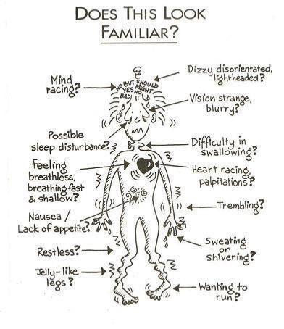
Fight or flight response
Physical sensations of anxiety

Slide 36
What behaviours do we see due to anxiety?
Reluctance to engage in exercise
School refusal/poor attendance
Reduced socialising
Over reporting/under-reporting of symptoms
Disturbed sleep
Over-dependence on salbutamol
Parents very protective
Impact on independence
Arguments, anger
Risk taking

Slide 37
Some worries described by young people with asthma
‘what will happen if I don’t get help quickly enough?”
‘what if people don’t know what to do?’
‘I hate needles’
‘I don’t want to look weak in front of my friends’
‘if I exercise it could trigger an asthma attack’
‘I’m embarrassed to use my inhaler in front of people’
‘I don’t want to have asthma’
‘my breathing feels tight, I could die’

Slide 38
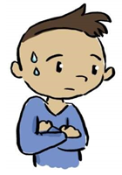
What can anxiety look like in young people?
1. Anger
6. Avoidance
3. Defiance or acting out
2. Difficulty Sleeping
5. Lack of focus
4. Emotional reactivity
7. Over planning
Adapted from www.gozen.com
Notes:
Some preteens and teenagers respond to worrying situations by acting out.
This could include reckless driving, and alcohol or drug use.
Others may become afraid to leave the home. They may cut back on how much time they connect with their friends. They can feel overwhelmed by their intense emotions and feel unable to talk about them. Their emotions may lead to increased arguing and even fighting with siblings, parents, carers or other adults. They may have concerns about how the school closures and exam cancellations will affect them.
Identifying anxiety in adolescents – use of HADS, PIED

Slide 39
Anxiety related to COVID-19
I can’t breathe in a mask
What if catch COVID
Education
Manage news & social media
Connect with others
Help others
Exercise
Focus on things you enjoy
Impact of others mood
What if I pass it on to my Gran
https://www.mentalhealth.org.uk/coronavirus/coping-coronavirus-guide-young-people
https://nhsforthvalley.com/wp-content/uploads/2020/04/COVID-19-Resource-pack-overs-its-ok-to-worry-about-coronavirus.pdf
Notes:
Higher rates of anxiety and depression in girls – related to COVID
Higher levels of depression in older adolescents
Chen et al. Brain Behav Immun. 2020 Aug; 88: 36–38. Depression and anxiety among adolescents
during COVID-19: A cross-sectional study.

Slide 40
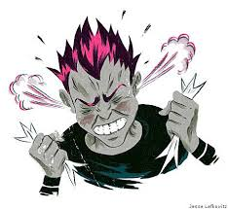
Talking with young people
How to listen so they will talk and talk so they will listen….a skill!
Give enough time
Be aware of wording of questions (e.g. use their words)
Use multiple choice questions, use ranking questions
(e.g. if 0 = worst you have ever felt and 10 = the best)
Name feelings and check-in with their experience
Teenagers respond better to suggestions
Offer hunches - “I imagine that must have upset you a lot”
Offer commonalties – “lots of people I speak to say that…”
Motivational Interviewing - https://new-learning.bmj.com/course/10051582
Notes:
Useful ways of wording questions –
If they use puffer, check which inhalers they are using it to refer to and you then also use puffer
What do you think would make a difference
If you were advising a friend what would you say

Slide 41
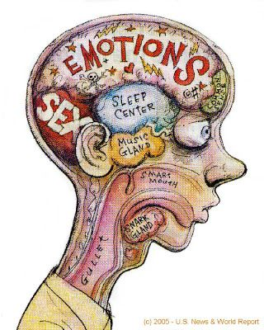
Normal developmental changes during adolescence
Social
Spend more time with friends
Thinking and Learning
Risk taking
Emotional
Strong emotions
Independence form parents
Thinking and Learning
More concern about future
Developing independent opinion
Egocentricity
Physical
Growth
Hormones
Sexuality

Slide 42
Impact on normal development for YP with asthma
Parents protective, gaining independence is more difficult
Fear of asthma attack
Side effects of medication – shaking, impact on growth
Ability to keep up with peers – around allergens, exercise, getting tired
Hospital appointments
Impact of risk taking – greater consequences
Impact on education

Slide 43
Transition – the highs and lows
Feeling ready and prepared
Change can be difficult
Service differences – age (14, 16, 18, 21 or 24)
Expectations of young person, parents, service
Adherence
Parent anxiety
Young person needs to be proactive in seeking help
Ward based care

Slide 44
What can we do to help manage anxiety?
Listen and acknowledge
Provide clear information about the situation
Be aware of your own reactions
Connect regularly
Create healthy routines
Limit exposure to media and talk more about what they have seen and heard
Emotional regulation

Slide 45
What can we do to help manage anxiety?
Psychoeducation of anxiety
Fight Flight Freeze – Anxiety Explained For Teens
https://www.youtube.com/watch?v=rpolpKTWrp4
Clear understanding of asthma
Good inhaler technique
Asthma Plans
Breathing techniques
Mindfulness
Therapy – Counselling, CBT, Graded Exposure

Slide 46
Therapy – where to access support
Within hospital
Paediatric Psychology Service
Play Team
CNS with training
CAMHS/Child Well-being Services
The Children and Young People’s Improving Access to Psychological Therapies - https://www.england.nhs.uk/wp-content/uploads/2014/12/delvr-with-delvrng-well.pdf
GP counselling services
School counselling services

Slide 47
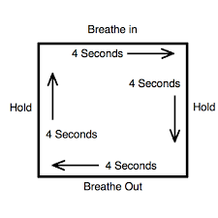
Breathing exercises
Mindfulness
www.headspace.com
https://www.bemindfulonline.com
Take 5 – finger breathing
https://www.youtube.com/watch?v=sh79w9pn9Cg
Box breathing
https://www.youtube.com/watch?v=Idx_XHS0xS0

Slide 48
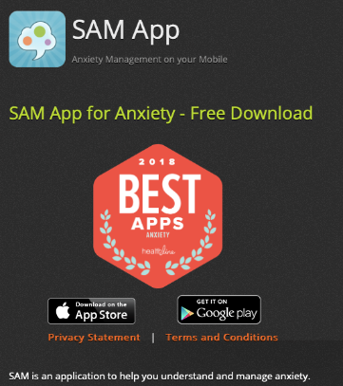
Anxiety management resources
Websites/Organisations
Young Minds:
https://youngminds.org.uk/find-help/conditions/anxiety/#treating-anxiety
NHS Choice:
https://www.nhs.uk/conditions/stress-anxiety-depression/anxiety-in-children/
Mental Health Foundation:
https://www.mentalhealth.org.uk/sites/default/files/anxious_child.pdf
Childline:
https://www.childline.org.uk/info-advice/your-feelings/anxiety-stress-panic/
Anxiety UK:
https://www.anxietyuk.org.uk/get-help/anxiety-information/young-people-and-anxiety/
Apps (psyberguide.com)

Slide 49
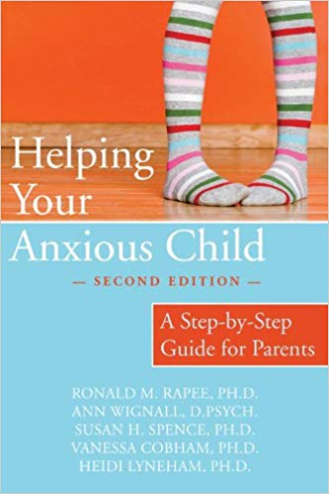
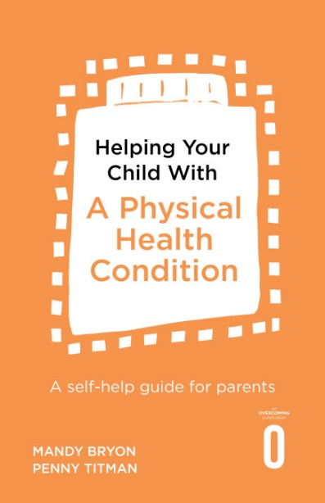
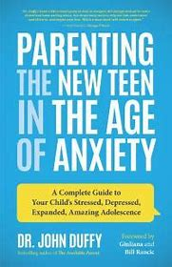
Recommended reading
Books for Parents
Books for Young People
https://www.youtube.com/watch?v=4ShU5BQAxJ8

Slide 50
The End
Any Questions?

Slide 51
All the work we do with our partners moves us closer towards our goal to make London the healthiest global city.
www.healthylondon.org
england.healthylondon@nhs.net
@healthyLDN

