Slide 1
#AskAboutAsthma – in the time of Covid
Virtual conference

Slide 2




Joining instructions/Teams etiquette
Use the mute button and camera off when you join the call or when others are talking
Raise your hand up if you want to speak during the Q&A session
Use the group chat feature to ask questions
This session is being recorded. A link will be available on the HLP website with any slides
2

Slide 3
Agenda for today
Time | Topic | Speaker
9:00 | Welcome, context and aims of the morning | Oliver Anglin, Chair of London Asthma Leadership & Innovation Group
9:15 | Clinical update and launch of the refreshed London Asthma Standards | Richard Iles, Consultant in Paediatric Respiratory Medicine, ELCH
10:00 | Update from the national team | Matthew Clarke, National Speciality Advisor Children and Young People, NHSE/I
10:30 | Same Day Emergency Services: launch of a new 111 paediatric asthma pilot | John Moreiras, Whittington Health; Giles Armstrong & Roland Bensted, Barts Health
11:00 | Learning from Covid-19- updates from across London: SEL SWL NEL NCL NWL | STP/ICS Clinical/Commissioning Leads - Amy Westpfel, Rebecca Kalamchi, Sarah Allmark, Richard Iles - Richard Chavasse, CHAH asthma nurses - Rita Araujo, Lynda Hassell - Sam Rostom, Oliver Anglin - Claire Galvin, Stephen Goldring
12:40 | Back to school and Covid | Heather Robinson & Emily Guilmant-Farry LB Newham & ELFT
13:10 | Reflections and next steps | Oliver Anglin

Slide 4
Agenda for this week
PHARMACY DAY | CHILDREN & YOUNG PEOPLE AND THEIR FAMILIES/CARERS | VIRTUAL CONFERENCE DAY | NURSES DAY | PRIMARY CARE DAY | WIDER SYSTEM | AIR QUALITY
Mon 14 Sept | Tue 15 Sept | Wed 16 Sept | Thurs 17 Sept | Fri 18 Sept | Sat 19 Sept | Sun 20 Sept
WEBINAR 1.30-2.30 PM | WEBINAR 12.30-1.30PM | VIRTUAL CONFERENCE 9-1.30PM | WEBINAR 12.30-1.30PM | WEBINAR 12.30-1.30PM | PODCAST | PODCAST
Air pollution, your patients and you - (run by Tower Hamlets and Global Action Plan) | Supporting the older child: transition to adult care and the relationship between anxiety and asthma | In the time of Covid | How specialist nurses can support 3 asks and improve asthma care across the system | Why is good primary care essential for CYP asthma? | Learning from the Tower Hamlet asthma programme | Air quality - what have we learned from Covid? Jonathan Grigg
PODCAST | PODCAST | PODCAST | PODCAST | PODCAST | BLOG | BLOG
How can community pharmacists improve care for young asthmatics? | Ask the Expert session for public/ patients/ parents | New tertiary protocol/referral criteria | Asthma Friendly Schools | Learning from asthma deaths | Developing an asthma network by Stephen Goldring | Protecting children from air pollution at school and beyond by Anthony Mysak
BLOG | BLOG | BLOG | BLOG | BLOG | BLOG | BLOG
Role of the specialist pharmacist: Sukeshi Makhecha, Royal Brompton and Evelina Hospitals | Croydon asthma champion programme, by Jo Massey and Jakki Sutherland, CHAH team | Why do an asthma peer review? By Sam Rostom | Video Group Consultations for children and young people with asthma by Sarah Kavanagh | Painting the picture of better asthma care for children and young people by Dan Devitt | Take a breather by Tori Hadaway | Asthma and indoor air quality by Catherine Sutton
WEBINAR 7.30-8.15PM | BLOG | BLOG | BLOG | BLOG | BLOG
WEBINAR 7.30- 8.15pm Role of pharmacy for CYP asthma during Covid-19 and beyond | Healthier Air Indoors – new resources for families Anne Greenough | How physiotherapy can help an asthmatic child by Charlotte Wells | St Georges Hospital asthma team update by Jo Lawson | How a Network Incentive Scheme can improve CYP asthma diagnosis and care by Tori Hadaway

Slide 5
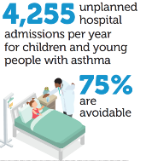









Context: This is the problem
Top 3 ED admissions Age group: 6-15 Spell_Primary_Diagnosis |  |  |  | Mean activity/ month | % contribution
J459: Asthma, unspecified |  |  |  | 14,277 | 5.2%
R103: Pain localized to other parts of lower abdomen |  |  |  | 8,770 | 3.2%
R104: Other and unspecified abdominal pain |  |  |  | 7,930 | 2.9%
3 pupils in every classroom have
asthma
Illness | Age |  |  |  |  |  |  |  |  |  |  |  |  |  |  |  | Total
 | 1 | 2 | 3 | 4 | 5 | 6 | 7 | 8 | 10 | 11 | 12 | 13 | 14 | 15 | 16 | 17
Asthma | 55 | 139 | 179 | 209 | 173 | 162 | 149 | 135 | 140 | 114 | 145 | 89 | 96 | 88 | 110 | 91 | 2074
Breathlessness (Dyspnoea) | 1622 | 1073 | 843 | 566 | 330 | 261 | 176 | 179 | 169 | 135 | 127 | 131 | 114 | 115 | 156 | 141 | 6138
Upper Respiratory Tract Infection | 627 | 430 | 334 | 219 | 155 | 109 | 82 | 79 | 42 | 58 | 46 | 36 | 36 | 47 | 51 | 44 | 2395
Ambulance call-outs: London Ambulance Service, 2019-20

Slide 6
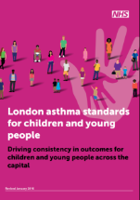

Context: This is the solution
When we work together, this is what can be achieved
Harrow 18% reduction in admissions through HLP audit
NCL whole system peer review: fall in admissions
Islington & Haringey Asthma friendly schools projects (Barnet to follow?)
20
Barnet
Enfield
Hillingdon: CNS role modelling clinics
21
Harrow
Barnet
North
Middlesex
Hillingdon Asthma friendly schools projects
NCL Asthma Network
Waltham Forest
Hillingdon
2
Northwick Park
Haringey
Whipps Cross
Brent
Royal
Free
34
King George
WSIC: Improvements in 3 #AAA areas and more
Whittington
Redbridge
33
19
22
NEL Asthma Network
31
Queen’s
4
Camden
Islington
Homerton
29
Hillingdon
Ealing
UCLH
Hackney
Havering
NWL Asthma Network
Westminster
18
Royal
London
Ealing
Tower Hamlets: increase in asthma diagnoses, fall in admissions
H&F
St Mary’s
City
28
Tower Hamlets
Newham
Barking and Dagenham
Work with Asthma UK on asthma health passport
1
Newham
Charing
Cross
West Middlesex
K&C
48
32
Hounslow
5
6
Southwark
Active CNS Nurses Forum
C&W
St Thomas’
46
49
Richmond
Wandsworth
Lambeth
King’s
Queen Elizabeth
50
Greenwich
Bexley
Greenwich Right care asthma project
Testing Asthma dashboard and templates
62
60
Lewisham
Kingston
St George’s
Lewisham
SEL Asthma Network
Kingston
Merton
St George’s emergency school bags
61
63
Croydon
St Helier
Bromley
Epsom
Sutton
Croydon
Princess Royal
Asthma networks in 4/5 STP/ICS areas of London
Wandsworth & Merton Asthma friendly schools projects
47
GP pilots – use of pharmacists for inhaler technique
Hammersmith & Fulham CCG
Bexley CCG
Islington CCG
More CNS in every STP area of London
6

Slide 7
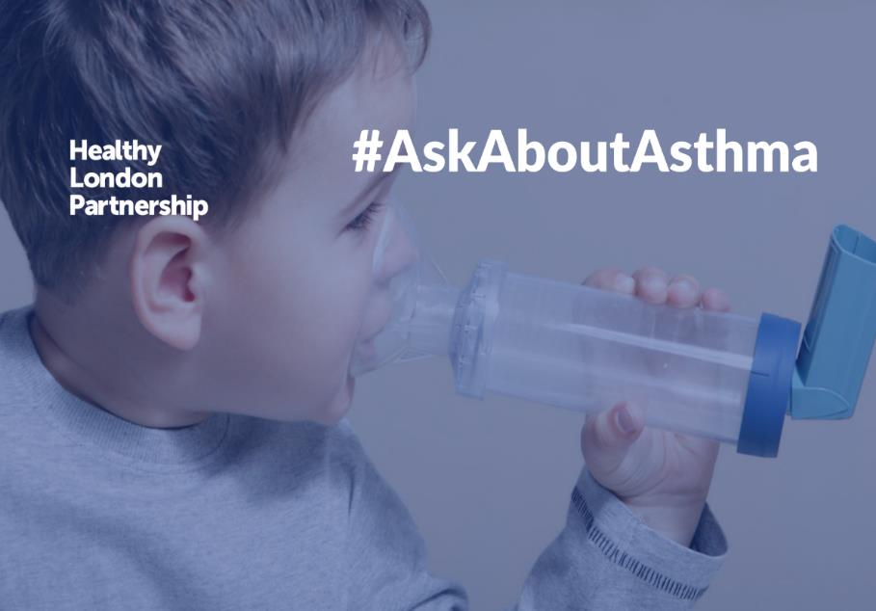
Mentimeter
If you have to leave before today’s virtual conference ends, please let us know what you’re going to take away from it – go to menti.com and enter code 25 88 88 5

Slide 8
The New (2020)
London asthma standards for children and young people
& “Clinical Update”
Dr Richard Iles
Consultant in Respiratory Paediatrics
ELCH

Slide 9
New (2020) London asthma standards for CYP
This revision was begun in the weeks before the COVID-19 pandemic. The months that followed impacted on service provision that could not have been envisaged at project commencement. Services have flexed to accommodate dramatic change overnight and are now further modifying into the “New Normal”. We plan a further document revision by the end of 2021 after a period of stabilisation and assessment.
This document is not another set of guidelines but aims to bring together some of the principles from all the other documents to aid their implementation and help drive up care for children with asthma or acute viral induced wheeze in London:
Royal College of Physicians (2014) National review of asthma deaths www.rcplondon.ac.uk/projects/national-review-asthma-deaths
Global Initiative for Asthma (GINA) (2018) Global Strategy for Asthma Management and Prevention (Section 2: Children 5 years and younger) https://ginasthma.org/2018-gina-report-global-strategy-for-asthma-management-and-prevention/
National Institute for Health and Care Excellence (NICE, 2013, updated 2018) Quality standards for asthma (QS25) https://www.nice.org.uk/guidance/qs25/chapter/Quality-statements
NICE (2017). Asthma: diagnosis, monitoring and chronic asthma management. NICE Guideline 80: www.nice.org.uk/ng80
British Thoracic Society, Scottish Intercollegiate Guidelines Network (2019). British guideline on the management of asthma. SIGN 158: https://www.sign.ac.uk/media/1048/sign158.pdf

Slide 10
New (2020) London asthma standards for CYP
Audience
This document will be of use to commissioners and providers of asthma services for CYP.
Providers will be able to use these standards to undertake self-assessment of their ability to deliver the required quality of care for CYP with asthma. The standards can be used to validate, challenge and quality assure services.

Slide 11
Proactive care
Every child with asthma should:
Have access to a named set of professionals trained in asthma care, working in a network that will ensure that they receive holistic integrated care, which must include their physical, mental and social health needs.
Be supported to manage their own asthma with the help of their family, including access to advice and support so they are able to lead lives free from symptoms.
Grow up in an environment that has clean air that is smoke free and be able to breathe safe air, both in and out of the home with access to clean air routes
Have access to an environment that is rich with opportunities to exercise.
NHS England and NHS Improvement (2019) Our vison for London www.england.nhs.uk/london/wp-content/uploads/sites/8/2019/10/London-Vision-2019-FULL-VERSION-1.pdf

Slide 12
Accessible care
Every child with asthma should:
Have their diagnosis and severity of wheeze established in a timely fashion with access to age appropriate diagnostics services
Have access to immediate medical care, advice and medicines in an emergency.
Have access to high quality, evidence-based care from primary, secondary and tertiary healthcare professionals within a timely manner, 24 hours a day, seven days a week.

Slide 13
Coordinated care
Every child with asthma should:
Be enabled to manage their own asthma by having access to a personalised, interactive, evidence-based asthma management plan that they understand and that is linked to their medical record.
Have a regular structured review by a healthcare professional trained in asthma care at least yearly or more frequently, depending on control.
Have a structured review post exacerbation. in a timely (within 5 days at most) manner and appropriate to the severity of the attack, to ascertain whether the attack is over (and whether further treatment is needed) and to identify and optimise any modifiable risk factors.
Have access to a package of care that includes education, self-management tools and access to peer support.
Be able to expect all professionals involved in their care to share clinical information in real time through a shared digital care record and ensure accurate recording of information by health professionals.
Have access to a structured, formalised transition process from child to adult care to ensure children do not fall between the gaps.

Slide 14
New (2020) London asthma standards for CYP
45 Standards
A. Organisation of care
B. Patient and family support, information provision and experience
C. Diagnosis and chronic care
D. Schools
E. Acute care
F. High risk care
G. Integration and care coordination
H. Discharge / care planning
I. Transitional care
J. Effective and consistent prescribing
K. Workforce education and training

Slide 15
ORGANISATION OF CARE
1 | Each STP CYP transformation board will have a named paediatric asthma lead with asthma expertise who is responsible and accountable for the dissemination and implementation of asthma services in their locality and auditing of defined outcomes.
2 | All organisations/services* must have a named lead with asthma expertise who is responsible and accountable for the dissemination and implementation of asthma standards and good asthma practice which includes CYP. These leads should collaborate across their networks.
3 | Each ICS should have a paediatric asthma network with an identified lead in paediatric asthma who interfaces with place based systems and primary care networks (PCNs), secondary care including emergency departments and urgent care, pharmacy, schools, community and severe asthma services, each of whom will have named representation on the network. This network should integrate and transition with adult services.
4 | Each ICS should develop and maintain a pathway of referral and ensure responsibilities between primary, secondary and tertiary care. This should include safeguarding at all levels of care**.

Slide 16


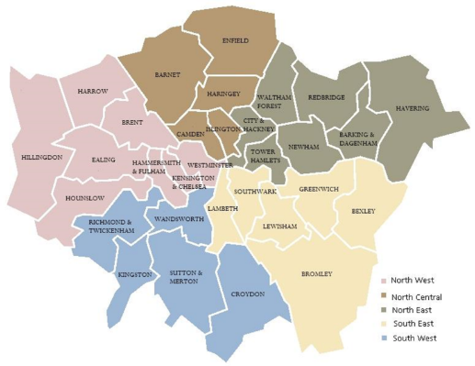






London Severe Paediatric Asthma Services (a national model)
Managed Clinical Networks

Slide 17
B. PATIENT AND FAMILY SUPPORT, INFORMATION PROVISION AND EXPERIENCE
16 | BTS/SIGN guideline 8.1: Whenever inhalers are prescribed patients should have received training in the use of the device and have demonstrated satisfactory technique. They should be provided with a video link to an appropriate demonstration of their device eg RightBreathe, Asthma UK. Children and young people should be given specific training and assessment in inhaler technique before starting any new inhaler treatment and this should be age appropriate. Children should be taught to use a pMDI and spacer as the first line treatment. They should not be prescribed a pMDI without a spacer. If a change of device is necessary, a pharmacist or other professional with appropriate training should advise patients on its use. As soon as a child is able to use a spacer with a mouthpiece, they should do so. Masks are not appropriate for children over 5 years unless there is a disability. Repeat in prescribing section

Slide 18
C. DIAGNOSIS AND CHRONIC CARE
17 | Diagnosis can be difficult in CYP. CYP with suspected asthma should be diagnosed on the basis of personal and family history (such as atopy, eczema and allergy), Objective measurements - reversible airflow obstruction (spirometry and peak flow diaries) FeNO (fractional concentration of exhaled nitric oxide) - and response to treatment. In younger children where objective measurements are not possible, response to initiation and stopping treatment should be used as a basis for diagnosis.

Slide 19
C. DIAGNOSIS AND CHRONIC CARE
18 | Each secondary care facility should have an appropriately trained asthma lead and dedicated time to be integrated into the STP paediatric asthma network. The asthma service should be led by a consultant with an interest in asthma along with an asthma specialist nurse who are responsible for ensuring adherence to standards of care across the hospital. The clinic should: Have capacity to see the number of children utilising the service with appropriate appointment times / lengths Should see referrals from GPs within 4-8 weeks Should see children after discharge from the ward within 4-6 weeks Identify children attending the ED with acute asthma / wheeze. Identify recurrent attenders of children at risk. Review in clinic rather than wait for crisis. Should perform spirometry / BDR / FeNO Should perform consistent inhaler training / asthma education – standardised within network Should issue asthma action plans for home and school (consistent within network Have a referral path for allergy, psychology and physiotherapy SPT / RAST in house (aeroallergens) – referral to allergy clinic Referral to psychology – local or CAMHS Referral to respiratory physiotherapy may be in house or require specialist referral. Have a referral path for smoking cessation. Should be in house tied into CCG services. Have a referral pathway for safeguarding. Have criteria for referral to tertiary care

Slide 20
D. SCHOOLS
21 | All schools should work towards achieving AFS status and have in place: A register of all CYP with asthma. A management plan for each child to include contact with GP/specialist caring for the child. A named individual responsible for asthma in school – the Asthma Champion. A policy for inhaler techniques and care of CYP with asthma. A policy regarding emergency treatment. If emergency treatment is provided in school, a parent should be notified and if the child does not improve an ambulance should be called. A system for identifying and taking appropriate action in the case of children who have poor control, as indicated by use of their blue inhaler or missing school or who are not partaking in sports / other activities. Action should include discussion with the parents, notification of the child’s GP via the school nurse and implementation of local policy to involve community asthma trained nurses. This should be communicated to after school care/clubs that take place on school sites.

Slide 21
E. ACUTE CARE
22 | The organisation complies with existing standards, such as the London Acute Care Standards for CYP (which incorporate the London Quality Standards), Out of Hospital Care Standards, High Dependency and PAU standards and safeguarding policies.* *All efforts should be made to support parents and children to engage with appointments utilising community services, school nursing etc. These efforts should be escalated where appropriate to safeguarding referrals if there is continued non-engagement. This escalation process should be written into each organisation’s Was Not Brought policy, with compliance audited regularly.

Slide 22
E. ACUTE CARE
26 | People admitted to hospital with an acute exacerbation of asthma have a structured review by a member of a specialist respiratory team* before discharge. The structured review includes: Assessment of current symptom control (using GINA table 2-2, Children’s ACT if aged 4 – 11, or ACT for 12+) and / or triggers for wheezing. Inhaler techniques. Self-management and how to manage acute exacerbations. Personalised asthma action plan. Identification and optimisation of modifiable risk factors (GINA Table 2-2, SIGN/BTS) If ≥2 acute attacks in previous year – refer to severe/difficult to treat asthma service or asthma clinical specialist

Slide 23
F. HIGH RISKS
27 | There are systems in place in acute and community care for identifying patients at high risk, with poorly controlled or severe asthma and for monitoring/tracing and managing those CYP who have had more than one admission in the last year OR any of the following: ≥ two asthma attacks in the previous 12 months (NRAD) Any admission to HDU, ICU or PICU ever. This is a lifetime risk. Two or more attendances to the emergency department or out of hours care in the last year. Two or more unscheduled visits to the GP (requiring short courses of oral steroids). Six or more salbutamol inhalers within a year. This should prompt an asthma review to establish clinical status and context of the prescription history. 80 per cent or less uptake of repeat preventer prescriptions to establish clinical status and context of prescribing history.

Slide 24
G. INTEGRATION AND CARE COORDINATION
31 | People with asthma receive a structured review* by someone appropriately trained at least annually, with provision for more frequent review in patients who are poorly controlled and after every attack. This must include understanding of their condition and treatment, assessment of adherence, inhaler technique and children’s ACT for those aged over four years, and identification of modifiable risk factors. The review process should consider safeguarding and Was Not Brought policies.** The review is an opportunity to encourage flu vaccination and smoking cessation.

Slide 25
H. DISCHARGE AND CARE PLANNING
35 | Systems are in place to ensure safe discharge and transfer between providers. This includes the following: All admitted CYP have discharge planning and an estimated discharge date as part of their management plan as soon after admission as possible. The primary care team / GP is informed of discharge within agreed timescale of each attendance and follow up is booked ideally within two days but at most within 5 days (including health visitor and school nurse) and where appropriate before the oral corticosteroid runs out. Information is provided to GP and community teams within 24 hours. Sufficient medication must be provided to ensure adequate treatment until expected GP review. Clear written information and advice is provided to families which includes what to do, when and where to access further care if necessary, clear instructions on follow up and arrangements in case of emergency at home. This includes telephone advice. Pharmacies ensure availability of medicines and utilisation of home delivery services. This is of greater relevance for weekend discharge. Secondary and tertiary care healthcare professionals should provide patients with a copy of changes in medication or initiation of a new inhaled medication or device to be handed to primary care pharmacists.

Slide 26
I. TRANSITIONAL CARE
36 | There is a clear lead clinician responsible for transition leading work on policies and pathway of care to prepare young people for the transition to adult services. Planning for transition should start early in the teenage years. Transition should be carefully planned from the age of 14 onwards for any child being seen in secondary or tertiary care for asthma. Any child who has been treated in intensive care for acute asthma, a HDU or paediatric HDU is at life-long risk and should be flagged as such on GP records.
38 | There is a shared pathway between children’s and adult services, which is a shared and active arrangement and is properly implemented. Follow up is then the responsibility of adult services if a young person does not attend their first adult appointment.

Slide 27
Clinical Update
Too much Guidance:
GINA – Not a guideline but an integrated evidence base strategy
NICE – Recommended treatments with an emphasis on cost saving and efficiency
Sign /BTS – Effective (national) practice guideline based on evidence
All are correct (in their own context) …………
Personalised asthma management should be based on an iterative process – as people are different ……
”Assess adjust and review”
Not one size fits all
Not just the medications
Goal is Asthma Control - Improved control =?= reduces risk (Death, Exacerbations, OCS or FEV1)

Slide 28
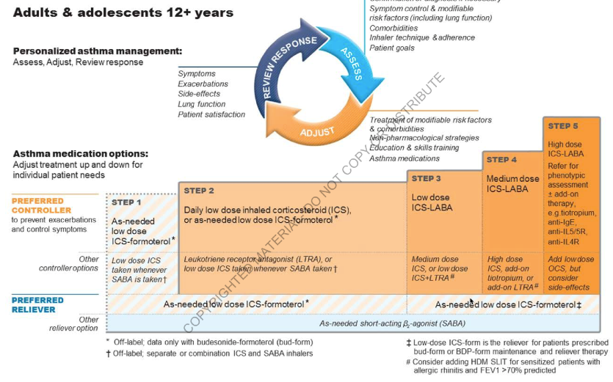
GINA 2019 – Step 1

Slide 29
Step 1 recommendations are for patients with symptoms less than twice a month and no exacerbation risk factors.
Step 1 recommendations are for patients with symptoms less than twice a month and no exacerbation risk factors, a group that is rarely studied.
As-needed low dose ICS-formoterol in Step 1 is supported by indirect evidence from a large study of as-needed low-dose budesonide-formoterol compared with SABA-only treatment in patients eligible for Step 2 therapy (O’Byrne et al, NEJMed 2018; see below).
In making this recommendation, the most important considerations were:
that patients with few interval asthma symptoms can have severe or fatal exacerbations (Dusser et al, Allergy 2007)
that a 64% reduction in severe exacerbations was found in the Step 2 study with as-needed low dose budesonide-formoterol compared with SABA-only, with <20% of the average ICS dose compared with daily ICS

Slide 30



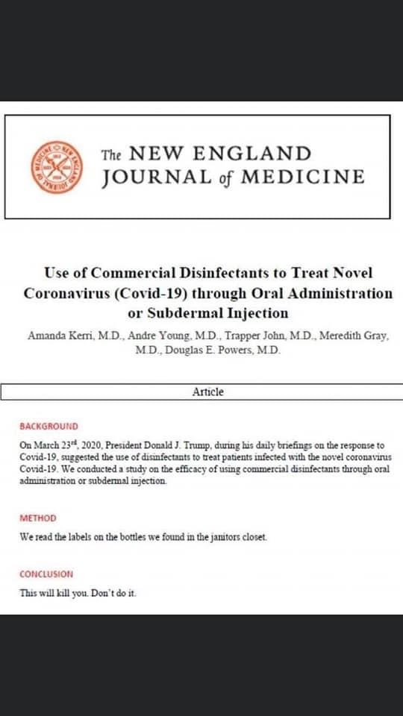




Slide 31
UNSEEN – Dr Will Carrol
U – Unrecognized risk
N – No Plan
S – Severity
E – Environment
E – Excess SABA
N – Non adherence

Slide 32
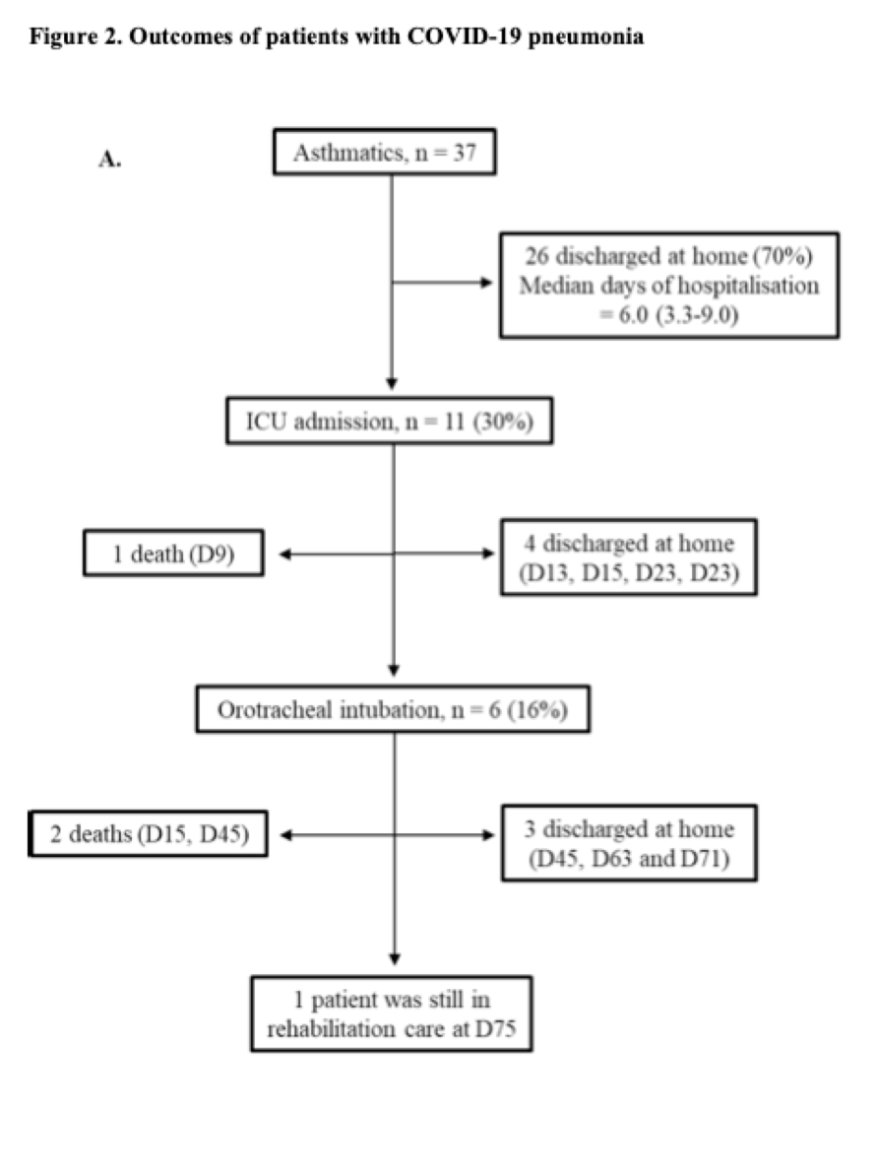
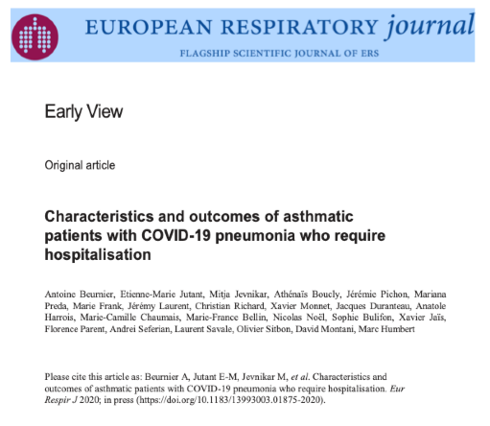
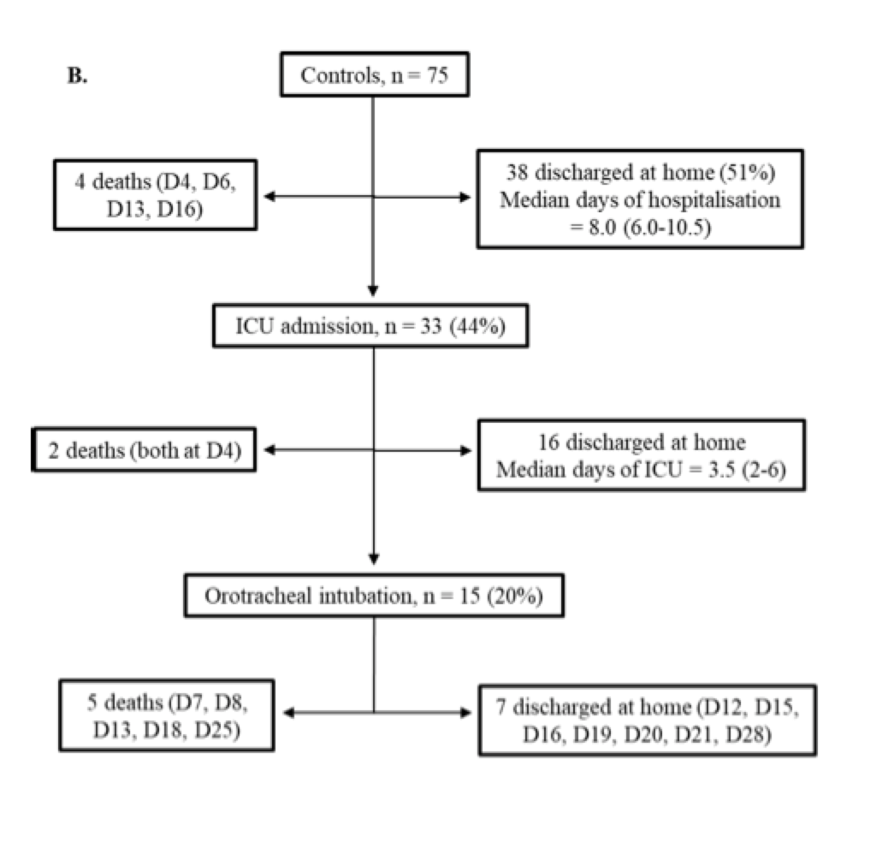
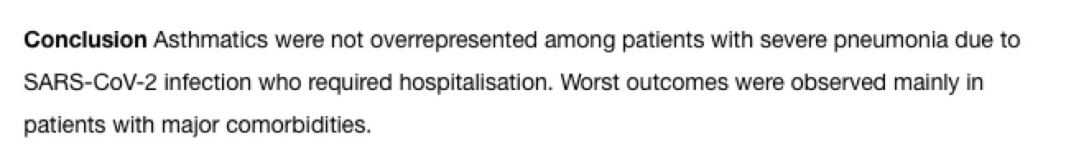
COVID and Asthma

Slide 33
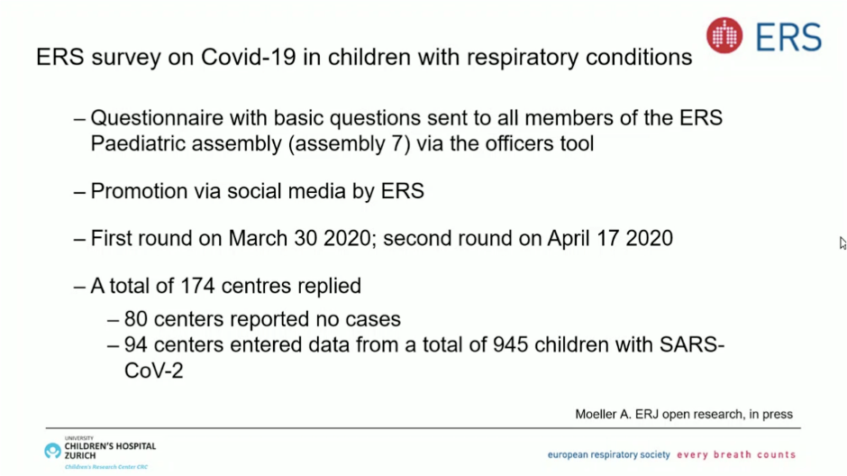

Slide 34
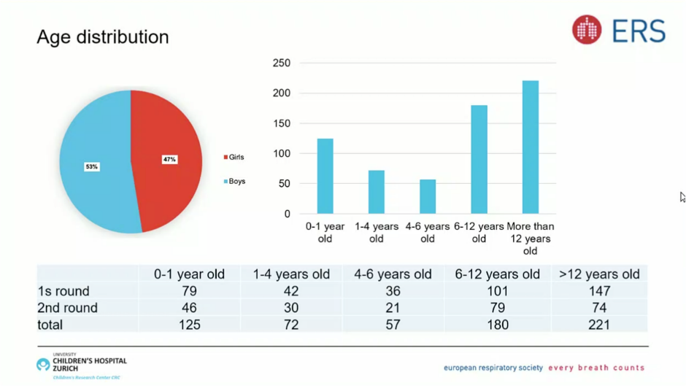

Slide 35
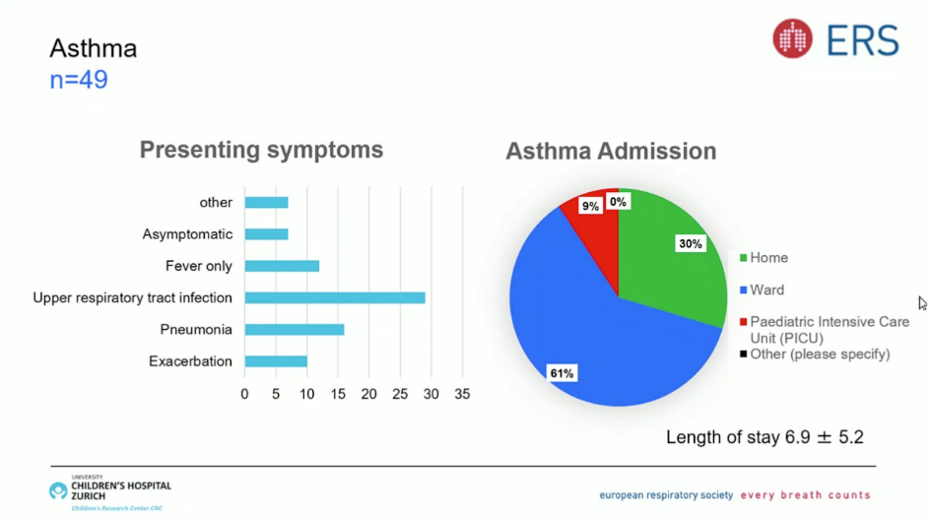

Slide 36
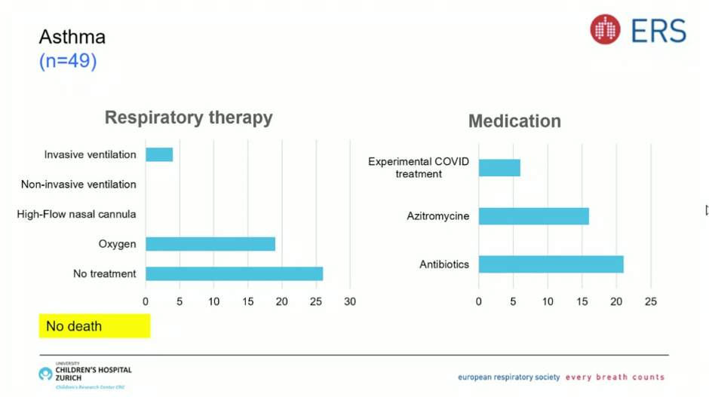

Slide 37
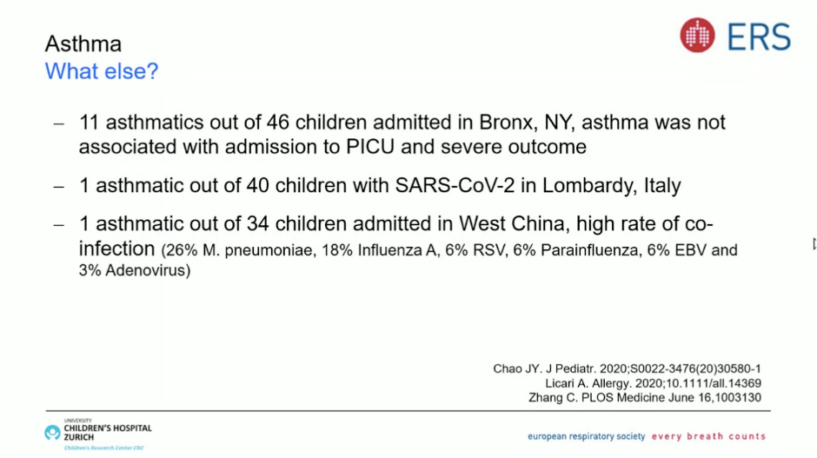

Slide 38
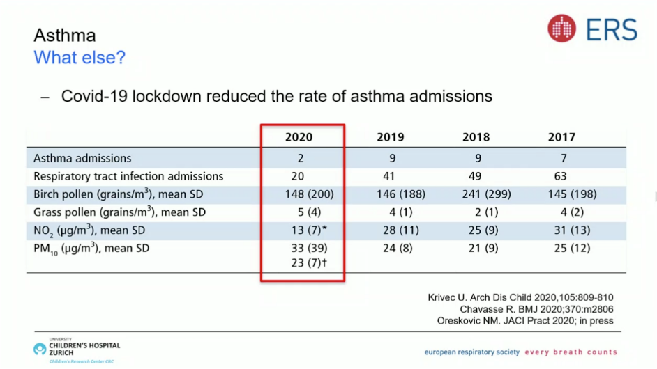
Can we learn from this ???

Slide 39
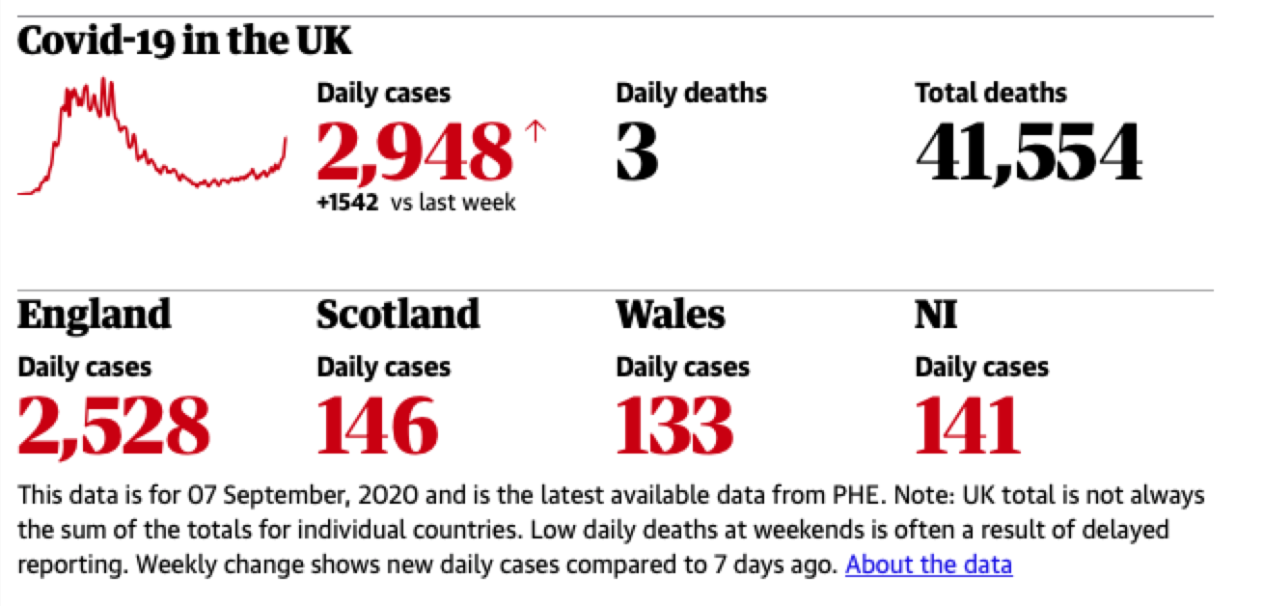

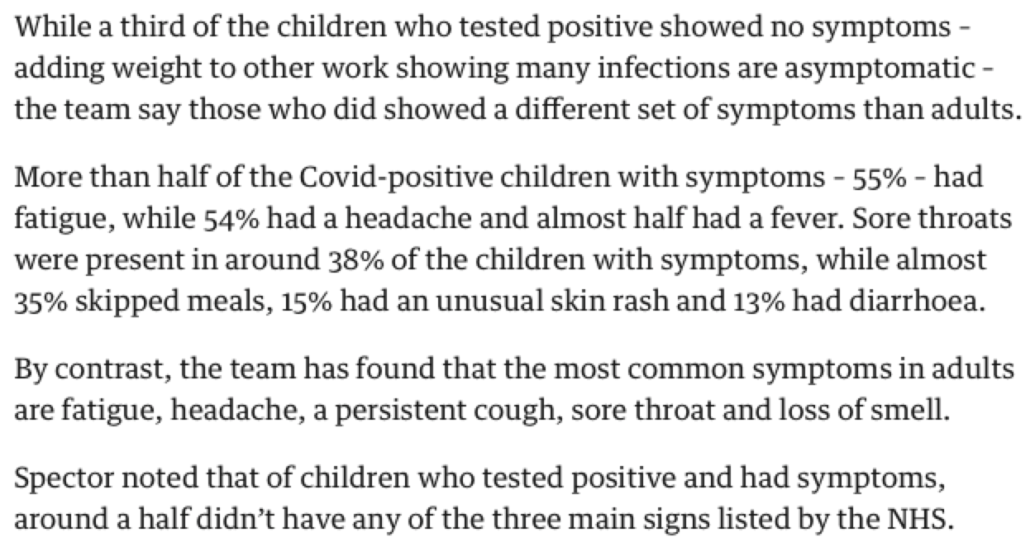
Ask about Asthma - Ask about COVID ???

Slide 40
Asthma – COVID
Un-Controlled
Prescription of VHD ICS / Biologics , B₂ antagonist via Smart Devices, Spacer,
Smart Peak Flow Meter (6+) and Shared Cloud Diary
Asthma Education inc Inhaler and PF / Spirometry Technique
PAAP – Self and Virtual Clinic Monitoring
Pre clinic Attend Anywhere physiology appts with Spirometry and FeNo Courier service
A Physical Clinic apt:
Post PICU
Patient request
Asthma Team request (if CND or DNA a virtual apt or failed data collection for ? 1 week)
A period of unexplained instability
Consideration of Biologics (with CT / Bronch etc)
Annual review (if unstable)
Centred Care
N= 5%
Prescription of HD ICS, B₂ antagonist via Smart Devices, Spacer,
Smart Peak Flow Meter (6+) and Shared Cloud Diary
Asthma Education inc Inhaler and PF Technique
PAAP – Self and Virtual Clinic Monitoring
Centred / Networked Care
N= 15%
Prescription of ICS, B₂ antagonist, Spacer,
Peak Flow Meter (6+) and Diary
Asthma Education inc Inhaler and PF Technique
PAAP and Self Management
Virtual clinic apt
Controlled
Primary / Secondary Care
N= 80%
Virtual monitoring of controlled
and uncontrolled asthma patients

Slide 41
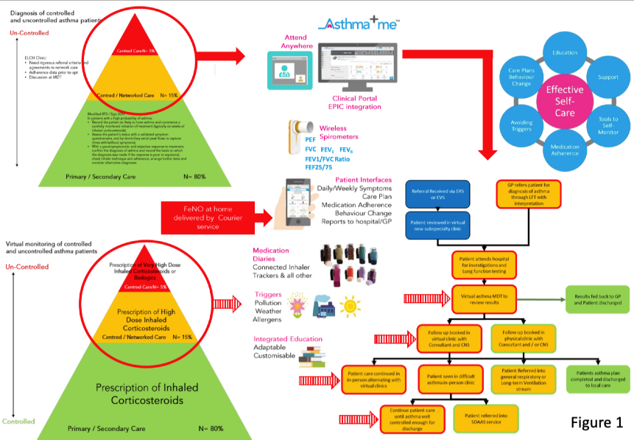
”Digital Poverty” – “designing systems that exclude” – No Smart Phone, No Computer / Tablet, No internet……….

Slide 42
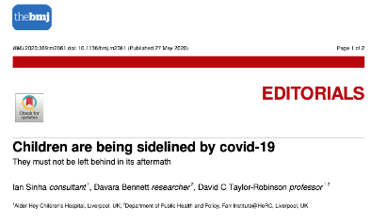
Inequalities in Child Health – Dr Ian Sinha
COVID 19 – Health and Economic fallout
  33% Inhaled Steroids
  33% Healthy Living
  33% self esteem
  ”1%” everything else >>>>>>>
Poverty - 1:3 children in UK live in relative poverty
Worse over the last 10 years (Gig economy / Zero hours)
Can a family afford school meals / birthday party / wash uniform each day / food banks
OR for asthma - Antenatal stress 1.8, Smoking 1.8, Poverty 1.5, Pollution 1.1, Obesity 1.3
”Digital Poverty” – “designing systems that exclude” – No Smart Phone, No Computer / Tablet, No internet……….

Slide 43
Questions?

Slide 44
Children and Young People Transformation Programme: Update from the national team
Dr Matthew Clarke
National Speciality Advisor, Children and Young People, NHSE/I

Slide 45
Evidence continues to suggest children and Young People suffer mild symptoms from Covid-19
Children continue to represent 1-2% of the total number of cases
If children do contract Covid-19 it tends to be less acute and PICU admission is very rare
There is a higher proportion of children admitted to hospital with at least one comorbidity
TE XT
Children with respiratory or complex neurodisability are over-represented in PICU admission data, groups for whom there is a background increased risk of complications from all respiratory viruses

Slide 46
However, protecting the health and well-being of children and young people has been a focus of the pandemic, across a number of issues
Protecting critical care capacity for children as we increased capacity across all ages.
Reducing delayed presentations to primary and emergency care
Protecting the most vulnerable children and young people where risk has increased due to the lockdown
Moving to new virtual models of care so children and young people receive care at home
Gathering and communicating the evidence as it emerges

Slide 47





Therefore, we will work across health, care and education to restore services for CYP whilst maintaining additional critical care capacity and ‘locking-in’ innovations
Over the next 6 – 12 months we will learn from new ways of working implemented rapidly during Covid19 and bring back services whilst ensuring we are balancing the rounded needs of children and young people. We will do this by
Bring back services
Virtual by default
Spotting the deteriorating child
Care in the community
Data and informatics
Balancing the need of children and young people by bringing back elective services whilst ensuring critical care capacity remains where we need it.
Learning from progress made during Covid19 to integrate care using technology, continue to provide specialist advice and enable CYP to continue accessing treatment in the community.
Build on progress in developing widescale adoption of an electronic paediatric early warning system to spot deterioration in children. We are also capturing learning from our work to deploy paediatricians into local NHS111 services.
The needs of vulnerable CYP and families are explicitly considered by health, care and education. This will include redeploying health visitors and community services.
Develop our data and informatics systems so we develop more evidence on how Covid19 impacts children and young people whilst monitoring health and health inequalities across England.

Slide 48
To take this forward we will prioritise work related to Covid19 restoration and recovery and continue programme development in the background
We are prioritising the following work for CYP as part of Covid19 restoration and recovery
We are also doing work in the background on five key policy areas identified in the NHS LTP
Integration of services within health and care systems by moving to a virtual by default model of care where possible
Identifying and protecting the most vulnerable children and young people
Developing our data and informatics capacity to monitor improvements in and understand the state of child health across the country
Detecting the deteriorating child
Working across NHSE&I to develop a joint approach to transition and 0-25 model of care
Launch an obesity pilot study to develop the evidence base and commissioning model for specialist MDT clinics to treat complications associated with severe obesity
Develop a national bundle to prevent asthma deaths
Keeping children well will focus on
  Speech and language
  Accidental injuries
Working across NHSE&I and with HEE to develop a workforce strategy for the short to medium term
The following slides provide more information on how we will reach our ambitions

Slide 49

Over the first year we will be drive integration of care
We know that during the Covid19 pandemic, years of progress was made in terms of care delivery and working together across the system. We will bank on this new way of providing care to ensure that CYP do not need to travel to hospital unless clinically necessary.
There are three ways that virtual by default can help drive integration:
(1) Multidisciplinary working
Use virtual working (i.e. phone, Microsoft Teams, Zoom) to collaborate across the system - across community, primary, secondary and tertiary care.
MDTs could be conducted between specialists, district general paediatricians, GPs and families.
(2) Outpatient
The delivery model for outpatient appointments could be changed going forward and that a ‘virtual by default’ position will be taken across the country. We will develop what this looks like for CYP and clarify whether there are additional considerations.
(2) Supporting CYP in the community
During the pandemic children and young people with long term conditions (i.e. Type 1 Diabetes) were able to receive support from their clinical teams to keep them well in the community and at home. We will learn from this to ensure that CYP do not need to travel to hospital unless clinically necessary.

Slide 50
This includes developing what integration means through key policy areas
We will develop what integration means across a few national policy areas, using virtual ways of working to accelerate integration and by developing a commissioning framework for adoption for local health and care systems. Refer to annex one for more detail.
Horizontal integration
NHS care
Local authority services (social care)
Education
Vertical integration
Inequalities
Mental health
Transition / 0-25
Vulnerability
Speech and language needs
Obesity
Specialist care
Secondary care
Accidental injuries
Asthma
DETECT
111
Primary care
Community care
Enablers
(i) Data and informatics
(ii) Use technology to move to a virtual by default model of care
(ii.a) Mechanism of collaboration for clinical teams
(ii.b) Mechanism to redesign the service offer - i.e. outpatient clinics
(iii) Workforce

Slide 51
We will map the opportunities in the patient pathway and develop a national bundle to prevent asthma deaths
Aug 2020
Sept 2020
Jan 2021
Summer 2021
Sept 2021
Dec 2021
April 2022
Work with expert clinicians and key stakeholders to agree discreet pieces of COVID-19 support
Publish National Bundle
Test policy proposals with Respiratory Delivery Board and CYP Board
Develop proposals for a national asthma bundle
Engage with wider stakeholders on proposals
Develop an asthma pathway across health and care
Consider levers and incentives (i.e. financial incentives)
Prevention
Parental smoking
Air pollution
Housing
Early/Accurate Diagnosis
Primary care
Secondary care
Tertiary care
Effective preventative medication
Self care
111/ primary care
Secondary care
Management of exacerbations
Self care/ apps/ peak flow
111/primary care
Secondary care
PICU
Severe Asthma
Service specification
New therapy
R&D

Slide 52
Same Day Emergency Services: Launch of a new 111 paediatric asthma pilot
Dr John Moreiras, Paediatric Consultant, Whittington Health
Dr Giles Armstrong & Dr Roland Bensted, Barts Health

Slide 53
Clinical SDEC pathway: Paediatric asthma
London is taking a 3-pronged approach to Winter preparation
In light of Covid-19, each of the 12 SDEC priority pathways for London is being clinically reviewed, especially for shielded patients. The clinical lead for each pathway will lead the development of the pathway in conjunction with clinicians from each ICS area.
Ambition
Agree a pan-London paediatric asthma management plan for use with GPs and clinicians in 111.
Timelines and engagement
Jun-August | First draft of pathway developed by clinical lead and pathway development support. The pathway was reviewed by: London’s IUC Clinical Reference Group who recommended the pathway to the London Clinical Advisory Group. All ICS’s were represented in these discussions with significant input from SEL (Robert Davidson) and NEL (Kate Adams). The London Asthma Leadership and Innovation Group (LALIG) with members including members of the London Respiratory Group, Richard Iles and Louise Fleming, who support the pathway. The London Ambulance Service (LAS) and London Central and West Urgent Care Collaborative (LCW) LAS Clinical Advisory Group, who support the pathway Helene Brown, NHS England Primary Care Lead, Gary Davies, London SDEC clinical lead and Vin Diwakar, Regional Medical Director for NHSE/I (London region) who have all contributed
August 27th | Pathway approved by the London CAG.
September | Organise and disseminate training for 111 clinicians. Meeting with ICS leads for Go/No Go meeting to decide on whether or not to implement. To be in place by early September ahead of annual spike in asthma presentations in the second week of September after schools return. Test and iterate pathway as a decision-making tool. Weekly evaluation and iteration.
Clinical lead and clinical support
Giles Armstrong | Consultant in Paediatric Emergency Medicine | Barts | NEL
Roland Bensted | Paediatric Registrar | UCLH | NEL
John Moreiras | Paediatric Consultant | Whittington | NCL
Richard Chavasse | Consultant in Paediatric Respiratory Medicine | St George’s | SWL
Mark Levy | GP special interest paediatric asthma | Primary Care | NWL
Stephen Goldring | General Paediatrician | Hillingdon Hospital | NWL
Simon Douglass | Medical Director | LCW | Pan-London
Agatha Nortley-Meshe | Assistant Medical Director | LAS | Pan-London

Slide 54
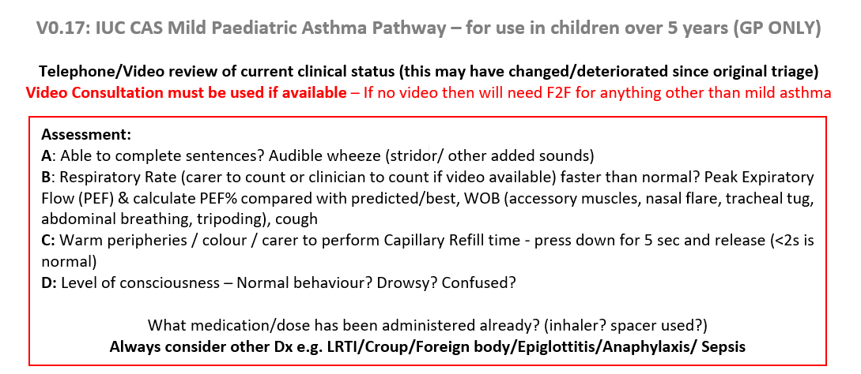
IUC CAS Mild Paediatric Asthma Pathway (1/4)
London is taking a 3-pronged approach to Winter preparation

Slide 55
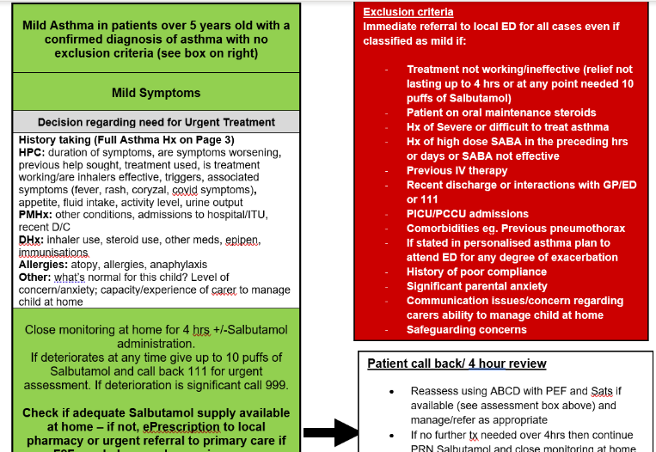
IUC CAS Mild Paediatric Asthma Pathway (2/4)
London is taking a 3-pronged approach to Winter preparation

Slide 56
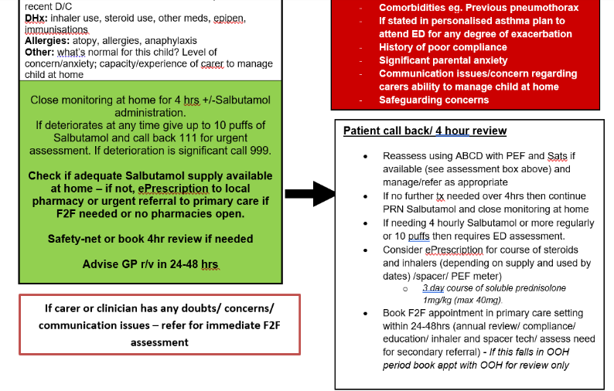
IUC CAS Mild Paediatric Asthma Pathway (3/4)
London is taking a 3-pronged approach to Winter preparation

Slide 57
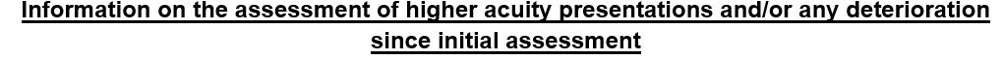
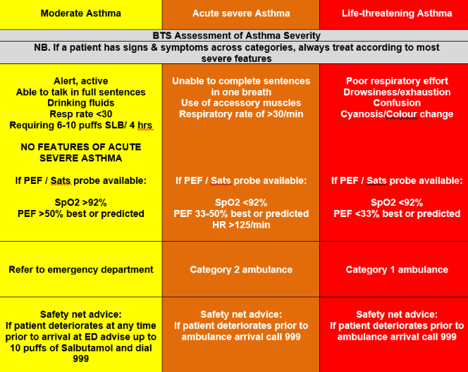
IUC CAS Mild Paediatric Asthma Pathway (4/4)
London is taking a 3-pronged approach to Winter preparation

Slide 58
Questions?

Slide 59
South East London Integrated Care System
Amy Westpfel and Rebecca Kalamchi, Community Children's Asthma Nurse Specialists, Lewisham and Greenwich Trust
Sarah Allmark, Primary Care Nurse (Asthma, Eczema, Constipation) CYPHP
Richard Iles, Consultant in Paediatric Respiratory Medicine, GSTT

Slide 60
#AskAboutAsthma
14th-20th September 2020
Amy Westpfel & Rebecca Kalamchi
Children’s Community Asthma Specialist Nurses
Lewisham and Greenwich NHS Trust

Slide 61
Who are we and where are we based
Rebecca Kalamchi & Amy Westpfel
Community Children’s Asthma Nurse Specialists
Community Children's Nursing Team
Kaleidoscope
32 Rushey Green
Catford
SE6 4JF
Tel: 0203 049 3780 - (08:00-18:00 Mon- Fri)
E-mail: lg.asthmanursespecialist@nhs.net

Slide 62
Introduction – Community Children’s Asthma Nurse Specialists
Commissioned by Lewisham CCG.
Started as a pilot project over 1 year, commencing December 2017
Extended and fully commissioned
Clinic consultations running for 2 years
Continually review and adapting practice to ensure that our patients are receiving the most up to date evidence-based care

Slide 63
What patients do we accept
Our inclusion criteria:
Children and young people who are aged between 0-16 years old
Registered with a Lewisham GP
48 hour review post hospital admission for:
  All asthmatic patients
  VIW patients – (3 or more attendances in 6 months)
Non-compliant asthmatics
Families in need of asthma education/support

Slide 64
Our service through COVID
Adapted to ensure no booked appointments were cancelled and instead converted to virtual/telephone appointments
Very few referrals for 48 hour reviews – new challenge reviewing over the phone
Continued to receive referrals for education and support from GPs through out
Virtual appointments via attend anywhere have been well received by parents
Opportunity to update and create new resources
  Created a new template for a follow up clinic letter
    Presentations for GP teaching, students and schools
    Created GP resources
    Created an activity book – awaiting input from UHL design team
    Created a new 48 hour review information leaflet
    Created a salbutamol diary for parents and families to completed at home
Complete audits of the service

Slide 65
Audit results
Incidence of hospital re-attendance post consultation with the Community Asthma Nurse Specialists v Paediatric A&E, in 2-16 year old's diagnosed with asthma

Slide 66
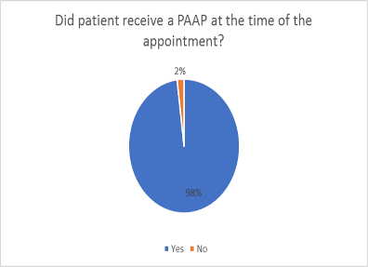
Results - PAAP
99 patients (98%) received a Personalised Asthma Action Plan (PAAP).
2 patients did not receive a PAAP:
  1 - did not qualify as parents were advised the Clenil inhaler was only for a two week trial.
    Not normal protocol for a trial of Clenil, clarification with the discharging consultant was sought.
    Parents misunderstood information given regarding treatment plan on discharge.
    Treatment plan clarified with parents by the Community Children’s Asthma Nurse Specialist.
    Follow up in place with the Paediatric Respiratory Nurse Specialist where a PAAP should be given.
  1 - no documentation.

Slide 67
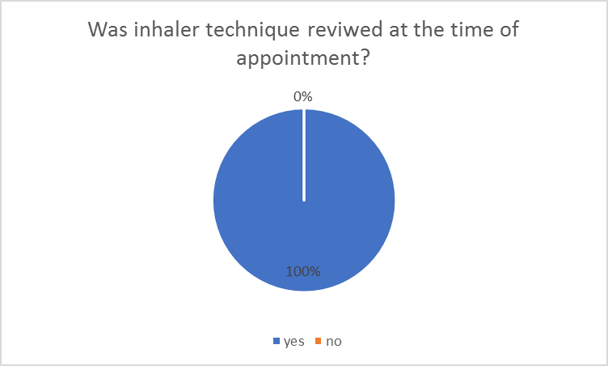
Results – Inhaler technique
During August 2019 – February 2020, all patients reviewed received inhaler technique assessment (100%).

Slide 68
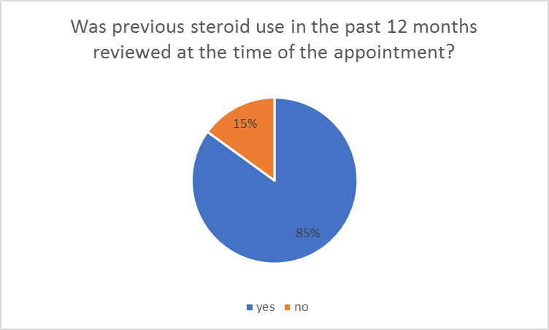
Results - review of oral steroid use in the past 12 months
15 patients (15%) - no documented evidence of a review of their previous oral steroid use in the past 12 months.
  Patients may have been asked but there was no documentation.

Slide 69
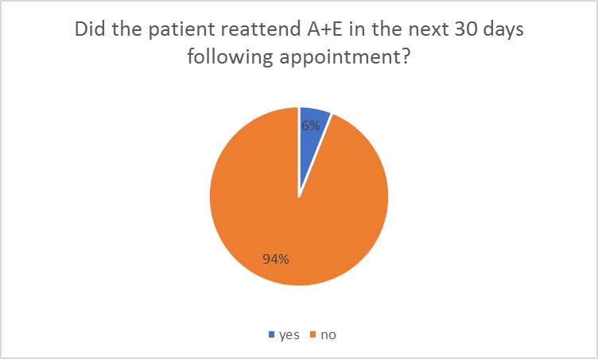
Results – returns within 30 days
6 patients (6%) returned within 30 days of referral. Reasons identified:
  2 patients re-attended prior to being seen by the Community Children’s Asthma Service.
  4 patients advised to return to PED by the Community Children’s Asthma Nurse Specialist’s, due to clinical concern.
  During the audit period no more than 2 patients per month re-attended PED.

Slide 70
Audit conclusions
The service is meeting the benchmarked objectives:
  Every patient is receiving inhaler technique review.
  Only one patient did not receive a PAAP.
  The re-attendance rate is small.
  The majority of patients who did not have their steroid use reviewed in the past 12 months were seen for a 48 hour review. (>asked but not documented). Documentation proforma used does not contain specific checkbox/section to document oral steroid use.

Slide 71
Audit 2 - Review the incidence of re-attendance post consultation for asthma exacerbation in PED at LGT prior to commencement of the community service delivered by the children’s asthma nurse specialists.
Aims:
  Measure impact service has had on unnecessary re-admission to PED for asthmatic patients.
  Confirm if care received in PED is in line with the NRAD report:
    Did patient receive a PAAP at time of review?
    Was inhaler technique reviewed?
    Was previous steroid use in the past 12 months reviewed?
    Did the patient re-attend PED 30 days post review? If so, what treatment did they require, why did they attend?

Slide 72
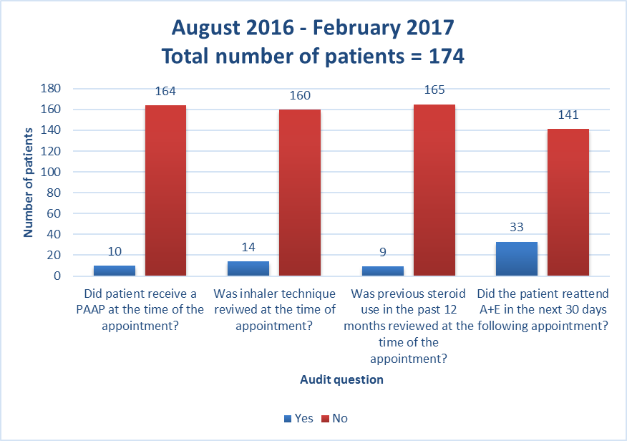
Results

Slide 73
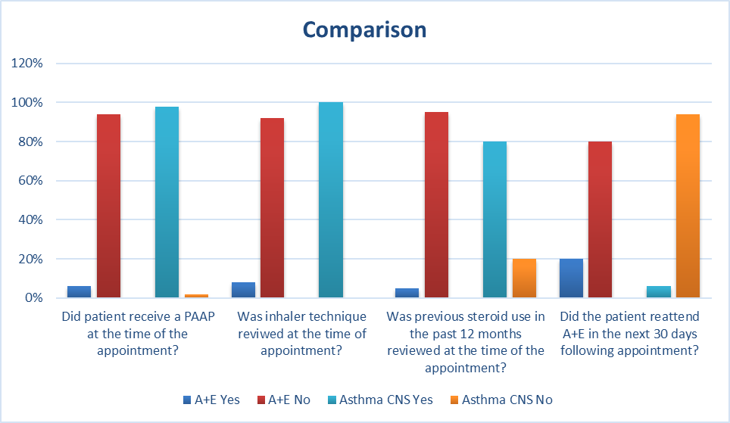
Data comparison

Slide 74
Conclusions
The Community Children’s Asthma Nurse Specialist Team have markedly reduced the number of attendances to hospital for asthma exacerbations, and dramatically reduced re-attendance 30 days post consultation for asthma exacerbation.

Slide 75
What we are doing for #askaboutasthma
We have arranged a virtual presentation for staff during the week
It will highlight the main aims of the campaign
Q&A will follow the presentation
Hospital stall – pending confirmation and support from infection control

Slide 76





6 locations, 4.5 clinics weekly.
1x Band 7, 3x Band 6 (primary care nurses covering eczema & constipation)
F2F: 85 patients a month (26% DNA)
Telephone: 134 patients a month (37% DNA)
Caseload: 284
5 virtual clinics
3 community clinic locations
Capacity to see:
15 patient virtually per week
12 F2F per week
Telephone reviews
Wait for initial assessment: 3.5 weeks
ALL NURSING STAFF REDEPLOYED
CYPHP Health check suspended
1 nurse allocated 2 hours per day.
All telephone calls
Initial assessments: 36
Review assessments: 118
Challenges
Community models have been heavily impacted due to more virtual work:
School
Safeguarding
Home assessments
Staffing
Large backlog of patients for initial assessments
Increased fatigue & stress with telephone reviews and inability to physically assess patients
Virtual appointments
Less personable
Technical difficulties
Learning
Parental anxiety:
Increased phone calls to nursing team to discuss asthma & covid-19
Stock piling medications contributed to national shortage of preventer medications
Reduced attendance for medical review
Collaboration:
Redeployment to Hospital@Home/CCN team was a great opportunity to work together and support more community focussed work e.g. Omalizumab injections in the home
Notes:
Pre-covid: we were expanding our clinics to the evening and seeing a considerable amount of children. We reviewed the entire asthma, eczema and constipation caseloads in 2 days and RAG rated these before redeployment. Asthma remained on a skeletal service where we continued to support our most vulnerable families.
Post-covid: starting to get back to a normal clinic pattern but we are seeing less patients than previously. This is a new way of doing clinical work for the nurses, CYP and parents
Parental anxiety
1. Focus on asthma preventer ALWAYS, not just around the pandemic. Regular preventer medication regime= good control. Interesting look into parental perception of asthma and that attention needs to be brought to other asthma triggers
2. Prescribing in primary care- lots of issues with other brands/strengths being used. Parents & GPs not aware that brands are NOT interchangeable
3. During Covid-19 known reduction in ED attendances & GP reviews or GP closed. Importance of opportunistic assessments, e.g. children identified through the CYPHP healthcheck with off target asthma scores – we inform secondary/tertiary asthma services if children under their care complete the healthcheck. E.g one patient identified through the healthcheck with low ACT, respiratory team informed and hospital appointment brought forward.
Collaboration
CCN/CH@H educated on asthma and trained to deliver Omalizumab at home. CYPHP Asthma CNS helped to develop pathway and train staff to complete asthma reviews.
This relationship has continued and CYPHP asthma CNS continues to go on home visits with CH@H to review asthma patients post discharge from hospital.
Challenges:
Not having school as an objective insight into the children
Safeguarding- very difficult to do virtually
Home environment tells you so much- triggers, family life, safeguarding
Virtual appointments:
Building a relationship is harder
Technical issues and also some families not having access to the IT equipment
More time consuming so less patients can be seen now

Slide 77
Thank you for listening
Any questions?

Slide 78
South West London
Richard Chavasse, St George’s Hospital
Croydon Community Asthma Nurses

Slide 79

South West London Network
Aim to engage with SW London CCG
Discussing overarching Children’s Board
Planning further ‘virtual’ network meetings

Slide 80
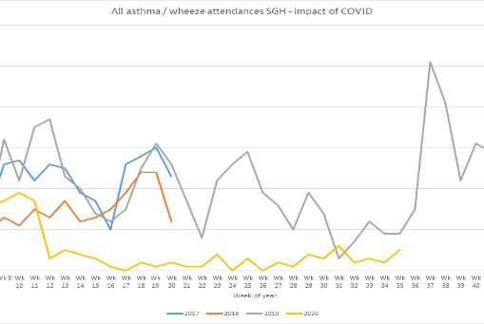
Asthma activity
Reduction in asthma presentations.
Virus / pollution / adherence / stress?
What happens next?
Arch.Bronconeumanol in press

Slide 81
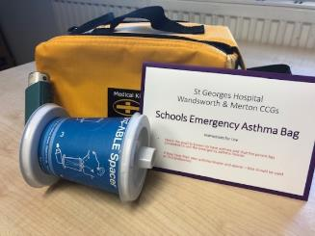
Wandsworth & Merton Asthma Board
School emergency asthma bags
  Arch dis child 2020 – in press
  Planning re-issue
School anaphylaxis bags
  Imminent distribution
48 hour reviews
  Planning to book from ED
Diagnostic Hubs
  On hold due to COVID restrictions

Slide 82
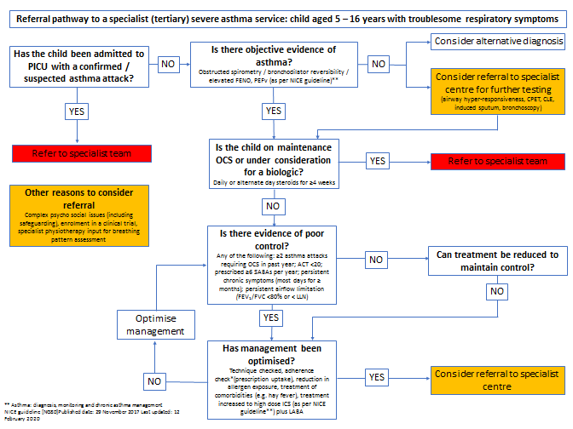
Other
SDEC
Difficult Asthma

Slide 83
SGH Asthma Clinic
Telephonic
(SGH unable to offer video clinics at present)
F2F if urgent need
Improved ‘attendance’.
Most patients stable
Redesign:
  Limited F2F – approx 35% pre COVID
    1 in : 1 out – air filtration where needed
  Limited physiology – alternatives: home spiro / IOS
  Telephone and video

Slide 84
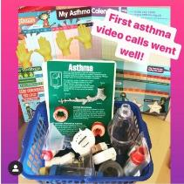
Croydon Asthma Team during Covid-19
During this challenging time, we had to find new ways of working. Using Attend Anywhere video consultations proved to be a fantastic success and enabled us to continue delivering our service.
We were able to show children and their families models of their airway, what an asthma action plan looked like, and of course assess their inhaler technique as well as demonstrate new devices.
Going forward, we will now be offering all referrals a video consultation and home visits will be carried out for more complex patients or those with safeguarding concerns. This will increase our team productivity, as we often spend time travelling to homes and can potentially see more CYP in one day!

Slide 85
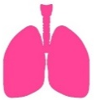











Impact of a Children’s Asthma Risk Register
Jo Massey and Jakki Sutherland (Children’s Asthma Nurse Specialists)
INTRODUCTION
Development of a high risk register for children with complex asthma Patients given additional interventions, such as regular telephone support + joint consultant clinics
METHODS
Patients assessed to see if extra interventions had been successful Telephone reviews used to look at symptom control, adherence to treatment + current medication
History checking of electronic systems to determine child’s medication history, further hospital presentations, or GP visits
RESULTS
Improved ACT scores
(better symptom control)
Improved adherence to
treatment, and satisfaction
with current medication
Improved asthma-related
quality of life
Better self management of
condition
Patient satisfaction
and feedback
Gaps in current service
provision identified
CONCLUSION
Asthma is a long term, chronic health condition, and as such requires long term support with management.
Tragically, 3 people die from asthma every day, and research shows that two thirds of asthma deaths are preventable.
Many children and young people with asthma are not being managed in line with national asthma guidelines, and often the basic requirements are not being met
Patients need ongoing support to empower them to successfully self manage their asthma so that they can have a normal life, free of asthma symptoms

Slide 86
Questions?

Slide 87


NEL CYP Asthma Network
September 2020
Lynda Hassell – Divisional Director of Nursing, CYP & Chair NEL CYP Asthma Network
Rita Araújo – Transformation Manager THCCG & Co-chair NEL CYP Asthma Network

Slide 88
Workforce: Asthma CNSs
NEL CYP Network founded 2017
2017: 2 Nurses
2020: 9 Nurses (FT/permanent funding)
  Delivering clinics (community/hospital based)
  Clinical reviews in inpatient wards/ED
  Connecting partners across the system
  Educating partners, hosting events
  Frequently meeting as a group
  Set up Pan London Asthma Nurse Forum

Slide 89
Pathways and Guidelines
Scrutiny and development of policies and guidelines
  Standardise: leaflets/information, PAAP, follow-up process, care plans in place, asthma specific proformas
  WNB policies & auditing across the system
  Operational policies to guide primary/secondary/tertiary thresholds & pathways in line with best practice
  Transition policy
  Locality/Network Incentive Schemes
  Discharge planning & EDS’s – timing/coding/accuracy
  48h review pathways - assurance and auditing
  Shifting into use of Aerochambers

Slide 90
Schools
Support School Health teams returning to school
Virtual education sessions/webinars
Building relationships
Asthma Friendly status
Group consultation to children, families and staff
Management plans in place

Slide 91
Air quality – interface asthma
Materials co-produced on air quality
Link to education session, CDP certified
Official launch AAA week
Please contact: rachel.parker8@nhs.net

Slide 92
Impact across the system
Reduction of 22% acute admissions, savings of at least £142,691
70% of CYP having an annual review in primary care
AE follow up revealed home nebuliser usage in child with poorly controlled asthma – letter to all GP’s + clinicians
Quarterly joint clinical review of CYP with secondary & primary care teams
Started review mtgs of shared care children with tertiary lead & secondary care team
40 school nurses/HV’s trained as Asthma Champions (one borough) & 4 videos made to clarify change of approach

Slide 93
The reason we do what we do
https://vimeo.com/386820362

Slide 94
Next steps
Adapting offer to COVID-19 – lung function/virtual consultations
NEL Data Dashboard – Benchmarking
Implementing policies and pathways – 48h review
LGC Award, October 2020
Present at Conferences - RCPCH, UK; BMJ, Denmark.

Slide 95

Questions
l.hassell@nhs.net
rita.araujo@nhs.net

Slide 96
Ask About Asthma 2020
Learning from Covid: Update from NCL
Presented by Dr Oliver Anglin, NCL CYP Clinical lead & HLP Asthma Lead
and Sam Rostom, Programme Director for Children & Young People

Slide 97
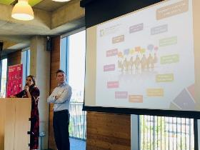
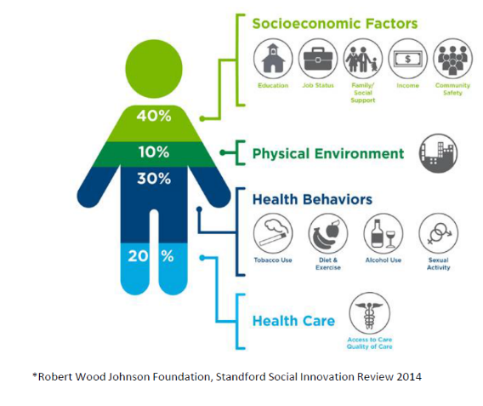
#AskAboutAsthma 2020
Dr Oliver Anglin and Sam Rostom speaking at HLP Asthma conference 2019

Slide 98
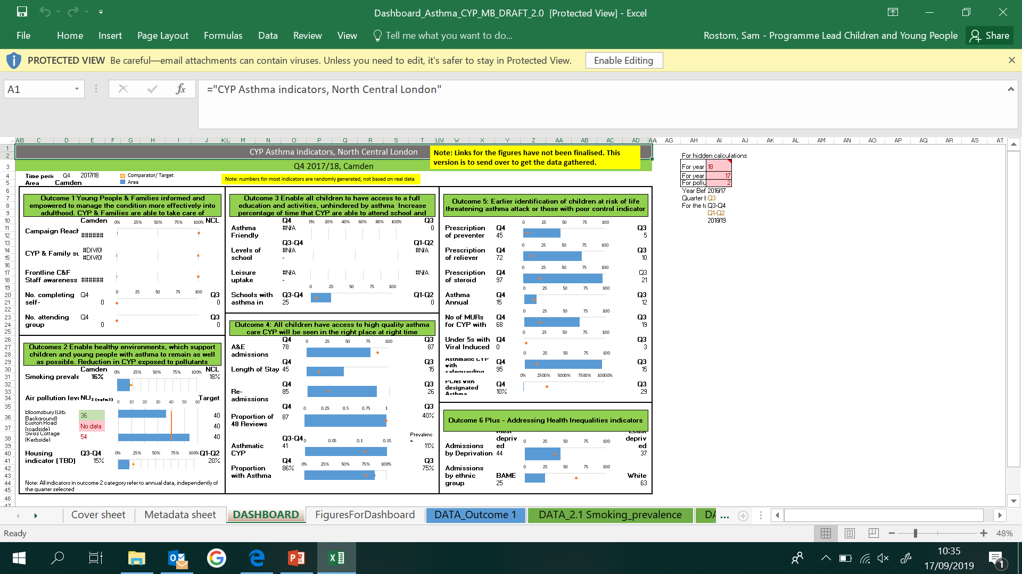
Overarching Outcomes
What we want to achieve for children, young people and families in North Central London
1. Young People & Families informed and empowered to manage the condition more effectively into adulthood
2. Enable healthy environments, which support children and young people with asthma to remain as well as possible
3. Enable all children to have access to a full education and activities, unhindered by asthma
4. All children have access to high quality asthma care
5. Earlier identification of children at risk of life threatening asthma attack or those with poor control.
Mock up

Slide 99
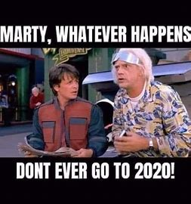

Slide 100
Hearing from families during lockdown
Fear of being misdirected
A number of YP have expressed their confusion of going to A&E after receiving advice from 111
Worry about infection prevention controls
“As a parent with a child with asthma it’s important that I normalise the condition and ensure that’s she’s not daunted by any symptoms she may have, so that she’s able to take her medication without fearing that’s she’s different”
When lockdown was put in place, I had a lot of phone calls from anxious parents worried about their child and how it will affect their asthma
would like better follow up. That initial care was good but follow up could be improved (more information, better processes etc.)
Parental perspective on service offer (or lack of) was a factor in accessing care
Many parents accessed support via WhatsApp groups
idea from the group was using the mechanism of schools to communicate some of the messages for families
Sources: YP engagement workshop May 2020, Parental Advisory Group April 2020, NCL clinicians

Slide 101

Adaptation of practice (community asthma nurses/ school nurses)
Development of community hubs
Use of technology for consultations
Extended asthma reviews
Continued work with schools and roll out of AFS across NCL
Air quality work: Anti-Idling project
Local NCL plan delivery

Slide 102
Learning from Covid: key themes from NCL
The power of partnerships
Embrace technology
The need to adapt…and learn
Conversations with YP & families

Slide 103
Questions?

Slide 104
North West London
Stephen Goldring, Consultant paediatrician, Hillingdon Hospitals
Claire Galvin, Head of Maternity, Children and Young People, NWL CCGs

Slide 105
Network development – the year to date
Just when we were getting started – 1st meeting in Jan, 2nd in July
And now we meet often!
- Outer and inner NWL weekly team meetings
- Monthly network meetings

Slide 106
North West London Paediatric Asthma Network Plan, Aug 2020
Asthma is a common long term condition that is under-diagnosed and often poorly managed. This results in unnecessary poor quality of life, time off school, acute asthma attacks, attendances in urgent care and hospital admissions. A small but significant number of children are admitted to intensive care, and children still die of asthma.
Problem
Aims
To improve the health and well-being of CYP with asthma across NW London
To reduce the use of emergency services for CYP with asthma
Target outcomes
by April 2023
Increased prevalence of asthma in primary care (indicating better diagnosis)
All CYP with asthma have an annual review by an appropriately trained professional including asthma action plan, inhaler technique check and education for self-management of asthma
All CYP with acute asthma have a post attack review by an appropriately trained professional
Reduced asthma attacks with emergency attendances down by 10%, hospital admissions down by 10%, Reduced PICU admissions, No deaths
Asthma friendly schools across all 8 boroughs
Patient pathway
Diagnosis and detection
Post-covid triage
Long term follow up
Medication management
Acute asthma
Post attack review
Referral to 2/3 care
Transition to adults
Digital
Single digital PAAP
NHS app for asthma
WSIC
Connected care between services
Schools
Asthma friendly schools
Consider school based interventions
Training
Clearly defined competencies and learning objectives for all HCP
Training resources
Network
Strengthen 1°/2°/3° relationships
Focussing asthma services in PCNs
Shared learning through MDT and case review
Trainee led QI
Workstreams
Underpinned by CYP engagement / Baseline gap analysis and peer review/ Monitoring outcomes through WSIC

Slide 107
Network development - priorities/ achievements
- COVID preparedness/ SDEC/ reducing winter admissions
- Developing risk assessment tools
for individual patients
to target interventions at practice/ PCN level
- ‘Asthma script’ - Advice and guidance to support asthmatics in school
- Asthma friendly schools initiative
- Virtual group clinics
- Post attack salbutamol guide

Slide 108
Asthma script for school nurses - Background
(With thanks to Helen Blackburn, Quality & Practice Development Facilitator, CLCH)
  We identified that access to usual health care was delayed
  Concern that CYP/ families had fears of attending hospital or GP practice
  Proposal to proactively call known asthmatics on the school caseload
      To support a school nurse to provide first line asthma health promotion
      To support CYP/ families to proactively manage their asthma
      Risk assess CYP who needed direction to their GP/ asthma specialist
      Merton, Richmond, Wandsworth, Barnet
      Brent, Ealing, and Hammersmith & Fulham

Slide 109
Asthma script for school nurses - Principles
  Health promotion ‘conversation’
  Every asthma consultation is an opportunity to
    “review, reinforce and extend the patients knowledge and skills…It is important to recognise this is a process and not a single event…. Brief simple education linked to patient goals is most likely to be acceptable to patients”. BTS SIGN 2019
  While the school nurse is not undertaking a formal asthma consultation their contact with the child and family is part of this process.
  School Nurses are expert in working with children, young people and their families to identify health needs, provide first line advice and signpost or refer to other services including the GP.

Slide 110
Asthma script for school nurses - Flow
Demographics
Conversation
Overall risk assessment
Advice and actions
Underpinned by risk assessment tool and advice resource

Slide 111
Asthma script
1 | Current parental concerns about child’s asthma
2 | GINA asthma control questions - to decide if ‘well controlled’ ‘partly controlled’ or ‘uncontrolled’ In the last 4 weeks has your child…
 | 1. Had daytime symptoms more than twice a week? |  |  | Yes/No
 | 2. Had any night waking due to asthma? |  |  | Yes/No
 | 3. Needed to use their reliever inhaler > twice a week? |  |  | Yes/No
 | 4. Had activity limited due to their asthma? |  |  | Yes/No
 | Well controlled | Partly controlled | Uncontrolled | For partly or uncontrolled asthma client to be directed to contact GP and email sent to GP to advise of expected contact and reason.
 | None of these | 1-2 of these | 3-4 of these
3 | Does anyone smoke at home? |  |  | Give smoking cessation advice
4 | Does your child have a written asthma management plan? |  |  | If no direct to GP + email GP directly
5 | Ask the parent/ carer to talk through the plan Usual reliever/ preventer (s) Do they have an adrenaline pen for allergies? Any other treatments for asthma? |  |  | If child has a preventer, reminder to use this daily Ask if medication is in date?
6 | Do they feel confident with their inhaler/ spacer technique? |  |  | Signpost to asthma uk videos If not confident →refer to GP/Asthma nurse
7 | Any problems collecting regular medications? |  |  | If Yes agree plan e.g. liaise with GP
8 | Do you know how to recognise a change or worsening asthma symptoms in your child? What are some signs of an asthma attack? How do you know when to call an ambulance/GP? |  |  | If No direct to GP and email GP directly Give parent first line advice and signpost to link - See Appendix 1
9 | Do you have any concerns or questions about your child’s asthma or any other area of their health?

Slide 112
Risk assessment tool

Slide 113
Advice and guidance resource
Problem | Rationale | Action
Asthma triggers | Awareness of triggers enables a patient to better understand and manage asthma | Ask about common triggers include exercise, damp, mould, pollen, dust, grass, cat/dog dander, viral illness, weather change, pollution, stress, cigarette smoke, pets, food. Some triggers are avoidable/ manageable such as smoking (stop) pollen allergy causing rhinitis (use rhinitis treatment)
Smoke exposure | Exposure to cigarette smoke reduced the effectiveness of inhaled steroids and is a trigger for asthma attacks. | Offer very brief advice on stopping smoking https://www.ncsct.co.uk/publication_very-brief-advice.php
Management plans | All children should have access to a written asthma management plan so they know what to do when they are well, and becoming unwell | If they do not have a plan, this needs to be agreed with their usual health professional. Examples of plans can be found here. https://www.asthma.org.uk/advice/child/manage/action-plan/
Appropriate devices | The vast majority of children and young people should use their inhaler via a spacer. Some children may use a breath activated device (such as a turbohaler) | Explain that direct use of an inhaler directly into the mouth is ineffective, and highlight the importance of using a spacer for their inhaler. (Unless on a breath activated device)
Inhaler technique | One of the commonest reasons for poorly controlled asthma is that children and young people don’t know how to use their device properly | Ask them to contact their GP to get an appropriate device. Signpost to resources on inhaler technique. https://www.asthma.org.uk/advice/inhaler-videos/ https://www.rightbreathe.com/
Adherence | Questions about adherence should be open-ended, acknowledge that poor adherence is the norm, and avoid use of potentially judgemental terminology. The questions are designed to stimulate an open discussion | Good questions include “Everybody forgets to take their medications sometimes - how many times a week do you miss doses…?” How do you think that the inhaler is helping you control asthma? Some people worry about taking regular medication – what do you think? People often find it difficult to remember to take regular treatment…?
Addressing poor adherence | One of the commonest reasons for poorly controlled asthma is that children and young people don’t use their preventer treatment regularly | Acknowledge concerns. Explain that Inhaled steroids only work if given regularly (every day), and can take a few weeks to become fully effective. They are safe to use in children. Advice on ways to remember to take treatment for example, use inhalers twice a day before brushing teeth, set alarms on mobile phone as a reminder.
Poor knowledge about how to manage an acute asthma attack | Increased risk of poor outcome if parents don’t know how to recognise or manage acute asthma. | Go through symptoms of acute asthma management (See appendix 1)

Slide 114
Asthma friendly schools
Agreed as a key aim for the network (in August)
Agreement between all boroughs
- Policy – definition of an asthma friendly school
- Single school asthma plan approach
- Buy in from all stakeholders
Challenge
- Aligning this programme to ‘covid priorities’
- A little bit of resource would go a long way…
Thanks to Alison Summerfield, Jacqui Reilly, Jonathan Hill-Brown, Marie McLoughlin for driving this forward

Slide 115
Virtual group consultations
What we learned from our first VGCs
The young people were comfortable and engaged happily with the technology and group session with excellent feedback
For a more full clinical review, a summary would be helpful with ACT score, recent events, medication use etc
Auto template for recording consultations in primary care
What to include/ not include on the ‘results board’ eg asthma control test
Its fun for clinician and patient

Slide 116
Post attack salbutamol use guidance
Post attack guidance – agreed at network meeting Aug 2020
As per pre attack:
Take your reliever inhaler (2 to 6 puffs) as needed up to every 4 hours
If you need your reliever inhaler more than every four hours, you’re having an asthma attack and you need to take emergency action now
Take up to 10 puffs and seek urgent help
If symptoms still not relieved take one puff every 30 – 60 seconds while waiting for an ambulance
Thanks to Dr Louise Fleming et al for agreement on wording

Slide 117
Any questions? sgoldring@nhs.net
www.healthylondon.org
england.healthylondon@nhs.net
@healthyLDN

Slide 118
Back to School and Asthma – Taking a Whole School Asthma Approach
Heather Robinson – Transformation Lead, Children’s Health 0-19 Service, LBN
Emily Guilmant-Farry – Children’s Community Asthma Nurse Specialist, ELFT

Slide 119


Quick disclaimer!
As with everything related to COVID-19 the information available is ever changing,
Please review these slides with the latest Government guidance.
04/09/2020

Slide 120
Back to School
All children and young people (CYP) have now returned to school
Shielding was paused on the 1st August 2020
Very few CYP remain on the shielding list should the need to shield return if rates of the disease rises in local areas
If a CYP with asthma remains on the shielding list they will have been advised by their specialist
Latest evidence suggests that the risk of serious illness for most CYP is low
04/09/2020

Slide 121
COVID-19 and CYP with asthma
COVID-19 had the opposite effect to the one most of us expected, of a high incidence of infection due to asthma co-morbidity. In actual fact the UK (and overseas) saw a significant drop in emergency attendance for asthma March – August 2020.
The reasons are not yet evidenced, but are thought to be around:
Improved adherence to preventer medications – Newham had an increase of 138% in preventer prescriptions for CYP in March 2020 compared to the year previous.
No school attendance, so decreased physical activity, and reduced availability of respiratory illnesses, so many common triggers were reduced.
Air pollution dropped significantly over lockdown, although sadly, rates are nearly back to pre-lockdown levels now.
Importantly, the risk of COVID-19 infection and illness is low compared to the risk of not treating asthma.
There is a greater risk of a fatal asthma attack if they do not seek help because of a fear of COVID-19
04/09/2020

Slide 122
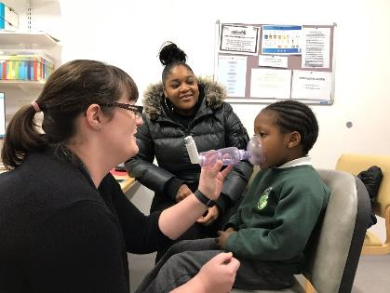
Asthma care in schools
Business as usual
Every CYP at school with asthma should have:
A Personalised Asthma Action Plan (PAAP)*
A reliever inhaler
The correct spacer
Every school should have as an absolute minimum:
An asthma policy
An asthma register
Trained staff and asthma leads
Emergency kit and consent to use
04/09/2020

Slide 123
Why does the risk of asthma attacks increase when returning to school?
And what impact could COVID-19 have?
Triggers | Cons | Pros
Seasonal colds | Spending more time indoors Spent up to 6 months apart | Better hand and respiratory hygiene Cleaner environment Wearing FC/masks Social distancing Self and household isolating
Dust mite and seasonal allergies | Increased exposure as more time spent indoors | Cleaner environment Wearing FC/masks
Preventer inhaler routines disrupted | Spent up to 6 months out of normal school routines | Improved concordance
Anxiety and stress | Increased time spent away from school COVID-19 concerns
04/09/2020

Slide 124

Spacers
Where possible maintain a social distance when supporting a CYP using a spacer
Adult to stand behind and to the side of the CYP, CYP breathing away from the adult but adult is able to observe valve moving back and forth and listen for whistle.
Ensure room is well ventilated, large enough space, open windows
No sharing
Storage
Not in a plastic bag, cotton bag is ideal
Washing spacers
Half termly or if visually dirty
Ensure the spacer is returned to the right CYP after washing
Wash hands
04/09/2020

Slide 125

Face coverings and masks
Government guidance should be followed re. where, when and who
CYP with asthma (even severe) can wear FC/masks if they are comfortable to do so
If it makes breathing difficult it could be due to uncontrolled asthma – talk to parent/carers, refer to School Health/GP
Practice wearing for short periods of time and try different types
Benefits - barrier between triggers
Filters the air – mould spores, dust, pollen, pollution
Improves respiratory hygiene
Warms the air
Anecdotally parents and CYP are reporting an improvement in symptoms since wearing FC/mask
04/09/2020

Slide 126
Cleaning
“ While professional cleaners often report respiratory symptoms, such as cough, when they are at work we believe this is due to the process of applying the products (and particularly sprays). The symptoms are thought to be due to irritation.
There is no evidence to suggest a newly cleaned room (even where ‘strong’ chemicals have been used) will have sufficiently high levels of cleaning agents lingering in the air to trigger respiratory symptoms; but it’s probably good practice, all things being equal, to open the windows after cleaning. For those with well-controlled asthma, strong smells (including bleach) do not generally trigger asthma symptoms.
Conversely, the increase in frequency of cleaning in schools may result in a reduction in virus transmission between children – viral infections being a common cause of respiratory symptoms.”
Dr Johanna Feary MRCP (UK), PhD, MSc
Senior Clinical Fellow in Occupational and Environmental Medicine
National Heart & Lung Institute, Imperial College
04/09/2020

Slide 127
Whole School Asthma Approach
A new approach to asthma care in Newham schools
Estimate there are 6000 CYP in LBN who have asthma
Sub-optimal housing (damp/mould), pollution (congested roads, industrial traffic)
Everyone with asthma should have a PAAP but we know these aren’t always completed in primary and secondary settings, they are completed but don’t make their way into school or they aren’t reviewed annually
Request for a PAAP or PAAP review accounted for 20% of all referrals to the School Health Service from schools in 2019/2020
School Nurses ‘mopping up’ for the wider system
In some schools, school staff writing PAAP
04/09/2020

Slide 128
Looking for a solution
LBN was already working towards all schools being ‘Asthma Friendly’
Already provide regular asthma management training for school staff but not achieving the reach of all school staff
Trying to shift the focus of School Health from completing PAAPs to supporting schools to become Asthma Friendly environments
Limited resource and capacity, stuck in firefighting mode ‘CYP still need PAAPs!’
PAAPs (or any IHCP) can take multiple appointments (e.g. was not brought, wrong medication/device), appointments take time to arrange, associated documentation, or if not completing the PAAP time is spent chasing from wider system
This is all when they should be and are better completed elsewhere in the system (GP, clinics, hospital)
04/09/2020

Slide 129

What have we done so far?
Both have membership at the Pan London CYP asthma nurse network meetings where we had the pleasure of hearing about the work taking place in Hillingdon schools in November 2019
We felt inspired to localise this way of working in Newham and set to work
Despite there being a global pandemic we have continued to drive this project through, recognising the anxiety that returning to school and asthma would cause for the schools CYP and their families and the increased workload for public Health services such as the SHS
Trained 40 Asthma Champions across the HV and SN workforce
Met virtually with Hillingdon
Designed a suite of materials for schools to use
Approved by our two governance boards
Approached a handful of schools to join us on the journey
Launched the Whole School Asthma Approach for all schools in LBN
04/09/2020

Slide 130
What is the Whole School Asthma Approach?
SHS will issue an asthma action plan for the whole school (or nursery, PRU, etc.) that will support all CYP with asthma in that setting
Issued providing the school has achieved a set of criteria that makes them an Asthma Friendly setting
The school is assessed or reviewed annually against the criteria rather than the School Nurse reviewing (or chasing others to review) each PAAP annually
Criteria - a school must have
  An asthma policy
  An asthma register of all CYP with diagnosed asthma
  An emergency asthma and allergy kit with procedures for use and ongoing management
  Consent from parent/carer of all CYP with asthma to use the emergency inhaler
  A system for recording the use of medication and flagging excessive use (3 times a week including at home)
  A system for identifying and referring CYP who are absent or unable to take part in PE due to asthma to the CHS 0-19.
  An asthma lead and other key staff trained in the management of asthma and allergies
  At least 85% of the school workforce trained in asthma awareness
  It is the school’s responsibility to make the SHS aware of any changes in their circumstances i.e. staff leave and minimum training numbers drop
04/09/2020

Slide 131
Why it works
The personalised element of the PAAP is information not required in an emergency or in the school/nursery environment e.g. preventer medication which is only given at home
What to do when a CYP with asthma is unwell or experiencing asthma symptoms and what to do when a CYP is having an asthma attack is the same for each CYP (age/setting adapted)
Ensures that school/nursery staff are able to support CYP in an emergency even if their PAAP is not in school/nursery
Does not replace the PAAP but is aligned so either will support in an emergency
Improves accessibility to information about asthma care
Can be used in conjunction with school emergency inhalers and AAIs
04/09/2020

Slide 132
Shift in the School Nurse role
Identified funding to create a new COVID-19 PH nurse and nursery nurse role which will include embedding the whole school asthma approach in every LBN school – a number of resources available for schools i.e. self assessment form, policy templates
By no longer completing PAAPs it builds capacity and we will be increasing the asthma training offer to schools by 800%
Providing training for more school staff will enable better identification of CYP who require further support and ensure the correct medication/spacers are in schools in a timely manner rather than making a referral and waiting for SN/HV to action
Builds capacity to see CYP
  Absent due to asthma
  Unable or have difficulty in participating in PE due to asthma
  Using blue inhaler more than 3 times in the space of a week
  Who have attended A&E due to asthma
04/09/2020

Slide 133
Whole school asthma action plan
3 versions of poster, design can be adapted for setting
  Nursery
  Primary
  Secondary
Different number of puffs and who to refer to (HV/SHS)
Age specific devices pictured
Display on the wall of every room in the school/nursery environment
Available in A3, A4, A5
A5 for school trips, PE off-site, emergency kits etc.
Think allergies!
04/09/2020
04/09/2020

Slide 134
Any questions?
04/09/2020

Slide 135
Next steps and close
What will you take away from today?
Go to menti.com and enter the code 25 88 88 5

Slide 136
All the work we do with our partners moves us closer towards our goal to make London the healthiest global city.
www.healthylondon.org
england.healthylondon@nhs.net
@healthyLDN

