Slide 1
South Thames Paediatric Network
Dr Marilyn McDougall, Network Director
16th May 2019

Slide 2
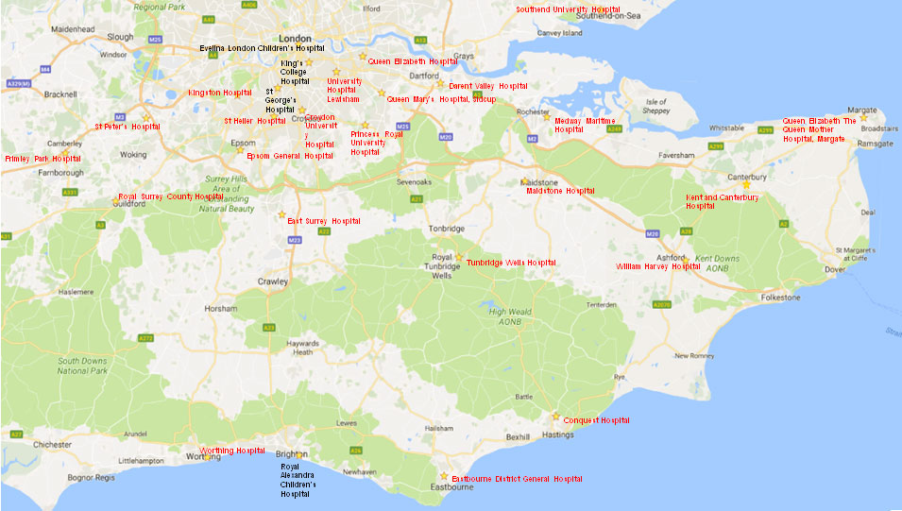
Our network

Slide 3
Network configuration
Tertiary centres
DGHs
Lewisham and Greenwich
Croydon
Host: Evelina London
Dartford and Gravesham
Ashford and St Peter’s
St George’s
Medway
Royal Surrey
King’s College Hospital
East Kent Trust
Surrey and Sussex
Royal Alexandra, Brighton
Maidstone and Tunbridge Wells
East Sussex Trust
Kingston
Epsom and St Helier

Slide 4
Network vision
Children in the network having access to high-quality specialist paediatric care in the place most suitable to their needs, at the appropriate time
Improved standardisation of care across the network governed by quality standards and agreed pathways
Shared learning across the partners on valuable aspects of service delivery or development from clinical best practice, service transformation, new models of care or new roles/workforce
Economic benefits for both providers and commissioners achieved through improved efficiency of services , avoiding unnecessary duplication

Slide 5
Network governance
The South Thames Paediatric Network is commissioned by NHS England and hosted by Evelina London
The core team is:
Dr Marilyn McDougall is Network Clinical Director
Harriet Ward is Network Manager
David Taylor is our Analyst
Miriam Cabib is our Project Manager
Teresa Davey is our Project Coordinator
Members of the network team can be contacted by email at england.stpn@nhs.net
The Network Board has been established with representation from each of our regions and tertiary centres, commissioners from both NHS England London and South, and a patient representative
The STPN has a strategic function to bring together partners from across the region, as well as develop, monitor and advise on the individual clinical Operational Delivery Networks
We are accountable to NHS England Specialist Commissioning

Slide 6
Critical Care ODN
Four key challenges facing our region:
Activity and commissioning: There appears to be a lack of clarity over level 1 and 2 provision (activity, capacity and commissioning) in DGHs
Workforce: There is variation in the workforce across units, both in terms of quantity and skill levels
Variation in practice: There is variation in the way that patients are cared for across units
Increase in Long-Term Ventilation (LTV) patients: There has been a significant growth in admissions for LTV patients
What will we do?
Review commissioning, funding and resourcing of level 1 and 2 critical care provision
Develop regional training and education plan, incorporating potential to share staff across centres
Explore potential for establishment of level 2 critical care hubs across the region
Establish regional management guidelines and referral pathways, training and study days

Slide 7
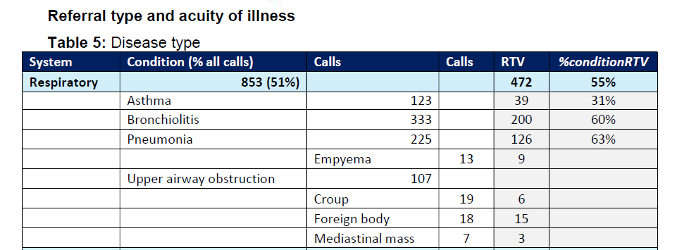
Asthma and PC & Asthma
2018
1702 STRS referral calls
1507 from ST region (88%)
868 retrievals activated : 56% respiratory, 8% asthma

Slide 8
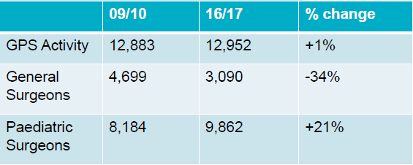
Paediatric Surgery ODN
Key challenges facing our region:
Feedback on the current emergency patient transfer system:
Reduction in surgery delivered by general surgeons outside tertiary centres:
What will we do?
More data: to test hypothesis
Working group: create a multi disciplinary working group with representatives from tertiary centres, from Spec Com, from DGHs, and from CCGs with both clinical staff and managers
Standardisation of the model of providing paediatric surgery across the network
Referrer: They never have beds. Then do not take any ownership in helping find beds. We don’t have a designated specialist centre
Tertiary centre: It takes longer than expected to transfer an emergency patient
GPS provision by DGH general surgeons: - 34%
HES data

Slide 9
Congenital Heart Disease ODN
Key challenges facing our region:
There has been ongoing discussion about how best to improve the quality of care delivered to CHD patients
Congenital Heart Disease Standards & Specifications published in 2016, mandating networks of specialist and local providers of cardiac care
Guys & St Thomas’ and Evelina London (GSTT-ELCH) host the CHD Network for centres across London and South East England
What are we doing?
Recruited to key posts (Clinical Director, Lead Nurse, Network Manager, Admin Support)
Stakeholder Mapping (Database of contacts)
Peer review against CHD standards – 25th and 26th June
Team taking part in peer reviews of other ODNs
Work Plan (establishing clinical and operational priorities)
Governance (creation of Network Board, organisational structure and SOPs)

Slide 10
ODN Enablers
Standardisation and central procurement of equipment – for example saturation monitors, ? Monitoring app
Regional agreement of clinical guidelines and pathways – for example, use of hiflow, acute severe asthma, sickle cell disease
Network website to publicise work, share education resources , provide contact information, host clinical guidelines
E-referral system: business case going through GSTT
Real-time demand and capacity data capture – Beautiful Information (East Kent Trust) to complete a feasibility study
Network passports to enable cross-site working
Establish joint working with London Neonatal ODN and South Thames Paediatric Cancer Network

