Slide 1
Severe Asthma Network
Dr Atul Gupta, MBBS, DM, DNB, MRCPCH, MD(Res)
Consultant in Paediatric Respiratory Medicine,
King’s College Hospital
Senior Lecturer, King’s College London

Slide 2
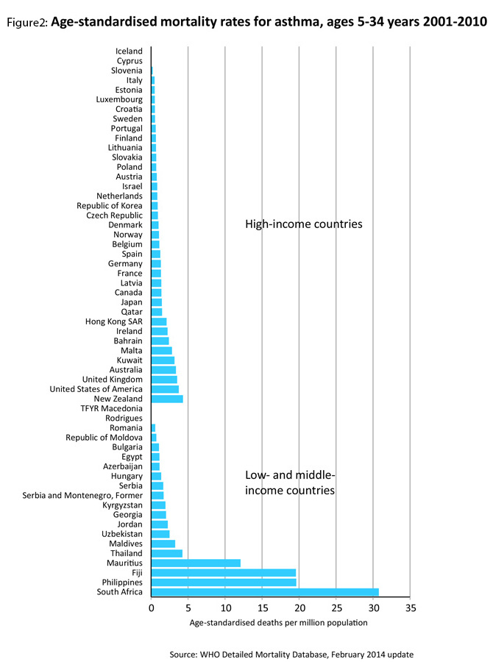
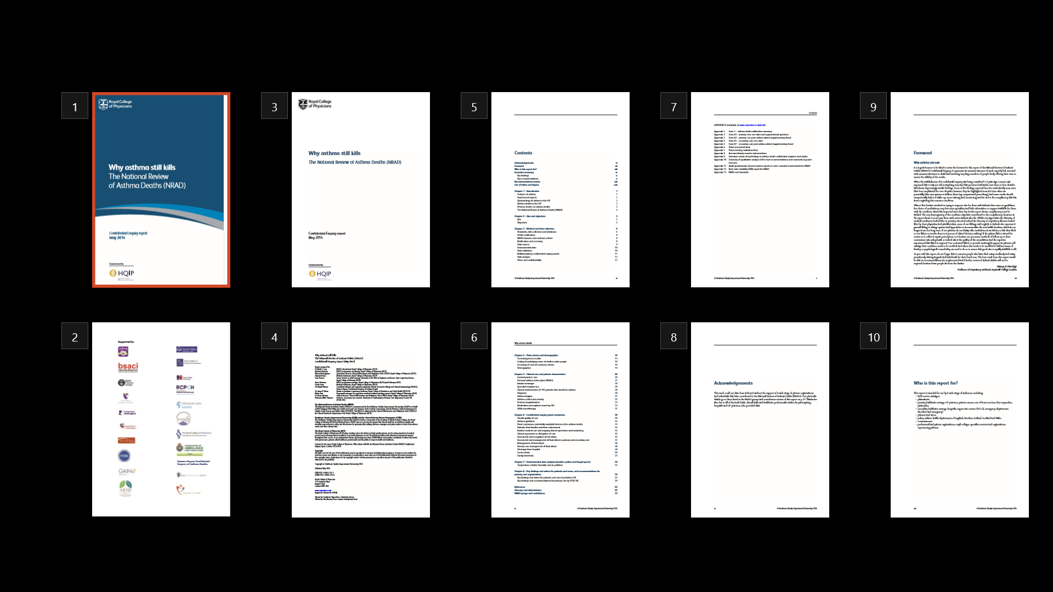
Age-standardised mortality rates for
asthma, ages 2001 - 2010
Wolfe, Lancet 2013;381:1224-1234
Review of 195 deaths
Highlighted widespread inadequacies in care
National Review of asthma deaths RCP 2014

Slide 3
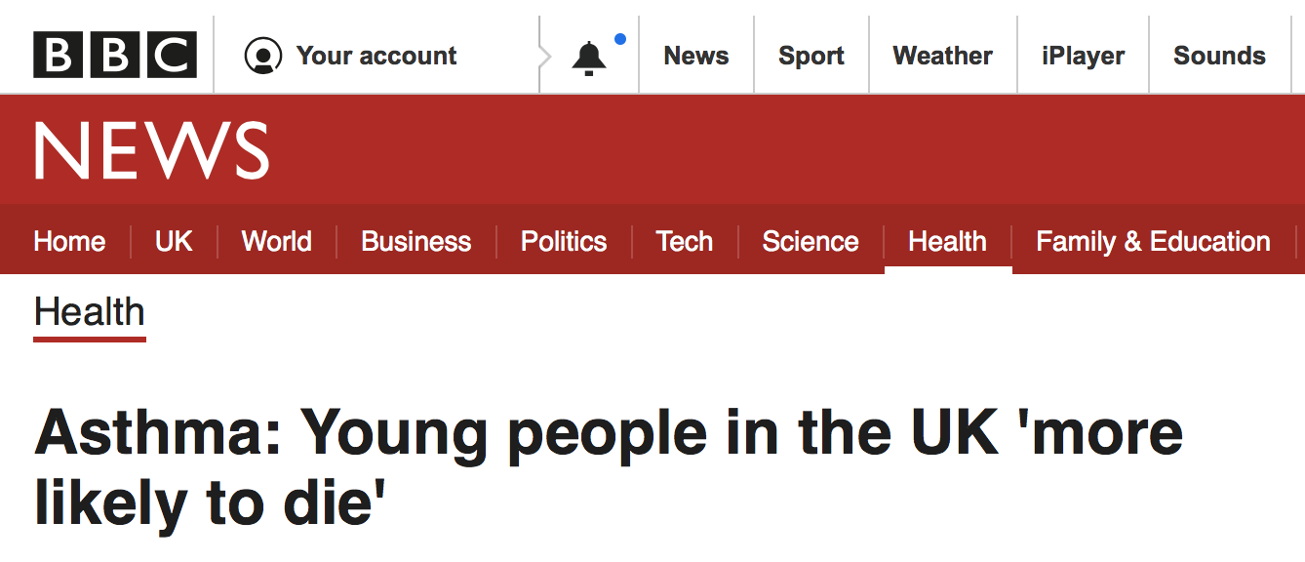
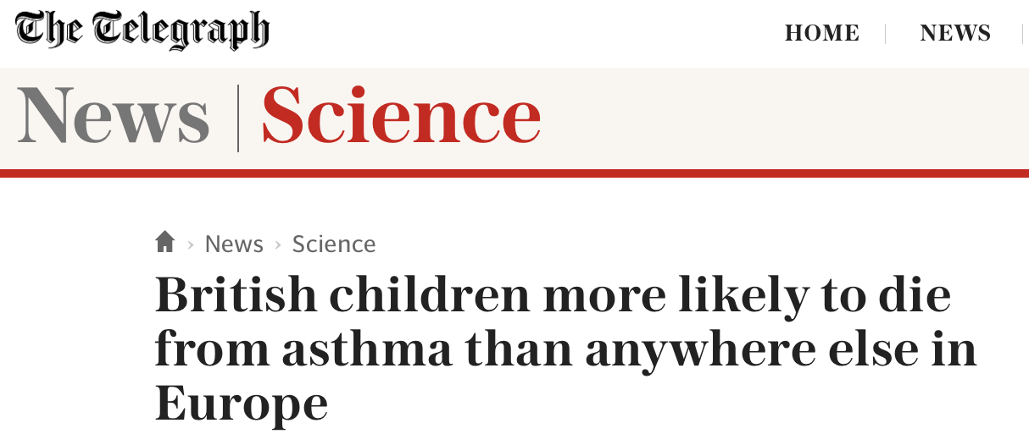

Slide 4
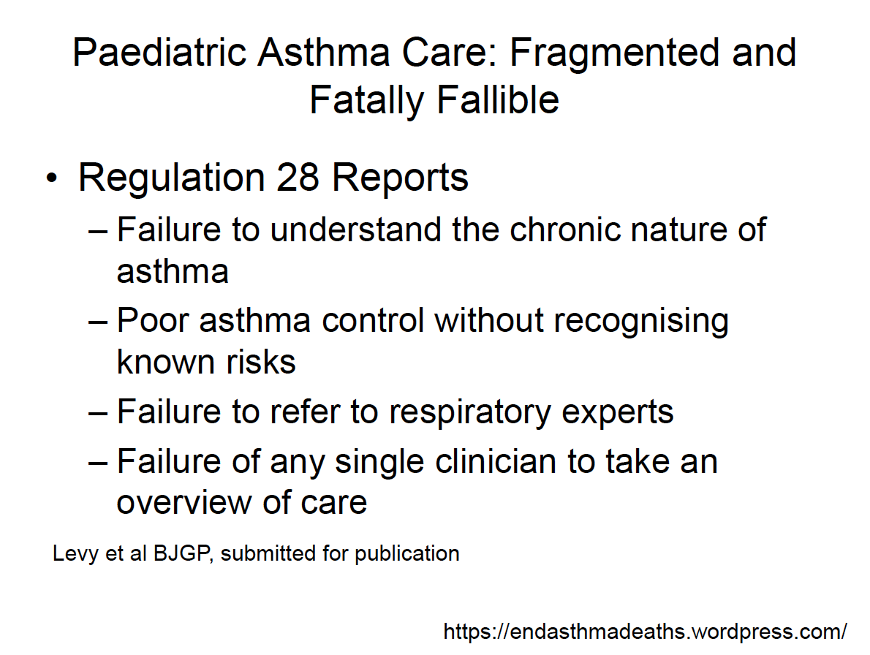

Slide 5
Slipping through the net
Why patients with difficult/severe asthma aren’t getting the care they deserve
Interviewed 17 severe asthma clinicians and nurses from across the UK
Surveying 72 primary and secondary healthcare professionals
Slipping through the net: the reality facing patients with difficult and severe asthma
- highlights concerns about the current state of difficult/severe asthma care in the UK.
Ref:AsthmaUK

Slide 6
Slipping through the net: Key recommendations
Determine the size of the Severe asthma population
Clear definitions of difficult & severe asthma
Clear referral criteria between primary, secondary & tertiary
Reduce Variations & Improve standards across tertiary care
NHSE & clinicians develop, publish and promote evidence-based strategies for the management of difficult and severe asthma.
Link & share patient care records across settings
Severe Asthma Registry
Digital opportunities

Slide 7
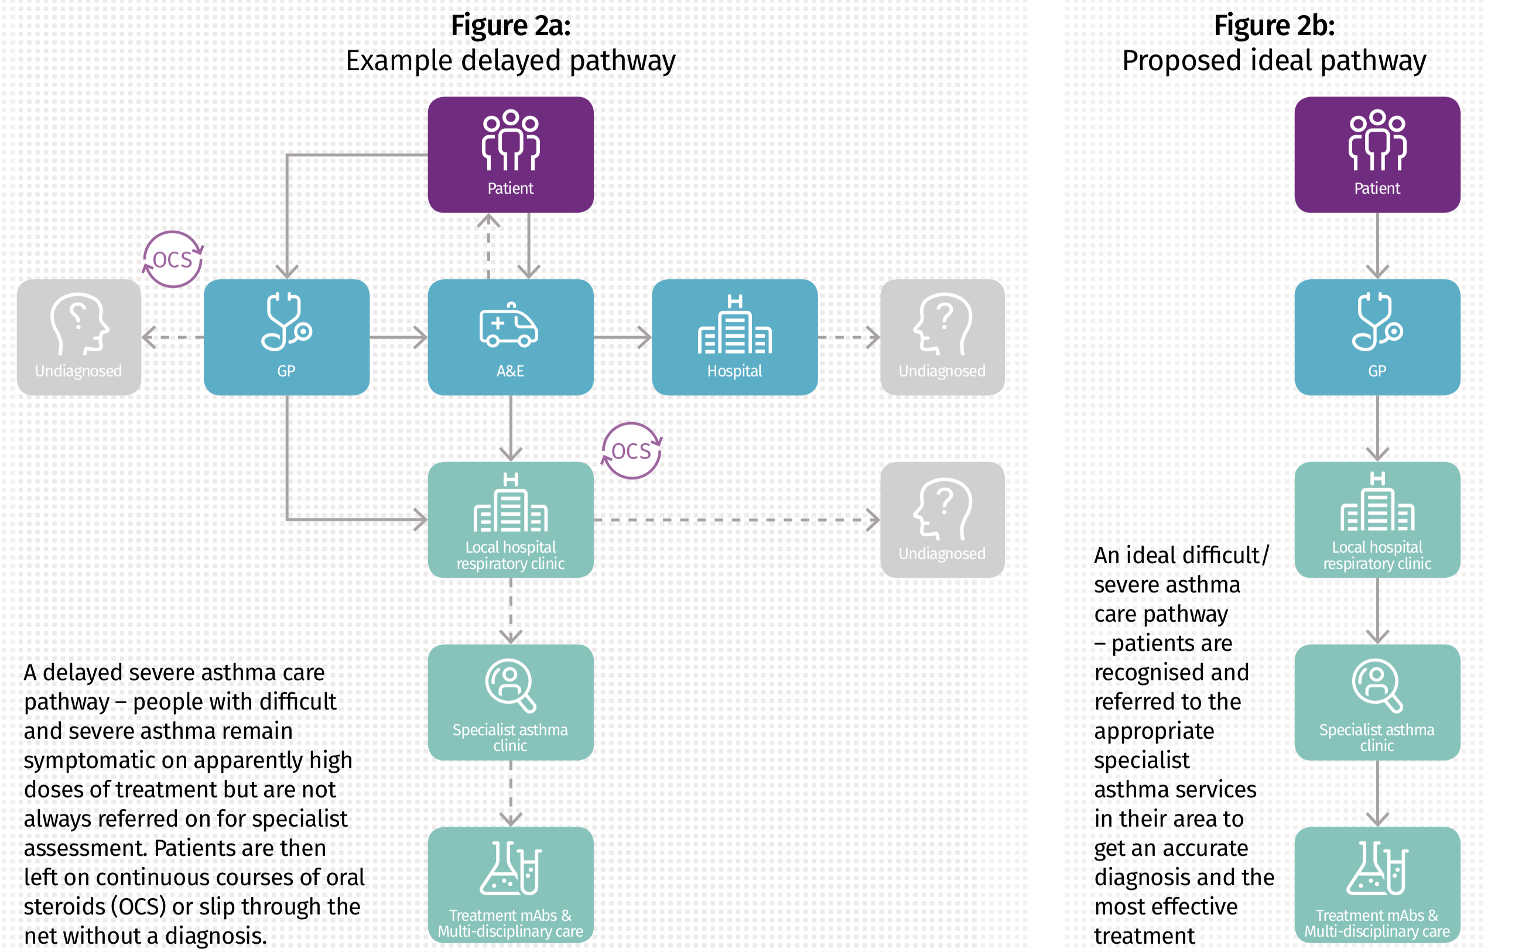
Ref:AsthmaUK

Slide 8
Market Research
GPs saw an average of 170 patients with asthma in the last 12 months, of whom, 27 (16%) needed more than 4 courses of OCS
Paediatricians saw an average of 37 patients needing treatment with 4 or more courses of oral corticosteroids in the last 12 months
Almost 6/10 patients needing 4+ courses OCS are not referred on by general paediatricians
Commissioned by Novartis

Slide 9
Okay, which patients are we talking about ?

Slide 10
Proposed Referral Guidelines to MDT Severe Asthma Services
Despite high dose treatment (high dose ICS plus long acting β₂ agonist)
  Recurrent severe exacerbations in the past year (≥3 per year requiring hospital admission or high dose OCS for ≥3 days)
  Children with poor control /Persistent chronic symptoms (most days for >3 months; Asthma Control Test (ACT) or Childhood Asthma Control Test (C-ACT) score of <20)
  Persistent airflow obstruction (FEV₁ <80% post bronchodilator)
Prescribed maintenance oral corticosteroids for 4 weeks
Admitted to PICU in last 2 years
Other considerations:
  Diagnostic uncertainty
  Complex psychosocial / safeguarding issues
  Dysfunctional breathing
  Enrolment in clinical studies

Slide 11
Severe Asthma
Poorly controlled Asthma

Slide 12
Severe Asthma
Wrong diagnosis
Poorly controlled Asthma

Slide 13
Severe Asthma
Wrong diagnosis
Poorly controlled Asthma
Non-adherent

Slide 14
Severe Asthma
Wrong diagnosis
Poorly controlled Asthma
Non-adherent
Symptoms out of proportion

Slide 15
Severe Asthma
Wrong diagnosis
Poorly controlled Asthma
Non-adherent
Symptoms out of proportion
Dysfunctional breathing

Slide 16
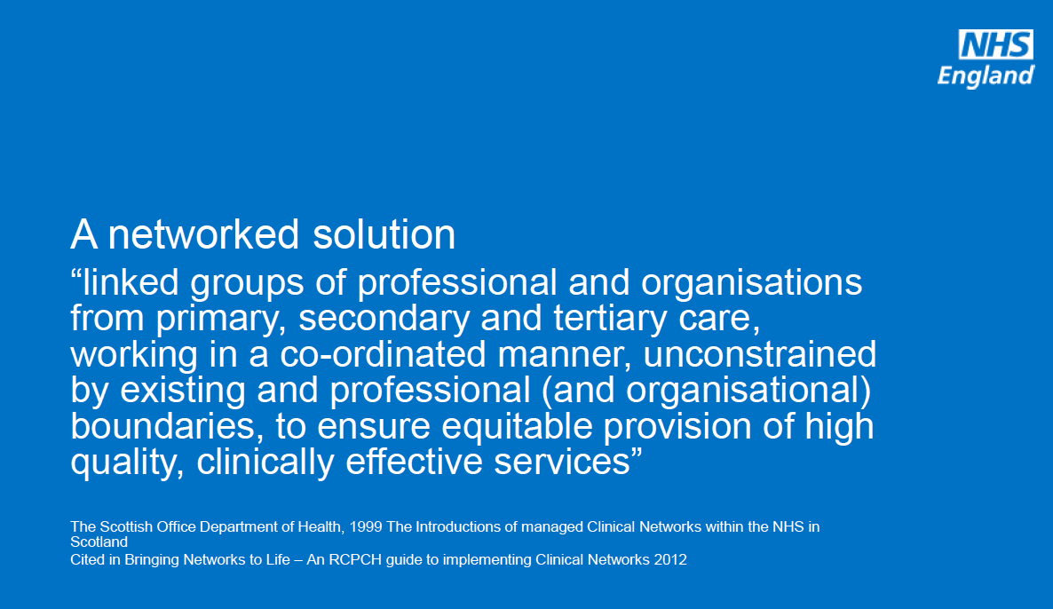

Slide 17
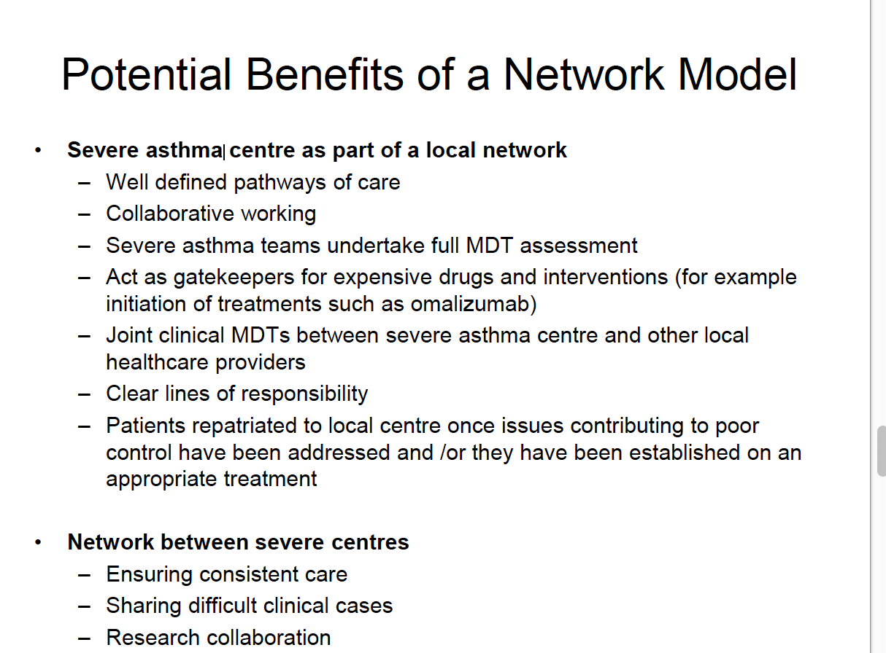

Slide 18
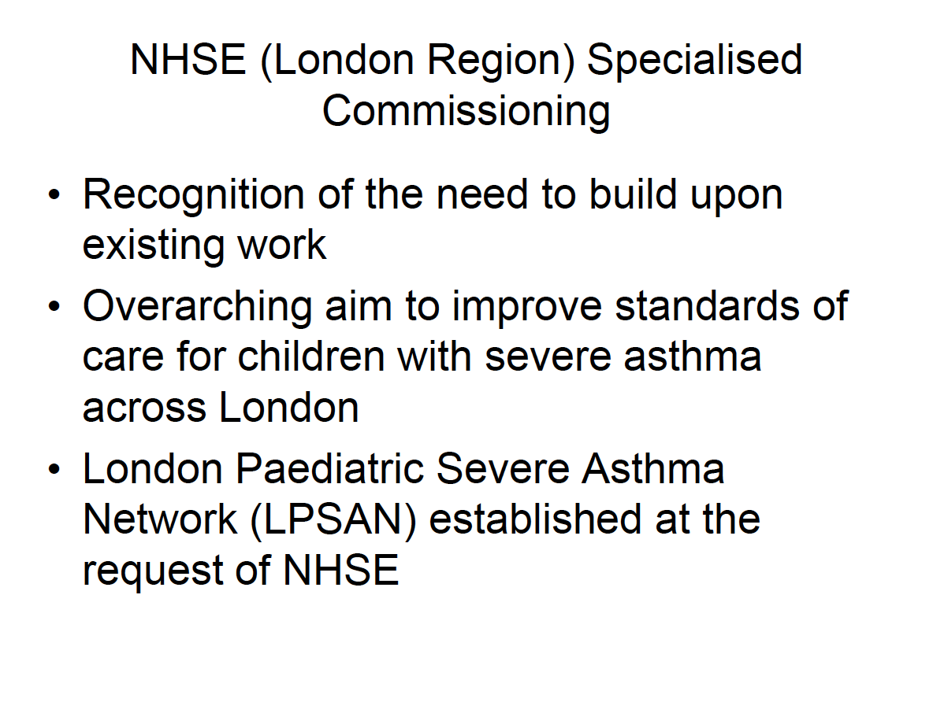
And in Specialised Commissioning, the Pan London Severe Paediatric Asthma Network was established in 2017

Slide 19
Proposed new KHP CYP Severe Asthma Service

Slide 20
KHP CYP Severe Asthma Service
PICU
ELCH
Difficult Asthma Clinic
North London centres
Allergy Clinic
Local GPs
Asthma
Clinic
ELCH
Difficult Asthma Service
ELCH
DGH
North networks
ED ELCH
PICU
King’s
Allergy Clinic
Difficult Asthma Service at
King’s
(Lead centre)
KHP CYP Severe Asthma Service
General Respiratory Clinic
King’s
Local GPs
ED King’s
DGH
SEL & SE network

Slide 21
KHP CYP Severe Asthma Service
Propsed New KHP CYP Severe Asthma Service
The Difficult Asthma services at ELCH and King’s to form a single “KHP severe asthma service”
King’s (Denmark hill) site to be the lead centre
Regular cross-site “Severe Asthma MDT meeting”
Reducing duplication
Streamline severe asthma services
Patients on BTS step 4 & 5 of the treatment should be discussed in the KHP MDT
The gate-keeping for biologic therapy by King’s. CYP eligible for such treatment should have had a prior rigorous systematic assessment in the DA clinic to ensure that they have severe therapy resistant asthma (STRA)

Slide 22
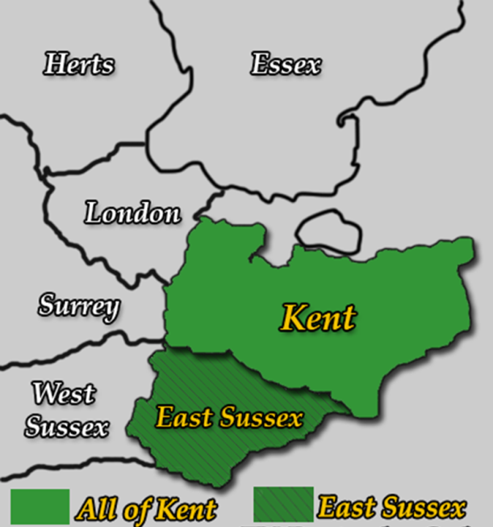
Severe Asthma Network
The DA Clinic at King’s has evolved over 20 years
Experienced MDT service
Referrals come from SEL & SE England through a clinical network formed with local hospitals in Pembury, Eastbourne, Medway, Bromley, East Kent, etc
Catchment in SEL and SE England:

Slide 23
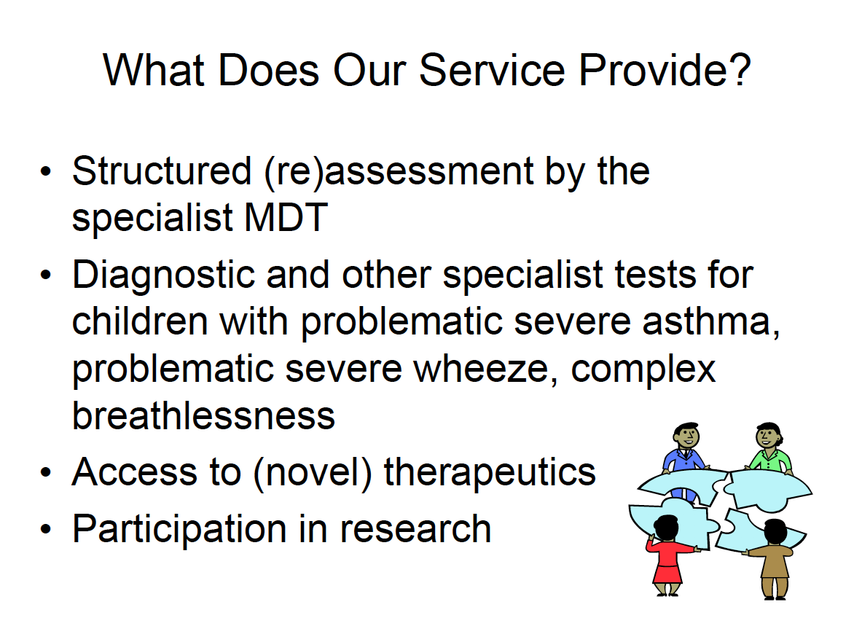

Slide 24
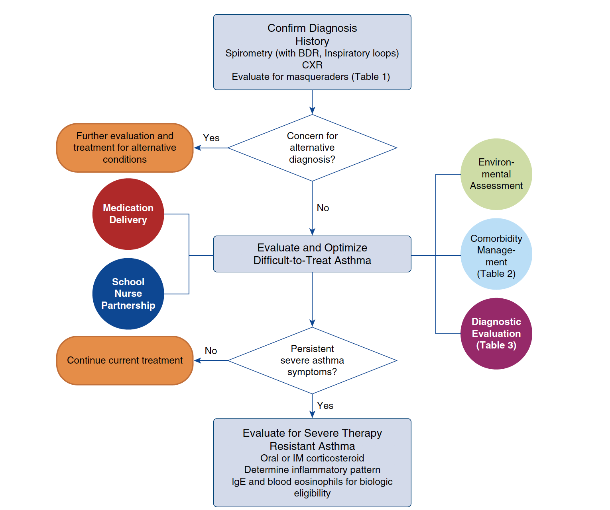
Summary: Practical Approach to Difficult / Severe Asthma

Slide 25
Proposed referral criteria

Slide 26
Referrals to Paediatrician
Referrals / under the care of a specialist paediatrician
BTS/SIGN recommends that children on medium ICS dose ‘should’ be under the care of a specialist paediatrician for the duration of the treatment.
>2 exab requiring steroids / ED attendance

Slide 27
Proposed Referral Guidelines to Severe Asthma Services
Despite high dose treatment (high dose ICS plus long acting β₂ agonist)
  Recurrent severe exacerbations in the past year (≥3 per year requiring hospital admission or high dose OCS for ≥3 days)
  Children with poor control /Persistent chronic symptoms (most days for >3 months; Asthma Control Test (ACT) or Childhood Asthma Control Test (C-ACT) score of <20)
  Persistent airflow obstruction (FEV₁ <80% post bronchodilator)
Prescribed maintenance oral corticosteroids for 4 weeks
Admitted to PICU in last 2 years
Other considerations:
  Diagnostic uncertainty
  Complex psychosocial / safeguarding issues
  Dysfunctional breathing
  Enrolment in clinical studies

Slide 28
Problems / challenges with the current severe asthma network model
Young People in UK are more likely to die of asthma (Nuffield report)
Fragmented care (regulation 28 reports)
Widespread inadequacies in the care (NRAD)
Deeply distressing for people with difficult/severe asthma (Asthma UK)
Poorly defined care pathways / thresholds for onward referral (Asthma UK)
Significant variation in the delivery of care. (Asthma UK)
As compared to the adults, not a specialised commissioning for severe asthma
As compared to Paed Diabetes, not a Payment by results / best practice tariff
Logistical and financial support
Formalising network

Slide 29
Taking Forward the Severe Asthma Network
Build upon existing networks and collaborations
NHS 10 year plan
HLP support
Joint MDT’s
SEL Asthma Network Meeting
Annual Shared care event
Peer review

