Slide 2
Children & Young People’s Health Partnership
Asthma Team
Laura King & Laura Doolan
Children’s Community Asthma Nurse Specialists
16th May 2019

Slide 3
What is CYPHP?
CYPHP is a partnership of local child health and care professionals improving children and young peoples health across Lambeth and Southwark.
We are testing at scale new ways of delivering better care for children, using a whole systems population approach.
CYPHP’s innovative approach uses evidence to improve quality, and is being evaluated in partnership with King’s College London.

Slide 4
How does CYPHP fit into the local child health landscape?
Urgent
Ur
Consultant Connect App
A&E
GP
Non urgent
CYPHP
KEY:
CYPHP Universal Services
Expert care for children with any condition
CYPHP Targeted Services
Tailored care for children with ongoing conditions
asthma, constipation, eczema, or epilepsy
Intervention + Control
practices
Intervention Practices
GP referral
CYPHP Support
GP guidelines for common child health conditions
Training for healthcare and non-healthcare staff
Active case finding (call-recall) Parent self-referral Professional referral
CYPHP Clinics
GP and Paediatrician
one-stop shop joint clinics at local GP practice
Health Check via patient portal
Biopsychosocial assessment
Information to tailor holistic care response
Engage family in care process
Health Support Packs
sent to all families
GP
GP
CYPHP Health team
Identify and engage with families who need additional care and support
CYPHP Support
Training for healthcare and non-healthcare staff
GP

Slide 5
Health Check Video https://www.youtube.com/watch?v=Y4WChnnmHaM

Slide 6
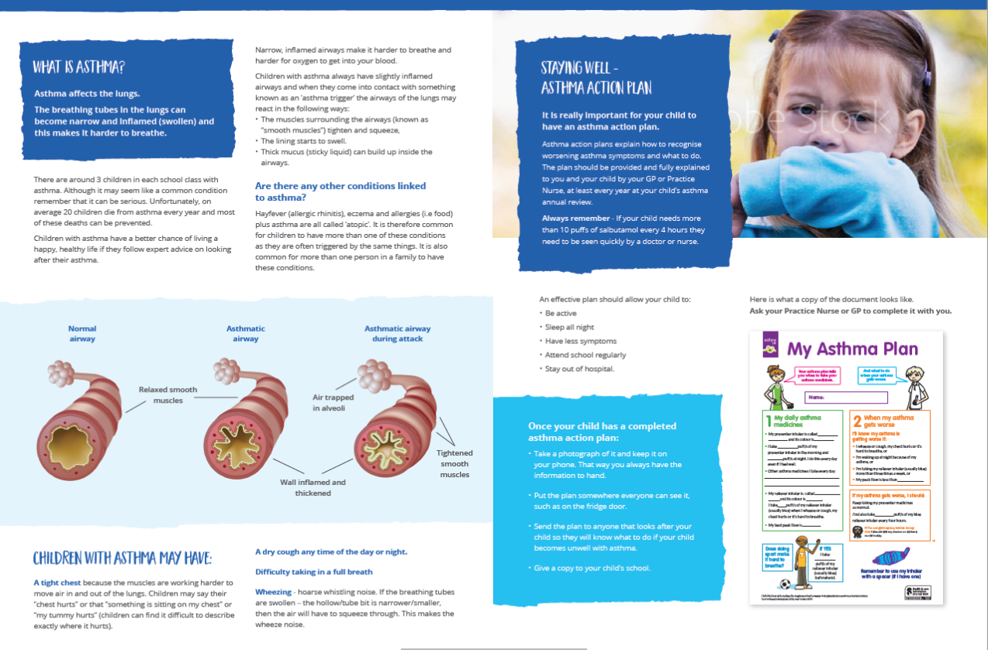
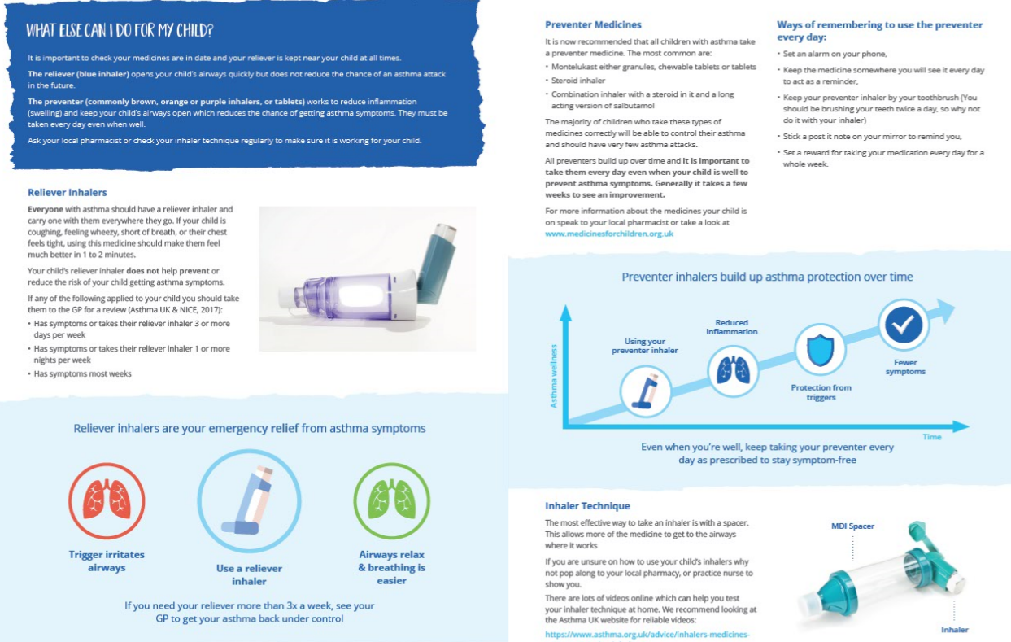
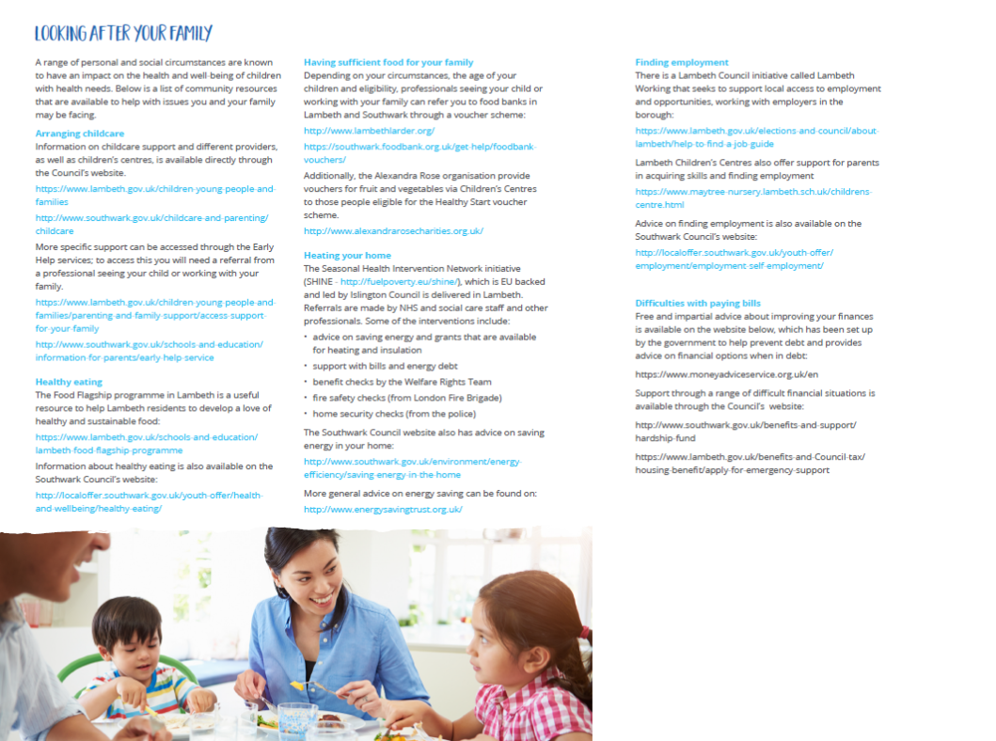
Asthma Health Support Pack

Slide 7
Completing the CYPHP Health Check

Slide 8
The Clinical Team
We are a team of Nurse Specialists and Mental Health Specialists, working across the boroughs of Lambeth & Southwark, carrying out community clinics and visits with an aim to provide effective care for mind and body.
Children & Young People can be referred in several ways: - The GP / Practice Nurses - School Nurses - Health Visitors - Hospital Paediatricians - Self-referral by the Health Check
During this phase of the study, the clinical team can provide a service to 57 GP practices, with a plan to roll-out to the remaining 31 practices in the next phase * The health check and health pack are offered to all practices

Slide 9
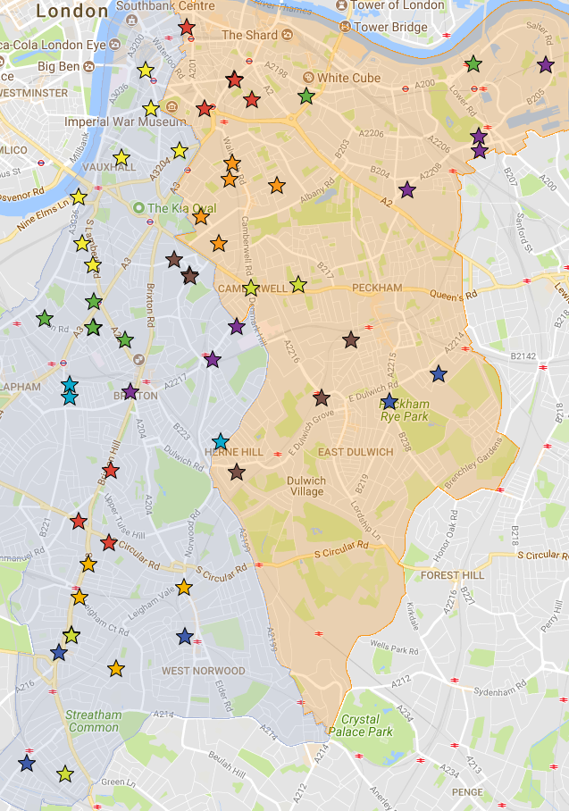
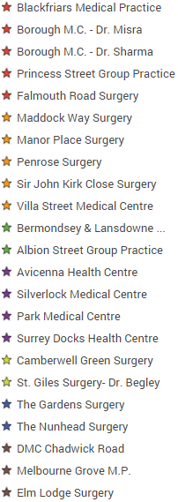
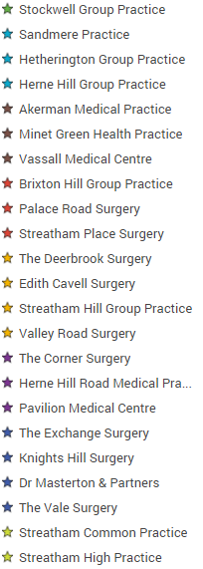
Phase 1 Practices
Cluster
Lambeth
Cluster
Southwark
Lam01
Swk01
Lam02
Swk02
Lam03
Swk04
Lam04
Lam06
Swk05
Lam08
Swk08
Lam10
Swk11
Lam14
Lam11
Swk12

Slide 10
What makes CYPHP unique?
Expert children’s healthcare at or near home.
Fully integrated care for children’s physical and mental health, in the context of family and community.
Weekly MDT including local GP, Paediatrician, Psychiatrist, Mental Health Specialists, Nurse Specialists & Community Matron
Supported self-management for families.
https://www.youtube.com/watch?v=5QbAEdbY0o4

Slide 11
Thank you for listening Any questions?

