Slide 1
Transforming the care of children and young people with asthma together in SEL
Anna Lucas, South East London STP
Georgie Herskovits, Healthy London Partnership

Slide 2
Our Healthier South East London
We aim to address three problems in local healthcare:
The health and wellbeing gap – people should be helped to lead healthier and longer lives
The care and quality gap – variation in the accessibility and quality of care should be improved
The funding and efficiency gap – the NHS must become more efficient and make better use of the money available

Slide 3
Priorities in SEL for children and young people
The priorities for the programme were established in 2018/19 and include children and young people’s:
mental health and wellbeing
urgent and emergency care and long-term conditions
Special Educational Needs and Disability and Autism
If successful we will see:
better physical and emotional support for families
more joined-up health and care services
easy access to the right services first time
shorter inpatient stays in hospital
fewer emergency admissions
straightforward transition into adult services

Slide 4
CYP in the NHS Long Term Plan
CYP commitments
CYP Transformation Programme
0-25 services
Mental health
Learning disability and autism
Cancer
Public health
Health inequalities
Maternity services
Support for carers and vulnerable families
Overarching changes:
Roll out of Integrated Care Systems
Decision making and accountability
Primary Care Networks
Changes to how care is delivered
Workforce
Legislative change

Slide 5
SEL priority: Urgent and emergency care and long-term conditions
SEL stakeholder workshops held in March and April 2019
Defined the problem
Children using Urgent & Emergency Care when they don’t need to or because their long-term condition has not been well-managed.
Develop a Case for Change
Family; Professionals; Primary care and Schools Perspectives
Create Vision
Strengthening community support
Hospital@Home
Developing integrated clinical networks and clinics (shared learning and paediatric clinics running in the community)
Next steps

Slide 6
Healthy London Partnership (HLP)
We aim to make London the healthiest global city in the world by working with our partners for Londoners to improve health and care, so everyone can live healthier lives.
Purpose
Bring together partners with improvement and transformation experts and Londoners, to work towards the common goals set out in Better Health for London, NHS Five Year Forward View, the Devolution agreement and now the NHS 10 Year Plan.
Develop an evidence base so we inspire London to be the best it can be, gathering insight and data, building on local successes and sharing learning and best practice.
Tackle issues best solved ‘once for London’ by pooling resources and attracting additional funding to specific London issues like homelessness or access to GPs.
Provide strategic challenge and robust governance through the London Health Board and the London Strategic Partnership Board.
www.healthylondon.org/
@HealthyLDN
Notes:
Healthy London Partnership works with CCGs, trusts and NHSE to deliver any once for london activities in healthcare. For example the asthma standards that we are going to talk to you about today were produced for anyone in London to use. We work with clinicians to make sure they are evidence based.
We are here from the children and young people’s team and we focus on CYP between 5 and 25.

Slide 7
London asthma data
One of top three causes of hospital admission for CYP
CYP with asthma action plan four times less likely to be admitted to hospital (Asthma UK)
Estimated that 75% admissions and 90% deaths preventable with optimal care
Annual cost unplanned admissions and PICU admissions £5.6 million across London
Investment in asthma reduces in-patient costs and improves self management, quality of life, reduces time off from school

Slide 8
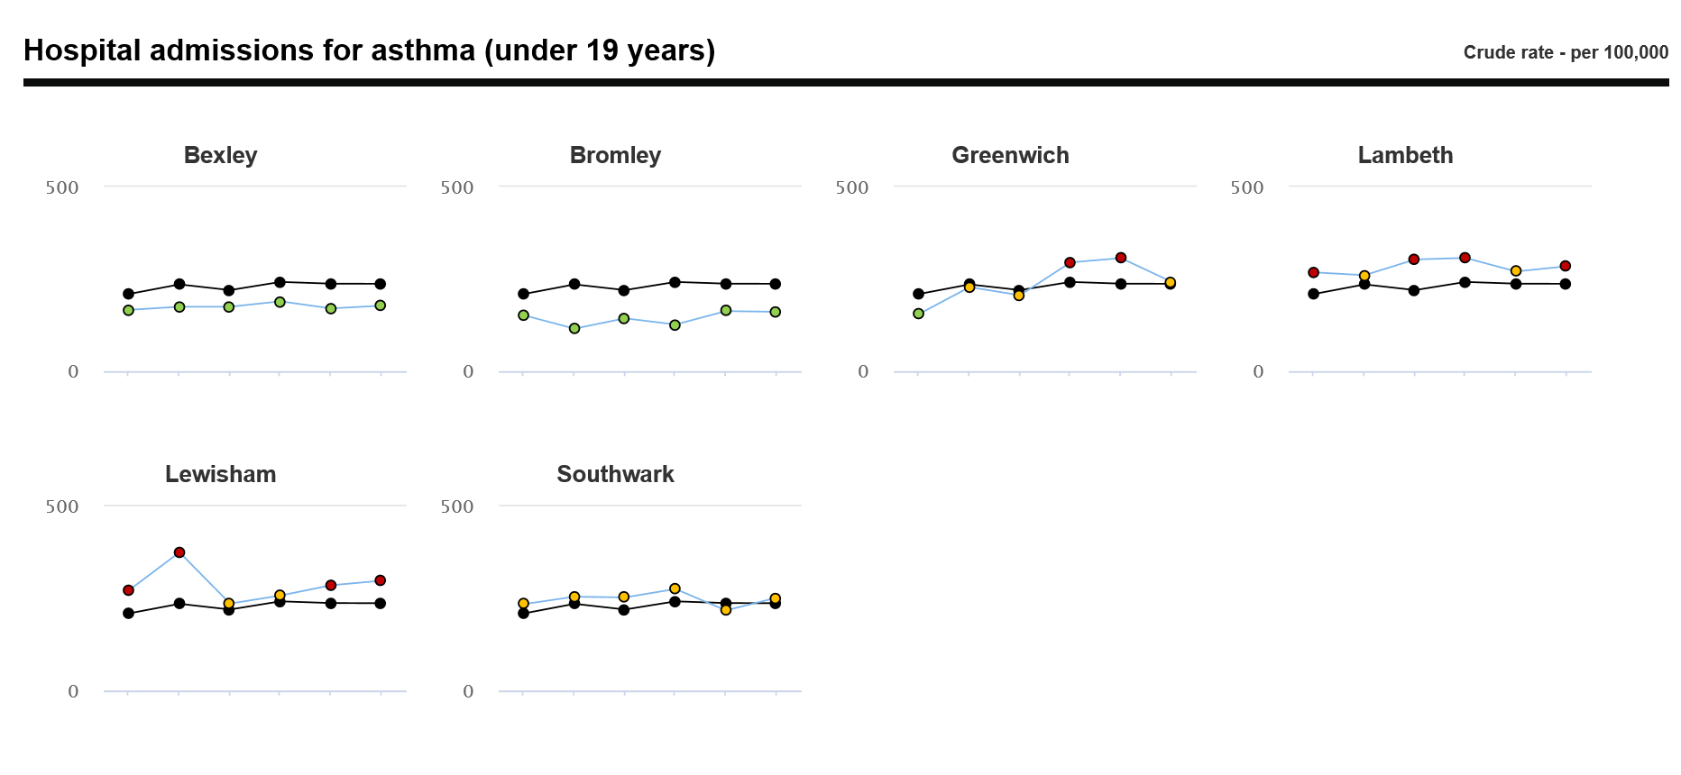
SEL asthma data

Slide 9
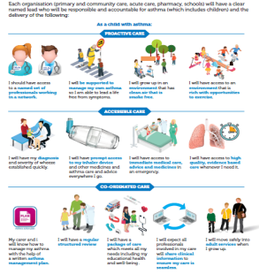
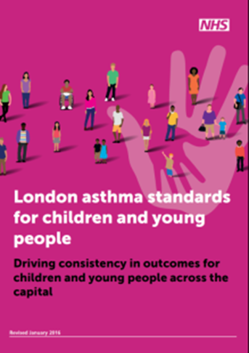
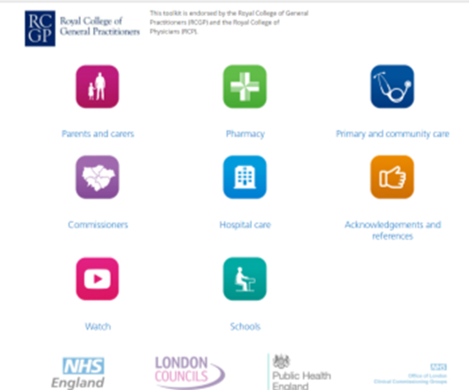
London Programme: Transforming the whole system through improved co-ordinated care, ambitions and standards for asthma care in CYP Support across the system to improve asthma care, reduce mortality, morbidity and admissions https://www.healthylondon.org/children-and-young-people/london-asthma-toolkit Ambitions
‘The London asthma standards for children and young people have been reviewed and published as a NICE Shared Learning example’
Notes:
AIG – group of expert clinicians and commissioners – guides our work.
Developed the London ambitions and standards and looked at a more joined up way of delivery
Covers all settings: Primary care, Secondary and tertiary care, Community pharmacies, schools, Self care, integration and co-ordination; discharge planning; transition; effective and consistent prescribing; workforce education and training
Prepared by collating a collection of standards already in existence, building on London Quality Standards, Primary Care Strategic Commissioning Framework and London Acute Care Standards for CYP
Purpose
Essential guide for commissioners and providers
Ensure responsible lead for asthma in each organisation
Improve consistency and quality in CYP services and reduce variation
Minimum standards of care in one place
Digital health passport:
The passport complements the London asthma programme which is aiming to reduce mortality, morbidity and admissions and improve experience of care through stated ambitions, collated standards and an online asthma toolkit to share best practice and useful tools and tips to prevent reinventing the wheel

Slide 10
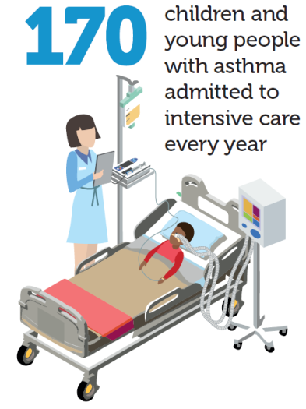
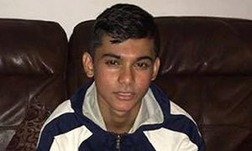
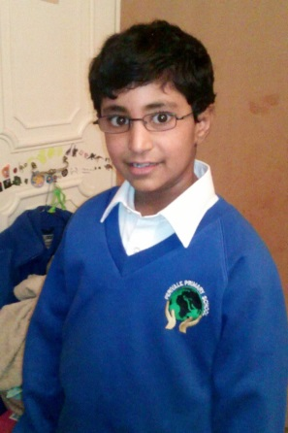
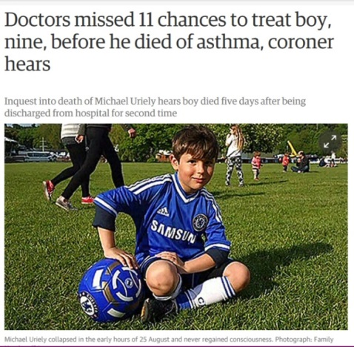
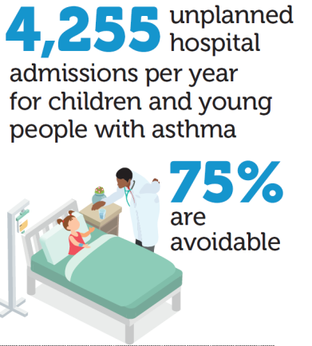
Why do we need to do this?
3000 LAS calls a year
The Ella Roberta story
https://app.box.com/s/h0sfrrmdczgcu9tk3fuweryugb2ghi7a
3 pupils in every classroom have
asthma
Notes:
No greater system failure than a child’s death Michael Urielay (in North London aged 9) and Naser Ahmed (14 year old who went in school in east london), 1 in SWL and 4 in BHR
Recent data shows that we have the worst outcomes in Western Europe
(International comparisons of health and wellbeing in adolescence and early adulthood)

Slide 11
We need to learn from these cases
Missed opportunities
No co-ordinating record, or analysis of frequency
No appreciation of underlying severity or risk factors or deteriorating nature of their conditions
No single clinician with overall responsibility
No coherent management plan or PAAP
Not referred to specialist respiratory paediatrician
Assessment and management of condition not in accordance with BTS/SIGN guidelines or NICE Quality Standards
No effective communication between primary and secondary care
Excess salbutamol (reliever) prescriptions and the presence of a home nebuliser, failure to collect preventer inhalers
Failure to recognise on-going and future risks
Notes:
Regulation 28 letter for most recent case in NEL
Failure of both primary and secondary care in a number of areas. Some of these issues show the real need to integrate health and care systems including school and pharmacy teams. The list was significantly longer in the final regulation 28 in NEL, but this is not about blaming individuals it is about what can we learn for the future.
Learning event held recently in NEL to try to learn from the tragedy of this little girl’s death.
One of the ways of learning will be to develop asthma networks (also highlighted in the long-term plan).

Slide 12
What are networks?
“Linked groups of professionals and organisations from primary, secondary and tertiary care, working in a co-ordinated manner, unconstrained by existing and professional (and organisational) boundaries, to ensure equitable provision of high quality, clinically effective services”
The Scottish Office Department of Health, 1999 The Introduction Of Managed Clinical Networks in Scotland
Notes:
Some areas are tackling this through networks.
So – what are networks?

Slide 13
Why have networks?
Promote uptake of evidence based practice (use of data)
Drive improvements in standards of patient care
Engage clinicians in improved models of care
Integration of services and multidisciplinary
Allow for continuous working relationships across boundaries
Improved flow of knowledge and best practice between individuals and organisation
Improved quality and access of care for patients
Notes:
What’s happening: NCL – best established – peer review carried out by HLP (against standards) and a system wide action plan and logic model/driver diagram developed on the basis of this.
NEL - well established – recently learning event (already mentioned)
NWL – just starting, building on existing Allergy and Asthma network. 1 event
SEL – early conversations, first meeting planned May.
SWL – an opportunity here?? We will support you to put one together.
Also a way of effectively linking with other networks (eg. SAN and paediatric networks that are developing in north and south London)
Mention PCNs?

Slide 14
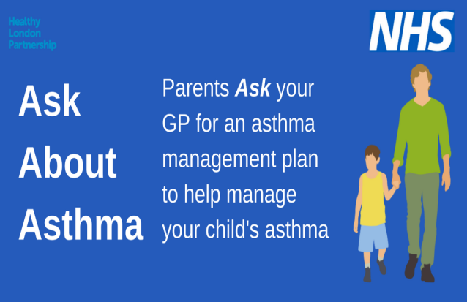
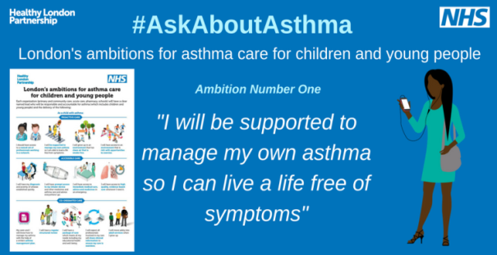
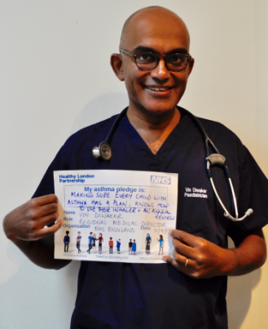
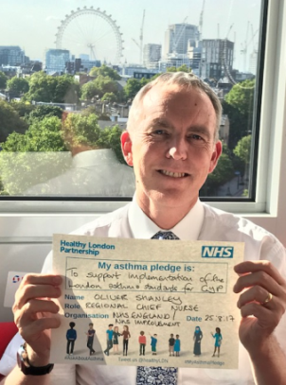
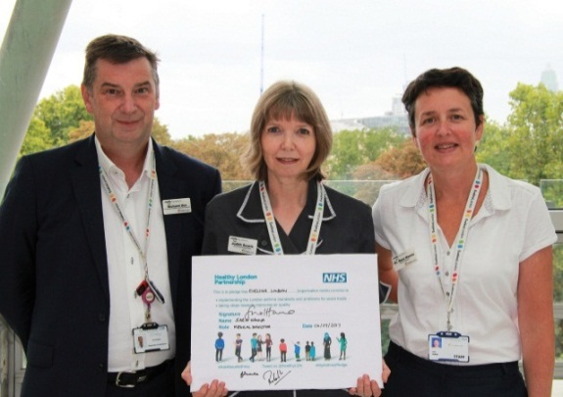
#AskAboutAsthma campaign
Organisations are asked in Sept (week 38) to pledge to:
Implement the asthma standards
Implement asthma ambitions for London
to pledge to reduce their impact on air pollution as a major trigger of asthma
Three key messages:
Asthma management plan
Effective inhaler use
Annual review
Notes:
Impact in London
National interest through a presentation to Jane Cummings and regional nurse leads at Quality Assurance Group July 12th
783,000 hits in 24 hours on facebook
Campaign success
Number of organisations and individuals signing pledges
Media reach
Social media reach
Seek formal feedback from CYP, CCGs, GPs, clinicians, pharmacists
Effect on asthma care (timeframes for measurement to be discussed)
Redo pharmacy audit – improved % CYP with asthma plan, inhaler technique, decreased emergency inhaler requests, increased flu vaccine uptake
Annual asthma review data – improved
Decreased emergency admissions for asthma
Reduction in PICU admissions
Reduction in asthma deaths

Slide 15
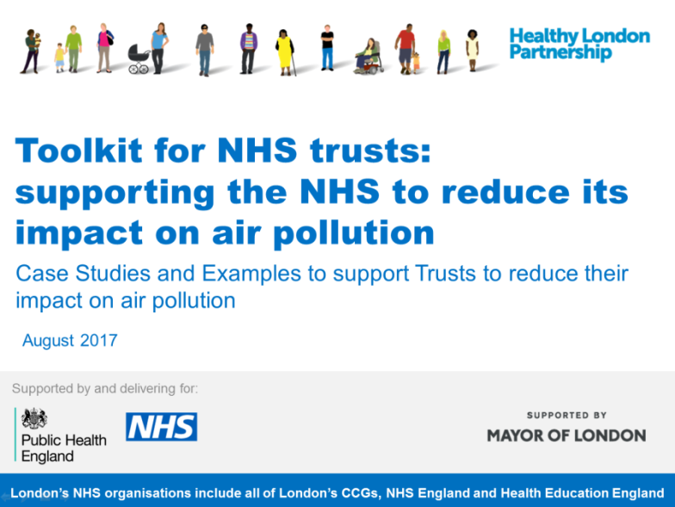
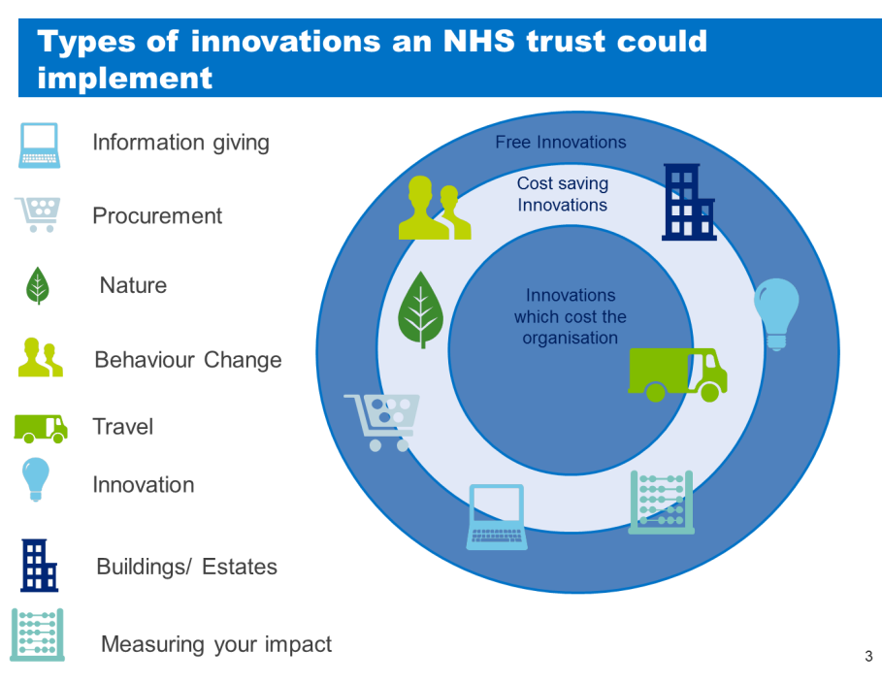
Support to NHS trusts reduce their air pollution
Three types of interventions described:
Ideas that are free to implement
Encouraging staff and patients to walk/take public transport
Encouraging use of car pools
Using volunteers to reduce engine idling outside premises
Demonstrating support for Mayor's air quality strategy
Ideas which can save an organisation money
Reviewing products purchased
Encouraging bulk deliveries
Reducing waste
Supporting the “circular economy”
Ideas which may cost money (potentially funded through trust charity funds)
Planting nitrogen fixing plants/green wall
Use air quality sensors
Clean air benches
Pollution-reducing paint
Download the Toolkit for NHS Trusts.

