Slide 1

The Future Workforce Modelling Tool
A step-by-step guide
August 2018

Slide 2
What is a Workforce Modelling Tool?
This is a tool we hope you find useful, especially for those wishing to bring about new models in primary and integrated care, and service re-design around specific groups of patients. Using a combination of population data (existing and growth), HEE supply data, and local information on service use and who does what (currently and in the future), the modelling tool can show future workforce profiles, thus informing requirements around the supply of new and existing roles.
This is a valuable planning asset that enables organisations to consider workforce implications of new ways of working and service transformation activities, both strategically and locally. It will help produce scenarios and options for what the future workforce might look like. Most importantly, it stimulates discussion amongst clinicians, providers and commissioners around future workforce requirements at the beginning of the design phase. A number of test sites have been identified and the tool is now available for use by commissioners, primary care networks, federations, workforce networks, service development groups, e.g. LTC.
The ‘Beta2’ version Future Workforce Tool was co-designed with providers and commissioners from all five London STP areas with the new capabilities and user-friendly interface. This is an early iteration of the tool which will likely further develop over time.
While the tool currently only looks at patient appointments, for future iterations, it may be useful to look at patient contacts as opposed to appointments. This may be a more accurate reflection on general practice workload, however there is less evidence and research to input the assumptions, but you may have more local data to support this.

Slide 3
Step-by-step guide
The first time you complete this model you are asked to complete with current data and assumptions. This will generate your 'baseline' scenario and allow you to see the skill mix required to deliver this model of care in 5 years. (Future Do-Nothing)
Following this you can revisit the model to amend assumptions and create future scenarios that can then be compared to your baseline and Future Do-Nothing scenarios. All starting assumptions and inputs are based on clinical feedback, research and national data sets. However if you have more local and accurate assumptions, you can add in your own knowledge via the orange boxed. The model runs from top to bottom and each section must be completed in order.

Slide 4
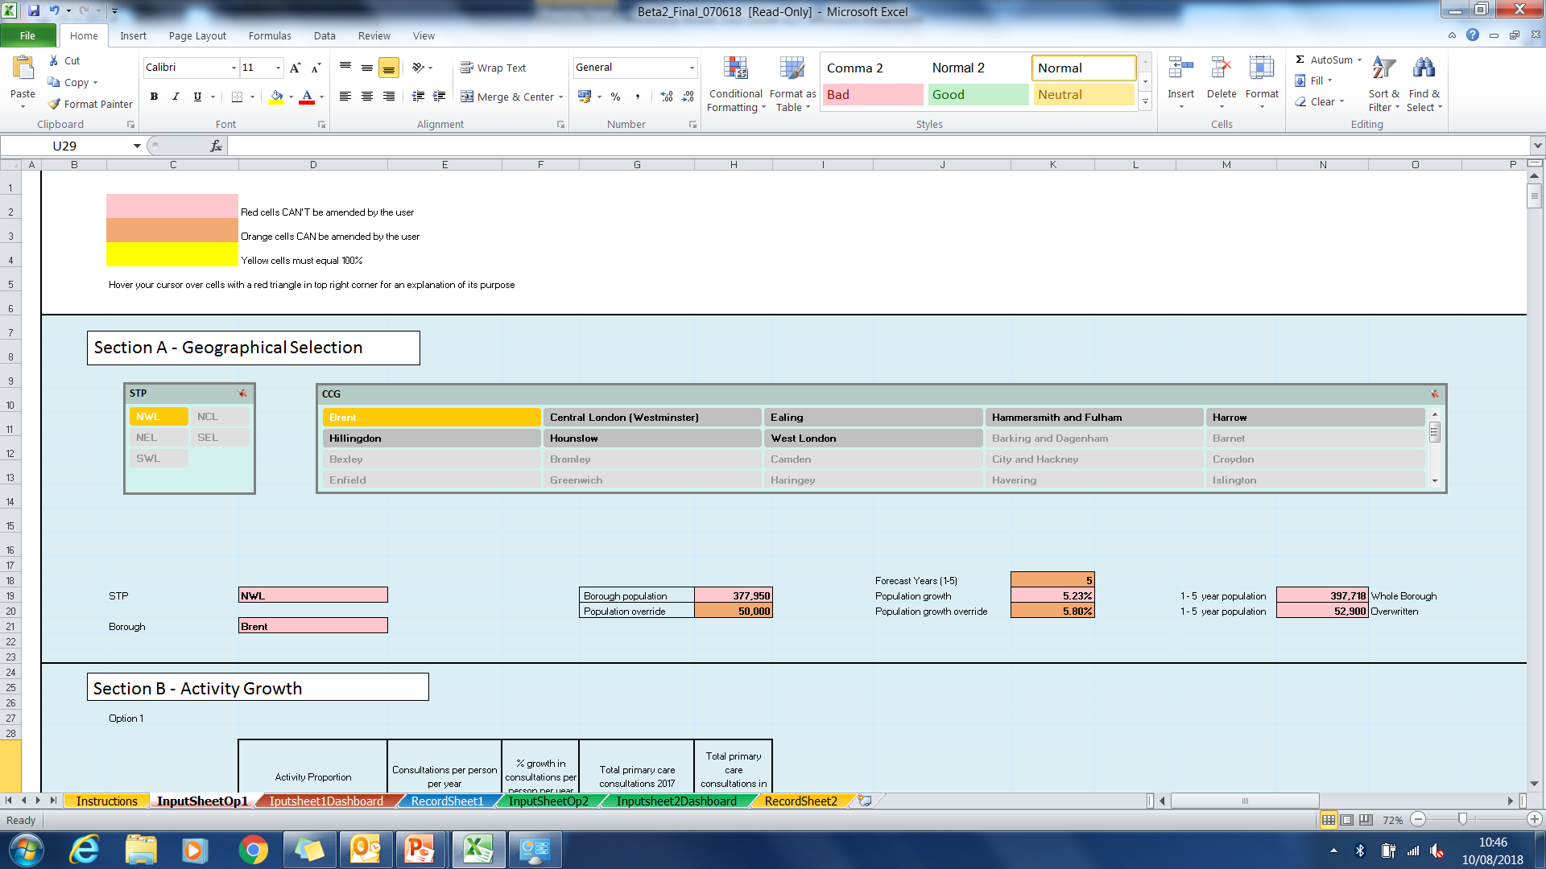
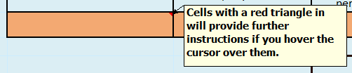
How to guide – General rules
The following worksheet tabs:
Instructions – Gives instructions on how to use the model
Input Sheet – this is where you input you data for modelling from Sections A-E (see next slides). Option 1 (Input SheetOp1) is for your primary care activity as a whole for your chosen population. Option 2 (InputSheetOp2) is for your primary care activity for a specific cohort of your chosen population. E.g. Long-term condition, elderly frail.
Dashboard – where dashboards of your outputs are automatically captured and you can create a narrative. This is split into Option 1 (Inputsheet1Dashboard) and Option 2 (Inputsheet2Dashboard)
Record Sheet - where at the press of a button the data used to create your scenarios is captured. This is split into Option 1 (RecordSheet1) and Option 2 (RecordSheet2)

Slide 5
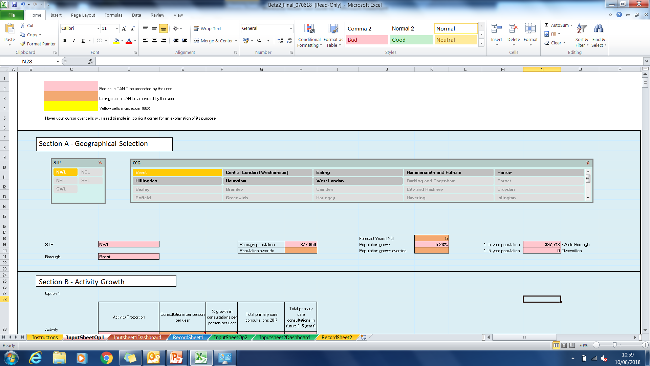
How to guide – Section A – Geographical Selection
This section acts as the starting point in Options 1 (Whole population) and 2 (Clinical subset)
1. Select your STP area
2. Select your borough
5. You can select projection year from 1-5 years in you workforce scenario’s using the drop down box.
3. You will see that the overall population will automatically populate along with projected population growth
4. You have the option to look at a sub-population if you wish to do so. By leaving this blank the model will run at a borough level. You the option to enter an alternative projected population growth rate if the rate of growth in your area is different to the borough average. By leaving blank the model assumes the borough average is correct.

Slide 6
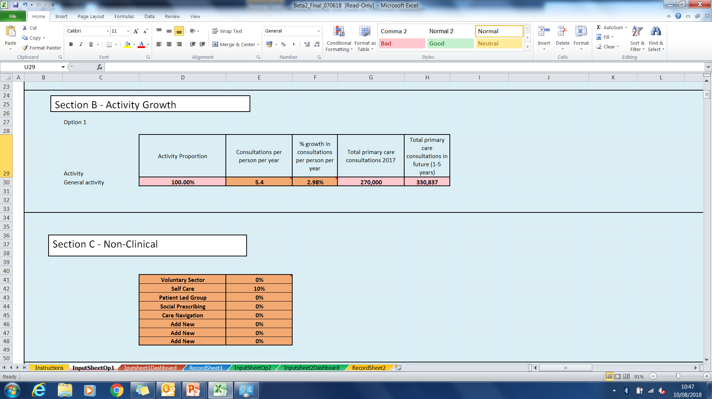
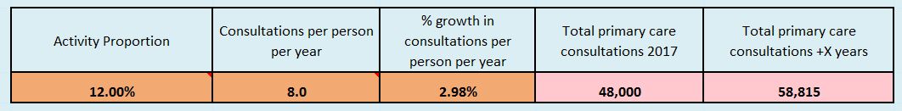
How to guide – Section B – Activity Growth
Option 1 is looking at the whole population you have chosen in Section A (100%). Option 2 is choosing a clinical ‘sub-population’ e.g. Type 2 Diabetes, Elderly Frail etc.
Option 1 (Whole population) – You can put in the figures for the average number of consultations for the population and the yearly growth in the number of consultations.
Option 2 (Clinical subset) – You can define the clinical population you are looking at by expressing it as a % of the total e.g. if 12% of a population has Type 2 Adult Diabetes you would put in 12. For this population you would then put in the figures for the average number of consultations for the defined population and the yearly growth in the number of consultations.

Slide 7
How to guide – Section C – Non-Clinical
Completing section A and B generates a total number of consultations required for your chosen population. In Section C for Options 1 and 2 you begin to distribute these consultations (activity). In this section you are asked to indicate the proportion of activity that is or could be delivered through ‘non-clinical’ interventions prior to looking at who is delivering clinical activities.
The list has come from the sorts of possible interventions that have been discussed during the development of the tool. If you have other ones you can replace this list with yours. The number is expressed as a percentage (reduction) in the overall consultations. E.g. if you believe that implementing a ‘Self Care’ plan would reduce overall consultations by 10% you would have ‘Self Care’ as a descriptor and then enter 10 into the adjacent cell.

Slide 8
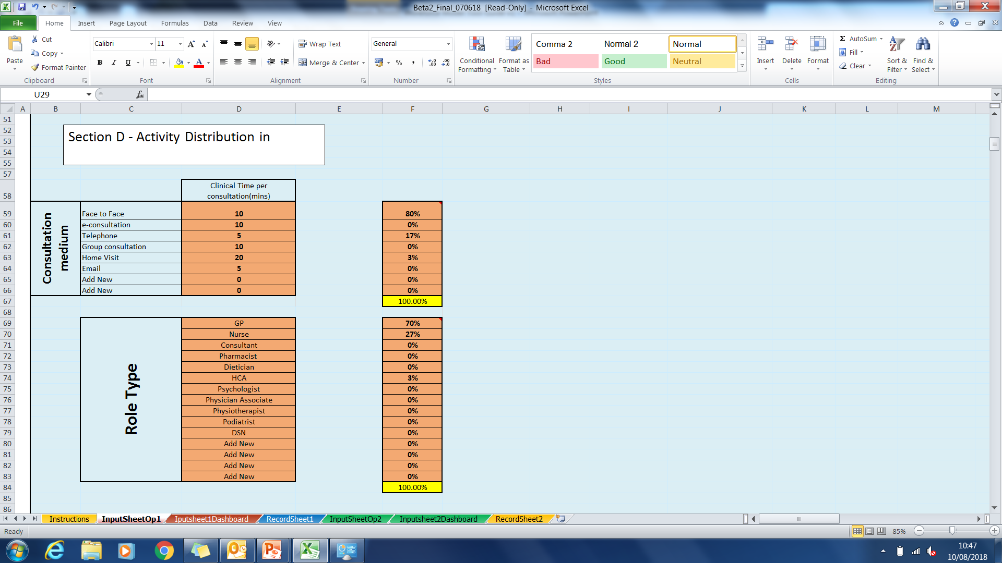
How to guide – Section D – Activity Distribution in Practice
Option 1 (Whole population)
1. Input the average length of consultation for each appointment medium (the numbers currently in the cells have been agreed during the development and are referenced in the comment box). You can add additional mediums in the ‘Add new' cells if required or overwrite the existing examples if you have different ones e.g. if an average ‘Face to Face’ consultation in your area is 10 minutes.
2. Now input how the proportions of each medium type used. e.g. 80% ‘Face to Face’, 17% ‘Telephone’, 3% ‘Home Visit’
3. Input the general split of activity e.g. 70% GP, 27% Nurse, 3% HCA

Slide 9
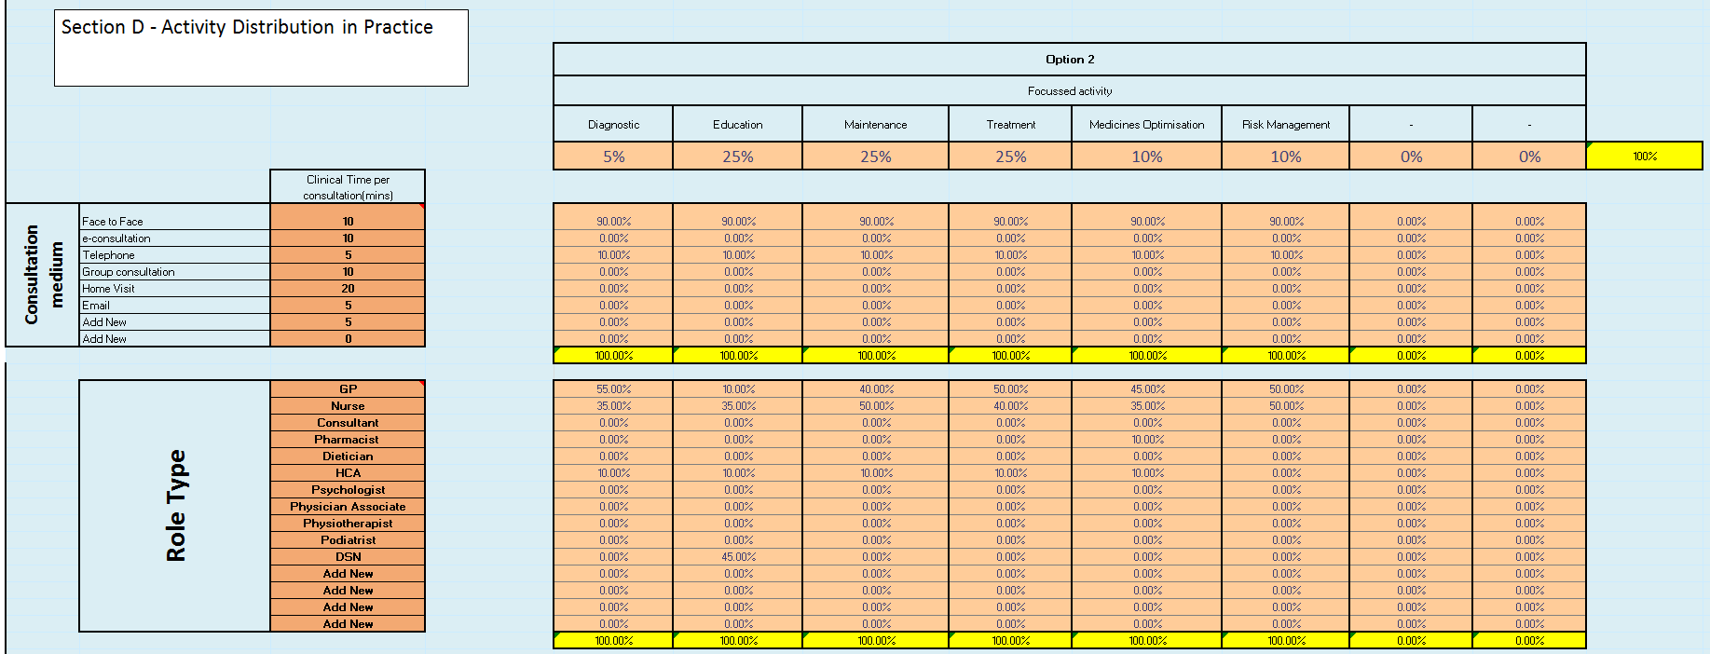
How to guide – Section D – Activity Distribution in Practice
Option 2 (Clinical subset)
1. Input the areas of activity relevant to the specific population cohort you are looking at. e.g. current activities associated with diabetes are described in the model (cell F55 – M55)
2. For each activity area input the proportion of total activity used as a percentage (cell F56 – M56) e.g. 5% of total activity is on diagnosis.
A selection of roles are included in column E. You can introduce any roles that you wish to look at.
3. For each activity area input the proportion of activities between the different mediums (col F - M, Rows 58 - 65)
4. For each type of activity examine who does what (col F – M, Rows 68 – 82)

Slide 10
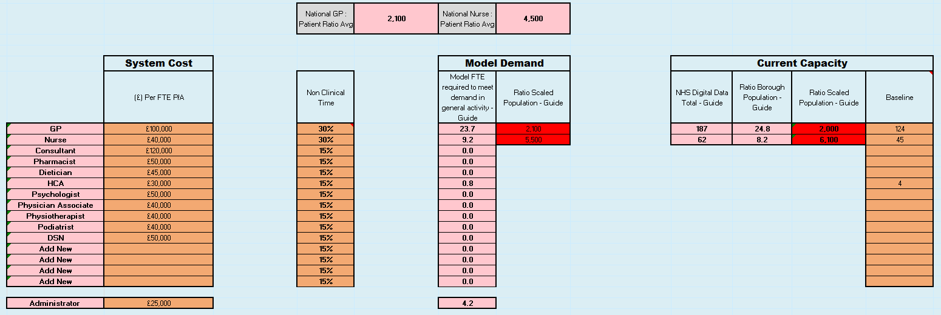
Section E - Demand , Capacity, Supply and Cost
Option 1 (Whole population) – For this option you will be comparing demand (required FTE), supply (available FTE) and local information to create a baseline
1. Add in cost data for different roles (Column D). Currently this is populated with indicative figures
Using the outputs of the model, role supply information (in Option 1) and local knowledge you will create a baseline on the first run through. When you are creating future workforce scenario’s in subsequent runs you will not need to revisit the baseline.
Column I is for information and shows the ratio of GPs and Nurses per head of population and compares this to national figures for reference. Green is similar to national, red is dissimilar to the national figure.
2. Examine non-clinical time as a percentage of total time for different roles (Column F)
Column H represents a view of FTE required to meet demand based on all your inputs in previous sections.

Slide 11
Section E - Demand , Capacity, Supply and Cost
Option 1 (Whole population) – For this option you will be comparing demand (required FTE), supply (available FTE) and local information to create a baseline
Column K represents the total number of FTEs for GPs and Nurses in the borough as a whole taken from NHS Digital.
Column M is again a reference to the national GP and Nurse per head of population ratios for information
Column L is the figure based on NHS Digital if you have inputted a sub-population
Columns N is asking you to input the current FTE if known or using the rest of the information in this section you can make a judgement on the actual FTE e.g. from the model outputs or the NHS digital data. From the first run this will act as the baseline position. This will be used to create the Future Do Nothing scenario automatically. I.e. what workforce will be required in the future if we continue to in the same way. NB It is essential complete Column N in this section.

Slide 12
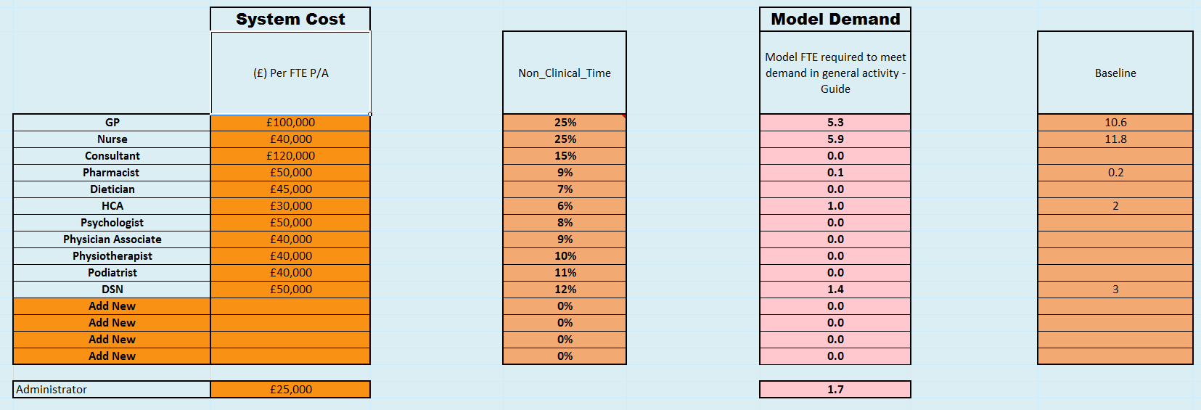
Section E - Demand , Capacity, Supply and Cost
Option 2 (Clinical subset) – For this option you will be looking at demand (required FTE) and local information to create a baseline
Column H represents the demand calculated by the model based on your previous inputs
Column J enables you to use calculated demand and /or local information to create a baseline. NB It is essential complete Column N in this section.

Slide 13
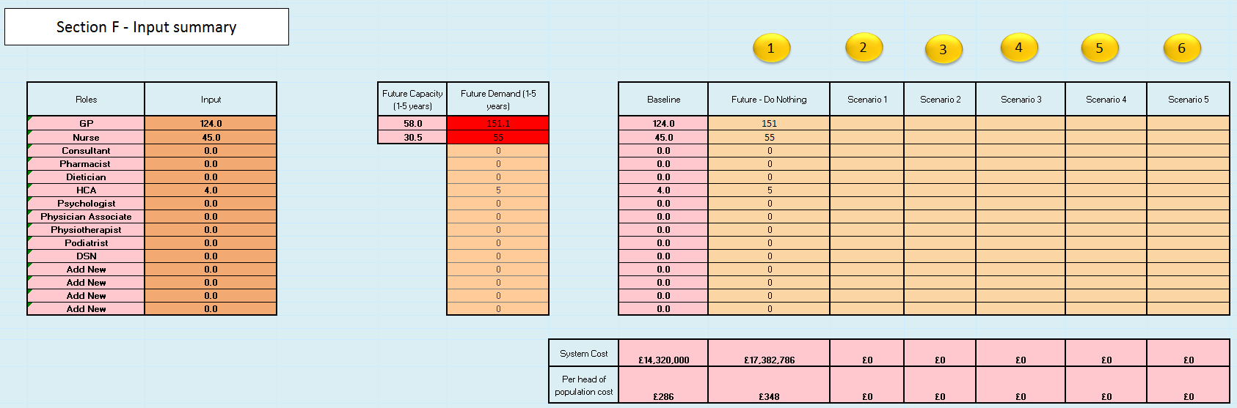
Section F – Supply and Demand Forecast
Option 1 (Whole population)
When you are happy with your baseline press the save 1 button (Column J) and the model will capture your baseline, calculate a Future Do Nothing scenario and record this in Section F (Column I and J) i.e. the model is forecasting your workforce requirements in five years based on delivering the service in the same way that you do now. It will also create graphics in the Option 1 Dashboard tab and save your inputs from Section C & D in the Option 1 Record Sheet. You are now ready to run scenarios looking at new ways of working. When you have finished creating a scenario you go straight to section F and press the save 2. You can then create another scenario in the same way and press the Save3 button. You have room to create five additional scenario’s.
You can re-visit Section A & B but it is likely that the geographical and activity assumptions will remain the same unless you have new information. In Section C you can explore non-clinical interventions e.g. are you embarking on a strategy encouraging self–management or care–navigation. What is the likely impact on the activity? In Section D you can again explore changes in the way that your population will interact with you e.g. are you encouraging more telephone or online consultations. In Section D you can also re-visit who could do what? E.g. use of pharmacists, nurses, new roles etc.

Slide 14
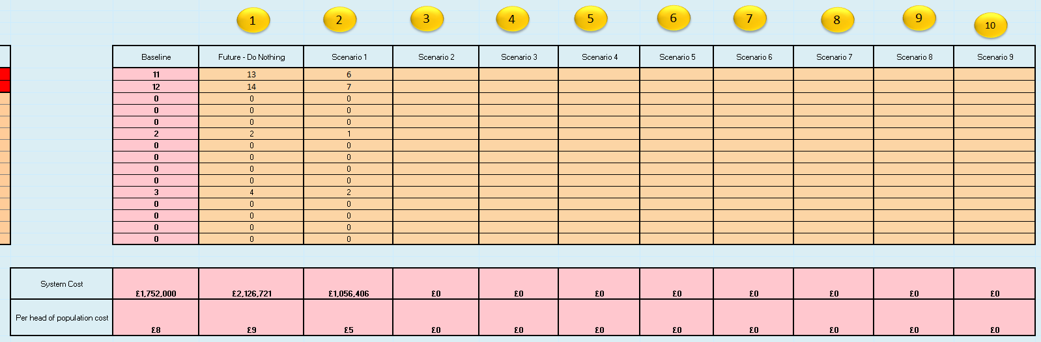
Section F – Supply and Demand Forecast
Option 2 (Clinical subset)
Press the save 1 button (Column J) and the model will capture your baseline, calculate a Future Do Nothing scenario and record this in Section F (Column I and J) i.e. the model is forecasting your workforce requirements in five years based on delivering the service in the same way that you do now. It will also create graphics in the Option 2 Dashboard tab and save your inputs from Section C+ D in the Option 2 Record Sheet. You are now ready to run scenarios looking at new ways of working. When you have finished creating a scenario you go straight to section F and press the save 2. You can then create another scenario in the same way and press the Save3 button. You have room to create nine additional scenario’s.

Slide 15
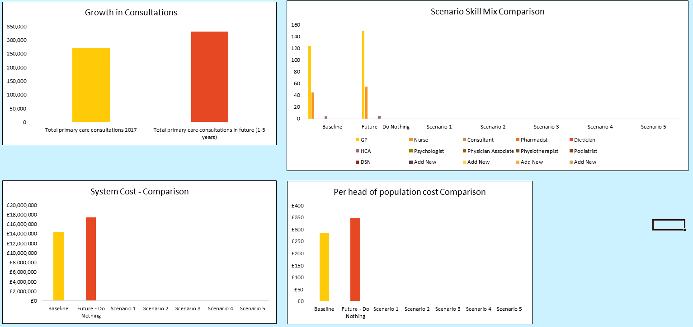
Input sheet Dashboard
Option 1 (Whole population) – Where dashboards of your outputs are automatically captured

Slide 16
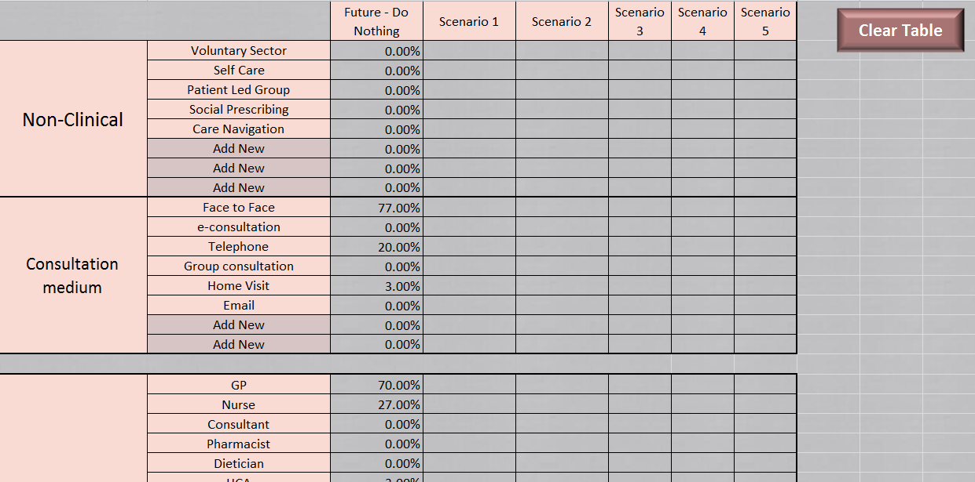
Record Sheet
Option 1 (Whole population) - Where your scenario inputs are saved

Slide 17
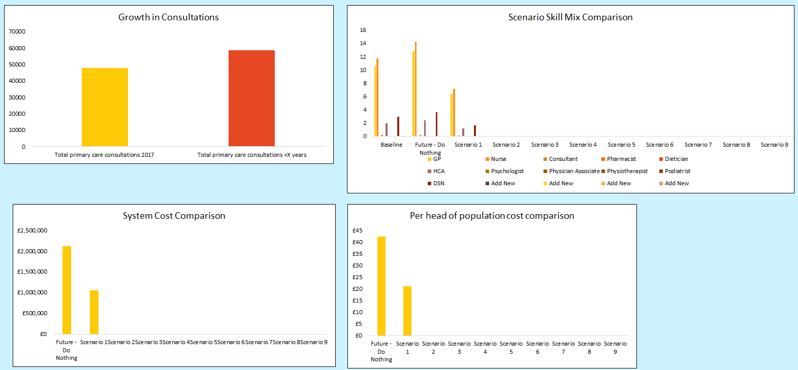
Input sheet Dashboard
Option 2 (Clinical subset ) – Where dashboards of your outputs are automatically captured

Slide 18
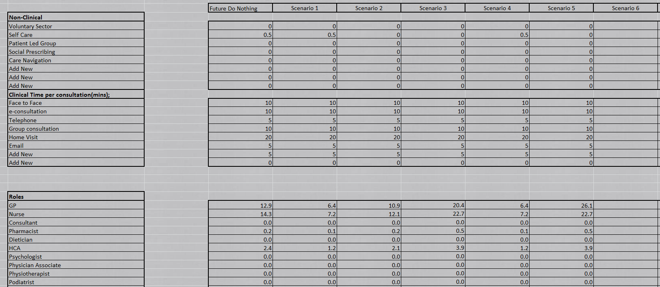
Record Sheet
Where your scenario inputs are saved (Option 2 – Whole population)

Slide 19
If you would like to find out more about the Beta2 workforce tool, please contact us at england.healthylondon@nhs.net

