Slide 1
NHS Go: designed for young people by young people
Information pack for schools
November 2018

Slide 2
NHS Go
Feedback from nearly 1000 young people in London told the NHS:
They wanted a trusted place to find health information confidentially
Navigating the NHS health services was a challenge for young people
They didn’t know when to access services, how to access services and where to access services.
NHS Go was created to address this feedback and help young people to get the advice and information they needed

Slide 3
Different sections on NHSGo
The health section contains
A health A-Z where you can search health conditions
A selection of information which young people wanted to know more about
A selection of quizzes

Slide 4
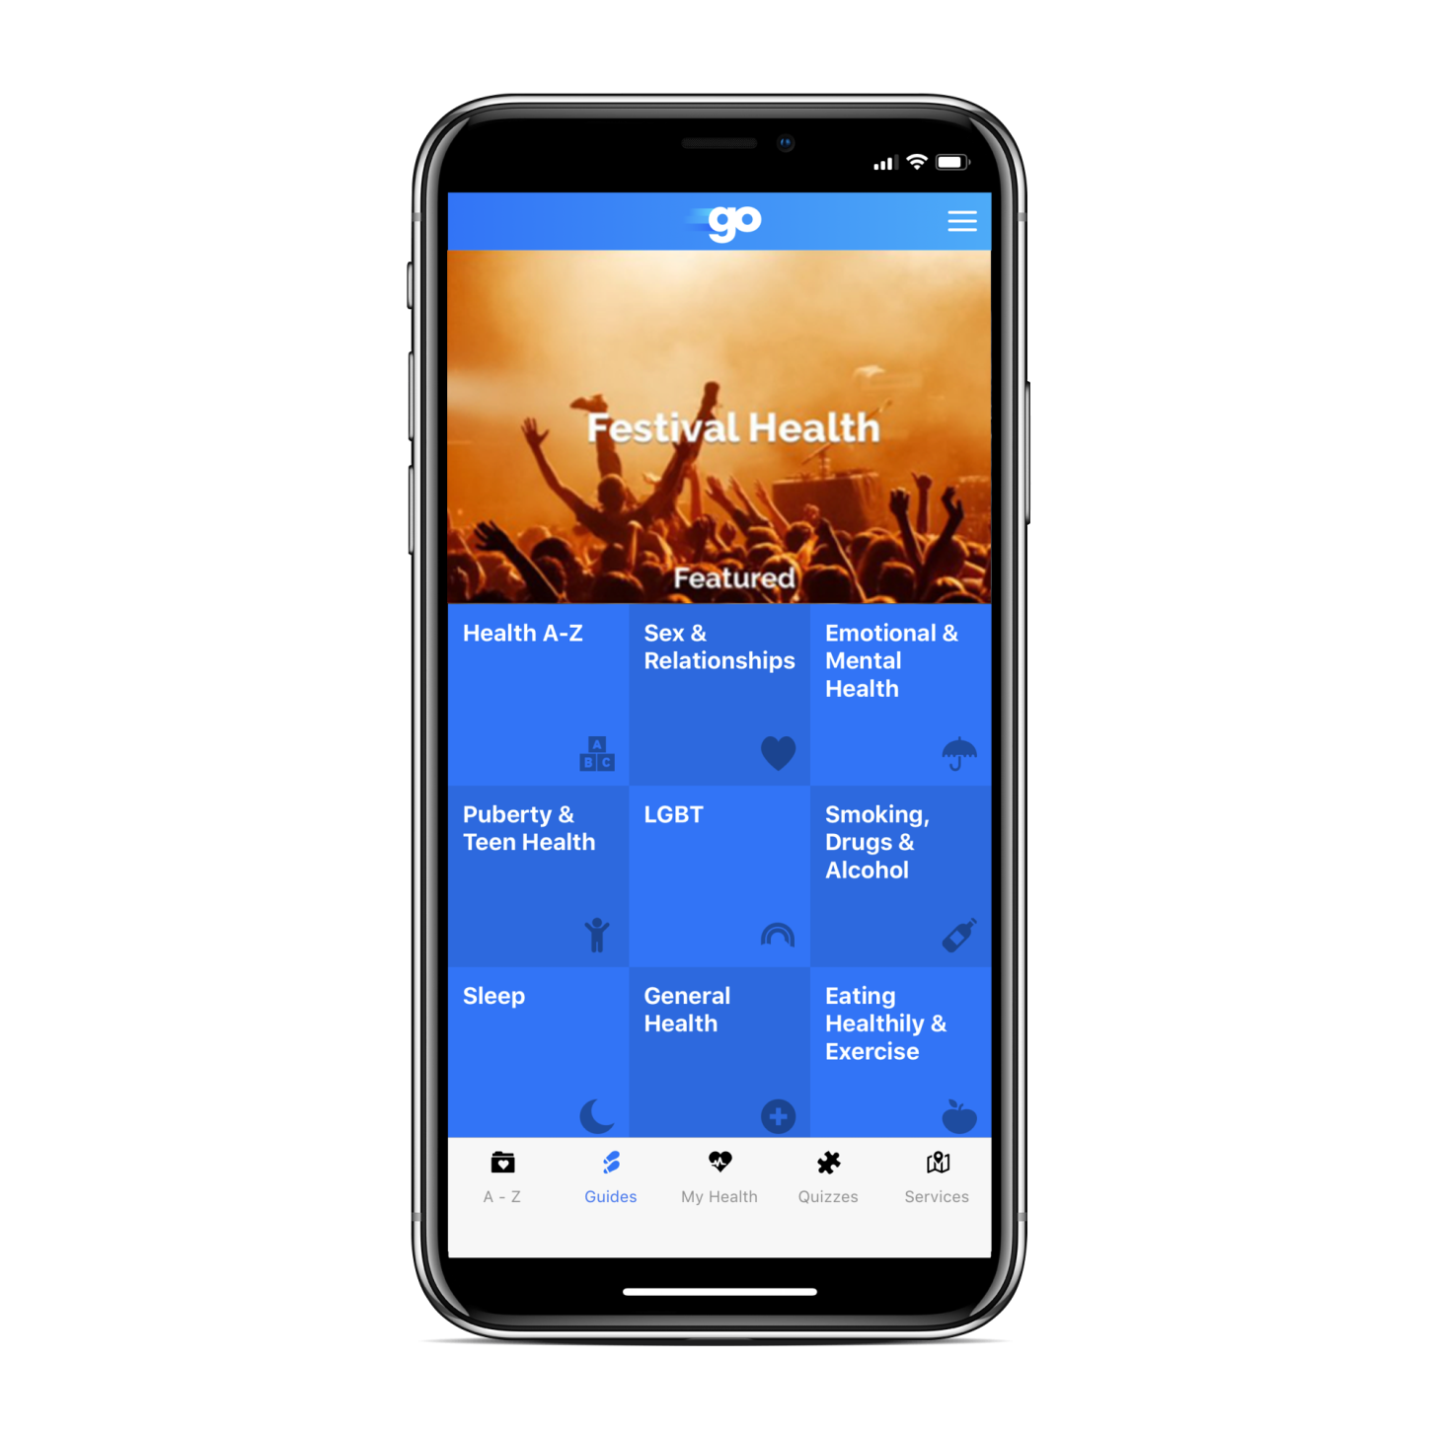
What topic areas does NHSGo cover?
Each month 3 topics are highlighted. e.g. In July, there was a focus on festival health, healthy eating and sleep
Depression and anxiety
LGBT
Smoking, drugs and alcohol
Sleep
Eating healthily and exercise
Puberty and teen health
Sex and relationships

Slide 5
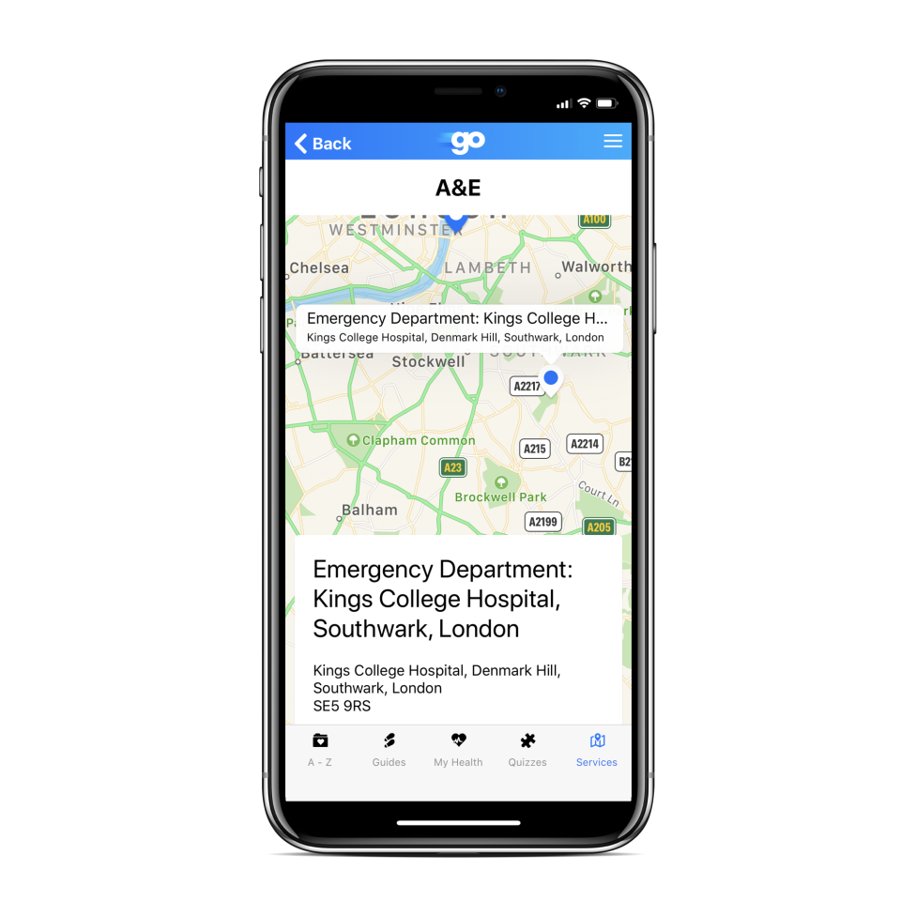
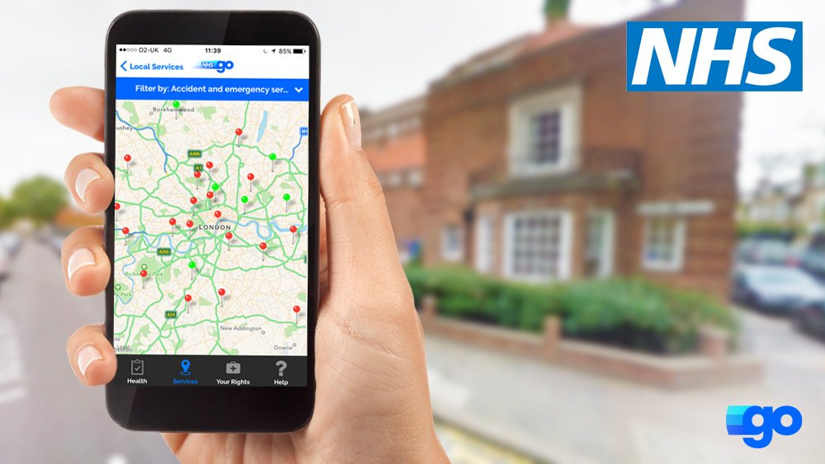
Service finder
Here you can put in your postcode and find services near you such as GPs, pharmacies, dentists, accident and emergency departments
Or you can use your location setting to find out where the closest services are to you at that time.

Slide 6
YouTubers
Some of the YouTube vloggers who promoted the app so far include:
Riyadh Khalaf
@RiyadhK
www.youtube.com/user/CaptRiyadh
Hannah Witton
@hannahwitton
www.youtube.com/hannahwitton
Lucy Moon
@Meowitslucy
www.youtube.com/meowitslucy

Slide 7
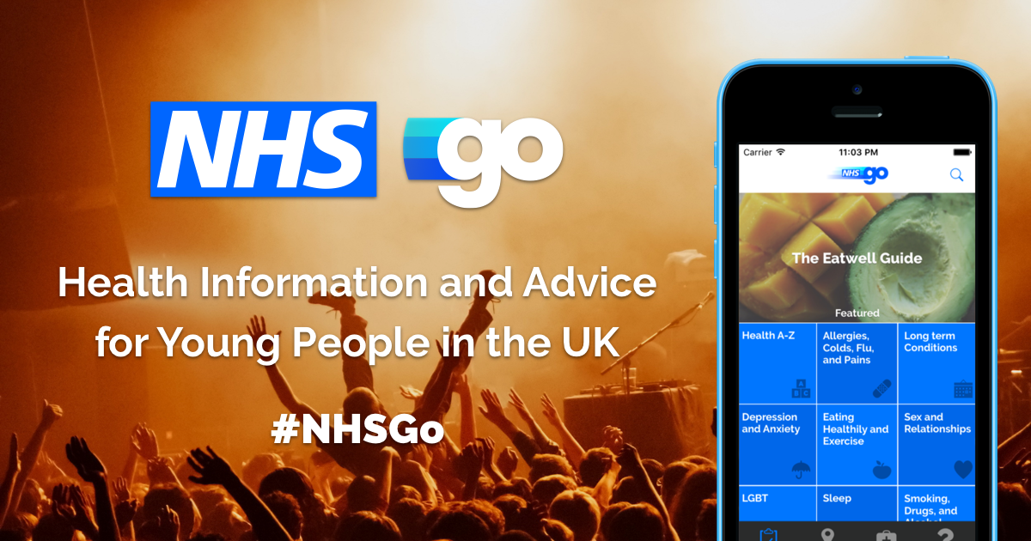
Where can I download it?
NHS Go is free to download on iTunes and Google play stores
You can also visit www.nhsgo.uk to see all the content online
You can follow us on twitter using #NHSGo and like us on Facebook www.facebook.com/NHSgo

Slide 8
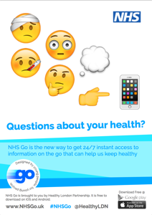
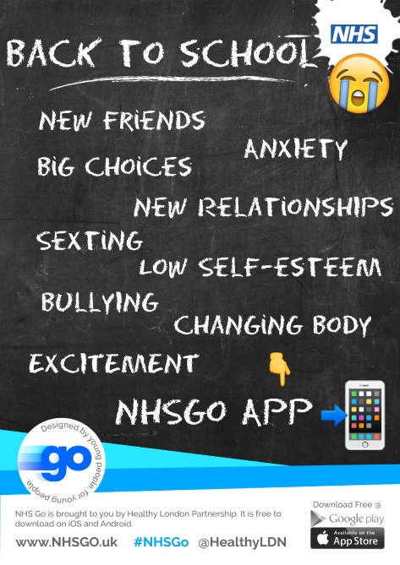
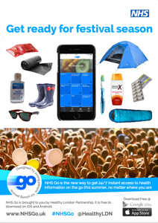
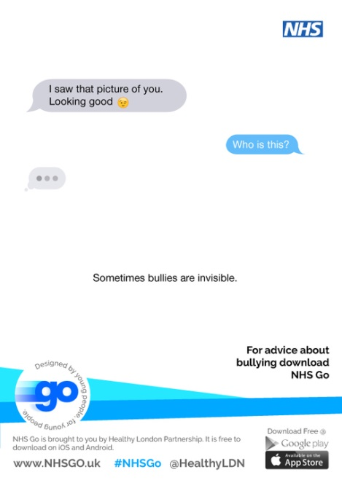
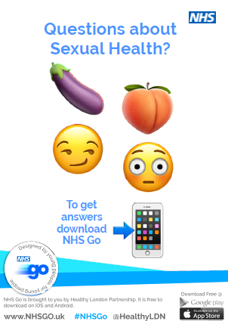
Look out for our posters
Downloadable from https://nhsgo.uk/

Slide 9
Page for school use

