Slide 1

Schools Emergency Asthma Initiative
Wandsworth and Merton
Dr. Richard Chavasse
Consultant Respiratory Paediatrician
St George’s Hospital

Slide 2
Schools Asthma Initiative / St George’s University Hospitals NHS Foundation Trust

Slide 3
Asthma in children
1,000,000 children in the UK – (Asthma UK)
One in 11 children has asthma.
On average there are three children with asthma in every classroom in the UK.
A child is admitted to hospital every 20 minutes because of an asthma attack.
The UK has among the highest prevalence rates of asthma symptoms in children worldwide.
Improved asthma management in school could reduce morbidity and improve school attendance.
Schools Asthma Initiative / St George’s University Hospitals NHS Foundation Trust

Slide 4




Asthma in Children - relationships
Home
School
2nd / 3ry
Hospital Care
Primary Care
School Nurse
Schools Asthma Initiative / St George’s University Hospitals NHS Foundation Trust

Slide 5
Asthma Management in School
The family of a child with asthma should:
  Ensure that the school are aware of the diagnosis
  Supply an inhaler & spacer available for use during school time
  Supply an asthma action plan for the school to follow (from GP / hospital)
  Inform school of potential triggers (exercise / pollen etc)
Schools Asthma Initiative / St George’s University Hospitals NHS Foundation Trust

Slide 6
Asthma Management in School
The school should:
  Have an asthma policy
  Have a register of pupils with asthma
  Hold an emergency inhaler and asthma plan for each pupil
  Ensure that pupils are given routine treatment if necessary
    Before PE
  Know how, and when, to give emergency treatment
  Should be able to identify children where asthma is impacting on access for education:
    School attendance
    Impact on PE, school trips etc
  Have an asthma champion (member of staff)
Schools Asthma Initiative / St George’s University Hospitals NHS Foundation Trust

Slide 7

Poor asthma control in school
Coughing / wheezing throughout class
Unable to do PE
SOB in Breaktime
Sitting out
Always ‘in goal’
Missing school
Late for school
Inform:
Parents
School nurse
GP
Paediatrician
Schools Asthma Initiative / St George’s University Hospitals NHS Foundation Trust

Slide 8








School Triggers
Schools Asthma Initiative / St George’s University Hospitals NHS Foundation Trust

Slide 9
Asthma Management in School - problems
Parents haven’t provided inhaler
Inhaler ‘empty’
No spacer
Child off site
Therefore no treatment available

Slide 10
Schools Emergency Inhalers
Schools Asthma Initiative / St George’s University Hospitals NHS Foundation Trust

Slide 11
Emergency Salbutamol Inhalers in Schools
Since 1st October 2014 the Human Medicines (Amendment) (No. 2) Regulations 2014 allows schools to buy and hold a generic salbutamol inhalers, without a prescription, for use in emergencies.
The emergency salbutamol inhaler should only be used by children, for whom written parental consent for use of the emergency inhaler has been given, who have either been diagnosed with asthma and prescribed an inhaler, or who have been prescribed an inhaler as reliever medication.
The inhaler can (only) be used if the pupils prescribed inhaler is not available.
https://assets.publishing.service.gov.uk/government/uploads/system/uploads/attachment_data/file/416468/emergency_inhalers_in_schools.pdf
Schools Asthma Initiative / St George’s University Hospitals NHS Foundation Trust

Slide 12
Emergency Salbutamol Inhalers in Schools
There has been variable uptake of this guidance
  Issues:
    Knowledge of guidance
    Cost
    Understanding
Discussed at Local Children’s Asthma Board
    The Chavasthma Bag
Schools Asthma Initiative / St George’s University Hospitals NHS Foundation Trust

Slide 13
St George’s Hospital, Wandsworth and Merton CCG
Schools Emergency Asthma Bag Initiative
Using health funding:
To provide an emergency asthma bag to all schools in Wandsworth and Merton
SCHOOLS
EMERGENCY ASTHMA
BAG
Schools Asthma Initiative / St George’s University Hospitals NHS Foundation Trust

Slide 14
Emergency Asthma Bag - Procedures
School nurses to provide training for asthma and use of asthma bag in their schools.
Include annual training to help staff identify a pupil having an asthma attack and what to do.
Remind all parents of pupils with asthma to provide:
  an asthma plan and
  ensure their child has an inhaler and spacer available.
Obtain consent for use of emergency inhaler
Keep register of pupils up to date – check every term
Keep bag available in an agreed, accessible location
Consider additional bag if school has multiple sites
Consider additional bag for school trips
Schools Asthma Initiative / St George’s University Hospitals NHS Foundation Trust

Slide 15
Emergency Asthma Bag - Use
Use child’s own medication if available
If not:
Check child has consent to use emergency inhaler
Administer emergency medication as per instructions
If not:
Call parent and, if necessary, ambulance
Schools Asthma Initiative / St George’s University Hospitals NHS Foundation Trust

Slide 16
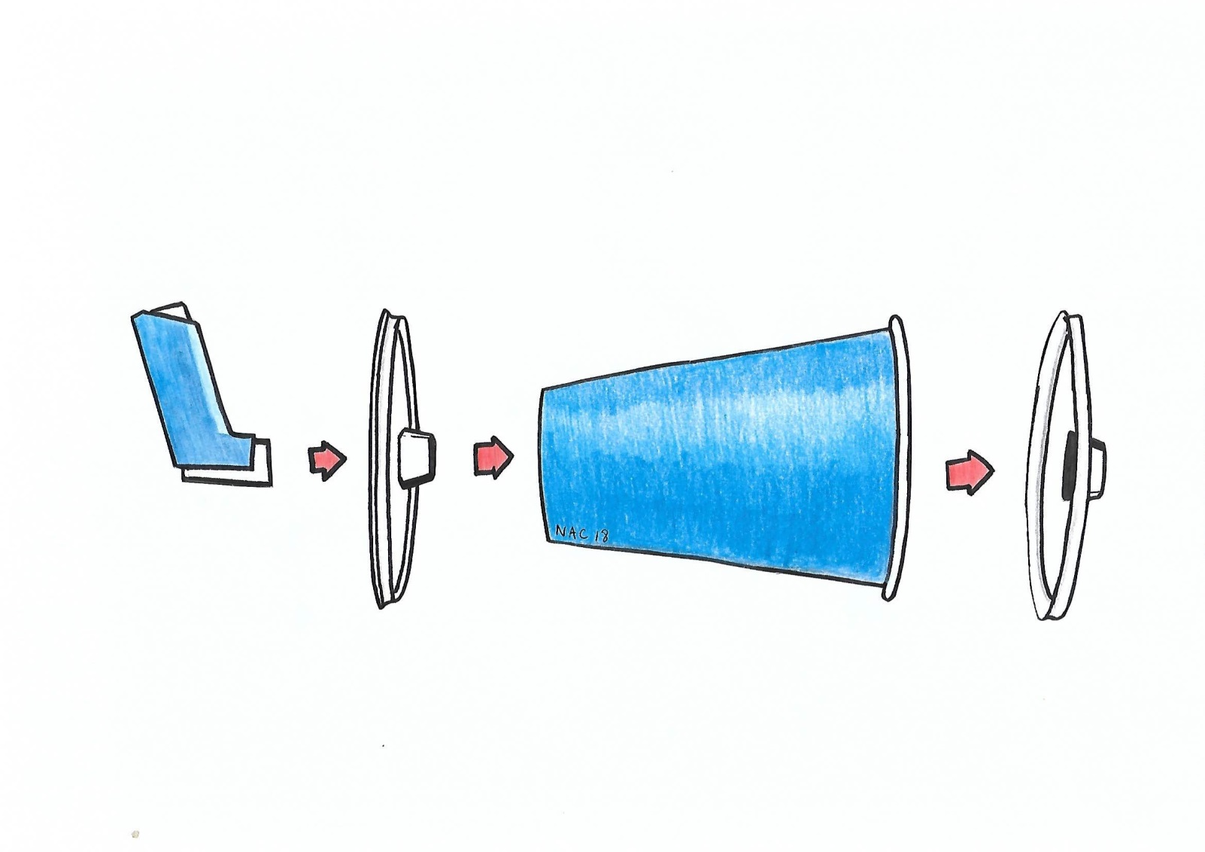
St Georges Hospital & Wandsworth CCG - Schools Emergency Asthma Inhalers
1. Construct inhaler as shown
2. Shake inhaler before inserting
Children and Young People should always use a spacer with an inhaler during an acute asthma attack
Schools Asthma Initiative / St George’s University Hospitals NHS Foundation Trust

Slide 17
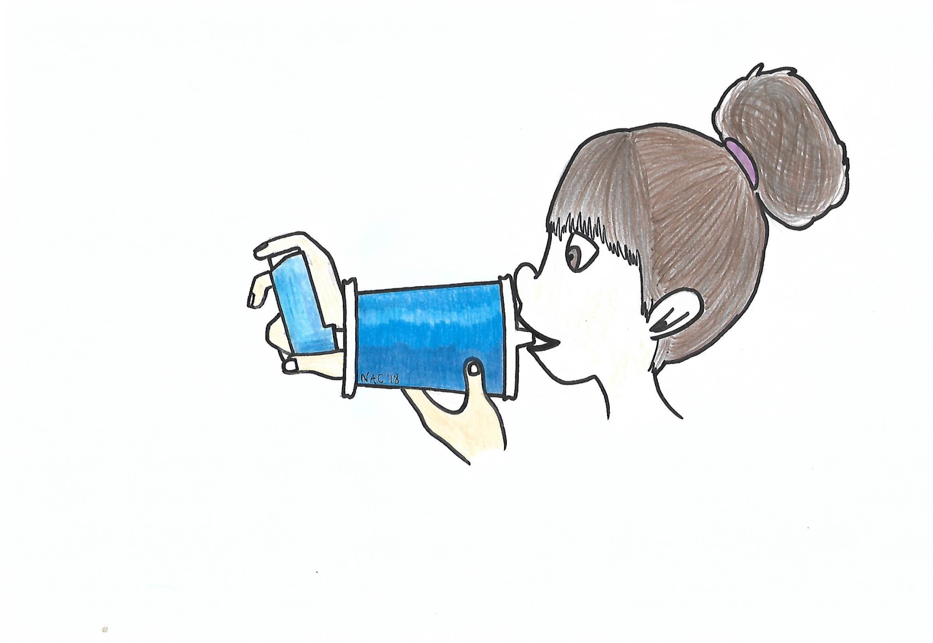

How to use inhaler and spacer
1.
x1
2.
x5
gentle breaths - in and out
3.
4. REPEAT up to 10 times – Shake inhaler before each dose
Children and Young People should always use a spacer with an inhaler during an acute asthma attack
Schools Asthma Initiative / St George’s University Hospitals NHS Foundation Trust

Slide 18
Emergency Asthma Bag - Use
Keep calm and reassure the child
Encourage the child to sit up and slightly forward.
Remain with child while inhaler and spacer are brought to them
Immediately help the child to take two separate puffs of the salbutamol via the spacer 60 seconds apart.
If there is no immediate improvement, continue to give two additional puffs every two minutes up to a maximum of 10 puffs, or until their symptoms improve. The inhaler should be shaken between puffs.
Stay calm and reassure the child. Stay with the child until they feel better. The child can return to school activities when they feel better
If the child does not feel better or you are worried at ANYTIME,
CALL 999 FOR AN AMBULANCE
If an ambulance does not arrive in 15 minutes you can give another 10 puffs in the same way if needed
The child’s parents/carers should be contacted after the ambulance has been called.
A member of staff should always accompany a child taken to hospital by ambulance and stay with them until a parent or carer arrives.
Schools Asthma Initiative / St George’s University Hospitals NHS Foundation Trust

Slide 19
Emergency Asthma Bag - Use
Record
The date
Name of child
Location
Number of puffs used
Staff member administering medication
Number of spacers left in bag (Dispose of the spacer just used - single use only)
Inform parents – may need to replenish child’s own inhaler or ensure it is available. Arrange GP review.
The school nurse should be informed of the use of the Emergency Asthma Bag after each occasion.
Ensure that there are no fewer than 2 spacers left in the bag.
Request that the school nurse help replenish the contents of the asthma bag
Return the Emergency Asthma Bag to its usual location.
Schools Asthma Initiative / St George’s University Hospitals NHS Foundation Trust

Slide 20
Sample Documents
Schools Asthma Initiative / St George’s University Hospitals NHS Foundation Trust

Slide 21
Emergency Asthma Bags
Problems
  Delay in provision of bags
    Internal ordering issues
    Decision to ask them to insert contents
    Difficulty in getting approval for them to supply inhalers
  Pharmacy / MHRA requirements
    They will now insert inhalers
    Check bag contents
Ready to distribute from
? Autumn 2018
1 per school
  schools may request 2nd or more
Parent communication – attached letter (or variant)
Agree standard school asthma plan & register
Where to store replacement spacers etc.
School Nurse system to check bags & replenish
Education for staff
Schools Asthma Initiative / St George’s University Hospitals NHS Foundation Trust

Slide 22
?
SCHOOLS
EMERGENCY ASTHMA
BAG
Schools Asthma Initiative / St George’s University Hospitals NHS Foundation Trust

