Slide 1
North Central London
STP

Slide 2
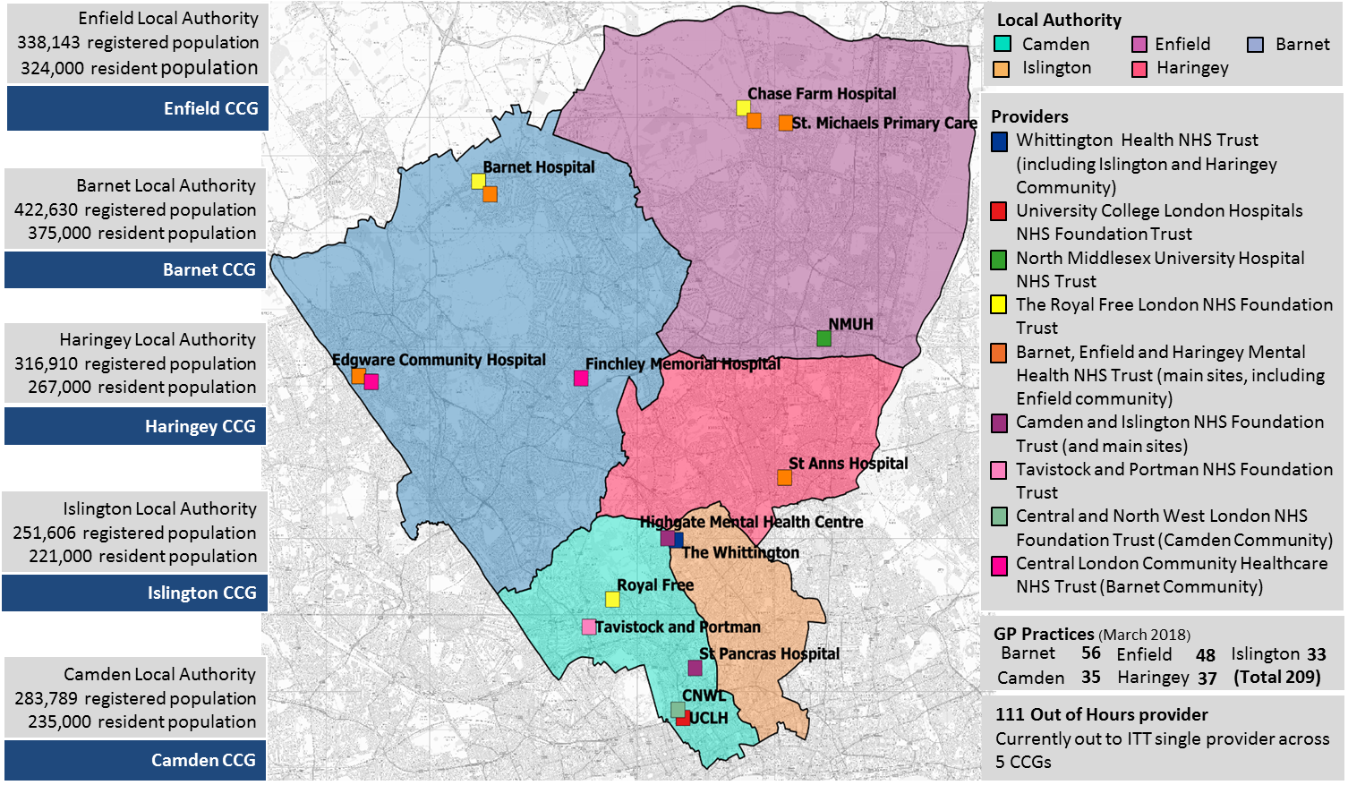
North Central London Overview

Slide 3
Children & Young People and Asthma
Prevalence of asthma understood to be 10% across CYP population.
Increasing A&E admissions for C&YP with asthma, particularly those under 5 in Haringey and Islington. Further compounded by rising C&YP populations.
Thought that up to 75% admissions might have been avoidable (+1000 admissions)
Poorer children 2.5 times more likely to be admitted to hospital in relation to asthma, high levels of deprivation in areas across NCL.
Poor housing (Inc. fuel poverty, damp, overcrowding and temporary accommodation) can make respiratory conditions up to 3 times more likely. Nationally, damp will affect approx. 4% of housing stock, even more for social housing and private rented.
Air Pollution known to affect C&YP with asthma, with significant emphasis from Mayor of London on London-wide initiatives.

Slide 4
Our Vision for Children & Young People with asthma in North Central London
To support children, young people and families with asthma to receive the appropriate treatment, at the right time and enable them to remain as well as possible.
Our design principles
Improving health and social outcomes
Whole system approach (shared vision)
Reducing health inequalities (targeted support)
Prevention (managing demand)
High quality services (effective and efficient)
Responsive (right time, accessibility)
Local provision (empowerment and choice)
Notes:
- The vison represents the parallel approaches of our plan. 1. To improve services to C&YP with asthma, whilst 2. also supporting the prevemntion agenda by enabling C&YP to remain as well as possible.
- Our design principles have been developed to help our transformation thinking – ensuring that everything we do is aligned to these 7 principles that are felt to be some of the most important features of good quality care.

Slide 5
Asthma work in North Central London
Articulating a shared challenge
Acknowledging that a system response is required
Working as a partnership
Developing our aspirations together
Notes:
Articulating a shared challenge
We have worked together to understand the challenge and the impact on both our C&YP/Families and the broader system.
Acknowledging that a system response is required
Using the principles of professor Marmot’s wider determinants of health, we understand that in order to effect change a system response is required. To move away from a reactive delivery of services (i.e. doing what we’ve always done), to a proactive and preventative approach to improving services for CV&YP whilst also addressing the health inequalities (i.e. delivering differently)
The system can also entail the ‘family system’, recognising the centrality of working with a whole-family approach, as parental decisions and actions impact upon the children within that system
Working as a partnership
Ensuring that partners are well represented across the system in order to contribute to the development and delivery of the transformation work. We all have a role to play here, whether in the centre or along the periphery – the every pair of ‘hands’ principle.
Understanding relationships across the system is imperative here, which levers affect which drivers is important in delivering improvements and ensuring that we are not blindsided by unintended consequence.
Developing our aspirations together
We have sieved the moment! We know that this is our opportunity to be truly aspirational for the C&YP of North Central London and it must not be wasted. We need to think bigger, beyond our organisational boundaries and current system restrictions (i.e. so no more ‘we can’t do that because its not been done before). Setting a precedent is always more challenging than following the tribe – but it is also far more rewarding (for C&YP and us)

Slide 6
NCL to date
Significant work locally and across borough boundaries
HLP Peer review, helped to articulate the challenges across the system
Stronger partnership engagement from across the system
Notes:
Significant work locally and across borough boundaries. This includes Locally Commissioned Services, Asthma Friendly Schools and an NCL-wide pathway.
HLP Peer review, has been a really valuable source of intelligence which helped to articulate the challenges in NCL and how we could improve across a number of key theme areas (embedding the asthma standards, building capacity within primary care, developing better/more consistent pathways, drawing together a system response)
Partners representing commissioners, clinicians, acute providers, primary care, pharmacy, local authority (inc housing and social care), public health – all around the table to develop a system approach to asthma across NCL

Slide 7
Next steps
Consolidate work to date and gather the learning (from NCL and from other partnerships) to inform plans
Developing a system-wide logic model
Detailed delivery planning
Implement – Monitor – Learn - Repeat
Notes:
Consolidate work to date (i.e. what has the impact been around the asthma friendly schools, what is the learning from the CPG work around reducing variation, how can we commission intelligently) and learn from others (i.e examples of Bromley by Bow social prescribing, really progressive environmental work in some areas (Southwark Council ‘Strawberry benches’ built in air quality sensors) or perhaps one better, the ‘city tree’ or ‘Artform’ benches, which cleans the air around those seated on it).
Developing a system- wide logic model. A partnership workshop planned later this month to develop the logic model, with the aim of agreeing NCL wide outcomes, measures and broad intentions (which would be interpreted locally where possible). Also important to include the views of C&YP and families – what does ‘improvement’ mean to them.
Detailed delivery planning (recognising the strategic and system-wide pieces vs. those local activities which need to be locally understood and implemented)
Implementing the plan – and being clear on what success looks like. What are we looking for? Reduced demand of course, but what about other important factors (i.e. increased self management, improved air quality, increased awareness etc.)

Slide 8
Thank you
Notes:
Hopefully that provides you with a brief overview of the work across NCL which we look forward to building on with increased momentum and

