Slide 1
NEL CYP Asthma Network 5th September 2018
Lynda Hassell - Director of Nursing CYP, BHRUT
Rita Araújo - Maternity and CYP Transformation Manager, THCCG

Slide 2
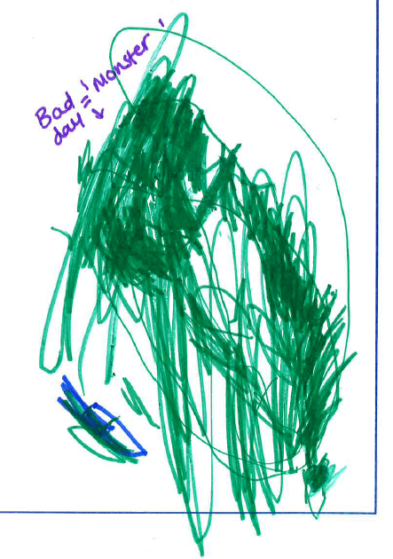
How did this network start?
Engagement workshop - 36 families & CYP – key themes of improvement identified
Seminar brought leaders from across the system
Agreement: clear pathway needed across NEL (health, social care & - network required
NEL CYP Network formed June 2017 meets bi-monthly
Aims:
Local system to implement evidence-based pathways
Highlight, share & promote best resources to achieve pathways
Collaboratively influence behaviour change from professionals, families and CYP

Slide 3
Achievements to date
Agreement at NEL level - implement single shared Asthma Action Plan
Collaboration, sharing ideas & co-designing resources – eg LAS and school nurses to devise poster to guide actions of school staff in emergencies
Improved current pathways of care & communication between different stakeholders - eg ensuring hospital discharge letters are shared with School Nursing teams
Provided an impetus for training for school nurses to conduct reviews, and identifying at-risk CYP
Supported 2 business cases in Tower Hamlets to ensure appropriate review of high risk CYP
Supported Darzi Fellow for CYP Asthma at Barts Health Trust
Assisted with recruitment to research projects e.g. recruitment of schools to participate in a project focused on CYP perception about the condition
A file-sharing platform so that resources can be easily shared across the network
Agreed approaches to new national policies & guidelines e.g. NICE chronic asthma management guideline
Showcased as a best practice exemplar at STP level – a way for East London Health & Care Partnership to achieve improvement in CYP’s outcomes.

Slide 4
Next steps
Tracking the implementation of single shared Asthma Action plan across NEL & continue to support organisations to implement it
Focus on self-management for CYP & their families, with an emphasis on identifying, supporting and promoting peer support
Ensuring ongoing engagement and participation of CYP & families in the network
Increased focus on safeguarding eg recommendations from Tower Hamlets SCR to be presented at the next network meeting by safeguarding team
Discussions between BHRUT & Commissioners – Asthma CNS in CCNT

Slide 5
Questions?

