Slide 1
Next steps
.
#AskAboutAsthma
Tracy Parr, Director of CYP Programme, HLP
Dave Finch, NWL Medical Director, NHS England (London)

Slide 2
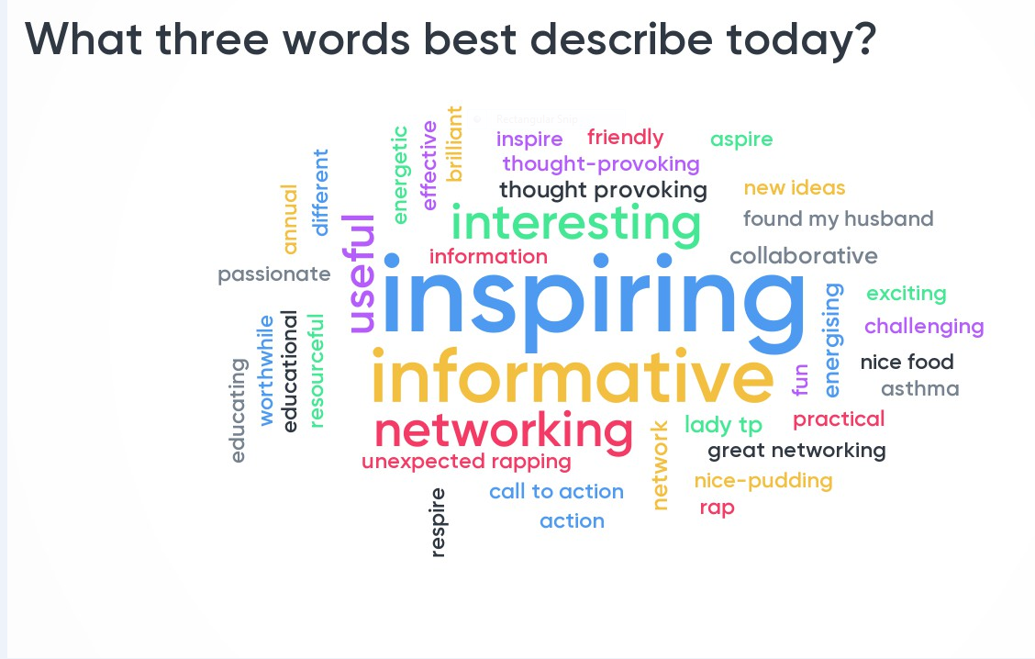
Next steps

Slide 3
