Slide 1

Action plans at HUH
Dr Tammy Rothenberg
Starlight Unit
Homerton University Hospital

Slide 2
Asthma Action Plans-
2012: rate of action plans 18%
June 2013: uploaded the Asthma UK action plans onto the intranet, and started the education regarding the need for this
October 2013, the nursing discharge checklist (for all admissions) was adjusted to include wheeze plan
Notes:
Adjustment of nursing discharge to include the item “wheeze plan in place following wheeze/ asthma admission”

Slide 3
Asthma Action Plans-
November 2013: 91% on basis of nursing checklist alone
In March 2014, implementation of “Action plan generator
Notes:
Adjustment of nursing discharge to include the item “wheeze plan in place following wheeze/ asthma admission”

Slide 4
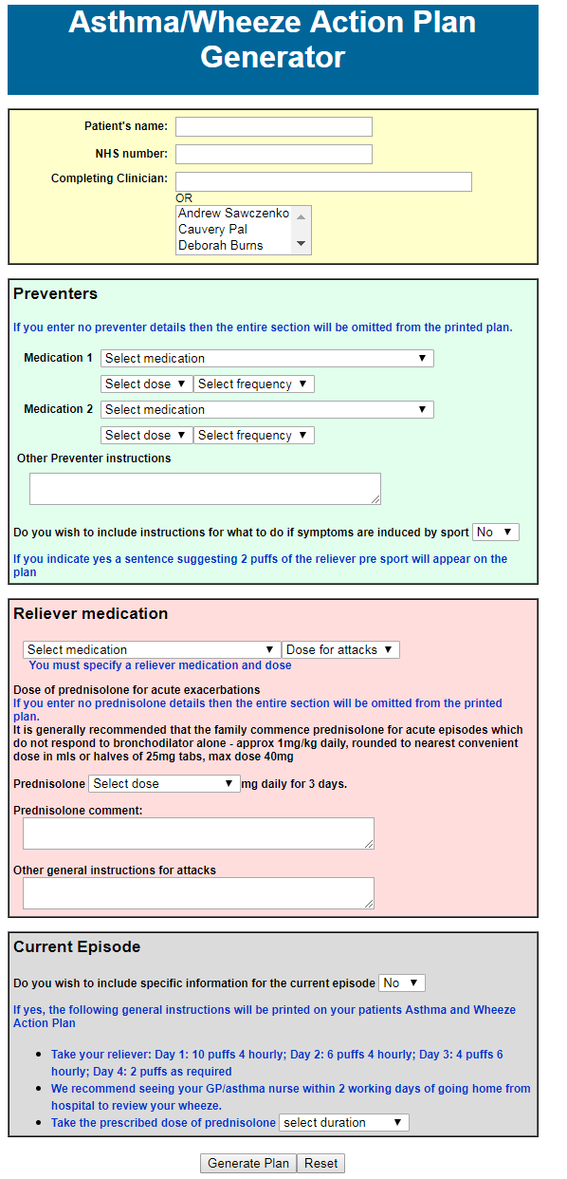
Notes:
Adjustment of nursing discharge to include the item “wheeze plan in place following wheeze/ asthma admission”

Slide 5
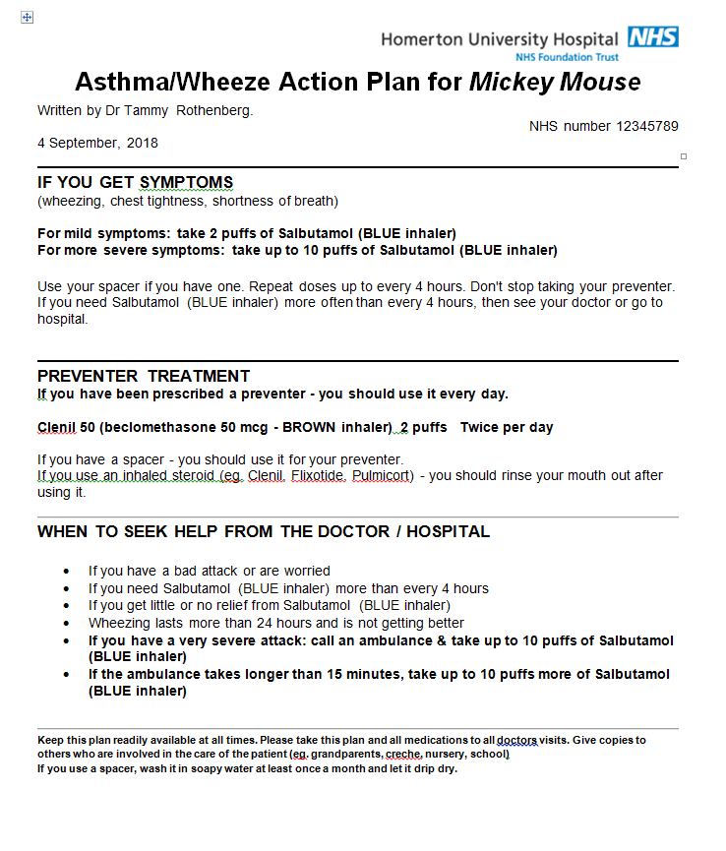

Slide 6
Asthma Action Plans-
In March 2014, implementation of “Action plan generator
November 2014 audit: Action plan rate 91%. (using nursing discharge checklist)
Notes:
Adjustment of nursing discharge to include the item “wheeze plan in place following wheeze/ asthma admission”

Slide 7
Asthma action plans
July 2015: paperless records. Includes pre-existing discharge checklist
November 2015: our data dipped to 64%
  ? Eye off the ball due to big change
  ? Related to measurement method ? those collecting the data did not look at discharge checklist to measure the rate of action plans, but rather, looked for a copy of the action plan.
  ? Related to change to paperless, less filing
2016: implemented the requirement to copy and paste the action plan into the paperless record , ongoing education

Slide 8
Asthma action plans
Nov 2017: the rate of admissions discharged with an action plan was 98%

Slide 9
Definition of action plan:
“a set of written instructions given to patients or carers that are intended to stay in their hands until the next visit with instructions for daily treatment and initiation or step-up treatment for acute deterioration and which provides information regarding when to seek urgent medical consultation”
(Bhogal, Zemek & Ducharme, 2006)

Slide 10
Resistance to action plan

Slide 11
Resistance to action plan
No one asked me to
I thought it was someone else’s job
I asked someone else to do if for me, didn’t they do it?
I don’t know where to find the paperwork
The printer was out of paper
I don’t have time
I don’t think it’s worth doing
The patient already has one which is up to date
We’ve run out of paper copies
I’m not sure which one to use
I didn’t know enough information to fill it in

Slide 12
Research
Sheares et al (2007)
  structured interviews with 45 specialist physicians providing patient asthma care in 2 New York City medical centres
  All 6 doctors in the non-WAAPs group stated that pre-printed plans were not available in their clinic sites and therefore they did not give them to patients, and this difference was statistically significant.
  45% of physicians who did use WAAPs stated that time was the major disadvantage to using WAAPs when asked an open-ended question about the disadvantages,
  21% stated that patients lose them or forgot that they received them (Sheares et al., 2007)

Slide 13
Cycles of PDSA
Zipkin 2013: 4 cycles of PDSA to improve action plans :
clinical care coordinator- identify admissions with asthma, help ensure action plans done ( increase 39 to 74%)- role discontinued due to funding
but improvement remained ==== culture change
integration of electronic action plan into EPR (increase 78-93%)

Slide 14
What did we do?
Electronic action plan https://www.rch.org.au/clinicalguide/forms/Asthma_Action_Plan/
Permission from Prof Mike South to adjust it
Input from tech-minded trainee
Multiple tweaks over time
Upload into intranet

Slide 15
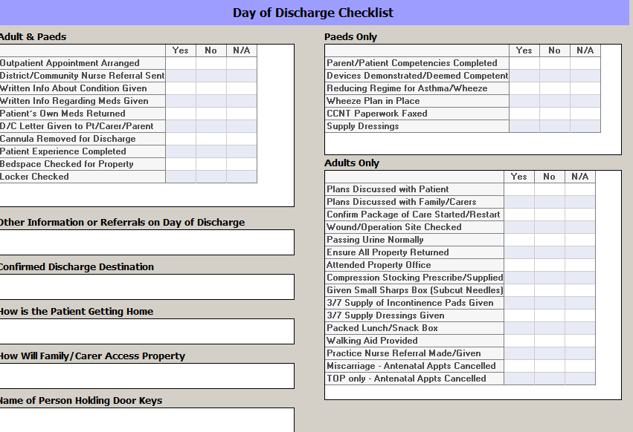
Nursing discharge checklist

Slide 16
What else can be improved?
 | 2012 | 2017
Written information given at discharge | 23 | 63
Device technique checked | 50% | 83%
Written plan at discharge | 18% | 98%
Advised GP at a week/ 2 days | 9% | 95%

Slide 17
What else did we do?
Keep it simple – simple technology, few things to go wrong
… keep going! Change takes time
Keep tweaking
Make friends with IT folks

Slide 18
shortcomings
Output is not child-centred
Output is not based on traffic light system
Output does not match GPs or NEL
Maintenance requires IT knowledge and IT buy-in from Comms team in hospital

Slide 19
Summary of why it works
Culture change: it is the norm
Developed with the needs of the issuer in mind
Buy-in from 3 sets of health care workers:
Nursing staff
Medical trainees
Medical consultants

Slide 20
Wish list for the future
Implement as the norm in A+E as well as the ward
Keep input fields simple but output to be child-centred- eg Monkey and Me
If you have the tech know-how PLEASE CONTACT ME!
Tammy.rothenberg@nhs.net

