Slide 1
Using networks to transform asthma care . #AskAboutAsthma
Tracy Parr Director of Transformation,
Children and Young People’s Programme, Healthy London Partnership
Dave Finch Medical Director, NW London NHS England

Slide 2
Social media
#AskAboutAsthma
@HealthyLDN
https://www.healthylondon.org/ask-about-asthma-3-16-september-2018/
Notes:
Directions to fire exit
No planned fire alarms
Directions to toilets
Turn mobile phones to silent
Please tweet us - @HealthyLDN or #HealthyLDN

Slide 3
What do you hope to achieve today?

Slide 4
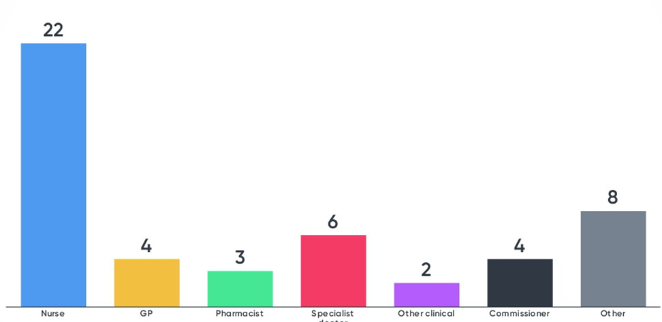
Who is in the room today

Slide 5
Five Year Forward View

Slide 6
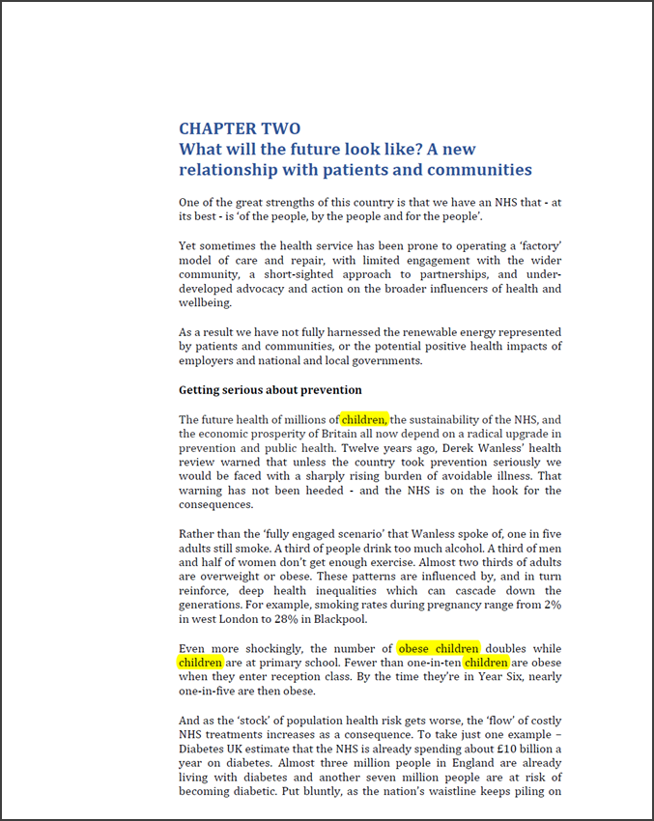
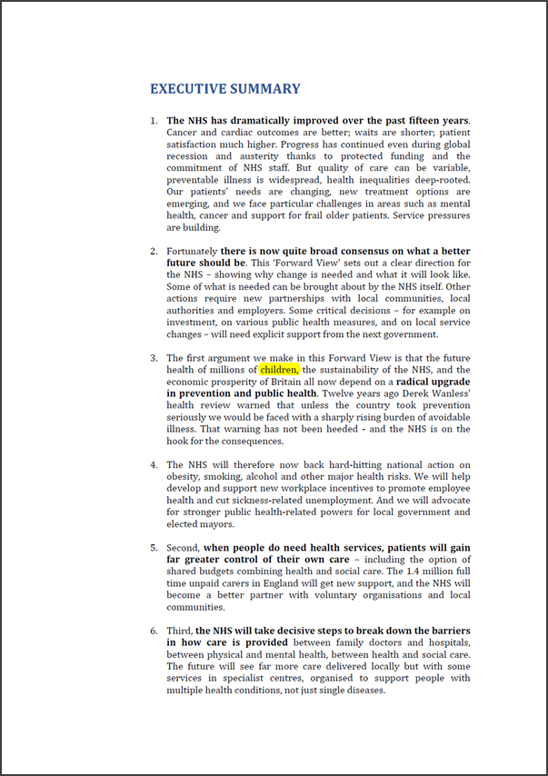
Control F
41 pages

Slide 8
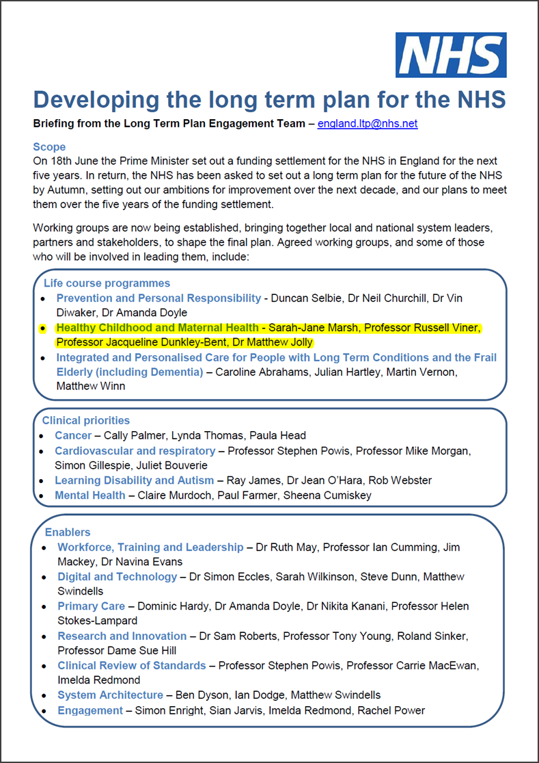
Long term plan

Slide 9
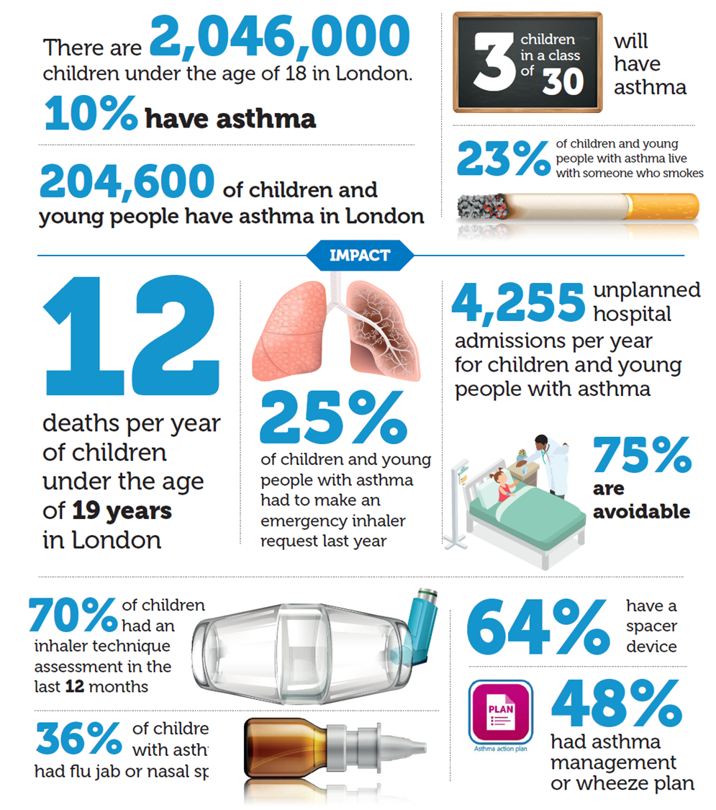
Asthma facts: children & young people in London

Slide 10
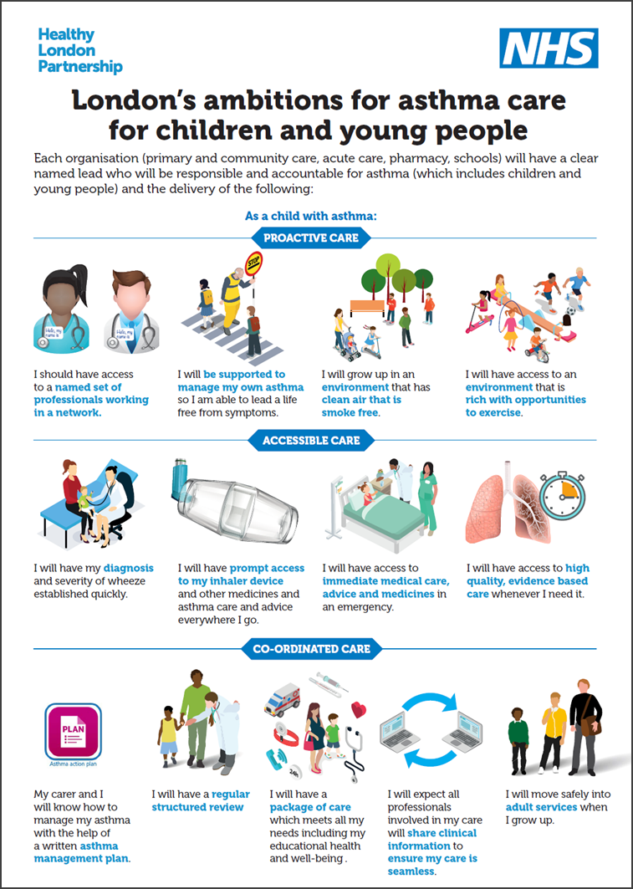
London asthma ambitions

Slide 11
London asthma standards

Slide 12
London asthma toolkit

Slide 13
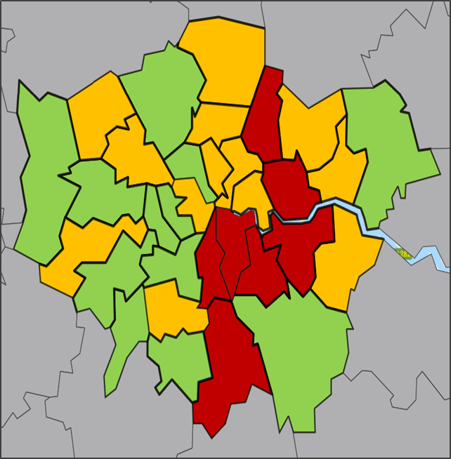
Emergency admissions London 2016 - 17
Hospital admissions for asthma (under 19 years) 2016/17
Notes:
Are there any similarities in these populations

Slide 14
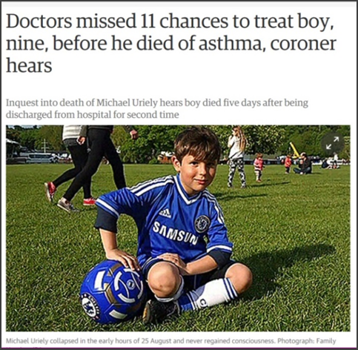
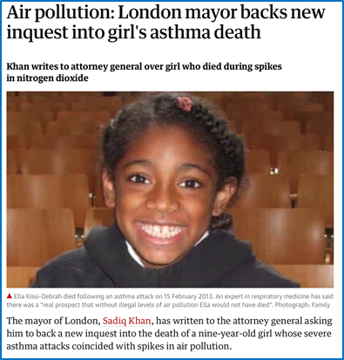
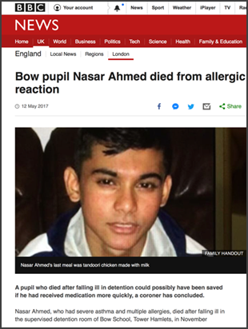
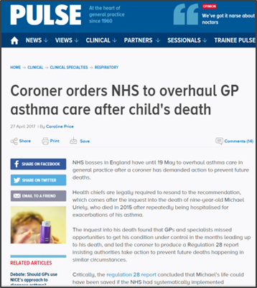
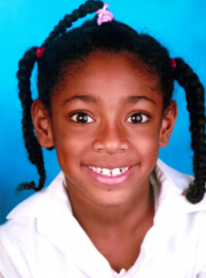
Why do we need to do this?
The Ella Roberta story
https://app.box.com/s/h0sfrrmdczgcu9tk3fuweryugb2ghi7a
Notes:
Michael Urielay (in North London aged 9) and Naser ahmed (14 year old who does in school in east london)

Slide 15
Asthma driver diagram Asthma driver diagram

Slide 16
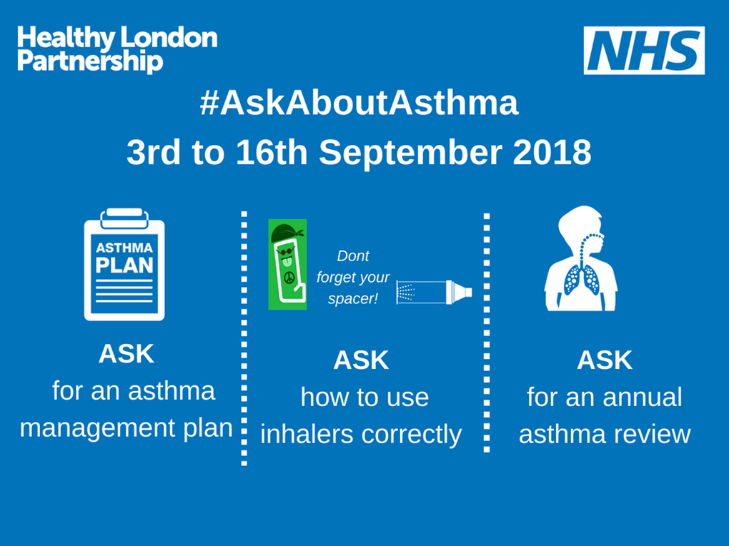

Slide 17
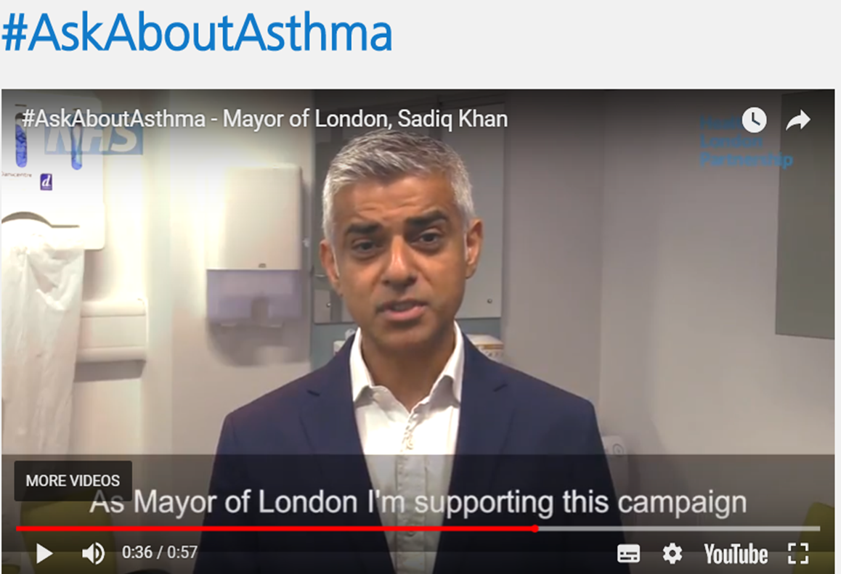
Campaign supported by the mayor
https://www.healthylondon.org/our-work/children-young-people/asthma/askaboutasthma/

Slide 18
Asthma deaths checklist

