Slide 1
What is the ECDS & how will it impact on Asthma
Giles Armstrong, Consultant in Paediatric Emergency Medicine, Royal London Hospital

Slide 2
What is the ECDS?

Slide 3
Emergency Care Data Set = ECDS
The Emergency Care Data Set is the new national data set for urgent & emergency care.
Original Timescale:
  Implemented in Type 1 & 2 units (Emergency Departments) by Oct 2017
  Implemented in Type 3 & 4 units (UCC & WIC) by Oct 2018
  No current timescale for introduction in Ambulatory Care but under consideration
ECDS includes:
  Reason for attendance
  Chief complaint
  Acuity
  Diagnosis

Slide 4
Why is ECDS needed?

Slide 5
Current data collection
Most EDs currently collect data using a system designed in the 1970s.
Significant changes in patient groups attending EDs since system designed
Poor data collection in multiple fields:
  Reason for attendance - currently only accurately collected in 5% of attendances
  Acuity – not currently collected at all
  Diagnosis - multiple issues with diagnosis…..

Slide 6
Difficulties with Diagnosis
Multiple issues with ED Diagnosis
  Only 50% of attendances have a “diagnosis” recorded
  But majority (74%) of recorded diagnosis are not true diagnosis - mainly symptoms
  41 of top 100 ”diagnoses” are not truly diagnoses
  Even when a diagnosis is a true diagnosis there are still issues:
    Some current diagnoses include – Dutch Shepherd Dog Breed, Mushroom & Brassica napus (Rapeseed)
    2% of all currently recorded pregnancy problems are coded as occuring in men

Slide 7
Why all the diagnosis problems?
Most ED systems currently code using SNOMED CT codes
  System formed from merger of SNOMED RT (USA) & CTV3 (UK) systems in 1999
  Currently 311,000 concepts linked by 1, 360, 000 relationships
  System is designed to be extremely comprehensive but was designed with expert coders with time to code clinical encounters
In ED mainly coded by:
  Non-expert coders.
  Under significant time pressure to code.
Results in significant mis-coding

Slide 8
How does ECDS improve things?

Slide 9
Diagnosis under the ECDS
ECDS limits diagnosis to only approximately 750 possible diagnosis
  All are true diagnosis
  Can be qualified as suspected or confirmed
  Devised through work with RCEM

Slide 10
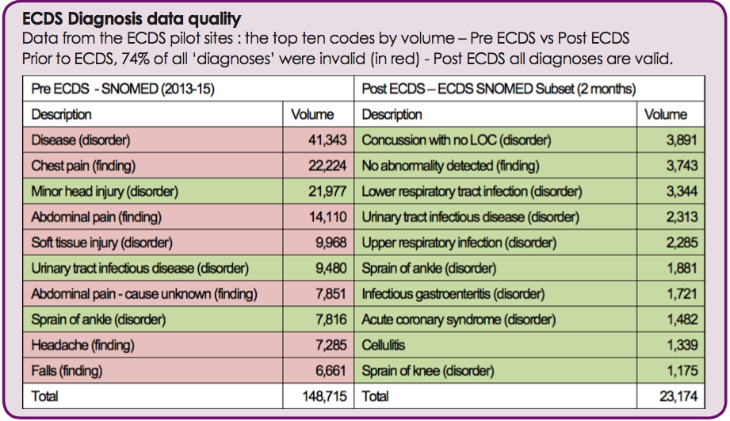
Pilot study

Slide 11
What are the benefits of the ECDS for Asthma?

Slide 12
Intended benefits of ECDS (in Asthma)
Currently poor quality in coding acute asthma episodes in patients attending ED
One local study found over 60 different SNOMED CT diagnostic codes used to code acute exacerbations of asthma
This leads to poor quality data for commissioners to:
  Plan local services
  Assess performance of local departments against national standards
Acute wheezy episodes in children can now only be diagnosed as
Asthma
Viral Induced Wheeze
Bronchiolitis

Slide 13
Looking forward
Diagnosis of asthma should improve for all ED attendances
Should allow for better planning of local asthma provision
Should allow for better assessment of any system interventions for asthma
Could allow for prospective study of presenting complaint -> diagnosis

Slide 14
Questions?

Slide 15
Some issues with implementation of ECDS
Still work in progress
Some specialist diagnoses missing from ECDS
Particularly an issue for paediatrics e.g Kawasaki’s missing from first version
Does rely on how well local IT system search function interfaces with ECDS codes e.g. Kawasaki’s officially listed as acute febrile mucocutaneous lymph node syndrome (disorder)
Can feedback to local ECDS leads and changes can be made.

