Slide 2
Introduction
Where did it come from?
Started approximately 5 years ago
NWL was chosen for the Integrated Care Pilot (ICP)
To use integrated care data to understand the population, to find innovative was of working together to better support the needs of the population
Years of work setting up Governance to allow information sharing between providers
NWL Information Governance Group established
Information Sharing Agreement (ISA) created
Data Controllers signing up to the ISA
Dashboards were developed to support the work that developed into Whole Systems Integrated Care (WSIC)
Clinical Advisory Group (CAG) set up to lead the direction of the development of the dashboards

Slide 3
Who is developing the WSIC Dashboards?
Key enabler to North West London’s Sustainability and Transformation Plans (STPs)
Key facts • Over 2 Million People • Over £4bn Annual Health & Care Spend • 8 Local Boroughs • 8 CCGs & Local Authorities • 373 GP Practices • 10 Acute & Specialist Hospitals • 2 Mental Health Trusts • 2 Community Health Trusts
Page 1

Slide 4
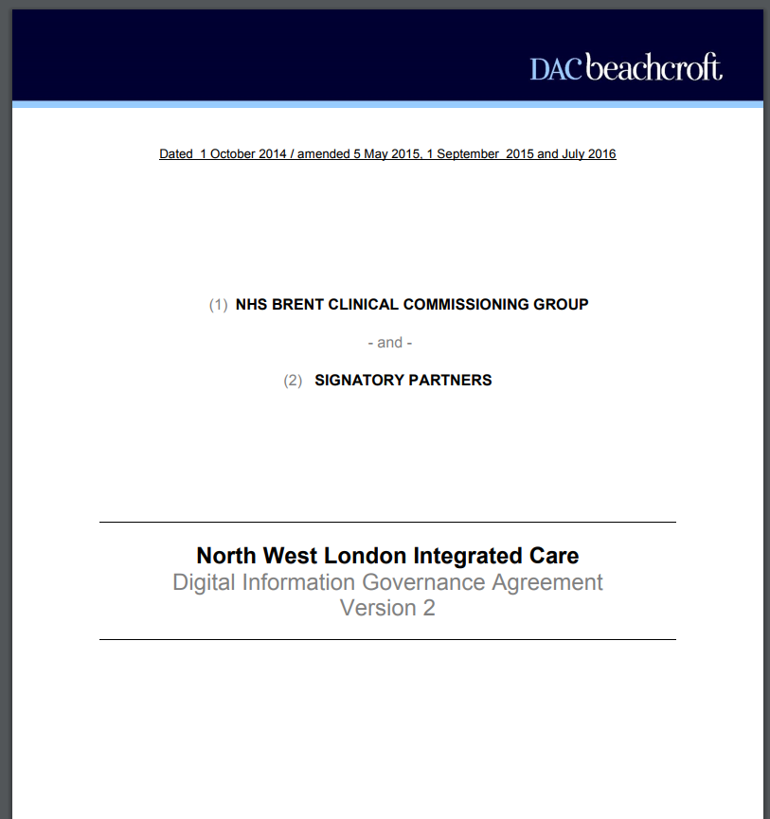
Data Sharing in NWL and the ISA
The purposes of the information sharing are to enable:
Care Planning Purpose - any Provider Partner providing Direct Care to a patient who has consented to access that patient's Individual Integrated Care Record electronically for the purpose of providing Direct Care.
Case Finding Purpose - Provider Partners to access information from the Whole Systems Integrated Care Record about their own patients, to support their identification of patients suitable for targeted care.
De-identification Purpose - the Host of the arrangement to de-identify shared information so that it may be used for the commissioning purposes of CCG Partners.
Patient Access Purpose - the development of Patient Access Services to enable patients and their carers to access their records.
Maintenance Purpose - the Host of the arrangement to maintain the Whole Systems Integrated Care Record, including by human intervention where required to ensure data integrity.
Patients CAN OPT OUT of data sharing
ISA being re-written in early 2018
Page 2

Slide 5
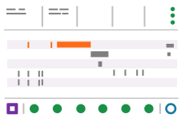
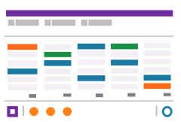
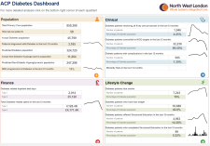
Whole Systems Integrated Care (WSIC) solution
Hospitals
GP Practice
Local Authorities
Community
WSIC Data Warehouse
Derived Measures
Long Term Conditions
electronic Frailty Index (eFI)
Spend
Core Data
Activity
Prescriptions
Demographics
Reference Data
Organisation
BNF
Postcode ‘out codes’
DE-IDENTIFIED
Integrated Patient Summary
Case Finding Tools
Long Term Condition Management Tools
Population Health
Benchmarking
De-identified dataset
District Nurses
Care Coordinators
GPs
Clinical teams in secondary care
ACPs
Researchers
Page 3

Slide 6
Care Professionals Dashboards

Slide 7
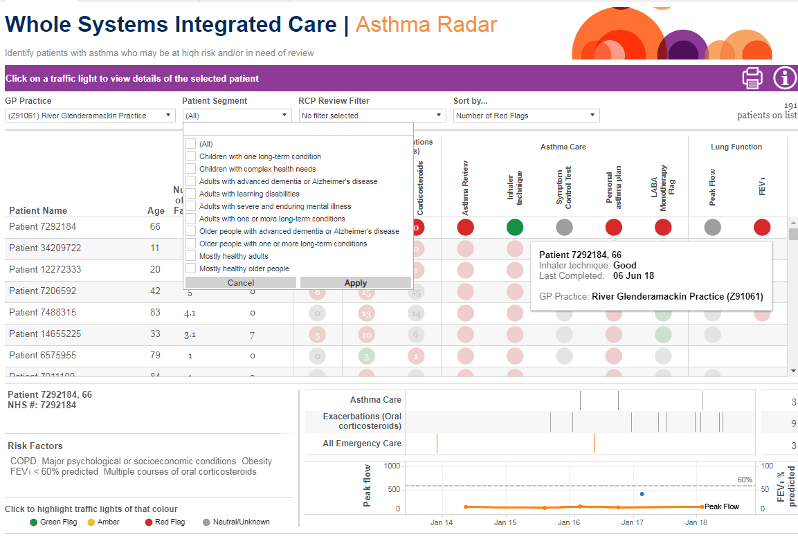
Patient Segments

Slide 8
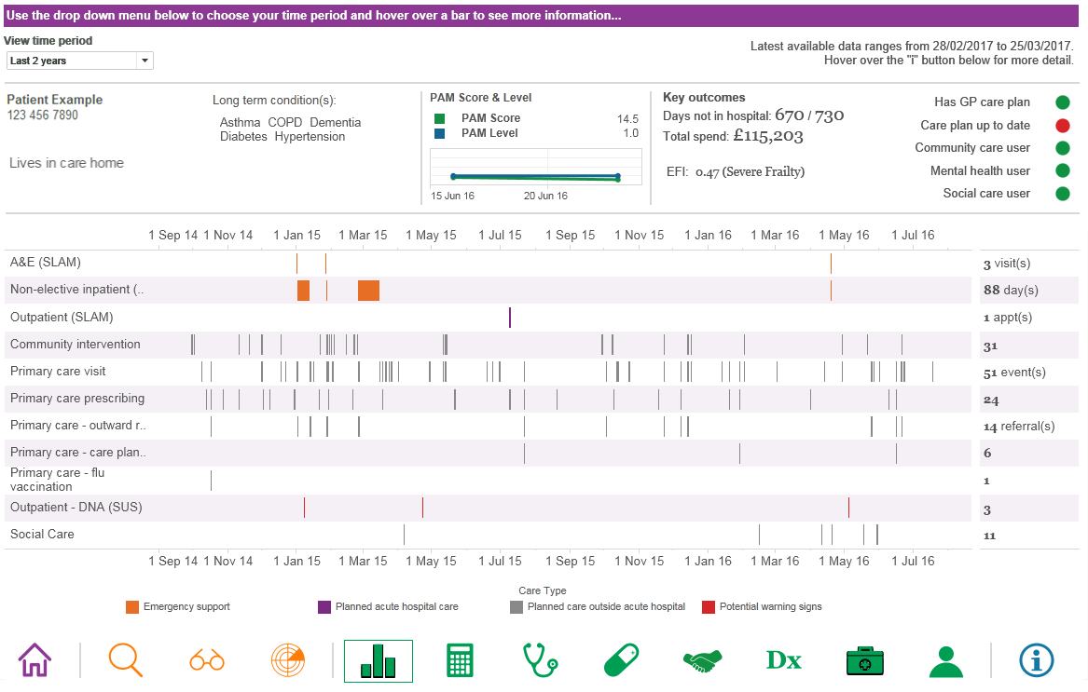
The patient activity summary
The WSIC Dashboard Clinical Advisory Group is continually evolving the product in response to prioritised user feedback
Page 8

Slide 9
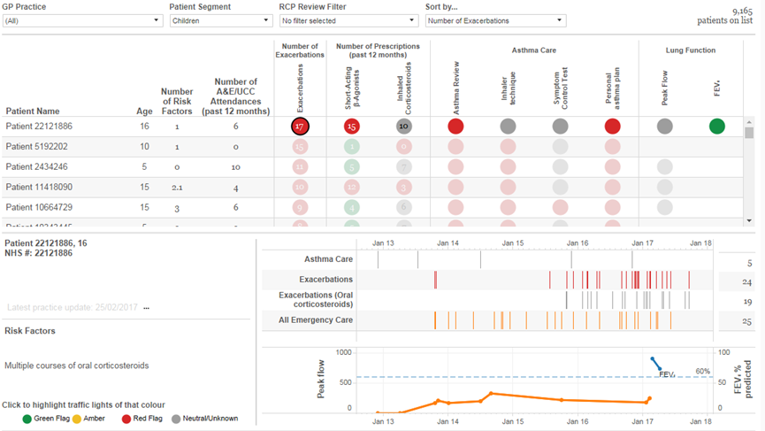
Specific LTC Dashboards: Asthma Radar
Patient level radar showing patients diagnosed with Asthma, prescriptions, number of asthma admissions and date of last Asthma review
Use to identify asthma patients who are having exacerbations and require a review of care and prescriptions
Page 11

Slide 10
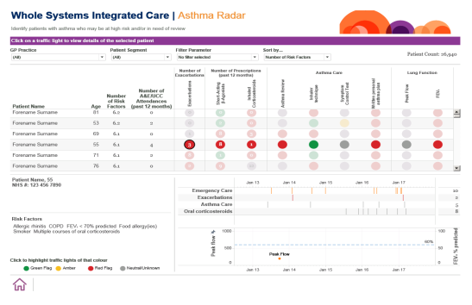
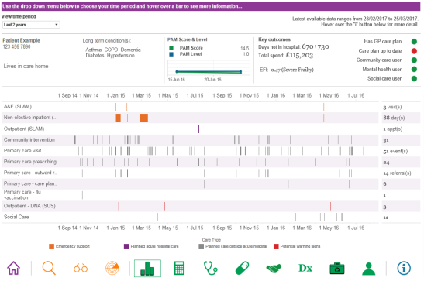
Using WSIC Dashboard to aid complex patient care CC4C Hub MDTs - Asthma
North West London Collaboration of Clinical Commissioning Groups
Case Finding
Foundation doctor used the Dashboard to identify complex patients before the CC4C Hub MDT.
Further information was gathered from their hospital notes and clinic letters.
The Patient
A 15-year-old girl with frequent asthma exacerbations was selected because she had numerous A&E attendances
This raised questions regarding the family’s understanding of asthma and whether her asthma management required escalation.
Clinic
The patient was booked for an extended Paediatric specialist appointment at their GP surgery.
Potential patient cases were identified using WSIC Watch lists for regular primary and secondary care attenders, frequent hospital admissions, missed appointments and out-of-date care plans.
These were summarised and sent to the Paediatric consultant running the MDT who finalised case selection.
Outcome
As a result of being identified using the Dashboard tool as a case for discussion and review, the patient and her family were seen by a Paediatric specialist in a community environment.
As well as optimising the patient’s asthma management medically, the patient and family were given support and education to help optimise her management conservatively.
It also allowed health promotion for the parents to stop smoking.
This allowed for an in depth discussion with the patient and her parents regarding avoiding asthma triggers, further conservative management measures such as using a peak flow diary, and medical management.
It was identified that her parents smoked at home, a common asthma exacerbation trigger, and they were signposted to smoking cessation services.
Using the Case finding list and viewing the Asthma Radar at the MDT
The patient activity screen was viewed and noted that she numerous primary care attendances.

Slide 11
Key indicators for YTD 2017 and 2018
Under 18 YTD 2017
Numbers of patients who have an asthma management plan- 7,678
Numbers of patients who have been shown how to use inhaler effectively – 11,421
Numbers of patients of have had an Annual review – 33,854
Under 18 YTD 2018
Numbers of patients who have an asthma management plan- 17,796
Numbers of patients who have been shown how to use inhaler effectively – 15,928
Numbers of patients of have had an Annual review – 36,778

