Slide 1
Using data for improvement in asthma care across London
Sara Nelson, RGN, QN
Notes:
Intro role The next 3 sessions are about the use of data to help with your local improvements and to gain some agreement around what we should be collecting acrss London to demonstrate large scale change

Slide 2
Where can you find the data for pathway improvements?
Ambulance data – LAS (new section of toolkit)
Acute care - Emergency care- HES, ECDS
Admission - Hospital episodes statistics HES
Outpatient care – HES
Mortality and Morbidity ONS – Outcomes rates 30 & 90 day,
Pharmacy data
    NHS Business services Authority
    Prescription information services
    ePACT2
    MUR and pharmacy quality payments
    PresQuip
Primary Care -QOF http://gpcontract.co.uk/ - (GP Practices)
PROMS/PREMs- Asthma UK Annual survey
Notes:
Giles will cover the emergency data set shortly

Slide 3

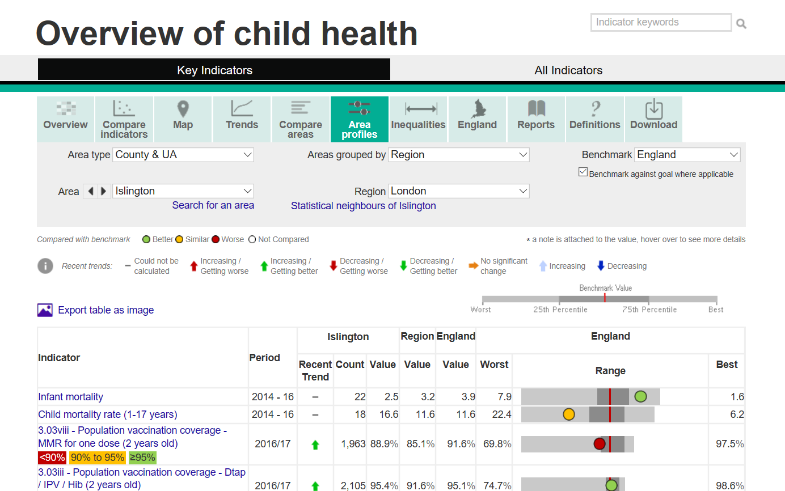
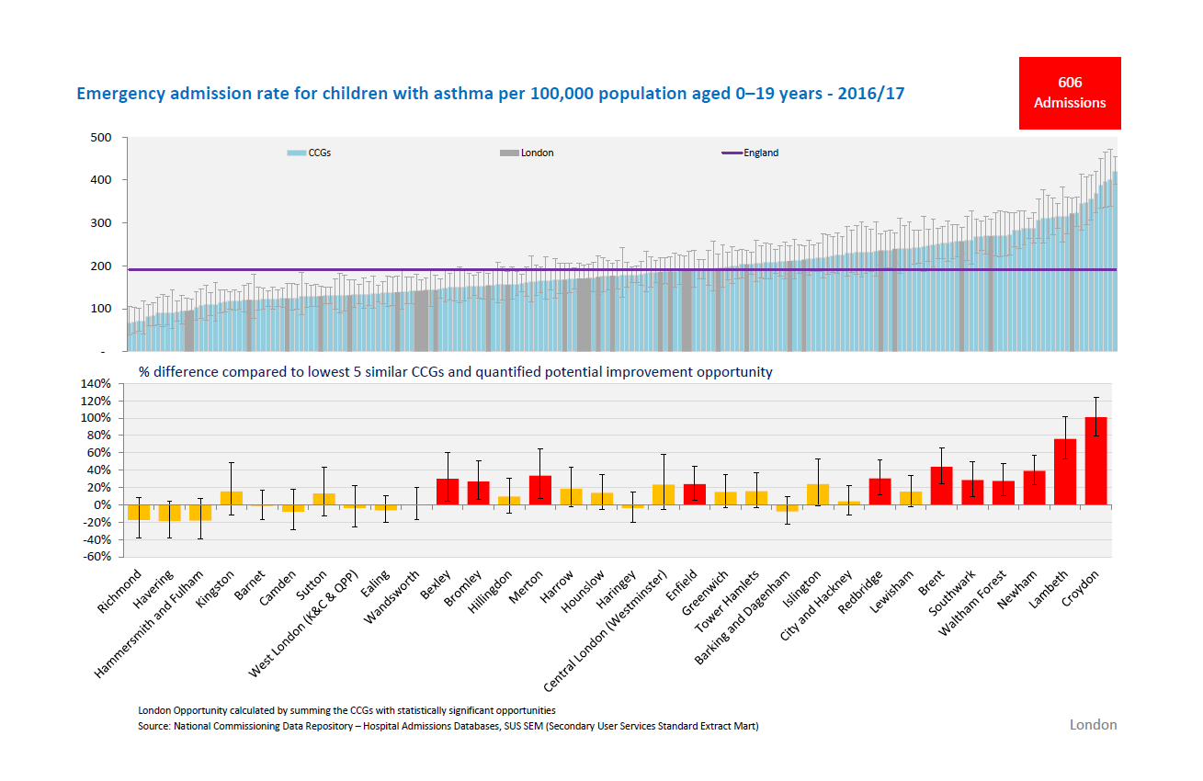
Where can you find the data cont?
Fingertips
https://fingertips.phe.org.uk/profile-group/child-health/profile/child-health-overview
https://www.england.nhs.uk/rightcare/
Asthma UK Data Portal https://www.asthma.org.uk/get-involved/campaigns/data-visualisations
AUKUR Observatory: https://www.aukcar.ac.uk/asthma-observatory

Slide 4
National Paediatric Asthma Audit 2015 results
Nov 2015 Findings
Most aspects of discharge planning suboptimal <60% had asthma action plan
Only 10% of children ≥ 5 years had peak flow measured at initial assessment
<50%had key components of care eg information, inhaler device technique check and plan
Only 24% advised to see GP within 2 working days of admission
15% of CYP readmitted (Nov 15-Jan 16)
National COPD and asthma audit
Commencing June 2019
Secondary care audit at discharge (incl other areas of pathway & snapshot)
Paediatric asthma –clinical and organisational (0-5yrs and 6-19 yrs)
Adult COPD and asthma – clinical and organisational
https://www.rcplondon.ac.uk/projects/national-asthma-and-copd-audit-programme-nacap-secondary-care-workstream-paediatric-asthma

Slide 5
London Data

Slide 6
Emergency admissions 2010
Wandsworth, Haringey, Westminster topped league
Hospital admissions for asthma (under 19 years) 2010/11
Notes:
Wandsworth, Haringey, Westminster topped league

Slide 7
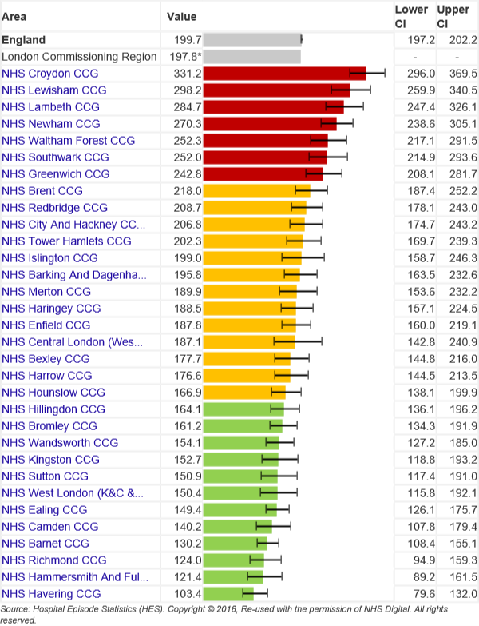
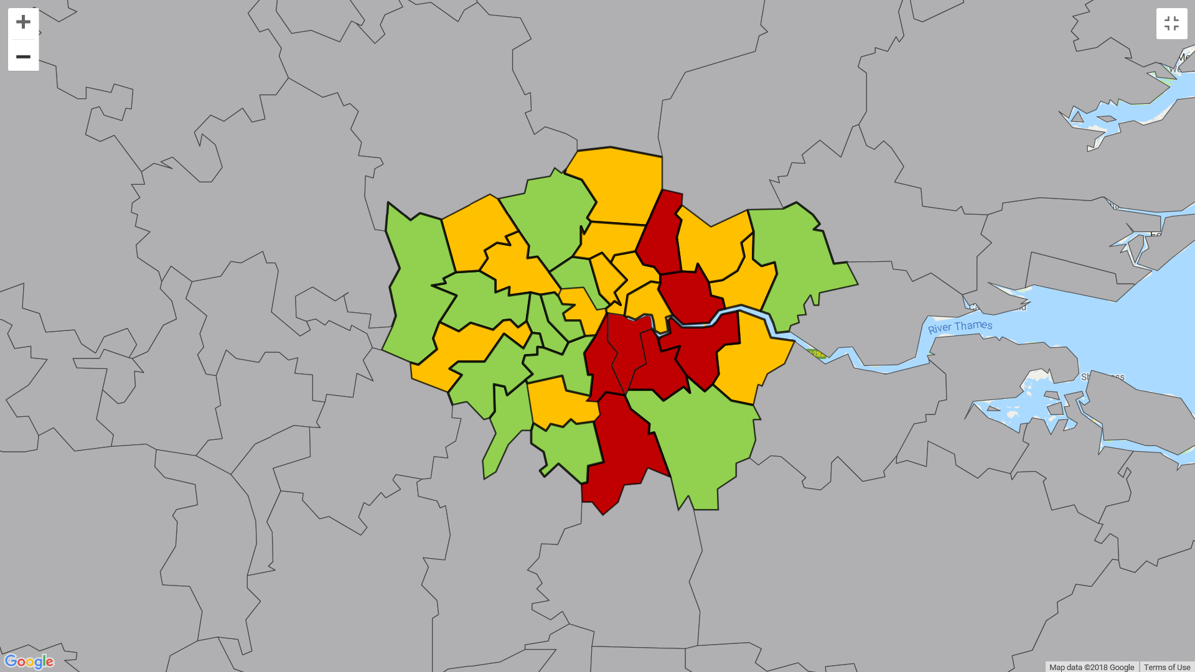
Emergency admissions 2016 - 17
Croydon, Lewisham and Lambeth top
Hospital admissions for asthma (under 19 years) 2016/17 https://fingertips.phe.org.uk/profile-group/child-health
Notes:
Are there any similarities in these populations

Slide 8
Deaths from Asthma 2012-2016

Slide 9
Why #AskAboutAsthma now -Week 38!
Male Female

Slide 10
London CCG hospital admission trends
2011/12 to 2016/17 (per 100,000)

Slide 11
London CCGs annual admissions
2011/12 to 2016/17 (per 100,000)

Slide 12
North Central London STP

Slide 13
North East London STP

Slide 14
North West London STP

Slide 15
South West London STP

Slide 16
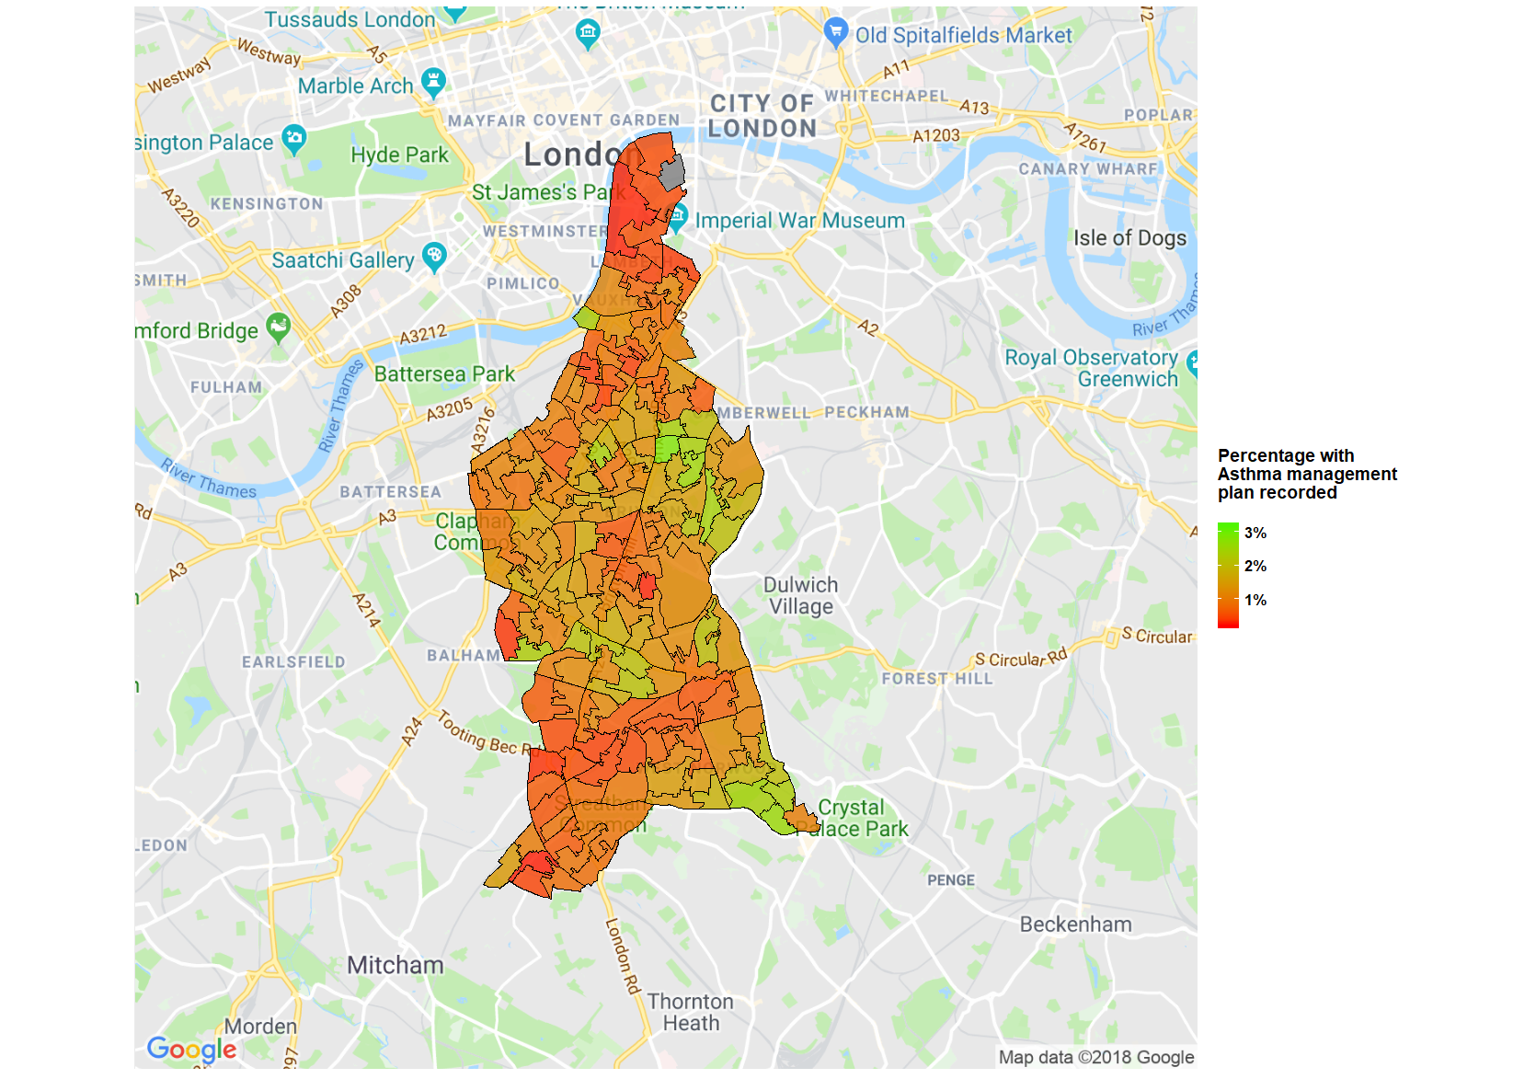
Asthma management plans
Green- Only 2% recorded
Percentage of Lambeth DataNet patients aged under 18 years registered on 30/04/2018 with Asthma management plan (663.. or 8CR0.) recorded by Lambeth LSOA

Slide 17
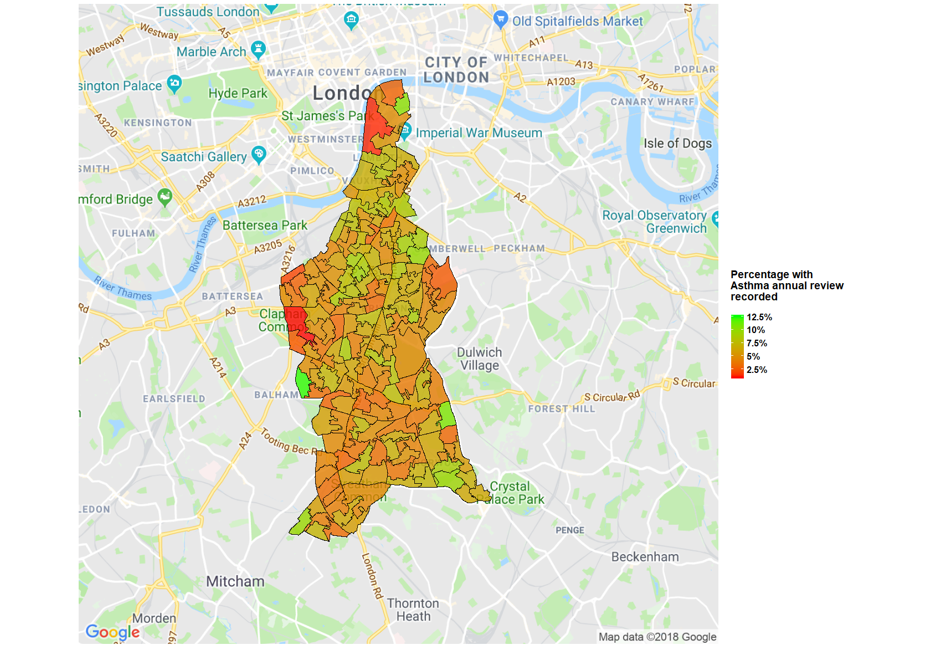
Annual Review
Green only 12% recorded
Percentage of Lambeth DataNet patients aged under 18 years registered on 30/04/2018 with Asthma annual review recorded by Lambeth LSOA

Slide 18
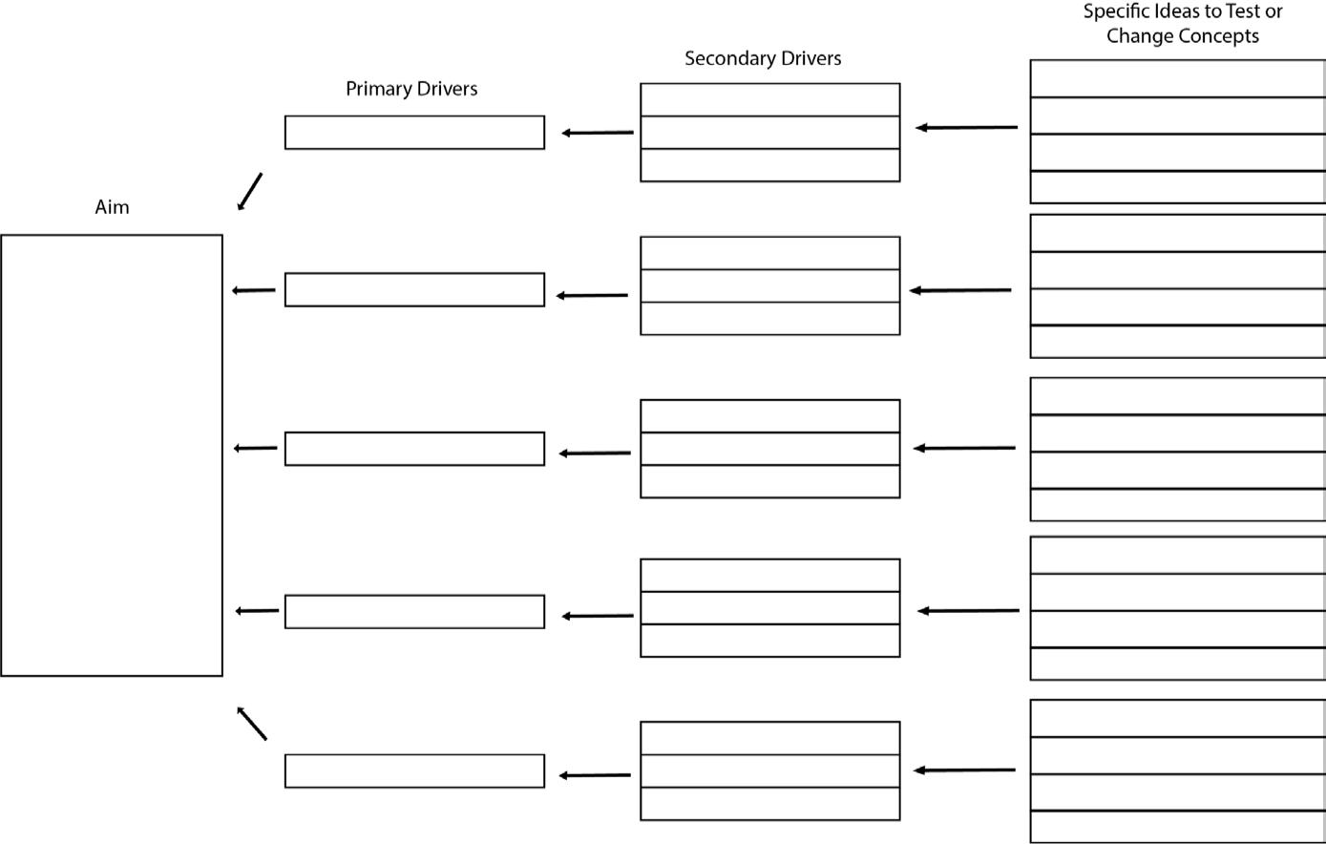
Promote asthma ambitions
Asthma networks peer reviews
Update and implement standards
Asthma in STP planning
Clear asthma pathways
Development of severe asthma Use Asthma CQUIN funding to establish networks
Support for STPs (LLA)
Roll out asthma dashboard
Complete and validate prevalence finder
To ensure all children and young people in London with asthma receive effective asthma care and outcomes improve for those with asthma (need
to quantify reduction in admissions, PICU/deaths costs, life impact? Etc.)
Reduce admissions by XXX%
Reduce ED/UEC attendance by XXX %
Each organisation to increase uptake of asthma action plans by ? 10%
Reduce asthma deaths across capital to 0
Prevalence finder
Promote EMIS/Systm1/Vision templates
Improve diagnosis
Recording QOF
Promote asthma toolkit
Protocols on diagnostics in primary care
Support new diagnostic techniques
Run awareness campaign - public and professionals - ensure wide engagement
#AskAboutAsthma campaign
Develop and monitor training materials
Improve management, review
Asthma friendly practices
Learning from deaths, auditing ED attendances/admissions
Rollout CDOP asthma death checklist
Promote asthma friendly GP practices
GP training
Develop online training materials
Pharmacist training
Amend, roll out pharmacy inhaler protocol
Develop workforce
Share learning group consultations
Practice nurse training
Promote online and other training
Promote asthma management in schools
Digital health passport adoption
Complete beta phase digital health passport
Improve self care
Asthma management plans and inhaler technique
Asthma friendly schools
Evaluate asthma in schools project
Shared asthma plan (GP and schools)

Slide 19
What should we all be measuring across London?
Aims
Drive effectiveness, efficiencies and collaborative working
Increased care co-ordination
Improved care structures
Care closer to home
Increased performance against standards
Take duplication out of the system
Reduced days off school
Reduced unsecure Urgent care and ED attendance and admissions
Increased uptake in flu vaccinations
Increased prescriptions for preventer medications
Decreased prescriptions for reliever medications

Slide 20
What should we be measuring across London
Measurement | Source | Target
Numbers on asthma register (prevalence) | QOF | Aim for 9-10%
Record of smoking (>14) | QOF | Reduce by
% of patients who have had an annual review | QOF | 80% by 2019 95% by 2020
% of patients had inhaler technique checked |  | 50% of pts on register by 2019 80% by 2020
% of patients given an asthma management plan | Audit/ QOF | 75% by 2019 100% by 2010
Increase in preventer inhalers | Px data | ? %
Reduction in reliever inhalers | Px data | ? %
Increase in 48 hour or monthly follow ups | HES/ QOF | 50% by 2019 75% by 2019
% patients on register or discharged with an assessment of peak flow and/or ACT | HES/ QOF | 50%??
% of CYP given flu immunication | QOF px data | 75% ?
Notes:
Are these realists

Slide 21
What should we be measuring across London
Measurement | Source | Target
Number of Urgent care attendances for asthma |  | Reduction by 10%? on last years
Number of asthma ED attendances |  | Reduction by 10%? on last years
Number of CYP admissions for asthma |  | Reduction by %105 on last years
Number of readmissions/ re-attendance |  | Reduction by ?10% on last years
Numbers seen in hub or community clinic |  | 80% of children seen outside acute hospital setting
Numbers of asthma friendly schools by borough |  | ?
Numbers /names of asthma leads/champions per organisation
? Diagnostic standard- what should it be?
Notes:
Are these realists

Slide 22

Future
Improving data sharing and use of technology
Smart inhalers
Digital health passport / apps

Slide 23
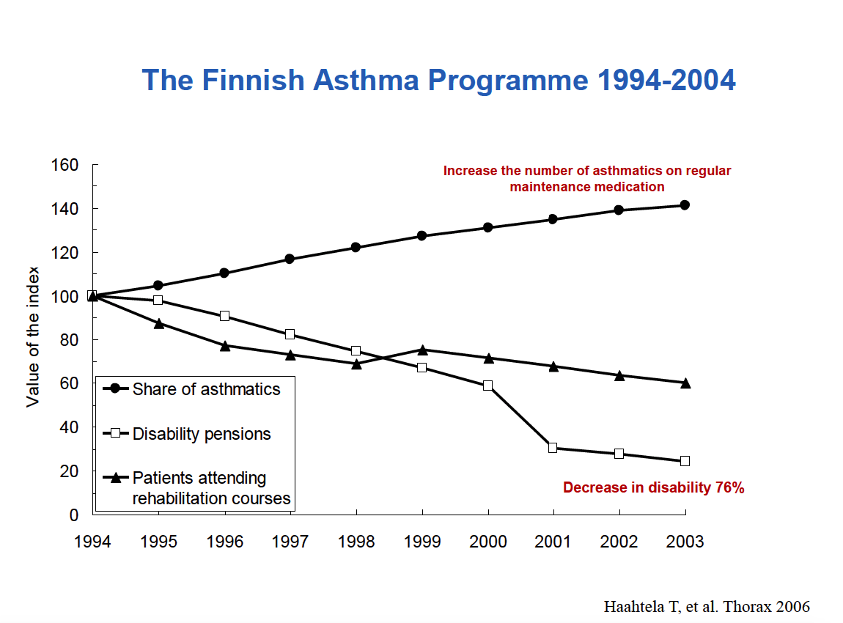
We would like to see the Finland effect!

Slide 24
All the work we do with our partners moves us closer towards our goal to make London the healthiest global city.
Sara.nelson@nhs.net
www.healthylondon.org
england.healthylondon@nhs.net
@healthyLDN

