Slide 1
Improving Asthma Management Through Group Consultations Georgina Craig, Group Consultations Lead, the ELC Programme 05 September 2018

Slide 3
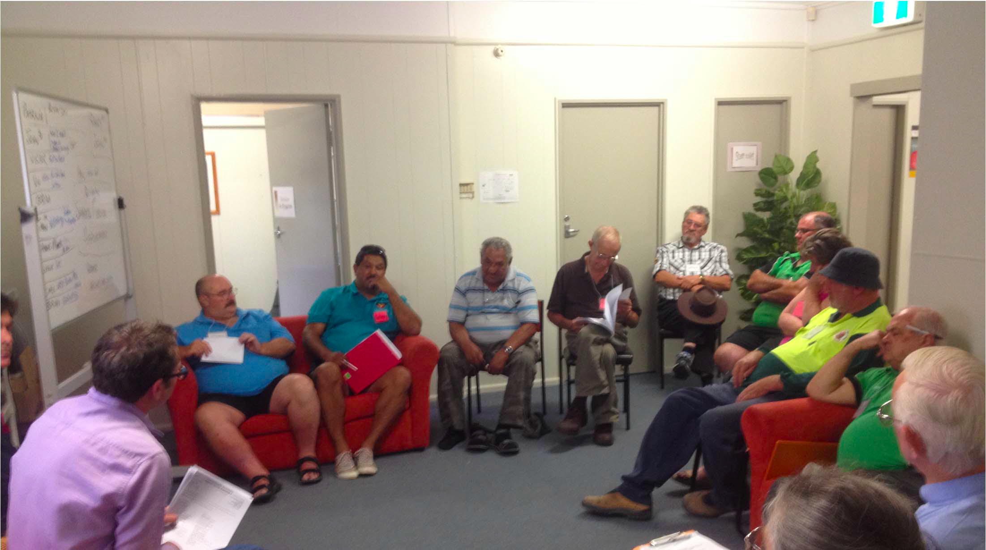
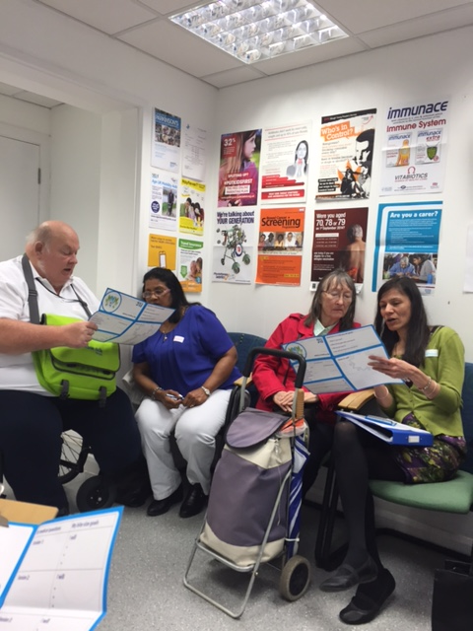
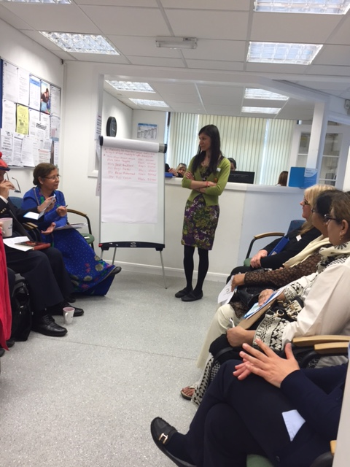
Not patient education, self help nor a peer support group, group consultations are planned 1:1 reviews and clinical care delivered in a supported group setting

Slide 4
Group consultations are…
An alternative way of consulting with patients
Individual clinical consultations delivered in a supportive peer group setting
Also known as “shared medical appointments” (SMAs)
A consultation where 10 -15 people with a similar condition or set of clinical problems are reviewed and supported
Managed by a process facilitator
1.5 - 2 hours long, with the clinician present for around half the time

Slide 6
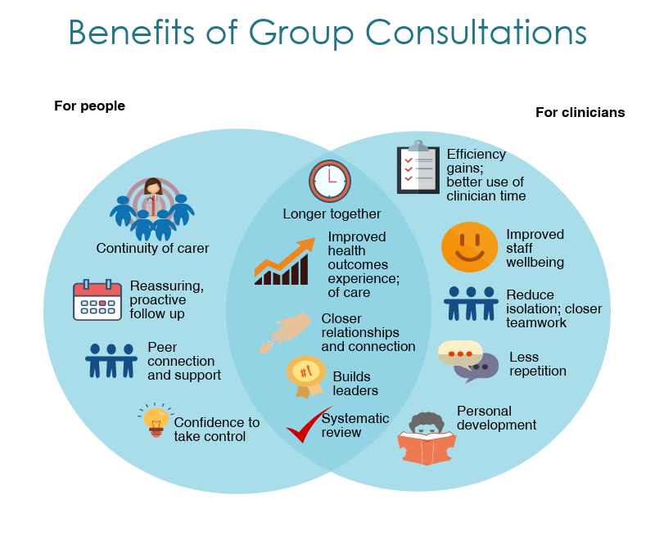

Slide 7
My experience of introducing group consultations:
Ana Marote, Asthma Paediatric Clinical Nurse Specialist, Whittington

Slide 8
For more information:
Georgina Craig, The ELC Programme
Tel: 07879 480005
Twitter: @GCAssoc
Email: georgina@elcworks.co.uk
Ana Marote:
Email: a.marote@nhs.net
HLP team:
Email: hlp.cyp-programme@nhs.net

