Slide 1
Health Check - Improving your annual asthma review
Laura Hale - Community Clinical Nurse Specialist in Paediatric Asthma
Stephanie Mayo - Mental Health Clinical Specialist
Charlene Smith – Communication and Engagement Lead

Slide 2
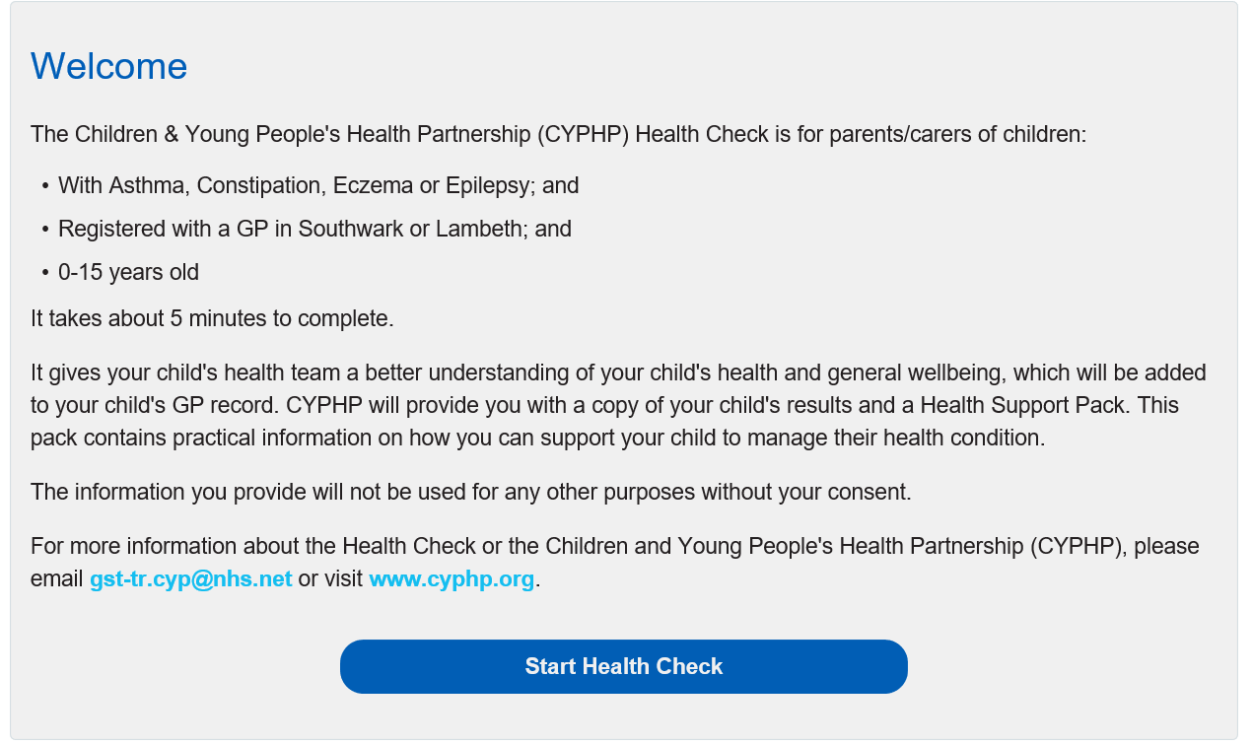
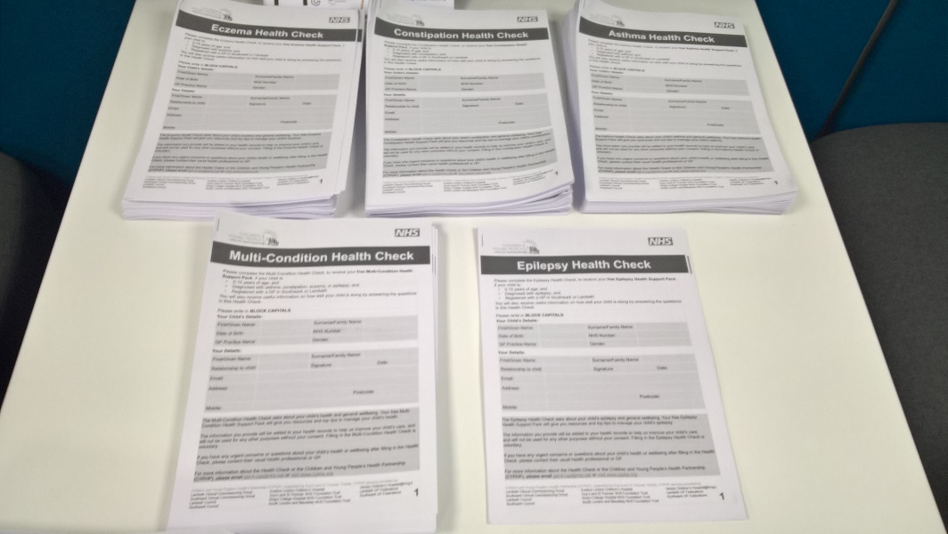
Health Check – who is it for?
The Health Check is for children and young people:
aged 0-15 years.
with asthma, constipation, eczema, or epilepsy.
registered with a Lambeth or Southwark GP.

Slide 3
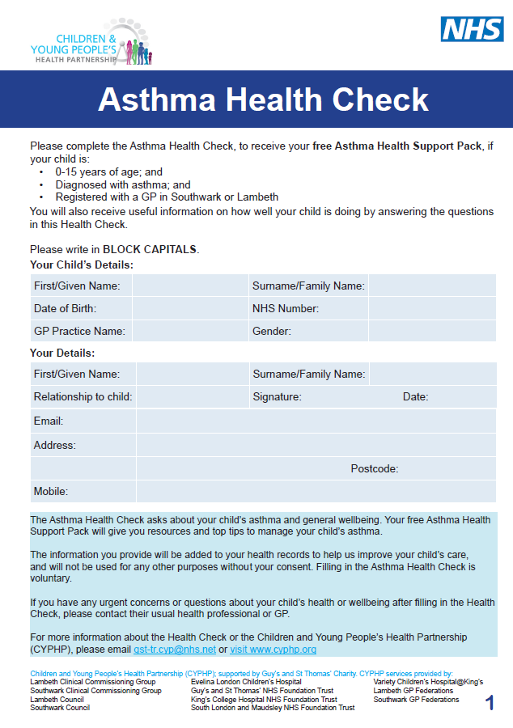
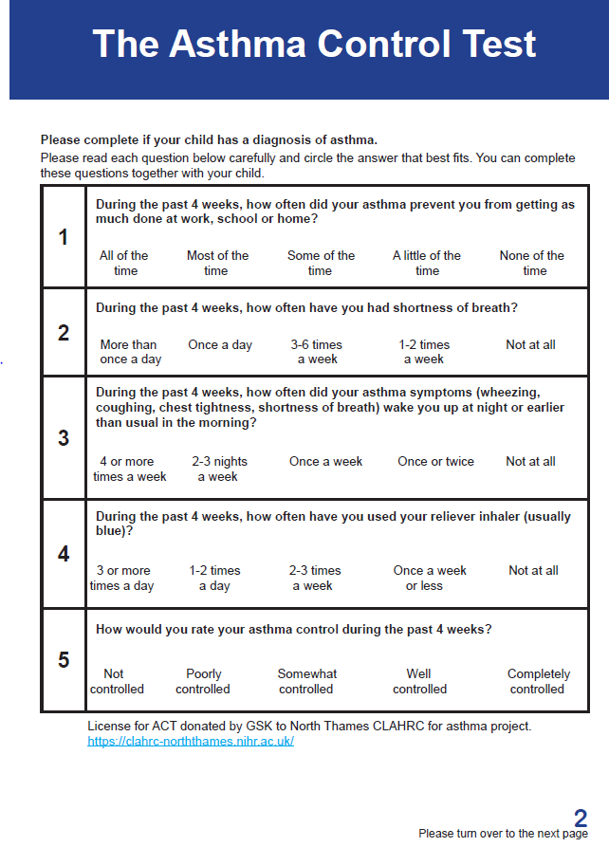
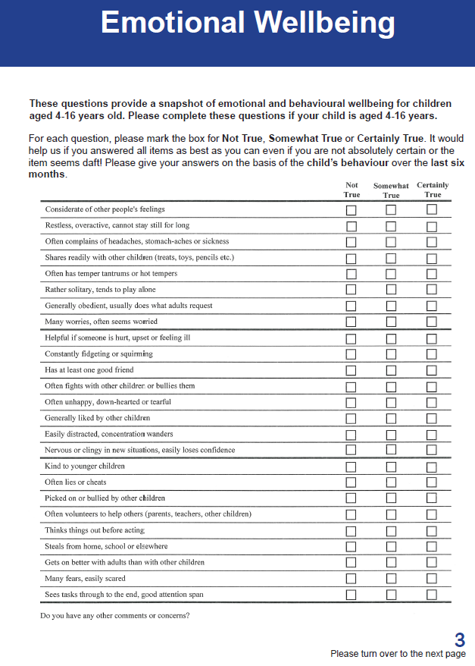
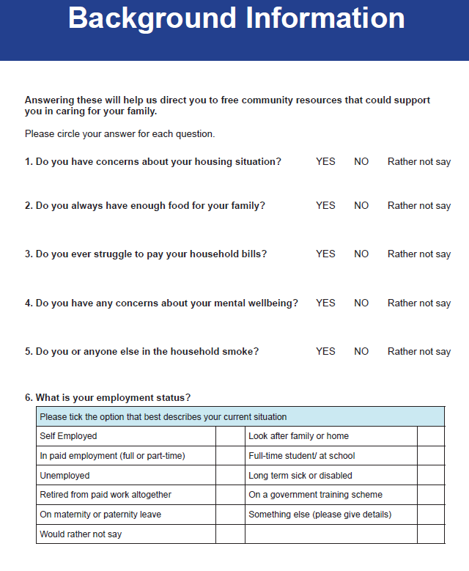
Health Check
Parent/carer invited to complete Health Check
Paper or
Online at www.cyphp.org/health-check
Notes:
The Health Check questionnaire will ask a parent/carer about their child’s condition and their general wellbeing.
It takes about 5 minutes to complete, either on paper or online.

Slide 4
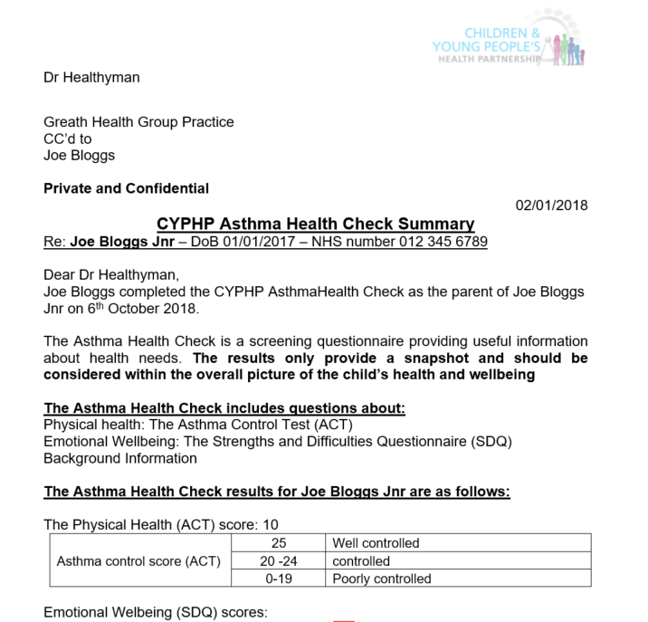
What happens next?
Parents/carers receive
Summary of their child’s results.
Health Support Pack; booklet with top tips on how they can support their child to manage their condition better, and links to community resources that they may find useful.
The GP Practice that the child is registered receive
The child’s summary - This can be added to their health record.
Notes:
Health Support Packs sent to families –
Health education and health promotion
Self –management support
Signposting for support – child’s emotional wellbeing, parental emotional wellbeing as well as community resources that families can find out about and use.
Health Check results added database and discussed by clinical team
Parents and GP notified
Tailored care offered as appropriate
Whole child, bio-psycho-social care
Follow up as appropriate
Clinical, health promotion

Slide 5
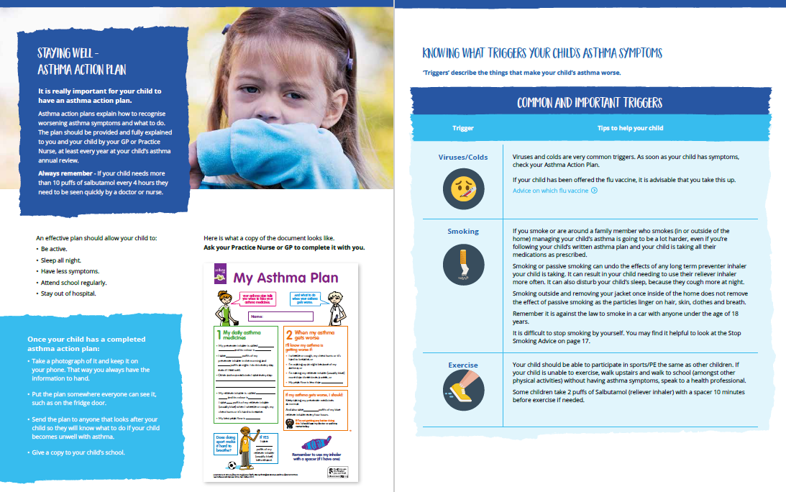
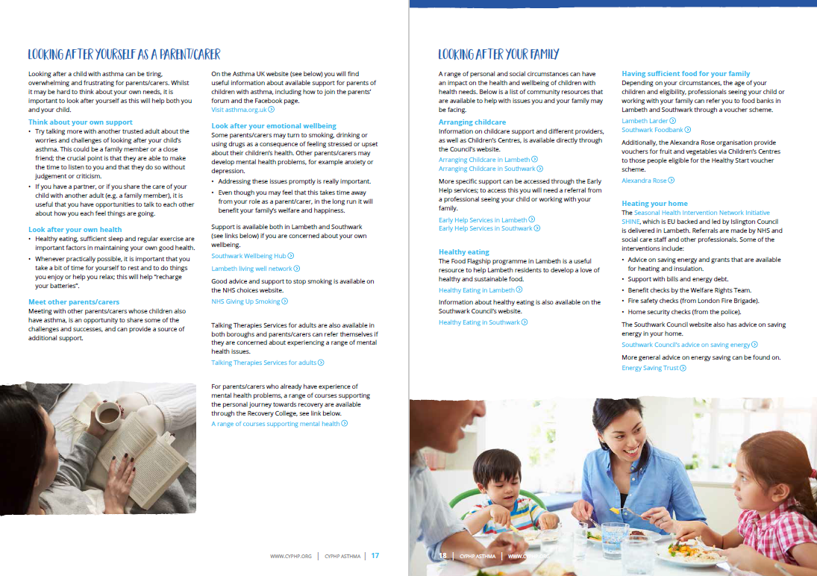
What’s in the Health Support Pack?
Physical +
Child and Family General Wellbeing
Notes:
Health Support Packs provide information, health promotion, and self-management support for parents and children. They promote better understanding of the child’s condition and health needs, and follow a similar three step approach to the Health Check. For example, the Asthma Pack starts with information about what asthma is, and what might make symptoms better or worse. It identifies ways to track symptoms and triggers, highlights common medications, and describes what to do if a child has an asthma attack. Importantly it then talks about general wellbeing, including advice about dealing with issues that may be experienced by children with asthma such as worries, difficult behaviour, and sleep problems. The pack concludes with sections specifically focussed on looking after yourself as a parent and looking after your family, with information, links and signposting to local resources.

Slide 6
Further questions?
Take the Health Check: www.cyphp.org/health-check
Visit www.cyphp.org
Sign up to our monthly newsletter: charlene.smith@gstt.nhs.uk

