Slide 1
Asthma inhaler pharmacy review project
Christine Kirkpatrick and Georgie Herskovits, Programme Managers
Children and Young People’s team, HLP

Slide 2
Project overview
Opportunistic review of asthma inhaler use in 5-24 year olds – pilot of protocol
Launched September 2017 in London Borough of Bexley
Piloted in three GP practices and 15 surrounding pharmacies
Captured on online template
Notification and any follow up needed communicated directly to GP practice.
“60-70% of CYP are not using their inhalers properly and are going back to their GPs and having their medication increased or changed” Bexley pharmacist

Slide 3
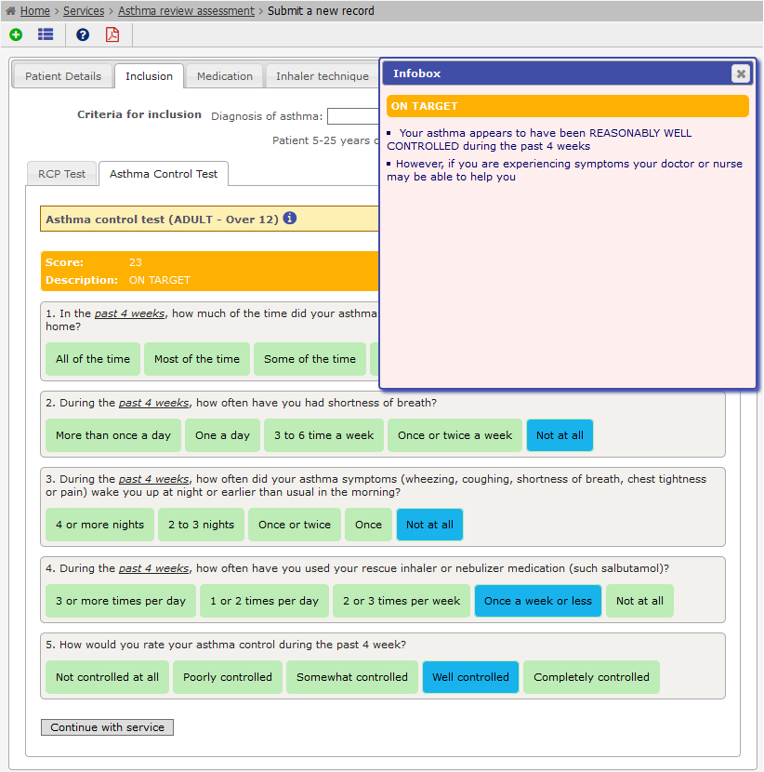
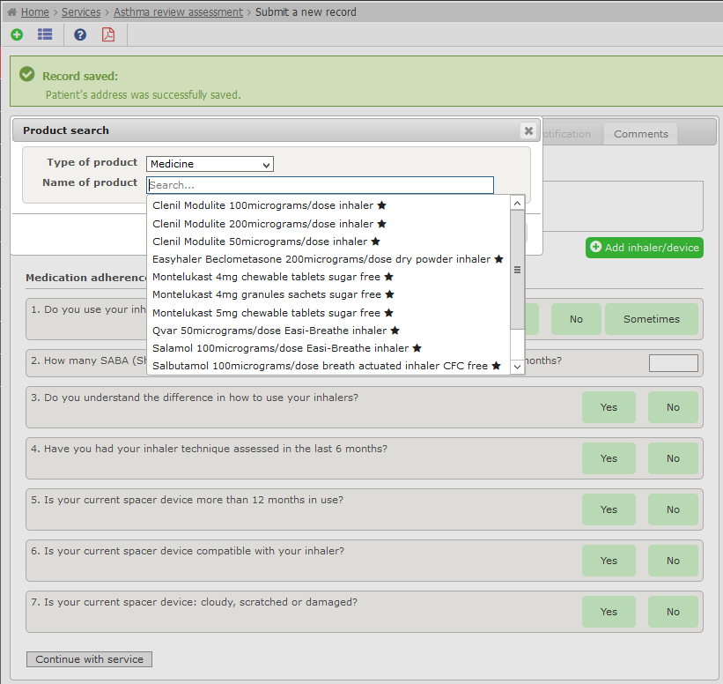
Sonar online platform

Slide 4
Key learning points
Timing
Ensure that training is closely followed by launch of the programme to keep momentum going
Patient recruitment
CYP do not often visit the pharmacist – targeted recruitment may improve this
Comms
Effective and targeted recruitment of pharmacists is needed: adequate notice, convenient timing and location, numbers of patients seen etc
Using text messages, as for smoking cessation programmes, was suggested
Ensure claims process is clear
Roll out over a larger area (more surgeries, more pharmacies) would improve patient recruitment
Whole-area approach easier from comms perspective

Slide 5
Pharmacy project: Next steps
Bexley CCG is now looking to expand the programme borough-wide and increase the eligibility age range up to 35.
Greenwich is looking to use the learning to develop a similar scheme.
The platform is to be offered for free to all interested CCGs in London by Sonar Informatics.
The CYP team will promote this and the project more generally through the CYP toolkit.
“A lot is growing from both the asthma in pharmacies and the group consultations projects …Even just raising the profile of asthma last year may have had an effect as we have had a drop in numbers of children attending A&E and also on admissions it seems”
[Karen Upton, GP safeguarding and asthma lead, Bexley]

Slide 6
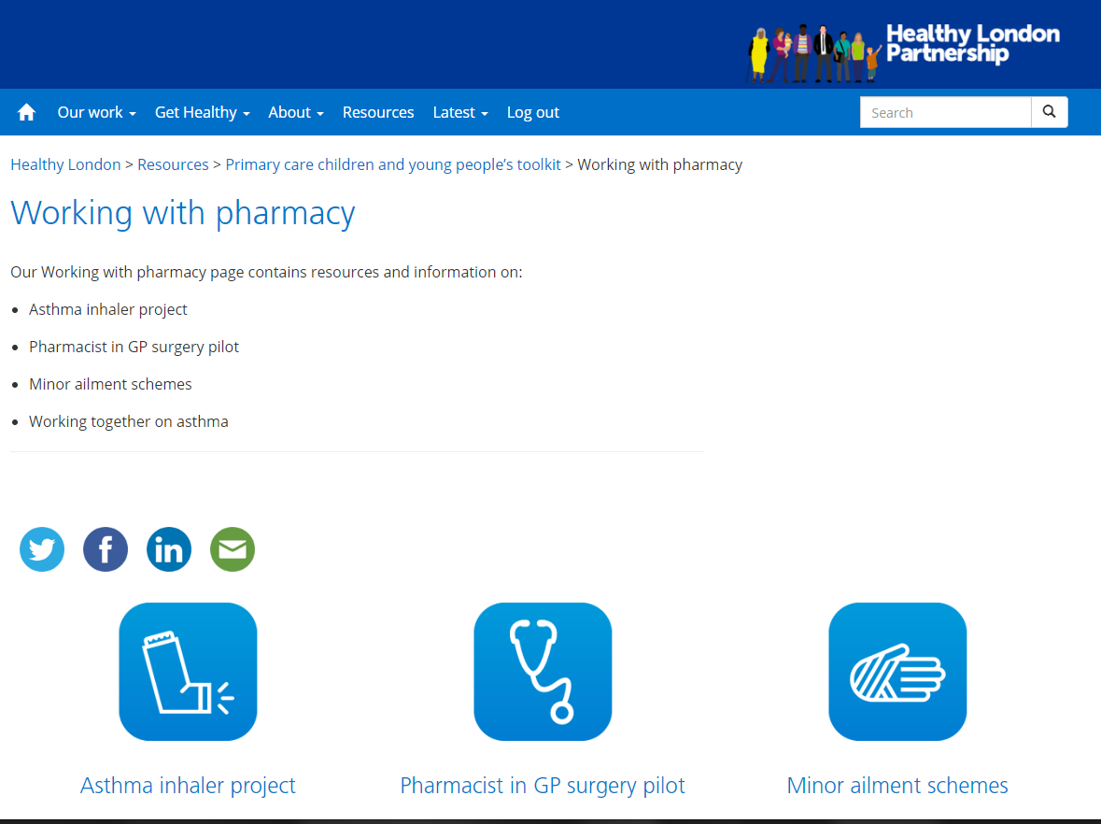
Resources and support
New CYP primary care toolkit –
pharmacy section
Film of lead pharmacist
Case study
Posters
Training slides and more

Slide 7
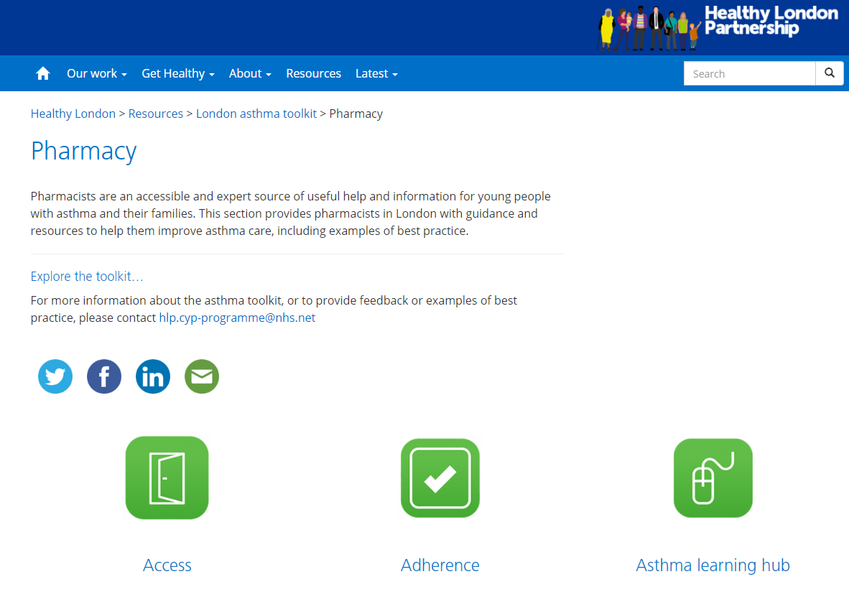
eLearning for community pharmacists
Developed by Education for Health
A free resource that we encourage pharmacists to use as part of ongoing CPD and training
https://www.healthylondon.org/resource/london-asthma-toolkit/pharmacy/

