Slide 1
Asthma Annual Reviews
Hetal Dhruve
Presented by Anh Vu
5th September 2018

Slide 2
Currently..
QoF targets achieved for asthma reviews
Self management plans issued
Payments received
However
Rise in number of children dying with asthma in the UK
  2016: 14 children died with asthma
  2017: 17 children died with asthma
  Approx. 4000 admissions per year https://www.ons.gov.uk

Slide 3
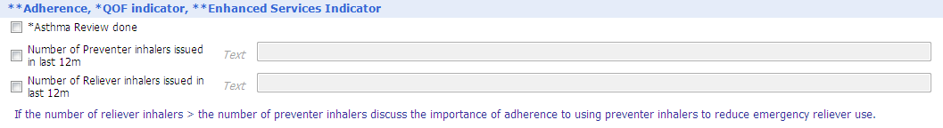
Adherence
Adherence is a key component of asthma management and yet studies have shown that in all severities of asthma, adherence to inhaled therapies is poor, with rates of non-adherence ranging from 30-70%.
Every asthma review should include the number of inhaler issued in 12months; both ICS and SABA. This can give you an insight into the way in which the patient is managing their asthma
ie. Clenil x 2 in 12 months.
Salbutamol x 12 in 12months.
This clearly suggests that the patient is non adherent to their ICS and
using their salbutamol to manage their asthma symptoms.
Notes:
**NEW**

Slide 4
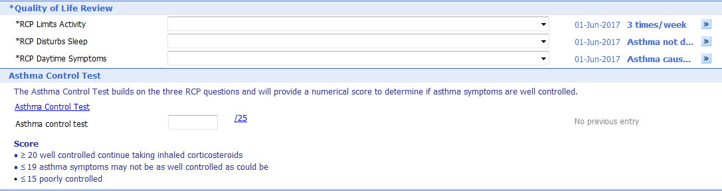
Quality of Life
QoF requires completion of the 3 RCP questions. The Asthma Control Test (ACT) adds to the RCP questions to give provide a score and suggests a level of control. Interestingly it also includes how well the patient thinks their asthma is controlled (Q5) – and often despite being symptomatic, patients suggest that they think their asthma is well controlled. It is important to realign expectations of good asthma control.
Notes:
**Addition of ACT** RCP mandatory for QoF.

Slide 5
What is good asthma control
No exacerbations
No daytime symptoms
No need for rescue medication
No night time wakening due to asthma
No limitations on activity- including exercise
Normal lung function; in terms of FEV1 and PEF > 80% predicted.
Minimal side effects from medication.
BTS/SIGN guidelines 2016

Slide 6
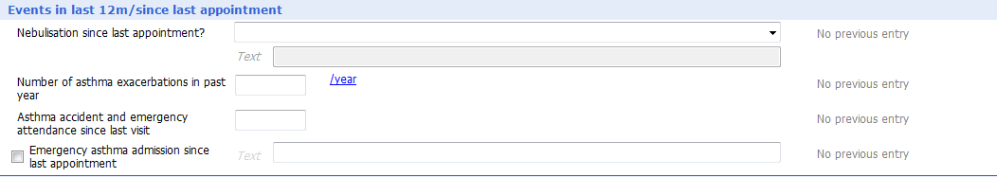
Exacerbations
For a child to have good asthma control, they should not be exacerbating. If the patient is experiencing exacerbations, a referral to a specialist should be made.
Notes:
**NO change**

Slide 7
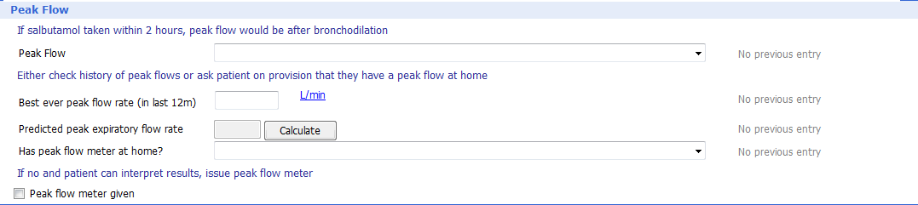
Peak flow
A good quality peak flow can be difficult to achieve for a child, but when done well is a good motivating tool for older children.
If the peak flow (when done well), is significantly below that expected and the patient is experiencing symptoms – an intervention needs to be made.
Remember to ensure the patient’s height has been updated to obtain the correct predicted PEF.
Notes:
Changes:
To highlight if salbutamol has been taking recently as PEF is a false negative so needs to be indicated here.
Best peak flow in 12 months – remember this changes every year as the patient grows. Essential to ensure height has been measured recently.
Peak flow meter should only be issued to patients who can interpret results.

Slide 8
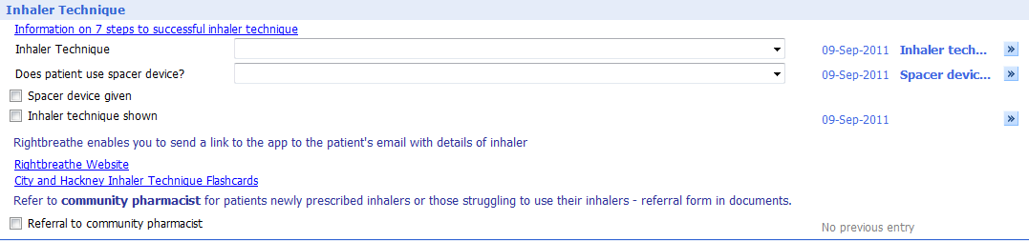
Inhaler technique
90% of patients do not know how to use a MDI.
91% of HCP who teach these patients, do not know how to use a MDI!
Spacer increase drug delivery by 20% and should be offered to all patients.
Patients are given different instructions from different HCPs.
Using the 7 steps can help standardise inhaler technique assessment.
All HCPs should use the UK inhaler group - inhaler standards and competency document to ensure they are competent in teaching inhaler technique. https://www.respiratoryfutures.org.uk/media/69775/ukig-inhaler-standards-january-2017.pdf
Several resources available:
  www.rightbreathe.com
  Flashcards (available on the HLP website).
  Community pharmacist
Notes:
**NEW**
Standardised so that all HCP assessing patient are consistent.
Resources for teaching inhaler technique.

Slide 9
Community pharmacists
Great resource for patients with respiratory conditions.
Utilising the national schemes of NMS and MURs.
  Inhaler technique
  Importance of adherence
  Self management
  Smoking cessation.

Slide 10
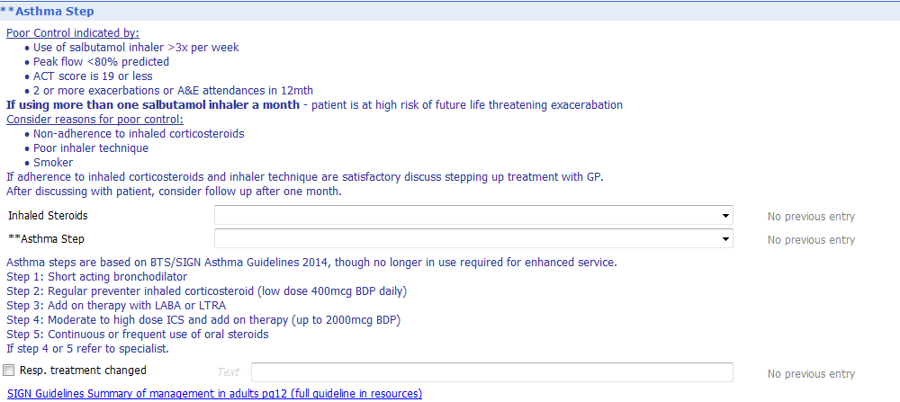
Asthma Severity
Although removed for BTS/SIGN 2016 guidelines, required by QoF.
Notes:
**before stepping patients up – consider the following:
Non adherence. Inhaler technique. Smoking.
Low dose: 200-400mcg BDP
Normal dose: up to 800mcg BDP
High dose: > 800mcg BDP.

Slide 11
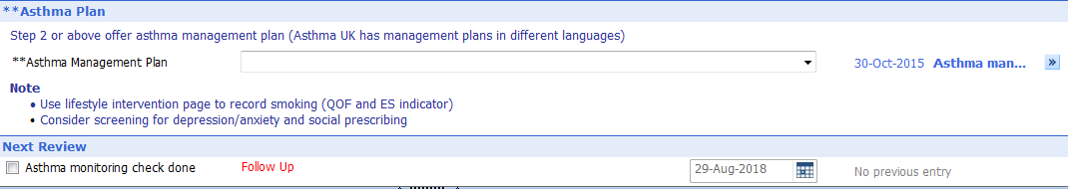
Action plan and follow up
Action Plans are often generated and given to the patient but not completed correctly.
Ensure the following is correct:
Name, Colour and dose of preventer inhaler
How and when to use the reliever inhaler
What to do with worsening symptoms (PEF < 80% annual best)
What to do in the event of an exacerbation (PEF < 60% annual best)

Slide 12
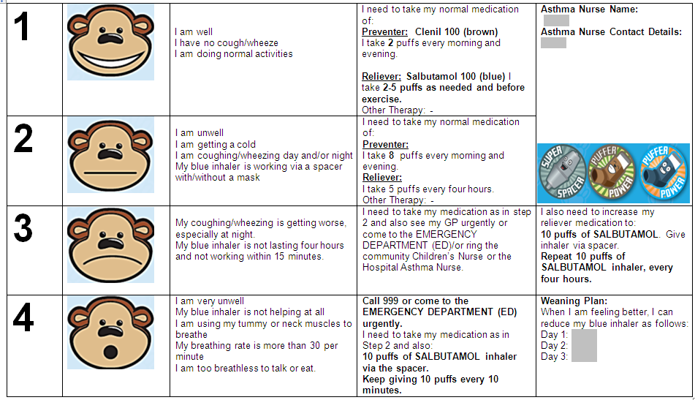
Wheeze Plan
www.monkeywellbeing.com

Slide 13
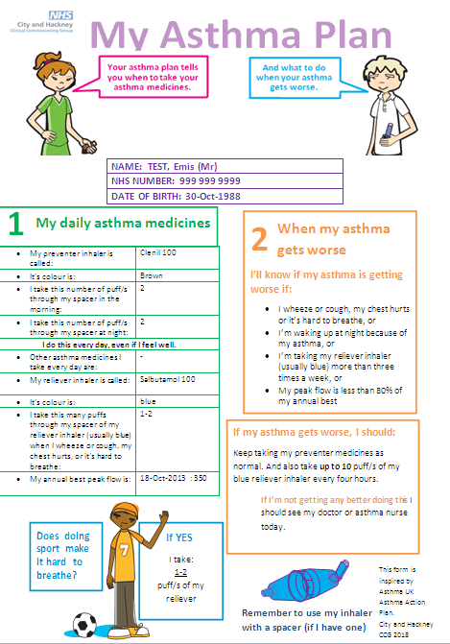
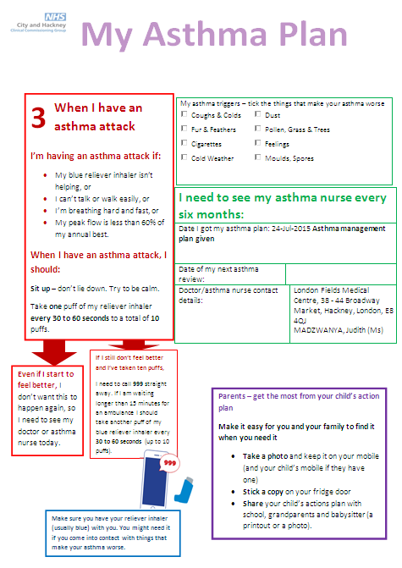
Asthma Action plan 6-11
www.asthma.org.uk

Slide 14
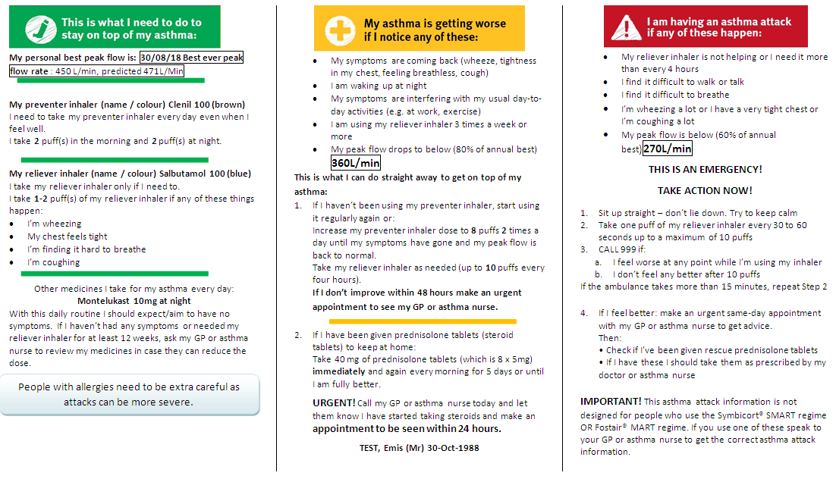
Asthma Action plan > 12
www.asthma.org.uk

Slide 15
Any questions
Please email hetal.dhruve@nhs.net

