Slide 1
Paediatric Critical Care in Practice (PCCP)
Supporting the development of highly skilled paediatric high dependency care
Tracy Parr
Director of Transformation, Children and Young People’s Programme
Healthy London Partnership
Association of Chief Children’s Nurses
September 7th 2018

Slide 2
Healthy London Partnership (HLP)
We aim to make London the healthiest global city in the world by working with our partners for Londoners to improve health and care, so everyone can live healthier lives.
Purpose
Bring together partners with improvement and transformation experts and Londoners, to work towards the common goals set out in Better Health for London, NHS Five Year Forward View and the Devolution agreement.
Develop an evidence base so we inspire London to be the best it can be, gathering insight and data, building on local successes and sharing learning and best practice.
Tackle issues best solved ‘once for London’ by pooling resources and attracting additional funding to specific London issues like homelessness or access to GPs.
Provide the strategic challenge and robust governance through the London Health Board and the London Strategic Partnership Board.
www.healthylondon.org/

Slide 3
Paediatric Critical Care Level 1 and 2
Paediatric Critical Care (PCC) Standards (Level 1 and 2) published 2016
London HDU data audit undertaken in 2016/17 and summary report published
Peer reviews PICU CQUIN HLP supported GOSH, Royal London and St Mary’s (including Whittington, Barnet, North Middlesex, Newham, Whipps Cross, Homerton, Queens Romford, Northwick Park, Hillingdon and Watford)
The peer reviews identified that there had already been improvements in paediatric critical care across all inpatient units since the Acute Paediatric Peer Reviews undertaken by HLP in 2016/17.

Slide 4
PCCP development using clinical experts
Funded by Health Education England (London)
Technical development by independent supplier (Brickwall)
Content developed by London clinicians
Steering Group
Nathan Askew Director of Nursing, Chelsea & Westminster
Shelley Riphagen Consultant Paediatric Intensive Care, Evelina/South London Retrieval Service
John Moreiras Consultant Paediatrician, Whittington
Working groups
Focusing on neurology and sepsis
Focusing on cardiac, endocrine and metabolic
Focusing on respiratory

Slide 5
Modules
Topics covered
Neurology
Seizures
Meningioencephalitis
Neuro recognition and protection
Respiratory
Asthma
Bronchiolitis
Non invasive ventilation
Endocrine and metabolic
Diabetic ketoacidosis
Acute abdomen
Cardiac
Neonatal collapse
Interacting vasoactive medicines
Supraventricular tachycardia
Cardiac failure
Sepsis

Slide 6
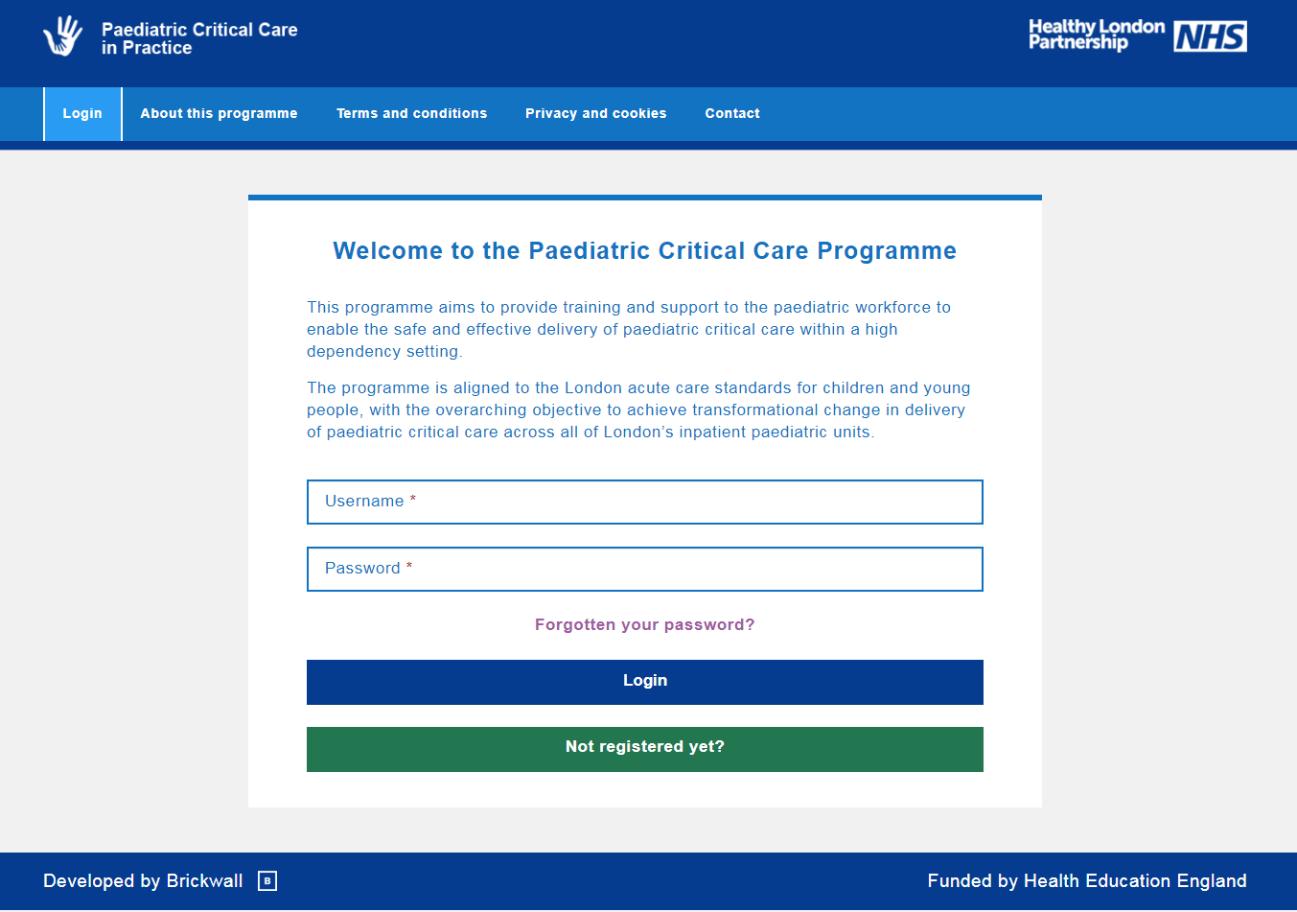
Home page

Slide 7
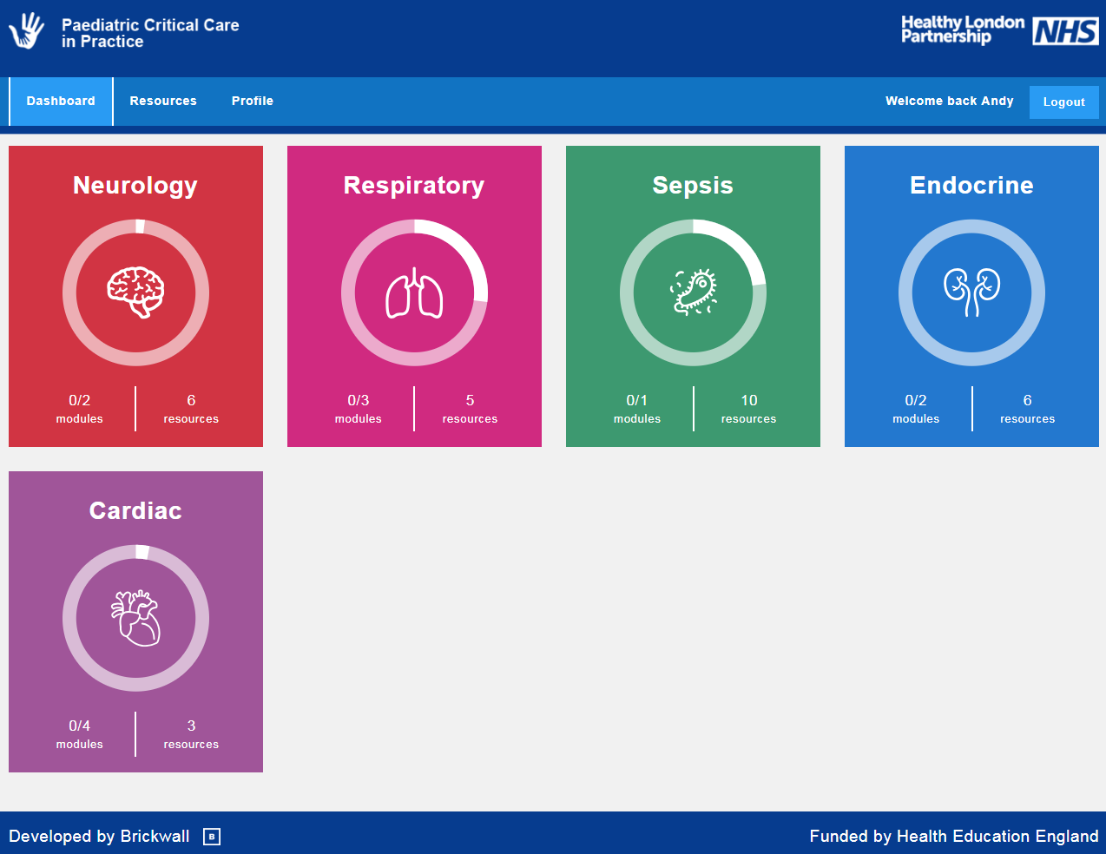
Platform dashboard
Notes:
A quick demo of the portal – bear with me!

Slide 8
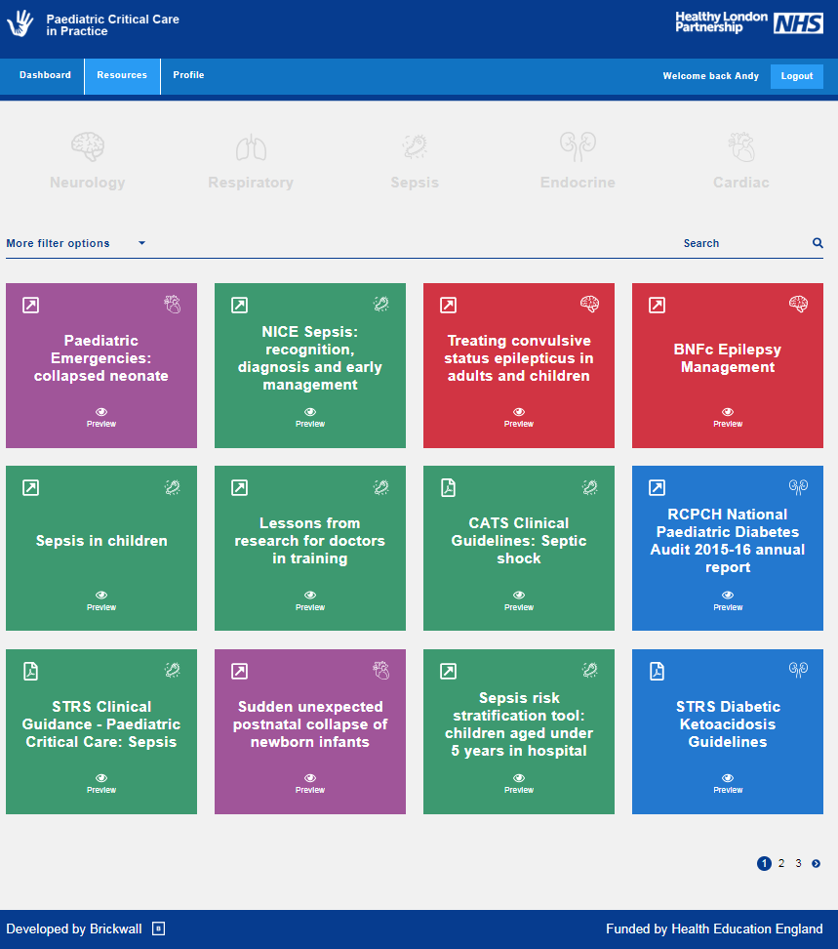
Platform resources
Notes:
A quick demo of the portal – bear with me!

Slide 9
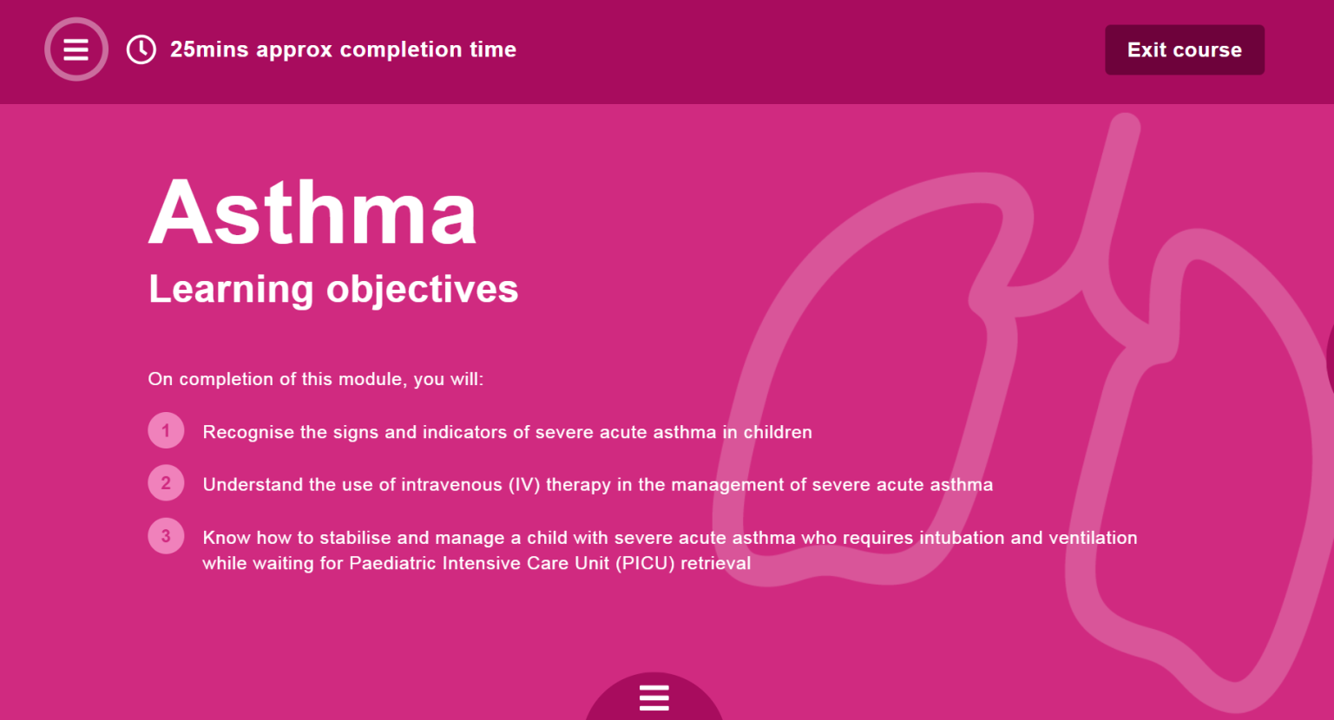
Platform features
Measurable learning objectives, stated at the beginning of each module
An approximate completion time – with save and quit function)
From experience (Brickwall), participants like short bursts of learning
All modules take around 30 minutes or less to complete.

Slide 10
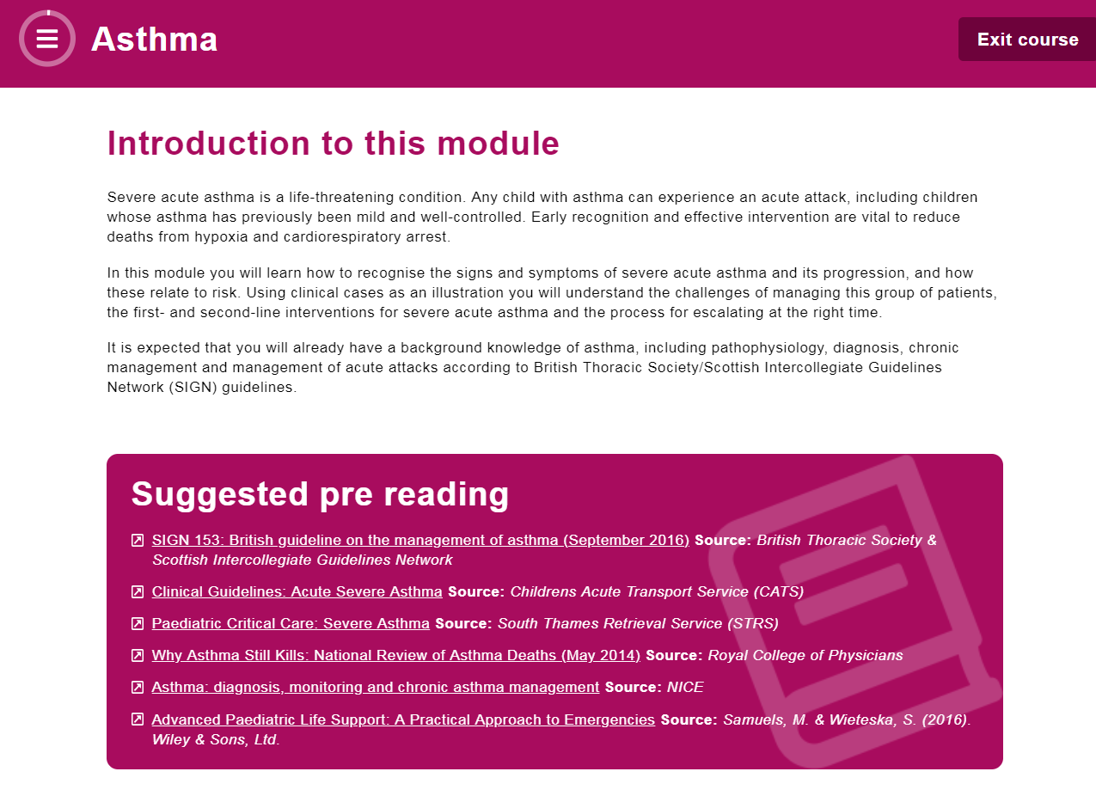
Platform features
Pre-reading materials recommended by the working group
All pre-reading texts are contained within the resource library

Slide 11
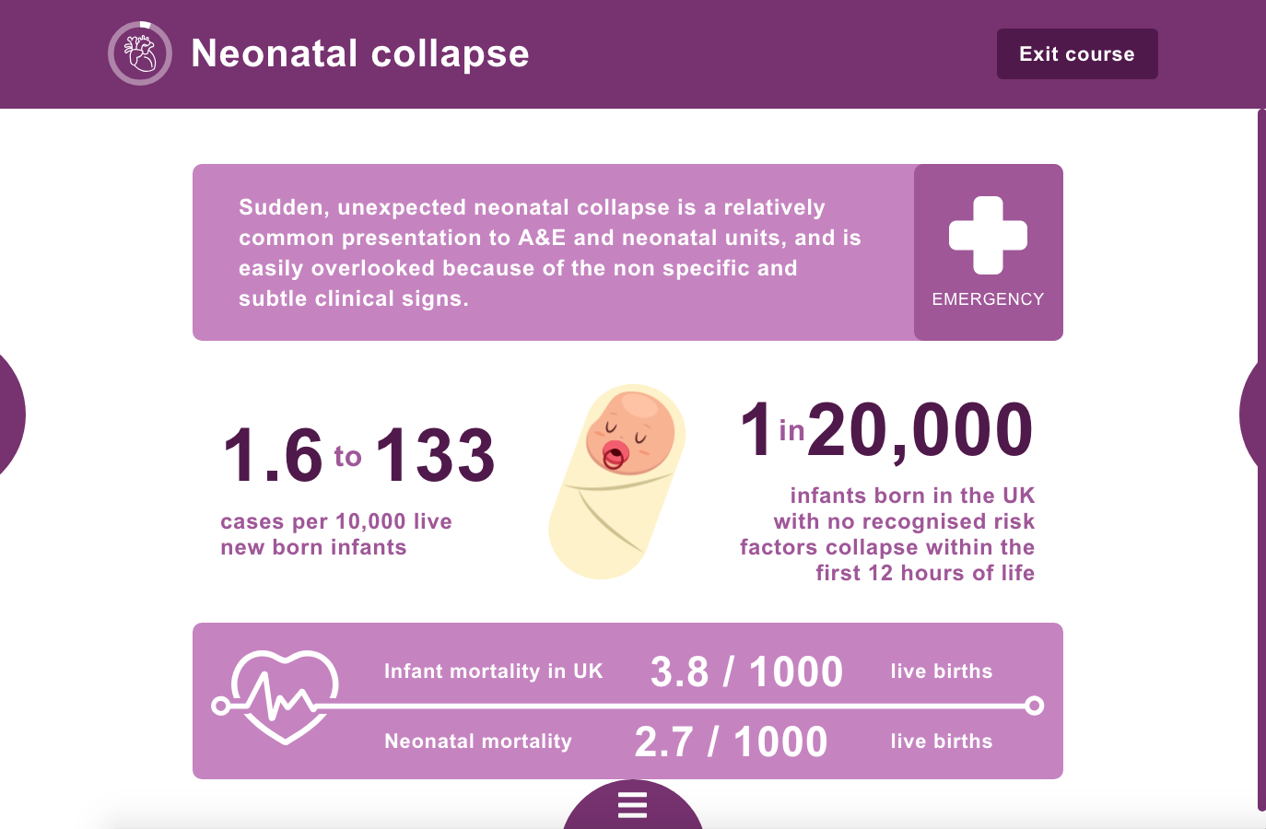
Learning styles - infographics

Slide 12
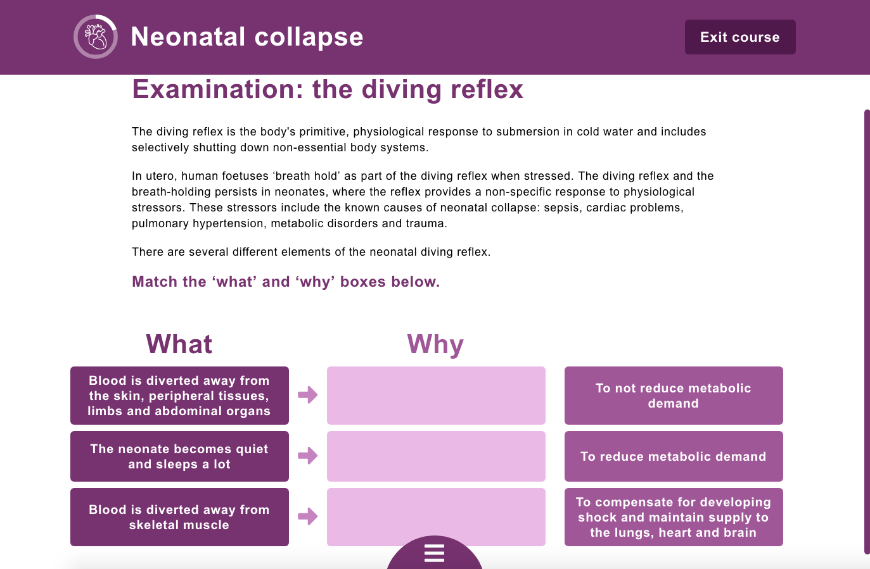
Learning styles – drag and drop activity

Slide 13
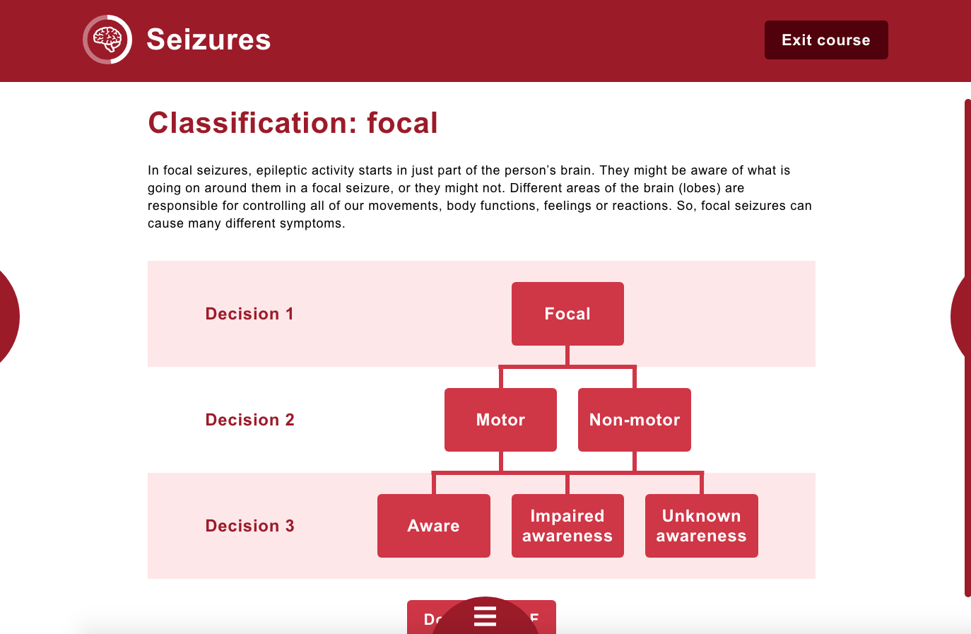
Learning styles – diagrams (downloadable PDFs)

Slide 14
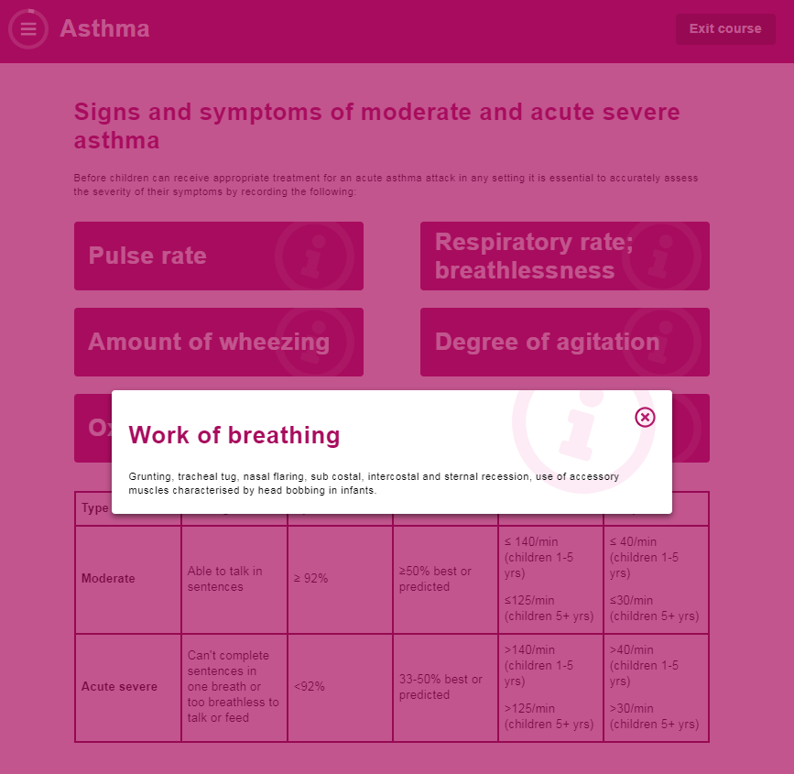
Learning styles – pop-outs

Slide 15
Learning styles – case scenarios
All modules feature case scenarios which encourage participants testing of theoretical understanding

Slide 16
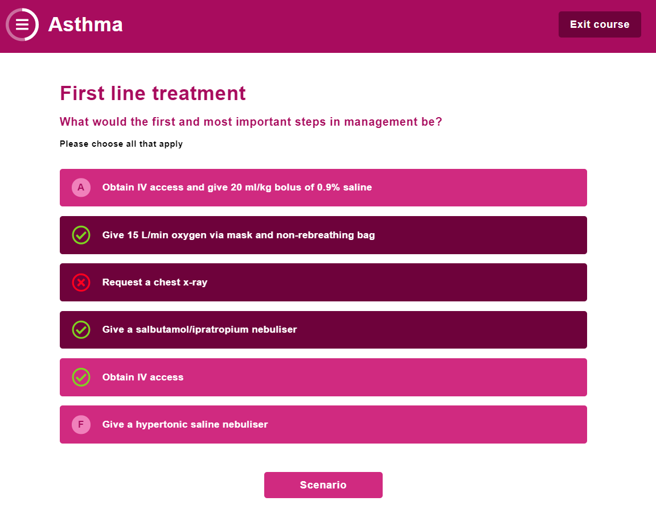
Learning styles - MCQs
Single select and multiple choice questions about how they would respond to the scenario, and what actions they might take.
Once answered, participants are given further theoretical information to confirm the correct answer, and then the next set of facts for the scenario
This style of reiterative learning is proven to support retention and understanding, helping participants to understand gaps in knowledge

Slide 17
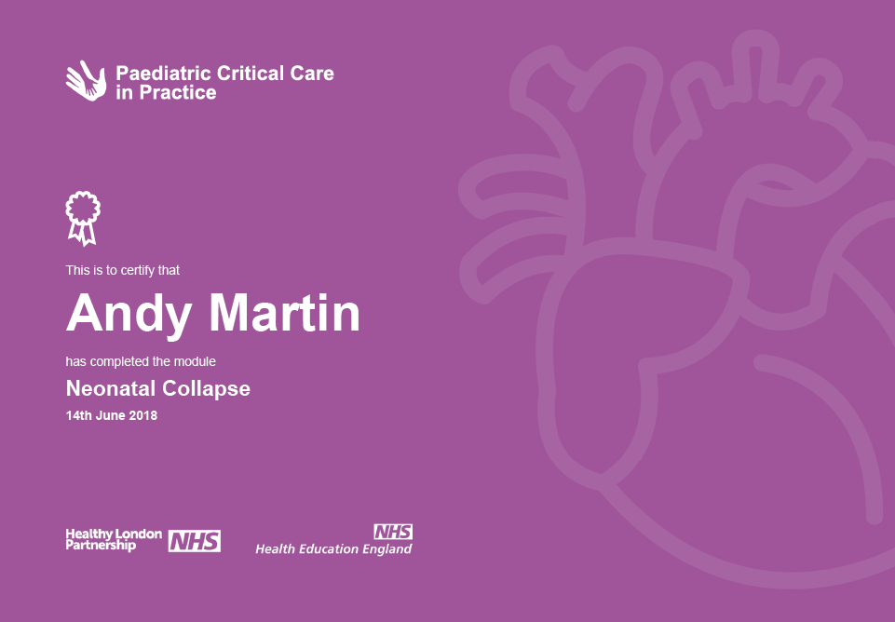
A record of learning for the participant
On completion of each module a downloadable PDF certificate is generated
This can be used as evidence of CPD in a revalidation portfolio
All certificates accessible via the participant’s user profile

Slide 18
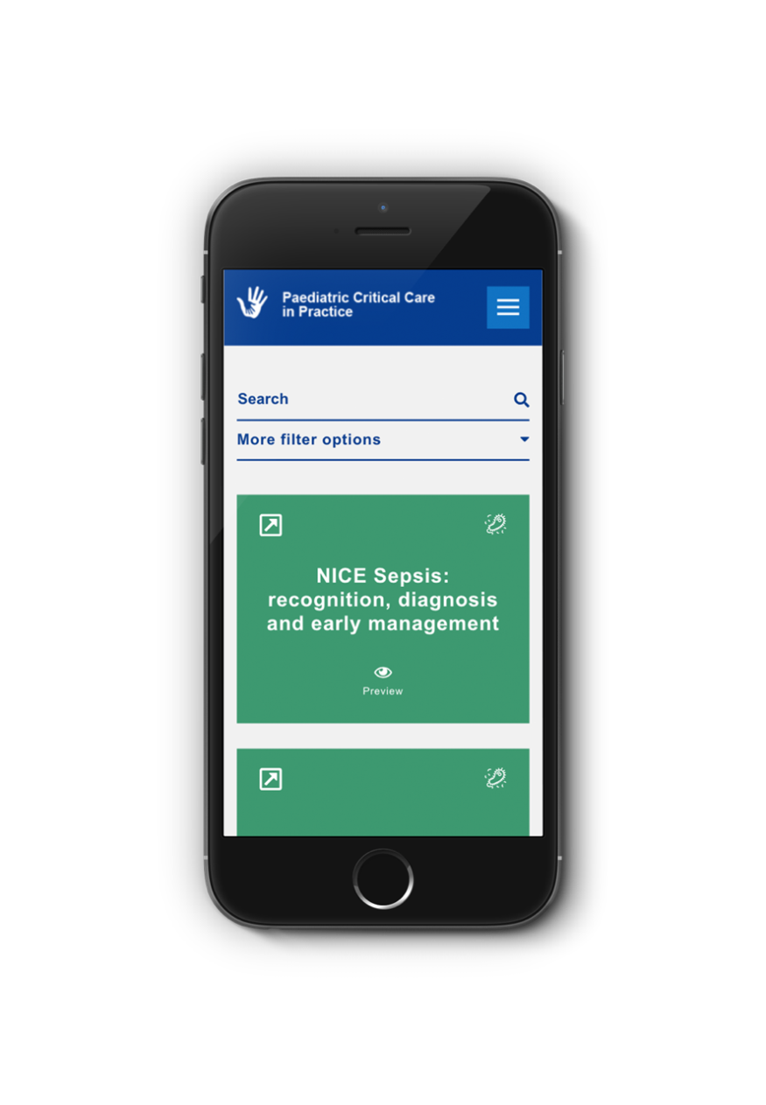
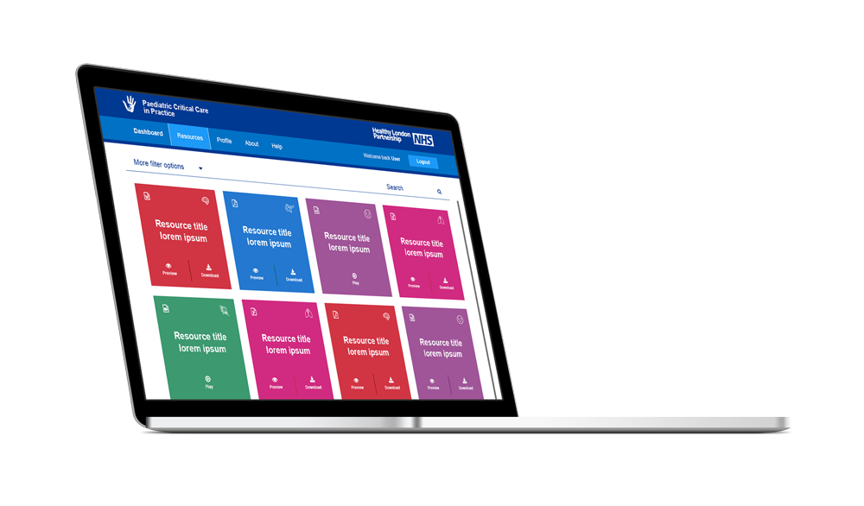
Extensive resource library
Useful resources logged from a range of sources
Each categorised according to the topic and subject it relates to
Each resource has been nominated by working groups
Mobile compatible, so can be accessed on a ward at 3am via a mobile.

Slide 19
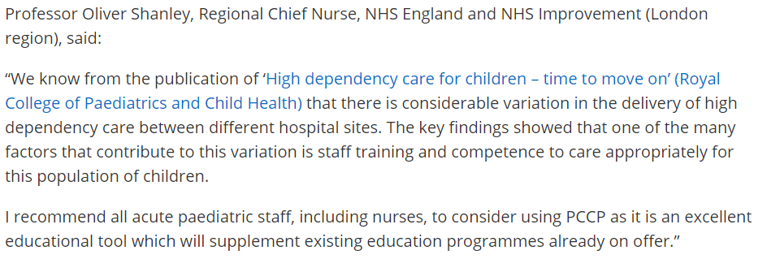
Initial feedback

Slide 20
Face to face assessment
To augment the e-learning platform each trust is suggested to hold a multi-professional face to face assessment day using simulation
The simulation can be high or low fidelity and should reinforce the theory that candidates have learnt on their e-learning modules.
Simulation Tools and Resources (STAR) , an app developed by Wessex University, is a valuable resource for all staff and free to use.

Slide 21
Face to face assessment
Individual departments may like to adapt the teaching to reflect real life scenarios their teams have faced.
It is not envisaged that the face to face assessment be used to attribute any qualification in HDU care to the staff member. It should demonstrate a structured A – E assessment and leadership skills as relevant to their role. The focus should be on team working in the best interests of the child, using clinical cases to strengthen understanding and clinical decision making.
It is suggested that each day has a faculty of medical and nursing lead, that scenarios are used in conjunction with local guidelines and that team working, communication and human factors are included as an addition to the clinical outcomes.

Slide 22
Update since launch August 2018
226 registrations
177 verified registrations (98 nurses, 74 doctors and 5 AHPs – varying bands)
128 log-ins
44 completed modules by 19 people
Completed modules:
19 seizures
10 sepsis
7 asthma
5 neonatal collapse
3 DKA

Slide 23
Next steps
Further engagement
Add further modules (Autumn roll out)
Accreditation (e.g. RCPCH)
Attempt to make part of Trust mandatory training for paediatric staff

