Slide 1
Group consultations
in primary care

Slide 2
Purpose of discussion
Share with you:
What group consultations are; what they are not Why group consultations matter right now
The evidence of impact
How you might apply group consultations to support children and young people with long term health issues

Slide 3
Group consultations are…
An alternative way of consulting with children and parents
Individual one to one clinical consultations delivered in a supportive group setting
10 -15 families with a similar condition or set of clinical problems
Consultation process managed by a trained facilitator
1.5 hours long, with the clinician present for around 45 minutes (half the time)

Slide 4
Group Consultations are not…..
Health education
Self help or peer support groups
Behavioral medicine programmes
A psychological intervention; group therapy
Expert patient interventions
They replace rather than become an adjunct to clinical care

Slide 6
Why group consultations matter right now
We need for innovation and new models of primary care
We need to create capacity and time to care
We need to spread specialist knowledge
We need to improve staff wellbeing: reinvigorate clinical practice ; reduce frustration, stress, burnout and depersonalisation

Slide 7
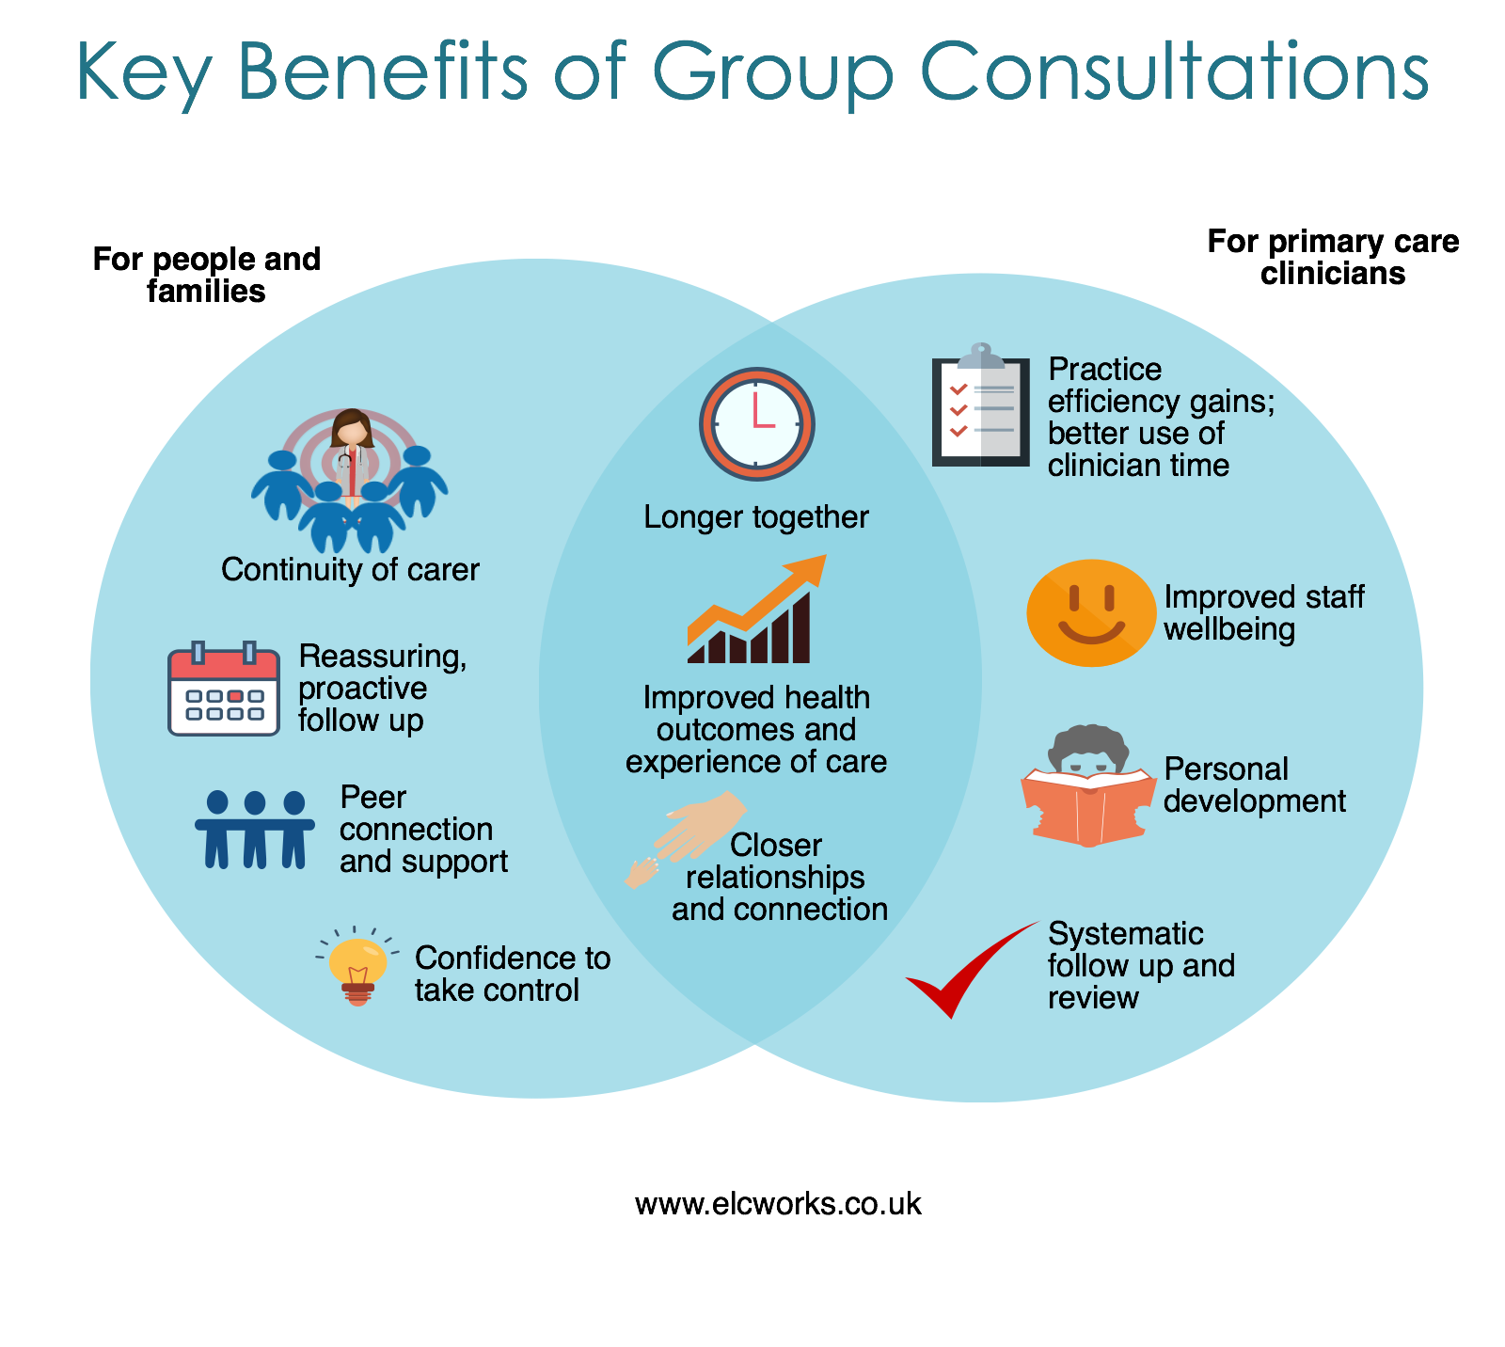

Slide 8
Why people love group consultations
Continuity of carer
Longer with their clinician (they perceive contact of 45-60 minutes)
Time to discuss the things that matter to me
Systematic and proactive follow up and review
A focus on personal goals and the family taking control
Connection with and support from people with the similar experience (peers)
Answers to questions they wouldn’t think or dare to ask

Slide 9
Why professionals love group consultations
Less repetition
Less professional isolation
Longer with patients (45-60 minutes)
Getting to the bottom of the story
Seeing ‘light bulb moments’ and tangible changes in real time
Expert patient input that supports their message (patients learning from each other)
Fewer DNAs and frequent attenders attend less
Impact especially in poorly controlled patients
An energising way to practice

Slide 10
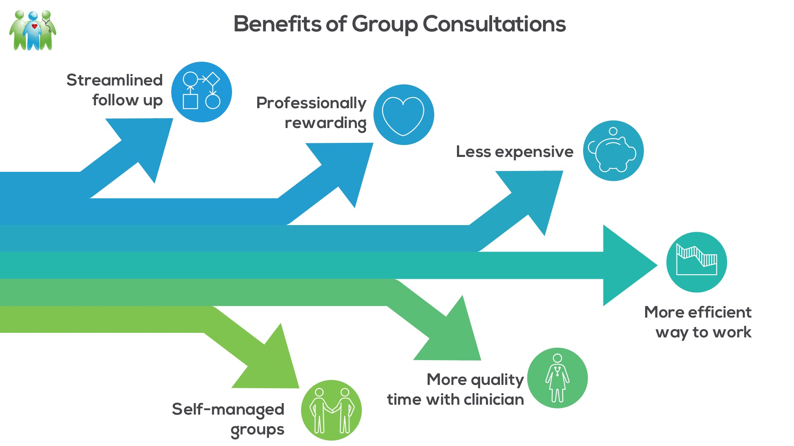

Slide 11
Published Research Evidence http://www.ncbi.nlm.nih.gov/books/NBK99785/
Group consultations compared to control:
Improve blood pressure control
Improve blood glucose control
Improve health related quality of life (bigger when using a condition specific QoL measure)
Reduce hospital admissions and A&E attendance, including in older adults
Improve patient experience and satisfaction

Slide 12
Benefits from interim analysis: Slough CCG
Frequent attenders are attending less frequently
DNAs for routine follow up reducing
GPs like working this way and find it liberating and rewarding
Better quality conversations and outcomes than one to one consultations
Saves GP time; highly productive
Work best for complex, poorly controlled patients
Improve patient compliance with monitoring and reviews
Nurtures clinical and patient leadership
“Patients love them and by 3rd session, they want to take over”

Slide 13
Benefits from Croydon CCG independent evaluation
High levels of patient satisfaction and acceptability
High levels of clinician satisfaction and acceptability, including GP perception that group consultations save time
Improved blood glucose control (greater impact in poorly controlled patients)

Slide 14
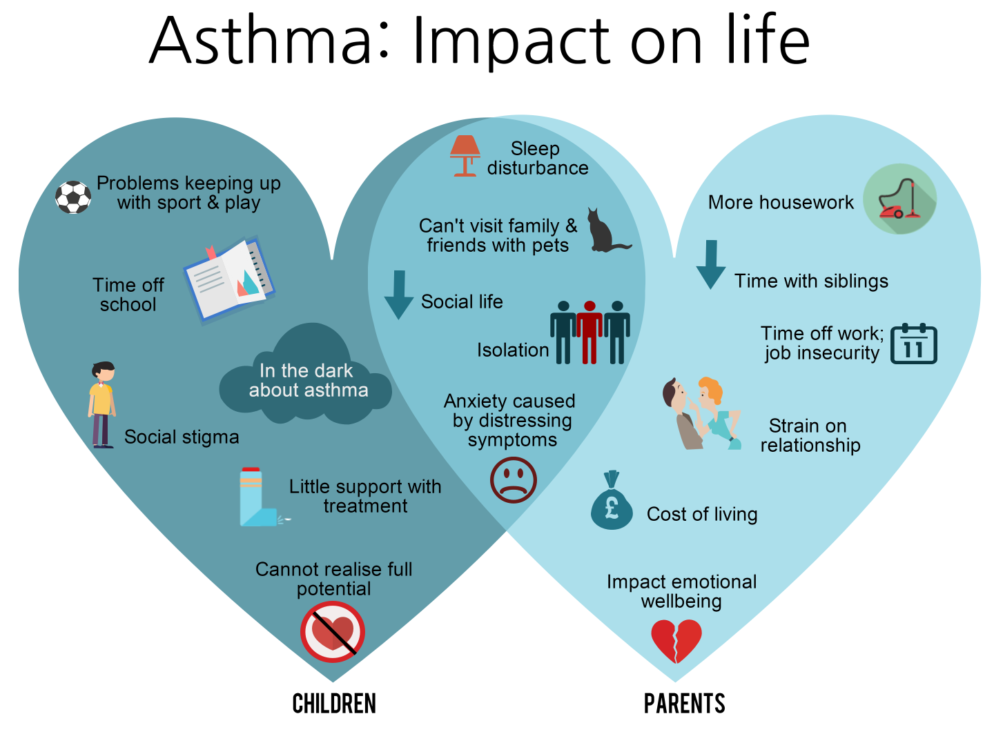
ADD

Slide 16
ADD

Slide 18
How might you apply group consultations?
Proactive planned care and management of children and young people with complex long term conditions?
Shared group consultations with specialists or pharmacists?
Routine follow up of families with young children e.g. annual asthma reviews? Flu jabs?
Targeted group consultations to preempt peaks in unplanned attendance e.g. “Week 38 Rule” (spike in admissions first week back at school)
Focused work to improve outcomes with: frequent attender families, looked after children, children with high unplanned hospital admissions?
OTHER?

Slide 19
Find out more
Georgina Craig
National Director, The ELC Programme
Tel: 07879 480005
Email: georgina@elcworks.co.uk
Twitter: @GCAssoc @elcworks

