Slide 1
Healthy London Partnerships
Children and Young People
Bexley Asthma Assessment Project in Pharmacies,
15th and 22nd May 2017
Pre service launch for GPs and Pharmacies
Donal Markey, Pharmacy Advisor NHS England (London)

Slide 2
Aims & Objectives
Bexley Asthma Assessment Project in Pharmacies
What is the service model?
What the benefits?
What are the measurable outcomes?
Funding
Training & Competency
Timelines
Evaluation

Slide 3

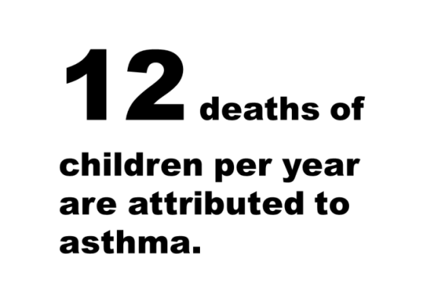


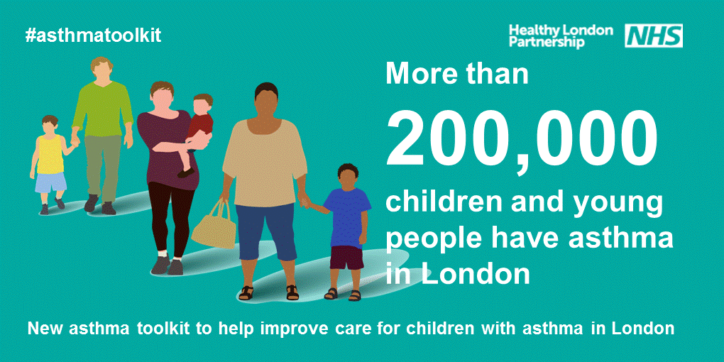
Why do we need to do this?
The Ella Roberta story
https://app.box.com/s/h0sfrrmdczgcu9tk3fuweryugb2ghi7a

Slide 4


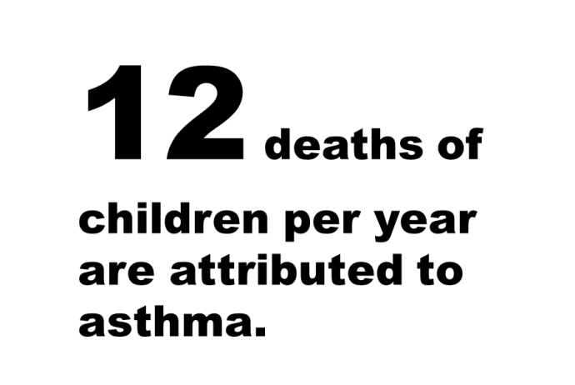

Issues in London
3 pupils in every classroom have
asthma
London has a high rate of asthma-related emergency admissions for children.
Notes:
high variation in diagnosis, treatment and care
high number of respiratory deaths
high rates of admission to hospital
low numbers of children with an asthma plan or having had an asthma review

Slide 5
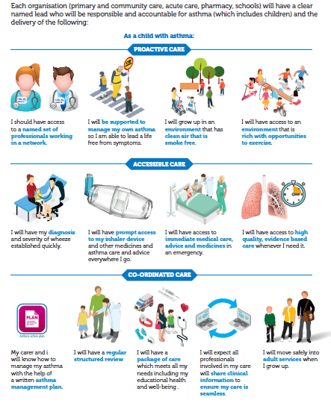
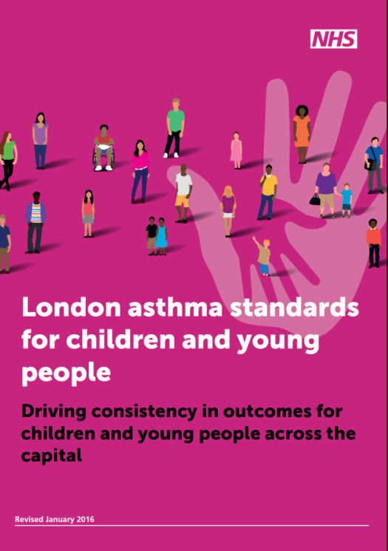
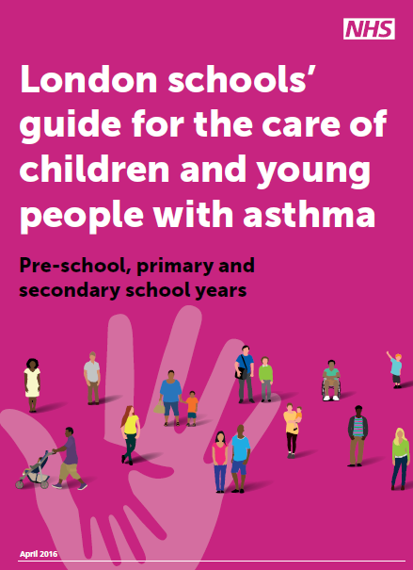
London's ambitions and standards for asthma care in CYP
Notes:
14 ambitions across specific areas
System-wide
Patient and family support
Schools
Acute and high risk care
Integration and co-ordination
Discharge planning
Transition
Effective and consistent prescribing
Workforce education and training
All settings: Primary care, Secondary and tertiary care, Community pharmacies, schools, Self care
Developed through the children and young people’s asthma leadership group
Prepared by collating a collection of standards already in existence, building on London Quality Standards, Primary Care Strategic Commissioning Framework and London Acute Care Standards for CYP
Purpose
Essential guide for commissioners and providers
Ensure responsible lead for asthma in each organisation
Improve consistency and quality in CYP services and reduce variation
Minimum standards of care in one place
It cuts across all organisations and covers: patient and family support; schools; acute and high risk care; integration and co-ordination; discharge planning; transition; effective and consistent prescribing; workforce education and training

Slide 6
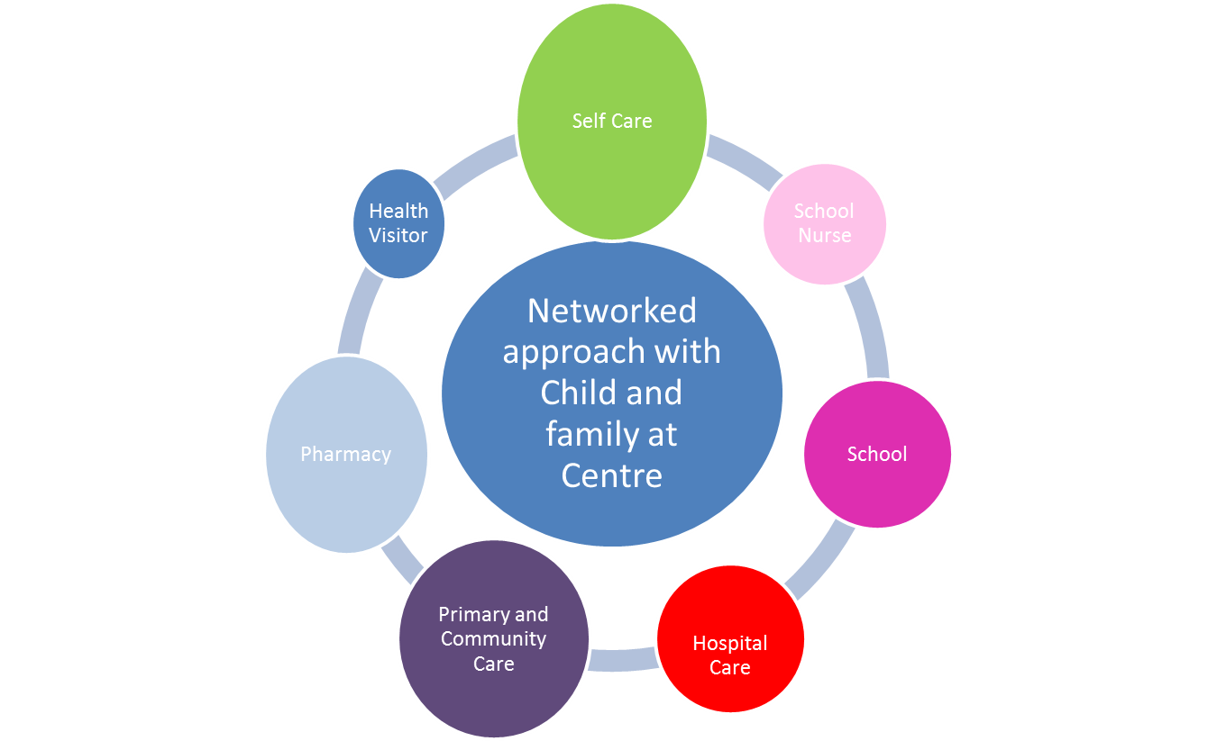
London Programme: Co-ordinated Care
Improving the pathway (using drivers of 5 Year Forward View) and creating a social movement for change
Standards:
Toolkit:
Communication strategy:
Digital:
Education strategy:
  Health professionals
  Schools
  Pharmacy https://pharmacyhub.educationforhealth.org/
Prevention programme:
  Schools
  Smoking
Commissioning strategy:
  Commissioning development programme
Notes:
Network approach which includes primary care community nursing services, schools and local pharmacy
The formation of a critical mass of well-educated professionals dedicated to the continuous improvements in care of CYP with asthma is essential.
Aiming for earlier diagnosis, more confident treatment, the early identification of risks, and the sharing of expertise at a local level.
Creating good asthma control in childhood aiming for the knock-on benefit in the adult years.
Creating a pivot point around which acute paediatrics in a primary care setting could be developed, and likewise could augment the skill sets of the adult focused respiratory team.

Slide 7
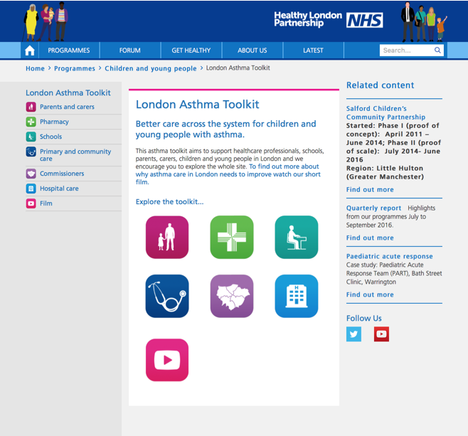
On-line Asthma Toolkit
Support across the system to improve asthma care
https://www.healthylondon.org/children-and-young-people/london-asthma-toolkit
Overarching asthma toolkit film: https://www.youtube.com/watch?v=ikdAB9qyk9U
Hospital care: https://www.youtube.com/watch?v=UK8wHN0sdJ0
Schools: https://www.youtube.com/watch?v=bIb80lOjoO8
Pharmacy: https://www.youtube.com/watch?v=kCAzCmI-R_k
Primary and community care: https://www.youtube.com/watch?v=A2iNQE7utRE
Parents and carers: https://www.youtube.com/watch?v=iNPSFal0OIM

Slide 8
The Cost in London
The current cost of emergency admissions per 100,000 population based on £702 PBR rate equates to London spending £4.6 million per year.
If 60% of child emergency admissions for asthma were prevented, this would mean asthma admissions would cost London £1.8 million amounting to around £2.8 million in savings across London.
If CCGs were able to achieve the 75% reduction this would be even greater at around £3.5 million savings.
If adult asthma was included in the plans there would be even greater returns.
Combined prescribing costs for bronchodilators and corticosteroids alone, in children and adults, is £1 billion in England and £100 million in London.
Notes:
. It is possible there would be a slight rise in drug costs as patients were prescribed more appropriately. This is what was found in the Finnish study 2 . Between 30% and 50% of prescribed medicines for long-term conditions are not taken as recommended. We need to make sure our children are receiving support to take their medicines so they receive the health benefits and the NHS gets value for money from those drugs dispensed.

Slide 9
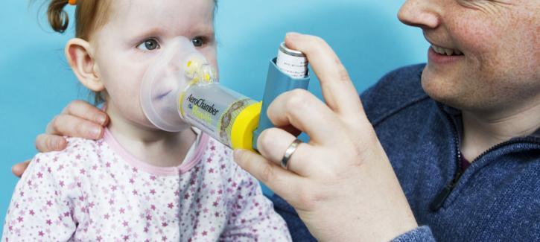
Its not just the money
These costs include diagnosis, acute and primary care, and medications, but there are significant indirect costs, beyond healthcare, to the wider economy:
•A child with poorly controlled asthma is three times more likely to take time off school than a child whose condition is well controlled.
•Poor school attendance is likely to have a detrimental effect on emotional wellbeing and educational attainment.
•A carer is four times more likely to take time off work, with a further effect on their own productivity.

Slide 10
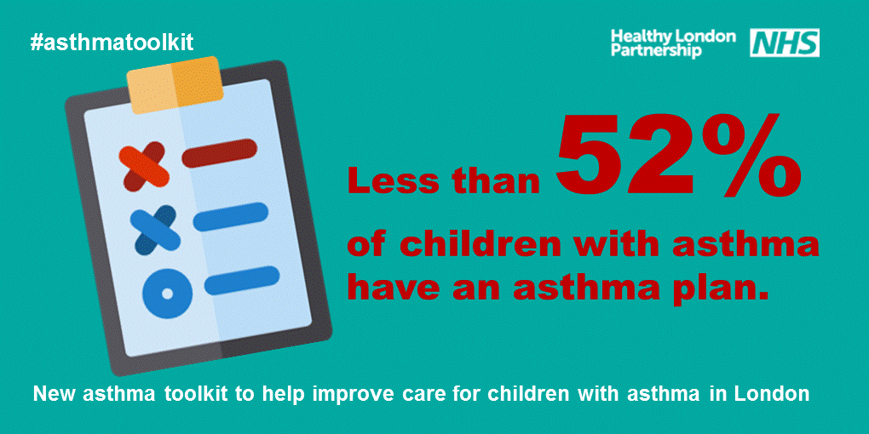
The evidence: facts about asthma in the UK
Community Pharmacy has a role in asthma management

Slide 11
Background to service concept

Slide 12
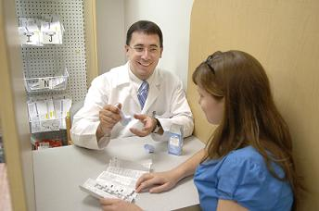
Overriding Principle
Inclusion of pharmacies in Bexley asthma management pathway
“Take what currently exists and work with what you have got… in many cases systems of care just need to join up more effectively as opposed to overlaying a whole new intervention or pathway”
Mando Watson Consultant Paediatrian , Imperial College Healthcare NHS Trust

Slide 13
Community Pharmacy Services
Categories & Funding sources

Slide 14
Asthma Assessment in the Pharmacy
What we ARE asking pharmacies to do
Competent in
  understanding the management of asthma
  promoting good inhaler technique in children & adults
  promoting effective use of appropriate spacers devices
  providing advanced services (Medicines Use Reviews)
  performing inhaler surveillance ( Quality Payment)
Learn how to use an e-template to record information and send it to the GP
Talk to your local GPs and Practice Nurses about your referrals
Follow up with patients
Participate in evaluation of the service
Service continuity and remain engaged

Slide 15
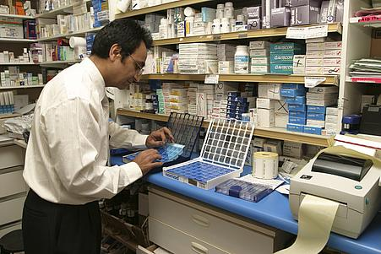
Asthma assessment in the Pharmacy
What we are NOT asking you to do
Diagnose Asthma
Specialists in asthma management in children & adults
Retrain as specialist pharmacists
Be a Prescribers
Read long and complicated service specifications
Spend excessive amounts of time studying and preparing for a service

Slide 16
Asthma Assessment in the Pharmacy
What we ARE asking GP Practice to do
Support the local asthma pathway
Process in place to accept the information from the pharmacy
Utilise the information in Asthma Reviews
Consider utilising pharmacies to target patients
Liaise with your local pharmacies and HLP
Follow up with patients
Feedback and participate in the evaluation of the service
Service continuity and remain engaged

Slide 17
SIMPLE Asthma Care
Getting it right!
S tepwise pharmacological management
Inhaled CorticSteroids
I nhaler technique and device suitable for age
M onitor control (ACT, B2 agonist use, preventer uptake)
P ersonalised Asthma Action Plan
L ifestyle. Learn symptoms and triggers
E ducation / ETS / Every Time

Slide 18
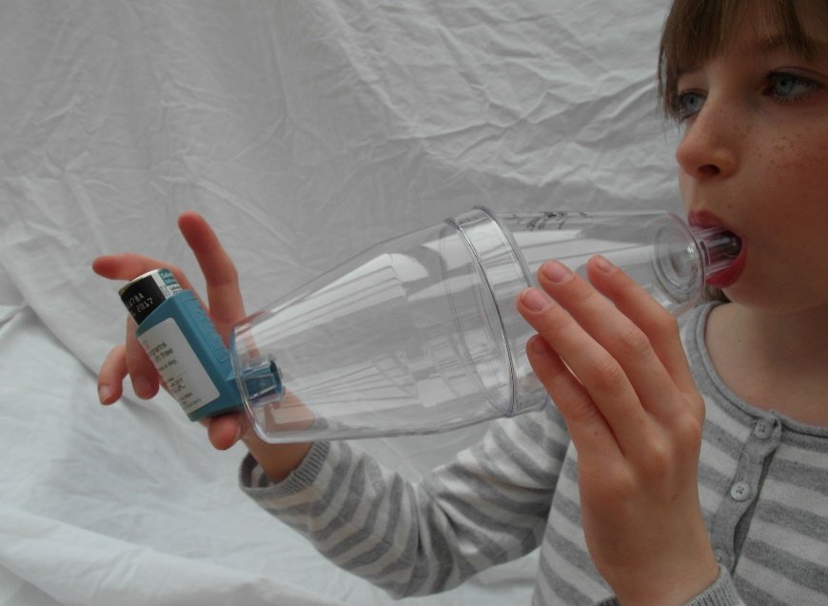
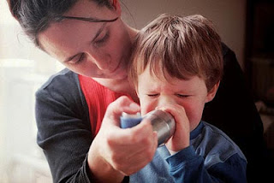
Inhaler Technique
Back to BASICs
B enefit
A sthmatics
with
S uitable
I nhalers &
C hamber
5 tidal breath technique

Slide 19





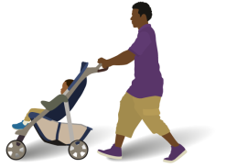
Healthy London Partnership –
Children and Young People’s programme
Pharmacy services in England: Key facts 2015/16
7.8m items of Fluticasone Propionate (inhaled) dispensed
11,688 community pharmacies in England and 1862 in London
1.08 billion prescription items
dispensed in the community
3.3 million Medicine Use Reviews , average of 280 per annum for a London Pharmacy
Fluticasone Propionate (inhaled) remains the highest costing medicine at £376m
£9.27 billion was the cost of prescriptions dispensed in the community
34.4 m
Simvastatin was the most prescribed chemical
35.4% of items dispensed by EPS
821,893 New Medicines Services interventions, average 78 per annum for a London Pharmacy

Slide 20
Asthma Management Pathways

Slide 21





The current situation
Should be better for patients. What could we do better?
Home
School
2nd / 3ry
Hospital Care
Primary Care
School Nurse
Source R Chavasse , St Georges

Slide 22
Service Model in the Pharmacy

Slide 23
Global Sum
Service Model utilises ADVANCED SERVICES & QUALITY PAYMENTS
This is NOT a new service
This is not an enhanced service
No additional service specification
Pharmacies are already commissioned to provide the services we seek to promote good asthma management in pharmacies
No additional fee structure
Payment is claimed through advanced services and quality payments

Slide 24
Patient Cohort
Who are we aiming this service at?
Children & Young people aged between 5 – 25 years of age
May or may not have a diagnosis of asthma
Should be registered with a local participating practice
Meet the criteria for PI , MUR or NMS
Patients who would benefit from an asthma review at their GP Practice
Patients who would benefit from an inhaler technique assessment

Slide 25
No double Payment
Opportunity to extract information/intelligence from the pharmacy
Pharmacists are NOT performing an asthma review
Pharmacists can pick up information which the GP Practice may not know which can aid the practice in the asthma review
  Patient emergency supply requests for inhalers
  Dispensing out of hours or urgent prescriptions for inhalers
  Requests for emergency supply through the NUMSAS service for inhalers
  Monitoring non-collection of prescriptions for inhalers
  Monitoring over the counter purchase by asthma patients e.g. cough & cold symptoms
  Inhaler surveillance - SABA inhalers this will include all of the above scenarios which the GP Practice system may not pick up.
  Pharmacies have access to summary care records (SCR)

Slide 26
Patient recruitment
Opportunistic
Detecting patients for a Medicines Use Review (MUR) or the New Medicines Service (NMS)….PMR prompts
Monitoring the number of SABA inhalers dispensed in a rolling 6-month period through the pharmacy patient medication records (PMR) or through routine or opportunistic access to summary care records (SCR)
Monitoring patient emergency supply requests for inhalers
Monitoring out of hours or urgent prescriptions for inhalers
Monitoring emergency supply request through the NUMSAS service for inhalers
Monitoring repeat prescription requests for inhalers
Monitoring non-collection of prescriptions for inhalers
Monitoring over the counter purchase by asthma patients e.g. cough & cold symptoms

Slide 27
Patient recruitment
Co-ordinating care with GP Practice
Non-attendance for asthma reviews at GP Practice
Patients who attend asthma reviews at GP Practice without their inhalers
Large patient cohorts – help GP practice to stratify the patients
Part gather data in the pharmacy which will support patient records in the GP Practice – QOF and in asthma reviews
Highlight access to inhalers in an emergency scenario - OOH prescriptions, NUMSAS supplies or requests in the pharmacy
Highlighting non-collection of prescriptions for inhalers
Highlighting inappropriate self care by asthma patients e.g. cough & cold symptoms

Slide 28
Training & Competence

Slide 29
Training & Competence
Numerous resources – Inhaler technique
Healthy London Partnerships - Asthma Tool Kit
Healthy London Partnerships – On line training Pharmacists & Inhaler Technique
SE London – Respiratory Disease Management training for Pharmacists
Asthma UK
PSNC
Local LPC
NHS England –London region Team
New Resource
RightBreathe

Slide 30
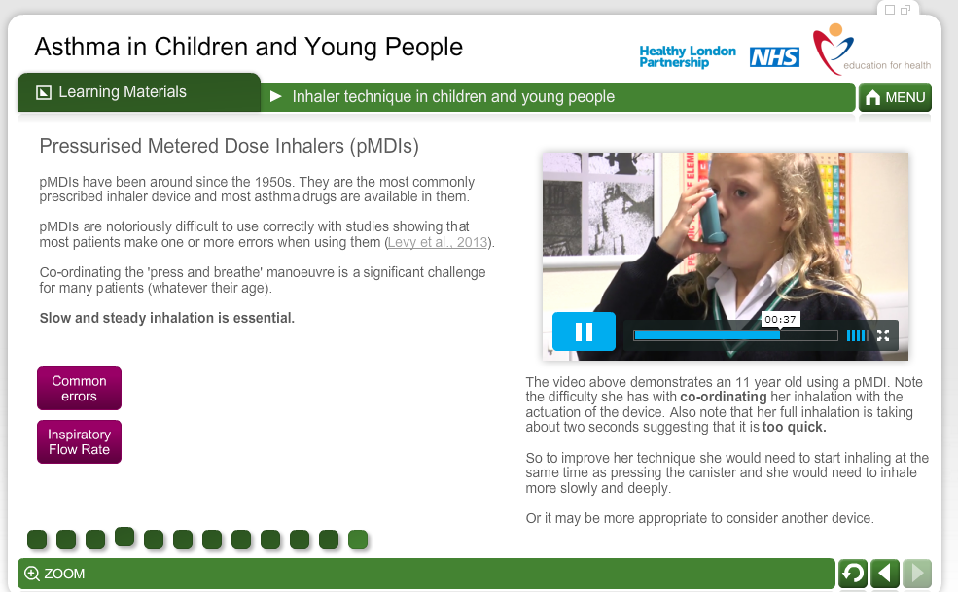
Healthy London Partnership
Learning materials - video content
www.myhealth.london.nhs.uk

Slide 31
Feedback
Community Pharmacists
“This is a fantastic tool kit for Asthma in Children. Thanks. I have asked all our pharmacists to do this course”
Dinesh Patel,
Pharmacist ( Proprietor),
Temple Pharmacy,
Pitshanger Lane,
Ealing.

Slide 32
Timeline, Next Steps, Evaluation

Slide 33
Timelines, Next Steps , Evaluation
12 month project
Timelines
Start date 01.06.17
Quarterly reviews
Darsi Fellow to support the review – academic publications etc
Support within Healthy London Partnerships
Next Step
Feedback from pharmacists
MDT meeting with Local GP Practices

Slide 34
Evaluation
Co-designing – need local input to identify measurable outcomes
GP Practice
Impact on patient care & local practice
Quality and relevance of the information
Pharmacy
Ease of administration
Use of the eTemplate
Service model based on Pi, MUR, NMs & quality payments
Training & competence
Patients
Satisfaction with the service
Access
Benefits to health and well being

