Slide 1
Healthy London Partnership
Children and Young People
Bexley Asthma Assessment Project in Pharmacies
Civic Centre 22nd March 2017

Slide 2
Agenda
Time | Item | Presenter
19:30 | Welcome and introductions and local context | Dr Laura Hindley GP,
19:35 | Background to the project – Healthy London Partnership, London prevalence for asthma CYP HLP asthma toolkit Scalability of the project - STP footprint & London Other HLP developments | Sara Nelson, Programme Lead, Healthy London Partnership
19:45 | The evidence NRAD/BTS/SIGN guidance ACT scores Inhaler technique Inhaler Surveillance HLP asthma tool kit, on-line training and other resources | Richard Goodwin, Highly Specialist Paediatric Integrated Care Pharmacist, Evelina
20:00 | Project proposal – what are we aiming to do? Pharmacy Advanced Services – medicines use reviews, new medicine services New Quality payments – inhaler surveillance Identifying patients with poorly controlled asthma for referral to their GP for an asthma review Asthma Assessment Tool Referral process Evaluation & monitoring Training & competence | Donal Markey, Head of Primary Care Commissioning – NHS England (London Region)
20:15 | Demonstration of the asthma assessment tool for community pharmacies | Pritpal Thind, Sonar Informatics Rep
20:25 | What's happening locally? | Jacqueline Leaver, Bexley CCG
20:30 | Panel Questions & Answer session Action Plan and Next steps | All
21:00 | Close
Welcome and introductions
Local Asthma prevalence for CYP and adults
Local Asthma management pathways for CYP and adults
Bexley Clinical Rep
Background to the project – HLP,
London prevalence for asthma CYP
HLP asthma toolkit
Scalability of the project - STP footprint & London
Other HLP developments
HLP Rep
NRAD
BTS/SIGN guidance
ACT scores
Inhaler technique
Inhaler Surveillance
HLP asthma tool kit, on-line training and other resources
Asthma rep

Slide 3
Aims & Objectives
Bexley Asthma Assessment Project in Pharmacies
Aims to utilise community pharmacies to identify patients aged between 5-25 years of age with poorly controlled asthma that would benefit from an asthma review by their GP.
Introduction and local context
Background to Healthy London Partnership
Introduction to the project and why it is needed
What is the service model?
Why should your pharmacy participate?
Funding
What we are asking pharmacies to do?
Training & Competency
Timelines
Evaluation

Slide 4
Asthma Management and Community Pharmacy Project in Bexley
Dr Laura Hindley

Slide 5
Why is asthma important in Bexley
In Bexley patients 2015/16 there were 88 children admitted for asthma under 18 years.
There were 70 admissions April to November 2016 under 25 years and 61 patients under 18 years.
An estimated 75% of hospital admissions for asthma are thought to be avoidable.
As many as 90% of deaths from asthma thought to be preventable.

Slide 7


Current Local Guidance
Most care carried out by practice nurses
Based on South East London Integrated Guideline for Management of Asthma/ BTS/SIGN Guideline/ QOF targets questions.

Slide 8
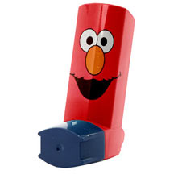
All patients with asthma (and/ or parents) should be offered self-management education which should include a personalised asthma plan which is reviewed regularly
Adherence to long term asthma treatment should be routinely and regularly addressed by all healthcare professionals within the context of accessible proactive asthma care.
All patients should be asked to demonstrate inhaler technique regularly
All patients should be reviewed at least annually

Slide 11
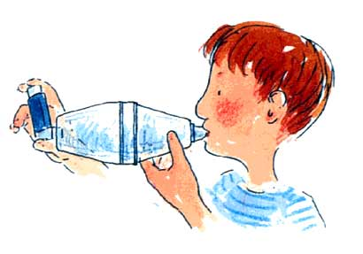
Thank you

Slide 12
Transforming care across the system: Implementing integrated care for asthma in London; the pharmacy opportunities
Sara Nelson, RGN, BSc, MSc,QNI
Children and Young People’s Programme lead, Healthy London Partnership

Slide 13




London Health Commission
Healthy London Partnership –
The delivery arm of the London Health Commission

Slide 14








Whole System Approach to Transformation for Children and Young People’s Health
System Leadership (CYP Board and clinical leadership group)
Long Term Conditions
Asthma standards
Asthma toolkit
Asthma baseline audit
Epilepsy standards
Primary Care
GP federation pilot model care CYP
Population based data
Toolkit for GP federations
Prevention and self care
NHSGo
Marketing campaign
Community Pharmacies
Audit of CYP with asthma
Online learning hub for MURs
Audit CYP with dental pain
Role of pharmacists CYP health
Mental health
LTP refresh support
Guidance for mental health crisis
Models of liaison psychiatry
Benchmarking/KPIs
Eating disorders CoP
Thrive (Mayor)
Learning disability (theatres)
Out of Hospital care
Compendium models of care
Standards for OOH care
Modelling impact different models
Urgent and Emergency Care
Acute care standards
Peer review
PAU standards
L1 and 2 PCC standards and education
CDOP
Baseline audit
Suicide prevention
Bereavement
Sharing data and learning
Cluster level working
Schools
Models of school nursing
Guidance for management CYP asthma and diabetes
Improved integration of care across the system for CYP
System wide enablers
Place based care and planning (data packs, support for networks)
Workforce
January 2017
Commissioning development programme
Notes:
Collaboration of the health and social care system in London

Slide 15

Why do we need to do this?
The Ella Roberta story
https://app.box.com/s/h0sfrrmdczgcu9tk3fuweryugb2ghi7a

Slide 16
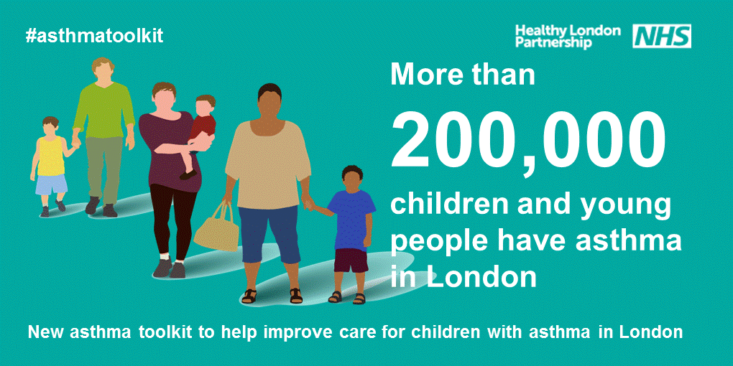




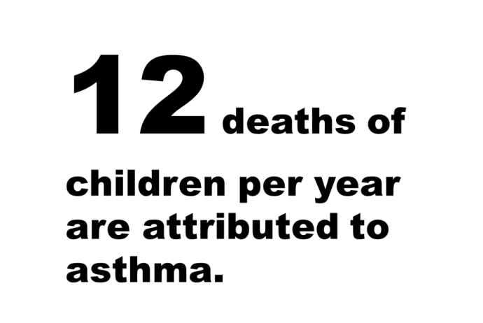

Issues in London
3 pupils in every classroom have
asthma
London has a high rate of asthma-related emergency admissions for children.
Notes:
high variation in diagnosis, treatment and care
high number of respiratory deaths
high rates of admission to hospital
low numbers of children with an asthma plan or having had an asthma review

Slide 17
The Evidence: Facts about asthma in the UK
Asthma is common:1 in 11 children have it, on average, there are two children with asthma in every classroom.
High mortality, large variation in care across the capital
High emergency admissions and variation, average cost is £951
There were 25,073 emergency hospital admissions for children in 2011-2012. On average that’s one every 21 minutes.
There were 1,167 deaths from asthma in 2011 (18 of these were children aged 14 and under).
90% of the deaths from asthma are preventable.
75% of hospital admissions for asthma are avoidable.
Patients with a personal asthma action plan (PAAP) were 4 times less likely to die from an asthma attack.
77% of patients had no record of having a PAAP (National Review of Asthma Deaths)
Source http://www.asthma.org.uk/asthma-facts-and-statistics
Notes:
Hugh mortality, large variation and high numbers of admissions. Mustn't simply look at end of pathway need to look across and further down track

Slide 18
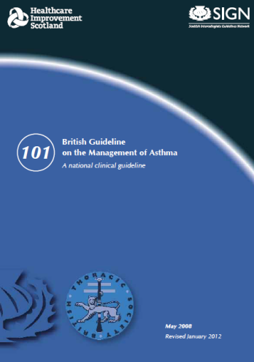
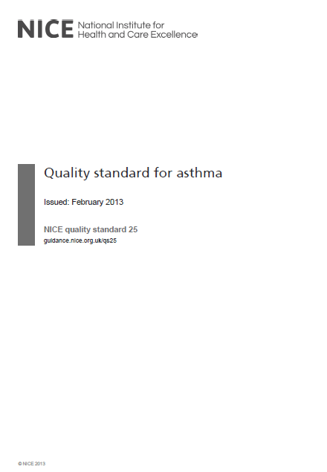
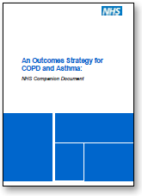
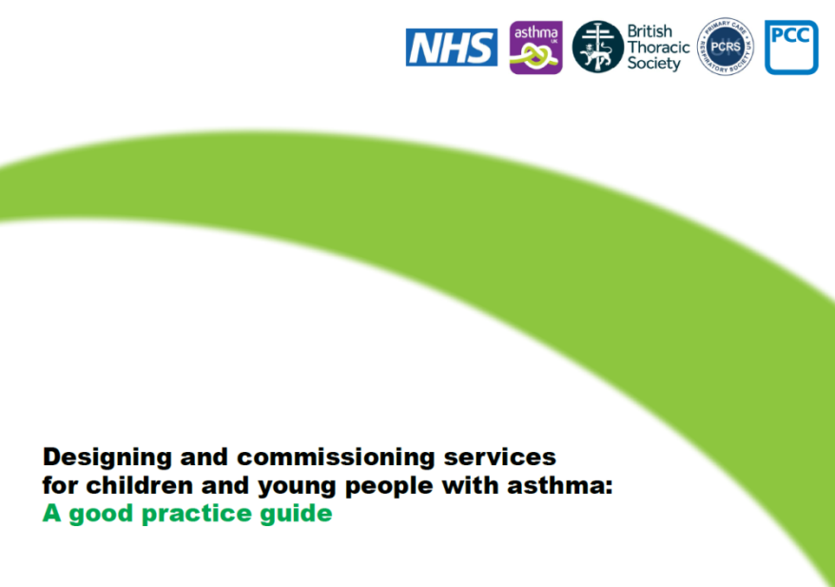
Despite >16 documents in the last 5 years, still high mortality, emergency admissions and variation in care: we don’t need more
Notes:
There have been over 16 pieces of guidance in last few years
Policy drivers, National guidance and standards
Evidence we are not achieving good outcomes for asthma care in London
high variation in diagnosis, treatment and care
high number of respiratory deaths
high rates of admission to hospital
low numbers of children with an asthma plan or having had an asthma review
CYP with asthma featuring strongly in the review of serious incidents and child deaths in London

Slide 19

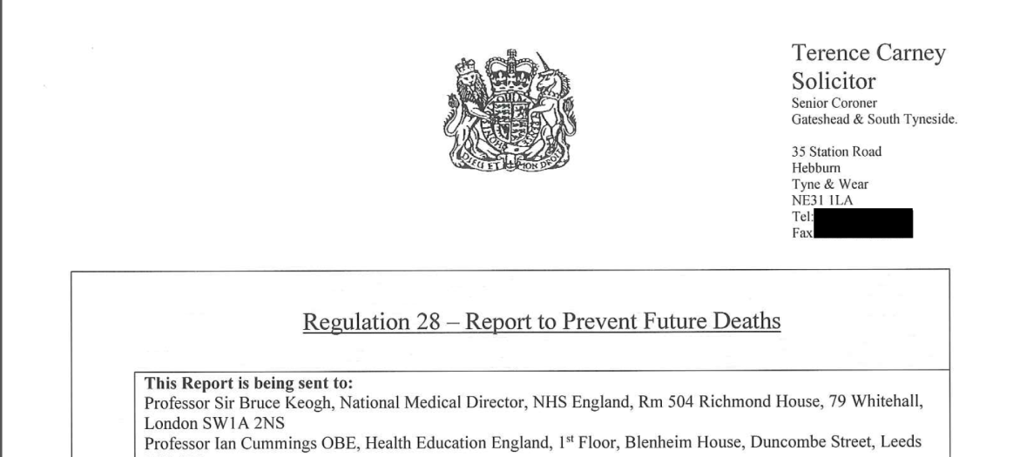
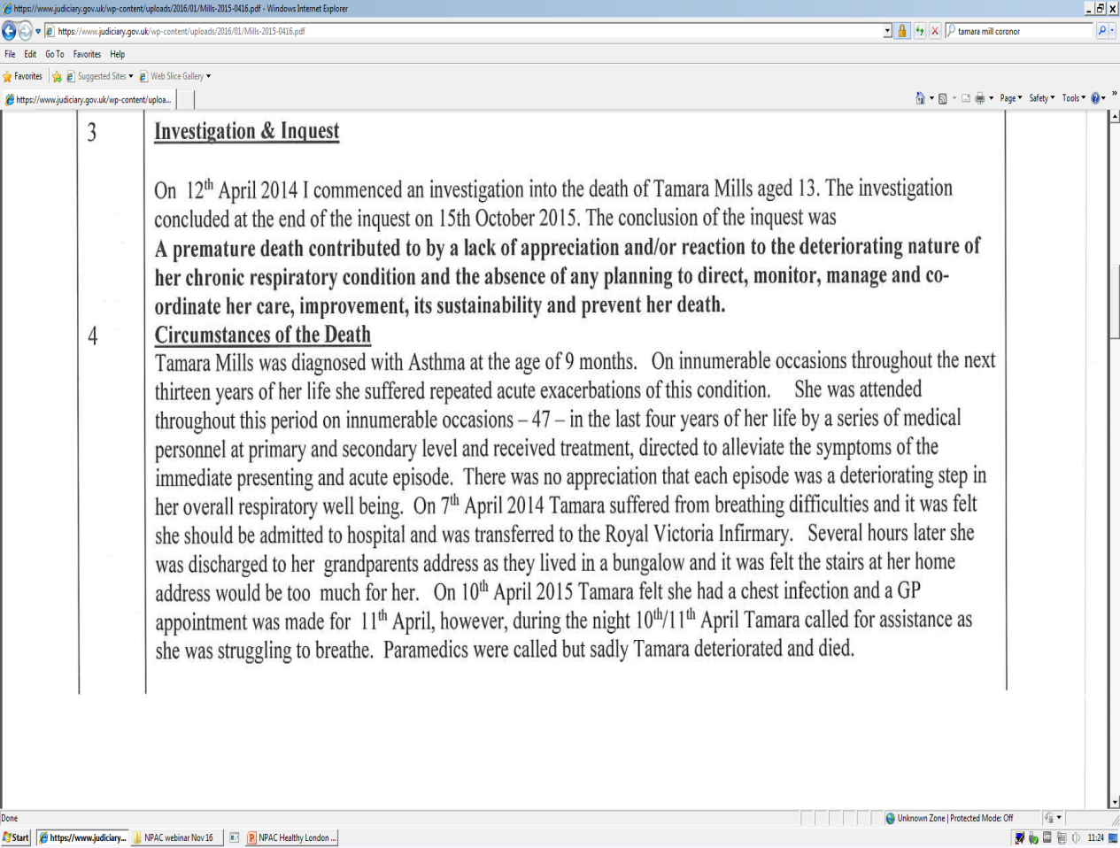
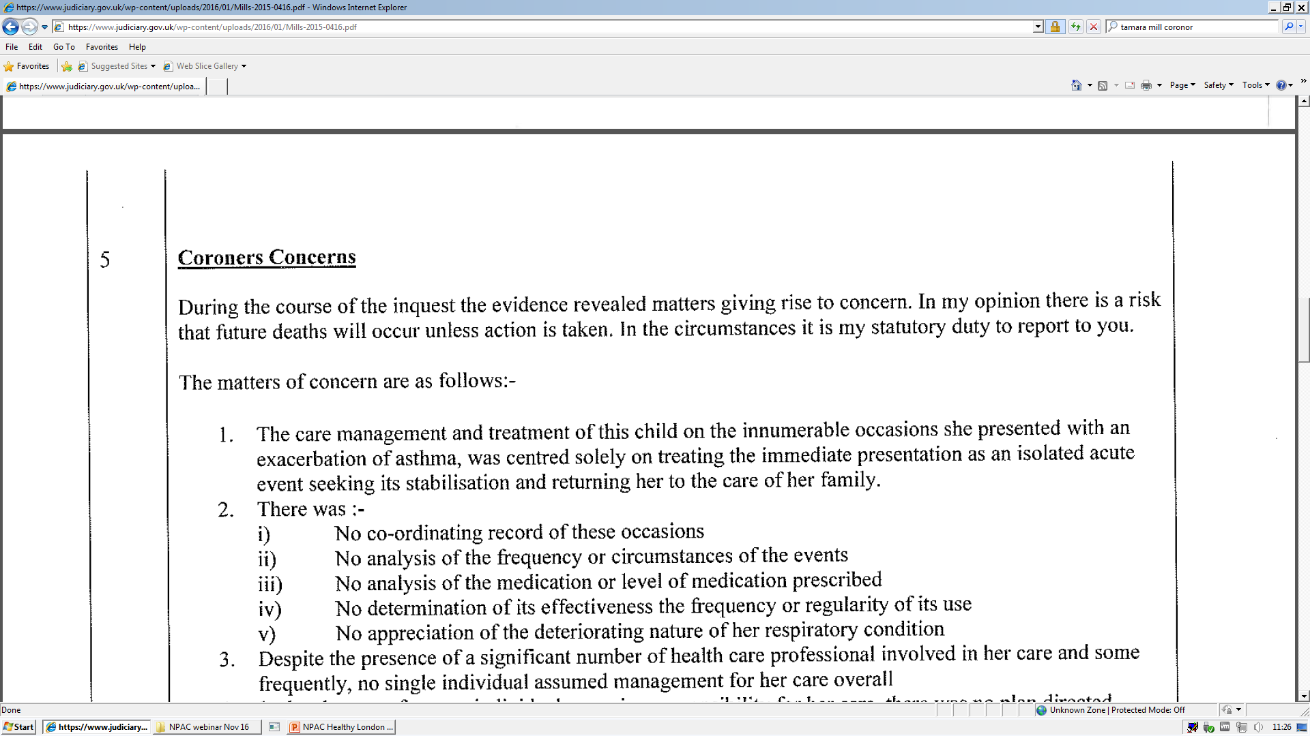
Why co-ordination and integration is essential
Notes:
The case of Tamara mills and how the coroner highlights the need for coordinated care – the toolkit aims to address this - each part of the pathway and how we can improve coordinated care.
Currently a lot in the newspaper about the 9 year old boy / chess champion

Slide 20
Asthma prevalence in London
Recorded prevalence of asthma in London (all ages) 2011/12 (Quality and Outcomes Framework)

Slide 21
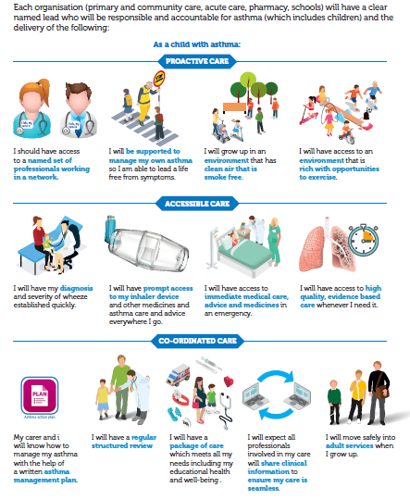
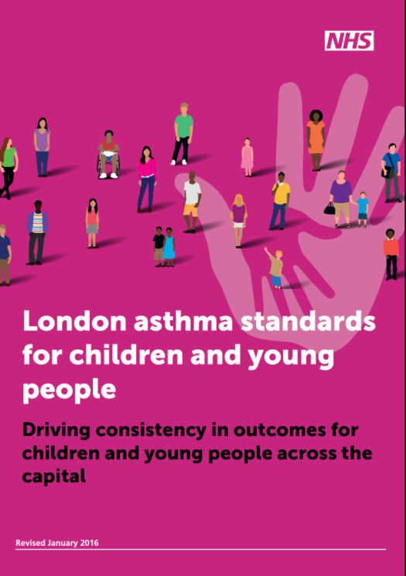
London's ambitions and standards for asthma care in CYP
Notes:
14 ambitions across specific areas
System-wide
Patient and family support
Schools
Acute and high risk care
Integration and co-ordination
Discharge planning
Transition
Effective and consistent prescribing
Workforce education and training
All settings: Primary care, Secondary and tertiary care, Community pharmacies, schools, Self care
Developed through the children and young people’s asthma leadership group
Prepared by collating a collection of standards already in existence, building on London Quality Standards, Primary Care Strategic Commissioning Framework and London Acute Care Standards for CYP
Purpose
Essential guide for commissioners and providers
Ensure responsible lead for asthma in each organisation
Improve consistency and quality in CYP services and reduce variation
Minimum standards of care in one place
It cuts across all organisations and covers: patient and family support; schools; acute and high risk care; integration and co-ordination; discharge planning; transition; effective and consistent prescribing; workforce education and training

Slide 22
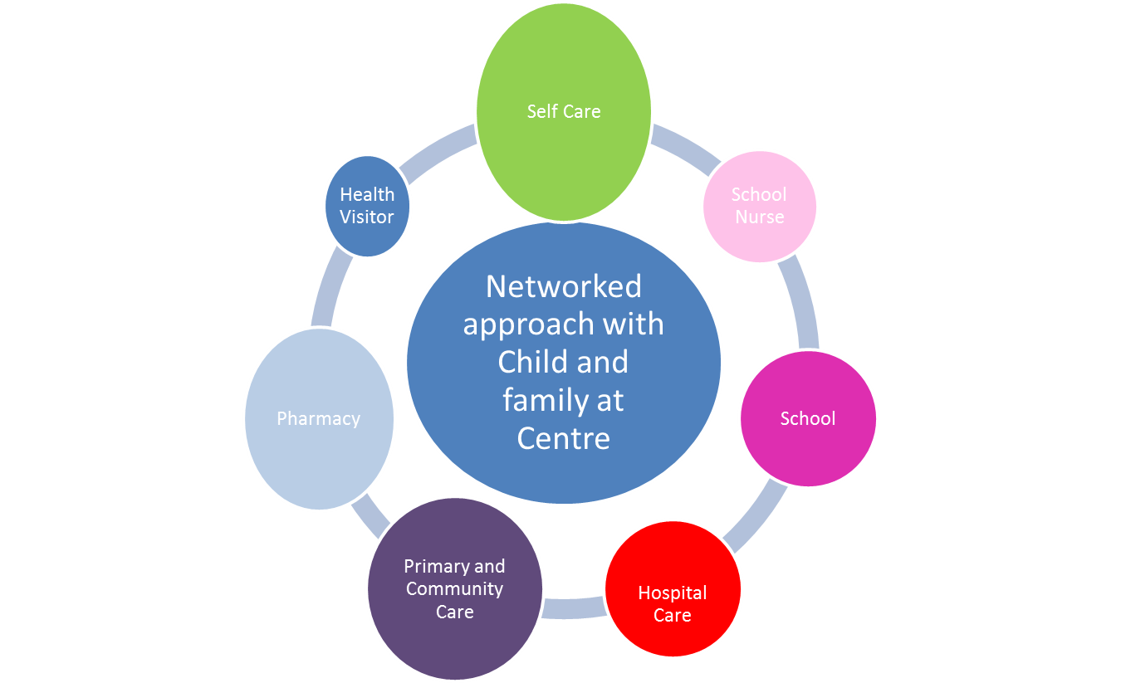
London Programme: Co-ordinated Care
Improving the pathway (using drivers of 5 Year Forward View) and creating a social movement for change
Standards:
Toolkit:
Communication strategy:
Digital:
Education strategy:
  Health professionals
  Schools
  Pharmacy https://pharmacyhub.educationforhealth.org/
Prevention programme:
  Schools
  Smoking
Commissioning strategy:
  Commissioning development programme
Notes:
Network approach which includes primary care community nursing services, schools and local pharmacy
The formation of a critical mass of well-educated professionals dedicated to the continuous improvements in care of CYP with asthma is essential.
Aiming for earlier diagnosis, more confident treatment, the early identification of risks, and the sharing of expertise at a local level.
Creating good asthma control in childhood aiming for the knock-on benefit in the adult years.
Creating a pivot point around which acute paediatrics in a primary care setting could be developed, and likewise could augment the skill sets of the adult focused respiratory team.

Slide 23
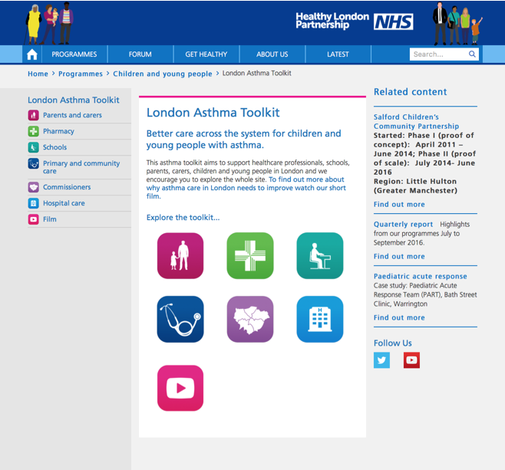
On-line Asthma Toolkit
Support across the system to improve asthma care
https://www.healthylondon.org/children-and-young-people/london-asthma-toolkit

Slide 24
Films to demonstrate what we are doing
Overarching asthma toolkit film: https://www.youtube.com/watch?v=ikdAB9qyk9U
Hospital care: https://www.youtube.com/watch?v=UK8wHN0sdJ0
Schools: https://www.youtube.com/watch?v=bIb80lOjoO8
Pharmacy: https://www.youtube.com/watch?v=kCAzCmI-R_k
Primary and community care: https://www.youtube.com/watch?v=A2iNQE7utRE
Parents and carers: https://www.youtube.com/watch?v=iNPSFal0OIM

Slide 25
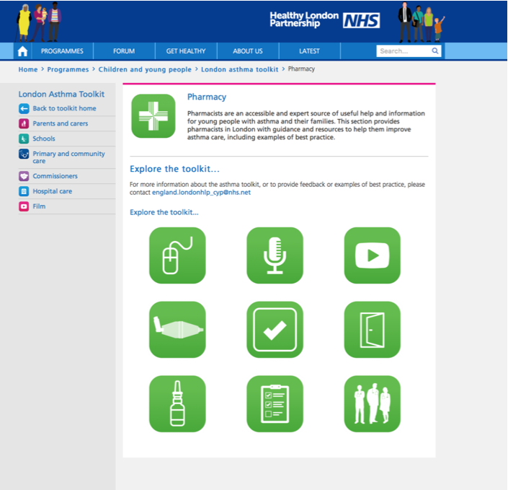
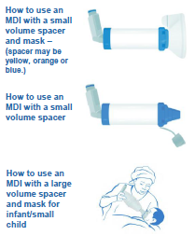
Pharmacy
https://www.myhealth.london.nhs.uk/healthy-london/programmes/children-and-young-people/london-asthma-toolkit/pharmacy

Slide 26
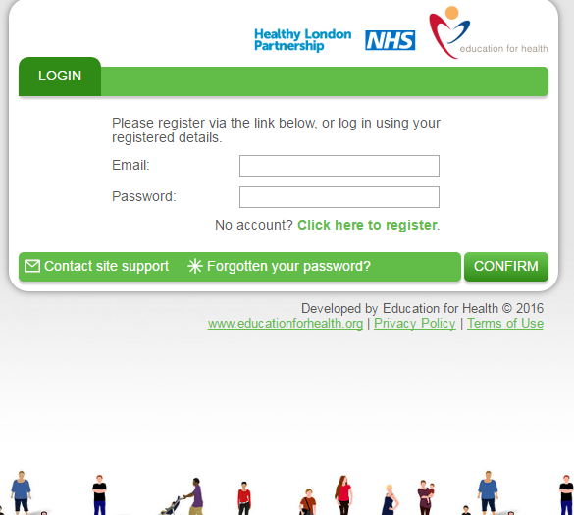
What’s on the toolkit for pharmacists?
Asthma pharmacy learning hub with free on line inhaler technique training
Adherence and Medicines Use Reviews
Pharmacy urgent repeat medication service
Flu and immunisations
Audit and case studies
Pharmacy public health campaign summarised in next slide

Slide 27
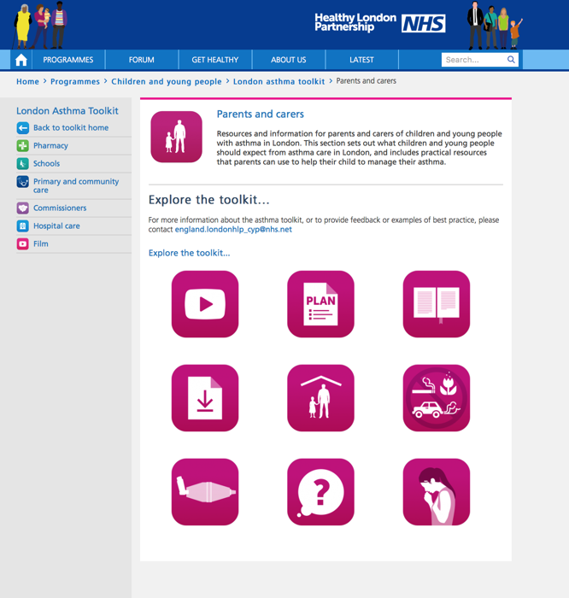
Self Care: Parents and Carers
https://www.myhealth.london.nhs.uk/healthy-london/programmes/children-and-young-people/london-asthma-toolkit/parents-and-carers

Slide 28
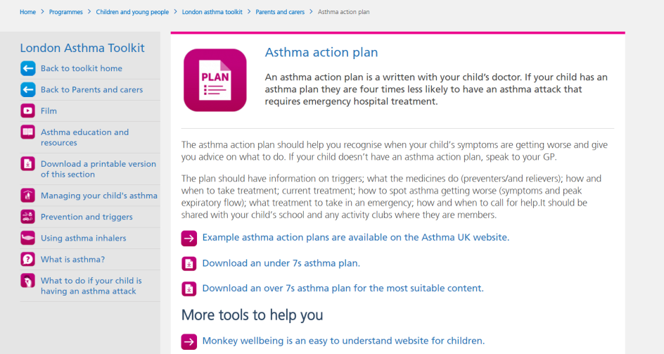
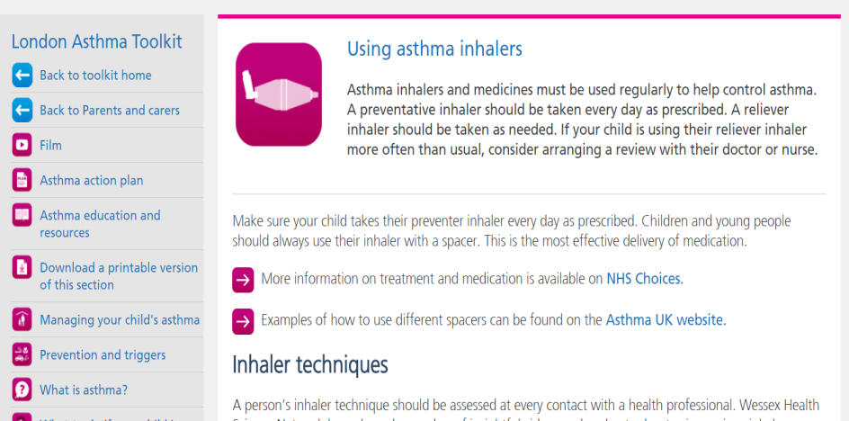
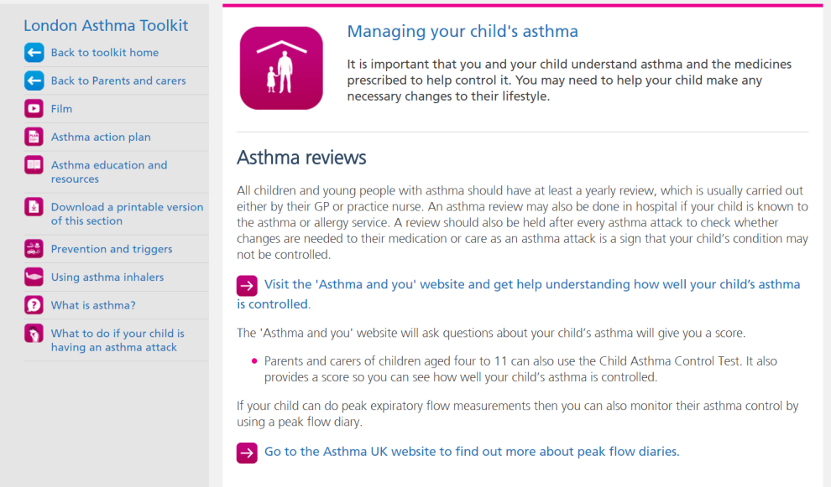
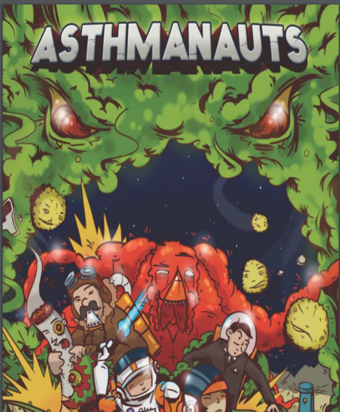
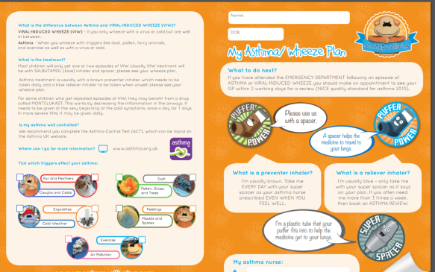
What can you find?
Film: https://youtu.be/iNPSFal0OIM

Slide 29
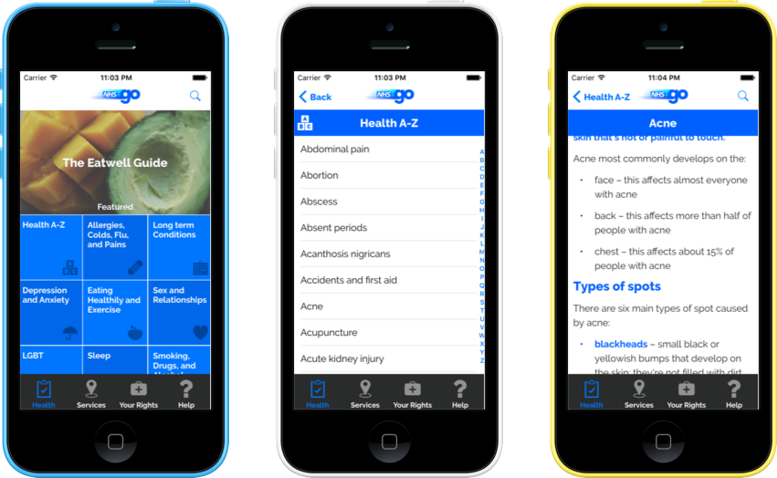
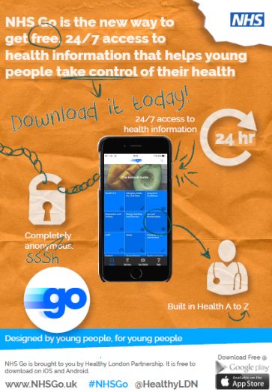


NHS Go
NHS Go is a health app designed by young people for young people
It is divided into 3 sections:
The health section (includes asthma)
The services section (includes pharmacies)
The rights section
Winner of Patient Experience National Award for Championing the Public 2016

Slide 30

Key messages
Asthma can kill but deaths are preventable
Care requires a coordinated approach
‘Community problem needs a community solution’
Need to get the basics right – they make the difference
The Asthma Toolkit provides tools for each aspect of care
Implementation of London asthma standards for CYP will help to introduce pathway working and reduce variation in care
Use of an integrated pathway between pharmacy and GP practice is an exciting development
Notes:
Toolkit help organisations to implement the standards

Slide 31
Any Questions?
For further information please contact:
Sara Nelson, Healthy London Partnership, Children and Young People’s Programme Lead sara.nelson@nhs.net
Reena Bhatt, Clinical Fellow, Healthy London Partnership
Richard Iles, Healthy London Partnership Clinical advisor
David Finch, Healthy London Partnership Asthma Clinical Chair

Slide 32
Clinical update
Richard Goodwin,
Highly Specialist Paediatric Integrated Care Pharmacist, Evelina

Slide 33
National Review of Asthma Deaths¹
  Reviewed possible asthma related deaths from 1st Feb 2012 to 30th Jan 2013
  46% of deaths were identified as avoidable if current guidelines had been followed
  57% of patients were solely seen within primary care
  23% of patients failed to have an PAAP
  Children who died were more likely to have not been offered key elements of care than adults
  Key recommendations which we aim to address through this pilot:
  Patients should have an PAAP
  Patients who have electronic surveillance of prescriptions in primary care
    Patients who receive high levels of salbutamol should be referred for a review
    Patients who are non-compliant with ICS are higher risk of poor asthma control and should be flagged
  Children and parents should be educated on asthma management: How, when and why to use their medications
1:Levy M, Andrews R, Buckingham R, Evans H, Francis C, Houston R, Lowe D, Nasser S, Pation J, Puri N. Why asthma still kills: The National Review of Asthma Deaths (NRAD) confidential enquiry report. Royal College of Physicians; 2014.
Notes:
Urgent and emergency care link to asthma. Mustn't simply look at end of pathway need to look further down track Variation across london

Slide 34
Requirements for an asthma annual review
  BTS/SIGN guidance² recommends the following occur in a structured annual asthma review. A number of these can easily be achieved within community pharmacy:
  Symptom score: Children’s Asthma Control Test, Asthma Control Test
  Asthma attacks | Oral steroids courses | Time off school
  Inhaler technique
  Adherence: Review of dispensing system
  Possession and use of Personal Asthma Action Plan
  Exposure to tobacco smoke
  Growth (height and weight centile)
2: British Thoracic Society and Scottish Intercollegiate Guidelines Network. British Guideline on the Management of Asthma – A National Clinical Guideline. Edinburgh2016.
Notes:
Urgent and emergency care link to asthma. Mustn't simply look at end of pathway need to look further down track Variation across london

Slide 35
BTS / SIGN Asthma Guidance
Complete revision of the section on diagnosis
New diagnostic pathway
Major update to the section on pharmacological management of asthma
Updates to the sections on:
  supported self management
  non-pharmacological management of asthma
  acute asthma
  difficult asthma
  occupational asthma
  organisation and delivery of care
Keep your eyes peeled for new NICE guidance due out this year.

Slide 36
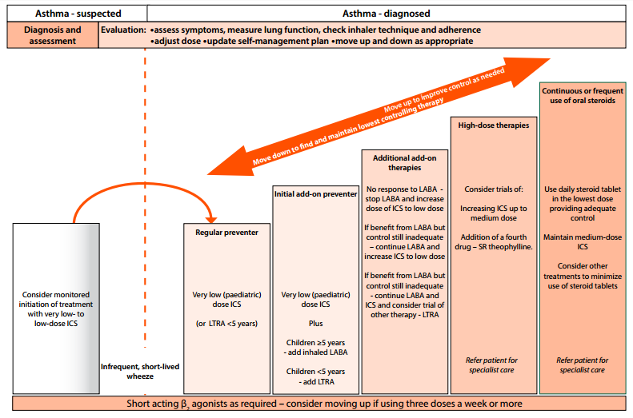
Where did the step ladder go?

Slide 37
BTS/ SIGN Mirroring NRAD
Inhaled short-acting beta-2 agonist as short term reliever therapy for all patients with symptomatic asthma
  Anyone prescribed more than 1 short-acting bronchodilator inhaler device a month (i.e. 6 in 6 months) should be identified and have their asthma assessed urgently and measures taken to improve asthma control if this is poor
  Patients should only be prescribed a device if they have satisfactory technique
  Ideal prescribe 1 device type across both preventer and reliver, this may improve outcomes
  LABAs should only be prescribed in combination with ICS, consider whether all patient should have dual device to ensure LABA delivery with ICS
  New NICE Guidance: We may see montelukast gain prominence
Notes:
From pg65: https://www.brit-thoracic.org.uk/document-library/clinical-information/asthma/btssign-asthma-guideline-2016/
Prescribe an inhaled short-acting β2 agonist as short term reliever therapy for all patients with symptomatic asthma.
Anyone prescribed more than one short-acting bronchodilator inhaler device a month should be identified and have their asthma assessed urgently and measures taken to improve asthma control if this is poor
Inhaled corticosteroids are the recommended preventer drug for adults and children for achieving overall treatment goals

Slide 38
Supporting Care in Children and Monitoring
Lifestyle advice
All families and children should be supported to identify their triggers
  Lack of evidence to support dust mite avoidance
  Animal allergens can remain for over 3months, if animals are a trigger avoidance is the only effective recommendation
  Air pollution: consider walking on the inside edge of the pavement | avoid main roads
  Maintaining a healthy weight can improve asthma symptoms
  Avoid smoking within the child and immediate family or carers
Concerns with ICS
  Medium or high dose ICS may be associated with systemic side effects
  Isolated growth failure is not a reliable indicator of adrenal suppression and monitoring growth cannot be used as a screening test of adrenal function
  Monitor growth (height and weight centile) of children with asthma on an annual basis
Notes:
From pg73 and 74:
https://www.brit-thoracic.org.uk/document-library/clinical-information/asthma/btssign-asthma-guideline-2016/
LABA: LABA: long-acting beta-2 agonist
SAFETY OF LONG-ACTING β2 AGONISTS
Following a review in 2007 of LABA in the treatment of adults, adolescents, and children with asthma, the Medicines and Healthcare products Regulatory Agency (MHRA) further reviewed the use of LABA, specifically in children younger than 12 years of age and concluded that the benefits of these medicines used in conjunction with ICS in the control of asthma symptoms outweigh any apparent risks.
Long-acting inhaled β2 agonists should only be started in patients who are already on inhaled corticosteroids, and the inhaled corticosteroid should be continued
In efficacy studies, where there is generally good adherence, there is no difference in efficacy in giving ICS and a LABA in combination or in separate inhalers. In clinical practice it is generally considered that combination inhalers aid adherence and also have the advantage of guaranteeing that the LABA is not taken without the ICS.
Combination inhalers are recommended to:
guarantee that the long-acting β2 agonist is not taken without inhaled corticosteroid
improve inhaler adherence.

Slide 39
How children may describe their asthma
Young Children Under 5 years | Children 5 – 11 years old | Teenagers (>12 years)
Struggle to verbalise that that their asthma is active. Will request medicine or provide non-specific symptoms. ‘I need my puffer’ ‘My tummy hurts | My chest hurts’ ‘I’m tired’ Sit very quietly Request drink after exercise | Able to verbalise specific symptoms but struggle with change over time. ‘I feel like an elephant I sitting on my chest’ ‘My throat / neck gets itchy’ ‘It feels like ants tickling me’ ‘I feel wheezy’ or ‘I cough’ | Sense of invincibility. ‘My chest is bad’ ‘I feel out of breath, ‘I can’t run fast’ ‘I cough a lot’ ‘It’s not my asthma, it’s just a cough’ ‘I cough and then I start getting wheezy’ ‘My chest is bad’

Slide 40
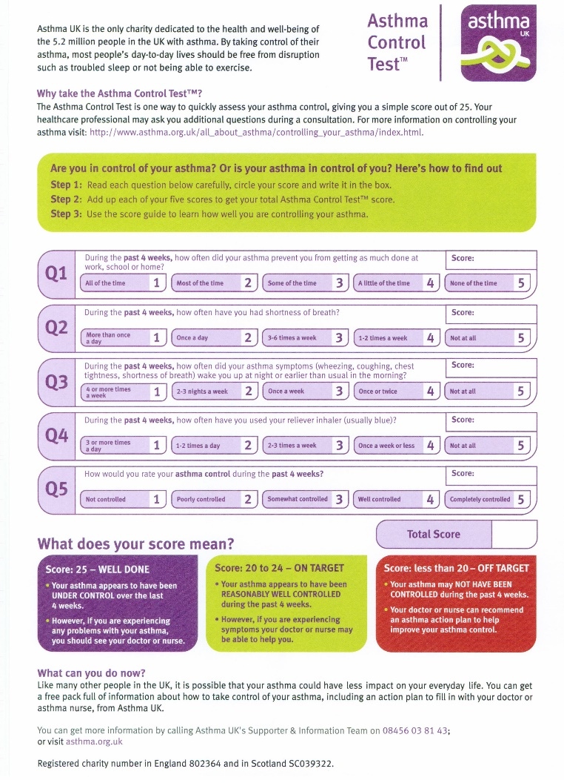
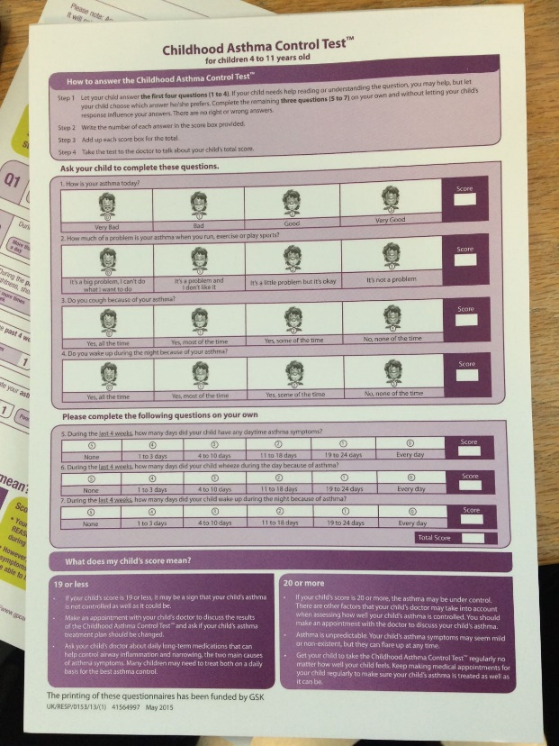
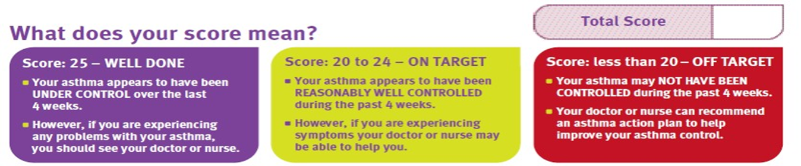
Assessing Control
Reliable, robust and evidence based symptom control scores:
Royal College of GP: 3 question
Children’s ACT | ACT
Inhaler surveillance
Discuss high salbutamol usage > 6 in 6months
Consider referral to GP under quality payments system if combined with no inhaled corticosteroid
Discuss actual medication adherence with family and time off school during consultation. School attendance should be over 95%
Notes:
There have been over 16 pieces of guidance in last few years
Policy drivers, National guidance and standards
Evidence we are not achieving good outcomes for asthma care in London
high variation in diagnosis, treatment and care
high number of respiratory deaths
high rates of admission to hospital
low numbers of children with an asthma plan or having had an asthma review
CYP with asthma featuring strongly in the review of serious incidents and child deaths in London
Despite these documents we don’t seem to be learning so we needed something different

Slide 41
Inhaler devices and technique
Up to 90% of patients fail to understand how to use an pMDI¹ or dry powder inhaler²
25% of patients failed to receive instructions on how to use a device and often information provided is of poor quality²
Main paediatric devices:
pMDI:+ spacer and mask | spacer and mouthpiece
Accuhaler
Turbohaler
Excellent sources of refresher training:
Teach patients essential steps. Companies advocate brand specific steps to ‘optimise’ dose but lets focus on essential for now.
https://www.asthma.org.uk/advice/inhalers-medicines-treatments/using-inhalers/
Interactive local study sessions (CPPE or local events: 6 upcoming events in SE London)
Healthy living London partnership website: https://www.myhealth.london.nhs.uk/
Simple steps: 7 step guide to inhaler technique http://simplestepseducation.co.uk/
Laza V, Sanchis J. Medical personnel and patient skill in the use of metered dose inhalers: a multicentric study. CESEA Group. Respiration 1998;65:195–8.doi:10.1159/000029259
Lavorini F, Magnan A, Dubus JC, et al. Effect of incorrect use of dry powder inhalers on management of patients with asthma and COPD. Respir Med 2008;102:593–604. doi:10.1016/j.rmed.2007.11.003
Notes:
Urgent and emergency care link to asthma. Mustn't simply look at end of pathway need to look further down track Variation across london

Slide 42
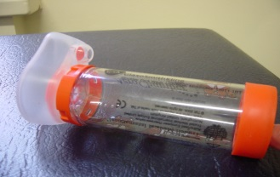
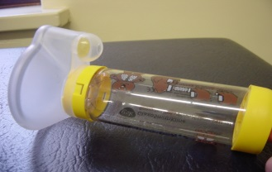
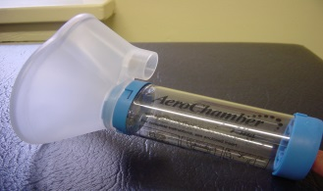
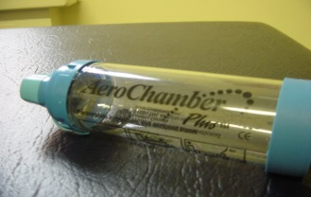
Spacers ‘The gap in therapy’
Device | Approx Age | Tidal Breathing | Tips
Infant ‘Aerochamber plus’ | 0-6months | ✓ | Mask very rigid, not always tolerated, switch to yell if mask will fit
Child ’Aerochamber plus’ | 6 months + | ✓ | Soft mask helps kids tolerate it better
Adult ‘Aerochamber Plus’ with mask | Over 4 years Avoid in teenagers too child like | ✓ | Useful for older children with learning disabilities who cannot use the mouth piece
‘Aerochamber Plus’ with mouthpiece | Approx. 4 years plus Can they hold their breath for 10s | Breath and hold | Ensure no musical sounds & nasal flaring if breathing in through nose
Multiple new spacer devices including collapsible spacers.
Rightbreathe App available from March 2017 provides compatibility information for popular inhaler devices and spacers
Notes:
There have been over 16 pieces of guidance in last few years
Policy drivers, National guidance and standards
Evidence we are not achieving good outcomes for asthma care in London
high variation in diagnosis, treatment and care
high number of respiratory deaths
high rates of admission to hospital
low numbers of children with an asthma plan or having had an asthma review
CYP with asthma featuring strongly in the review of serious incidents and child deaths in London
Despite these documents we don’t seem to be learning so we needed something different

Slide 43
Use and care of spacers
pMDI and a spacer gold standard device for all children
Adolescents should be given a choice of devices but keep to 1 device type
All adults using a pMDI should be recommended to use this via a spacer
Patient can either use tidal breathing or breath and hold technique
1 puff per inhalation cycle
Spacers should be cleaned monthly rather than weekly as per manufacturer’s recommendations
  They should be washed in detergent and allowed to dry in air
  The mouthpiece should be wiped clean of detergent before use
Plastic spacers should be replaced at least every12 months but some may need changing at 6 months
Notes:
From pg88: https://www.brit-thoracic.org.uk/document-library/clinical-information/asthma/btssign-asthma-guideline-2016/
USE AND CARE OF SPACERS
The spacer should be compatible with the pMDI being used.
A change in spacer may alter effective dose delivered.
The drug should be administered by repeated single actuations of the metered dose inhaler into the spacer, each followed by inhalation.
There should be minimal delay between pMDI actuation and inhalation.
Tidal breathing is as effective as single breaths.
Spacers should be cleaned monthly rather than weekly as per manufacturer’s recommendations or performance is adversely affected. They should be washed in detergent and allowed to dry in air. The mouthpiece should be wiped clean of detergent before use
Drug delivery via a spacer may vary significantly due to static charge. Metal and other antistatic spacers are not affected in this way
Plastic spacers should be replaced at least every 12 months but some may need changing at six months

Slide 44
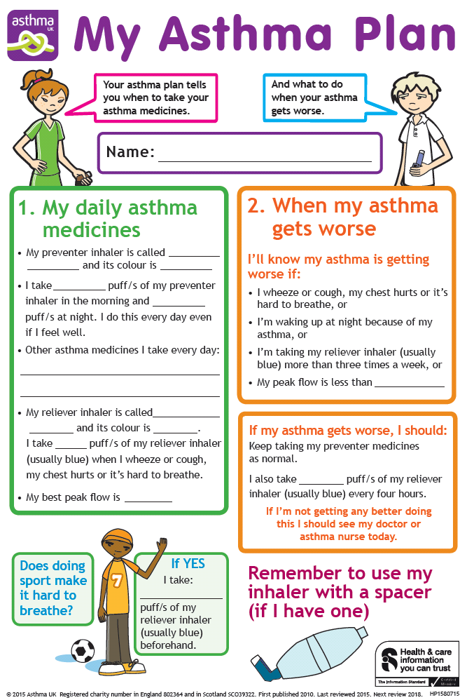
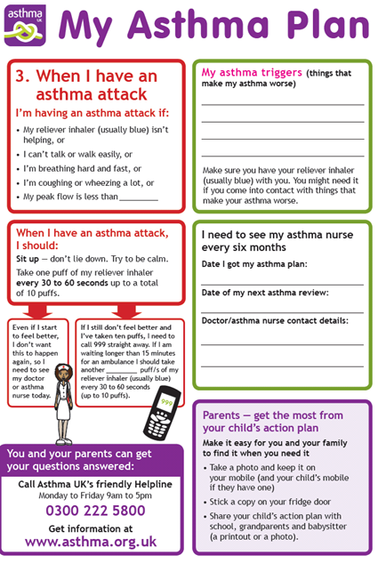
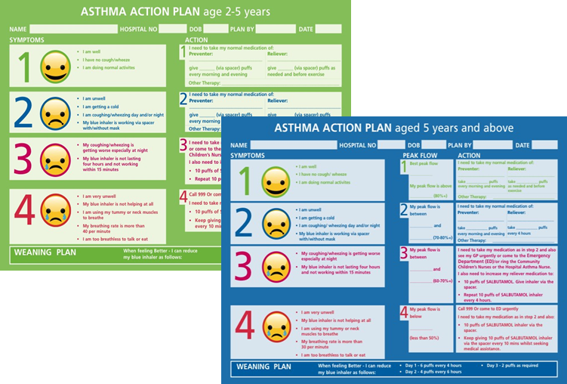
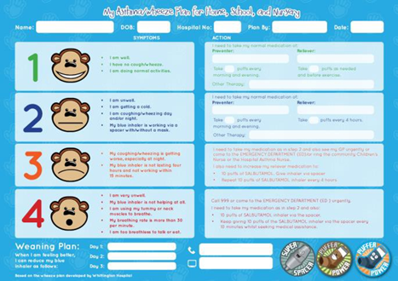
Personalised Asthma Action Plans / Wheeze Plan
Asthma action plans shown to reduce A&E attendance and hospitalisation
Empower the patient and provide self management
Provide support at school
Provision is variable across the country. Review of all age asthma deaths identified 73% had not received a plan.

Slide 45

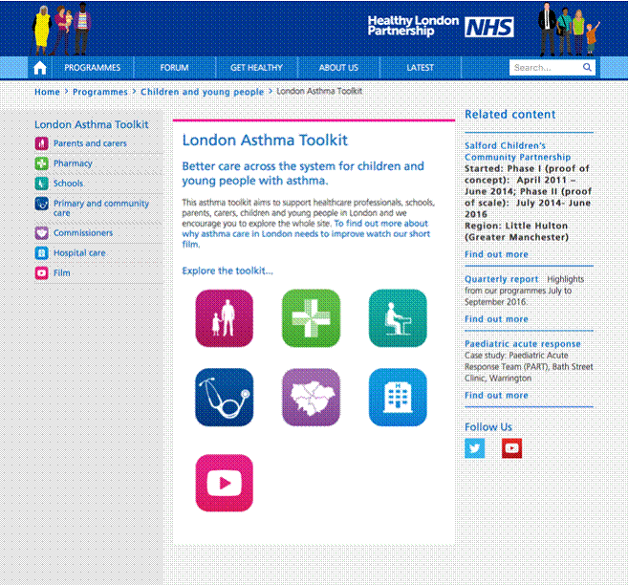



Sources of help
HLP Community Pharmacy Toolkit:
“This is a fantastic tool kit for Asthma in Children. Thanks. I have asked all our pharmacists to do this course”
Dinesh Patel,
Pharmacist ( Proprietor), Temple Pharmacy, Pitshanger Lane, Ealing.
Right breathe app and website

Slide 46
Healthy London Partnerships
Children and Young People
Bexley Asthma Assessment Project in Pharmacies
E-learning and education: Pharmacy Matters!
Donal Markey, Pharmacy Advisor NHS England (London)

Slide 47
Aims & Objectives
Bexley Asthma Assessment Project in Pharmacies
What is the service model?
Why should your pharmacy participate?
Funding
What we are asking pharmacies to do?
Training & Competency
Timelines
Evaluation

Slide 48
Background to service concept

Slide 49
Asthma Assessment in the Pharmacy
What we ARE asking you to do
Competent in
  understanding the management of asthma
  promoting good inhaler technique in children & adults
  promoting effective use of appropriate spacers devices
  providing MURs, NMS
  performing inhaler surveillance ( quality payment)
Learn how to use an e-template to record information and send it to the GP
Talk to your local GPs and Practice Nurses about your referrals
Follow up with patients
Participate in evaluation of the service
Service continuity and remain engaged

Slide 50
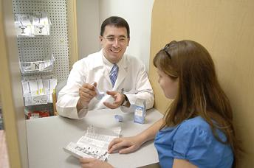
No Reinvention Required!
Some CPD -revisit of asthma management & inhaler technique

Slide 51
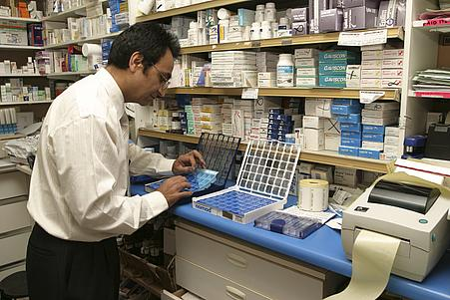
Asthma assessment in the Pharmacy
What we are NOT asking you to do
Diagnose Asthma
Specialists in asthma management in children & adults
Retrain as specialist pharmacists
Be a Prescribers
Read long and complicated service specifications
Spend excessive amounts of time studying and preparing for a service

Slide 52
Overriding Principle
Inclusion of pharmacies in Bexley asthma management pathway
“Take what currently exists and work with what you have got… in many cases systems of care just need to join up more effectively as opposed to overlaying a whole new intervention or pathway”
Mando Watson Consultant Paediatrian , Imperial College Healthcare NHS Trust

Slide 53
SIMPLE Asthma Care
Getting it right!
S tepwise pharmacological management
Inhaled CorticSteroids
I nhaler technique and device suitable for age
M onitor control (ACT, B2 agonist use, preventer uptake)
P ersonalised Asthma Action Plan
L ifestyle. Learn symptoms and triggers
E ducation / ETS / Every Time

Slide 54
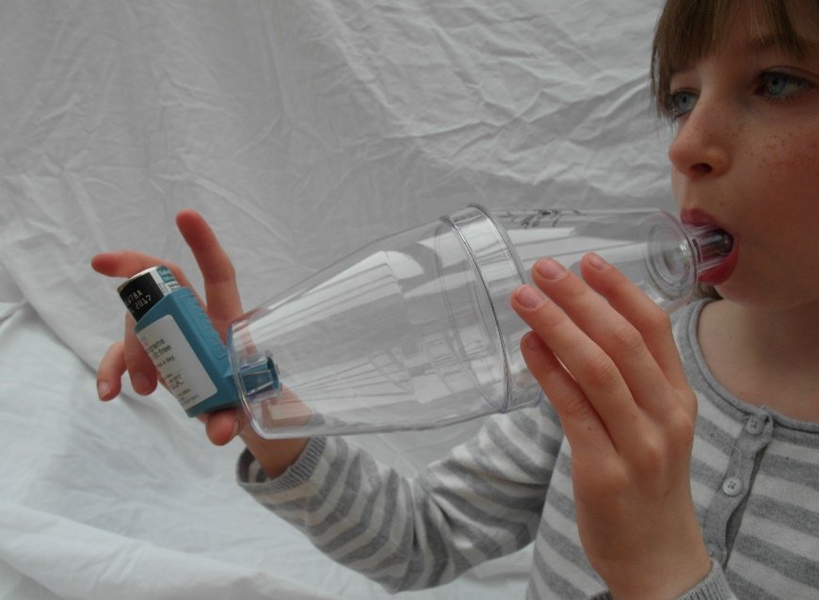
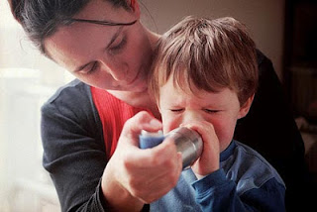
Inhaler Technique
Back to BASICs
B enefit
A sthmatics
with
S uitable
I nhalers &
C hamber
5 tidal breath technique

Slide 55

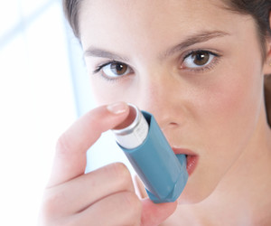
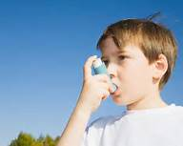

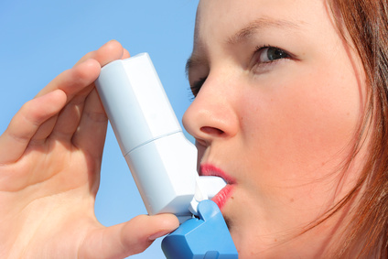
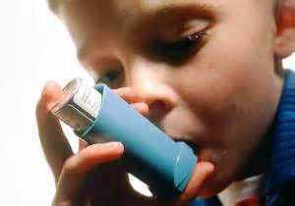
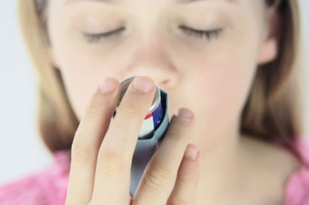
Subliminal Confounders
Promoting good inhaler technique in CYP?
Understanding Acute Asthma Attacks: Answers.com
Allergy website
Acute Asthma Attack Kills Teenage Girl – Did She Have Hidden Allergies?
…imab
New asthma drug can cut hospital admissions by half: study
Daily Telegraph
North West and Wales Transport Service acute asthma guideline
Medical Observer
CHILDREN with severe or persistent asthma could be at a higher risk of …. Dying!
Daily News
New asthma procedure 'cooks' lungs ….

Slide 56
Asthma Management Pathways

Slide 57





The current situation
Should be better for patients. What could we do better?
Home
School
2nd / 3ry
Hospital Care
Primary Care
School Nurse
Source R Chavasse , St Georges

Slide 58





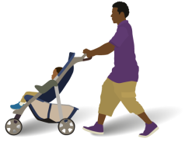
Healthy London Partnership –
Children and Young People’s programme
Pharmacy services in England: Key facts 2015/16
7.8m items of Fluticasone Propionate (inhaled) dispensed
11,688 community pharmacies in England and 1862 in London
1.08 billion prescription items
dispensed in the community
3.3 million Medicine Use Reviews , average of 280 per annum for a London Pharmacy
Fluticasone Propionate (inhaled) remains the highest costing medicine at £376m
£9.27 billion was the cost of prescriptions dispensed in the community
34.4 m
Simvastatin was the most prescribed chemical
35.4% of items dispensed by EPS
821,893 New Medicines Services interventions, average 78 per annum for a London Pharmacy

Slide 59
Community Pharmacy Services
Categories & Funding sources

Slide 60
The current situation
Its not working. What could we do better?
Home
School
2nd / 3ry
Hospital Care
Primary Care
School Nurse
Source R Chavasse , St Georges

Slide 61
Service Model in the Pharmacy

Slide 62
Global Sum
Service Model utilises ADVANCED SERVICES & QUALITY PAYMENTS
This is NOT a new service
This is not an enhanced service
No additional service specification
Pharmacies are already commissioned to provide the services we seek to promote good asthma management in pharmacies
No additional fee structure
Payment is claimed through advanced services and quality payments

Slide 63
Patient Cohort
Who are we aiming this service at?
Children & Young people aged between 5 – 25 years of age
May or may not have a diagnosis of asthma
Should be registered with a local participating practice
Meet the criteria for PI , MUR or NMS
Patients who would benefit from an asthma review at their GP Practice
Patients who would benefit from an inhaler technique assessment

Slide 64
Patient recruitment
Opportunistic
Detecting patients for a Medicines Use Review (MUR) or the New Medicines Service (NMS)….PMR prompts
Monitoring the number of SABA inhalers dispensed in a rolling 6-month period through the pharmacy patient medication records (PMR) or through routine or opportunistic access to summary care records (SCR)
Monitoring patient emergency supply requests for inhalers
Monitoring out of hours or urgent prescriptions for inhalers
Monitoring emergency supply request through the NUMSAS service for inhalers
Monitoring repeat prescription requests for inhalers
Monitoring non-collection of prescriptions for inhalers
Monitoring over the counter purchase by asthma patients e.g. cough & cold symptoms

Slide 65
Patient recruitment
Co-ordinating care with GP Practice
Non-attendance for asthma reviews at GP Practice
Patients who attend asthma reviews at GP Practice without their inhalers
Large patient cohorts – help GP practice to stratify the patients
Part gather data in the pharmacy which will support patient records in the GP Practice – QOF and in asthma reviews
Highlight access to inhalers in an emergency scenario - OOH prescriptions, NUMSAS supplies or requests in the pharmacy
Highlighting non-collection of prescriptions for inhalers
Highlighting inappropriate self care by asthma patients e.g. cough & cold symptoms

Slide 66
Training & Competence

Slide 67
Training & Competence
Numerous resources – Inhaler technique
Healthy London Partnerships - Asthma Tool Kit
Healthy London Partnerships – On line training Pharmacists & Inhaler Technique
SE London – Respiratory Disease Management training for Pharmacists
Asthma UK
PSNC
Local LPC
NHS England –London region Team
New Resource
RightBreathe

Slide 68
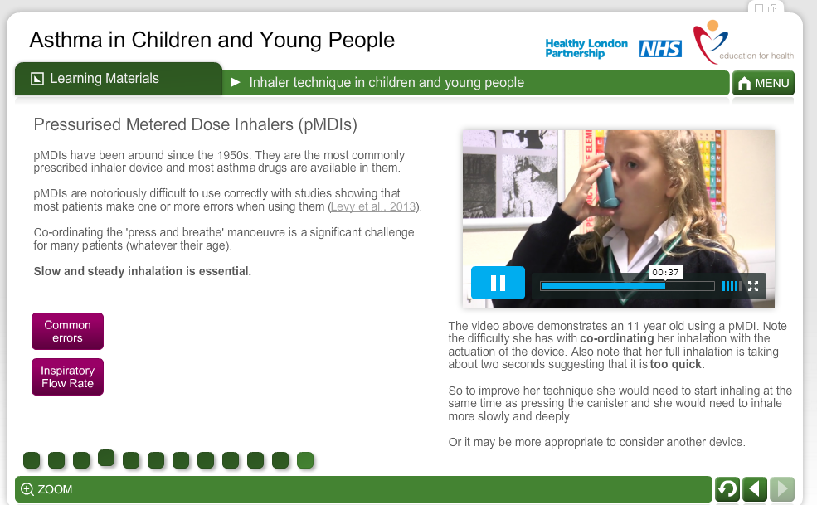
Healthy London Partnership
Learning materials - video content
www.myhealth.london.nhs.uk

Slide 69
Feedback
Community Pharmacists
“This is a fantastic tool kit for Asthma in Children. Thanks. I have asked all our pharmacists to do this course”
Dinesh Patel,
Pharmacist ( Proprietor),
Temple Pharmacy,
Pitshanger Lane,
Ealing.

Slide 70
Timeline, Next Steps, Evaluation

Slide 71

The evidence: facts about asthma in the UK
Community Pharmacy has a role in asthma management

Slide 72
Timelines, Next Steps , Evaluation
12 month project
Timelines
Start date 02.05.17 ( world Asthma Day)
Quarterly reviews
Darzi Fellow to support the review – academic publications etc.
Support within Healthy London Partnerships
Next Step
Feedback from pharmacists
MDT meeting in April with Local GP Practices

Slide 73
Evaluation
Co-designing – need local input to identify measurable outcomes
GP Practice
Impact on patient care & local practice
Quality and relevance of the information
Pharmacy
Ease of administration
Use of the eTemplate
Service model based on Pi, MUR, NMs & quality payments
Training & competence
Patients
Satisfaction with the service
Access
Benefits to health and well being

Slide 74
What is happening locally?
Jacqueline Leaver, Head of Children, Young People and Maternity Commissioning, Bexley CCG/Bexley LA

Slide 75
The Local Agenda
Integrated Children's Hubs aligned to the STP footprint
Working towards sustained outcomes
Patient Involvement

Slide 76

Questions and next steps?

