Slide 1

Food Allergies in Children
Dr C Macaulay
Dr C Lemer
Dr R Bhatt

Slide 2
Background
Food allergy may be confused with food intolerance
Food allergy can be classified into IgE-mediated and non-IgE-mediated reactions.
  IgE-mediated reactions are acute and frequently have a rapid onset.
  Non-IgE-mediated food allergy is frequently delayed in onset.
Most common foods causing allergies
• fish
• hens' eggs
• kiwi fruit
• peanuts and tree nuts
• sesame
• shellfish
• soy
• wheat.

Slide 3
Epidemiology
The prevalence of food allergy in Europe and North America has been reported to range from 6% to 8% in children up to the age of 3 years.
Only 25–40% of self-reported food allergy is confirmed as true clinical food allergy by an oral food challenge

Slide 4
Focused history
A personal or family history of atopy is the most significant predictor of allergy.
Ask about history of the reaction
  Timing
  likely precipitants.
Include history of eczema, asthma, Gastroesophageal reflux
Note that the absence of signs or symptoms does not exclude a food allergy
Notes:
Taking a good history is key to diagnosis

Slide 5
Immediate reactions -IgE mediated
Occur within 2 hours of contact or ingestion
Symptoms are consistent and reproducible and include rashes, itching, wheeze, GI symptoms, angioedema and anaphylaxis
Skin prick tests (or blood tests for specific IgE antibodies to allergens/likely co-­‐allergens) can help diagnosis

Slide 6
Treatment in IgE Mediated
Exclusion
Should have dietician advice
Should have an EpiPen if history of anahylaxis or have food allergy and asthma

Slide 7
Delayed reactions – Non IgE mediated
Occur > 2hrs after ingestion but within 2-­‐3 days
Often difficult to reproduce and symptoms less specific
May present:
  eczema, colic, reflux, loose stools, constipation, food aversion
No tests help diagnosis

Slide 8
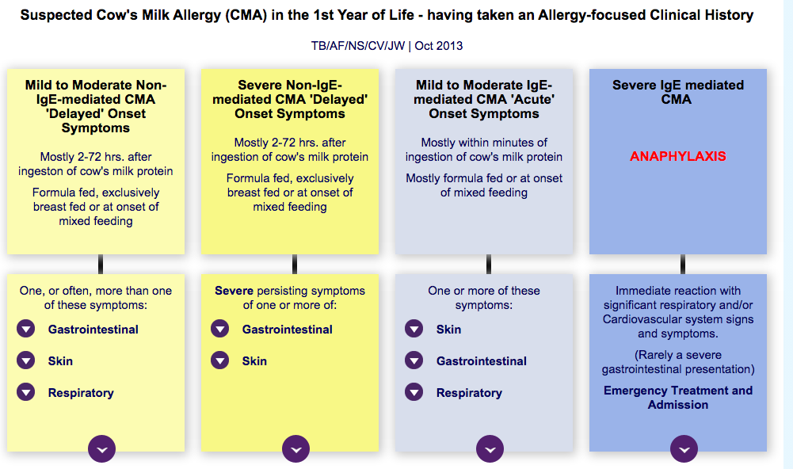
Treatment Non IgE mediated
Treatment is 2-­‐6 week trial of exclusion of the suspected food followed by reintroduction
If cows milk protein allergy suspected – see GOR guideline

Slide 9
When to refer
has had an anaphylactic reaction
had one or more severe delayed reactions
has immediate or delayed allergic reactions to multiple allergens or food groups, especially if there is faltering growth
has had acute allergic reaction with coexisting asthma
moderate – severe eczema where cross reactive or multiple food allergies suspected
has not responded to a single –allergen elimination diet
Or:
There is strong clinical suspicion of Ig E-­‐mediated food allergy but allergy test results are negative

Slide 10
Top Tips
All children who are excluding multiple foods should be referred to a paediatric dietician
Most cases of urticaria lasting over several days are associated with a viral infection and do not represent a food allergy
Do not use serum-­‐specific IgE testing to diagnose delayed food allergy
Allergy UK : www.allergyuk.org/ has excellent advice sheets for families and clinicians

Slide 11
Resources
https://www.nice.org.uk/guidance/cg116
Cows milk protein allergy:
http://cowsmilkallergyguidelines.co.uk/interactive-algorithm/
https://www.allergyuk.org/childhood-food-allergy/food-allergy-in-babies-and-children

