Slide 1
Atopic Eczema in children
Dr C Macaulay
Dr C Lemer
Dr R Bhatt

Slide 2
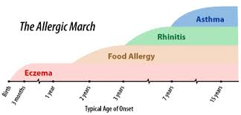
Background
Chronic inflammatory itchy skin condition
Episodic (have flares)
Can affect any age
Will resolve in some children but others may develop other atopic conditions i.e. the ‘Atopic march’

Slide 3
Why is it important?
Affects many children in different severities
Can have significant impact on a child or young person and their family
Success of management relies on the relationship with healthcare professional and the child
Education is key for management
Can have coexisting allergies

Slide 4
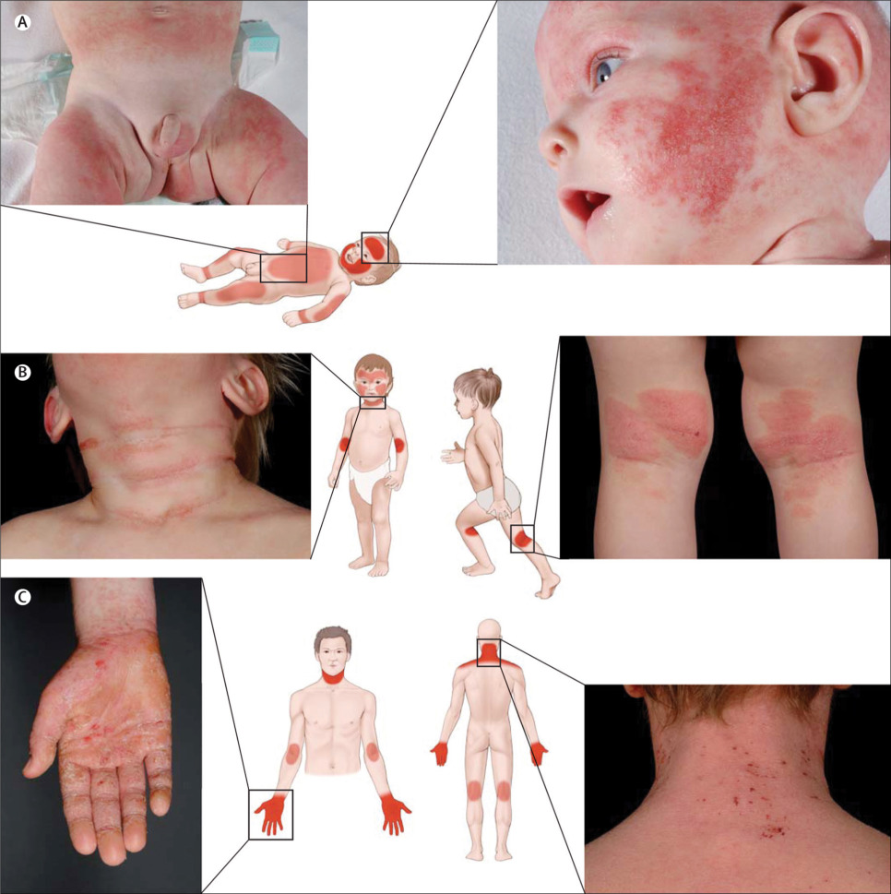
Management
Is hard!
Important to assess the severity and impact on life
Distribution can vary depending on age

Slide 5
Assessing severity
The severity of the atopic eczema is grouped into 4 categories:
Clear suggests that the skin is normal with no evidence of active atopic eczema.
Mild indicates areas of dry skin and infrequent itching, with or without small areas of redness.
Moderate severity is areas of dry skin, frequent itching, redness with or without excoriation and localised skin thickening.
Severe atopic eczema has widespread areas of dry skin, incessant itching and redness with or without excoriation, extensive skin thickening, bleeding, oozing, cracking and alteration of pigmentation.
There are also 4 categories for the impact on quality of life and psychosocial wellbeing:
None, as it suggests, has no impact on the child’s quality of life.
Mild means there is little impact on everyday activities
Moderate is defined as moderate impact on everyday activities and psychosocial wellbeing, with frequently disturbed sleep
Severe indicates that there is severe limitation of everyday activities and psychosocial functioning, with loss of sleep every night

Slide 6
Are there any triggers?
Identify potential trigger factors including:
irritants
skin infections
contact allergens
food allergens
inhalant allergens.
Notes:
When clinically assessing children with atopic eczema, healthcare professionals should seek to identify potential trigger factors including:
irritants, for example soaps and detergents (including shampoos, bubble baths, shower gels and washing-up liquids)
skin infections
contact allergens
food allergens
inhalant allergens.
Healthcare professionals should consider a diagnosis of food allergy in children with atopic eczema who have reacted previously to a food with immediate symptoms, or in infants and young children with moderate or severe atopic eczema that has not been controlled by optimum management, particularly if associated with gut dysmotility (colic, vomiting, altered bowel habit) or failure to thrive.

Slide 7
Treatment – A Stepped approach
Emollients are the mainstay of treatment
Treatment should be tailored to severity
Can be stepped up or down depending on response
Families should be educated in spotting flares and how to step up or down therapy

Slide 8
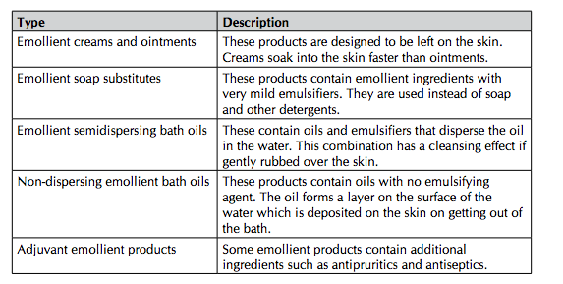
Treatment - Emollients
Should be used multiple times a day
Should be continued even when the skin is clear
Should be using 250-500g/week

Slide 9
Treatment – Steroid creams
For the face and neck
use mild potency steroids except for short-­‐term (3–5 days) use of moderate potency for severe flares
For flares in vulnerable sites -­‐
use mild potency steroids except for short-­‐term (7–14 days) use of such as axilla and groin moderate or potent preparations for short periods only

Slide 10
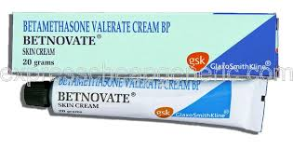
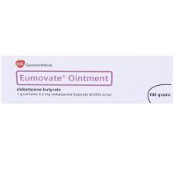
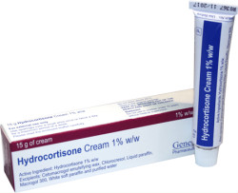
Topical Steroids
Severe
Moderate
Mild
Increasing potency
Notes:
For mild atopic eczema
use mild potency steroids e.g. 1% hydrocortisone once daily
For moderate atopic eczema
use moderate potency e.g. clobetasone butyrate 0.05% once daily
For severe atopic eczema
use potent e.g. betamethasone valerate 0.1.%, Mometasone furoate 0.1%

Slide 11
DO NOT USE….
Potent topical corticosteroids on the face and neck
Potent topical corticosteroids in children under 1 year unless advised by a specialist
Very potent steroids e.g Dermovate without specialist dermatological advice

Slide 12
Secondary infections
Consider secondary infection:
Particularly if not improving, rapidly worsening or if there is weeping, crusting, fever or malaise
Treat with tropical or oral antibiotics
If frequent infections consider antimicrobial emollient E.g. Dermol 500
Beware eczema herpeticum -­‐ Requires immediate referral to paediatrics. Important to alert parents on how to recognise infection

Slide 13
Top tips
Do not use aqueous cream as an emollient
Encourage daily bathing with bath oils & soap substitute unless otherwise specified
Don’t be afraid to start topical steroids
Step up and step down steroid strengths – use weakest that you can to gain control then reduce
Ointments are oil based and more hydrating
1 fingertip (little finger) unit of steroids should be used for an area of two palms

Slide 14
Take Home Messages
Common presentation and largely managed in primary care
Can have significant impact on life and self esteem
Its all about emollients
Important to educate the family
Using emollient
Stepping up/down therapy
Recognising secondary infection

Slide 15
Resources
http://www.nhs.uk/conditions/pregnancy-and-baby/pages/eczema-in-children.
https://nationaleczema.org/eczema/child-eczema/
https://www.allergyuk.org/atopic-dermatitis-and-eczema-in-children/atopic-dermatitis-eczema-in-children

