Slide 1

Wheeze and Asthma
Key Facts and Updates
Dr Reena Bhatt, Paediatric Darzi Fellow in Asthma

Slide 2
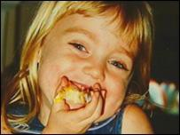
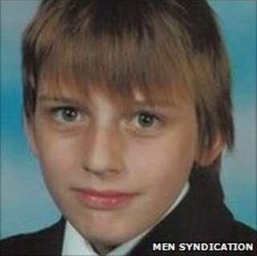
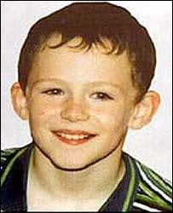


Slide 3

Outline
Scale of the problem
Viral Induced Wheeze vs Asthma
How to approach an asthma (annual) review

Slide 4
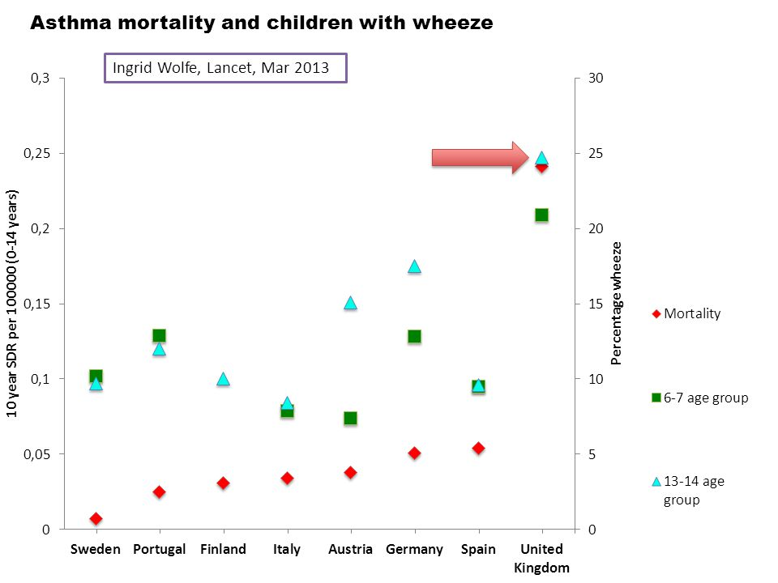

Slide 5
The scale of the problem
• 1.1 Million children in the UK are currently receiving treatment for
asthma
• 2 in every class (1 in 11 children have asthma)
• Every 17 minutes a child is admitted to hospital in the UK because of
their asthma, 75% preventable
• 30,000 – 40,000 admissions a year
• 1/3 of preschool children have a wheezy episode

Slide 6

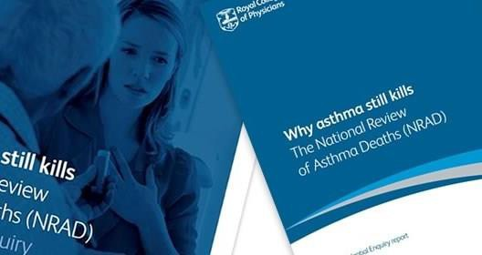
Asthma Death Review Summary

Slide 7





Slide 8
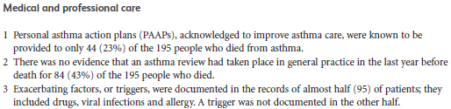

Slide 9
Wheezing in the preschool child (< 5 years)
Common presentation to paediatric services
1/3 of preschool children will have a wheezy episode
Only about 20% of these will go onto have a diagnosis of asthma
Tucson Children's Respiratory Study: 1980 to present
  Wheeze for many pre-school children is not associated with atopy and resolves by school age in the vast majority of cases
Taussig LM, Wright AL, Holberg CJ, et al. J Allergy Clin Immunol 2003;111:661–75

Slide 10
Wheezing Patterns
Temporal pattern of wheeze
•Episodic (viral) wheeze
Wheezing during discrete time periods, often in association with clinical evidence of a viral cold, with absence of wheeze between episodes
•Multiple-trigger wheeze
Wheezing that shows discrete exacerbations, but also symptoms between episodes
Duration of wheeze
•Transient wheeze
Symptoms that commenced before the age of 3 yrs and are found (retrospectively) to have disappeared by the age of 6 yrs; transient wheeze may be episodic or multiple-trigger wheeze
•Persistent wheeze
Symptoms that are found (retrospectively) to have continued until the age of 6 yrs; persistent wheeze may be episodic or multiple-trigger wheeze
•Late-onset wheeze
Symptoms that start after the age of 3 yrs; late-onset wheeze may be episodic or multiple-trigger wheeze

Slide 11
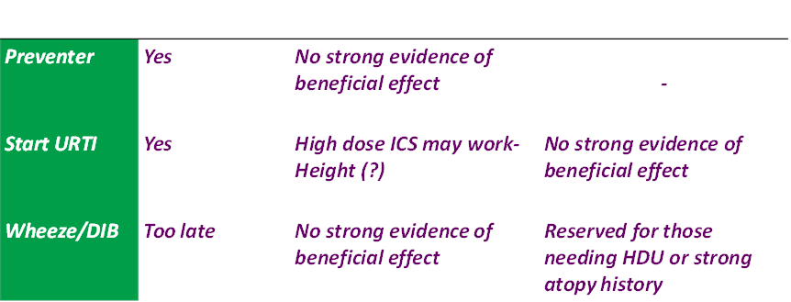
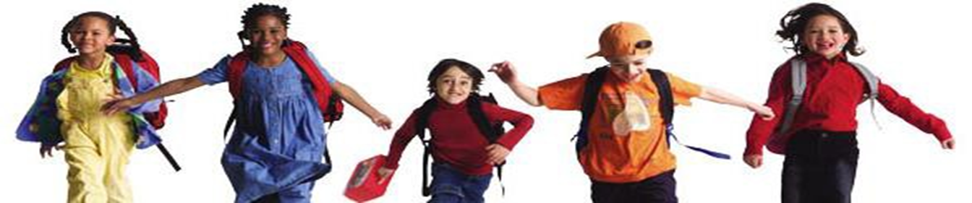
Treatment options for Viral Induced Wheeze

Slide 12
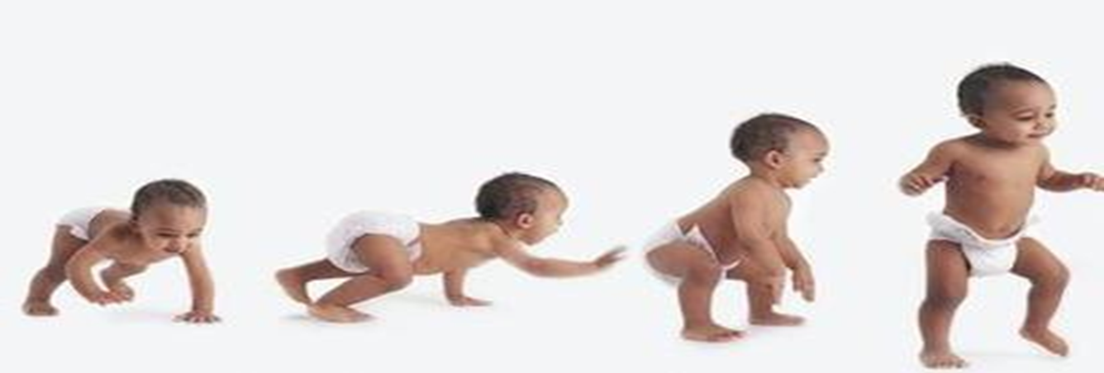
Four key Steps:
Is this asthma?
Is there good control?
What is impacting on control?
What action needs to be taken?

Slide 13
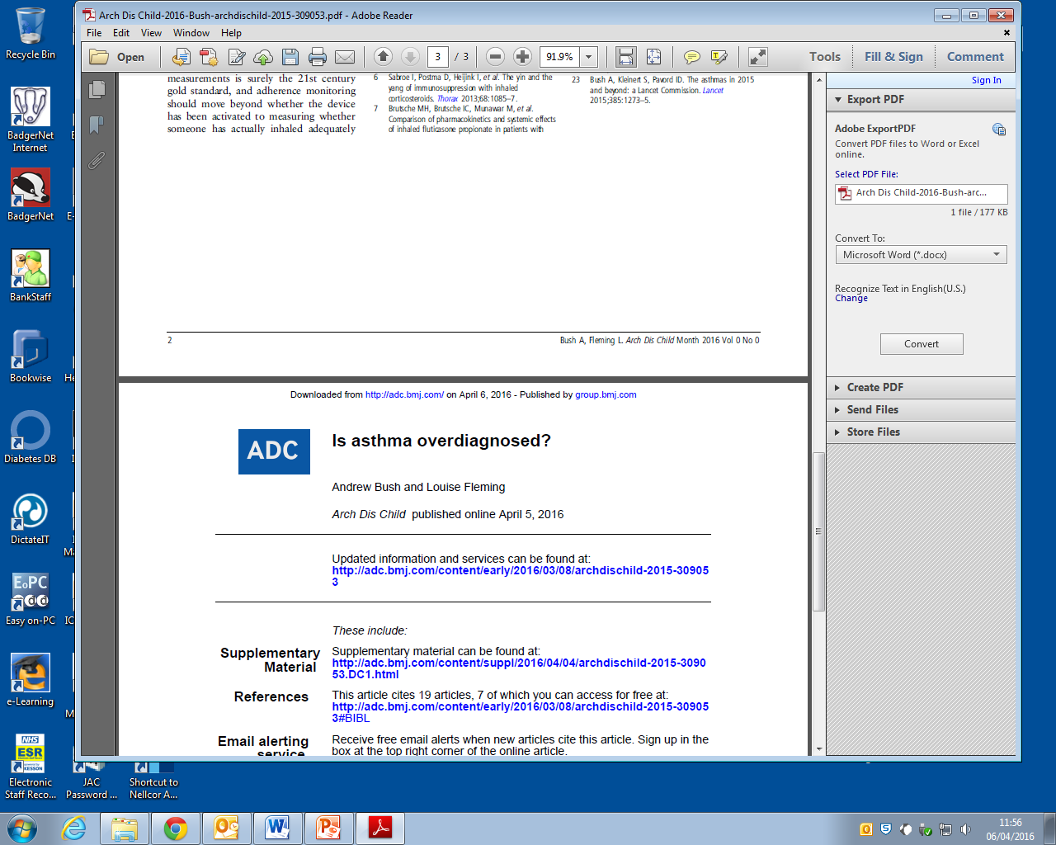
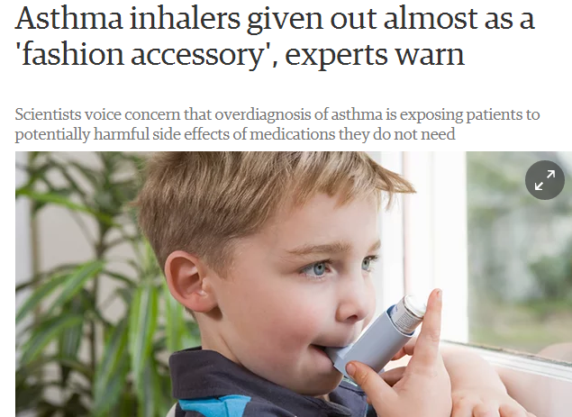
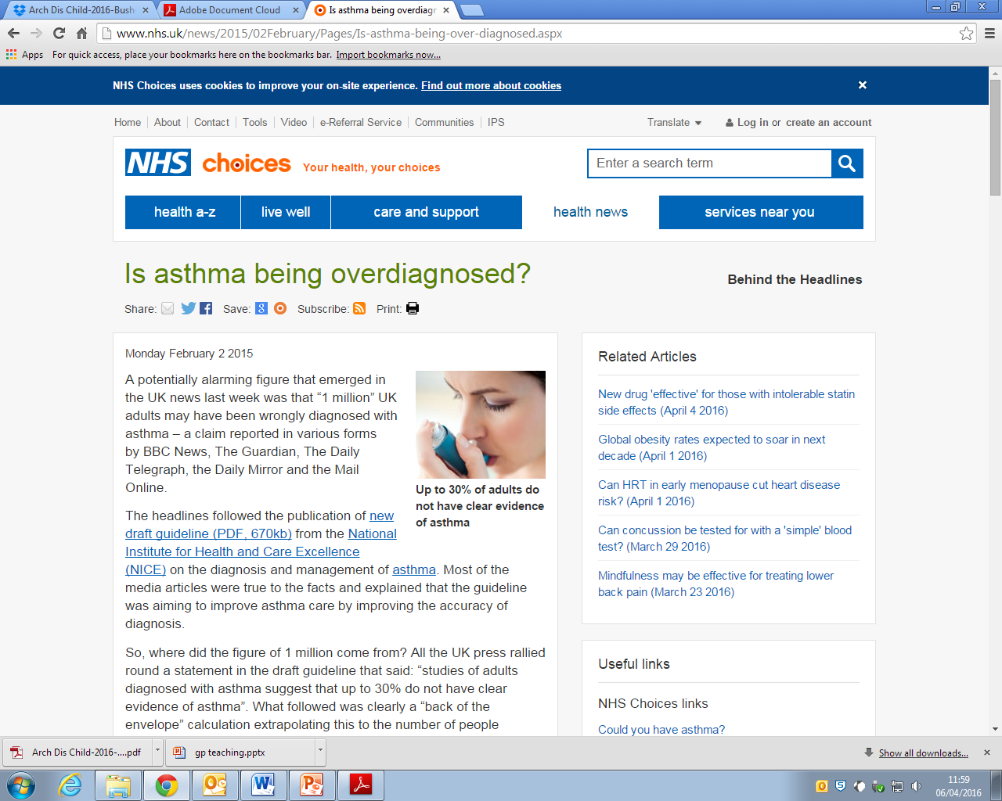

Slide 14
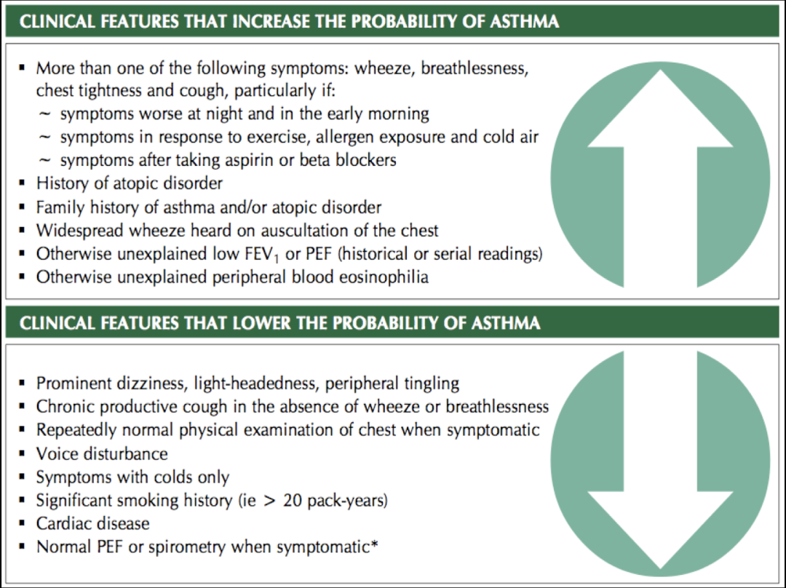
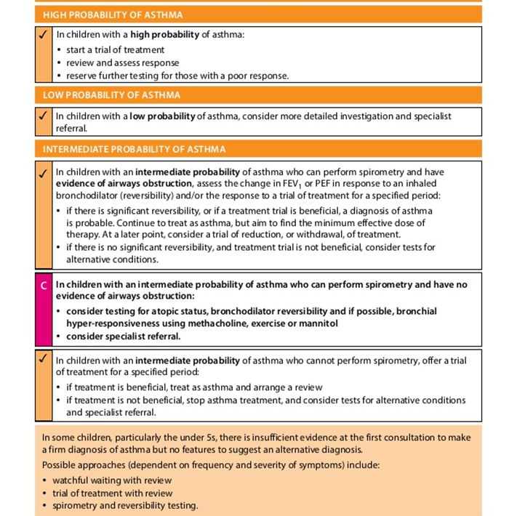

Slide 15
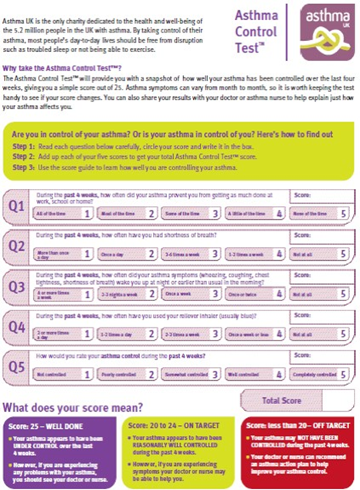
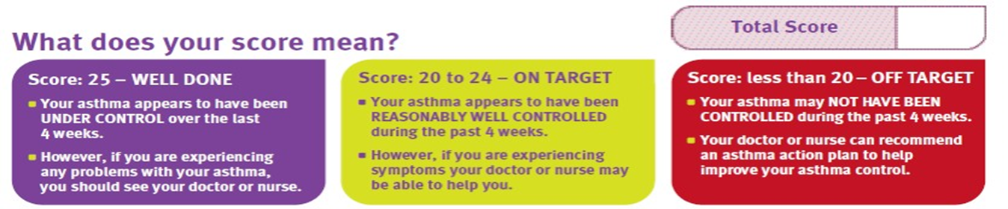
Asthma Control Test (ACT)
During the past 4 weeks:
1.How often did your asthma prevent you from getting as much done at work, school or home?
2.How often have you had shortness of breath?
3.How often did your asthma (wheezing, coughing, chest tightness, shortness of breath) wake you up?
4.How often have you used your reliever inhaler?
5.How would you rate your asthma control ?

Slide 16
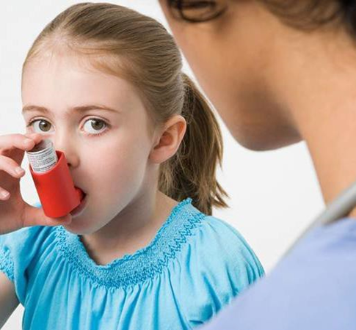
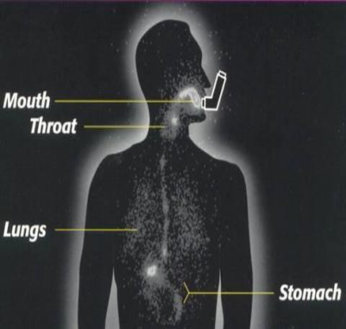


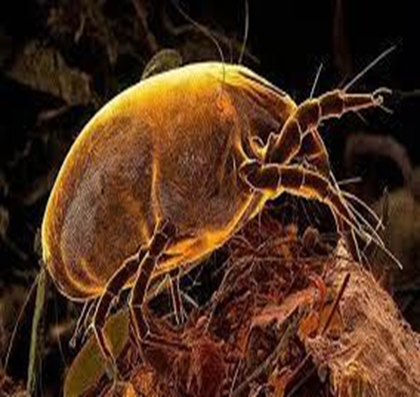

Slide 17
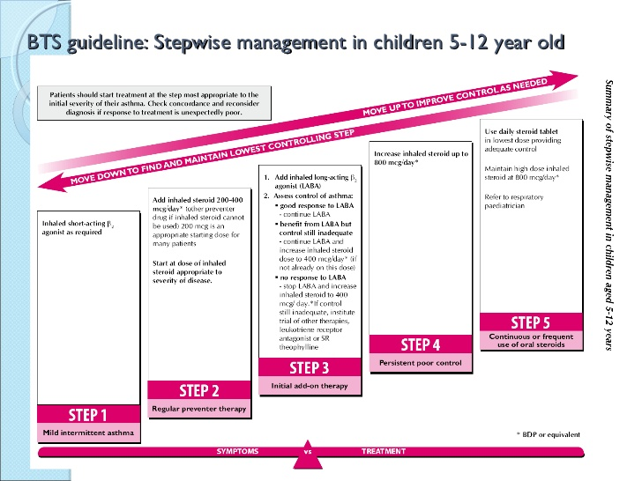
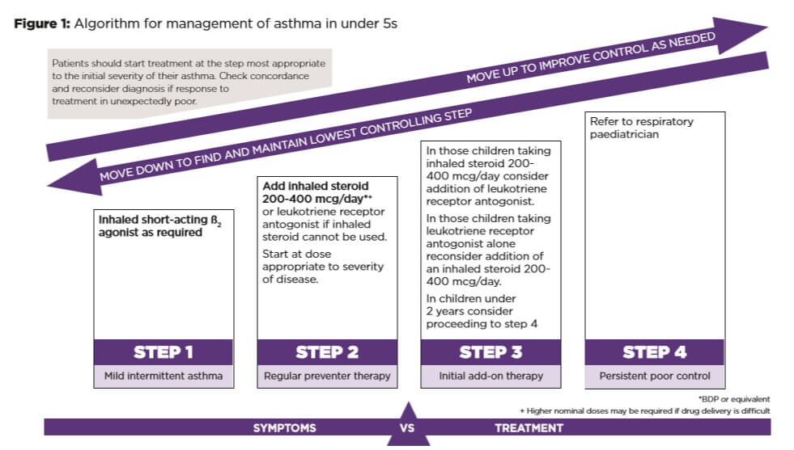

Slide 18
BTS Guideline: Major Changes
•More ipratropium bromide in first 2 hours in
acute severe or life-threatening asthma
•1st choice add on to inhaled steroids:
  if <5yo: montelukast
  If >5yo: long-acting beta-agonist
•Serial PEFR, spirometry or eNO offers little benefit in monitoring over clinical symptom- based assessment in children

Slide 19
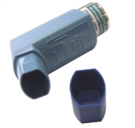
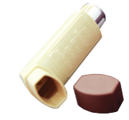
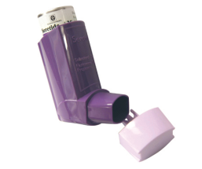
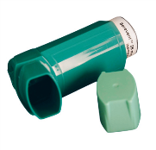
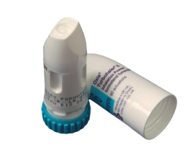
Which Inhaler & What Strength?
Bronchodilator
Inhaled corticosteroid (ICS)
ICS/LABA
LABA
Salbutamol
100mcg
Fluticasone
50, 125 & 250mcg
Seretide
50, 125 & 250
Plus 25mcg Salmeterol
Salmeterol 25mcg
Beclometasone 50mcg
Beclometasone
100mcg
_{Meter Dose inhaler}
_{Always with Spacer}
Salbutamol
200mcg
Fluticasone
50, 100 & 500mcg
Seretide
100, 250 & 500
Plus 50mcg Salmeterol
Salmeterol
50mcg
_{Accuhaler}
Symbicort
100/6, 200/6 &
400/12mcg
Formoterol
6 & 12mcg
Bricanyl
500mcg
Pulmicort
100, 200 & 400mcg
_{Turbohaler}

Slide 20
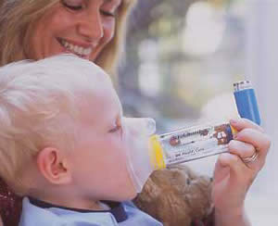
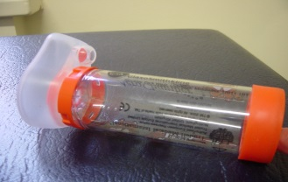
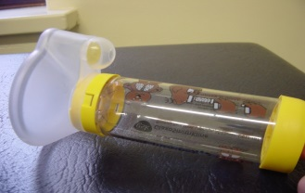
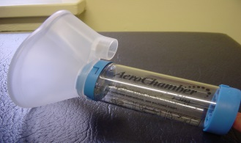
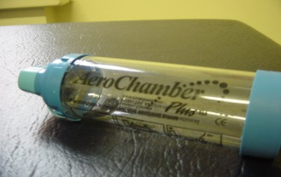
A Guide to Selecting an ‘Aerochamber Plus’?
Device | Approx Age | Tidal Breathing | Tips
Infant ‘Aerochamber plus’ | 0-6months | ✓ | Mask very rigid, not always tolerated, switch to yell if mask will fit
Child ’Aerochamber plus’ | 6 months + | ✓ | Soft mask helps kids tolerate it better
Adult ‘Aerochamber Plus’ with mask | 10 years + Avoid if possible | ✓ | Useful for older children with learning disabilities who cannot use the mouth piece
‘Aerochamber Plus’ with mouthpiece | 4 years plus (approx) | ✗ | Ensure no musical sounds & nasal flaring if breathing in through nose

Slide 21
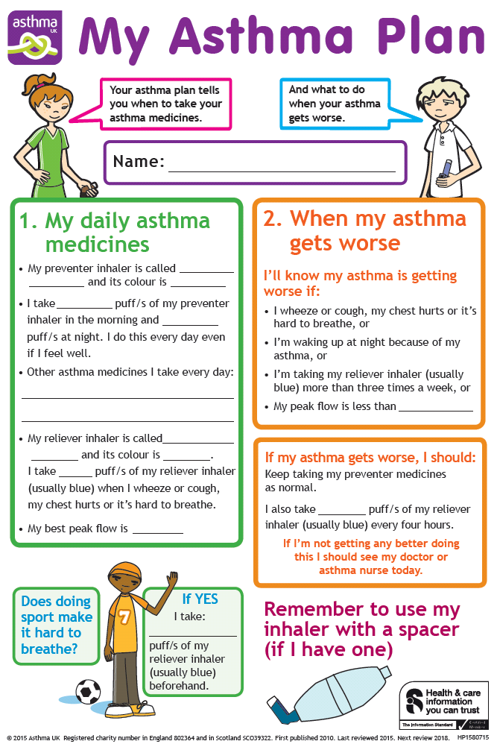
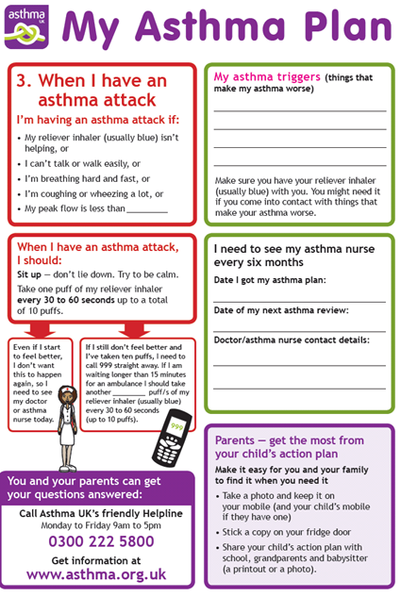
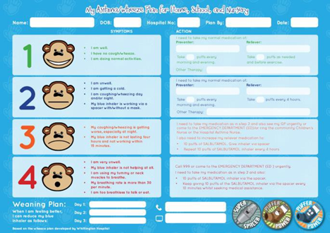
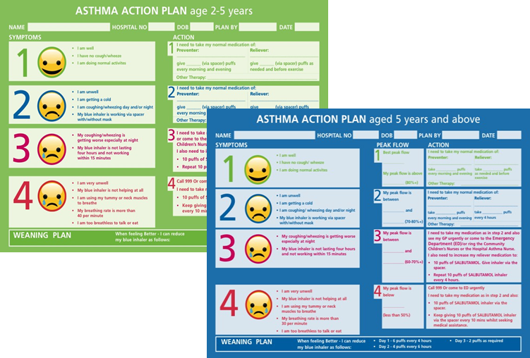

Slide 22
