Slide 1
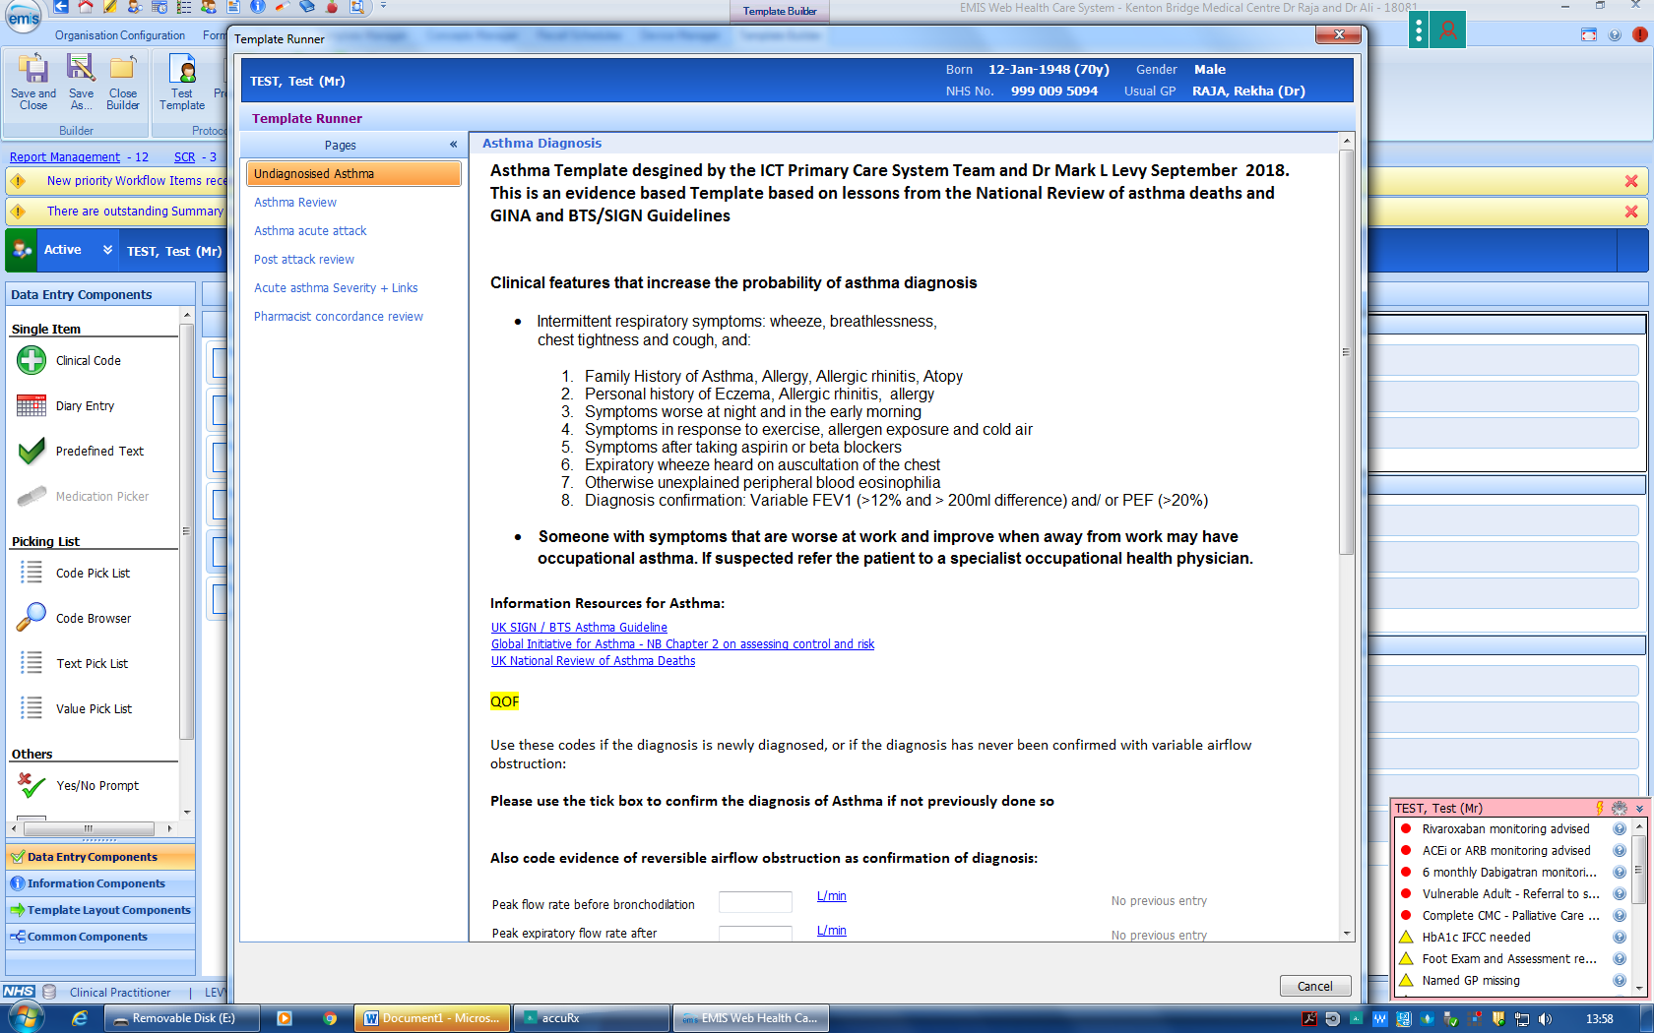
Dr Mark L Levy’s EMIS Asthma Template
This EMIS template has been designed by Dr Mark L Levy – based on lessons from asthma deaths :
The template is divided into 6 sections
Suspected asthma - diagnosing asthma
Routine review
Assessing & treating acute attacks
Post attack review
Defining severity of attacks and some links
Pharmacist concordance review
www.rcplondon.ac.uk/nrad
www.ginasthma.com
BTS/SIGN 153
NICE QS 25

Slide 2
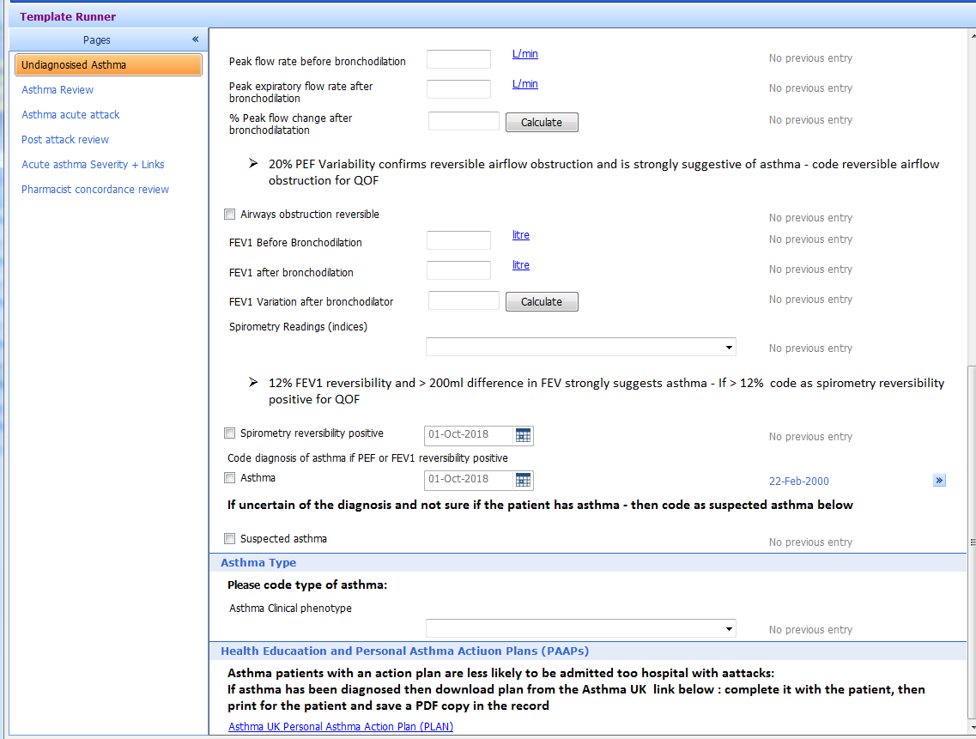
Dr Mark L Levy’s EMIS Asthma Template
The diagnosis tab emphasizes the need to demonstrate evidence of reversible airflow obstruction with either spirometry or Peak Expiratory Flow with guidance on thresholds

Slide 3
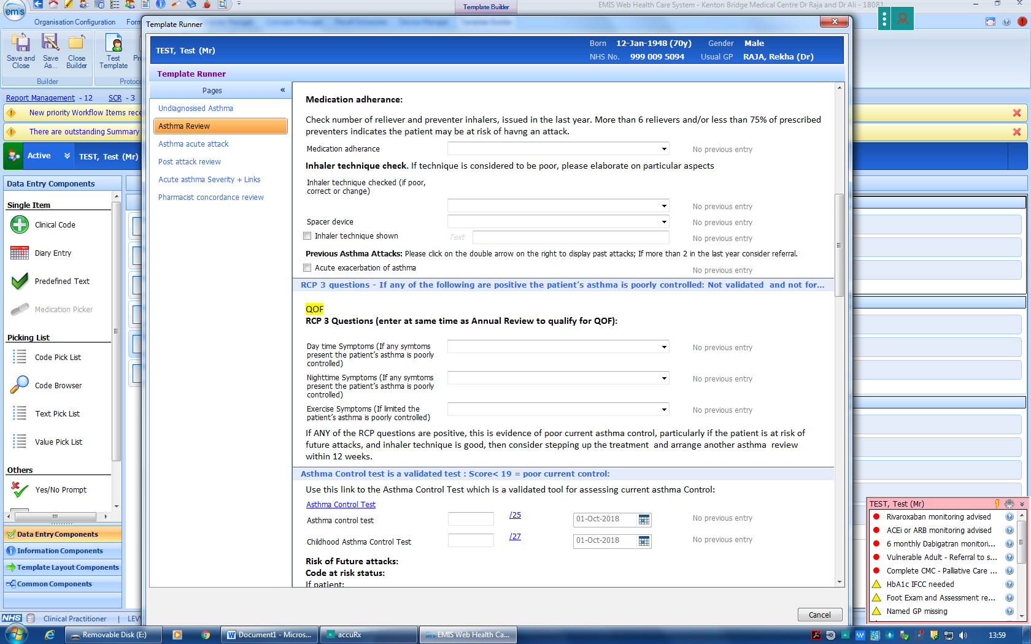
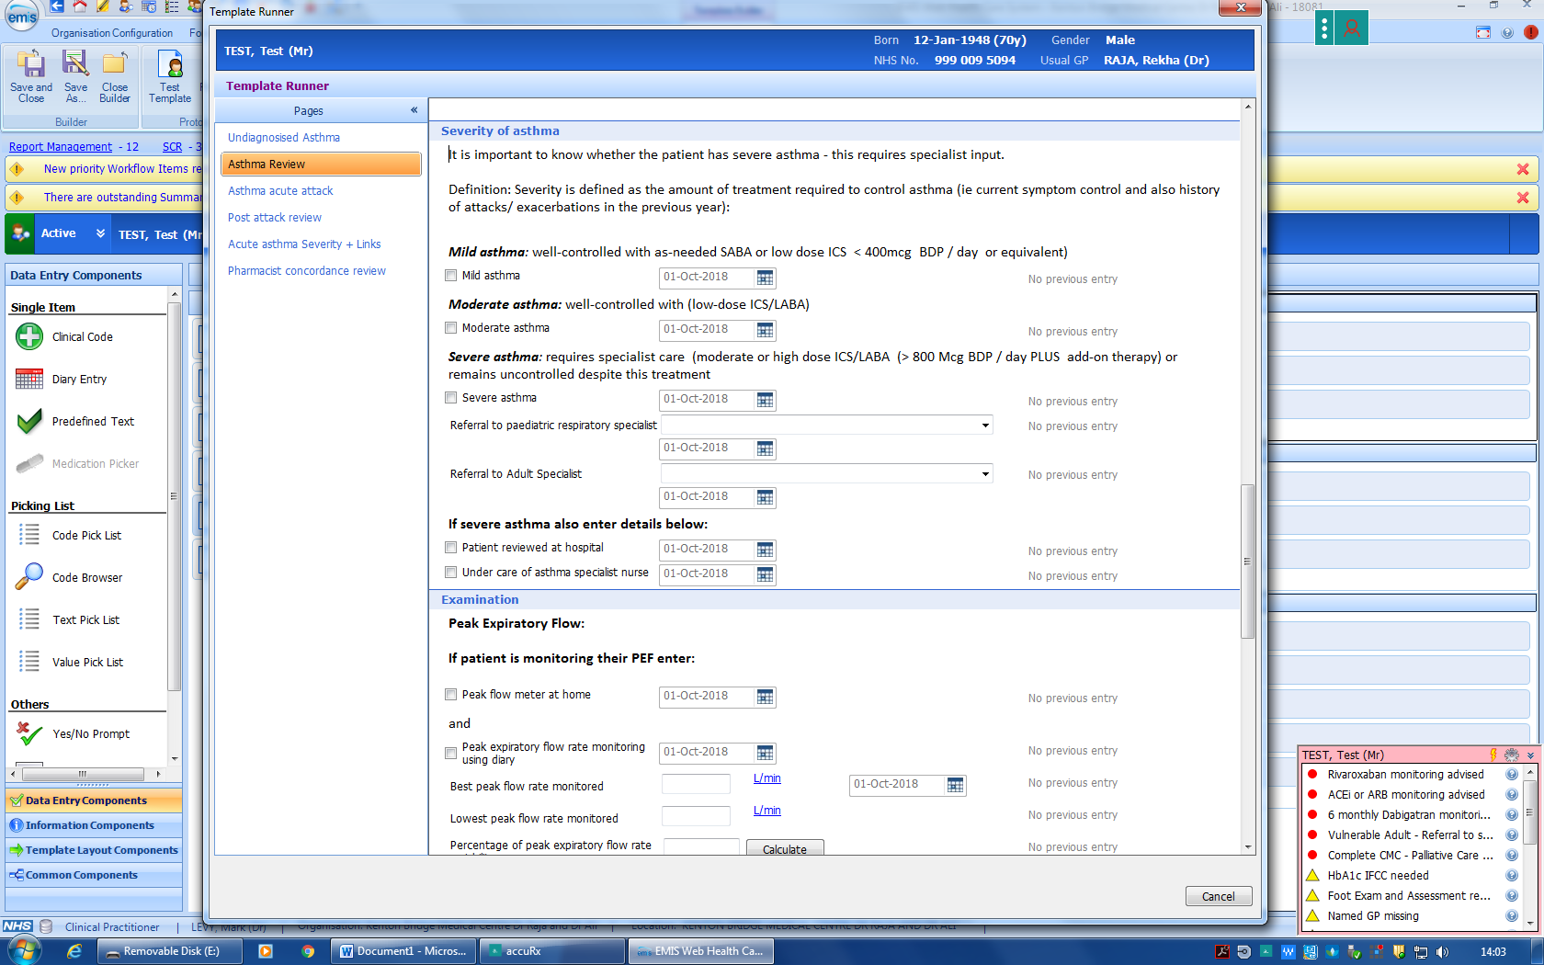
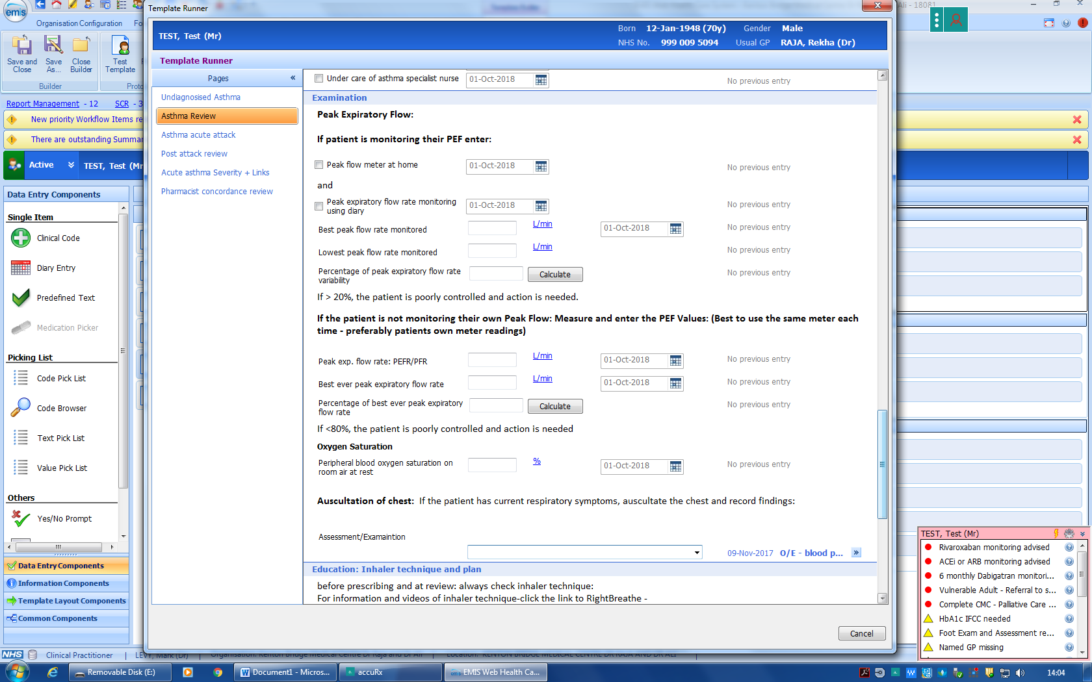
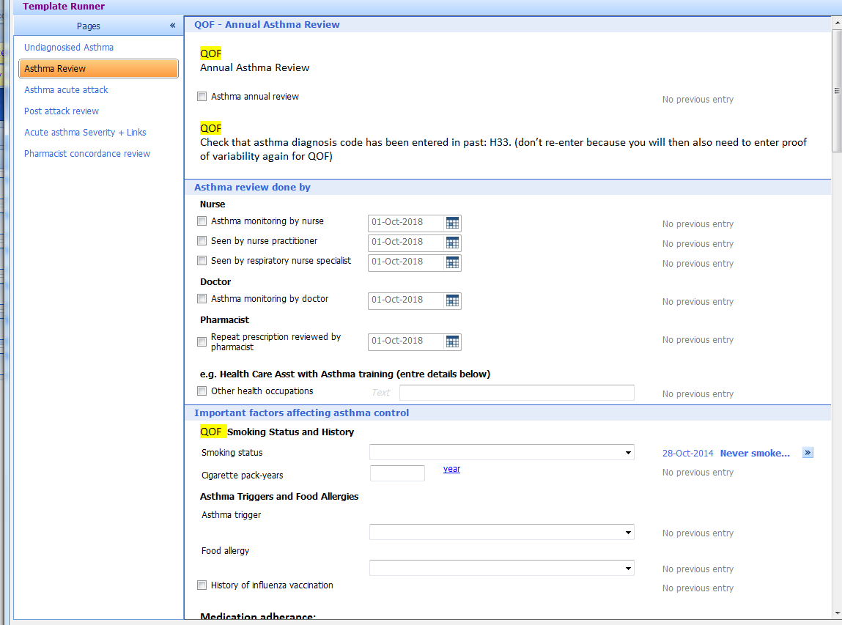
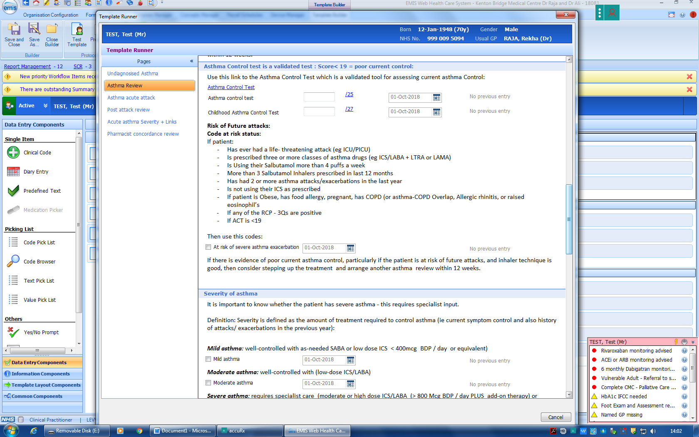
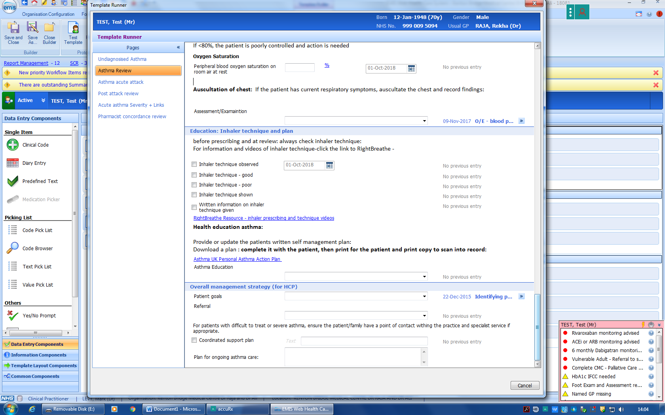
Dr Mark L Levy’s EMIS Asthma Template
The Routine Review tab includes assessment of asthma control, defining severity* inhaler technique, identification of risks, optimizing treatment and setting patient Goals.
Patients with severe asthma must be referred to a severe clinic
The Routine Review is not just a tick box process – this template serves to educate the user as well as to ensure patient safety and improved care

Slide 4
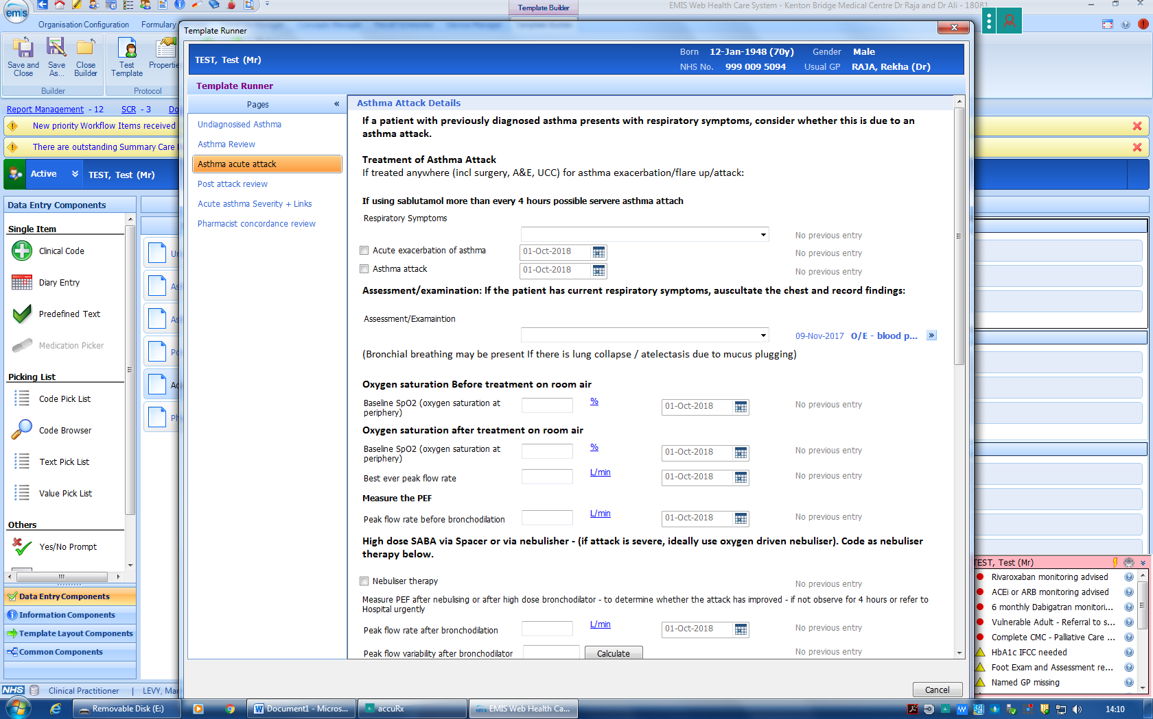
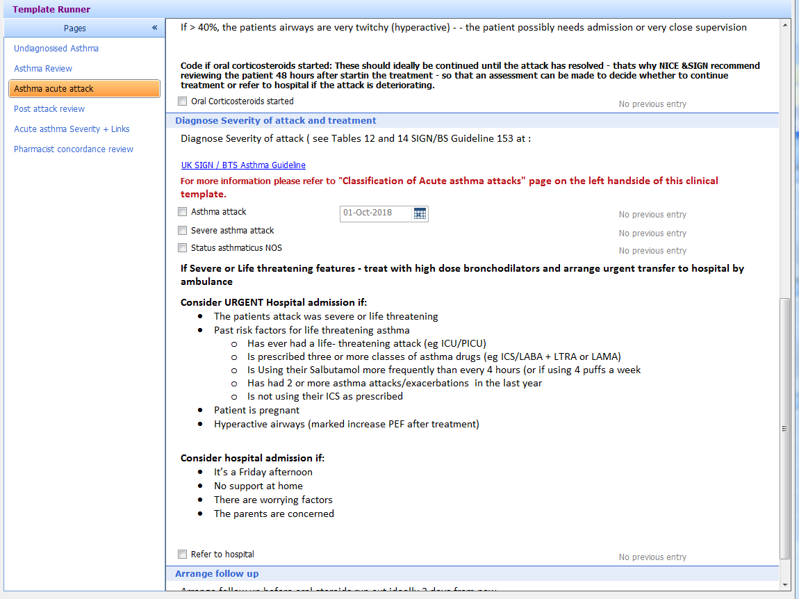
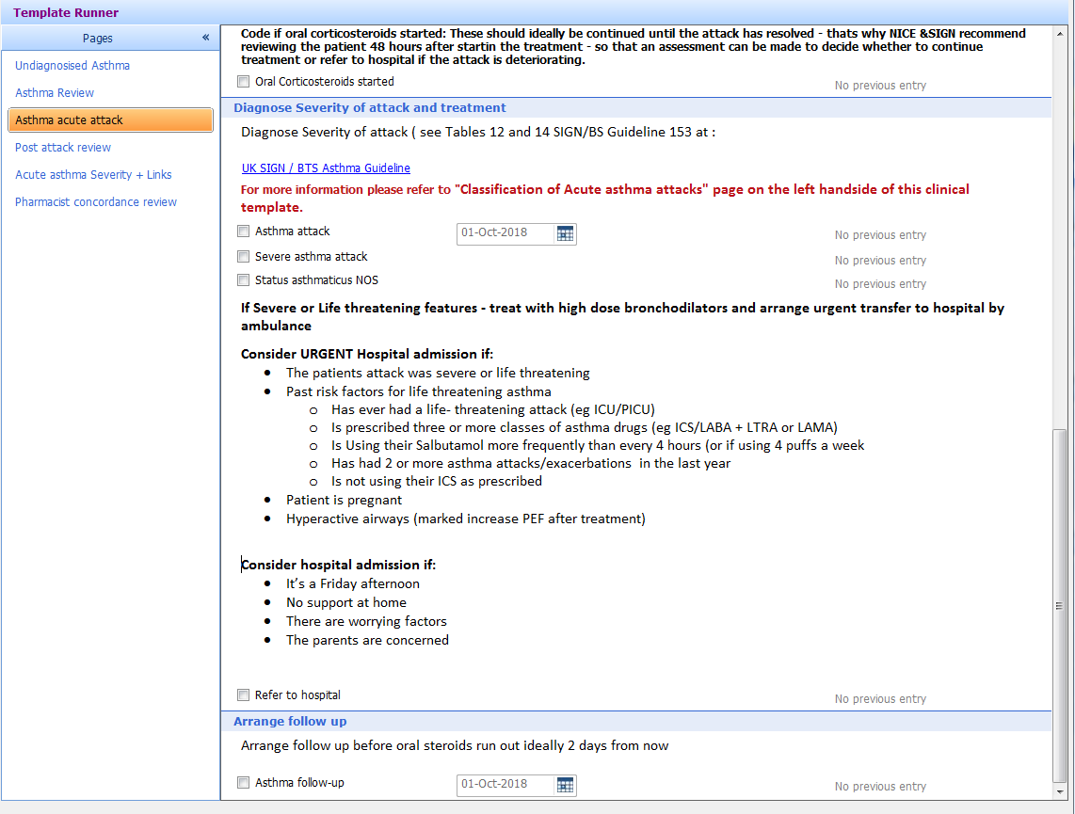
Dr Mark L Levy’s EMIS Asthma Template
The Acute attack tab includes assessment of severity to determine the nature of treatment and also the need for hospital admission.
The TAB with tables defining severity should be referred to when managing an acute attack.
Objective measures post treatment are emphasized so the clinician can decide on the need for transfer to hospital

Slide 5
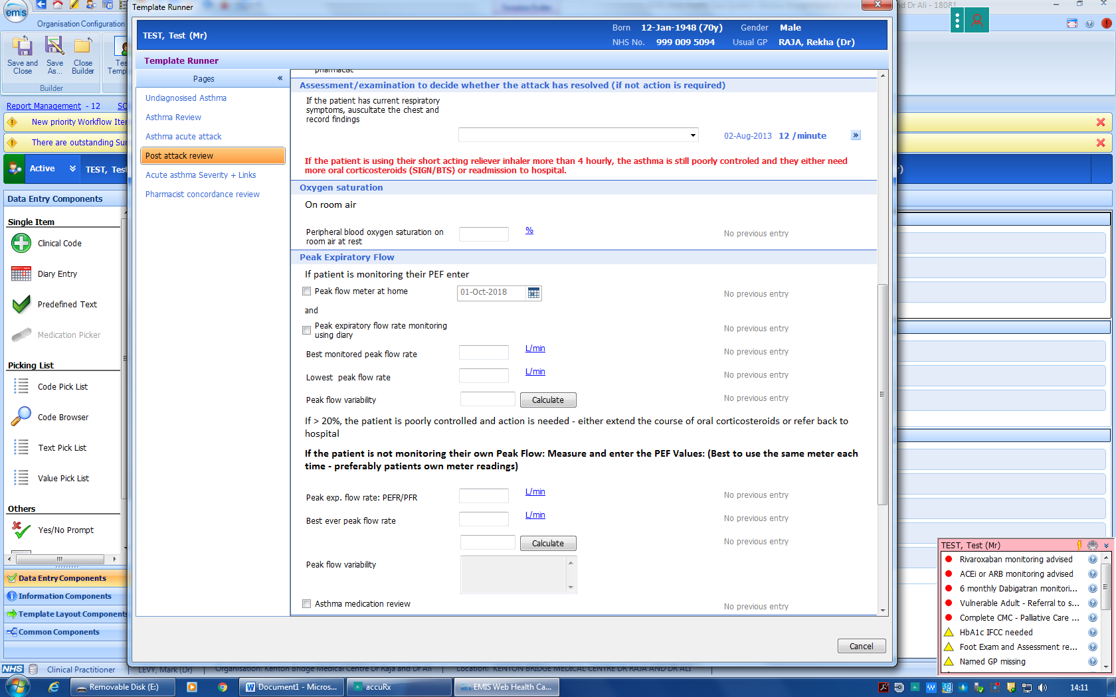
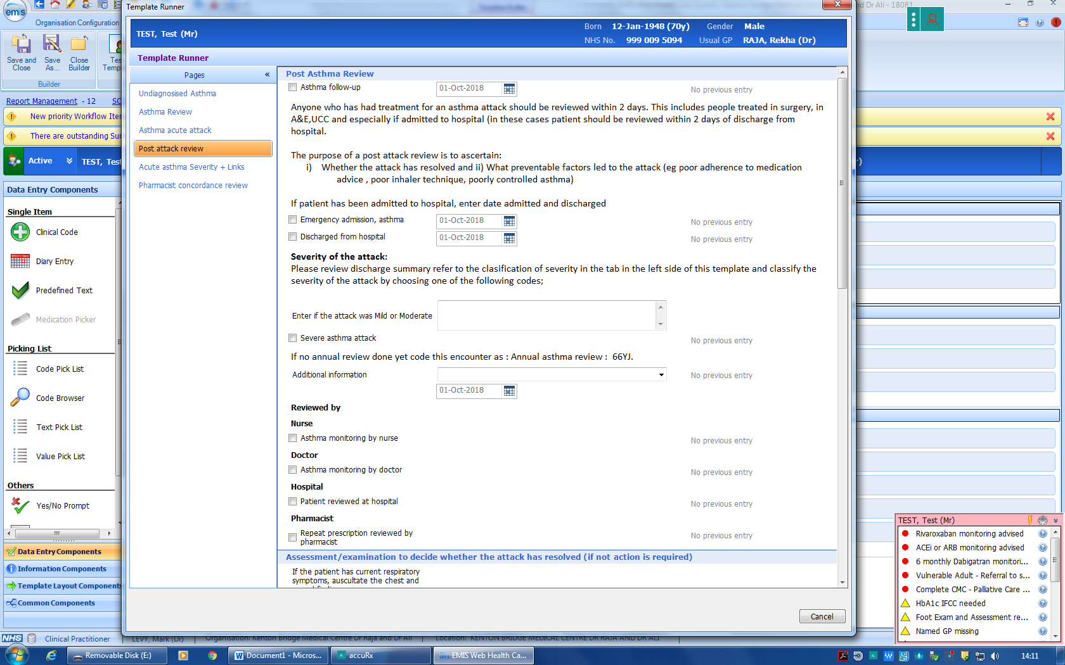
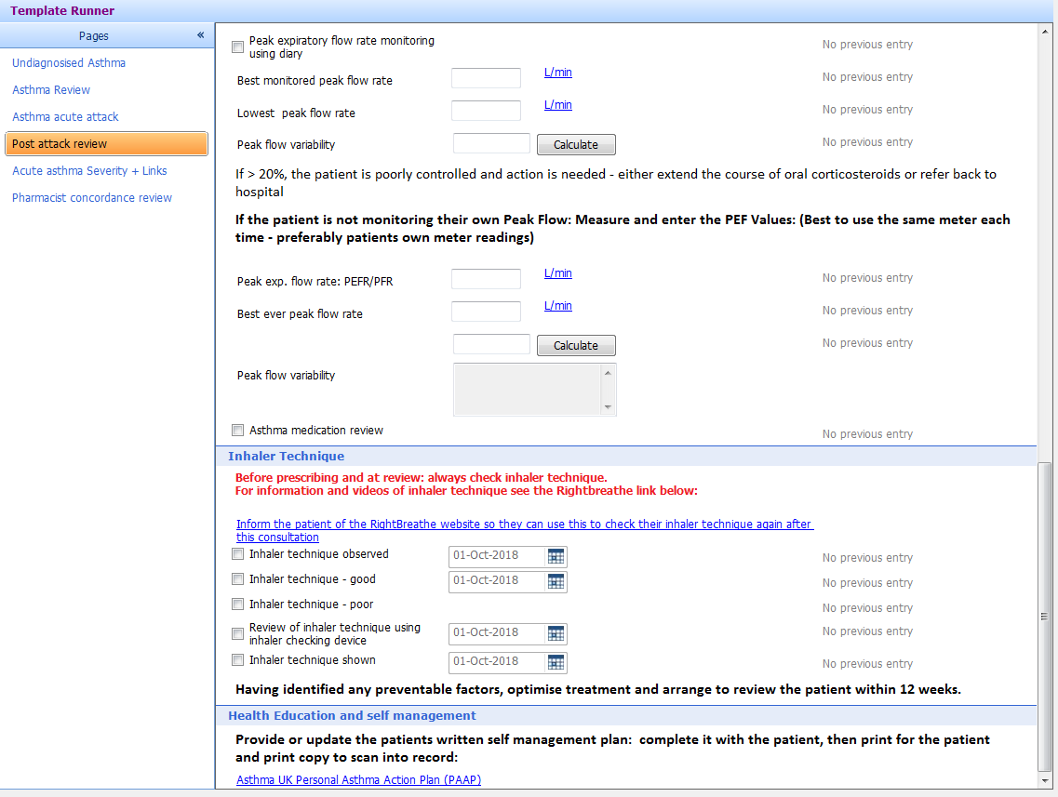
Dr Mark L Levy’s EMIS Asthma Template
The Post attack tab guides the clinician through the process of assessing i) whether the attack is over (and the need for action) and ii) identification of modifiable risk factors to be dealt with. The user could refer to Mark Levy’s Blog at www.endasthmadeaths.wordpress.com for guidance on doing a post attack review.

Slide 6
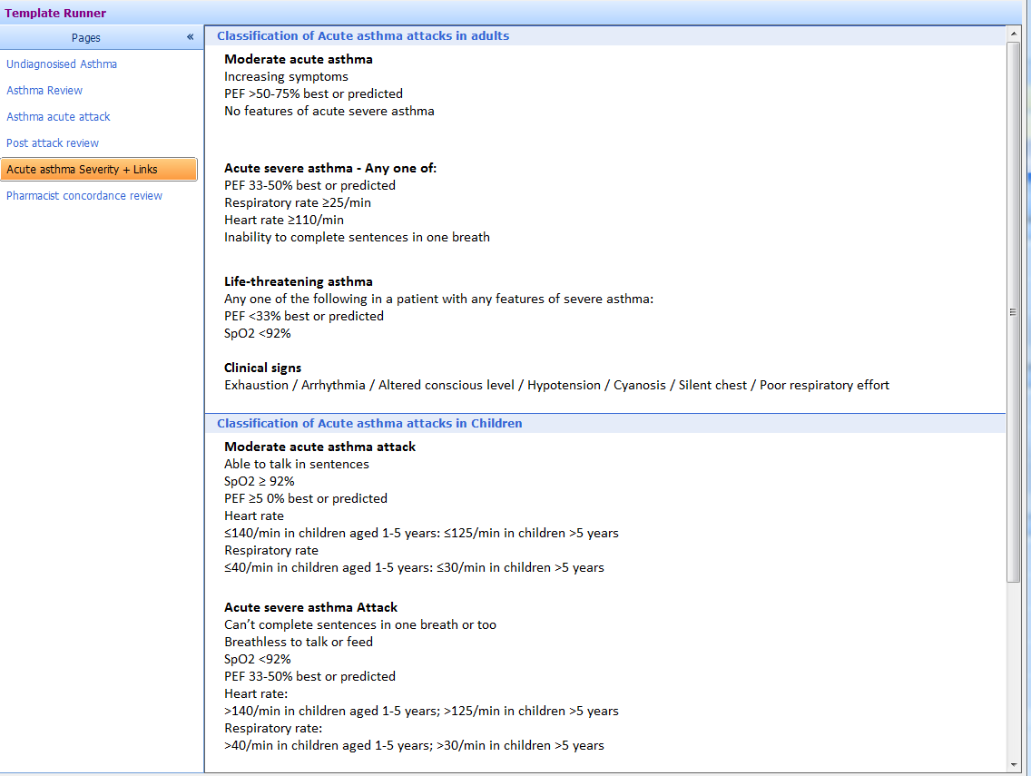
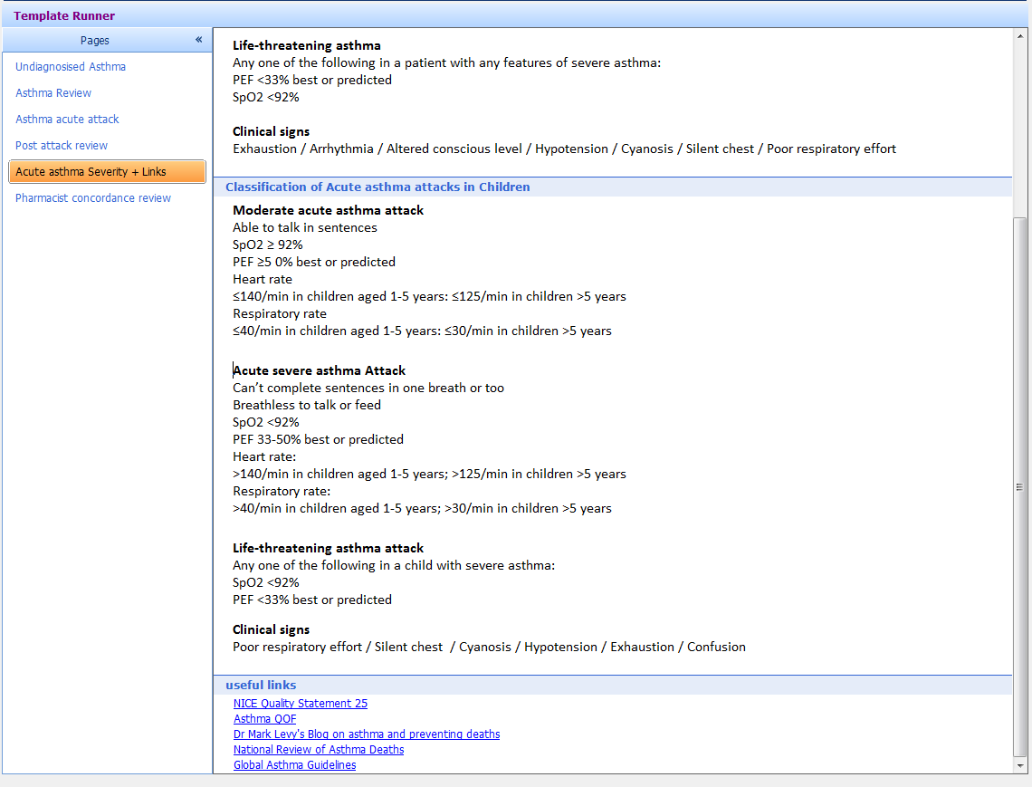
Dr Mark L Levy’s EMIS Asthma Template
The Severity and links tab provides a quick reference to assessment of severity of asthma attacks – Severe attacks should be treated with oxygen driven nebulized salbutamol and referral to hospital
BTS/SIGN 153 Guideline Tables 12 and 14

Slide 7
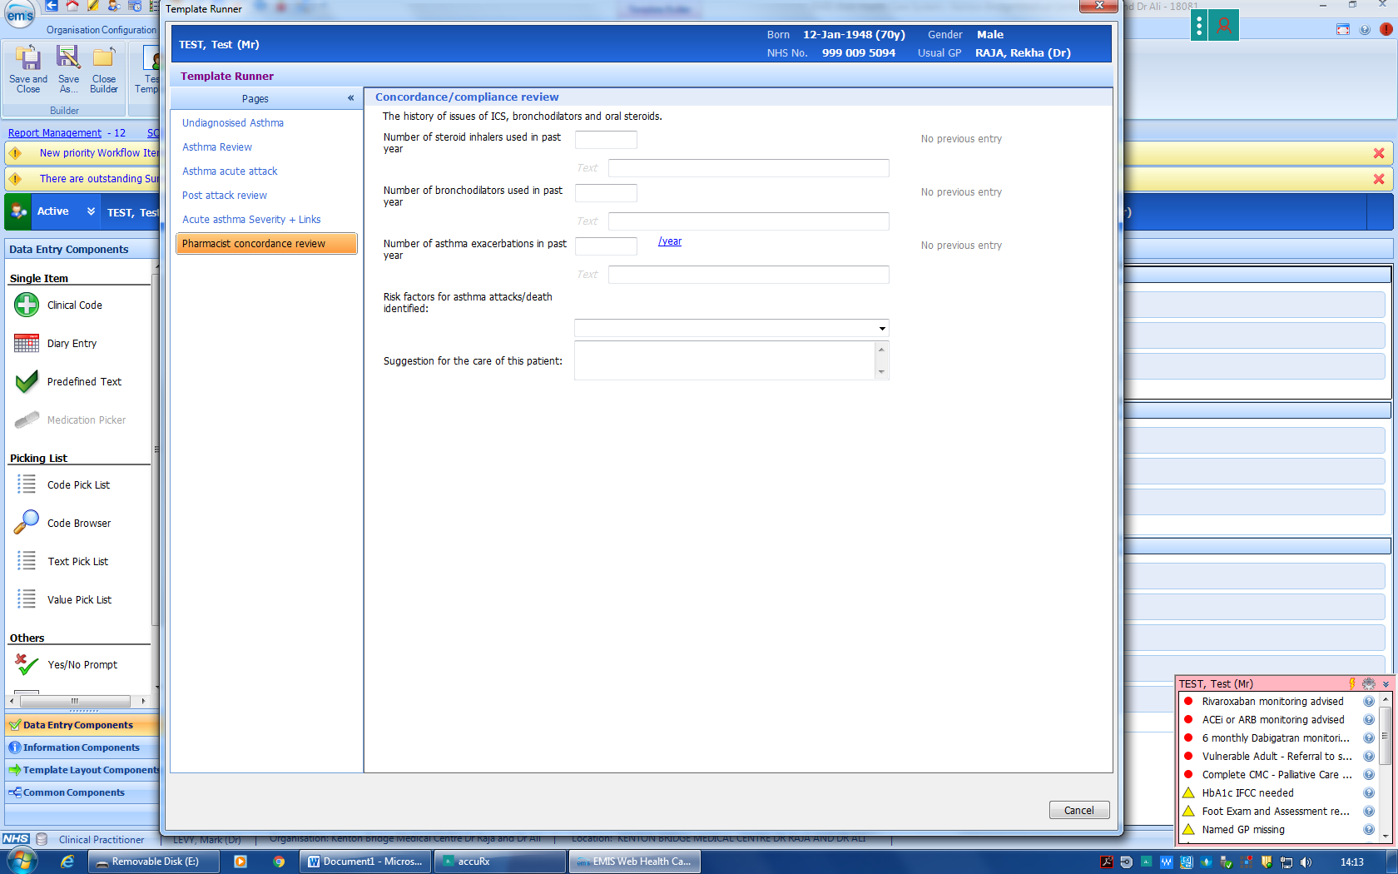
Dr Mark L Levy’s EMIS Asthma Template
The Pharmacist concordance review tab helps the practice pharmacist make recommendations for improved patient
care

