Slide 1
Asthma Friendly Schools
ASSEMBLY FOR SECONDARY karen.rodesano@nhs.net

Slide 2
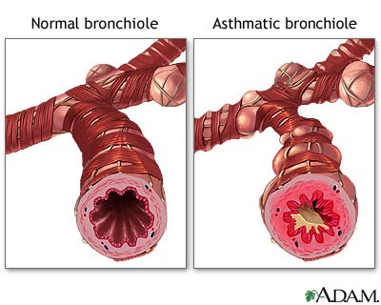
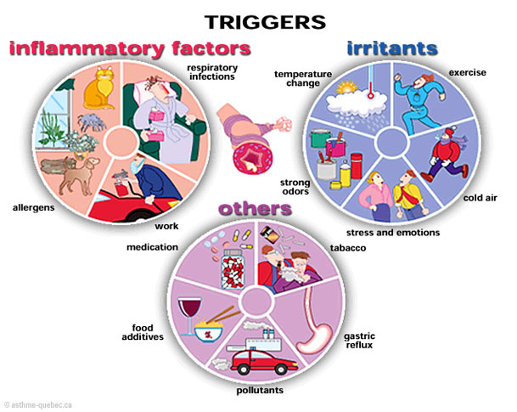
WHAT IS ASTHMA ?

Slide 3
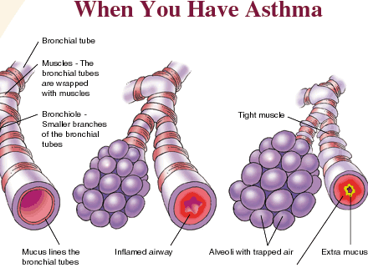
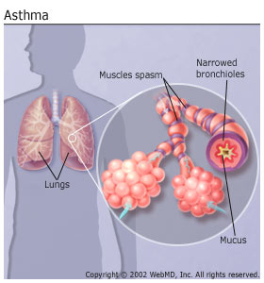
Asthma

Slide 4

ASTHMA
How many children and young people in this school have asthma ?
How many children and young people in the UK have asthma?
How many asthma related child and young people deaths last year ?

Slide 5
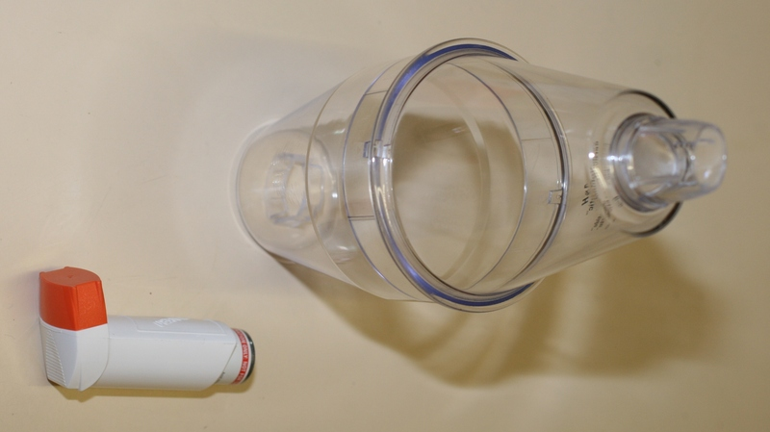
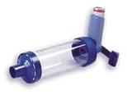
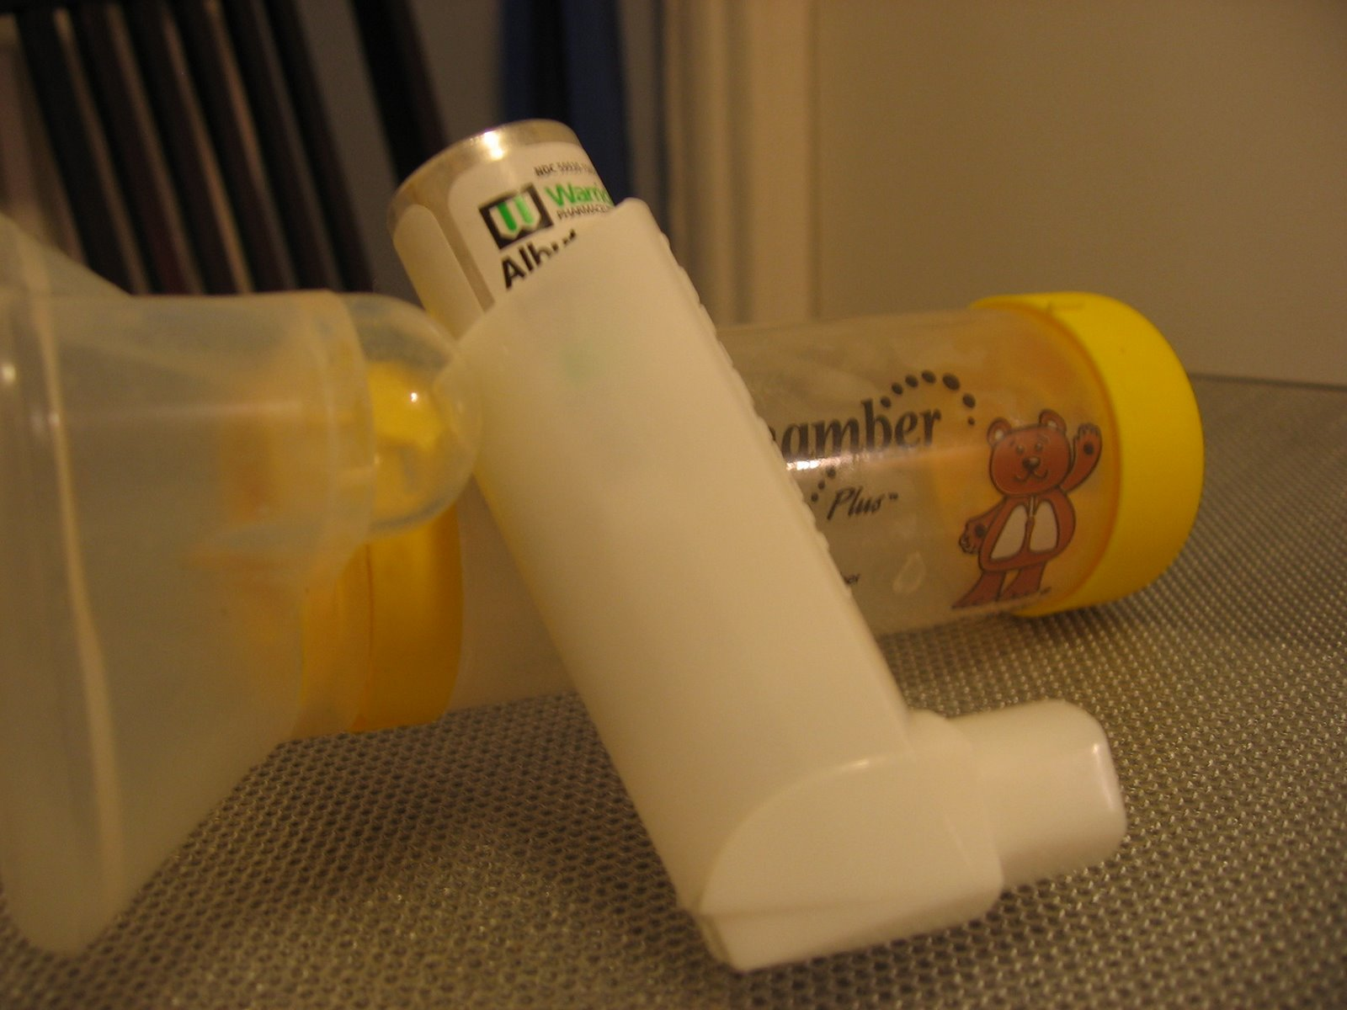
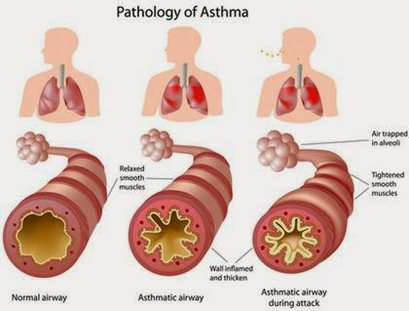

Inhaler and Spacer technique
1. How to use Inhaler and Spacer
2. When to use an preventer.
3. When to use a reliever.

Slide 6
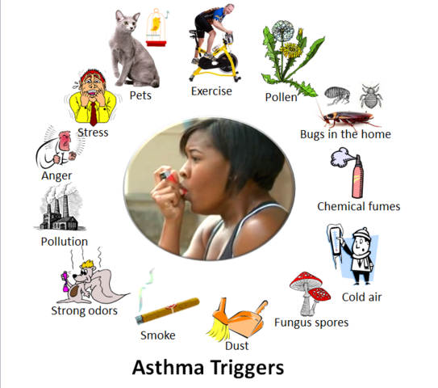
What Happens when you ha
ASTHMA TRIGGERS

Slide 7
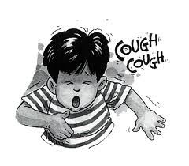
What does it feel like to have an asthma attack?
https://m.youtube.com/watch?v=EK8nzKzdnIM

Slide 8

ANY QUESTIONS ???
ANY QUESTIONS ?

Slide 9
Whittington Health
Magdala Avenue
London
N19 5NF
7272
Tel: 020 3070
Fax: 020 7288 5550
Website: www.whittington.nhs.uk

