Slide 1

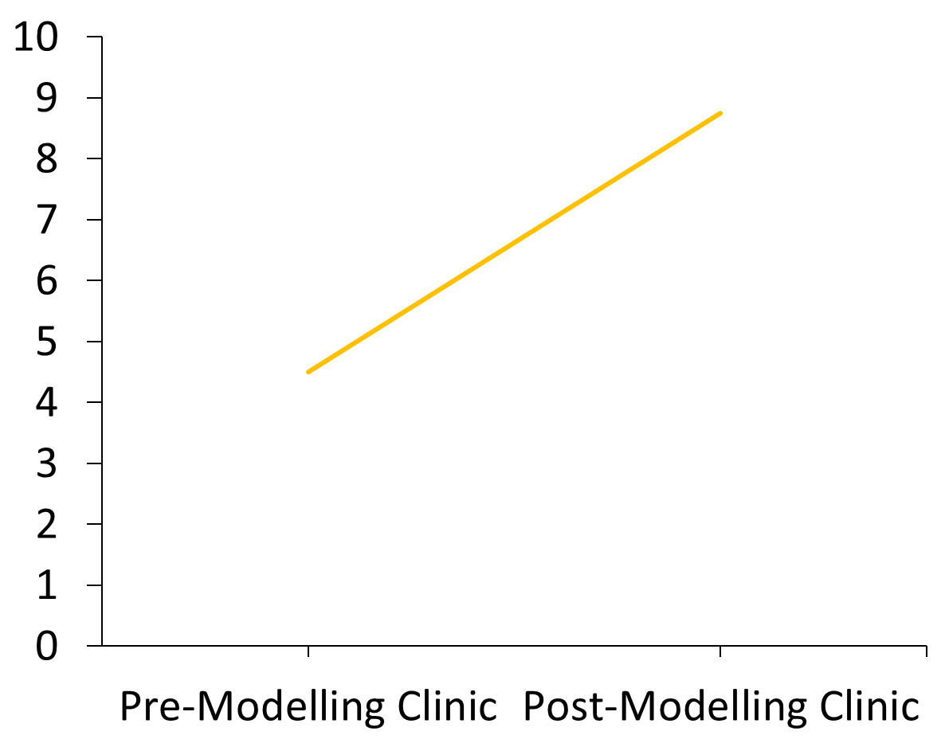
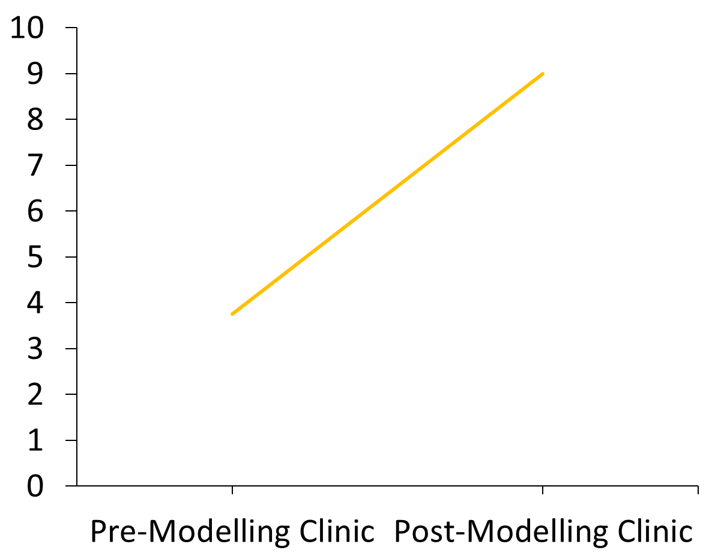
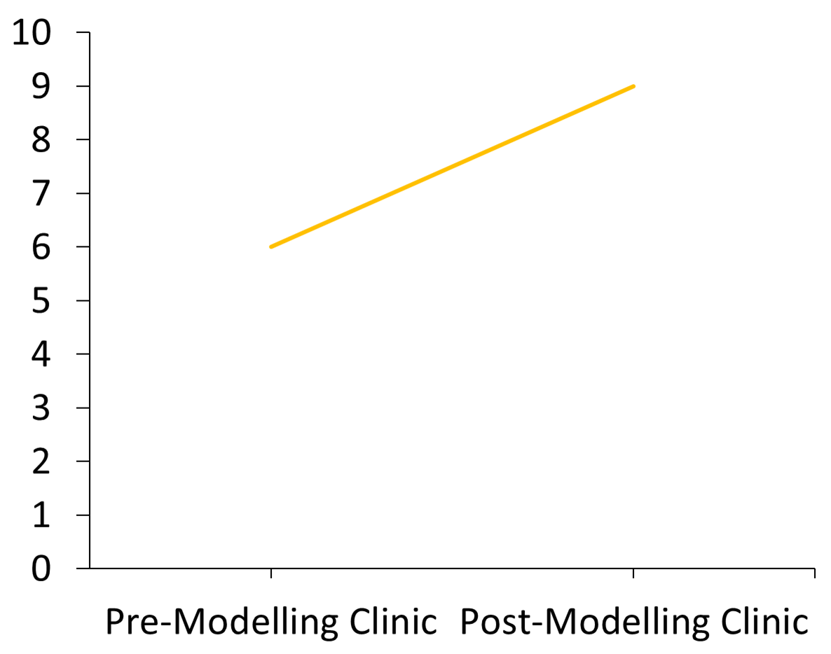
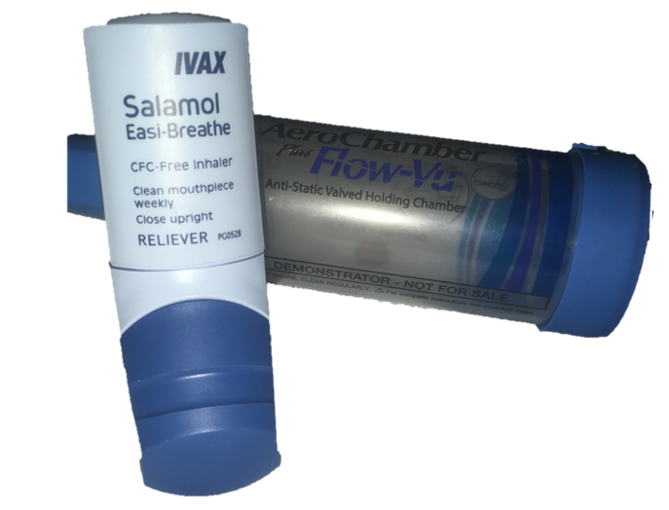
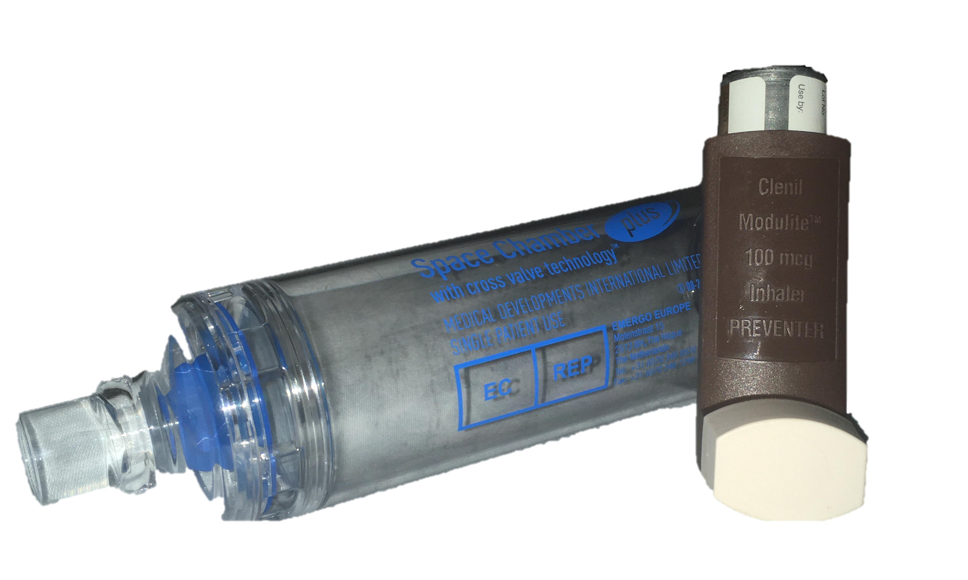
Role Modelling Asthma Clinic Project (Hillingdon): Supporting & Upskilling Practice Nurses in Primary Care
The Hillingdon Hospital NHS Trust – Children’s Asthma Team & Hillingdon Clinical Commissioning Group
Alison Summerfield, RGN,RSCN, BSc Hons, Dip. Asthma, Dip Allergy, NMP; SJ Stock, RGN,RSCN, Dip Asthma, Dip Allergy, NMP; Stevie Strutton, RN – Child BSc Hons, Dip Asthma, Dip Allergy, NMP; Lucy Wallace, RN – Child, Dip Asthma ; Dr Stephen Goldring MB ChB, MD
Background and Implementation
Results and Discussion
Hillingdon Children’s Asthma Team launched it’s Itchy Sneezy Wheezy project in 2017 with an initial focus of moving more Children’s Asthma care into the community. We aimed to develop a more effective integrated pathway alongside up skilling health care professionals through education and support. Our experience of providing Primary Care practitioners with opportunities to attend specialist clinics , delivering bespoke training and courses was harboured through time constraints to release key practitioners.
Aims of the role modelling clinic within individual practices were to enable Primary Care practices to proactively identify children with Asthma or pre-school wheeze and support better self management and prevention of crisis / exacerbation of symptoms.
Four GP Practices in the South of Hillingdon Borough were invited to engage in the Pilot project. Hillingdon Clinical Commissioning Group provided financial support for the pilot project .
Practice Nurse Clinical Qualifications and Experience
Out of four Practice Nurses (PN) :
Two PN had completed Diploma in Asthma Care (2010 & 2014).
One PN had attended Asthma Update Training (AUT) GP meeting in 2018
One PN had attended AUT eight years previously
One PN was currently undertaking Asthma reviews in children over 5 years of age
Three of the PN not generally undertaking Asthma reviews in children under 16 years.
The role modelling clinics ran weekly for 6 weeks led by Paediatric Respiratory Clinical Nurse Specialist (PRCNS) & PN.
Seven appointment slots – 30 minutes per slot.
Weeks one, three and six – Five appointment slots to allow 1 hour MDT with GP, PN, CNS & Paediatric/Nurse Consultant.
Criteria agreed previous to undertake data search in the Primary Care Practice to identify appropriate patients to be reviewed in the Role Modelling clinic.
Appointments | Attendance | Did Not Attend | Cancelled
A&E/Admissions | 29 | 12 | 4
Practice list | 43 | 25 | 10
School Nurse referral | 3 | -
GP referral | 2 | -
Follow up | 2 | -
Consultant referral | 1 | -
Total | 80 | 37 | 16
Table 1: Available appointments (n=133) to patients throughout the project. Numbers in absolute frequency.
Figure 1: Comparison of PN General Confidence Pre- and Post- Modelling Clinic. Values given as mean, average (n=4).
Figure 2: Comparison of Average PN Confidence in using the ACT Tool Pre- and Post- Modelling Clinic. ACT: Asthma Control Test. Values given as mean, (n=4).
Figure 3: Comparison of Average PN Confidence in undertaking a Structured Paediatric Asthma Review Pre- and Post- Modelling Clinic. ACT: Asthma Control Test. Values given as mean, (n=4).
  Practice Nurse Confidence in undertaking a structured Paediatric Asthma review rose from 47.5% to 87.5%
  Furthermore the confidence of the Practice Nurses completing structured reviews in children rose from 60% to 90 %
  Use of the Asthma Control Tool (ACT) by the PN as part of the review rose from 0 to 100%
  PN interpretation of the ACT rose from 32.5% to 90%
  Provision of a Personal Asthma Action plans rose from 25% to 100%
  Child and Parent feedback provided evidence of 97.5% reporting a positive experience . 90% of those attending would recommend the service to friends and family and expressed a preference to future appointments being held within the community setting .
  The primary aim of this pilot project was to support and up skill Practice Nurses to undertake a structured Asthma review in children. The data search with set criteria was undertaken prior to the clinic commencing identifying those children who should be invited for an Asthma review. At the initial clinic during the Multi Disciplinary Team (MDT) meeting, there was an opportunity to undertake a virtual review of some patients identifying, highlighting and discussion around the clinical concerns .
  Each Practice was provided with an Asthma tool kit comprising of Placebo inhaler devices , specific Asthma signposting information, Personal Asthma Action plans and information specific to our Paediatric Asthma Integrated pathway.
  The cancellation and attendance rates were disappointing. It was lower for those children who had been identified from the data search as recent hospital attendance or through our local Asthma Friendly schools programme.
  Through the duration of the role modelling clinics in each practice, the PN ‘s confidence and understanding developed significantly. During the first two weeks the PRCNS led and undertook the structured review with the PN observing. Thereafter the PN with PRCNS providing support prior to and during the structured review took the lead. The structured reviews were purposeful and focused using a Paediatric asthma template which supported the PN in delivering and developing the knowledge base to understand the underpinning reasons . Each PN developed confidence in undertaking a structured Paediatric Asthma review, using and comprehending the benefit of the ACT as part of the review, as well as developing the knowledge base to assess and perfect inhaler technique or make changes to inappropriate inhaler devices.
Impact and Future Development
This pilot project in Hillingdon has been part of a wider project focusing on Paediatric Asthma . It is a building block that has the potential to enable more Children’s Asthma services to be co delivered in the community/neighbourhoods in primary care networks with support from the specialist nurse team.
The role modelling clinics enabled a change in practice, enhanced the quality of the structured asthma reviews for those children and families seen optimising their asthma care through supporting and upskilling the PCN. The ambition is to roll out the programme in 2019/20 – 2020/2021 in order to achieve coverage across all practices within the Borough of Hillingdon. .

