Slide 1
Promoting Flu Vaccination in Asthma Population
Christine Ogundele
Immunisation Specialist Nurse

Slide 2
Flu Vaccinations
Plan for today
Brief overview of Flu as a disease
The importance and effectiveness of Flu vaccination
How to encourage Asthma population to Consent and access the vaccine.
Changes to the way it’s delivered this year due to COVID
Answer any questions you have about flu and vaccinations

Slide 3
Just the Flu – Basic Overview
In an average year the flu virus kills 11,000 people and hospitalises many thousands more.
Flu is a viral infection that mainly affects the lungs and can cause:
  A high temperature (fever)
  Dry cough
  Aching muscles and joints
  Headache and sore throat
More severe than a common cold, many people have to remain in bed for a few days to recover
Flu will often get better on its own, but it can make some people seriously ill. It's important to get the flu vaccine if you're advised to.

Slide 4
Just the Flu….
The over 65 year olds or in a clinical ‘at risk’ group are more susceptible to complications from flu infection which includes:
  Bacterial chest infection, which can develop into pneumonia
  Middle ear infection (otitis media)
  Septic shock (a severe and life-threatening infection of the whole body)
  Meningitis (inflammation of the covering of the brain)
  Encephalitis (inflammation of the brain)
Very young children are also susceptible to complications
Children from 2 years old to 12 years old are less susceptible to complications from flu but can easily pass on the virus to elderly or more vulnerable members of their families – they are “Super Spreaders”

Slide 5
Who is eligible for the flu jab
60,000 Islington residents are eligible for flu vaccine in 2020/21
people aged 65 years or over
household contacts of those on the NHS Shielded Patient List,
people living in long-stay residential care homes or other long-stay care facilities
those who are in receipt of a carer’s allowance
health and social care staff who are directly involved in the care of vulnerable patients (including care homes, hospice and those employed through Direct Payments (personal budgets) and/or Personal Health Budgets)
all children aged two to eleven
all pregnant women
those aged from six months to less than 65 years of age, in a clinical risk group

Slide 6
At-Risk” Groups
.Chronic respiratory disease, including asthma
- Asthma that requires continuous or repeated use of inhaled or systemic steroids or with previous exacerbations requiring hospital admission.
-Children who have previously been admitted to hospital for lower respiratory tract disease.
Chronic heart, renal, liver and neurological diseases
Asplenia and splenic dysfunction
Learning disability
Diabetes
Immunosuppression
Elderly*
Morbid obesity BMI>= 40
Pregnancy
People in long stay facilities
Children*
ALSO OFFERED TO
Carers – health, social and home carers
Residential contacts of shielded and immunosuppressed individuals

Slide 7
Contraindications to live attenuated influenza vaccine – Severe Asthma
.Children with asthma on inhaled corticosteroids may be given LAIV, irrespective of the dose prescribed
.Not recommended for those currently experiencing an acute exacerbation including
-those who have had increased wheezing and/or
-needed additional bronchodilator treatment in the previous 72 hours
-(offer a suitable inactivated influenza vaccine to avoid a delay in protection)
.Children who require regular oral steroids for maintenance of asthma control , or have previously required intensive care for asthma exacerbation should only be given LAIV on the advice of their specialist

Slide 8
How to encourage Asthma population to consent
Importance of Getting Flu vaccination in the current Climate:
People who are susceptible to flu are also those who are most vulnerable to complications from COVID
People infected with both flu and COVID are more than twice as likely to die as someone with COVID alone
There is some crossover of common symptoms (cough and fever) and so getting the vaccine means less chance of having to self isolate with symptoms that are not due to COVID
The flu vaccine has been administered regularly in the UK since 2000 and is given safely to around 17 million people each year

Slide 9
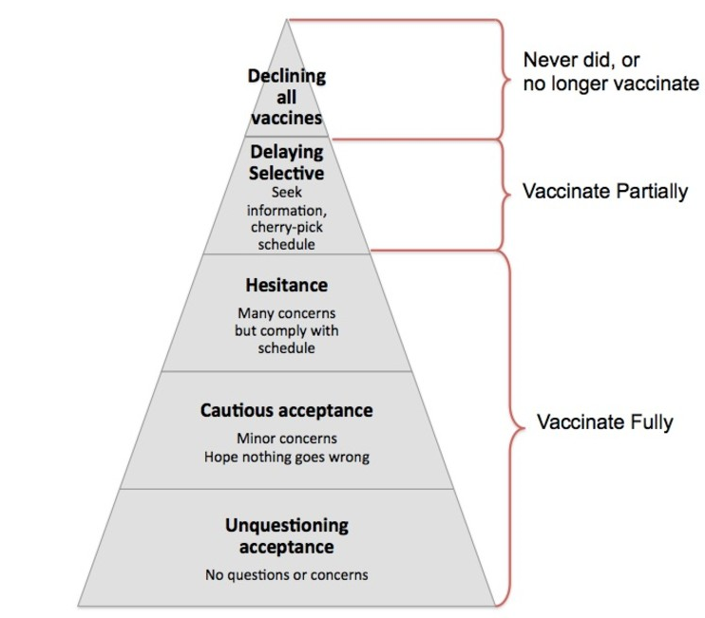
Parents have differing needs for information based on their position on immunisation - even fully vaccinating parents have questions and concerns
Parents have differing needs for information based on their position on immunisation - even fully vaccinating parents have questions and concerns
c.2%
Most parents discuss imms with health professional
(Most discussions with HV)
Trust advice from health professionals
Some parents feel they need more information
Limited evidence on ways to successfully address vaccine refusal.
But for parents with questions and concerns the opportunity to discuss them with a well informed health care professionals can be pivotal in their decision making
Well informed confident and competent health care professionals are an important asset to maintain public confidence in vaccines
Ref: Adapted from Leask et al 2012.

Slide 10
How to improve Flu uptake in Asthma population
Cleaned practice list/ Up to date Clinic list
Accurate recording of imms given
Proactive reminders with call - recall system
Personalised appointments with information about vaccines
Family-friendly clinics
Trained staff with time to answer parents questions
Building Trust is pivotal

Slide 11
Children’s nasal spray flu vaccine
If parents refuse the nasal spray vaccine on religious grounds, then they should be directed to have a conversation with the school age vaccine provider (School Nurse or Vaccination UK) who will discuss alternatives in the context of trying to allay any fears they have over the nasal spray
If parents decline the nasal spray, they can request an alternative, injectable vaccine that will be given in a catch up clinic (not on school property)
This vaccine will only be available in Nov/Dec and subject to stock availability
Does the flu jab have side-effects
Mild side effects such as soreness around the injection site and aching muscles are common, but these are far less serious than the effects of contracting flu
Only one in a million people get serious side effects from the flu vaccine

Slide 12
What is being done differently this year?

Slide 13
GP Surgeries
All GPs are working to strict infection control procedures to minimise the risk of COVID infection
GPs are only offering booked appointments for flu jabs and all other childhood vaccinations to ensure they are able to maintain social distancing in the waiting room
There will be a ‘one way’ route through the practice with a separate entrance and exit
Staff will wear a surgical mask and sanitise their hands and work space prior to each vaccination
All patients must wear a face covering whilst in the premises (unless they have a valid reason not to)

Slide 14

Flu vaccination promotion is everyone’s business…
GPs
Asthma Specialist Nurses
Practice Nurses
Practice Managers
Health Visiting Teams
School Nursing Teams
Looked After Children’s Team
Safeguarding Teams
Children's centre
Social Workers
Child Health Team

Slide 15

Any Questions?

