Slide 1







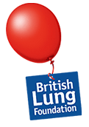
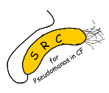







Preschool Wheeze
Andrew Bush MD FHEA FRCP FRCPCH FERS FAPSR ATSF
Imperial College & Royal Brompton Hospital
a.bush@imperial.ac.uk

Slide 2
Conflict of Interest
No COIs, financial or otherwise

Slide 3
Aims of the Presentation
I will first discuss which children with pre-school wheeze should not be given treatment
I will show that asking ‘at what age can we diagnose asthma?’ is a question with no meaning
I will describe options for those who need medications, and how we are starting to personalise therapy in a practical way
I will demonstrate how to look beyond the prescription pad to other treatment approaches

Slide 4
Treating preschool wheeze
When not to treat! Is the child normal?
Can we diagnose ‘asthma’, and what does it mean for treatment?
How do we define future risk, and future risk of what?
Can we prevent at least some future risk: lessons from pathophysiology
Summary and Conclusions

Slide 5
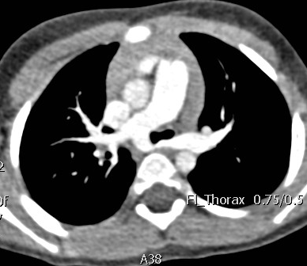
Five groups of Coughs and Wheezes...
Normal child (hardest diagnosis)
Serious illness - eg CF, TB (rare, but must get right)
An ‘asthma syndrome’
Minor problems (rhinitis, reflux) which mimic or exacerbate wheezing syndromes
Overanxious (often first-time) parents

Slide 6
All that wheezes is not asthma!
Take a good history, and carry out a detailed physical examination
Isolated chronic dry cough is rarely if ever due to ‘asthma’
Cough variant asthma is over-diagnosed and over-treated
Targeted investigations
Many need none
Selective approach in those who are tested

Slide 7
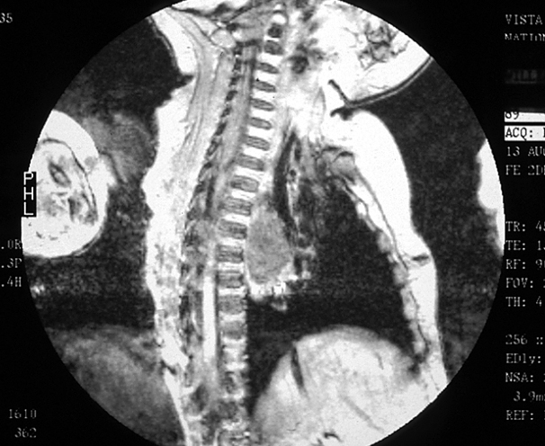

Slide 8
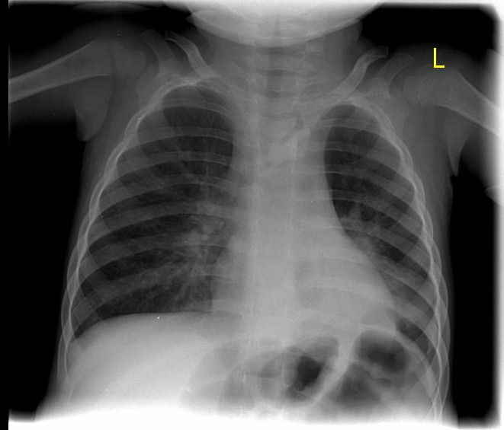
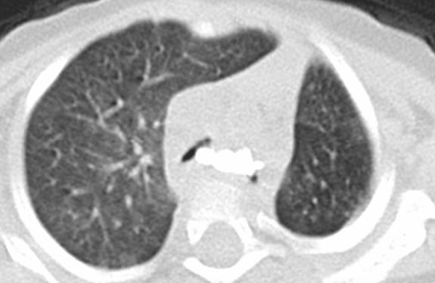
What caused the Symptoms?
15/12 old girl with 4 months of cough intermittently
Admitted centrally cyanosed on one occasion, never ventilated
Poor response to therapy
CXR, CT scan, bronchoscopy:

Slide 9
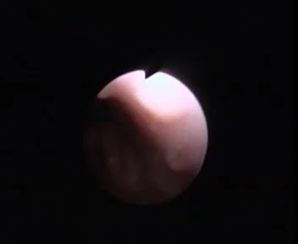

Slide 11
What caused the Symptoms? Foreign Body
Very sudden onset of symptoms
Ask specifically about the possibility of choking or aspiration
Listen for abnormal signs – asymetric, fixed monophonic wheeze; Signs MAY be bilateral, or absent
CXR may be normal
Bronchoscope on history alone
World Record – 25 years delay?

Slide 12
Normal Childhood Respiratory Symptoms
‘Normal’ Cough
Nursery School Syndrome
Post-viral/bronchiolitic cough
Viral colds: 10% children have >10/year, may have symptoms >2 weeks
Acute otitis media: many children have >3/year
Pertussis and its relatives
Usually 1st Child
Early placement in child care facility
Repeated viral infections, one viral cold merging into another
No response to antibiotics, bronchodilators, ICS, etc.
BMJ. 2013 Dec 11;347:f7027. doi: 10.1136/bmj.f7027.

Slide 13
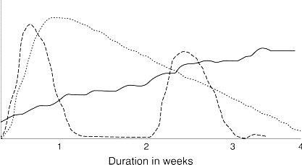
Points in the History
Is it really wheeze?
Upper airway symptoms prominent?
Symptoms from day one of life
Sudden onset symptoms
Chronic moist cough and sputum – reliable!
Worse after meals, irritable feeder, arches back, vomits
Chokes when drinking
Systemic illness or immunodeficiency
Continuous, unremitting symptoms

Slide 14
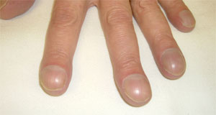
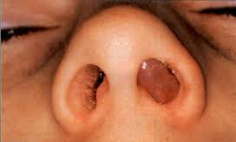

Physical Examination
Clubbing, weight loss, failure to thrive
Upper airway disease – tonsils, rhinitis, NASAL POLYPS
Unusually severe chest deformity
Fixed monophonic wheeze, stridor, asymmetrical signs
Signs of cardiac or systemic disease

Slide 15
Treating preschool wheeze
When not to treat! Is the child normal?
Can we diagnose ‘asthma’, and what does it mean for treatment?
How do we define future risk, and future risk of what?
Can we prevent at least some future risk: lessons from pathophysiology
Summary and Conclusions

Slide 16

What IS this thing called asthma?
Airway inflammation?
Variable airflow obstruction?
Bronchial hyper-responsiveness?
A Dr said so?
I once got an inhaler?
Or what?
Anaemia= low haemoglobin
Arthritis = hot red painful joints
Asthma = Wheeze, dyspnoea, chest tightness + cough

Slide 17
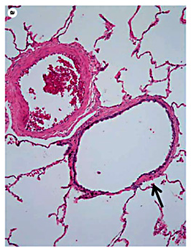

Deconstructing the airway
Fixed and variable airflow obstruction
Bronchoconstriction
Airway anatomical instability – guy ropes
Intraluminal mucus
Airway inflammation
Present or not, cell type
Beneficial or not?
PATHWAYS!
Airway infection and impaired host defences
Treatable Trait-1
Is there bronchodilator responsiveness?
If so, prescribe β-2 agonists
Treatable Trait-2
Is there airway eosinophilia?
If so, prescribe ICS
Treatable Trait-3
Is there airway infection?
If so, prescribe antibiotics

Slide 18
Symptom Patterns
Episodic (viral) wheeze
Wheeze in association with (usually) clinically diagnosed viral URTI
NOT the same as transient wheeze!
NO eosinophilic inflammation – ICS????
Multi-trigger wheeze
Wheeze both with viral URTI and with other triggers between URTIs
NOT the same as persistent wheeze!
Eosinophilia and remodelling – ICS in some?!

Slide 19
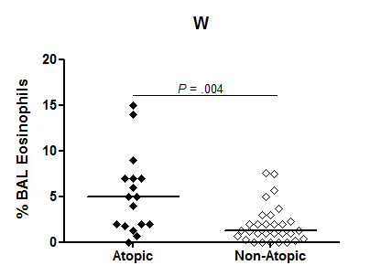
Airway eosinophilia does not relate to clinical wheeze phenotype, but is present in atopic wheezers
Clinical phenotype
Wheeze
P=0.43
JACI 2019; 143: 1607-1610

Slide 20
Indications for Treatment
Prevention of disease progression
(anti-histamines)
Intermittent ICS
Continuous ICS
Treatment of symptoms
LTRAs
Inhaled corticosteroids
The A-word - antibiotics
Oral Corticosteroids

Slide 21
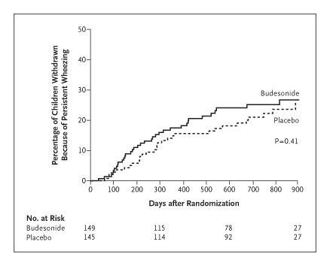
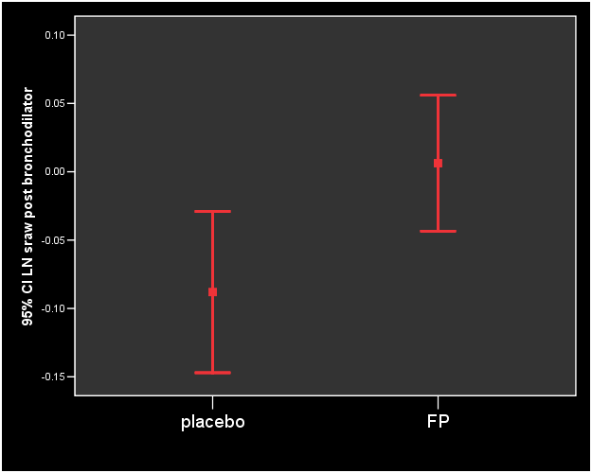
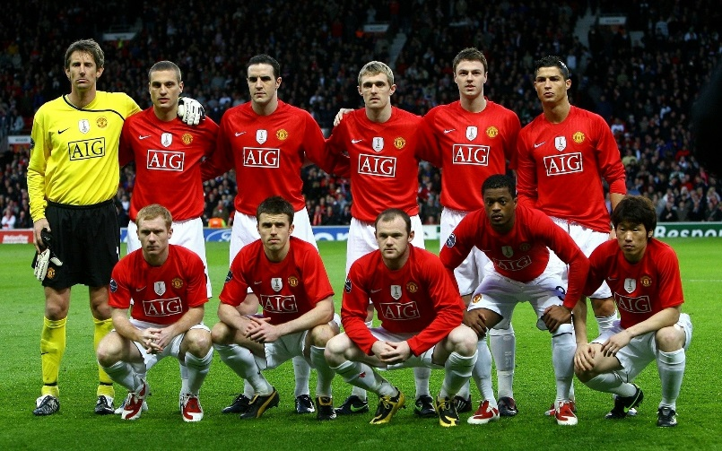
ICS not disease modifying
PEAK, IFWIN:
Continuous ICS
are not disease
modifying
NEJM 2006; 354: 1985-7
Lancet 2006;368:754-62
COPSAC:
Nor are intermittent ICS
NEJM 2006; 354: 1998-2005
No free lunch either? IFWIN

Slide 22
Role of ICS?
Continuous inhaled BUD failed to prevent wheeze in pre-school children (n=40, ADC 1995; 72: 317-20)
USA: intermittent ML and intermittent neb BUD better than standard (n=238, JACI 2008;122: 1127-35)
USA: intermittent FP 1.5 mg/day reduced pred requirement (n=129, NEJM 2009; 360: 339-53)
USA: neb BUD intermittent and continuous equally (in)effective (n=278, NEJM 2011; 365: 1990-2001)

Slide 23
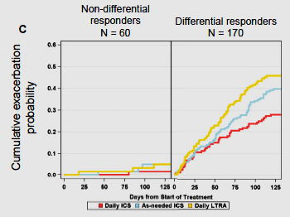
INFANT
Many got
better!!
N=300 children age 12-59/12 at step 2, 18 USA sites
Daily ICS vs. daily LTRA vs. prn ICS/albuterol, three way crossover, blinded
Composite outcome of asthma control days and time to attack requiring OCS
Aeroallergen sensitization, gender and wheeze attacks pre-specified predictors, not blood eosinophil count

Slide 24
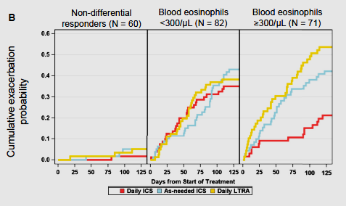
INFANT
Post-hoc blood eosinophil analysis
Post-hoc blood eosinophil and aeroallergen combined
JACI 2016; 138: 1608-18

Slide 25
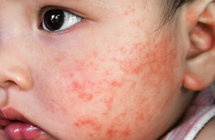
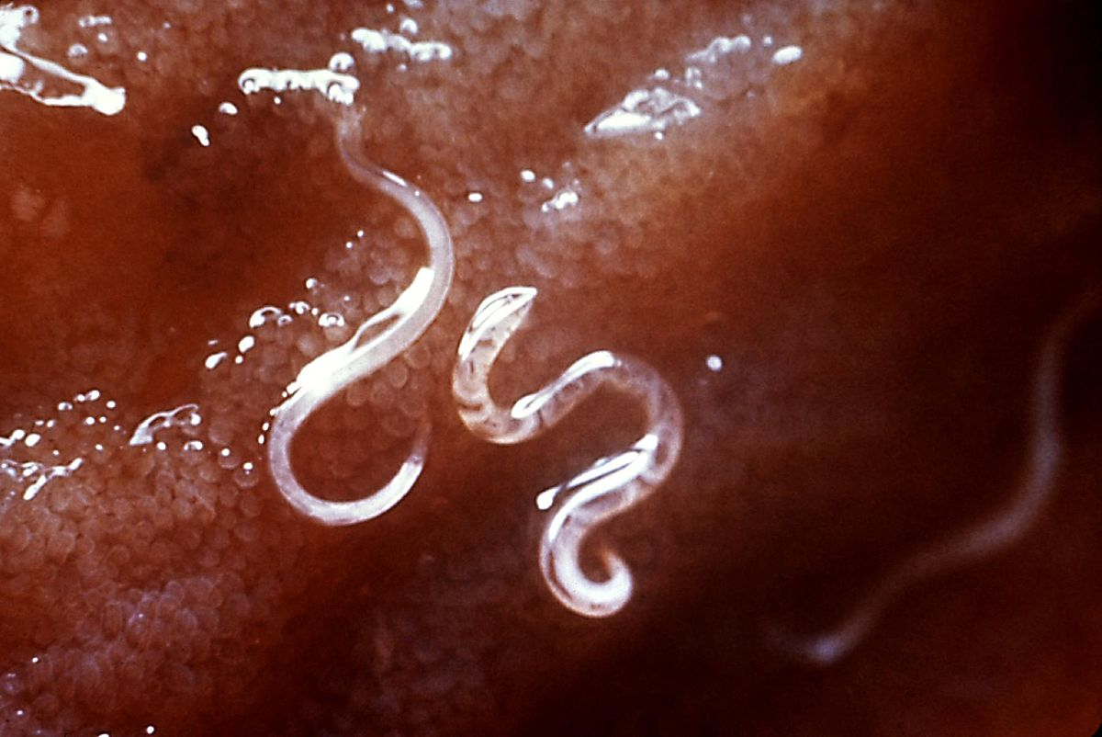
Blood, IS, BAL & Airway disease
(IS is better than cough swabs for detecting infection, probably at least as good as BAL)
IS is a poor marker of airway eosinophilia
No blood eosinophilia likely = none in BAL
Blood eosinophilia may be driven by other atopic disease
LMICs – remember parasites

Slide 26
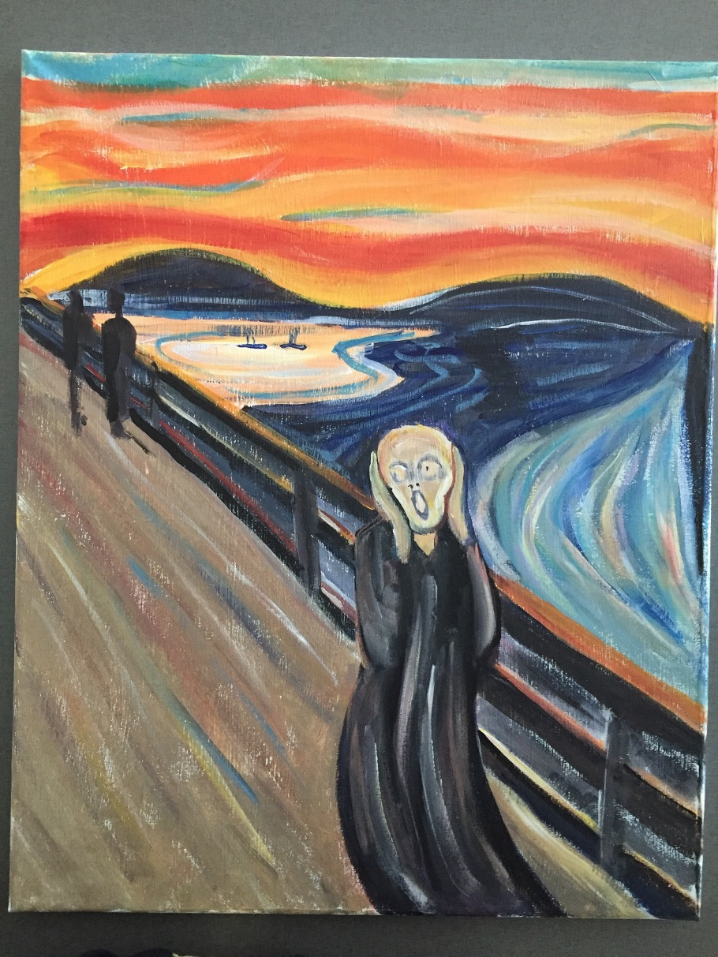
Montelukast: old & new
Montelukast is at best a minority medicine!
Cys-LTs only raised acutely, parents probably will not medicate well children
PREEMPT: intermittent ML superior to placebo (n=220, AJRCCM 207; 175: 323-9)
USA: intermittent ML and intermittent neb BUD better than standard (n=238, JACI 2008;122: 1127-35)
International: no difference between placebo (n=591) intermittent ML (n=591) & daily ML (n=589) (AAAI 2011; 106: 518-26)
WAIT study: 669 intermittent ML, 677 placebo, one year FU; No benefit LRM 2014; 2: 796-803

Slide 27
Episodic Treatment for Episodic problems
FIRST CHOICE: nothing more than bronchodilators! – does the child NEED treatment at all?
NEXT: Intermittent or continuous LTRA? but probably won’t work
NEXT: Intermittent high(?) dose ICS; dose and duration unknown, MONITOR carefully
COUNCIL OF DESPAIR: combinations of the above; evidence base = zero

Slide 28
Therapeutic trial in MTW
Step 1: commence treatment
with 200 mcg bd BDP equivalent
for 6 weeks via appropriate spacer
Consider alternative
diagnoses
Consider alternative
therapies, e.g. LTRA,
AZM
NO
Child symptomatically improved
YES
Step 2: stop treatment, reassess
child regularly
NO
No further
action
Symptoms recur on stopping treatment
YES
Step 3: restart BDP, titrate to lowest
dose needed to control symptoms

Slide 29
Any role for Macrolides?
Multiple anti-inflammatory anti-viral and other effects
158 asthma-like episodes lasting >3 days, 72 children age 1-3 in COPSAC₂₀₁₀ - symptoms shortened (LRM 2016; 4: 19-26)
607 children (12-71/12), previously prescribed >1 course of prednisolone, no interval symptoms – less prednisolone given (JAMA 2015; 314: 2034-44)
300 children aged 12-60/12 in ED: no effect! (PLoS One 2017; 12(8): e0182411)
AZM may be justifiable in those with acute really, severe wheeze heading for HDU or PICU – BUT antibiotic resistance!

Slide 30
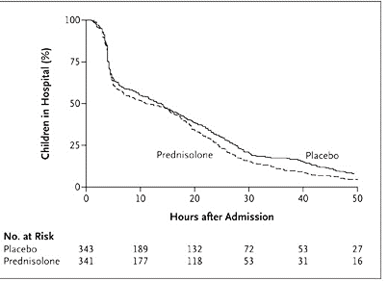
Episodic Wheeze: Prednisolone Two big conflicting studies!
N=624
Mean time saving with
Prednisolone = 170 minutes,
p=0.0227!!!
LRM 2018; 6: 97-106
N=687
Mean time saving with
Prednisolone = 170 minutes,
P=NS
NEJM 2009; 360: 329-38.

Slide 31
Prednisolone & pre-school wheeze: Meta-analysis
A. Hospital
admissions
N=1773 children age <6 years
11 studies (n=4 OP, n=5 IP, n=2 ED)
A. Overall admissions – no benefit
B. OP studies: placebo, fewer admissions
C. ED studies: small benefit of OCS
Favours OCS
Favours Placebo
B. OP studies &
hospital
admissions
C. ED studies &
hospital
admissions
Pediatr Pulmonol 2016; 51: 868-76

Slide 32
Meta-analysis: Further results
D. All comers, does not reduce need for extra OCS
E. If you are an IP, does reduce need for more OCS
Overall:
Most children, no benefit
OCS a hospital only medication
A hint that there may be some benefit in sicker patients
Could this be non-genomic, e.g. reducing airway oedema?
D. Need for
further OCS
E. IP only need
for further OCS

Slide 33
Treating preschool wheeze
When not to treat! Is the child normal?
Can we diagnose ‘asthma’, and what does it mean for treatment?
Beyond inhalers: what else can we do to treat?
One for the future: can we move beyond palliative care to prevention?
Summary and conclusions

Slide 34
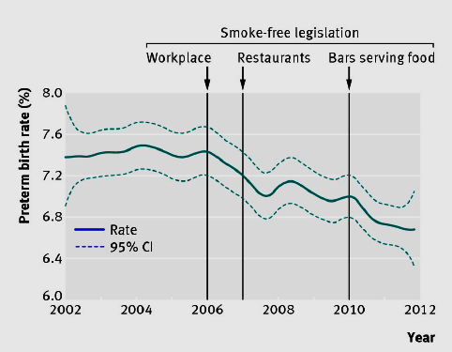
Does smoke free legislation deliver?
What was the effect of sequential smoke free legislation in Flanders?
Jan 2006 public places and most workplaces
Jan 2007 restaurants
Jan 2010 bars serving food
N=606,877 live born singletons 24-44/40, N=448520 spontaneous deliveries
Outcome: preterm birth < 37/40
BMJ 2013; 246: f441

Slide 35
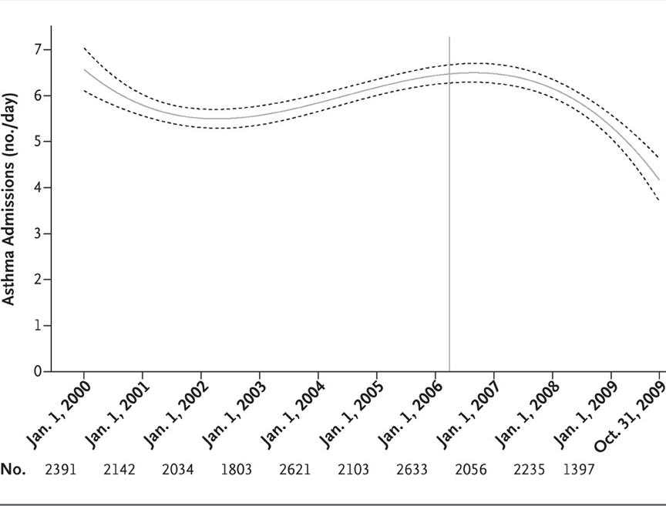
Banning smoking in public
Ban benefits those occupationally exposed, non-occupationally?
Childhood (<15) asthma admissions, Scotland 2000-2009
Pre-ban: rising 5.2%/year
Post-ban: fell 18.2%/year, p<0.001
All ages, all SES etc
NEJM 2010; 363: 1139-45

Slide 36
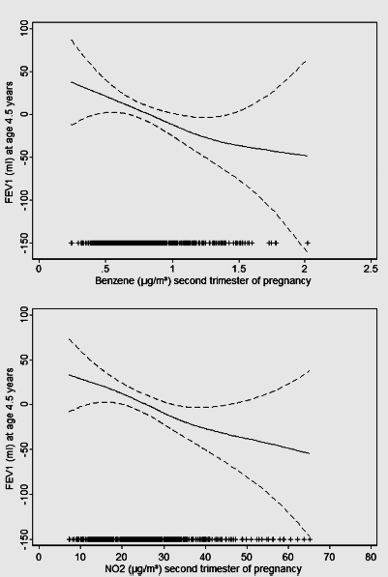
Pollution!
624 children, spirometry age 4.5 years
Developmental residential exposure to benzene, NO₂
Effects for pregnancy, and no other time point, including recent and current
Worse for allergic children, low SES
Thorax 2015; 70: 64-73

Slide 37
Treating preschool wheeze
When not to treat! Is the child normal?
Can we diagnose ‘asthma’, and what does it mean for treatment?
Beyond inhalers: what else can we do to treat?
Summary and conclusions

Slide 38
Treating preschool wheeze
When not to treat! Is the child normal?
Can we diagnose ‘asthma’, and what does it mean for treatment?
Beyond inhalers: what else can we do to treat?
Summary and conclusions

Slide 39
Take-home summary
Pre-school wheeze fits into five groups: history and physical examination is initially used for that categorisation
We are on the verge of personalised medicine for pre-school wheeze, rather than putting steroids in the tap-water
We need to consider non-pharmacological approaches to treatment, including smoking cessation
Acute attacks, atopic sensitization and tobacco exposure predict a high-risk group for future asthma, but we (as yet) cannot do anything about this!

Slide 40
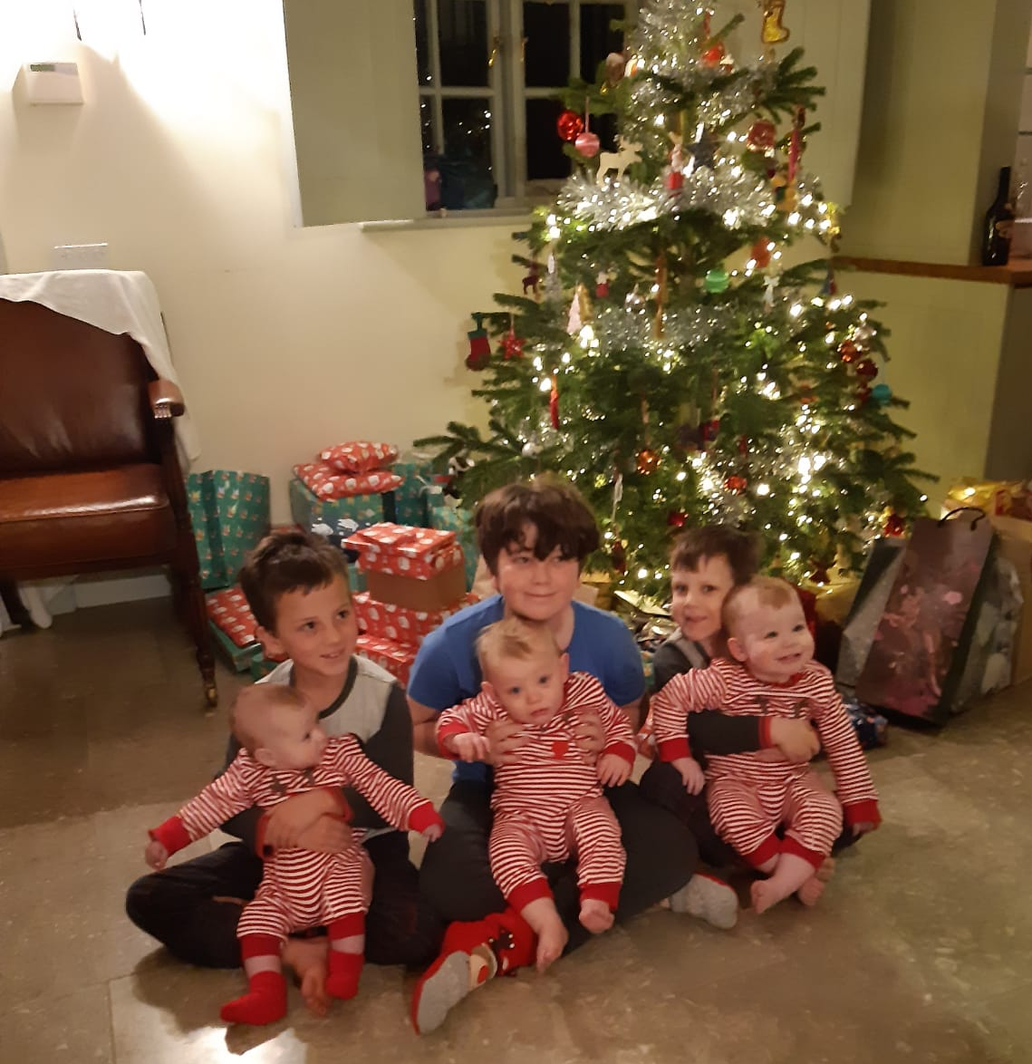
Thanks for listening!

