Slide 1
National Review of Asthma Deaths (NRAD)
Key Findings and Recommendations
Thank you to Mark Levy / Jimmy Paton for use of their slides

Slide 3
Why do a study?

Slide 4
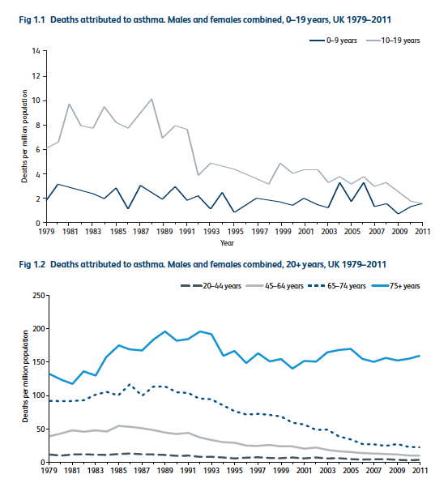

Slide 6
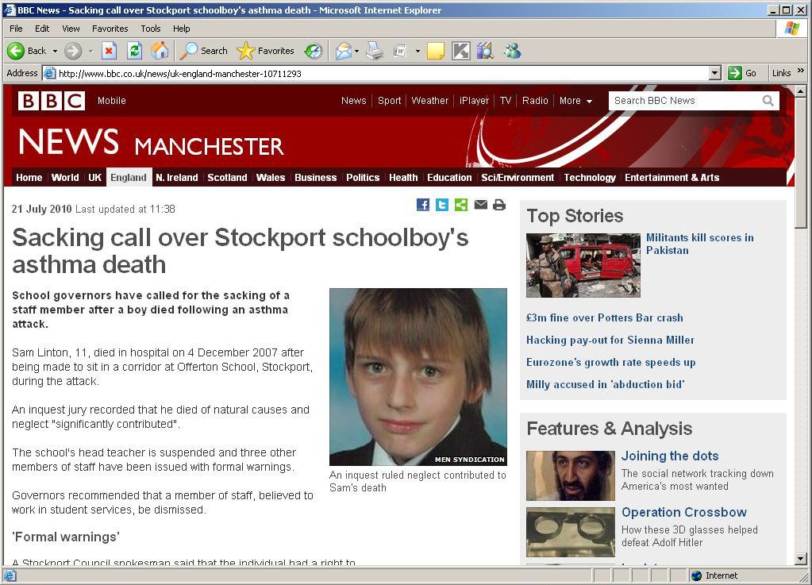

Slide 7
National Review of Asthma Deaths (NRAD)
Medication
Patient compliance
Medical care
Trigger factors
Awareness of school/
work colleagues
Medical care received
Location of death
Involvement of
school/ work
Environmental conditions
– climate/ allergic factors
Longer term
clinical
history
received
Lifestyle/ activity
Psychosocial factors
Hours
before death
Onset of asthma/
diagnosis
Weeks/months
before death
Date/time
of death

Slide 8
Aims of NRAD
To identify avoidable factors and make recommendations for changes to improve asthma care
To understand effect of asthma and death from asthma on families and carers
Assess effectiveness of the management of asthma at the moment (acute and chronic)

Slide 10
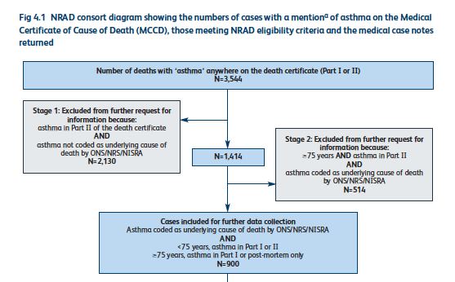
NRAD flow diagram

Slide 11
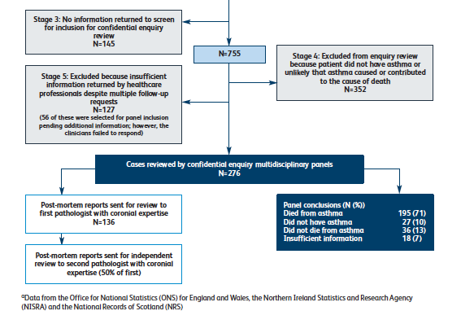
NRAD flow diagram

Slide 12
Asthma deaths
195 people who died from asthma analysed
174 expert clinical assessors
2 assessors per case who present to panel and agreement sought
28 children and young people died of asthma
< 10yrs = 10 (5%) youngest 4yrs
10-19yrs = 18 (9%)

Slide 13
Demographic data

Slide 14
Location of death
45% of all died from asthma without any medical help during final episode
11% tried to get help but died before any help arrived
80% of < 10yrs
72% of 10-19yrs
Died before reaching hospital

Slide 15
Personal asthma action plan
Only 23% of the 195 patients that died was there a record of them having a PAAP
Only 4/28 children had a PAAP
RECOMMENDATION
All people with asthma should have PAAP that mentions:
Triggers and current treatment
How to spot symptoms getting worse and what to do then
What to do in emergency and when to call for help

Slide 16
Asthma severity
Overall data (n=155)
Mild = 14 (9%)
Moderate = 76 (49%)
Severe = 61 (39%)
In children
< 10 years
Mild 0%
Moderate 30%
Severe 60%
NK 10%
10-19 years
Mild 6%
Moderate 44%
Severe 39%
NK 11%

Slide 20
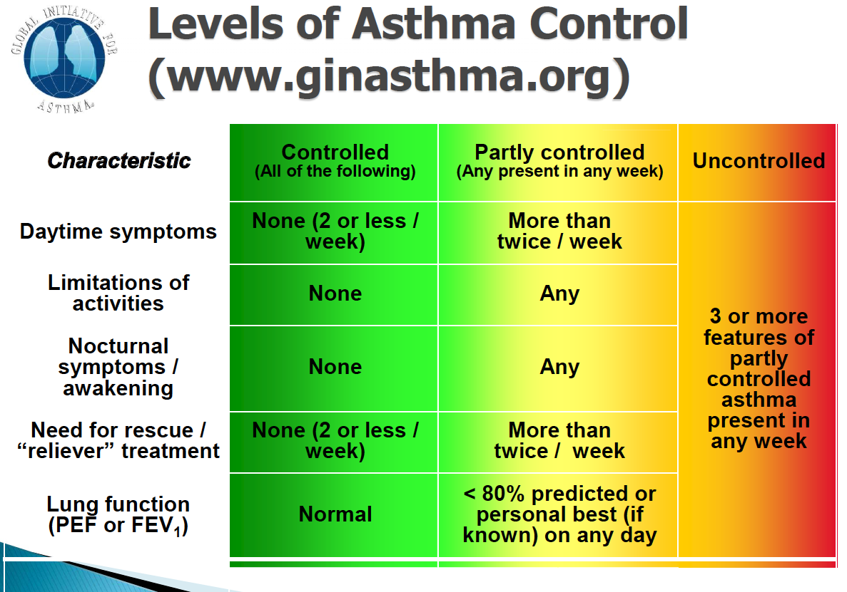
19% had assessment of control!

Slide 22
Secondary care
We need to ask about control for every exacerbation that comes to hospital
Opportunity to review background treatment and increase accordingly
Opportunity for education and PAAP.
We need to take more control of these patients, take referrals from A+E, have clear criteria – don’t leave it for GP

Slide 34
What does this mean for us?
Remember asthma attacks can kill – do your parents know this?
Everyone have an action plan with right information
Good adherence is possible and work at it
Passive smoking big risk factor – can we do more?
Work with local GPs re implementing guidelines and ensuring more appropriate referrals
Follow ups at discharge – should we do the review?
We are complacent and need to change

Slide 39
Back to slide 2……

