Slide 1
Greener Respiratory Prescribing in Children & Young People
Supporting ICBs to safely introduce greener inhalers for CYP.
The following slides should be used together with the top tips guide for healthcare professionals which is available in A3 and A4 format.

Slide 2
Introduction
The NHS long-term plan, NICE patient decision aid and the Greener NHS agenda have emphasised the importance of finding lower carbon inhalers. This is because inhalers alone represent around 3% of emissions in the NHS.¹
Dry powder inhalers (DPIs) do not contain hydrofluoroalkane propellants, so from this perspective have less of a carbon footprint in comparison to traditional inhalers. However, DPIs require children and young people (CYP) to adapt to a new way of using an inhaler (from tidal breathing via a spacer) and will require training in the appropriate technique.
To ensure that any changes to inhalers used by children and young people are appropriate, the London CYP Asthma Pharmacy group have developed a top tips guide for healthcare professionals in greener respiratory prescribing in A3 and A4 format.
The guide applies to decision makers i.e. commissioners, primary, secondary and tertiary care and ALL healthcare professionals involved in the care of CYP with asthma.
We would like your support to ensure this guide reaches the right people, for example, by sharing in your monthly newsletters or in your regular communication updates with front line healthcare professionals.
Better care = greener care
Right diagnosis
Right drug
Right device
Right disposal
*adapted from PrescQIPP

Slide 3
Why is the top tips guide important for children and young people?
Children require different approaches to asthma care to adults. There are examples of children and young people who have switched to lower carbon inhalers without appropriate assessment by a healthcare professional and have ended up in hospital.
The carbon footprint of a hospital stay due to poorly managed asthma is much worse than any inhaler.
Good asthma care and prevention will naturally lead to reduced short-acting beta-agonists (SABA) inhaler use with benefits all round.
The lower carbon agenda must not compromise care and the greenest inhaler is the one the patient can and will use.
Blanket switching of inhaler devices to lower carbon inhalers is not good practice. Treatment with inhalers should be a shared decision between the child and family. Inhalers should only be initiated or changed where clinically warranted and with appropriate assessment and coaching of inhaler technique by a competent healthcare professional.
¹

Slide 4
Why is the top tips guide important for healthcare professionals?
Many CYP are admitted to hospital every year due to their asthma. In 2021/22 there were 3645 hospital admissions due to asthma.²
Sadly some CYP in London also die each year because of asthma. Between 2015 and 2021, there were 36 deaths in CYP aged 0 to 19. ³
Most admissions and asthma deaths are preventable.⁴
The main issues/dangers to children and young people with asthma are in relation to:
over-reliance on a SABA/emergency inhaler, which increases chances of hospital admissions.^{5,6} Using three or more SABA inhalers per year is associated with having twice as many asthma attacks.⁷
underuse of inhaled corticosteroids and poor adherence
not being able to use a device effectively
If every one of the 73,000,000 inhalers used in the UK was returned to pharmacy for disposal rather than binned it could save 512,330 tonnes of carbon dioxide (CO2) equivalent of a Volkswagen golf being driven around the world 88,606 times.⁸
Appropriate use of inhalers means there is less of a risk of overspending on drug budgets.

Slide 5
What are the steps to introducing greener inhaler prescribing in CYP?
Step 1: To understand the importance of different types of inhalers and knowing that there are complexities around inhaler usage including training and education of healthcare professionals
Step 2: To understand that there are differences between CYP and adults
Step 3: To understand the carbon footprint of each inhaler
Step 4: Shared decision making and creation of educational resources to understand why changes are being made using local communication teams to spread messaging
Step 5: Setting local prescribing guides illustrating lower carbon alternatives where appropriate and suggesting changes
Step 6: Bringing in all stakeholders including community pharmacy
Step 7: Reviewing opportunities to spread the message: NMS, DMS, structured medication reviews in GP practices and annual asthma reviews
Using inhalers is not easy: 8/10 do not know how to use an inhaler correctly and people need to be trained 3 times before they correctly use their inhaler.⁹

Slide 6
Sources
NHS England. Delivering a ‘Net Zero’ National Health Service. 2022. Available from: B1728-delivering-a-net-zero-nhs-july-2022.pdf (england.nhs.uk)
SUS (Secondary Uses Service) data. Accessed September 2022.
NOMIS. Accessed January 2023.
HQUIP. Why asthma still kills: The National Review of Asthma Deaths (NRAD). 2014. Available from: NRAD (asthma.org.uk)
London Asthma Leadership and Implementation Group for CYP Asthma (LALIG). Clinical recommendation on use of salbutamol post acute asthma attack. 2022. Available from: LALIG statement on salbutamol
Medicines & Healthcare product Regulatory Agency. Nebulised asthma rescue therapy in children. 2022. Available from: Drug Safety Update (publishing.service.gov.uk)
Bloom, C.I., Cabrera, C., Arnetorp, S. et al. Asthma-Related Health Outcomes Associated with Short-Acting β2-Agonist Inhaler Use: An Observational UK Study as Part of the SABINA Global Program (2020)
The Pharmaceutical Journal, PJ, June 2019, Vol 302, No 7926;302(7926)::DOI:10.1211/PJ.2019.20206619
Chrystyn H, et al. npj Prim Care Respir Med. 2017;27:22

Slide 7
Appendix 1
Greener Respiratory Prescribing Pyramid in Children & Young People.
The following summarises the key points from the top tips guide and can be used to help with a structured medication review, correct diagnosis and inhaler technique.

Slide 8
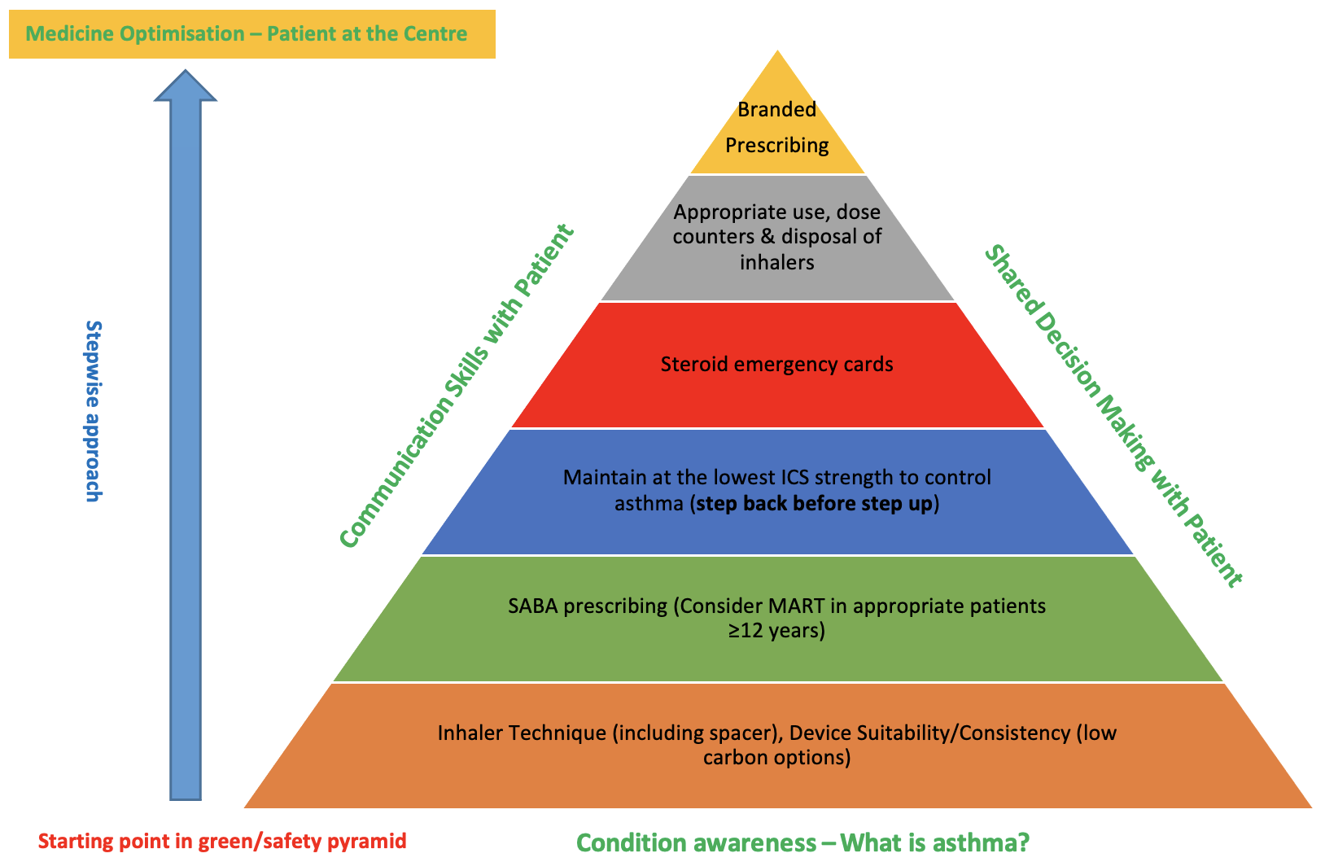
Greener Respiratory Prescribing Pyramid in CYP
Good asthma control = Good for the patient & Good for the planet
Branded prescribing - device consistency
Switching without a review = safety issue Reduce mixed device type if possible
Repeat prescribing of ICS & not SABA
Disposal - Return to community pharmacy
Schools emergency SABA policy
medium & high dose ICS – emergency card
Review ICS uptake, PAAP, inhaler technique
Exposure to indoor/outdoor pollution
Smoking/Vaping exposure
Allergens
Monitor vaccine uptake
≥3 SABA a year – review
Initiate lower carbon brands
E.g. Salamol pMDI + Spacer or
DPI in ≥ 10 years old with ability to use
Trained clinical inhaler technique coach
No blanket switching for all inhalers
Especially new device types
Face to Face/Video reviews, NMS
Reinforce F2F coaching with videos: A+LUK www.rightbreathe.com
pMDI: Metered Dose Inhaler
DPI: Dry Powder Inhaler
Patients without a clear diagnosis of asthma should have a clinical review regarding appropriateness of inhaler prescription
ICS: Inhaled Corticosteroid
SABA: Short Acting β2 Agonist
MART: Maintenance & Reliever Therapy
PAAP: Personalised Asthma Action Plan
NMS: New Medicines Service - pharmacy
Early and accurate diagnosis will support optimal greener prescribing
Darush Attar-Zadeh ©
Notes:
Prior to exploring SABA prescribing, these are some of the other considerations that are on the mind of a medicines optimisation pharmacist
For patients with asthma – our aim is to try and shift the ratio of ICS/SABA from 2:12, to more like 12:2

